Slide 1


Slide 2
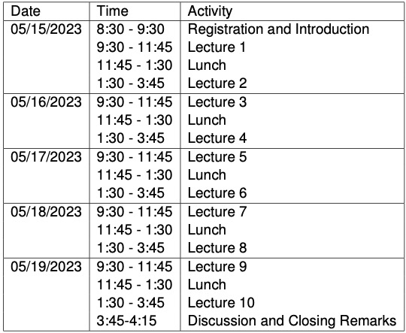
WiFi: TAMU_VISITOR or eduroam
Course materials: https://web.stat.tamu.edu/~yni/cbms/
Visitor parking: 1st floor of the North Side Parking Garage
Travel awardees:
Domestic: a check will be sent to you (no need to send us your receipts)
International (Mexico and Canada included): please email your receipts to Carrie Relles (carrie@stat.tamu.edu) for reimbursement

