Slide 1
Data preprocessing in R
Charles Wu
Notes:
Put the dataset in the course github
Today we will be talking about data preprocessing or data cleaning. The content will be different than the recitation notebook: the point is to get you to see different examples--variability leads to generalization.

Slide 2
Review of last recitation
Bash commands
Navigate your directory to the course Github directory
Git commands
Update changes to the repository on your personal laptop
Notes:
So you remember we cloned the course github repository into your personal laptop?
use git pull
or you could just download from the github page
then copy and paste into your own personal github repository
Today, you will need R studio. Does everyone have R and Rstudio downloaded and installed?

Slide 3
Motivation
Notes:
-Data is rarely in the final condition
-preprocessing or cleaning is necessary
-survey data missing, or extreme RT values.
-filter out noise in neuroimaging data
-right now you might be doing it by hand
-If you are doing this, you are probably dealing with vey small data sets.

Slide 4
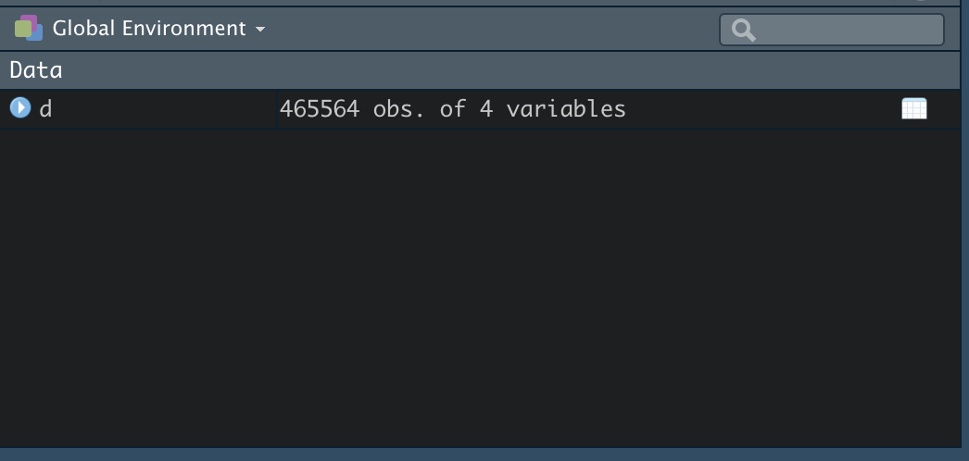
Motivation
Notes:
-But imagine if your data looked like this with rows and columns
-as your dataset gets bigger and more complicated, preprocessing gets more complicated
-almost impossible
-for example

Slide 5
Motivation
One participant: 701 X 24 X 1895 X 32
Notes:
number can look something like this: this is the EEG data for one participant, where the data is now high-dimensional and on each dimensional there are a lot of data points.

Slide 6
Motivation
Fast, convenient and automatic pre-processing
Notes:
use scripting langauge like R is fast conve…

Slide 7
Motivation
Fast, convenient and automatic pre-processing
Reproducibility
Notes:
also, reproducible

Slide 8
Motivation
Fast, convenient and automatic pre-processing
Reproducibility
For R: statistical computing
Notes:
use R for staitsitcal computing

Slide 9
Package installation
install.packages(‘tidyverse’)
Notes:
Open your R studio. type in this line in the console, install.packaes.
Today in class, we will be doing something that’s difference than what you will see in the recitation notebook.
So I want you to write all the code in either R script or R markdown.

Slide 10
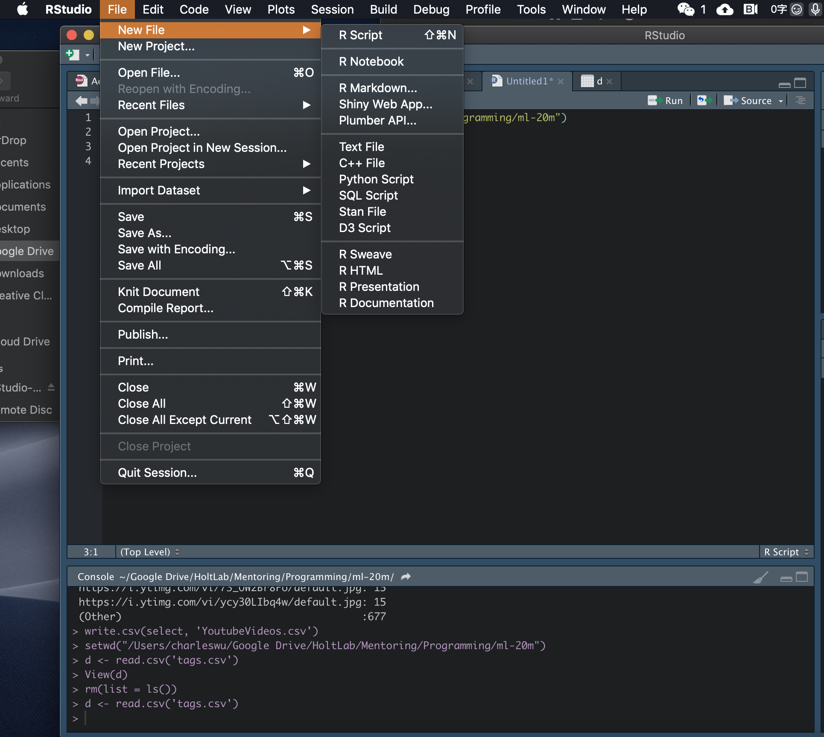
R script
Notes:
How you do that is you go to File and select either R script or R markdown. And save whatever you write in the script.

Slide 11
Basic R commands
Basic arithmetic:
5 ^ 3 = 125

Slide 12
Basic R commands
Data structures:
-vectors:
a <- c(1,2,3)
b <- c(4,5,6)
a * b
-data frames:
c <- c(“one”, “two”, “three”)
data <- data.frame(cbind(a,b,c))
Notes:
-Two data structuers: vector and data frames.
-Vectors are lists of numbers, assign a and b and element-wise operation
-Another data structure is data frame. put different data types together. Most common for data processing
-Let’s put them three together and call them data.

Slide 13
Basic R commands
Data indexing:
data[n,m]
data[n, ]
data$a
Notes:
Now we have the data variable in the workspace (Look to your right you will see the data work space), we need to know how to extract pieces of information from the dataset.
Either row number, column number or variable name using dollar sign.
Website for R resources

Slide 14
Basics of data preprocessing
Set your working directory:
setwd(‘your personal github repo’)
Load the library:
library(‘tidyverse’)
Reading data:
d <- read.csv(“YoutubeVideos.csv”)
Notes:
-working with some real world data.
-Let’s start by setting the working directory to where your data file is stored (your personal github repo)
-load library
-Read in the dataset use the function read.csv.

Slide 15
Basics of data preprocessing
Examine data:
summary(d)
head(d, 5)
Notes:
any problems?

Slide 16
Basics of data preprocessing
Problems with the numeric data:
Missing values
out-of-range values
Notes:
look at these summaries and see if you can spot any problems with the numeric data in this dataset.

Slide 17
Basics of data preprocessing
Deal with missing values
d <- na.omit(d)
Dealing with out-of-range values
d <- d[d$dislikes >= 0, ] OR
d <- subset(d, dislikes >= 0)
Notes:
So we can use na.omit to get rid of rows
get rid of rows with extreme values.

Slide 18
Basics of data preprocessing
The “pipe” operator %>%
d %>%
na.omit()
Notes:
I want to introduce the pipe operator. It makes the code very convenient and clean.

Slide 19
Basics of data preprocessing
The “pipe” operator %>%
d %>%
na.omit() %>%
subset(dislikes > 0) -> d
instead of
d <- na.omit(d)
d <- subset(d, dislikes >= 0)
Notes:
its output as input into the next function.
-don’t need to type input anymore
-streamline the analysis
-aesthetic, clean code
You can see that instead of

Slide 20
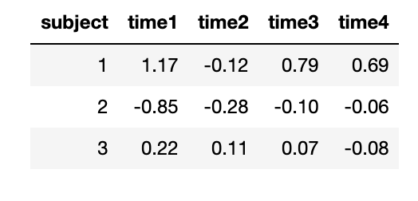
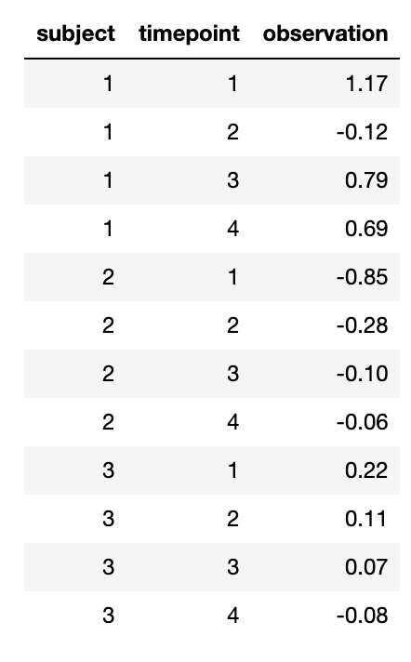
Basics of data preprocessing
Long and wide format
Notes:
its output as input into the next function.
-streamline the analysis
-aesthetic, clean code

Slide 21
Basics of data preprocessing
Long and wide format
Notes:
its output as input into the next function.
-streamline the analysis
-aesthetic, clean code

Slide 22
Basics of data preprocessing
?gather
?spread
short %>%
gather(timepoint, observation , time1:time4) -> long
long %>%
spread(timepoint, observation) ->short
Notes:
gather needs additional column names

Slide 23
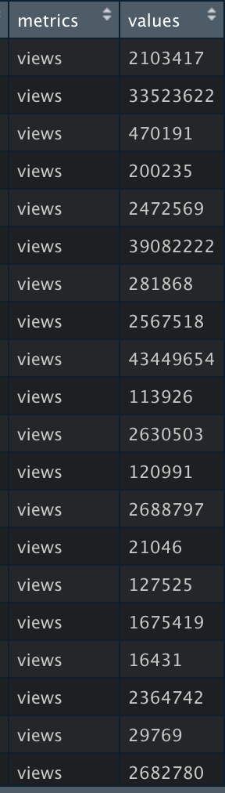
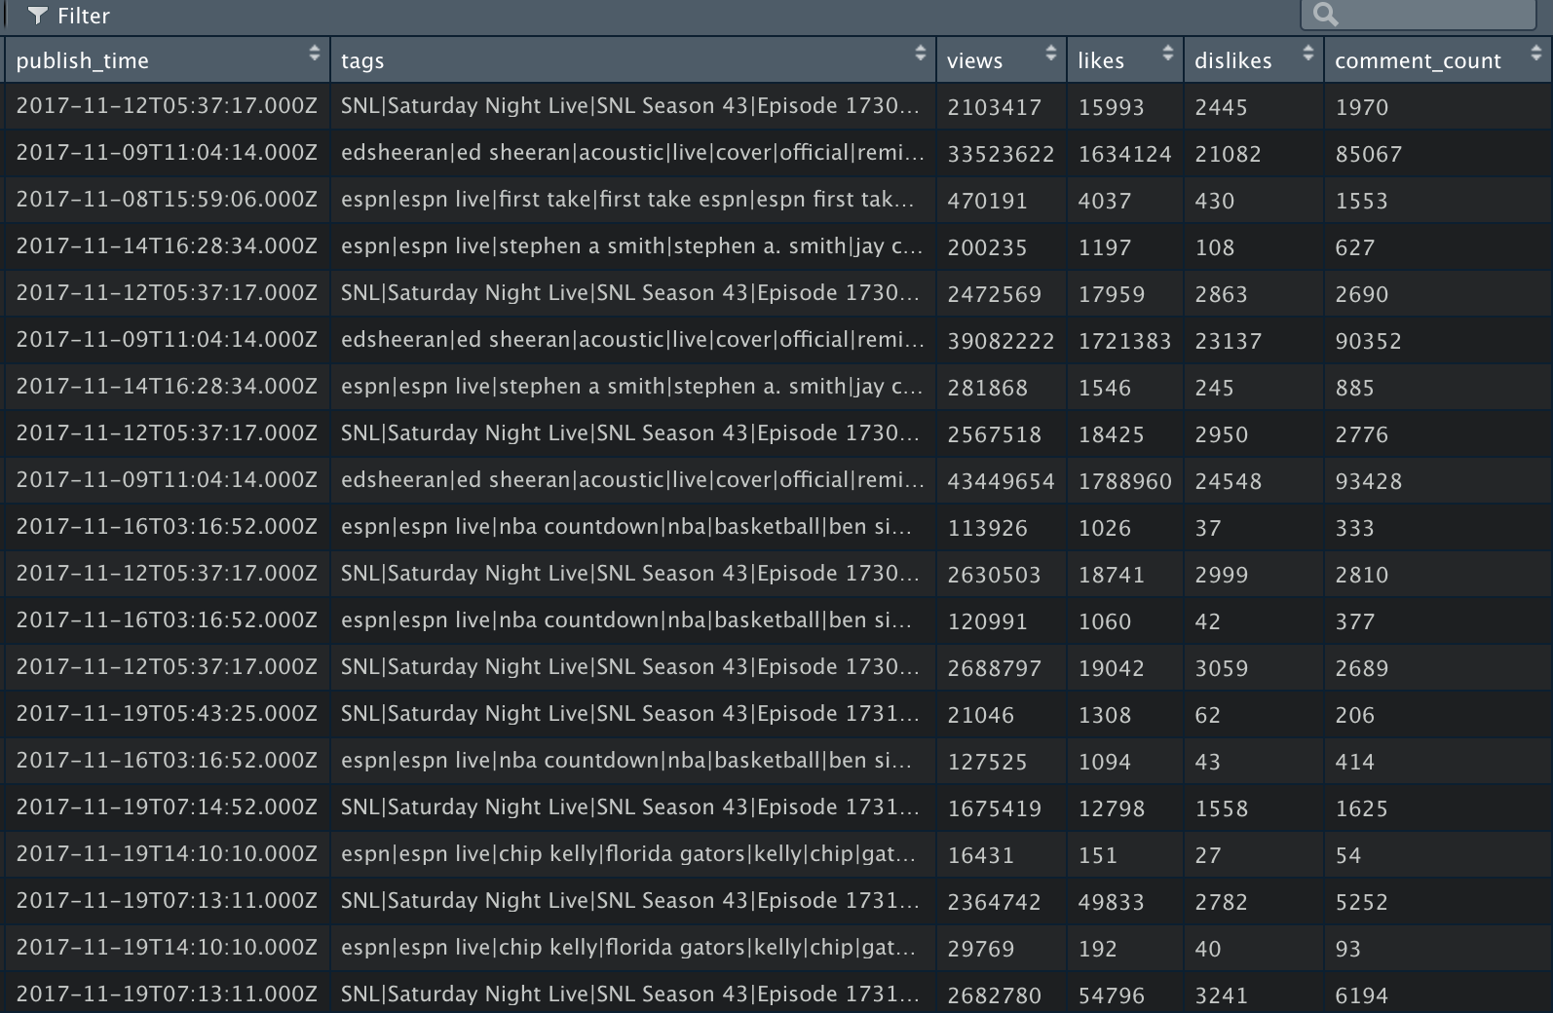
Basics of data preprocessing
Long and wide format
Notes:
its output as input into the next function.
-streamline the analysis
-aesthetic, clean code

Slide 24
Exercise
Given d1,
d1 <- d[, -16:-12]
convert d1 to long format where comment_count, likes, dislikes and views are collapsed to one column and the values are to the next column.
Notes:
gather needs additional column names
d1 and d3 are the same matrix!

Slide 25
Basics of data preprocessing
d1 <- d[, -16:-12]
?gather
?spread
d1 %>%
gather(measurement, values , views:comment_count) -> d2
d2 %>%
spread(measurement, values) ->d3
Notes:
gather needs additional column names
d1 and d3 are the same matrix!

Slide 26
Basics data manipulation
Create new metrics using “mutate”
d_centered <- mutate(d, z = (likes - mean(likes))/sd(likes))
OR
d %>%
mutate(z = (likes - mean(likes))/sd(likes)) ->d_centered
Notes:
create new metrics of measures

Slide 27
Basics data manipulation
Summarise information
d %>%
mutate(z = (likes - mean(likes))/sd(likes)) %>%
summarise(mean = mean(z))
Notes:
mutate creates a new variable but it doesn’t change the row numbers of the matrix. which means it creates the number for every row
Summarise, gives you a summary information (low dimensional) such as in this case it’s range, or you could do mean, sd etc.

Slide 28
Basics data manipulation
“filter” and “select”
filter(d, channel_title == ‘Saturday Night Live’)
select(d, likes)
Notes:
select rows and columns

Slide 29
Exercise
Define a metric, difference = likes - dislikes and find the difference values for all of Ed Sheeran’s videos and find the mean and variance of these differences. Store the mean and variance in a variable called ‘diff’

Slide 30
d %>%
mutate(difference = (likes - dislikes)) %>%
filter(channel_title == 'Ed Sheeran') %>%
summarise(mean = mean(difference),
sd = sd(difference)) -> diff

Slide 31
Basics data manipulation
Group by:
d %>%
group_by(channel_title, title) %>%
summarise(mean_likes = mean(likes),
mean_dislikes = mean(dislikes),
avg_comments = mean(comment_count)) -> sum
Notes:
Now what if you want to do this for different groups,
conditions?

Slide 32
Basics data manipulation
arrange
sum %>%
arrange(channel_title, mean_likes)
Notes:
You see that osme of these don’t have standard deviations because theres only 1 observation

Slide 33
Exercise
Create a column with normalized number of comments with respect to the general mean and create another column with normalized number of comments with respect to the group mean for each channel title (within one chunk of code)
Notes:
You see that osme of these don’t have standard deviations because theres only 1 observation

Slide 34
d %>%
mutate(z_all = (comment_count - mean(comment_count))/sd(comment_count))%>%
group_by(channel_title) %>%
mutate(z_group = (comment_count - mean(comment_count))/sd(comment_count)) -> exercise2
Notes:
You see that osme of these don’t have standard deviations because theres only 1 observation

Slide 35
Model objects
Linear regression model
model.fit <- lm(views ~ comment_count, data = d)
Check model structure and information
str(model.fit)
summary(model.fit)
model.fit$coefficients
Notes:
run some simple regression models.
model object concept: model fitting results will be stored in model objects
see the model info

Slide 36
Model objects
Linear regression model
model.fit <- lm(views ~ comment_count, data = d)
Check model structure and information
str(model.fit)
summary(model.fit)
Notes:
You see that osme of these don’t have standard deviations because theres only 1 observation

Slide 37
Model objects
Fit models for all subgroups
d%>%
group_by(channel_title) %>%
nest(-channel_title) %>%
mutate(model_fit = map(data, function(data) {lm(views~comment_count, data = data)}),
coef = map(model_fit, function(fit) {data.frame(names = names(fit$coefficients),
beta = fit$coefficients)})) %>%
Notes:
You see that osme of these don’t have standard deviations because theres only 1 observation

Slide 38
Model objects
Fit models for all subgroups
d%>%
group_by(channel_title) %>%
nest(-channel_title) %>%
mutate(model_fit = map(data, function(data) {lm(views~comment_count, data = data)}),
coef = map(model_fit, function(fit) {data.frame(names = names(fit$coefficients),
beta = fit$coefficients)})) %>%
unnest(coef)
Notes:
You see that osme of these don’t have standard deviations because theres only 1 observation

