Slide 1



11-785 Introduction to Deep Learning
Recitation 10: Pittsburgh Supercomputing Cluster
1
What is PSC? What are its Grants?
2
The ‘Explore’ grant - 3500 GPU Hours!
3
Managing your grant
TAs: Shrey Jain (shreyj), John Liu (johnliu)

Slide 2



11-785 Introduction to Deep Learning
Pittsburgh Supercomputing Cluster: No more GPU-shy!
A bit of trivia
It’s a computational research center
How can it help you: Grants
Founded in 1986
Joint venture between CMU & UPitt
Supported by many such as NSF, federal agencies and industry
Simply put, it’s a HUGE computer!
Train large-scale research projects
Multiple GPUs and large storage; undertake large projects
Empowering the next gen of research
Provides grants and resources
From a few hundred to few thousand GPU hours of grants available
What is PSC? What are its Grants?
Applying for the ‘Explore’ grant
Managing your grant
Icons from flaticon.com

Slide 3
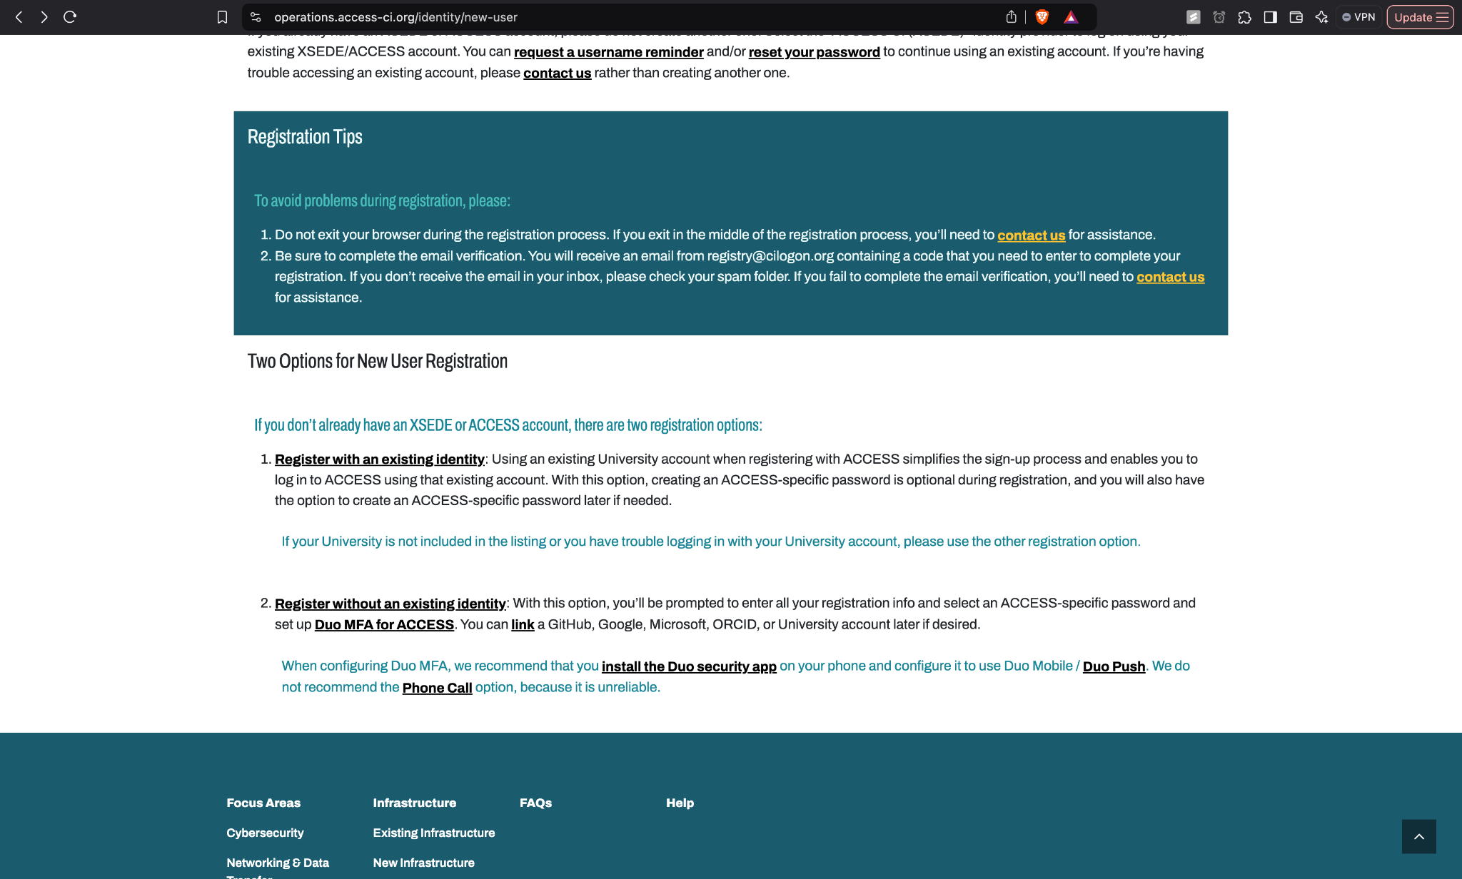
11-785 Introduction to Deep Learning
Apply for the Explore ACCESS Grant
Steps
Sign up on https://identity.access-ci.org/new-user
Sign up here
What is PSC? What are its Grants?
Applying for the ‘Explore’ grant
Managing your grant
Icons from flaticon.com

Slide 4

11-785 Introduction to Deep Learning
Apply for the Explore ACCESS Grant
Steps
The TA assigned to your project can provide you with the advisor letter
Sign up here
Ask TA for advisor letter
What is PSC? What are its Grants?
Applying for the ‘Explore’ grant
Managing your grant
Icons from flaticon.com

Slide 5
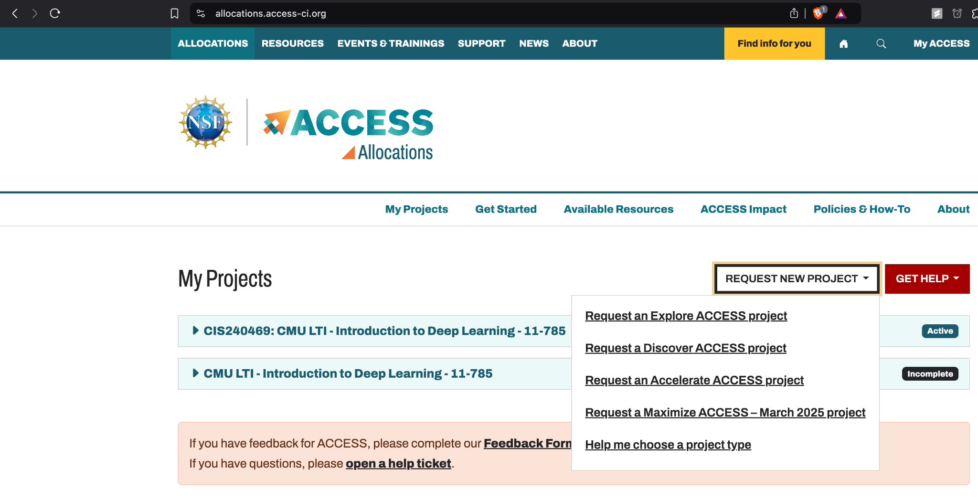

11-785 Introduction to Deep Learning
Apply for the Explore ACCESS Grant
Steps
On the dashboard, Request an Explore ACCESS Project
Sign up here
Ask TA for advisor letter
Request an Explore ACCESS Project
What is PSC? What are its Grants?
Applying for the ‘Explore’ grant
Managing your grant
Icons from flaticon.com

Slide 6
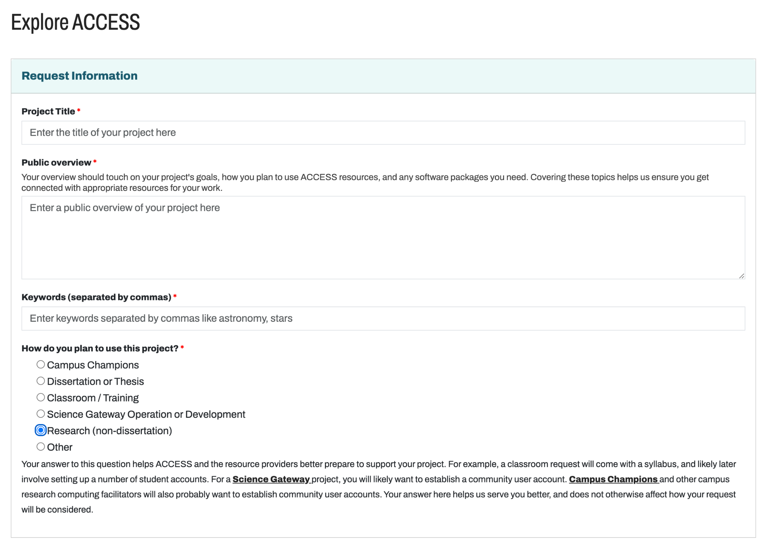
11-785 Introduction to Deep Learning
Apply for the Explore ACCESS Grant
Steps
Fill the details diligently; Public overview matters a lot, focus on it
Sign up here
Ask TA for advisor letter
Request an Explore ACCESS Project
Fill the details diligently
What is PSC? What are its Grants?
Applying for the ‘Explore’ grant
Managing your grant
Icons from flaticon.com

Slide 7
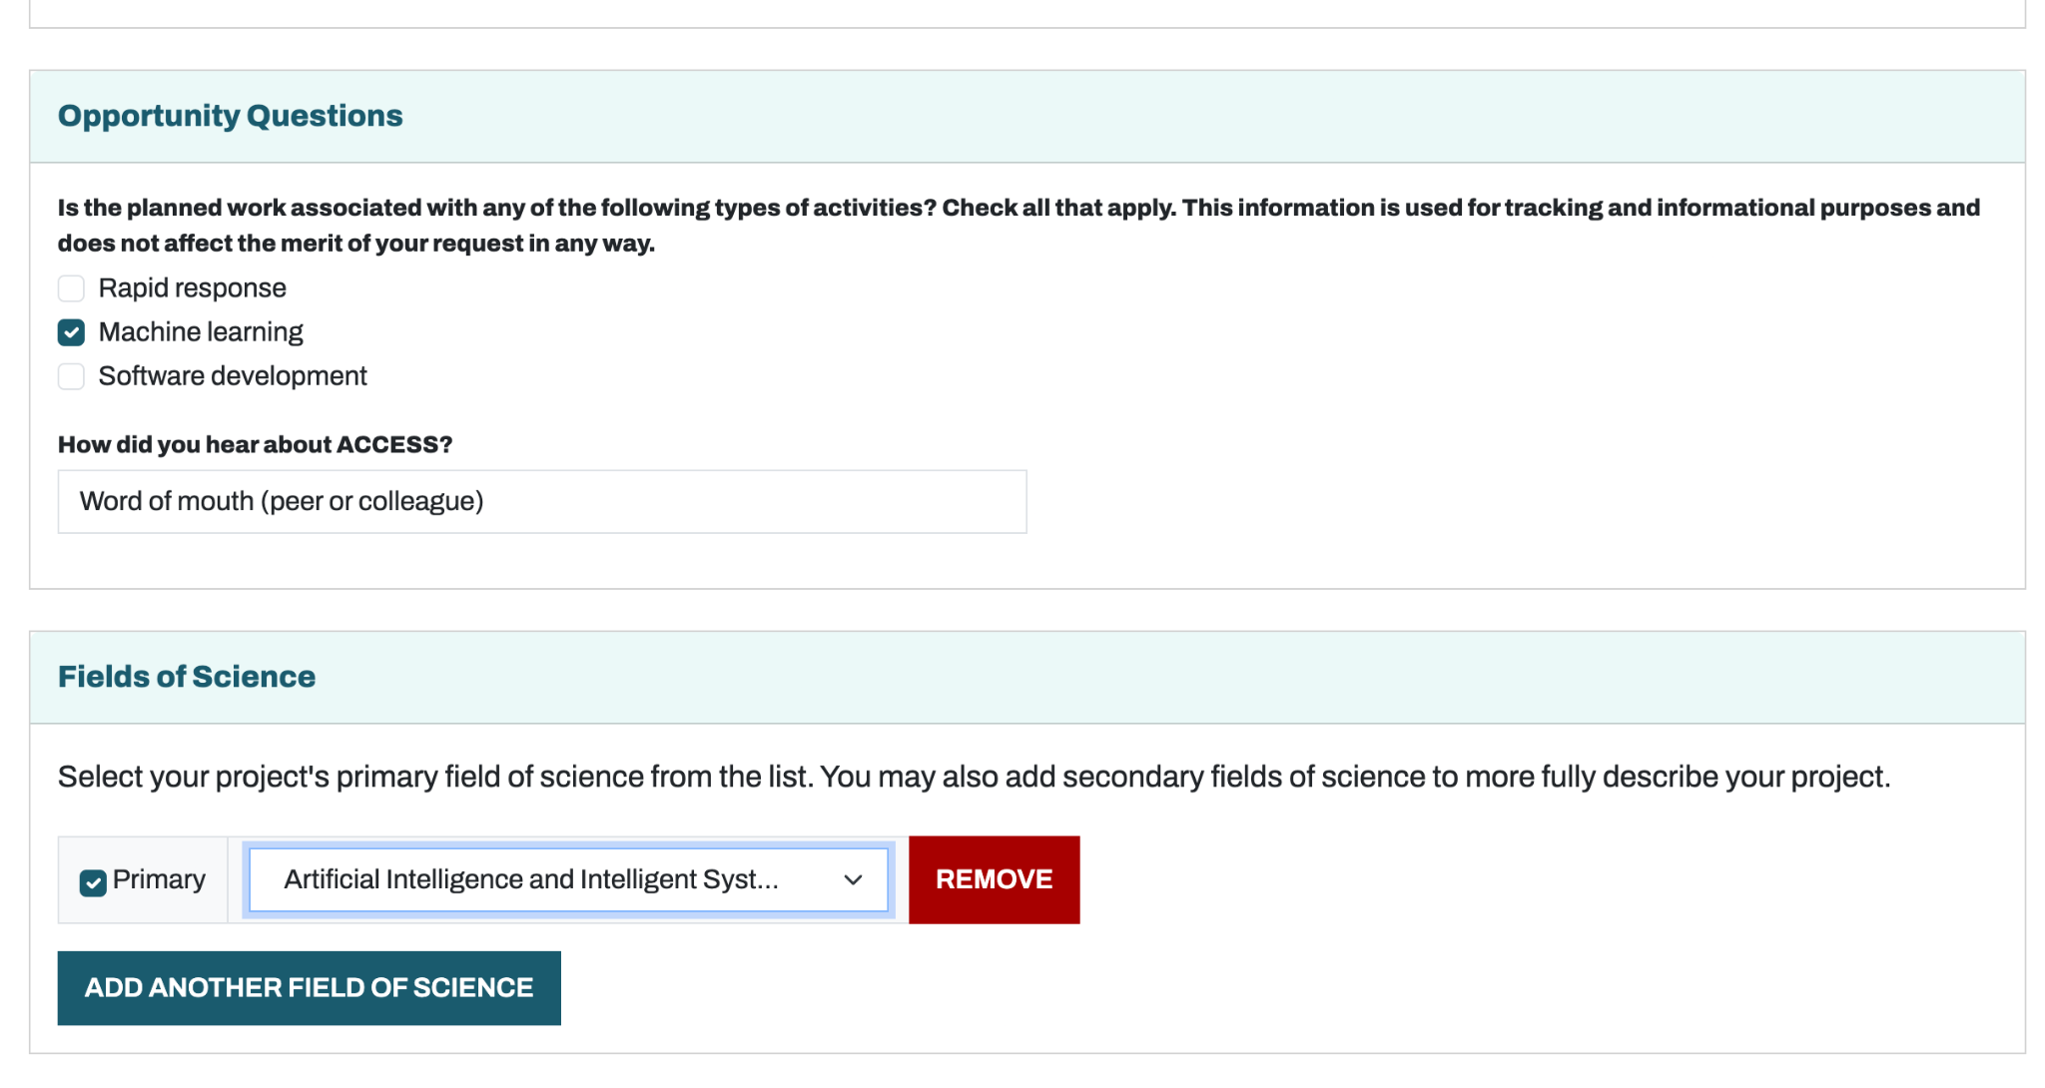
11-785 Introduction to Deep Learning
Apply for the Explore ACCESS Grant
Steps
Pick the following fields
Sign up here
Ask TA for advisor letter
Request an Explore ACCESS Project
Fill the details diligently
Pick the following fields
What is PSC? What are its Grants?
Applying for the ‘Explore’ grant
Managing your grant
Icons from flaticon.com

Slide 8
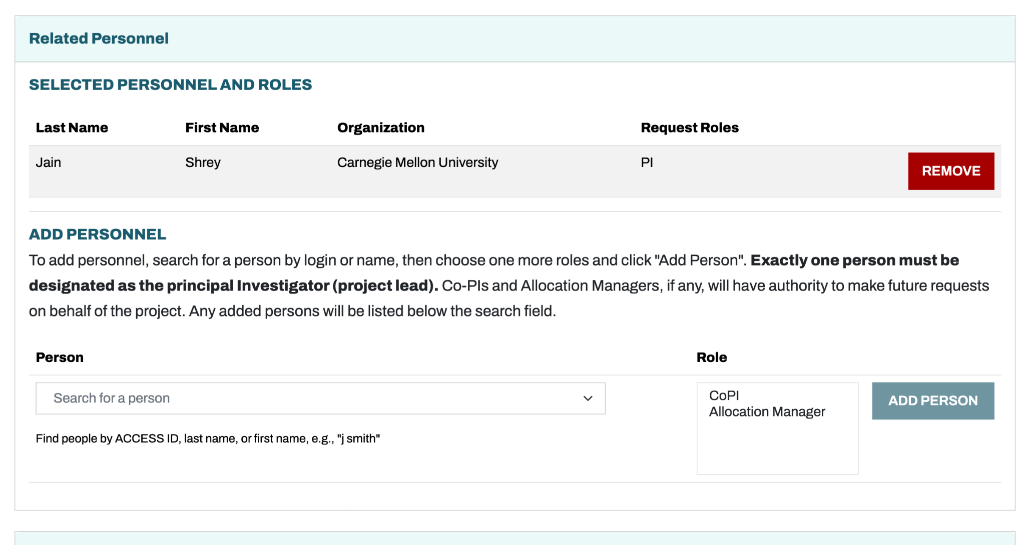
11-785 Introduction to Deep Learning
Apply for the Explore ACCESS Grant
Steps
Add teammates: get them to sign up too and add them
Sign up here
Ask TA for advisor letter
Request an Explore ACCESS Project
Fill the details diligently
Pick the following fields
Add teammates
What is PSC? What are its Grants?
Applying for the ‘Explore’ grant
Managing your grant
Icons from flaticon.com

Slide 9
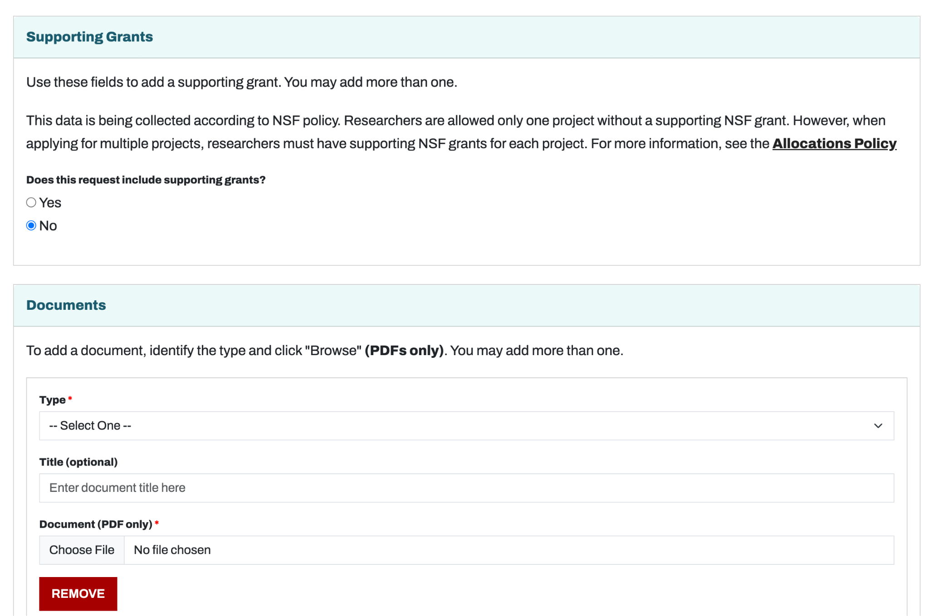
11-785 Introduction to Deep Learning
Apply for the Explore ACCESS Grant
Steps
Add PI Resumes: Add CV for PI and CoPIs (incl. Research projects)
Sign up here
Ask TA for advisor letter
Request an Explore ACCESS Project
Fill the details diligently
Pick the following fields
Add teammates
Add PI Resumes
What is PSC? What are its Grants?
Applying for the ‘Explore’ grant
Managing your grant
Icons from flaticon.com

Slide 10
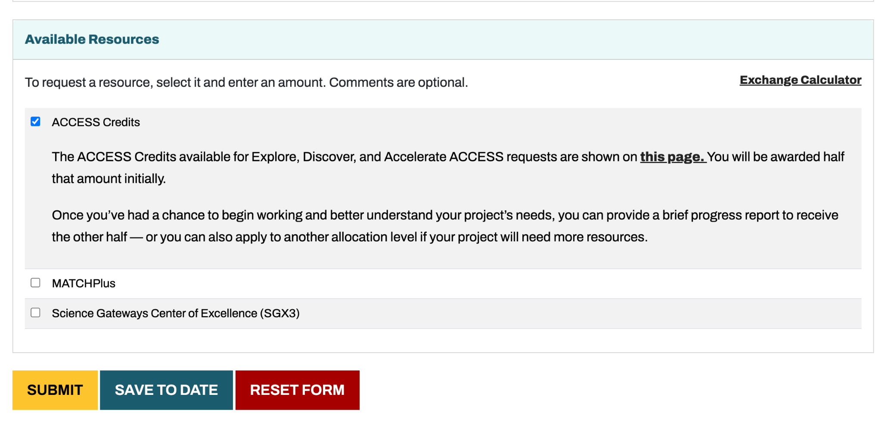
11-785 Introduction to Deep Learning
Apply for the Explore ACCESS Grant
Steps
Select ACCESS Credits
Sign up here
Ask TA for advisor letter
Request an Explore ACCESS Project
Fill the details diligently
Pick the following fields
Add teammates
Add PI Resumes
Select ACCESS Credits
What is PSC? What are its Grants?
Applying for the ‘Explore’ grant
Managing your grant
Icons from flaticon.com

Slide 11

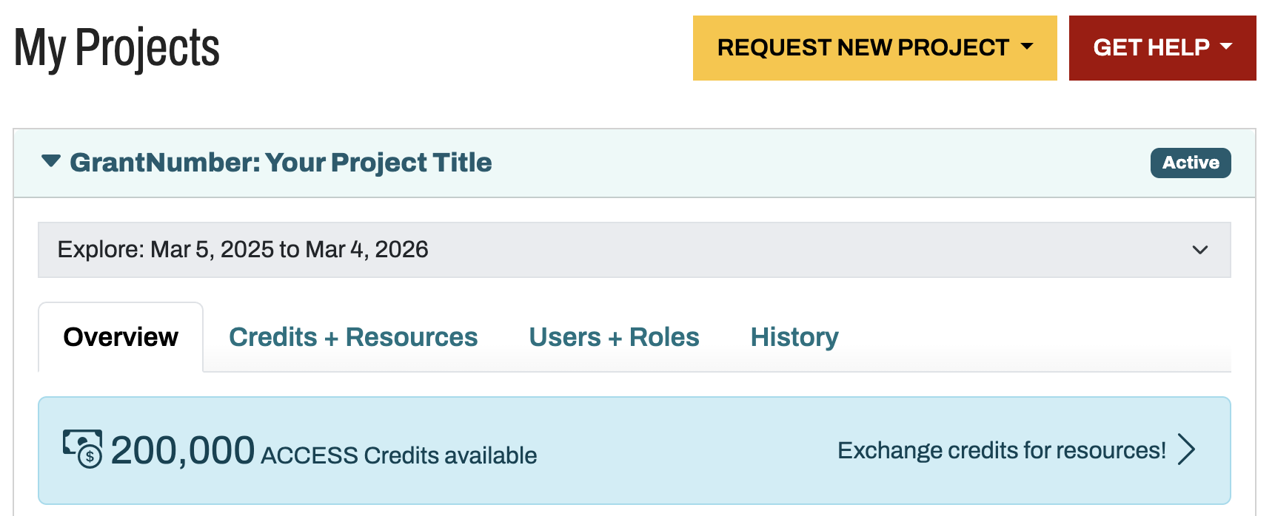
11-785 Introduction to Deep Learning
Managing the Grant: Use Credits to get GPU Hours and Storage
Once grant is given, dashboard shows 200k Credits
What is PSC? What are its Grants?
Applying for the ‘Explore’ grant
Managing your grant
Icons from flaticon.com

Slide 12
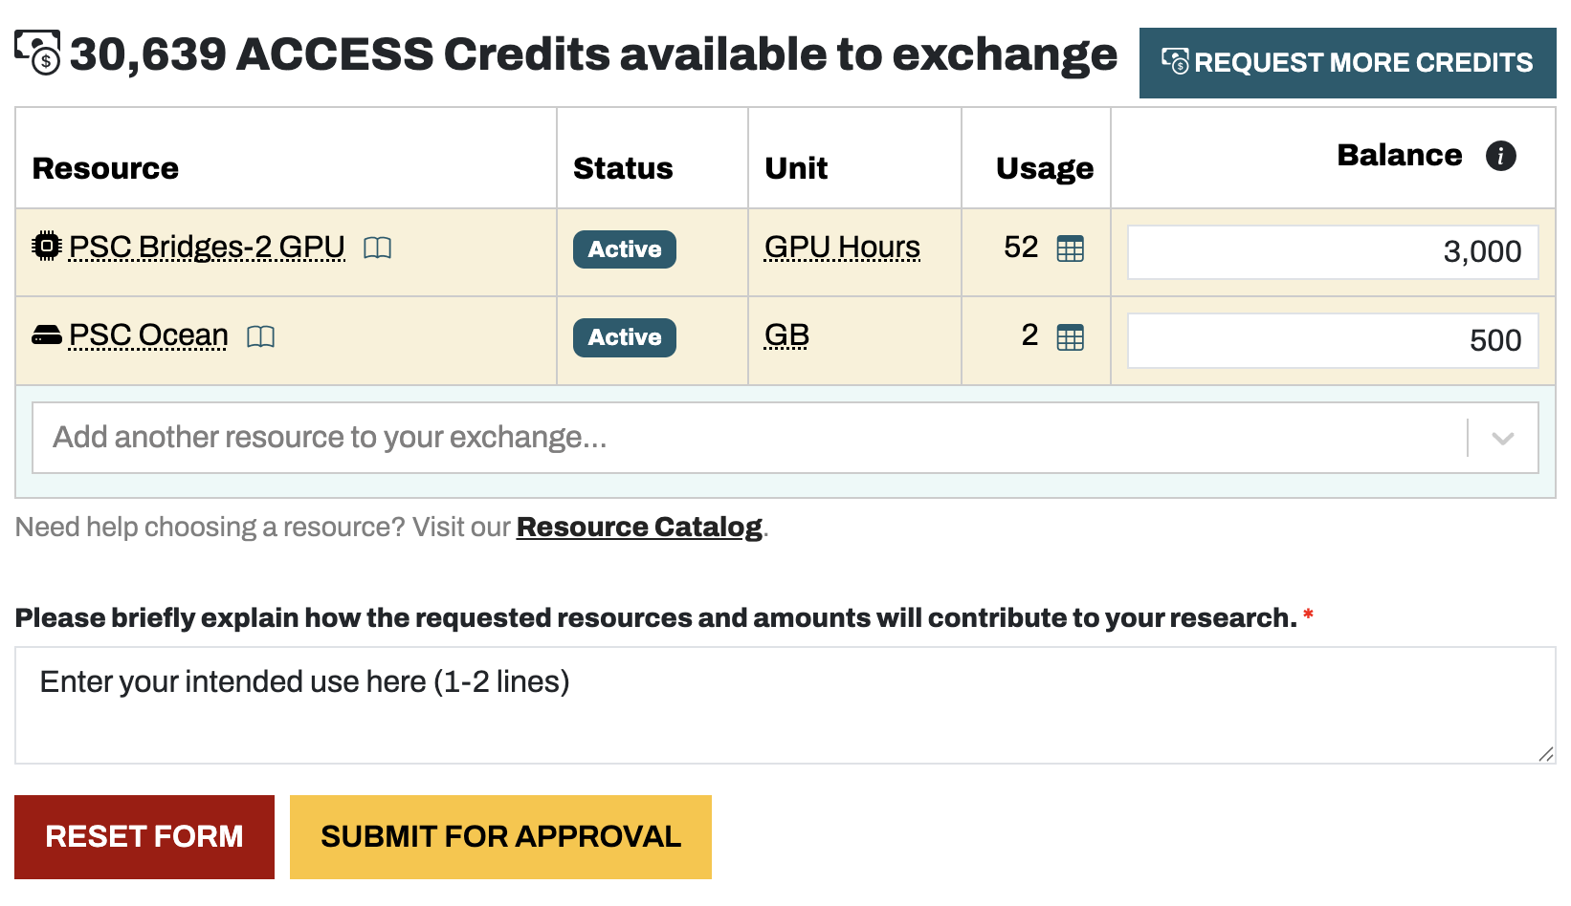
11-785 Introduction to Deep Learning
Managing the Grant: Use Credits to get GPU Hours and Storage
PI / CoPI manage the credits, use it to get GPU and storage
Add IPSC OceanI and IPSC Bridges-2 GPUI
Update your balance (can start with 1000+500)
1-2 lines explaining your use case
What is PSC? What are its Grants?
Applying for the ‘Explore’ grant
Managing your grant
Icons from flaticon.com

