Slide 1
Saving and Loading Model
Recitation 0.25
Introduction to Deep Learning – 11785/685/485
Hunter Lin

Slide 2
Checkpointing Basics: why checkpoint, and what one contains
The Checkpointing Workflow: Train → Save → Load → Resume
Saving Checkpoints: locally with torch.save(), or to wandb Artifacts
Loading & Resuming: local .pth, wandb downloads, same-run resume
Partial Loading: selecting weights with strict=False
Live Demo: end-to-end in the notebook

Slide 3
Checkpointing Basics
The Challenge
Training takes hours or days — time limits, preemption, OOM, and bugs end runs early
Die at epoch 47 of 100, and without a checkpoint you restart at 0
What Is Checkpointing?
A snapshot of your training state — a plain Python dict you build:
model · optimizer · scheduler state_dict() · epoch · metrics · wandb_run_id
Weights alone aren't enough: no optimizer → loss spikes on resume; no scheduler → LR resets
Why We Need Checkpoints
Resume after crashes · keep the best-validation model · branch from any saved point
Checkpointing Basics

Slide 4
The Checkpointing Workflow
Local Session
(Training / Inference)
1. Init
wandb.init()
6. Resume
wandb.init(id=..., resume="must")
2. Save
torch.save()
Weights & Biases
(cloud artifacts)
5. Load
torch.load() +
load_state_dict()
3. Upload
wandb.save() / log_artifact()
4. Download
wandb.restore() / artifact.download()
Local Storage
(.pth files)
Init and Resume are session ↔ cloud. Upload and Download are storage ↔ cloud.

Slide 5
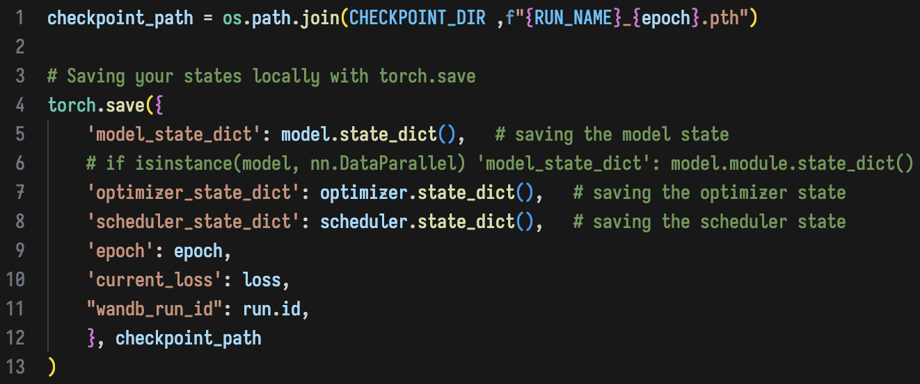
Saving Checkpoints (Locally)
Save Locally with torch.save()
Saves a dictionary you build — written to a .pth file by Python's pickling
Save the state_dict, Not the Model
torch.save(model) ties the file to your class's import path — it breaks if you rename or move it
What Goes In the Dict
model.state_dict() — weights and biases
optimizer.state_dict() and scheduler.state_dict()
Current epoch and loss metrics
wandb_run_id — which run the file belongs to
Saving Checkpoints

Slide 6
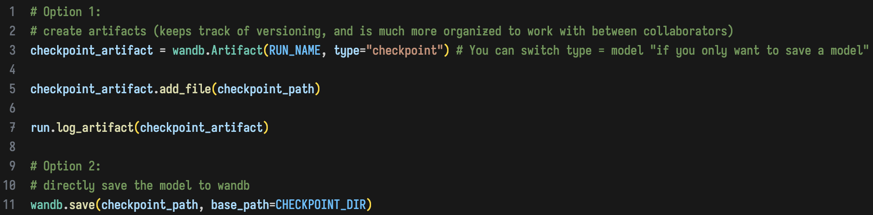
Saving Checkpoints (Wandb)
Option 1 — Artifacts (use by default)
Versioned — each upload is a new version you can pin with :latest or :v3
Stored under the file's BASENAME, not the artifact name
Use when you'll need a specific version back, or want lineage
Option 2 — wandb.save() (quick)
Unversioned — the file just lands in the run's Files tab
Use when you only need the file attached to the run
Watch out: artifact names allow letters, digits, - _ . only — a <run_name>-style placeholder errors here, even though wandb.init(name=...) accepts it.
Saving Checkpoints

Slide 7
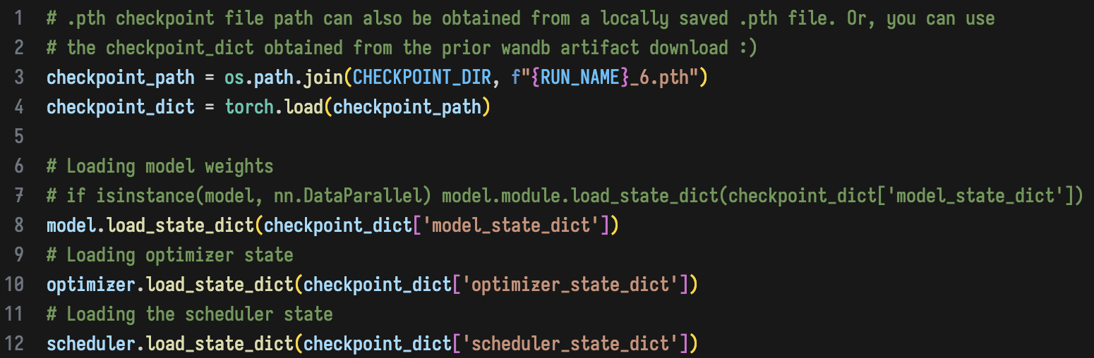
Loading Checkpoints (Locally)
Load the File
One torch.load() gives back the dict you saved
Restore Each Component
All three state_dicts — model, optimizer, scheduler. Restoring only the weights is the most common mistake
epoch — the one that FINISHED; resume at epoch + 1
current_loss — where you left off
Important: model architecture must match exactly, and optimizer / scheduler types must match the checkpoint.
Hyperparameters such as learning rate or momentum can be changed.
Loading & Resuming

Slide 8
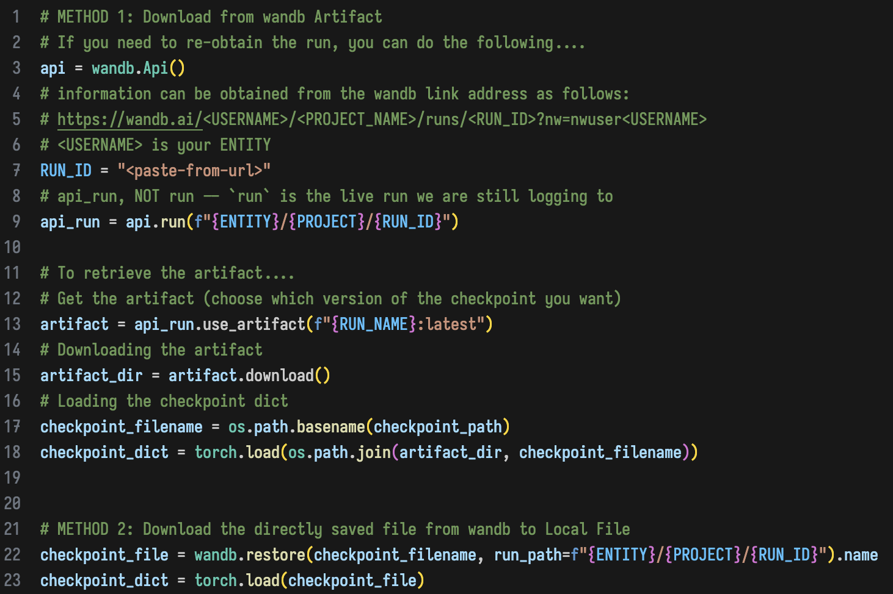
Loading Checkpoints (Wandb)
Get a Handle on the Old Run
api_run, NOT run — run is your live session's run; overwriting it breaks the saving cells above
RUN_ID has to be pasted from the run's URL. It can't be derived: a new session means a new run with a new id
Two Ways Down
Artifacts — pick a version with :latest or :v3, then download
wandb.restore() — grabs the file directly, no versioning
Then Load It
The file sits under its BASENAME, not the artifact name
From here it's identical to local loading
Loading & Resuming

Slide 9
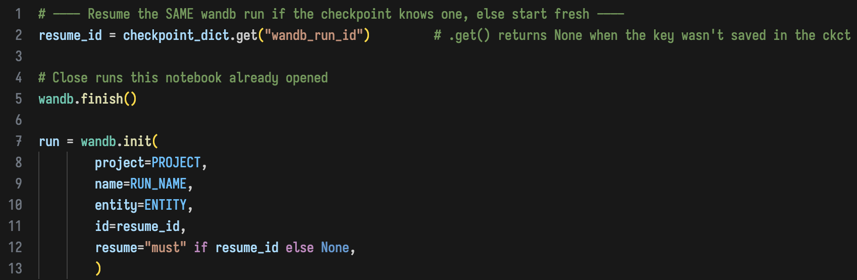
Resuming the Run
"must" vs "allow"
"must" — fail loudly if that id doesn't exist
"allow" — resume if it exists, quietly start a NEW run if it doesn't
No id in the checkpoint? resume=None starts fresh
Why This Matters
Nothing to paste — the .pth carried its own run id
Compare the wandb path: no local file meant hunting RUN_ID out of a URL
Watch out: project and entity must match the original run — resume looks the id up inside that project, so a mismatch fails even when the id is correct.
Loading & Resuming

Slide 10
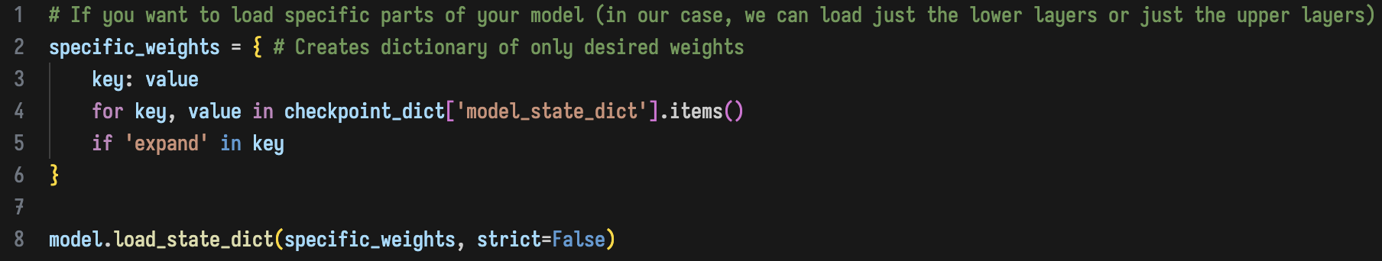
Partial Loading
Why Only Part?
Reuse a trained block in a new model, or restore one piece and leave the rest freshly initialized
Read the Result
missing_keys — model keys you didn't supply; left at their current values
unexpected_keys — keys the model doesn't have; a typo signal
A typo'd filter builds an EMPTY dict: loads nothing, raises nothing. missing_keys is your only evidence
Watch out: names must match exactly, and shapes must match for the parameters you do load. strict=False forgives missing and extra names — it does not forgive wrong shapes.
Partial Loading

Slide 11
Live Demo

