Slide 1




Flow of the Project: Your Guide for the 11-785 Final Project
This guide provides a comprehensive framework for structuring,
executing, and excelling in your Intro to Deep Learning course project.
Presented by: Uwimana Lowami and Hunter Lin
11-785 Intro to Deep Learning | Fall 2026
Material adopted from Rec. 0.28, Spring 2026 by Ahmed Issah

Slide 2
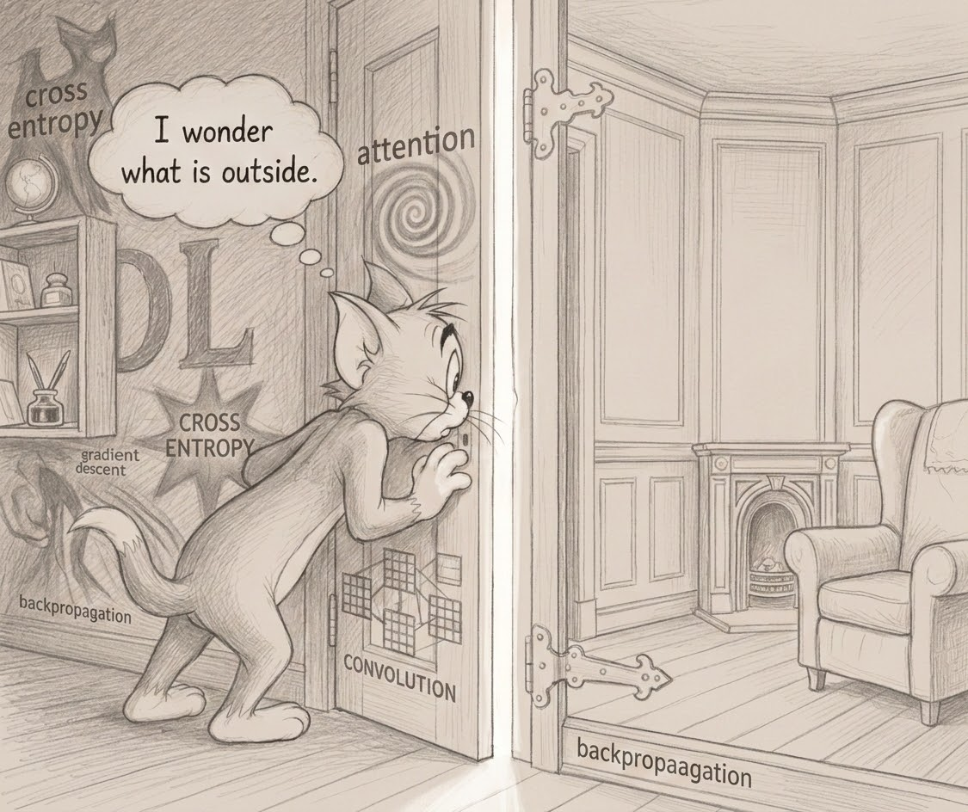
PROJECT PURPOSE
Long live the explorer
The final project is your chance to explore a topic of your interest that we do not cover in the class.
A new method to do deep learning, an application to a certain problem, or any other wild idea - the choice is yours. You’re the explorer!

Slide 3
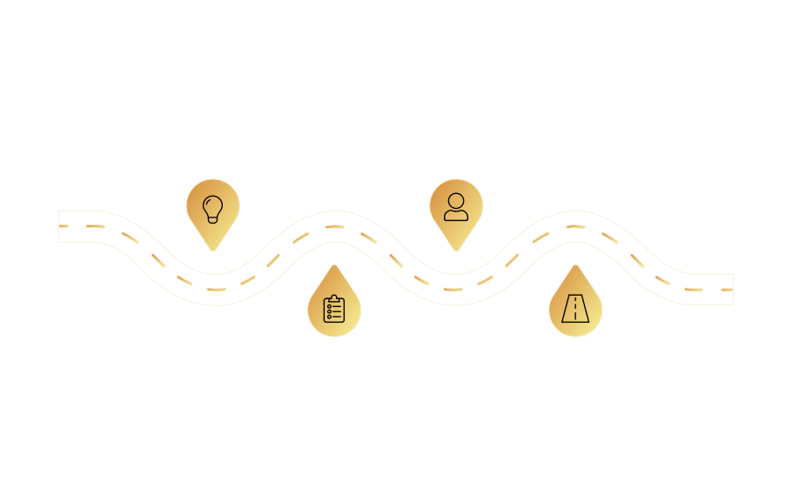

Execution Makes the Difference
Ideation
Collaboration
Concept generation
Build team and seek
and defining goals
mentorship
Preparation
Execution
Plan structure, resources, and risks
Implement, monitor,
and iterate

Slide 4

Why This Matters: The Project is 25% of Your Grade
Your course project represents a significant component of your overall grade as graduate students. Understanding the breakdown is crucial for strategic planning:
Final Project Report: 40%
Final Project Video: 35%
Midterm Report: 20%
Piazza Responses: 5%

Slide 5

PHASE 1
Laying the Foundation
The choices you make in the initial weeks will profoundly influence the next three months of your project. Before you even write a single line of code, establish a robust foundation built upon three critical pillars:
Topic
Team
Mentor
Choose a problem that genuinely excites you and aligns with your interests.
Assemble a dedicated and collaborative group committed to shared success.
Seek guidance from an experienced individual who can provide valuable insights.

Slide 6




The Three Pillars of Success
TOPIC: Passion Fuels Perseverance
TEAM: Collaborative Commitment
Focus on problems that genuinely excite you, offer potential for impact (publication or product), and
align with current trends in
top conferences like NeurIPS
and ACL.
Badteams kill more projects than bad ideas ever will. Be intentional with check-ins, honest reporting and communication.
MENTOR: Alignment and Availability
Alignment and availability are paramount. Ensure your mentor works in your field, has dedicated time to guide you, and approach them early with a specific idea.

Slide 7

PHASE 2
The Execution Engine
This phase focuses on a structured, repeatable workflow to transform your raw idea into a polished output. Maintain continuous feedback with your mentor throughout.
1
Inspiration
Identify a compelling problem.
2
Exploration
Dive deep into existing literature.
3
Formulation
Clearly define project scope.
4
Execution
Implement your proposed solution. If you need compute, request it much earlier. You don’t want it to be a bottleneck.
5
Iteration
Debug, pivot, and refine.
6
Output
Deliver a paper, demo, or tool.

Slide 8







Connecting Your Work to Your Grade
Project deliverables serve as crucial milestones, marking your progress through the workflow and contributing directly to your final evaluation.
Project Proposal
Detail your topic, conduct a literature review, outline your baseline model, and clearly define team roles.
(Strict 2-page limit)
Midterm Report
Present an enhanced literature review, showcase your implemented baseline with initial results, and outline individual contributions for accountability.
Final Report
A comprehensive document including an executive abstract, structured academic sections, and key
visuals. (40% of grade)
Final Video
A concise 5-minute video detailing your problem, implementation, comparison, and results. (35% of grade)

Slide 9
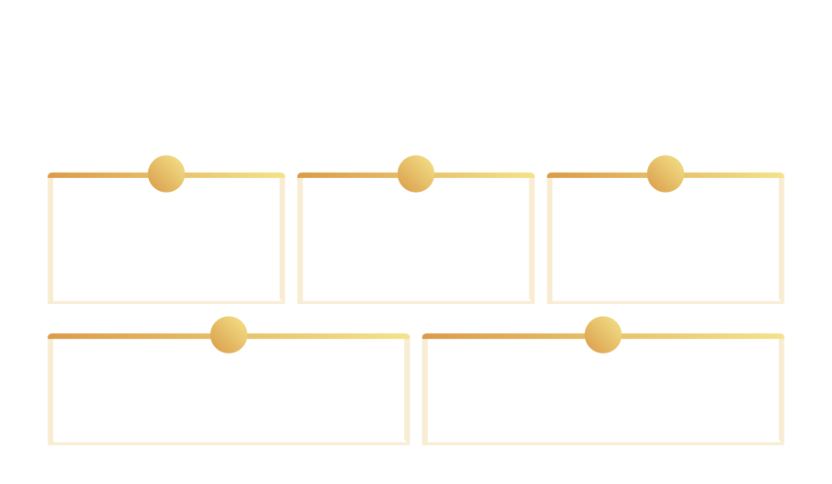

Run Your Project Like a Startup
“We’ll all do everything together” is a surefire recipe for slow-motion failure. Embrace the startup playbook for efficiency and success:
:
1
2
3
Assign Clear Roles
Start Building Early
Set Internal Deadlines
Decide who leads, writes, and codes. Own your tasks and responsibilities.
The sooner you begin, the faster you can identify challenges and learn from them.
Prevent last-minute panic by establishing mini-deadlines throughout the project lifecycle.
4
5
Stay Organized
Over-communicate
Utilize a single, consistent workspace or platform for all project-related materials.
Silence often leads to more problems than open disagreement. Keep communication channels active.

Slide 10


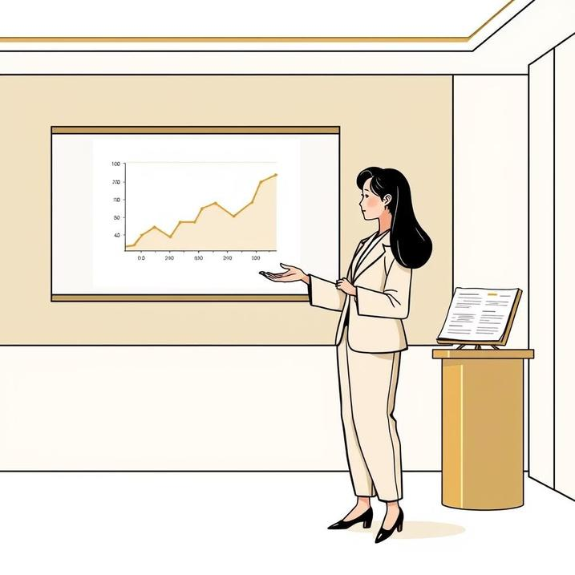
PHASE 3
Finishing Strong: Delivery and Dissemination
Transform your hard work into a compelling narrative with these four key principles:
Clarity
Your writing must be easy to understand and follow.
Relevance
Focus directly on your topic with strong supporting evidence.
Brevity
Be concise; avoid unnecessary details or verbose explanations.
Accuracy
Ensure all data, analysis, and formatting (e.g., IEEE) are correct and consistent.

Slide 11

Your Project is Your Story: Make it Worth Telling
Treat your project with the seriousness of a real product launch. Plan and execute relentlessly, building upon your strong foundation of topic, team, and mentor. Communicate effectively and take full ownership of your role — no one is coming to rescue you. This is your unique story; execute it well and share it with pride.

