Slide 1
Introduction to Deep Learning
0. Logistics
Fall 2026
Presented By:
Bradley Warren
Head TA

Slide 2
Outline
Introduction
•
The Instructor, TAs, Course Topics, and You
•
The Challenge of the Course
•
Components of the Course
•
“Give it everything you’ve got”
•
Components of the Grade
•
Common Sense and Integrity
•

Slide 3
Outline
Introduction
•
The Instructor, TAs, Course Topics, and You
•
The Challenge of the Course
•
Components of the Course
•
“Give it everything you’ve got”
•
Components of the Grade
•
Common Sense and Integrity
•

Slide 4
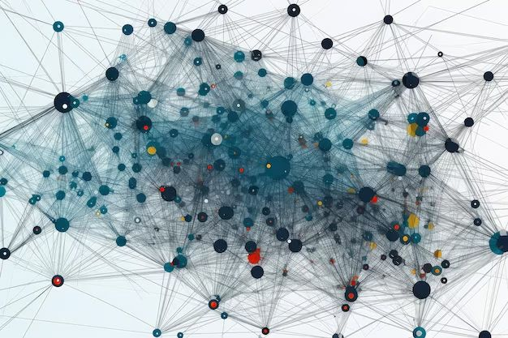
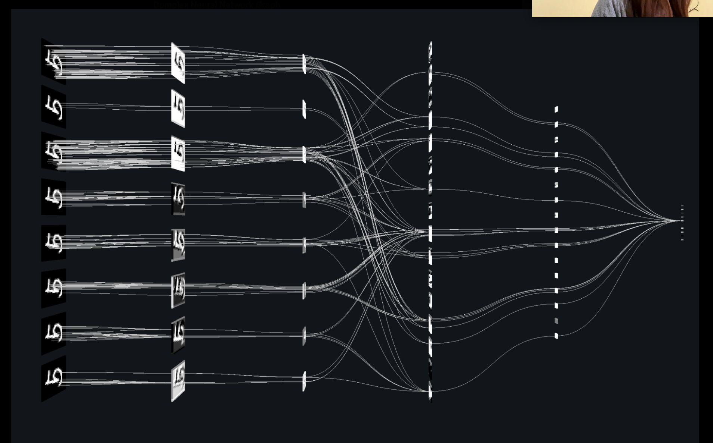
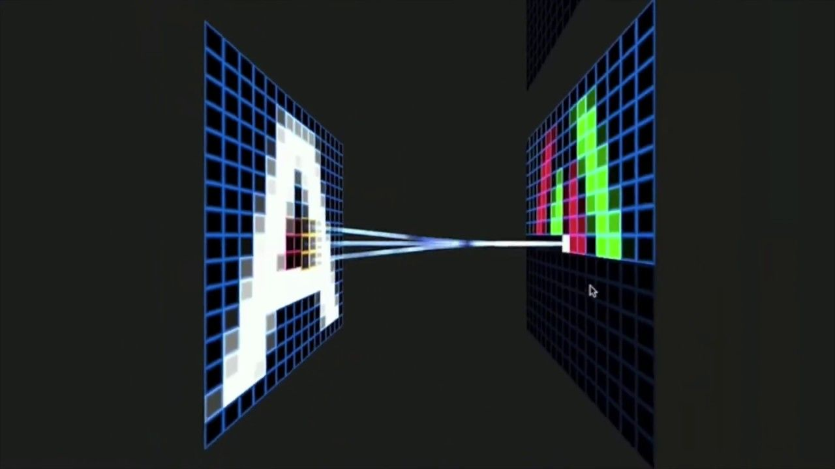
Neural Networks
are taking over!

Slide 5




Neural Networks are taking over!

Slide 6
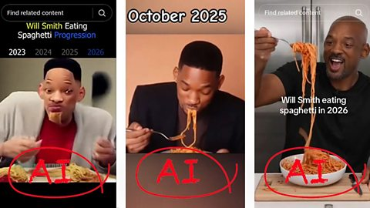
Breakthroughs

Slide 7
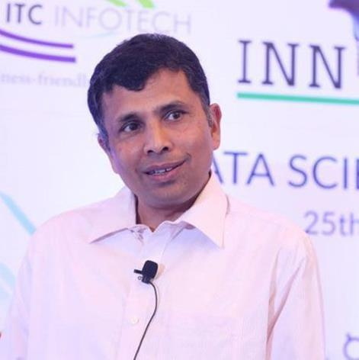
Instructor and TAs
•
Instructor:
–
Bhiksha Raj
–
Rita Singh
•
TAs:
–
List of TAs, with email ids on
course page
–
We have TAs from the Pittsburgh,
Kigali, and Silicon Valley Campuses
–
Remote and in-person office
hours are provided
•
Office hours: see course webpage
https://deeplearning.cs.cmu.edu

Slide 8
Who is the course designed for?
•
Required Classes
-
Fundamental of Programming (or equivalent) -
-
Python, PyTorch
•
Highly Recommended Classes:
-
Calculus and Linear Algebra
•
Nice to have:
-
Vector Calculus and Software Engineering

Slide 9
General Course Topics
•
Introductory Network Structures
–
Multilayer Perceptrons
–
Convolutional Neural Networks
–
Recurrent Neural Networks
–
Boltzmann Machines
•
Beyond the Basics
–
Generative models: VAEs
–
Adversarial models: GANs
–
Graph Neural Networks
–
Transformers
•
Practical Focus Areas:
–
Computer vision: recognizing images
–
Text processing: modelling and generating language
–
Machine translation: Sequence to sequence modelling
–
Modelling distributions and generating data
–
Speech recognition

Slide 10
Who is the course designed for?
•
This course is implementation heavy
–
There is a lot of coding
–
There is a lot of experimenting
–
You will work with some large datasets
•
Course Language of choice: Python
•
Course Toolkit of choice: PyTorch
–
You are welcome to use other languages/toolkits, but the
TAs will not be able to help with coding/homework

Slide 11
This course is not easy
•
A lot of work!

Slide 12
This course is not easy
•
A lot of work!
•
A lot of work!!

Slide 13
This course is not easy
•
A lot of work!
•
A lot of work!!
•
A lot of work!!!

Slide 14

This course is not easy
•
A lot of work!
•
A lot of work!!
•
A lot of work!!!
A LOT OF WORK!!!!
Not for chickens!
•

Slide 15

This course is not easy
•
A lot of work!
•
A lot of work!!
•
A lot of work!!!
•
A LOT OF WORK!!!!
•
But the most you’ll ever learn

Slide 16
This course is not easy
•
Mastery-based evaluation
–
Quizzes to test your understanding
of topics covered in the lectures
–
HWs to teach you to implement
complex networks and optimize
them to high degree
–
For non-485 students, projects to
expose you to real world DL
problems
–
FYI: Anyone who gets an “A” in the
course is technically ready for a
deep learning job

Slide 17
Outline
Introduction
•
The Instructor, TAs, Course Topics, and You
•
The Challenge of the Course
•
Components of the Course
•
“Give it everything you’ve got”
•
Components of the Grade
•
Common Sense and Integrity
•

Slide 18
Lectures
•
In-class lectures
•
Live streaming for remote sections
•
Lectures will also be recorded and uploaded to
the course website
•
Importance of viewing lectures
•
Even if you think you know the topic
•
Quizzes: your marks depend on viewing
lectures
•
We monitor attendance (more on this later)
*some lectures may be conducted entirely over zoom.

Slide 19
Weekly Quizzes
•
Questions are related to topics covered that week
–
In lecture slides
–
Released Fridays @ 11:59PM EST
–
Closed Sundays @ 11:59PM EST
–
(this may occasionally shift, don’t panic!)
•
14 total quizzes
–
We accept the best 12 (you may skip 2)
•
This is expected to account for any
circumstance-based inability to work on quizzes
•
Each has 10 multiple-choice questions
–
We accept the best of 3 attempts per quiz

Slide 20
Recitations, Hackathons, and Bootcamps
We strongly recommend you attend all recitations,
hackathons, and bootcamps.
•
Recitations
–
14 recitations, held on Fridays in the lecture room
–
It is hands-on and will cover implementation specifics while you
follow along
•
Hackathons
–
14 hackathons, held on Saturdays
–
In-person in Pittsburgh and Kigali (room TBD)
–
It is a giant office hour session with pizza
•
Bootcamps
–
4 bootcamps, one for each HW (+1 for Guided Project)
–
Held on Saturdays before hackathon
–
It will cover HW implementation specifics while you follow along

Slide 21
Assignments
•
There will be four main HWs, bonus HWs, and an
autograd bonus
•
Main HWs all have two parts:
–
Part 1: Autograded problems with deterministic solutions
•
You must upload them to autolab and CHECK YOUR SCORE
–
Part 2: Open problems posted on Kaggle
•
HW Bonus and Autograd Bonus:
–
There will be bonus homeworks associated with some (or all)
of the homeworks; there will also be a separate autograd
bonus homework.
–
These marks will not contribute to final grading curves and
give you the chance to make up for marks missed elsewhere

Slide 22

Study Groups
•
Everyone must join a study group
•
Each study group will be assigned a TA mentor
for help throughout the course
•
We recommend study groups of 3-4 people
•
If you do not have a study group, we will form
one for you
–
Please register via forms we post on Piazza

Slide 23
Course Project
•
If you’re taking 11-785, you will do an original project
•
If you’re taking 11-685, you will do a project “Guided
Project”
•
If you’re taking 11-485 this slide does not apply to you
•
Projects are intended to exercise your ability to
comprehend and implement ideas beyond those
covered by the HWs
•
Projects can range from
•
Implementation and evaluation of cutting-edge ideas from recent
papers
•
Problem-solving that might lead to publication, if completed well
•
New models/learning algorithms/techniques, with proper evaluation
•
Verification of results from “hot” published work

Slide 24
Lecture Attendance
•
You get marks for attendance (i.e. class participation)
•
Our performance metrics over the semesters show a
distinct correlation between attendance and course scores
•
We also note a distinct inverse correlation between attendance
and the amount of help you require on piazza and during office hours
•
To encourage attendance, we assign 1 mark for attendance
•
1% of your total grade for 11685 and 11785
•
1.3333% of your total grade for 11485
•
This can be the difference between a B and an A
•
We will track lecture attendance through Polls

Slide 25
Recitation 0 & HW1p1
•
If you have any doubts about your preparations for
this course, please, please, please, please go through
the videos for Recitation-0 and complete the
notebook exercises
–
Gain comfort with the coding required in the homeworks,
early on
–
Info on Compute Infrastructure:
Amazon tokens (AWS) will be provided
Google Cloud Platform (GCP)
Kaggle
•
HW1 Part 1 has components intended to help you
later in the course

Slide 26

Course Communication
●
Lecture and Attendance Polls
●
Questions and Answers
●
Announcements and Reminders
●
Student Collaboration
●
Instructor Notes
https://piazza.com/

Slide 27
Reading Materials
•
Free resource: 'Dive Into Deep Learning'
(interactive Jupyter notebooks).
•
Recommended: François Chollet's 'Deep
Learning with Python' (Second Edition)
•
Additional reading material will also appear
on the course pages

Slide 28
Study groups
•
What study groups may do:
–
Discuss homework problems and solutions
–
Discuss papers
–
Discuss class work
–
Discuss quizzes
•
We encourage you to meet regularly to
discuss IDL work
•
Study groups may also go on to form project
teams

Slide 29
Study Group Mentors
•
Every study group will be assigned a TA mentor
–
We will track your progress and reach out to you if you appear to
be in trouble
•
If in trouble, first reach out to your TA mentor
–
If you feel you’re falling behind, reach out to your mentor
–
If you feel you are struggling, reach out to your mentor
–
If you feel pressured/unable to cope, reach out to your mentor
–
We will try our best to help you
•
We aim to make this a successful course for all of you
–
In our intro to deep learning, ID(ea)L world, everyone performs well
enough to get an A without lowered standards
– i.e. we would like to bring you all up to where we believe you
deserve an A
–
Everything about this course is geared to this objective

Slide 30
Project Group Mentors
•
Every project group will be assigned at least one
TA mentor
–
We will track your progress and be in touch about your
project status throughout the semester
•
You are allowed to seek a “external” mentor who
has more expertise in your topic of interest
–
If you need more guidance and expertise

Slide 31
Evaluation
•
Scores are evaluated based on 3 types of tests:
•
Attendance
•
Weekly Quizzes
•
HW Assignments
•
Team Project or Guided Project (not for 11-485
students)

Slide 32
Lecture Attendance: Rules
•
You must either attend the lectures in person, or watch via zoom
–
With some exceptions: see below
–
We get attendance stats from your participation during in-class polls
–
Polls will be conducted via Piazza for in-person lectures. It is recommended to use
the Piazza app available both on Android and iOS.
–
Lectures conducted over zoom will use zoom polls
–
Use of electronic devices during in-person lectures is not permitted except during
polls
•
Students in SV, and in other time zones where your local time is before
8am or after 5pm for the class, may alternately watch recorded lectures on
mediatech instead
–
Mediatech records who watched and for how long. Entire lectures must be viewed.
–
If viewed on mediatech, the lectures of each week must be viewed before 8AM of
the Monday following the following week
–
Otherwise, it doesn’t count
•
The precise mechanism for computing the class participation score from
attendance will be decided at the end of the semester. Our advice to you:
just attend

Slide 33
Weekly Quizzes
•
Slides often contain a lot more information than
what is presented in class
•
Quizzes will contain questions from topics that are on the
slides, but not presented in class
•
Will also include topics covered in class, but not on online
slides!
•
Sometimes there will be questions based on
latest research papers in the quiz – the links to
the papers will be provided

Slide 34

Homework: Part 1
•
HW Part-1s evaluate your ability to code neural nets on your own
from scratch
–
If you implement all mandatory and bonus questions of part 1 of all
homeworks, you will, hopefully, have all components necessary to
construct a little neural network toolkit of your own
•
“mytorch”
•
The homeworks are autograded
–
Be careful about following instructions carefully
•
The autograder is setup on a computer with specific versions of
various packages
•
Your code must conform to their restrictions, if not the
autograder will often fail and give you errors or 0 marks, even if
your code is functional on your own computer
–
Note: you get some bonus points if you submit the homework early

Slide 35
Homework: Part 2
•
HW Part-2s test your ability to solve complex problems on
real-world data sets
•
Unlike part-1s, initial early submissions are required and
worth 10/100 points (to show you have gotten started)
•
The remaining 90/100 points are determined by your
final score relative to the cutoffs

Slide 36
Homework: Part 2
•
The standard cutoffs are (After 10 pts ESD)
•
High cutoff
: 90 pts
•
Medium cutoff
: 70 pts
•
Low cutoff
: 50 pts
•
Very Low
: 30 pts
cutoff
: 0 pts
•
No submission
•
Your score is linearly interpolated between cutoffs. Ex, if an 85%
accuracy model is for the high cutoff and 75% model is for the
medium, a model with 80% accuracy will get 82.5/90 pts
•
There is a 5th bonus cutoff for extra credits (10 pts) determined by
the highest scoring student
•
Ex. If the highest accuracy is 92%, the scoring student will get
110/100 and anyone between 85% to 92% will get 100+/100
(assuming they have 10 bonus points from early submission)

Slide 37
Course Project
•
Teams: think about forming project teams as soon as
possible (we may help, too)
•
11-785 teams are of 3-4 students maximum
•
11-685 teams are of 2-3 students maximum
•
Project requirements:
•
Report:
•
Submit a project proposal by the proposal deadline listed on the website
•
Submit an initial report 3⁄4 way through the semester
•
Submit an updated report draft 3 days before the presentation due date
•
Submit a final report during finals week, at the end of the semester
•
Video:
•
Make a 5 min video presentation of the project at the end of the semester
•
The video can be presented by one, some, or all team members
•
Video should explain the problem, proposed solution, and evaluation
•
Defend your project by answering questions about your video, on Piazza
•
The project is often the most enjoyable portion of the
course

Slide 38
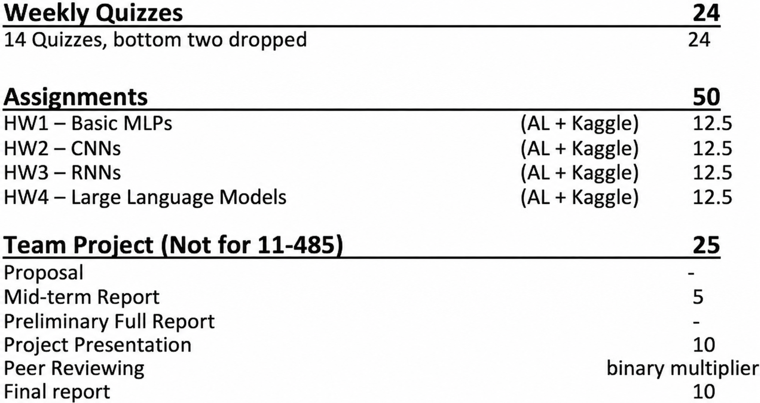
Grading
* Note: There is 1 mark for attendance

Slide 39
Homework Deadlines
•
There are separate deadlines for Part-1s and Part-2s
•
HW Part-2s have multiple deadlines
•
Early Submission Deadline: worth 10% of Part-2 and affirms you have
started the assignment
•
On-time Submission Deadline: determines your eligibility for full cutoff marks
•
Late/Slack Deadline: everyone gets up to 10 total slack days (does not
apply to initial submissions, all bonus points, nor HW Part-1s) -- you
can distribute them as you want across your HWs, and once you use up
your slack days, all subsequent late submissions will accrue a 10%
penalty (on top of any other penalties)
•
Note: Kaggle: Kaggle leaderboards stop showing updates on
full-submission deadline
•
We will continue to accept submissions until you run out of slack days (the
drop-dead deadline)
•
Please refer to the course webpage for a complete set of
policies

Slide 40
Common Sense Piazza Posts
•
Feel free to post on piazza for any clarification or doubts
•
We strive to respond to student queries immediately
•
With Regards to Code-Related Questions on
Piazza..
–
Make a good title to your question, on the post.
–
Describe the problem concisely and clearly.
–
Include relevant, short code blocks if necessary... do not
paste entire notebooks or python files, please!
–
Explain your debugging process:
■
What you tried, initially (prior to error)
■
The results you got
■
The errors and expanded stack traces
■
What you tried, subsequently (after the error)
■
What roadblock are you stuck at now / what do you
need help understanding?

Slide 41
Personal and Academic Integrity
•
You are here to learn DL yourself, not to demonstrate
how well you can pretend to learn
•
You are at CMU – which means you are among the
brightest and best students in the world
–
You probably were among the top students in your peer
group all your life, before you came here
–
It will be an insult to yourself, to lower your integrity
•
Try your best, honestly. If you are unsure about
something, reach out to us

Slide 42
Integrity and Study Groups
•
Every student must solve their quizzes by themselves
–
You may discuss the questions with your study groups/friends,
but when you solve the quiz, isolate yourself and do it alone
•
Every student must solve every homework by themselves
–
You may discuss the homeworks with your friends, and even
help them debug their code, but when you finally solve it, every
line of your code (except libraries that have been okayed by
course staff) must be written by you
–
Your solution must be yours
•
Plagiarizing code from the web or your friends constitutes an
academic integrity violation
–
Submitting any solutions not obtained by you constitutes an AIV

Slide 43
Thank you for deciding to take this
journey of Deep Learning with us
- Prof. Bhiksha and TAs

