Slide 1

The 4th Data Prefetching Championship (DPC4)
Co-located with HPCA 2026
Organizers: Rahul Bera, Konstantinos Kanellopoulos, and Onur Mutlu
February 1, 2026
Sydney, Australia

Slide 2
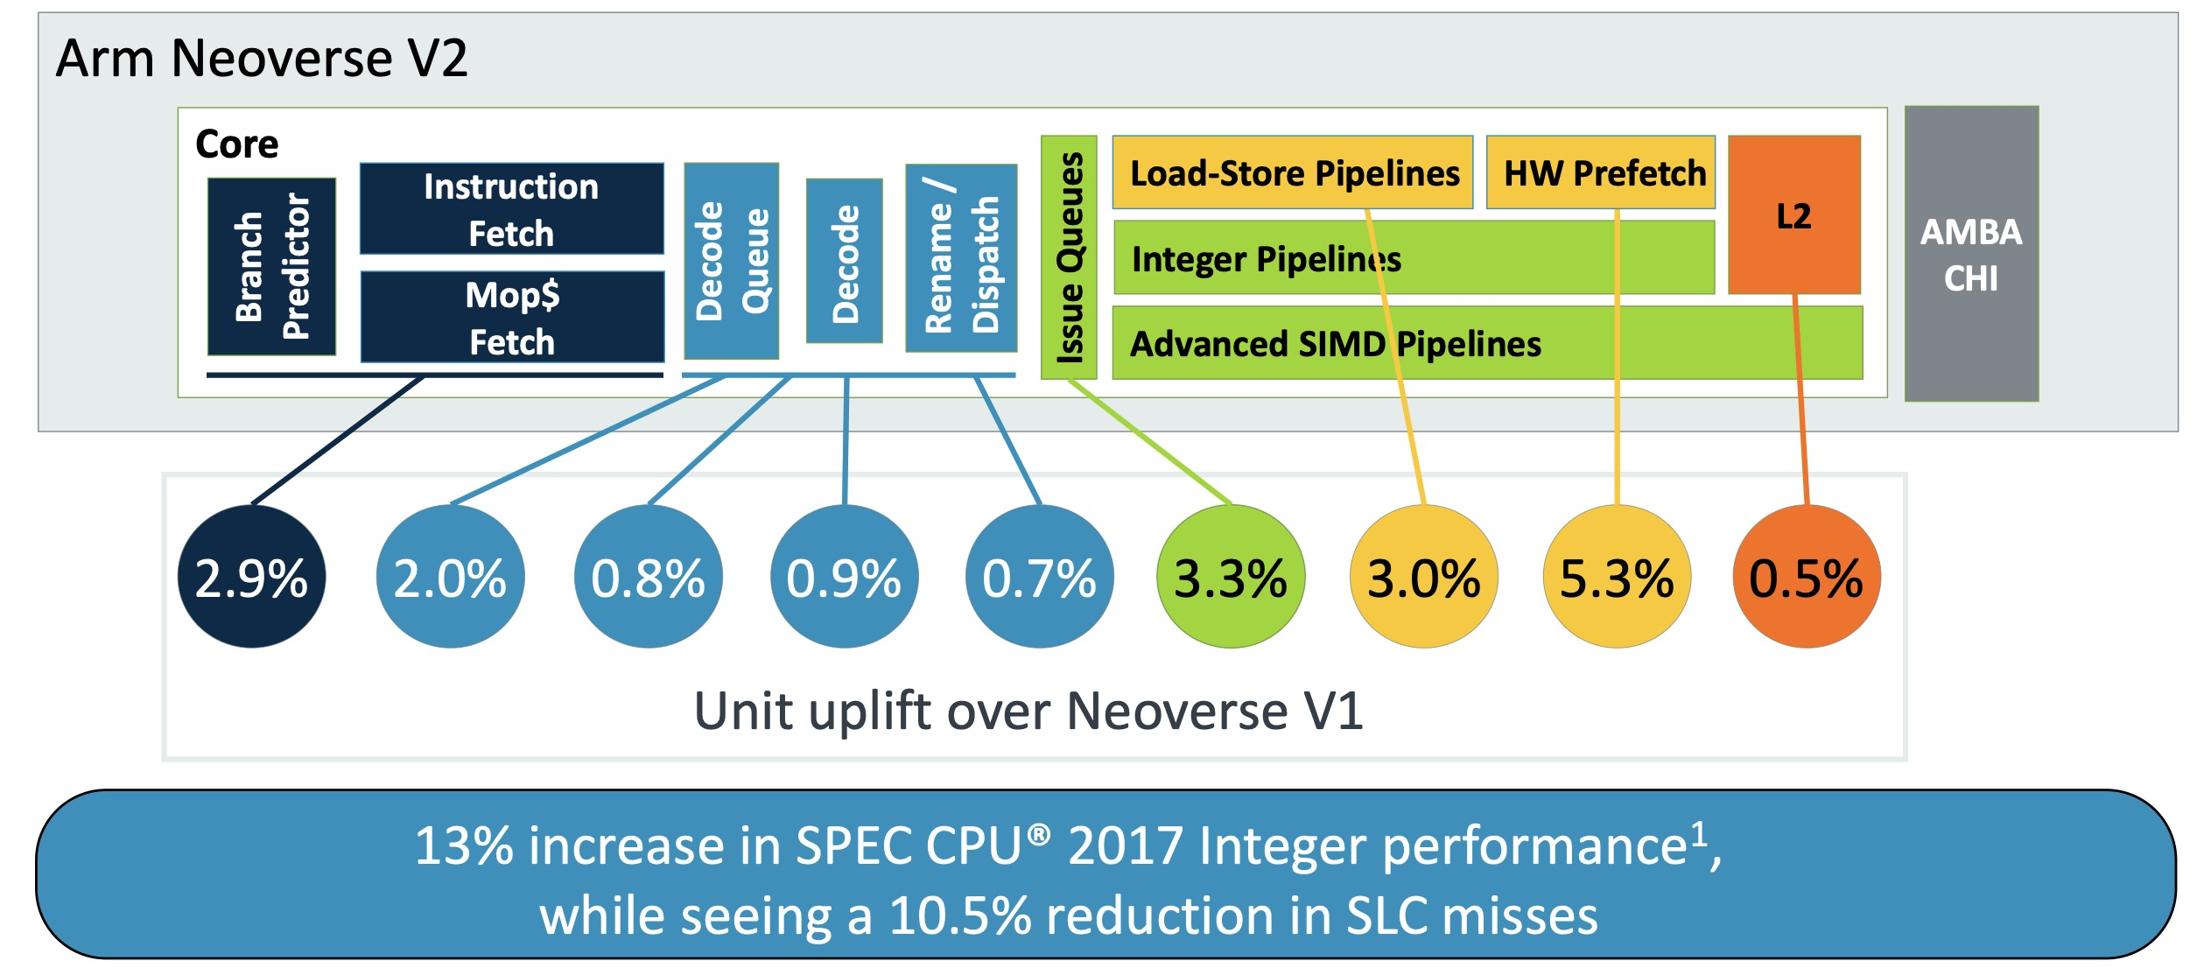
Why Do We Care about Prefetching?
Arm Neoverse v2, HotChips 2023
https://hc2023.hotchips.org/assets/program/conference/day1/CPU1/HC2023.Arm.MagnusBruce.v04.FINAL.pdf

Slide 3
Why Do We Care about Prefetching?
Prefetching is important for providing performance
Arm Neoverse v2, HotChips 2023
https://hc2023.hotchips.org/assets/program/conference/day1/CPU1/HC2023.Arm.MagnusBruce.v04.FINAL.pdf

Slide 4
Why Another DPC?
It’s been a while ...
~7 years
Once in ~4 years
DPC1
HPCA 2009
DPC3
ISCA 2019
DPC4
HPCA 2026
DPC2
ISCA 2015
ML Prefetching
ISCA 2021

Slide 5
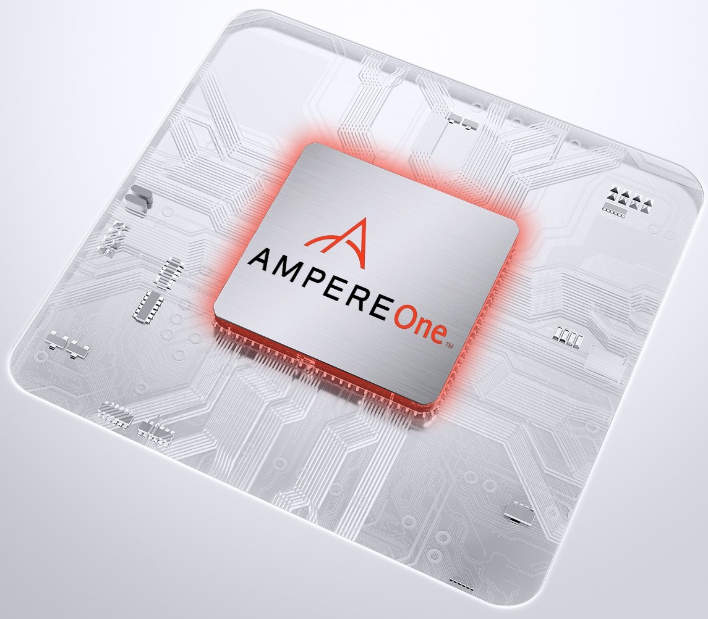



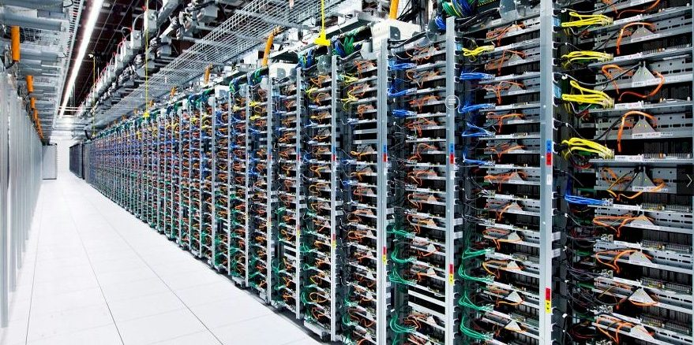
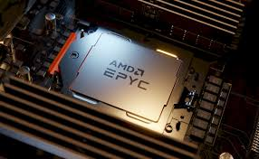
What Changed since Last DPC?
Workloads
Data Footprint
System Configuration
AI/ML inference,
datacenter-class workloads,
complex graph-based apps
Ever increasing working dataset size
32+ core datacenter-class processors with limited
per-core DRAM bandwidth

Slide 6
Goal of DPC4
Evaluate innovative ideas on prefetching
under a common evaluation framework
to tangibly advance the state-of-the-art

Slide 7
Format of DPC4
Simulator: ChampSim
Participants are free to implement prefetchers at L1/L2/LLC
Limited hardware budget
  32KB for L1 data cache prefetcher
  128KB for L2 prefetcher
  256KB for LLC prefetcher
No limitation in complexity
System-level feedback are available to enable dynamic adaptation
  Prefetcher accuracy, memory bandwidth usage, rolling-window IPC, ...

Slide 8
New Things in DPC4
New Workloads representative of our time
State-of-the-art AI/ML inference
  LLama2 (LLM), ViT (image generation), Whisper (text-to-speech), ...
Real workloads from Google’s warehouse-scale computers
Graph mining workloads
Broader evaluation across diverse system configurations
Every submission was evaluated on three system configurations:
  Single-core with ample DRAM bandwidth (FullBW score)
  Single-core with limited DRAM bandwidth (LimitBW score)
  Four-core random mixes (MC score)
Dynamic system-level feedback, instead of static knobs (e.g., bandwidth usage)

Slide 9
DPC4 at a Glance
Evaluated across
610
single-core workloads and
484
four-core workload mixes, totaling
3TB
of space
Over
50,000
CPU core-hour
spent on evaluation
Overall
8
competing teams across the globe
9
Program committee members,
providing three reviews
to each submission

Slide 10
Did We Meet the Goal?

Slide 11

Sneak Peak: DPC4 Advances the State-of-the-Art
5.2% across 610 traces!
2.6% across 610 traces!
2.8% across 484 mixes!
Berti@L1 + Pythia@L2: Already +15.1% over no-prefetching

Slide 12
Sneak Peak: DPC4 Advances the State-of-the-Art
27.7%
1.1%
4%
4.5%

Slide 13
Sneak Peak: DPC4 Advances the State-of-the-Art
27.7%
More opportunities for the future
1.1%
4%
4.5%

Slide 14
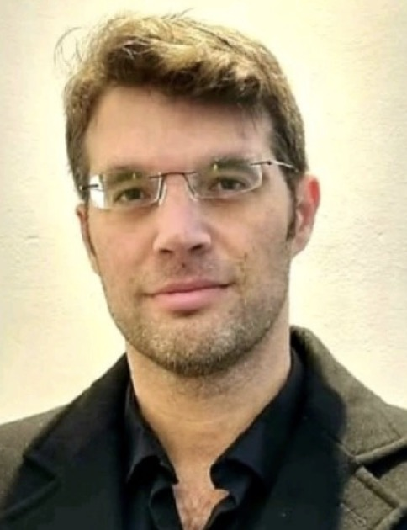
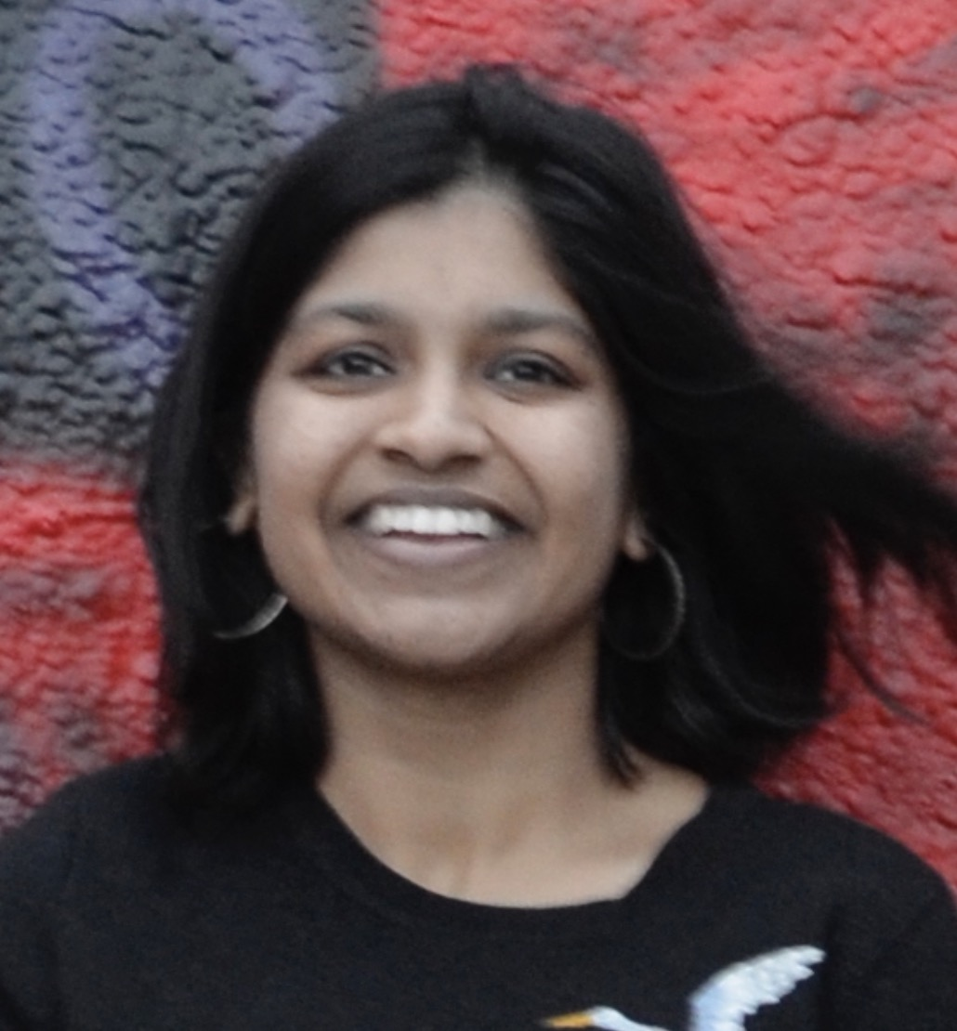
Today’s Agenda (I)
2 invited talks from industry veterans
8 competitors’ talks
Dr. Leeor Peled, Huawei Research
Title: “Is Prefetcher Research
Still Alive?”
Dr. Akanksha Jain, Google
Title: “Data Prefetching:
A Data-Center Perspective”

Slide 15
Today’s Agenda (II)
Session 1 (13:45 – 15:35): 1 invited talk + 4 papers
  Invited talk by Dr. Leeor Peled
  Crossing the Boundary – Lee+, Yonsei University
  SPPAM – Merrell+, Texas A&M
  Emender -- Chen+, Tsinghua University
  sBerti – Zhou+, HKUST, Guangzhou
Break
Session 2 (15:50 – 17:40): 1 invited talk + 4 papers
  Invited talk by Dr. Akanksha Jain
  Pushing the Limits of Berti – Singh+, University of Murcia and University of Zaragoza
  Entangling Data Prefetcher – Torres+, University of Zaragoza , University of Murcia, and IIT Bombay
  uMAMA – Block+, UIUC
  Global Berti – Posluns+, University of Toronto

Slide 16
The 4th Data Prefetching Championship (DPC4)
Co-located with HPCA 2026
Organizers: Rahul Bera, Konstantinos Kanellopoulos, and Onur Mutlu
February 1, 2026
Sydney, Australia

