Slide 1

Emender: Optimizing Prefetch Priority and Throttling in VBerti+Pythia
DPC4 Championship
Jiajie Chen · Tingji Zhang (Presenter)
Xiaoyi Liu · Xuefeng Zhang · Peng Qu · Youhui Zhang
Tsinghua University
1
Notes:
Hello everyone. My name is Tingji, and I am presenting on behalf of my team from
Tsinghua University, led by Jiajie.
Our work is called Emender, which focuses on optimizing prefetch priority and
throttling, based on the VBerti and Pythia prefetchers.

Slide 2
Presentation Overview
1
Background & Motivation
2
Competition Approach
3
Problem Analysis
4
Four Key Optimizations
5
Evaluation Results
6
Conclusion
2
Notes:
Here is the agenda for my talk. I will explain the specific problems we found in
existing solutions. And then, I will detail the four key optimizations we designed to
solve these problems. Finally, our evaluation results.

Slide 3
Background - Data Prefetching
The Memory Wall Problem
Growing performance gap between processor and memory speeds
Data prefetching has become increasingly critical
What is Data Prefetching?
Hardware/software component that predicts future memory accesses
Proactively loads data from main memory into cache
Reduces or hides data access latency
Ideal: Data already in cache when processor needs it
3
Notes:
First, let's briefly look at the background. As we all know, we face the 'Memory Wall' problem. Processors are getting faster, but memory speed isn't keeping up. This is why data prefetching is so critical today. The goal is simple: we need to predict what data the CPU needs and load it into the cache before it is actually requested.
Our work builds on this foundation, focusing on how to optimize state-of-the-art prefetchers like VBerti and Pythia to better utilize limited prefetch queue resources and improve multi-core fairness.

Slide 4
Competition Approach - Finding SOTA
Step 1: Evaluate Existing Prefetchers
Step 2: Comprehensive Evaluation
Evaluated 13 Prefetchers
Evaluation
SMS (ISCA '06), ISB (MICRO-46), SPP (MICRO-49), Bingo (HPCA '19), Triage (TC '21)
BOP (DPC-2), Berti (DPC-3), IPCP (DPC-3)
Pythia (MICRO-54), PMP (MICRO-55), VBerti (MICRO-55), Bandit (MICRO-56), Gaze (HPCA '25)
Tested on DPC4 trace suite
Measured performance across configurations
Searched for optimal combination
VBerti + Pythia = Best Performing Combination
Methodology
Found implementations or built from scratch
Ported to DPC4 ChampSim platform
Replaced baseline L1/L2/L3 prefetchers
4
Notes:
Our first step was to find the current SOTA prefetchers. We evaluated 13 different prefetchers, ranging from early classics like SMS from ISCA 2006 to very recent ones like Gaze from HPCA 2025. We ported all of these to the DPC4 simulator.
After testing many combinations, we found that combining VBerti (at L1 cache) and Pythia (at L2 cache) gave us the best baseline performance.
You might see both 'Berti' and 'VBerti' mentioned. Berti, from DPC-3, uses physical addresses for prefetching. VBerti, published at MICRO-55, is an enhanced version that uses virtual addresses - hence the 'V'. VBerti's virtual addressing approach generally performs better, which is why we chose it as our baseline.

Slide 5
Challenge: Evaluation Time
The Problem
Methodology
Challenge
Use 1% scale for rapid evaluation of many combinations
Validate promising candidates at full scale
Full evaluation takes ~1 day per prefetcher combination
Too many combinations to test exhaustively
Our Solution: Scale Validation
Result
Experiment
VBerti + Pythia = Best Performing Combination
Tested traces at 1%, 10%, and 100% scale
Compared relative rankings
Key Insight: Scale validation enabled us to evaluate 100x more combinations in the same timeframe
Finding
Relative performance consistent across scales
5
Notes:
During testing, we faced a big practical challenge: Time. Running a full simulation for just one configuration took about a day. With so many parameters to tune, we couldn't test everything.
In fact, we tested traces at just 1% of their length in most cases. We found that the relative ranking of prefetchers at 1% was consistent with the full 100% run. This allowed us to test 100 times more combinations and finally choose VBerti and Pythia.

Slide 6
Problem Analysis
Findings
Observation: VBerti+Pythia generates massive prefetch request volume
Prefetch Requests Generated
Prefetch Queue Capacity
Very high
Limited
Key Insight
Must use limited prefetch queue more efficiently
Prioritization: Send more useful prefetches first
Filtering: Don't send useless prefetches at all
6
Notes:
With our baseline selected, we conducted detailed profiling to understand what was limiting performance. As we can see, this combination is very aggressive, and it generates a massive volume of prefetch requests.
The problem is that the prefetch queue is limited, only 8 entries. Our tests show the prefetch queue is full 80% of the time, and most of prefetch requests were being dropped due to a full prefetch queue.
This gave us our key insight: we must use the limited prefetch queue more efficiently. We identified two approaches: prioritization and filterling.

Slide 7
Two Optimization Directions
1
2
Prioritization
Filter Useless Prefetches
If only some prefetches can enter queue, prioritize high-confidence ones
Some prefetches target already-cached cachelines
Current VBerti Limitation
Challenge
Only prioritizes prefetches from the same load instruction
Multiple load instructions → no cross-instruction prioritization
Waste of precious prefetch queue space
No benefit, only cost
Need cache membership query with less hardware overhead
Opportunity
Need
Global prioritization across all load instructions
Approximate, efficient cache membership test
7
Notes:
Prioritization: If the queue is full, which request should go first? We need to make sure the most useful ones get priority. The original VBerti only prioritized within the same load instruction. We saw an opportunity to prioritize globally across all load instructions.
Filtering: We noticed many prefetches were fetching data that was already in the cache. This is a waste. The challenge is that we need a cache membership query with minimal hardware overhead - direct cache lookups would cause port contention and increase hardware cost significantly.

Slide 8
Optimization 1 - Pending Target Buffer
Design: Global Prefetch Prioritization
Implementation Details
Each Entry Contains
Load Instructions → Generate Prefetches
Cache line address (58 bits)
Confidence level (5 bits)
Status, IP hash, Sequence ID
Failure count (1 bit)
↓
Pending Target Buffer
(sorts by confidence)
↓
Issue high-confidence first
Policies
Duplicate filtering within buffer
Replace lowest-confidence when full
Periodic eviction of old entries
Evict entries with excessive failures
Key Features
Buffers prefetch requests from ALL load instructions
Sorts by confidence globally
Issues high-confidence prefetches first
Hardware Cost: 6,884 bits (~861 bytes)
8
Notes:
Our first optimization is the Pending Target Buffer (PTB). Its a global waiting room. Before sending requests to the queue, we put them here first.
Each entry contains the cache line address, confidence level, status, IP hash, sequence ID, and a failure count.
We implement several policies: duplicate filtering within the buffer, replacing the lowest-confidence entry when full, periodic eviction of old entries, and eviction of entries with excessive failures.
It uses very little hardware, only about 860 bytes.
This simple but effective mechanism ensures the best prefetches get sent first, making optimal use of the limited queue capacity.

Slide 9
Optimization 2 - Cuckoo Filter
Goal
Our Application
Eliminate prefetches for data already in cache
Tracks which virtual addresses are in L1D cache
O(1) query time
Supports insertions and deletions
High accuracy, low false positive rate (zero false negatives)
Challenge: Direct Cache Lookup
Why not just check the cache?
Cache read port contention
Additional read ports increase hardware cost
Prefetcher should not interfere with cache operations
Hardware Cost: 53,248 bits (6.5 KB)
1024 sets x 4 ways
Each entry: 1-bit valid + 12-bit fingerprint
Solution: Cuckoo Filter
Key Benefit: Zero false negatives - when filter says "not in cache", confidently prefetch
What is it?
Probabilistic data structure for set membership
Like Bloom Filter, but supports deletions
Better space efficiency
9
Notes:
Our second optimization is the Cuckoo Filter. The goal here is to stop prefetching data that is already in the L1 cache. So why not just check the cache tags? Well, checking the cache tags requires read ports, and we don't want to interfere with the CPU's actual work.
So, we use a Cuckoo Filter, which is similar to a Bloom Filter, but is better because it has better space efficiency and supports deletions. It tells us if an address is in the cache with zero false negatives.
The hardware cost is about 6.5 KB, where each entry contains a valid bit and a 12-bit fingerprint.
If the filter says 'it's not there,' we can safely prefetch. When it says data is in cache, there's a small chance it's wrong, meaning we might occasionally miss a useful prefetch. However, this false positive rate is low enough that the trade-off is worthwhile.

Slide 10
VIPT Cache Aliasing Problem for Cuckoo Filter
The Challenge
Our Solution
Our Design Choice
Track Last-Accessed VA
Use virtual addresses for prefetching (better performance)
Cache records last-accessed VA for each cacheline
Store extra 22-bit hash alongside cacheline
Used for cuckoo filter updates
Hardware Reality
L1D cache uses VIPT (Virtually Indexed, Physically Tagged)
Multiple VAs can map to same PA (aliasing)
Implementation
Extra storage in Shadow Cache
22-bit index+fingerprint per cacheline
Handles most common cases efficiently
Problem
Note on False Negatives
VA₁ → PA → Cache Line
Cuckoo Filter itself has zero false negatives. However, due to VIPT aliasing, we only track the last-accessed VA per cacheline. This may cause unnecessary prefetches when different VAs alias to the same cacheline, but the impact is minimal since aliasing is rare.
VA₂ → PA → Same Cache Line (aliasing!)
10
Notes:
Implementing the Cuckoo Filter had a tricky technical challenge. The L1 cache uses Virtual addresses for indexing but Physical tags (VIPT). Sometimes, different virtual addresses point to the same physical data. This 'aliasing' could confuse our filter. To fix this, we added a small mechanism to track the 'Last-Accessed Virtual Address' for each cache line, which needs 22 bits for index and fingerprint, and is used for cuckoo filter updates.
The reason this works is that in most cases, the same virtual address is used repeatedly. Aliasing is relatively rare in practice so generally this is acceptable.

Slide 11
Opt. 3 - Dynamic Confidence Threshold
Observation
Solution: Per-PC Throttling
Some Load PCs Have Semi-unpredictable Patterns
Track Per-Load Instruction Effectiveness
Accesses: A, A+2, B, B+2, C, C+2, ...
Where A, B, C are random addresses
Maintain saturating counter per load PC
Increment on cache miss
Decrement probabilistically on hit
Problem
Delta=2 appears frequently
Prefetches A+4, B+4, C+4 (often useless!)
Short access intervals → prefetches arrive too late even for A+2, B+2, ...
Dynamic Adjustment
High miss rate → Increase threshold → Less prefetching
Low miss rate → Decrease threshold → Normal prefetching
Hardware Cost: 10-bit miss counter per entry
11
Notes:
Our third optimization deals with unpredictable patterns.
We observed that some load PCs have semi-unpredictable patterns. For example, accesses might follow a pattern like A, A+2, B, B+2, C, C+2, and so on, where A, B, and C are relatively random addresses.
The problem is that the delta 2 appears frequently. The prefetcher learns this pattern and uses it, prefetching A+4, B+4, C+4, which are often useless.
Our solution is per-PC throttling. We track the miss rate of each instruction. If an instruction causes too many misses, we automatically raise the bar, we throttle it.
If it starts doing well, we let it prefetch more. It adapts effectively to the pattern.
The hardware cost is minimal - just a 10-bit miss counter per Berti Table entry. This provides self-adaptive throttling that further reduces useless prefetches.

Slide 12
Optimization 4 - L3 Fairness-based Throttling
Problem: Multi-core Resource Contention
Solution: Cross-core Coordination
VBerti+Pythia is Very Aggressive
Mechanism
Single core can monopolize memory bandwidth
Other cores starve for resources
Poor overall multi-core performance
Competition metric: Harmonic Speedup penalizes unfairness
L2 reports useless prefetch statistics to L3
L3 aggregates statistics from all cores
Identifies worst offender
Throttles that core's prefetching
Metadata Exchange
Core 0: ████████████████████ (hogs)
Inter-prefetcher communication channel
Periodic statistics collection
Distributed throttling decisions
Core 1: ██ (starved)
Core 2: █ (starved)
Core 3: ███ (starved)
Hardware Cost: 64B counters
12
Notes:
Our final optimization focus on multi-core performance. VBerti+Pythia is very aggressive. In a multi-core system, one core can 'hog' all the memory bandwidth, starving the other cores.
This hurts the overall score because the competition metric uses harmonic speedup and penalizes unfairness.
We introduced Cross-core Coordination. First, L2 prefetchers report useless prefetch statistics to L3. L3 aggregates these statistics from all cores and identifies the worst offender - the core with the highest useless prefetch count. Then it throttles that core's prefetching.
This restores fairness and yielding better overall performance; the hardware cost is minimal: just 64 bytes for counters.

Slide 13
Emender Architecture Overview
L1D Cache (Emender-L1D)
L3 Cache (Emender-L3)
Base: VBerti prefetcher
Design: No prefetching at L3
Enhancements:
Rationale:
Pending Target Buffer
Cuckoo Filter
Dynamic Confidence Threshold
L3 patterns difficult to exploit
Aggressive L3 prefetching hurts multi-core
DPC4 scoring: lowers score
22.8 KB (within 32 KB limit)
Role: Fairness-based throttling coordinator
64 B (within 256 KB limit)
L2 Cache (Emender-L2)
Key Design: Hierarchical optimization with coordinated metadata exchange
Base: Pythia prefetcher
Enhancements:
Extended throttling response
Metadata exchange with L3
25.5 KB (within 128 KB limit)
13
Notes:
Here is the full picture of our solution Emender.
At L1: We use VBerti, enhanced with our Pending Target Buffer, Cuckoo Filter, and Dynamic Threshold. The total storage is 23KB, within the 32 KB limit.
At L2: We use Pythia with extended throttling logic. It needs 26 KB.
At L3: We do not prefetch data here. Instead, the L3 only serves as the Fairness Coordinator. It requires 64 bytes (not kilo bytes)
The key design principle is hierarchical optimization with coordinated metadata exchange across all cache levels.
.

Slide 14
Evaluation Setup
Platform
Traces
DPC4 ChampSim Framework
DPC4-Traces: Publicly available
Subset used (time constraints)
Trends consistent with full set
Configurations
1C.fullBW (Single-core Full)
Scoring Methodology
1 core, 4800 MT/s
Full memory bandwidth
Score = (1C.fullBW × 1C.limitBW × 4C)^(1/3)
1C.limitBW (Single-core Limited)
1 core, 800 MT/s
Memory-constrained
Single-core: Geometric mean of IPC
Multi-core: Geometric mean of harmonic speedup
4C (Multi-core)
4 cores, 4x LLC
Tests fairness
Baselines
Competition: Berti (L1D) + Pythia (L2)
14
Notes:
For our evaluation, we used the standard DPC4 ChampSim framework and tested
three standard configurations provided:
1. Single-core with full bandwidth.
2. Single-core with limited bandwidth.
3. 4-Core system.
We also report our score using the standard scoring methodology, and our baseline was Berti at L1 plus Pythia at L2 plus no prefetcher at L3.

Slide 15
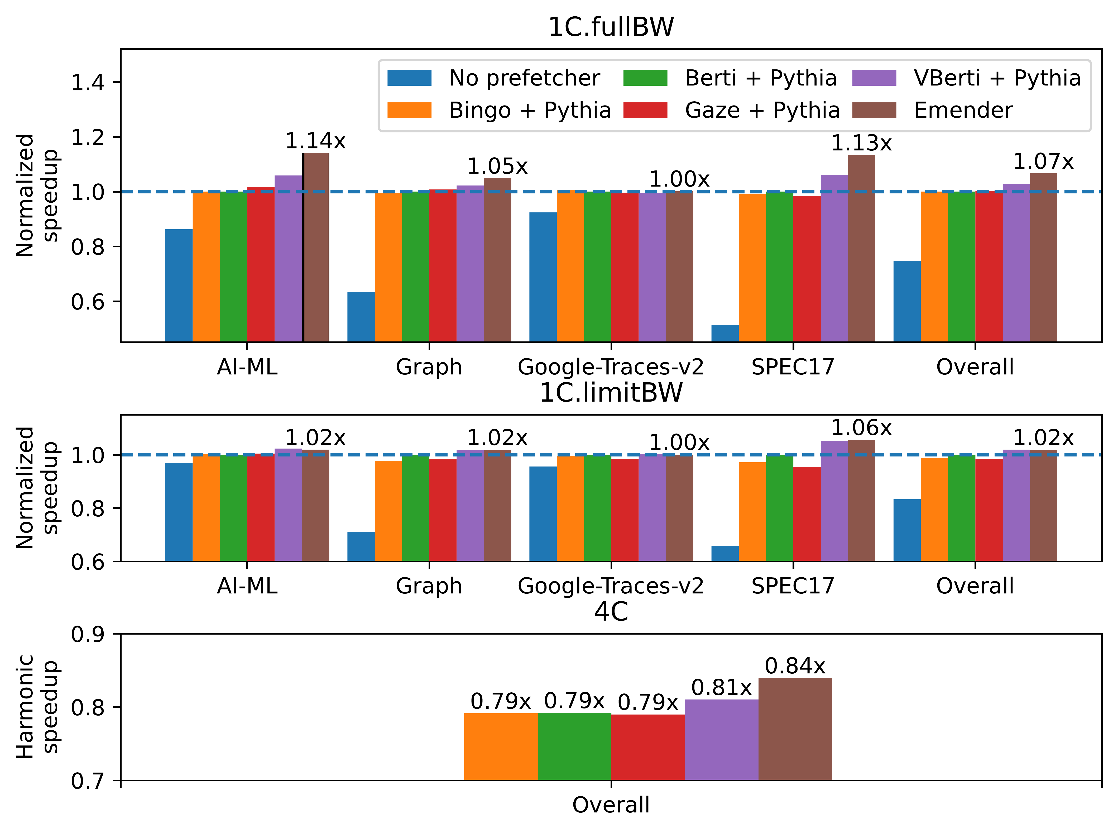
Overall Results
Speedup vs. Baseline and other prefetchers
Chart Interpretation
Key Observations
Emender outperforms all compared prefetchers
VBerti slightly better than other prefetchers
Consistent gains across all three configurations
Overall Score: +4.8% improvement
15
Notes:
Now, let's look at the results. The graphs show our speedup compared to the baseline and other prefetcher combinations. Emender is the brown bar on the far right.
For single-core full bandwidth, we see a 6.6% speedup. This is the unconstrained memory bandwidth scenario, where our optimizations improve prefetch accuracy.
For single-core limited bandwidth, we achieve a 2.0% speedup. This is the memory-constrained scenario, showing a smaller but still significant improvement.
For multi-core 4C, we achieve a 6.1% speedup. Here, the L3 throttling improves fairness and harmonic speedup.
The overall score improvement is 4.8%.

Slide 16
Ablation Study
Individual Feature Impact
Feature
1C.fullBW
1C.limitBW
4C
Overall
Cuckoo Filter
1.3%
0.2%
1.0%
0.8%
L3 Fairness Throttling
0.0%
0.0%
2.6%
0.9%
Dynamic Confidence Threshold
0.1%
0.2%
0.2%
0.1%
Pending Target Buffer
0.4%
0.0%
0.4%
0.2%
Combined (Emender)
6.6%
2.0%
6.1%
4.8%
Cuckoo Filter
L3 Fairness Throttling
Other Features
Largest benefit for single-core
Eliminates redundant prefetches
More effective with plentiful bandwidth
Critical for multi-core performance
No single-core impact (as expected)
2.6% improvement in 4C
DCT: Modest but consistent
PTB: Foundation for others
All contribute positively
16
Notes:
We also did an ablation study to see which feature helped the most.
The Cuckoo Filter (top row) gave the biggest boost in single-core performance, because it saves bandwidth. It have a contribution of 0.8% overall.
The L3 Fairness Throttling (second row) was helpful for the 4-Core test, improving it by 2.6% and 0.9% overall.
Dynamic Confidence Threshold and Pending Target Buffer improve overall performance by 0.1% and 0.2%. They serve as the foundation for other optimizations.
When combined, all features contributed to a total score improvement of 4.8%.

Slide 17
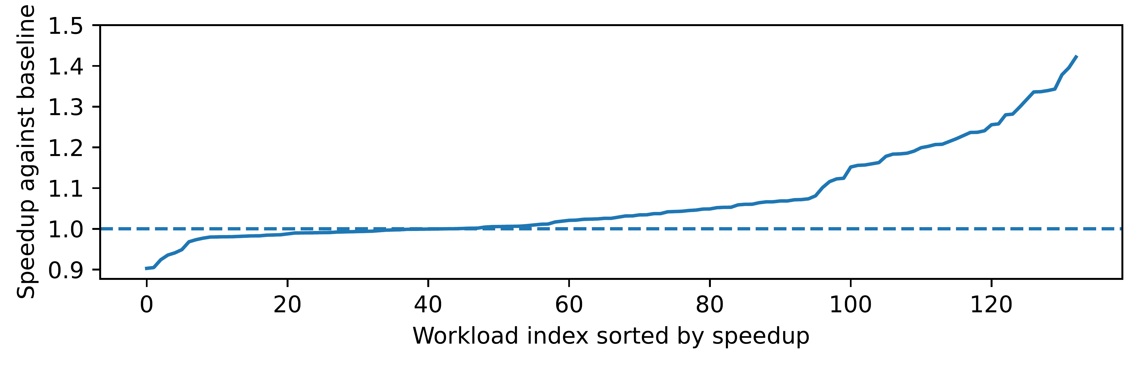
S-Curve Analysis (1C.fullBW)
Distribution of Speedup
Visualize S-Curve
Best Case
>1.4x speedup
Predictable workloads benefit greatly
Median Case
~1.1x speedup
Majority of workloads benefit
Interpretation: Majority of workloads see improvement, few significant regressions
Worst Case
Robust across diverse applications
<10% slowdown
Very few workloads see regression
Robust design avoids significant degradation
17
Notes:
Finally, we wanted to make sure our design was robust.
This S-Curve shows the speedup distribution.
As we can see, the vast majority of workloads (the blue line) are above the dashed line, with the median case shows about 1.1x speedup, meaning the majority of workloads benefit.
There are very few regressions, and the gains in the best cases are significant (over 1.4x).
This proves Emender is a stable and robust solution.

Slide 18
Conclusion
Built upon VBerti+Pythia with Four Optimizations
1
2
3
4
Pending Target Buffer
Cuckoo Filter
Dynamic Confidence Threshold
L3 Fairness-based Throttling
Global prioritization
~861 bytes
Eliminates redundant prefetches
6.5 KB, most impactful for single-core
Per-PC throttling
Self-adaptive
Multi-core coordination
Critical for multi-core
Results: Overall Score Improvement +4.8%
Single-core Full BW
Single-core Limited BW
Multi-core
+6.6%
+2.0%
+6.1%
18
Notes:
To sum up, Emender is built on top of the powerful VBerti and Pythia prefetchers,
adding four key optimizations:
1. Pending Target Buffer for global priority.
2. Cuckoo Filter to stop redundant prefetching.
3. Dynamic Thresholds to adapt to difficult patterns.
4. L3 Fairness Throttling to coordinate multi-core systems.
The overall impact is a 4.8% improvement, broken down as 6.6% for single-core full bandwidth, 2.0% for single-core limited bandwidth, and 6.1% for multi-core.
This work demonstrates a systematic optimization approach, validates our methodology of scale validation followed by bottleneck analysis and targeted optimizations, and shows the value of cross-level coordination.

Slide 19
Discussion and Future Work
Hardware Implementability
Prefetch Filtering Techniques
Berti Table Design
Multiple Filtering Layers in Emender
Current: Fully-associative design
Future: Set-associative (e.g., 16-set, 4-way with NRU)
Reference: Berto approach for practical implementation
Cuckoo Filter: Eliminates redundant L1D prefetches
Pending Target Buffer: Deduplication
Prefetch Queue: Additional filtering
Existing Techniques
T-SKID: Shadow Cache + Prefetch Queue filtering
Sangam: 40-entry Recent Access Filter
PPF: Perceptron-based filtering
Pending Target Buffer Sorting
Challenge: Sorting overhead in hardware
Solution: Bucket sort-like mechanism
Partition entries by priority levels
Future Research: Comprehensive comparison of trade-offs in hardware overhead, accuracy, and performance impact.
19
Notes:
Then, I'd like to discuss some implementation considerations and future work.
Hardware reality: Our Berti Table is fully-associative now, but a real chip would likely use a simpler 16-set, 4-way design.
PTB: Full hardware sorting for the PTB is costly, so we can use a few priority buckets instead.
Prefetch filtering: We already filter with a Cuckoo Filter + dedup, and we should compare it with Shadow Cache / Recent Access Filter / perceptron options.

Slide 20
Thank You!
Acknowledgments
DPC4 organizers and ChampSim developers
Authors of VBerti and Pythia prefetchers
Questions?
20
Notes:
Thank you for listening.
I'm happy to take any questions you might have.

Slide 21
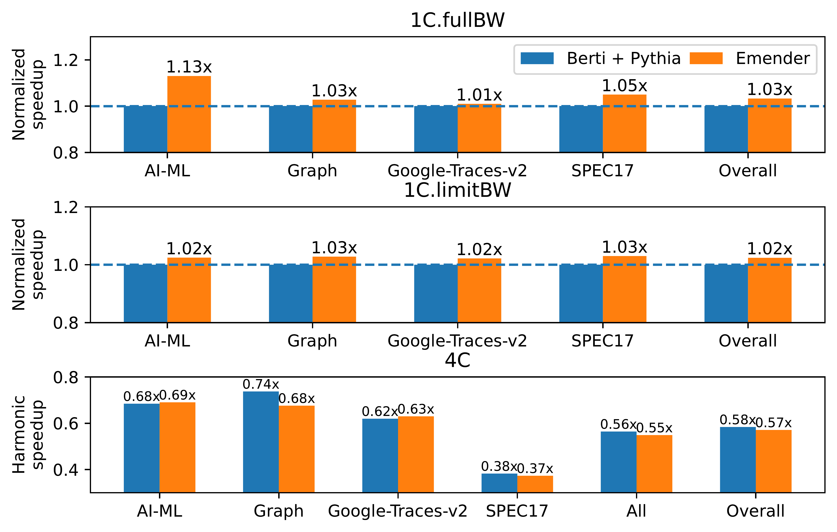
Appendix: Evaluation on DPC4-All-Traces
Performance Results
Methodology
Training vs Evaluation Traces
Training: DPC4-Traces (public)
Evaluation: DPC4-All-Traces (official)
Earlier: 1% instruction subset
Appendix: Complete traces tested
Key Differences in Trace Composition
Different benchmark distribution
Google-Traces-v2 proportion: 32% → 59%
More SPEC17 benchmarks with non-memory bottlenecks
Notes:
For the camera-ready submission, we evaluated on the official DPC4-All-Traces, which differ from the training traces used during development.
On the left is the performance comparison on evaluation traces. As you can see, the overall trends remain consistent with our training results. The peak improvement reaches up to 1.71x IPC speedup on specific traces, demonstrating the potential of our optimizations.
The methodology difference is important: we trained on DPC4-Traces using 1% instruction subsets due to time constraints, but for the final evaluation we tested complete traces. The evaluation traces have a different composition - notably Google-Traces-v2 increased from 32% to 59% of the total.
This composition shift affected our overall score, as our optimizations provide minimal benefits for Google-Traces-v2. Additionally, more SPEC17 benchmarks with non-memory bottlenecks were included.

Slide 22
Appendix: Analysis and Insights
Single-Core Performance
Multi-Core Performance
Trends Consistent with Training
Divergent Characteristics
Most categories match training trace results
SPEC17 shows slight regression
Due to non-memory-bound benchmarks (e.g., leela)
Training: Random sampling across all benchmarks
Evaluation: Category-independent sampling
Results in more homogeneous behavior across cores
Overall Score Reduction Factor
Google-Traces-v2 proportion increased
From 32% to 59% in evaluation traces
Our optimizations provide minimal benefits for these traces
Throttling Mechanism Impact
Training: High diversity amplifies throttling effectiveness
Evaluation: Homogeneous behavior reduces throttling benefits
Current throttling proves suboptimal in evaluation scenario
Insight: Throttling effectiveness depends on workload diversity across cores.
Notes:
This slide provides deeper analysis of why our results differ between training and evaluation traces.
For single-core performance, most categories match well, but SPEC17 shows slight regression due to benchmarks like leela where memory access isn't the primary bottleneck. The key factor in overall score reduction is the increased proportion of Google-Traces-v2, rising from 32% to 59%. Our optimizations simply don't help these traces as much.
The multi-core performance shows more interesting divergence. In training, random sampling across all benchmarks created high diversity across cores, which amplified our throttling effectiveness. However, evaluation traces use category-independent sampling, resulting in more homogeneous behavior across cores. Under these conditions, our current throttling mechanism proves suboptimal.
The key insight is that throttling effectiveness heavily depends on workload diversity. Future work could explore more sophisticated throttling strategies that adapt to the actual diversity observed at runtime.

