Slide 1

Global Berti: Simultaneous Streaming and Spatial Prefetching
Gilead Posluns Mark C Jeffrey
Data Prefetching Championship 4
Feb 1 2026
Notes:
Hi, I’m Gil from the University of Toronto, and I’m here to present our DPC4 entry, Global Berti: Simultaneous Streaming and Spatial Prefetching

Slide 2
Expanding prefetcher coverage for (almost) free
Streaming prefetchers like Berti collect local deltas[Navarro-Torres et al. MICRO’22]
It prefetches only streaming access patterns
By accessing Berti’s history table in a new orientation, we collect “global” deltas
Our Global Berti prefetches Spatial access patterns too, for ~0 additional cost
Global Berti is up to 1.89X (gmean 1.08X) faster than Berti (1.49X/1.06X with Pythia)
Notes:
The point of this work is that we can expand our prefetcher coverage from the streaming patterns covered by Berti to also collect Spatial patterns, and we can do this for almost 0 additional cost. We achieve this by accessing Berti’s history table vertically, reading columns where Berti read rows. Our Global Berti is up to 1.89X faster than DPC3 Berti without any other prefetchers, and still up to 1.49X faster when Pythia is present at the L2.

Slide 3
Streaming and Spatial Access Patterns
Notes:
First, I will explain what is the difference between streaming and spatial access patterns.

Slide 4
Streaming and Spatial access patterns
Memory
int sum = 0;
for (int i = 0; i < N_LISTS ; i++) {
ListNode * h = heads[i];
ListNode * t = tails[i];
while (h != t) {
sum += h->data;
h = h->next;
}
}
f(sum);
Time
Δ₁
Δ₂
Δ₃
Streaming
Δ₄
Both
Spatial
Notes:
Consider the simple example code on the right. This code iterates through an array of linked lists and sums up their data, which includes both streaming and spatial access patterns.
[C] Here we have an example of a streaming access pattern in red. On each access, this line of code will access a memory location a consistent delta from the previous instance of that line, making its accesses predictable far into the future.
[C] On the other hand, in green we have a Spatial access pattern. Here, the list nodes are distributed randomly through memory, so the accesses to h->data are not predictable without an expensive markov prefetcher or a content-directed prefetcher. However, the access to the h->next is predictable once we’ve seen the access to h->data. The accesses after the first in the spatial pattern are a consistent delta from the first access. Prefetching for a spatial pattern will miss on the first access, but can then hide some of the miss latency for future accesses within the miss for the first access.
[C] Finally, in blue, we have a line with both a streaming pattern and a spatial pattern. The access to the list tails is a streaming pattern just like the heads, but it is also a constant delta from the prior access to the heads. These dual patterns happen whenever we have multiple streaming patterns with the same delta.

Slide 5
Background: Berti Design[Navarro-Torres et al. MICRO’22]
Notes:
Now, lets go over some background on how the Berti Streaming prefetcher works

Slide 6
Berti Overview
History Table
Fill Latencies
Instruction Pointer (IP),
Access Address,
Cycle
Timely Deltas
Delta Table
Prefetch Addresses
Notes:
Berti uses 2 tables to detect and prefetch streaming access patterns. There is some additional storage to calculate the fill latencies for cache misses, but we will skip that here.
Berti uses the instruction pointer to index into a local history table that also stores the cycle when the access was demanded as a timestamp. When fill latencies become available, Berti uses the information in the history table to calculate timely deltas, which it stores in a delta table. On each demand access, Berti uses the access instruction pointer and address to generate prefetch addresses from the delta table.

Slide 7
How Berti prefetches with timely deltas
History
Fill Latencies
Instruction Pointer (IP),
Access Address,
Cycle
Timely Deltas
Delta
Prefetch Addresses
Timely Δ=0x10
LD 0x120
IP | Counter | Delta | Coverage | Delta | Coverage | …
LD heads[i] | 5+1 | 0x10 | 3+1 | 0x20 | 1 | …
… | … | … | … | … | … | …
Prefetch 0x120+0x10=0x130
Notes:
Berti issues prefetches for streaming patterns by checking each load against its delta table.
The Berti Delta table maps Instruction Pointers to delta-coverage pairs tracking how often a delta is timely. The counter for each row is incremented every time that row is demanded. When the counter overflows, deltas which were timely more than a threshold are activated for prefetching.
[C] On each demand access, Berti checks the Delta table for a row with a matching instruction pointer, and if it finds one it uses the high-coverage deltas from that row for prefetching, by adding their deltas to the access address to generate prefetch addresses.
[C] Each timely delta gets its own coverage counter in the row, and each time timely deltas are found their coverage fields are incremented.
Where do these timely deltas come from?

Slide 8
How Berti finds timely deltas for streaming patterns
History
Fill Latencies
Instruction Pointer (IP),
Access Address,
Cycle
Timely Deltas
Delta
Prefetch Addresses
h = heads[0] Loads Addr 0x100 at timestamp 5
0x100 @ 5
Notes:
Berti finds timely deltas using its history table.
The contents of the berti history table for each instruction pointer is a FIFO queue storing address/timestamp pairs. For instance, let’s suppose that the first access to the heads array from our previous code example loads address 0x100 at timestamp 5. That access would be placed in the FIFO queue.

Slide 9
How Berti finds timely deltas for streaming patterns
History
Fill Latencies
Instruction Pointer (IP),
Access Address,
Cycle
Timely Deltas
Delta
Prefetch Addresses
h = heads[1] Loads Addr 0x108 at timestamp 15
0x108 @ 15
0x100 @ 5
Notes:
And if the next access loads address 0x108 at timestamp 15, that would also go into the queue behind 0x100.

Slide 10
How Berti finds timely deltas for streaming patterns
History
Fill Latencies
Instruction Pointer (IP),
Access Address,
Cycle
Timely Deltas
Delta
Prefetch Addresses
h = heads[2] Loads Addr 0x110 at timestamp 35
0x110 @ 35
0x108 @ 15
0x100 @ 5
35
15
5
10
25 Cycles to fill
-
<=
<=
0x100
0x110
-
-
0x10 = Timely Δ
Notes:
Finally, if the third access loads address 0x110 at timestamp 35, the queue now looks like this.
[C] Now, lets suppose that the left access takes 25 cycles to be filled into the L1. In that case, Berti will subtract that 25 cycle fill latency from the access timestamp to get 10 as the maximum cycle for timely prefetching. Berti will compare that maximum cycle with the timestamps of every earlier access in the FIFO, and find that the middle access at cycle 15 is too late, but the right access at cycle 5 is in time. If Berti had prefetched address 0x110 when address 0x100 was demanded, it would have been in time to hide all the memory latency.
[C] So Berti subtracts the right address from the left address to get the timely delta for this instruction.

Slide 11
Motivation
Notes:
Now, lets talk about how Berti could be better.

Slide 12
The Berti History table is a collection of FIFOs
History
Fill Latencies
Instruction Pointer (IP),
Access Address,
Cycle
Timely Deltas
Delta
Prefetch Addresses
0x110, 35
0x108, 15
0x100, 5
LD heads[i]
LD tails[i]
0x208, 20
0x208, 10
Index by IP
LD h->data
0x300, 25
0x330, 22
0x390, 7
LD h->next
0x308, 30
0x338, 23
0x398, 8
Notes:
We previously showed one FIFO for the Berti history table, but it’s actually a collection of FIFOs, once for each instruction pointer. But this is a very abstract diagram, laid out in an actual table it would look more like this: [C]

Slide 13
One FIFO is one row
History
Fill Latencies
Instruction Pointer (IP),
Access Address,
Cycle
Timely Deltas
Delta
Prefetch Addresses
IP tag | Addr | Cycle | IP tag | Addr | Cycle | IP tag | Addr | Cycle
0x552 | 0x110 | 35 | 0x552 | 0x108 | 15 | 0x552 | 0x100 | 5
0x554 | 0x200 | 10 | 0x554 | 0x208 | 20
0x560 | 0x300 | 25 | 0x560 | 0x330 | 22 | 0x560 | 0x390 | 7
0x562 | 0x308 | 30 | 0x562 | 0x338 | 23 | 0x562 | 0x398 | 8
Berti finds streaming patterns by reading a row, but not spatial patterns that cross rows
Notes:
The contents here are the same as the previous slide, with the addition of instruction pointer tags to disambiguate aliasing instructions. New accesses shift in from the left, and the oldest accesses exit the FIFOs from the right.
[C] Whenever Berti searches for timely deltas, it accesses one FIFO, or one row of the table, reading it horizontally.
[C] By doing so, Berti finds streaming patterns, because those deltas exist between accesses in the same row.
[C] Spatial patterns, on the other hand, appear as deltas between accesses in different rows.
[C] As a result, while Berti finds streaming patterns by reading a row horizontally, it cannot find spatial patterns that cross rows.

Slide 14
The first column is a global history
History
Fill Latencies
Instruction Pointer (IP),
Access Address,
Cycle
Timely Deltas
Delta
Prefetch Addresses
The first column of the history table stores the most recent access by each IP
IP tag | Addr | Cycle | IP tag | Addr | Cycle | IP tag | Addr | Cycle
0x552 | 0x110 | 35 | 0x552 | 0x108 | 15 | 0x552 | 0x100 | 5
0x554 | 0x200 | 10 | 0x554 | 0x208 | 20
0x560 | 0x300 | 25 | 0x560 | 0x330 | 22 | 0x560 | 0x390 | 7
0x562 | 0x308 | 30 | 0x562 | 0x338 | 23 | 0x562 | 0x398 | 8
Accessing the first column of Berti’s history table finds deltas for spatial patterns
Notes:
The spatial patterns are still in the table though.
[C] If we look at just the first column of the Berti history table, we can see that it forms a useful subset of the global history of all accesses.
[C] In fact, the first column of the Berti history table is storing the most recent access by each instruction pointer.
[C] Just what we need if we want to identify spatial patterns.
[C] By accessing the first column of Berti’s history table, reading vertically can allow us to find deltas for spatial access patterns.

Slide 15
Global Berti Design
Notes:
So, lets see how we design our Global Berti.

Slide 16
Global Berti Overview
History Table
Fill Latencies
Instruction Pointer (IP),
Access Address,
Cycle
(IPs, Deltas)
Delta Table
Prefetch Addresses
Notes:
The tables in our global berti look the same as Berti’s from the outside. We have a history table and a delta table. The difference is in how we access our history table.
When latency information becomes available, we access the history table horizontally, just like Berti, producing a set of streaming deltas for a single instruction pointer.
On each demand access, we instead search the first column of the history table, accessing it vertically to produce one spatial delta for each instruction pointer in the first column. All of these deltas go into the delta table rows for their instruction pointers, and are used to produce prefetch addresses on each demand access if they have high coverage.
This simple an naive approach is almost everything we need to prefetch spatial patterns. It just has one problem, which is that

Slide 17
There are too many spatial deltas
Memory
int sum = 0;
for (int i = 0; i < N_LISTS ; i++) {
ListNode * h = heads[i];
ListNode * t = tails[i];
while (h != t) {
sum += h->data;
h = h->next;
}
}
f(sum);
Time
Δ₁
Δ₂
Δ₃
Δ₃
Streaming
Δ₄
Both
Δ₃
Δ₅
Spatial
Δ₆
When both streaming and spatial deltas are present, we must ignore the spatial
Notes:
There are too many spatial deltas
We now return to our example code and memory layout. Here, I showed a few streaming and spatial deltas, but there are actually many more.
[C] For instance, streaming access patterns have a valid delta for each multiple of their stride. This is a good thing, and Berti takes advantage of this when it finds timely deltas.
[C] Spatial patterns don’t give the same options to choose from, because we can only start predicting from the first access, but the same delta could show up multiple times. This isn’t a problem in a consistent spatial pattern, but if there isn’t a consistent pattern, it could saturate our coverage too quickly.
what about accesses with both streaming and spatial patterns?
[C] Here, we see a excessive number of deltas between the two streams. This is a problem, because it could fill our delta table with redundant spatial deltas, leaving no storage for the streaming deltas.
[C] As a consequence, when both streaming and spatial deltas are present, we need to ignore the spatial deltas.

Slide 18
Rate-limiting spatial deltas
History
Fill Latencies
Instruction Pointer (IP),
Access Address,
Cycle
Timely Deltas
Delta
Prefetch Addresses
Coverage is incremented at most once per counter increment
Global deltas are not added to/from rows with a streaming pattern
IP | Counter | Stream? | Delta | inc | Coverage | Delta | inc | Coverage | …
0x552 | 3 | 1 | 0xC | 0 | 1 | - | 1 | - | …
…
…
…
Notes:
To limit the spatial deltas we add some additional bits to the delta table. The increment bit controls whether coverage can increment. We set it on each demand access to that delta table row, and reset when we increment the coverage. This enforces at most one coverage increment per demand access.
Second, if a horizontal row access to the history table results in a high coverage streaming delta, we set the stream bit in a row. When the stream bit is set, we block adding spatial deltas to or from that instruction pointer, because if a streaming pattern is present, then any spatial patterns will also have their own streaming patterns, and streaming patterns take priority over spatial ones.
These additional bits, 1 per row and 1 per delta, are the entire overheads of our global berti over the original berti.

Slide 19
Global Berti Costs (almost) the same as Berti
Berti | Entries | Entry Size (b) | Total Size (B)
History Table | 64 X 16 | 47 | 6016
Delta Table | 64 | 17 + 32 X 19 | 5000
MSHR Timestamps | 16 | 16 | 32
L1 Latencies | 768 | 12 | 1152
Total |  |  | 12200
Global Berti | Entries | Entry Size (b) | Total Size (B)
History Table | 64 X 16 | 47 | 6016
Delta Table | 64 | 18 + 32 X 20 | 5264
MSHR Timestamps | 16 | 16 | 32
L1 Latencies | 768 | 12 | 1152
Total |  |  | 12464
Global Berti’s overheads over Berti are negligible

Slide 20
Evaluation

Slide 21
Methodology
L1
L2
LLC
DRAM
We use the DPC4 1C full-BW config across all public traces
50M Warmup Cycles, 200M Test Cycles
We compare to DPC3 Berti at the L1, with and without Pythia at the L2
Core | 8-wide OoO, 576-entry ROB, 160 issue slots, 240-entry load queue, 112-entry store queue
L1D | 48KB, 12-way, 16 MSHRs, 5-cycle latency, DPC3Berti/Berti/GBerti/
L2 | 2MB, 16-way, 32 MSHRs, 10-cycle latency, Pythia/No prefetcher
LLC | 3MB, 12-way, 64 MSHRs, 35-cycle latency, No prefetcher
Mem | 1 channel, 4800 MTPS

Slide 22
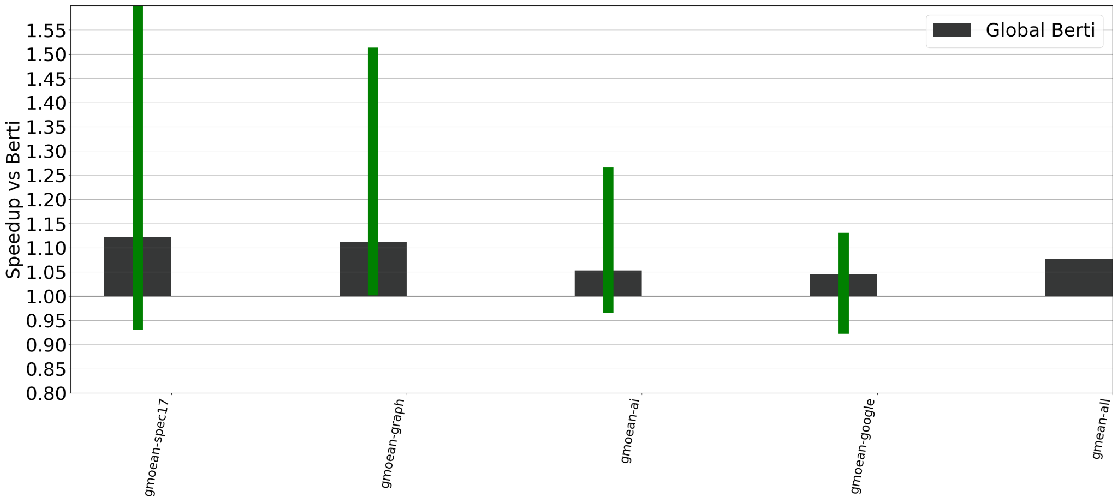
Global Berti outperms DPC3 Berti
1.89X
Global Berti outperforms Berti by gmean 8%, ranging from -8% to 89%
Notes:
What we find is that our global Berti outperforms the DPC3 implementation of Berti by a wide margin. In this plot, each black bar is the gmean speedup of Global Berti over berti for a category of benchmark traces. The green bars represent the range of speedups stretching from the worst to the best.
[C] First off, we see our largest speedup on SPEC17, with up to an 1.89X improvement. On SPEC traces, replacing Berti with our Global Berti results in a gmean 12% IPC improvement.
Graph benchmarks also see a large improvement, with a gmean 11% speedup and no traces with a slowdown.
AI traces see a smaller improvement, which is driven by the llama models that see large improvements. The other AI traces are largely a wash. The AI gmean speedup is 5%.
Google’s traces see a small but relatively consistent speedup, except for the Charlie workloads that see a small slowdown. The gmean for them is also 5%.
[C] Overall, our Global Berti outperforms DPC3 berti by a gmean of 8%, with a range of -8% to 89%.

Slide 23
Methodology: Pythia at the L2
L1
L2
LLC
DRAM
IP
RL Agent
Last 4 Deltas
Prefetch Delta
BW utilization
Prefetch Useful?
Pythia can only prefetch within a page, and produces <= 1 prefetch/access
Notes:
Of course, be baseline configuration for DPC4 does not just use Berti. It also has Pythia at the L2. Pythia is a Reinforcement Learning based prefetcher.
The RL agent takes in the instruction pointer, the last 4 deltas between any accesses, and the current bandwidth utilization, and outputs whether or not to prefetch, and which delta to apply to the current address for prefetching. Whether or not the prefetch was useful gets fed back as a reward to guide the agent’s learning.
[C] As an L2 prefetcher, Pythia can only prefetch within a page, and it also produces at most 1 prefetch per memory access, which limits its ability to hide latency from spatial patterns with multiple accesses.

Slide 24
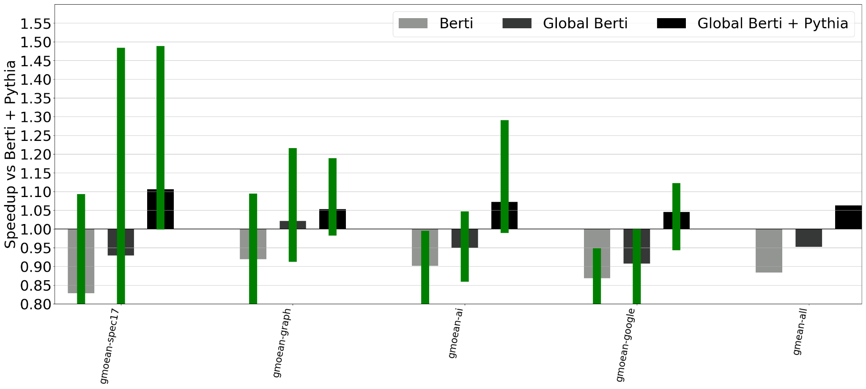
Global Berti sometimes outperforms Berti+Pythia
With L2 Pythia, Global Berti outperforms Berti by gmean 6%, (-6%-49%)
Notes:
In this plot, we normalize to the full DPC3 baseline, with Berti at the L1 and Pythia at the L2. The first 2 bars are Berti and Global Berti on their own, showing the benefits of adding Pythia to the system, while the third bar is Global Berti with Pythia at the L2. Here, the different trace categories bethave differently.
Spec17 and Google workloads see no particular change in the speedup from replacing Berti with Global Berti when we add Pythia at the L2. Here, the benefits from Global Berti are orthogonal to the benefits from Pythia, so we get the same speedup from replacing Berti with Global Berti regardless of whether or not Pythia is present.
[C] On the other hand, for graph benchmarks the result is completely different. For graph benchmarks, we first see that our Global Berti alone already outperforms Berti+Pythia by about 2%. However, The speedup of GLobal Berti + Pythia over Berti+Pythia is only about 5%, half what it was before without Pythia. For graph algorithms, Global Berti and Pythia are finding many of the same prefetches, so the benefit of Global Berti over Berti is much smaller, since Pythia was already bringing much of this information to the L2.
[C] For AI traces, we actually see a larger gmean speedup from our Global Berti over Berti when Pythia is present. This is mostly driven by the rwkv traces, where neither Pythia nor our Global Berti provide a large speedup on their own, but when Global Bertia nd Pythia are used together we suddenly see a large speedup. What we think is happening here is that Global Berti’s prefetches are providing useful hints to Pythia’s reinforcement learning agent.
[C] Overall, when Pythia is at the L2, our Global Berti outperforms Berti by gmean 6%, ranging from -6% to 49% across all public traces.

Slide 25
Conclusions
By reading the last column from the per-IP history table, we enabled the Berti streaming prefetcher to also prefetch spatial patterns, for almost 0 additional cost.
We expect that this approach will also work for other prefetchers that use per-IP history structures, meaning that prefetchers no longer need to choose between local or global histories.
We can have both, at once, for free.
Gilead Posluns Mark C Jeffrey

Slide 26
Streaming vs Spatial Prefetching
Streaming Prefetching: If instruction A accesses address B, then A will access B+Δ in the near future
Spatial Prefetching: If instruction A accesses address B, then B+Δ will be accessed in the near future (by some instruction)

Slide 27
DPC3 Berti does some spatial prefetching
Recorded Pages Table
PPN
Δ=2
DPC3 Berti Can prefetch streaming or spatial patterns, but only one at a time

Slide 28
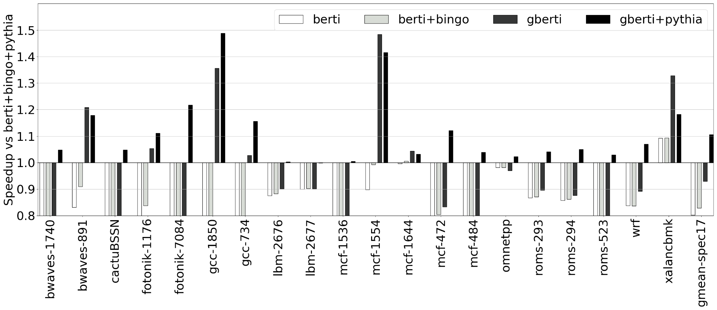
Global Berti is Orthogonal to Pythia on Spec17
With L2 Pythia, Global Berti outperforms Berti+Bingo by gmean 11%

Slide 29
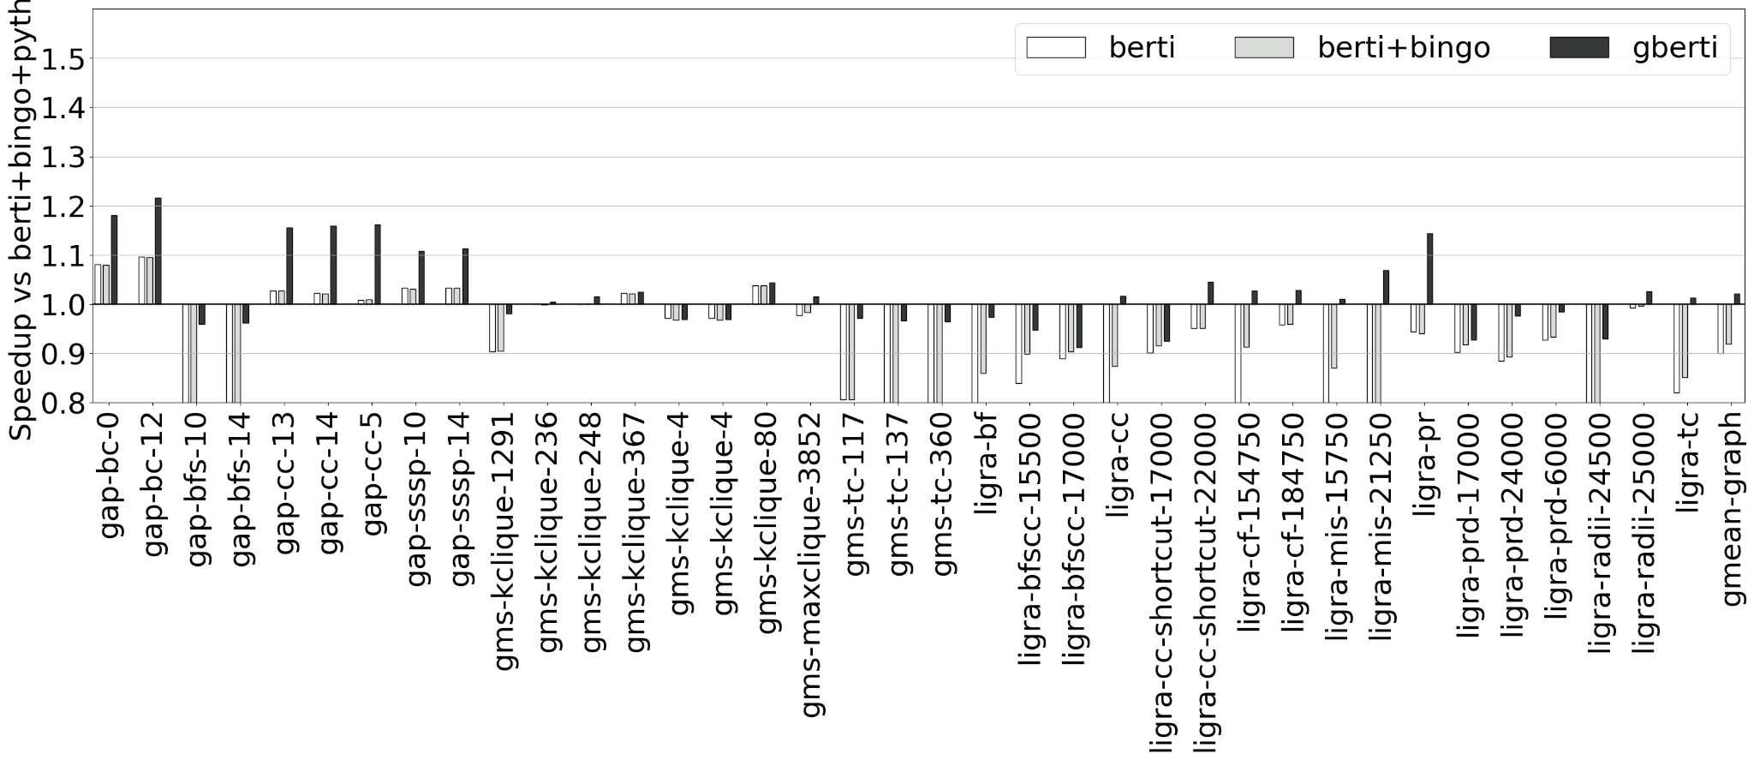
Global Berti Overlaps Pythia on Graphs

Slide 30
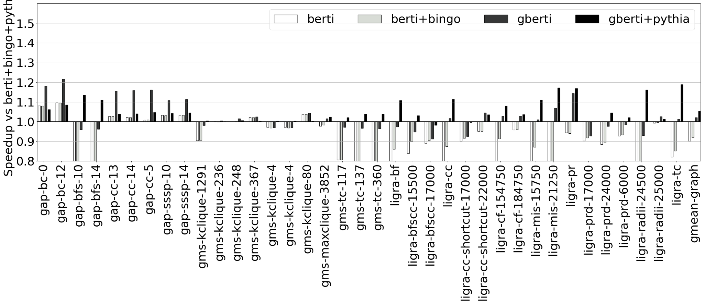
Global Berti Overlaps Pythia on Graphs
With L2 Pythia, Global Berti outperforms Berti+Bingo by gmean 6%

Slide 31
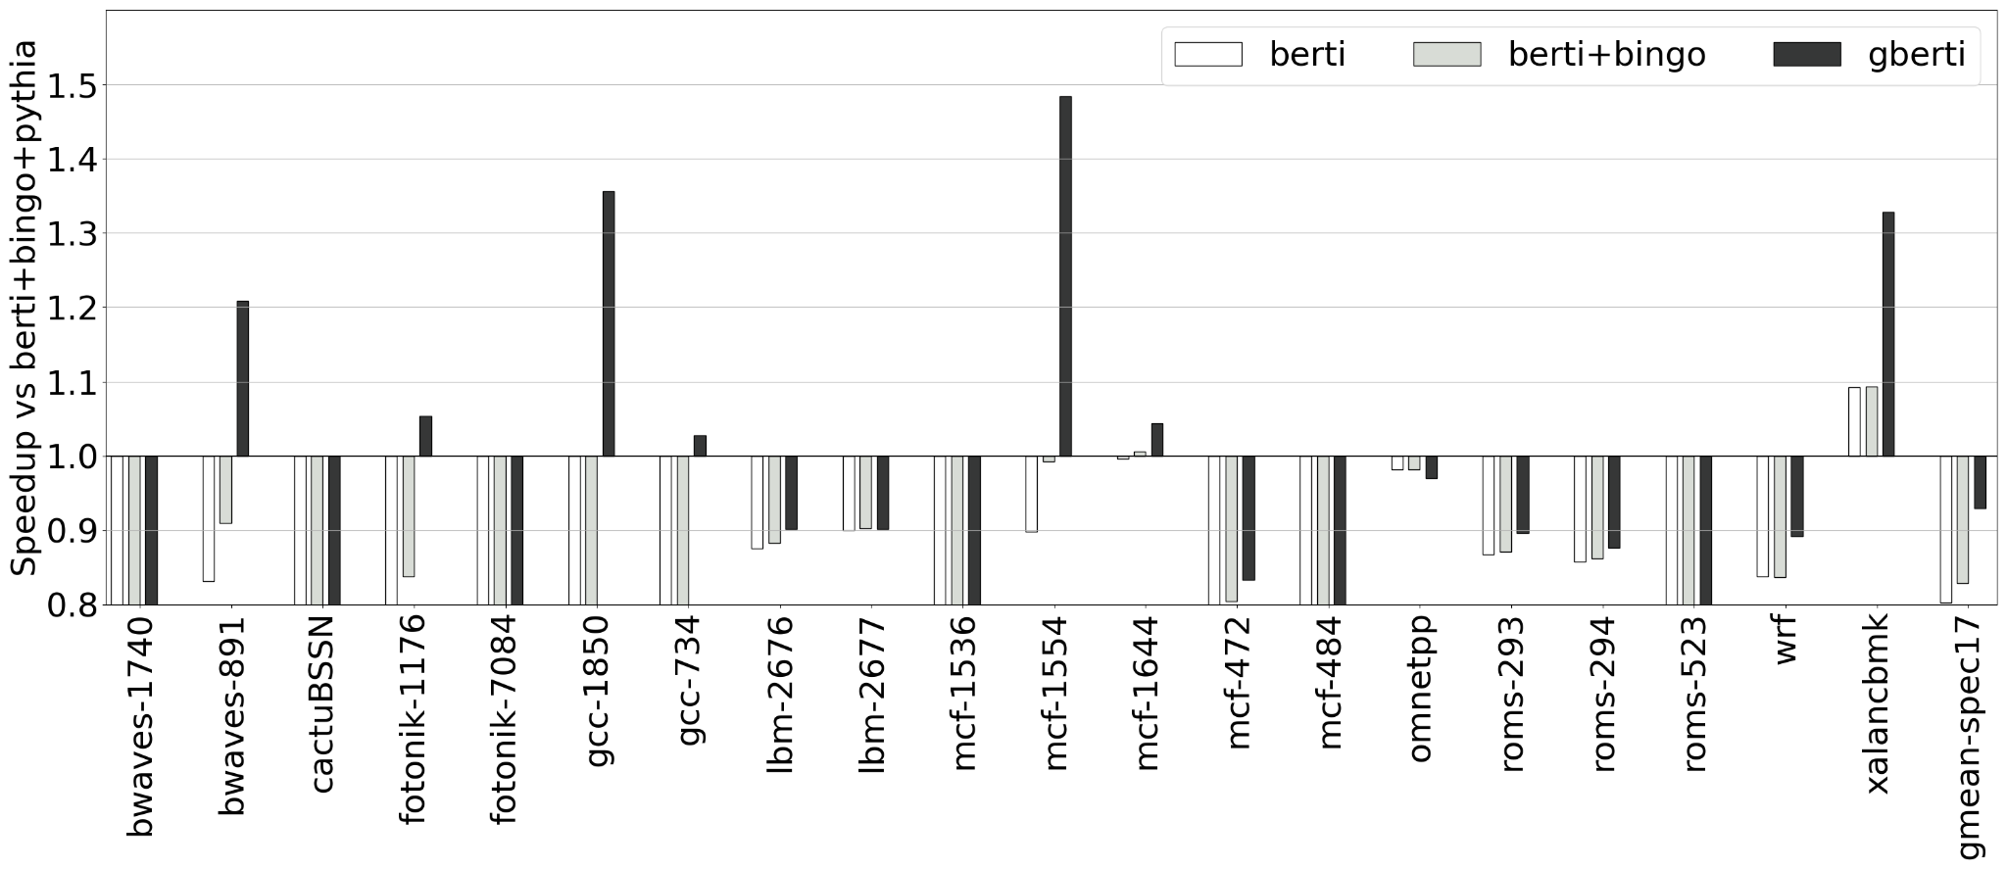
Global Berti is Orthogonal to Pythia on Spec17

Slide 32
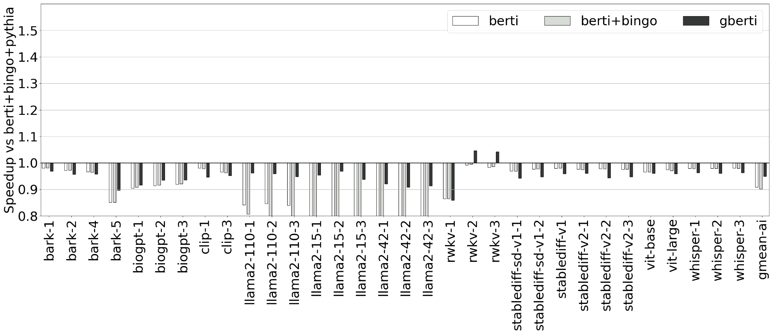
Global Berti Synergizes with Pythia on AI

Slide 33
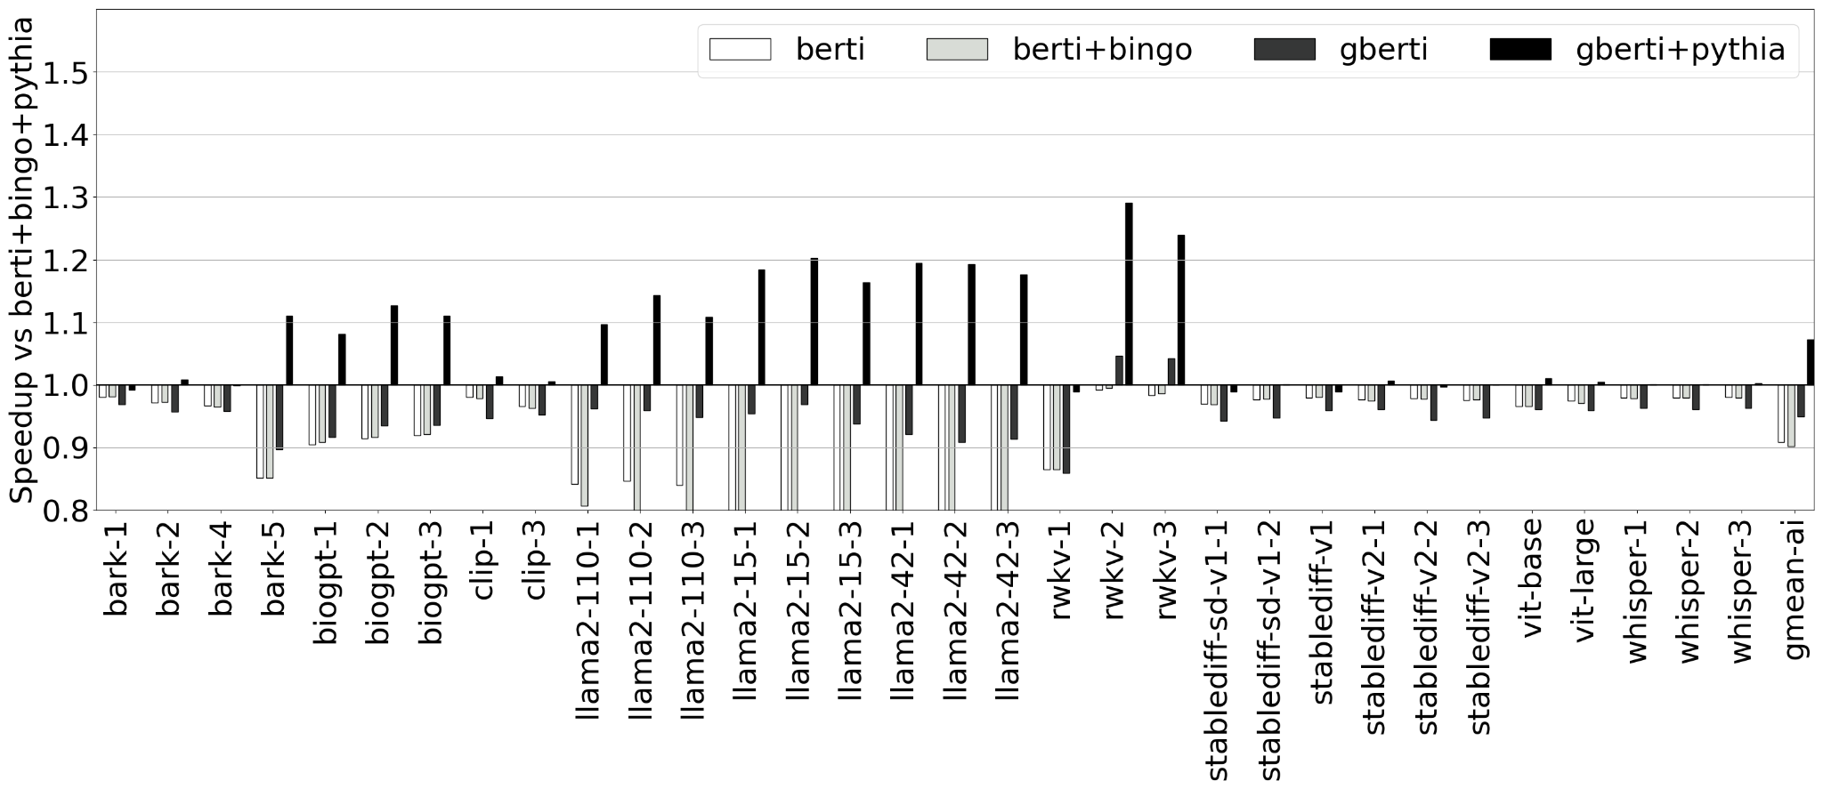
Global Berti Synergizes with Pythia on AI
With L2 Pythia, Global Berti outperforms Berti+Bingo by gmean 7%

Slide 34
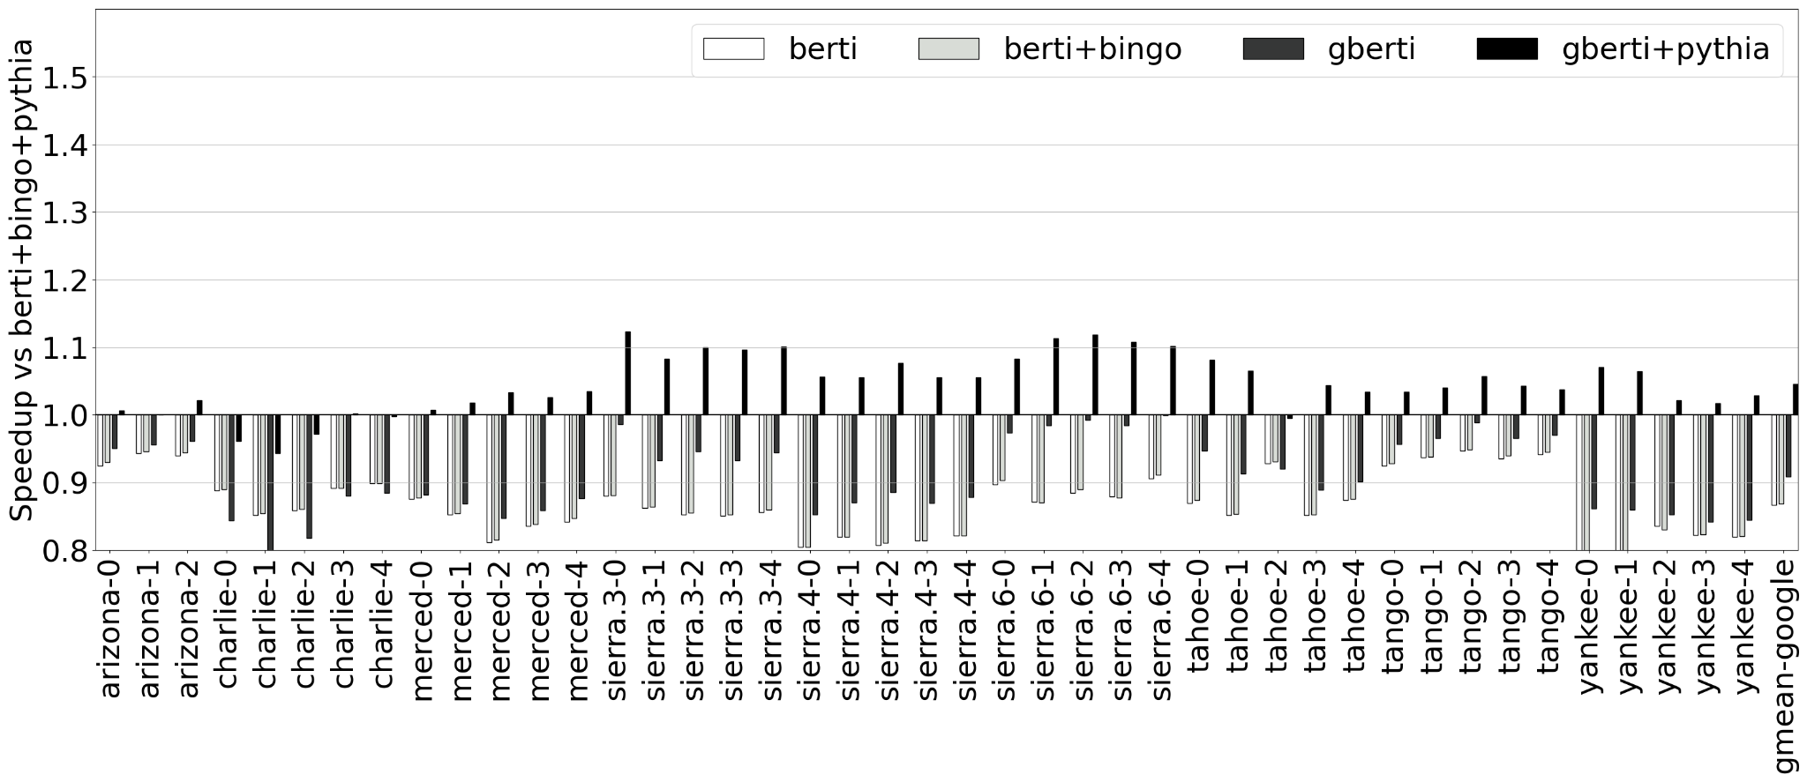
Global Berti is Orthogonal To Berti for Google
With L2 Pythia, Global Berti outperforms Berti+Bingo by gmean 5%

Slide 35
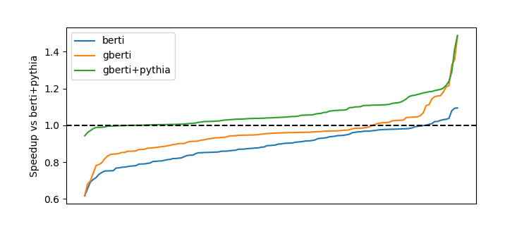
Global Berti sometimes makes Pythia redundant
For the fastest benchmarks, Global Berti IPC is similar with or without Pythia

Slide 36
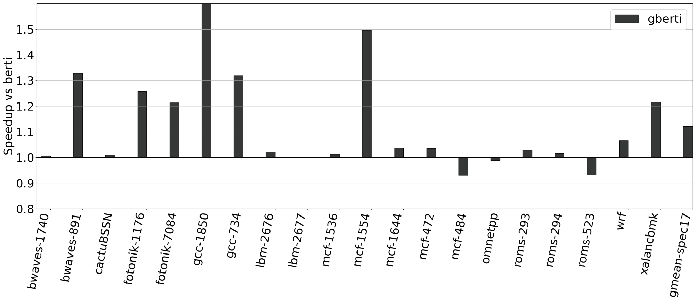
Global Berti outperforms Berti: SPEC17
1.89X
Global Berti outperforms Berti on SPEC17 by gmean 12%

Slide 37
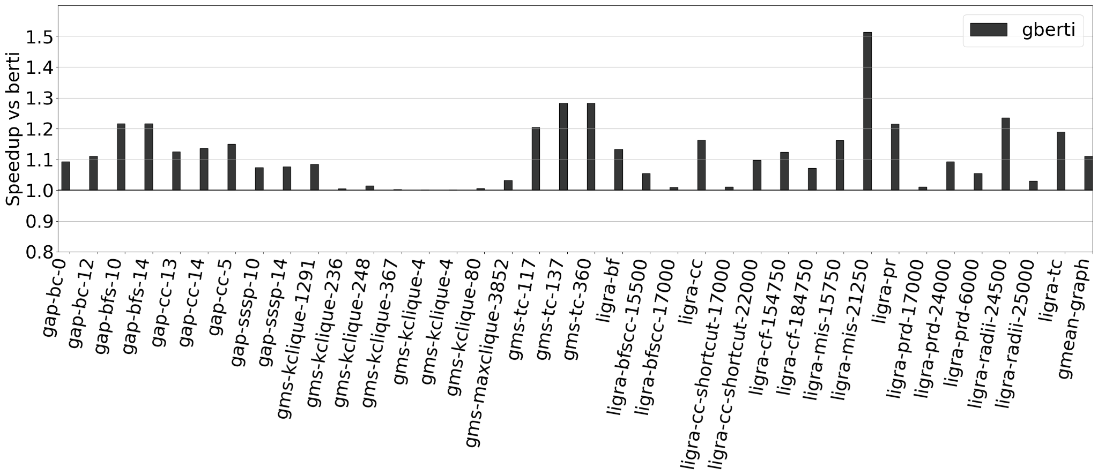
Global Berti outperforms Berti: Graph Algorithms
Global Berti outperforms Berti on graph benchmarks by gmean 11%

Slide 38
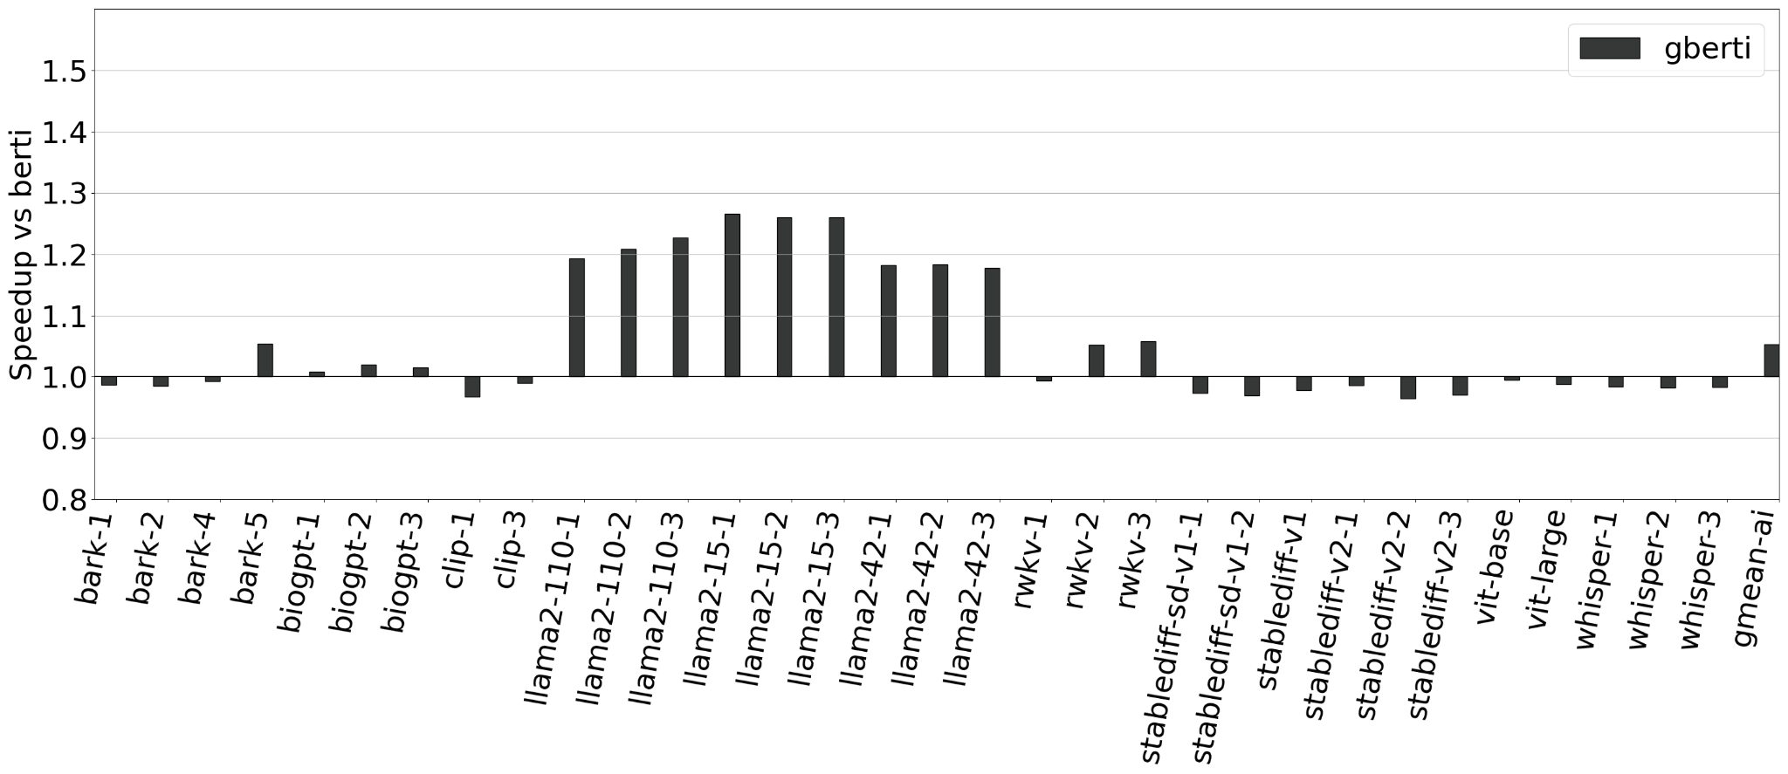
Global Berti outperforms Berti: AI
Global Berti outperforms Berti on AI workloads by gmean 5%

Slide 39
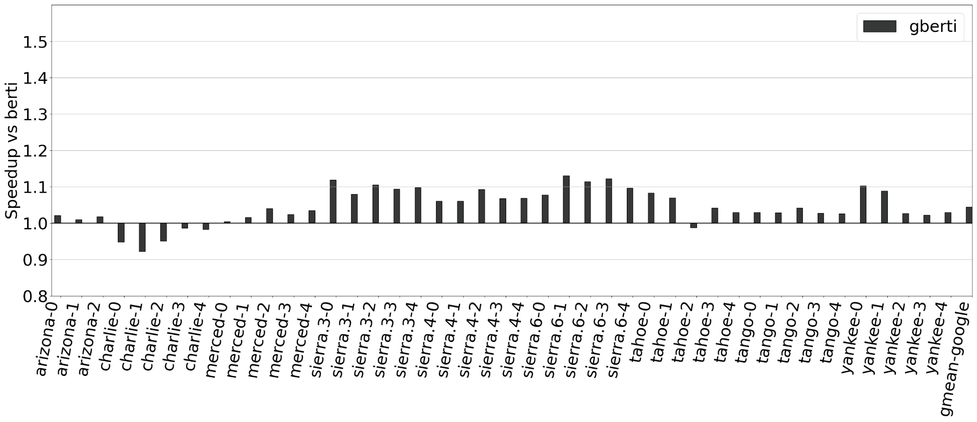
Global Berti outperforms Berti: Google
Global Berti outperforms Berti on Google’s workloads by gmean 5%

Slide 40
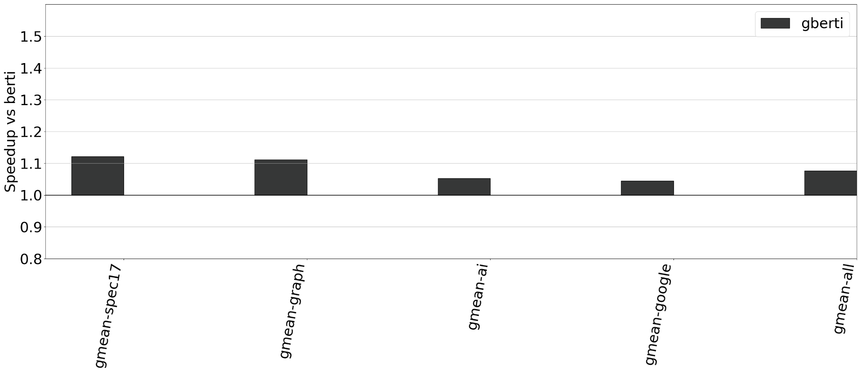
Global Berti outperforms Berti: Overall
Global Berti outperforms Berti by gmean 8%, ranging from -8% to 89%

Slide 41
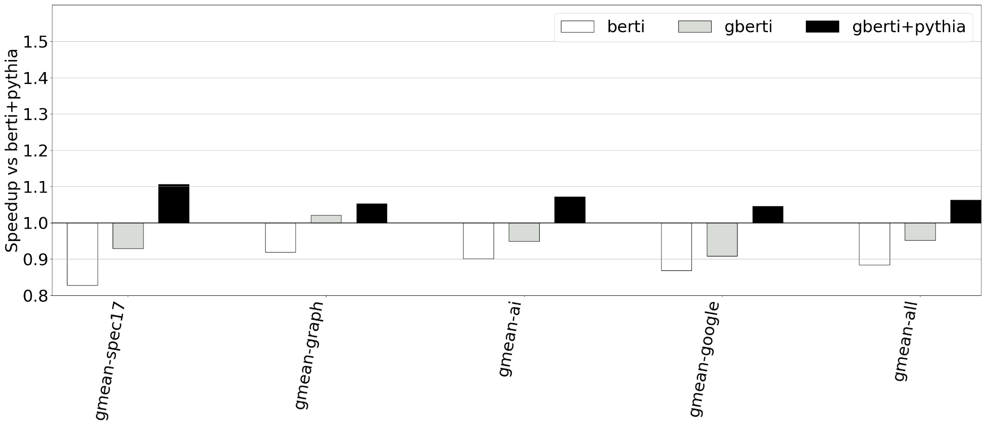
Global Berti+Pythia outperforms Berti+Pythia
With L2 Pythia, Global Berti outperforms Berti by gmean 6%, (-6%-49%)

Slide 42
