Slide 1
Data Prefetching Championship 4 (DPC4)
Virtual Inter-Page Prefetching for
Physical-Address Prefetchers
Ho Je Lee, Won Woo Ro
Yonsei University

Slide 2
Characteristics of Multi-Level Prefetchers
L1 Prefetcher
Input Stream:
All Memory Accesses
Address Space:
Virtual Address
Characteristics:
Conservative (short-
distance, low latency,
avoids L1 pollution
Main Effect:
MPKI Reduction of L1
L2 Prefetcher
Input Stream:
L1 Miss Stream
Address Space:
Physical Address
Characteristics :
Aggressive (long-
range, long latency,
higher bandwidth
Main Effect:
MPKI Reduction of L2
Due to Prefetcher’s
Placement
Due to Cache’s
Characteristic
A prefetcher’s behavior and capability depends on where it is placed in the cache hierarchy.
Notes:
Let’s start with how multi-level prefetchers work.
A prefetcher’s characteristic and behavior depends on where the prefetcher is placed.
If a prefetcher is placed at the L1, the prefetcher can see all memory accesses, and works on virtual address. However, because of the limited capacity of the L1 and the view of full memory stream, the prefetcher works more conservatively.
On the other hand, if the prefetcher is placed along with the L2, the prefetcher sees a sparser memory stream, the miss stream in the L1 cache, and works on physical addresses. But because of the sufficient capacity of the L2 cache and a view of sparser memory streams, the prefetcher works more aggressively.
Because of these characteristics and behaviors, each prefetcher naturally exhibits a different effect:
the L1 prefetcher mainly reduces L1 MPKI, while the L2 prefetcher mainly reduces L2 MPKI.

Slide 3
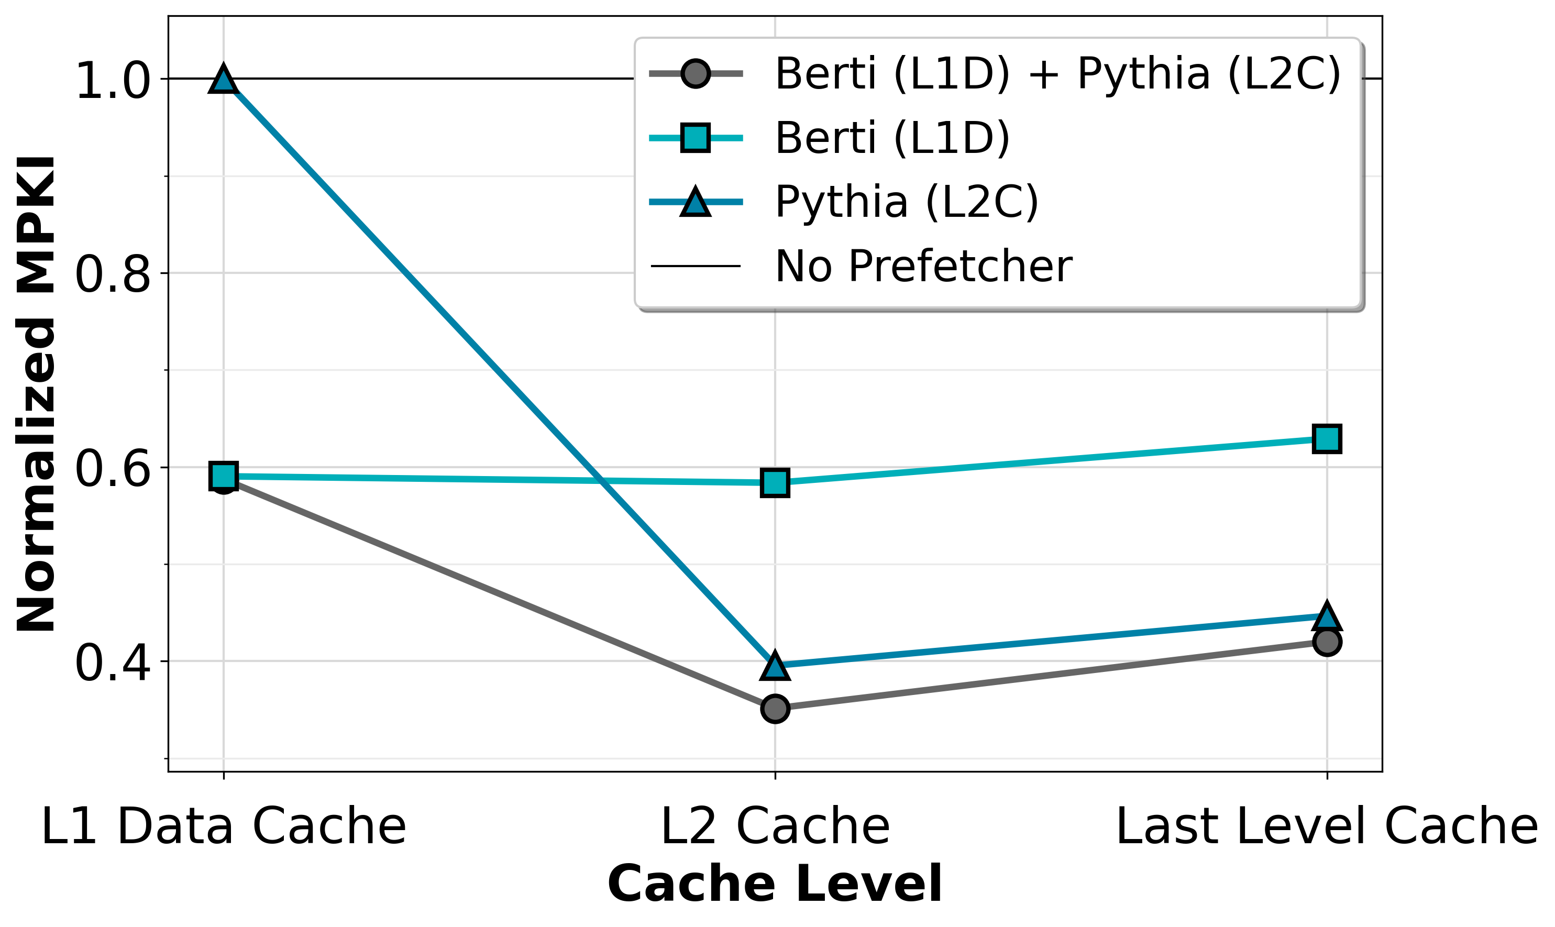
Complementary Roles of L1 and L2 Prefetchers
• L1 MPKI: Multi-level ≈ L1-only prefetching
: L1D prefetcher excels at short-range, low-latency, pollution-aware prefetching
• L2/LLC MPKI: Multi-level ≈ L2-only prefetching
: L2C prefetcher excels at long-range, high-latency-tolerant prefetching
Each prefetcher remains effective at its target level; the L2 prefetcher captures long-range access patterns.
Notes:
This can be supported by a very simple experiment.
We measure the MPKI at each cache level under different prefetcher configurations.
Here, we compare L1-only prefetcher with Berti, L2-only prefetcher with Pythia, and a multi-level prefetcher that combines both. The MPKI is normalized to a no prefetcher configurtion.
As shown in the figure, the multi-level design achieves L1 MPKI reduction identical to L1-only prefetcher. This is very straightforward because an L2 prefetcher doesn’t prefetch to L1. But also, we can see that the L2/LLC MPKI reduction comparable to L2-only prefetcher.
This indicates that each prefetcher remains effective at its target cache level, showing clearly distinct effects.
So, we can see that the L2 prefetcher reduces the L2/LLC MPKI more effectively than the L1 prefetcher by capturing long-range access patterns.

Slide 4
Limitation of Physical Address Based Prefetchers
Deeper-level prefetchers (L2/LLC) can’t cross pages because they operate on physical addresses
Hardware conservatively drops prefetch if it lies beyond 4 KB boundary, due to security problems
L1 prefetchers can cross pages by consulting the TLB to verify permissions
Page boundaries force physical address-based prefetchers to drop predictable accesses,
sharply limiting their long-range coverage.
Notes:
However, the fact of the matter is that there is an inherent limitation in physical-address–based prefetchers.
Because L2 prefetchers operate on physical addresses, they cannot safely cross page boundaries.
The hardware doesn’t have information about whether the next page belongs to the same process, whether it has the required permissions, or whether it is part of a large page mapping.
Allowing these prefetches could lead to security risks, including potential side-channel attacks.
As a result, hardware drops prefetches beyond the 4KB boundary, even when the access pattern is predictable.
This inherent limitation fundamentally limits the long-range coverage of deeper-level prefetchers.

Slide 5
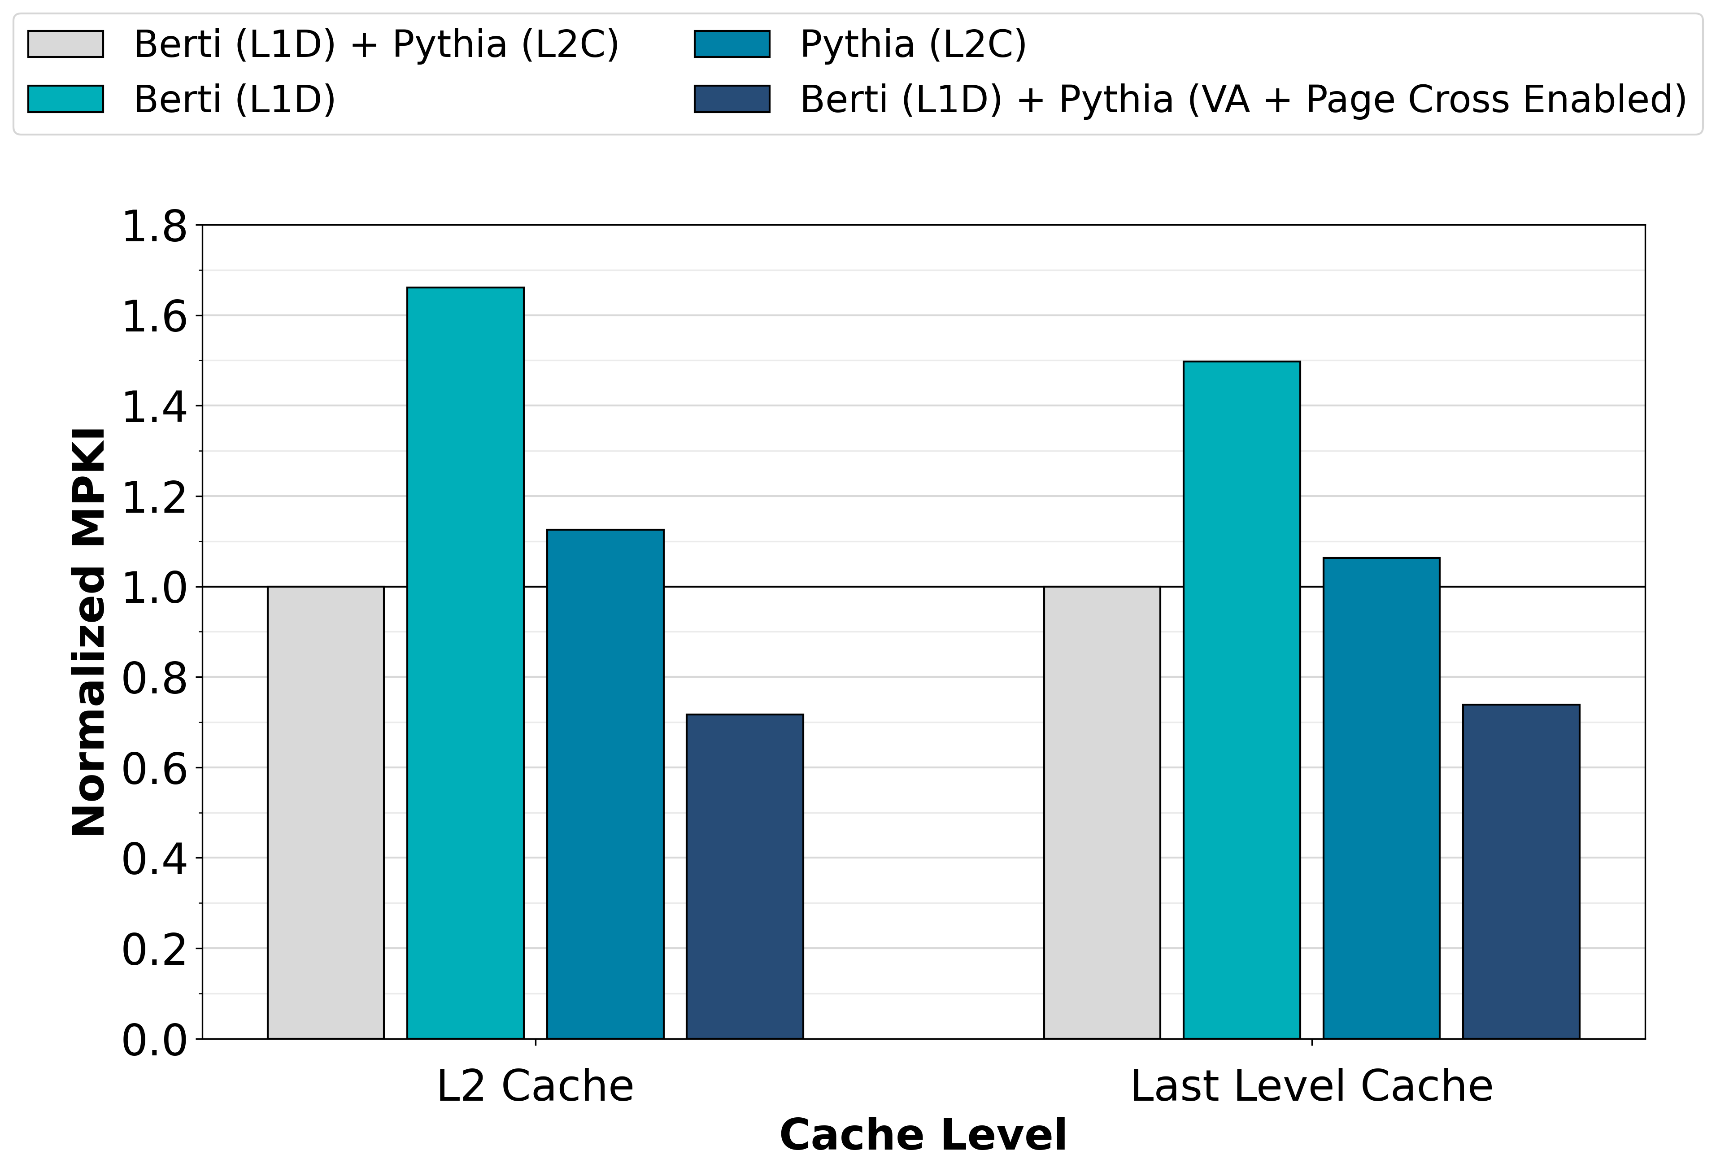
Missed Benefits Without Cross Page Prefetching
PA-based prefetchers begin prefetching the next page after the page’s first access arrives
Page-boundary stalls hide long-range patterns from L2/LLC prefetchers, reducing their coverage.
Timeliness is crucial: an untimely prefetch forces the access to pay full LLC or memory latency
Continuous Data
Access Stream
Prefetched after
an access
in the page
Headroom of
page cross prefetching
Prefetching
Behavior
X
X
4KB
Boundary
4KB
Boundary
4KB
Boundary
4KB
Boundary
Notes:
To illustrate the missed benefits of page-cross prefetching, let’s consider a very simple example.
Suppose an application generates a continuous data access stream that is highly predictable and spans multiple pages.
Even though the access pattern itself is easy to predict, physical-address–based prefetchers are constrained by page boundaries.
They must wait for an access to arrive in the next page before issuing any prefetches within that page.
As a result, prefetching is delayed at every page boundary, breaking the continuity of the access stream and hiding long-range patterns.
This effect is reflected in the results shown on the right.
To quantify the potential benefit of page-cross prefetching, we run an experiment where we modify Pythia to operate in the virtual-address domain and enable page-cross prefetching.
This configuration is not architecturally realistic, but we just use it for an oracle experiment to estimate the performance headroom.
As shown in the figure, enabling page-cross prefetching significantly reduces MPKI at both L2 and LLC, revealing substantial headroom that is otherwise left untapped by conventional multi level prefetchers.

Slide 6
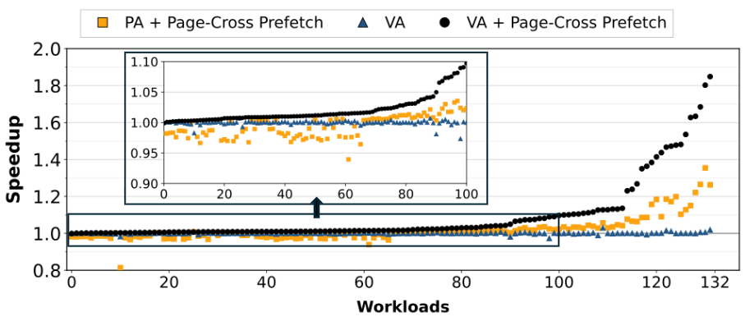
Virtual vs. Physical Addresses: Accuracy & Headroom
Virtual address better captures cross-page locality while PA suffers from fragmentation and noise
Removing page-boundary stalls reveals significant performance headroom
NOTE: This configuration is not architecturally realistic and is used to estimate the performance headroom.
Pythia (L2C) Variants
Virtual address prefetching predicts cross page locality more accurately than physical address, showing huge performance headroom when page-bound stalls are removed.
Notes:
Furthermore, to gain deeper insight into the impact of page-cross prefetching, we compare three L2 prefetcher variants on top of the multi-level prefetcer baseline with Berti (L1D) and Pythia (L2C). We also enable large page allocation.
We evaluate Pythia operating on physical addresses, and on virtual addresses with and without page crossing. All speedups are normalized to the physical-address–based multi-level prefetcher without page crossing. Note that these setups are also not realistic—they’re just used to get some insights.
What we observe is that using virtual addresses without page-crossing provides little benefit and behaves similarly to the baseline.
Once page-cross prefetching is enabled, both physical- and virtual-address–based prefetchers see clear performance gains.
But also, the virtual-address–based prefetcher consistently outperforms the physical-address one.
This is because virtual addresses preserve access continuity across pages, giving the prefetcher a cleaner and more stable view of the access stream.
In contrast, physical addresses fragment streams at page boundaries, resulting in noisier training, less accurate prefetches, and increased cache pollution.

Slide 7
Structural Blind Spot & Design Choices
L1 sees virtual continuity but lacks lookahead, while L2 has the lookahead without virtual continuity
Two ways to exploit page-cross prefetching
  Make the L2 prefetcher virtual-address aware → Needs additional data-path (virtual address and TLB port), additional treatment when L2 cache is shared
  Increase the lookahead of the L1 prefetcher
L1 Prefetcher
Input Stream:
All Memory Accesses
Address Space:
Virtual Address
Characteristics:
Short Lookahead
(Conservative)
L2 Prefetcher
Input Stream:
L1 Miss Stream
Address Space:
Physical Address
Characteristics :
Long Lookahead
(Aggressive)
Notes:
So, To exploit the performance headroom of page-cross prefetching, we must address the structural blind spot in current multi-level prefetchers.
L1 prefetchers observe virtual address but lack sufficient lookahead, while L2 prefetchers provide lookahead but operate only on physical addresses.
As a result, huge performance headroom is left untouched.
There are two possible ways to resolve this limitation: either making the L2 prefetcher virtual-address aware, or providing additional lookahead capability to the L1 prefetcher.
However, enabling virtual-address operation at L2 requires additional datapaths, TLB access ports, and careful handling when the L2 cache is shared across a lot of cores, making it architecturally complex.
Instead, we choose to increase the lookahead of the L1 prefetcher, which already sees virtual addresses and does not require much architectural changes.

Slide 8
Design Constraints & Choices
Limited L1 storage budget with an existing L1 prefetcher
  Use a simple IP-stride to capture contiguous streams across pages with minimal storage overhead
Need deeper lookahead with low bandwidth cost
  Increase prefetch degree, and operate on the L1 miss stream
Must avoid L1 pollution
  Fill prefetched lines into L2 instead of L1
Notes:
However, simply making the L1 prefetcher more aggressive is not sufficient—it must be done carefully under several practical constraints.
First and foremost, the L1 cache has a very limited storage budget and must coexist with existing L1 prefetchers.
Therefore, we choose a simple IP-stride prefetcher that can capture contiguous streams across pages with minimal state.
At the same time, we need deeper lookahead to exploit page-cross locality, but without significantly increasing bandwidth consumption.
To achieve this, we increase the prefetch degree while operating only on the L1 miss stream, which is much sparser than the full access stream.
Finally, aggressive prefetching must not pollute the L1 cache.
Therefore, prefetched lines are filled into L2 rather than L1, preserving the L1 capacity.

Slide 9
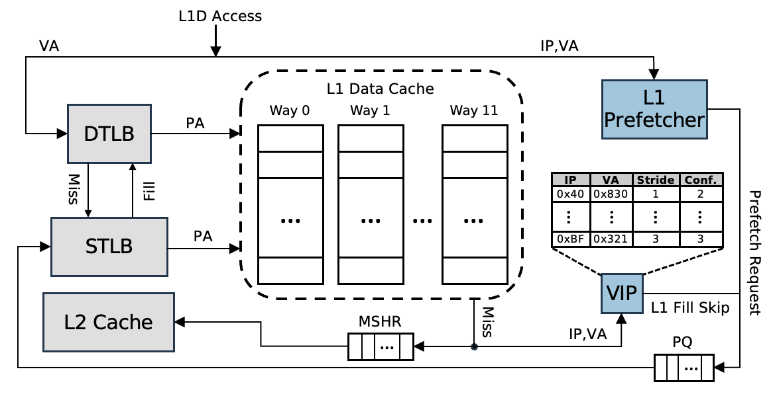
VIP(Virtual Inter-page Prefetcher)
VIP is a lightweight L1-side extension that enables timely cross-page prefetches for the L2 prefetcher
VIP uses a confidence based ip-stride prefetcher based on virtual address and L1 cache miss streams
  Virtual-stride patterns reliably expose cross-page behavior with low storage overhead
  Prefetch degree is adaptively adjusted according to prediction confidence
  MSHRs track VA and IP for replay and fault handling, VIP leverages this to observe L1 miss stream in the VA domain
VIP (Virtual Inter-page Prefetcher) Design Overview
Notes:
Based on these design choices, we propose VIP, the Virtual Inter-page Prefetcher.
VIP is a lightweight extension on the L1 side that enables timely page-cross prefetching on behalf of the L2 prefetcher, while keeping both existing L1 and L2 prefetchers unchanged.
Modern processors already store virtual address and instruction pointer (IP) information in each MSHR entry to support replay, page-fault, and coherence handling.
VIP leverages this existing metadata to observe the L1 miss stream in the virtual-address domain.
At its core, VIP employs a simple IP-stride prefetcher trained on the L1 miss stream.
Like an L2 prefetcher, VIP operates on L1 misses, but unlike L2 prefetchers, it observes these accesses before translation, allowing it to learn inter-page stride patterns before being fragmented.
When VIP predicts the next virtual address using IP-stride correlation, it performs a TLB lookup, and then injects the prefetch directly toward the L2, bypassing the L1 to avoid pollution.
In this way, VIP supplies the missing page-cross predictions, while the conventional L2 prefetcher continues to handle intra-page locality, providing complementary coverage without architectural disruption.

Slide 10
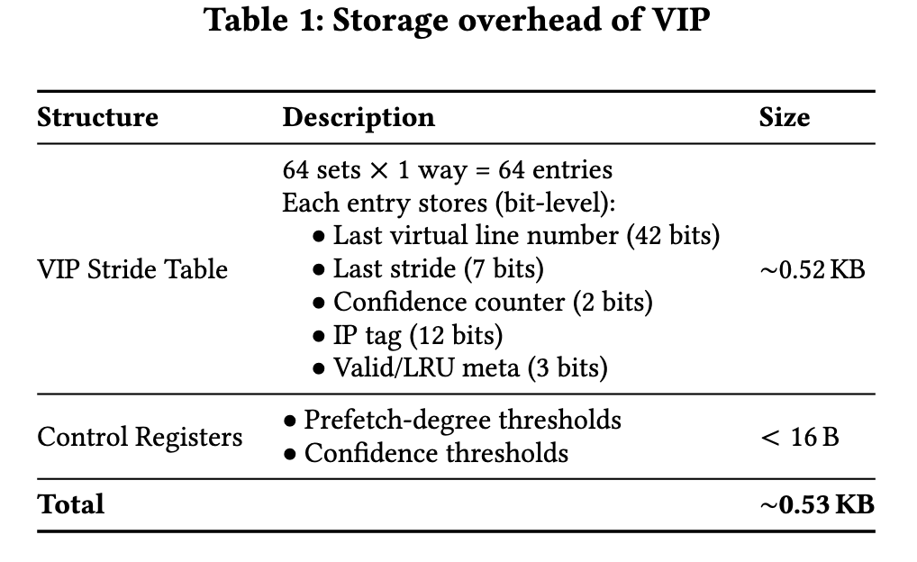
Storage Overhead of VIP
L1D, L2C, and LLC should not exceed the storage budget of 32 KB, 128 KB, and 256 KB, respectively
  Berti (L1D, 29.5KB) + Pythia (L2C, 25.5KB) already -> ~2.5KB left for L1 prefetchers!
Sparser memory stream (miss stream from L1) enables VIP to predict well with few entries
Notes:
Although L1 storage is extremely limited, VIP remains lightweight.
In the DPC4 baseline, Berti and Pythia already consume most of the available space, leaving only about 2.5 KB for additional L1-side structures.
VIP addresses this in two ways.
First, it uses an IP-stride prefetcher, which is inherently lightweight due to its simple, low-state design.
Second, VIP operates on the L1 miss stream, which is much sparser than the full access stream.
This sparsity allows VIP to learn stable stride patterns with very few entries.
As a result, the entire VIP structure requires only about 0.53 KB of storage, well within the remaining L1 budget.

Slide 11
Evaluation
Overall: VIP improves performance by +4.77% geomean across 132 workloads
AI workloads: See the largest gains (+16.83% geomean) due to long, virtually contiguous memory accesses
Others: SPEC (+3.30%) and Graph (+1.96%) benefit moderately, while Google traces show a small regression (−0.46%) due to control-heavy executions
(a) SPEC/Google Benchmarks
(b) AI/Graph Benchmarks
Notes:
Overall, VIP improves performance by 4.77% geomean across 132 workloads, showing consistent gains on top of Berti + Pythia.
AI workloads see the largest benefits, because many AI kernels traverse long, virtually contiguous memory regions, where page boundaries would otherwise introduce frequent L2/LLC misses. VIP effectively removes these page-cross stalls.
SPEC and Graph workloads show moderate gains, reflecting a mix of regular and irregular access patterns, where page-cross locality exists but is less dominant.
In contrast, Google production traces show a small regression.
These workloads are control-heavy, with limited long, contiguous data streams, and are less sensitive to data-side miss reduction. In such cases, additional data prefetching can slightly increase cache contention without providing enough benefit.
Overall, these results show that VIP is most effective for data-intensive workloads with strong virtual contiguity, while remaining stable and non-pathological across diverse workloads.

Slide 12
Thank You
Notes:
L1 prefetchers observe the full memory access stream, which is dense, so their achievable coverage is fundamentally limited. In contrast, long-range coverage typically comes from L2 prefetchers that operate on the filtered L1 miss stream—this is why combining L1 and L2 prefetchers consistently outperforms L1-only designs. VIP is designed around this principle. It operates on the L1 miss stream to preserve L2-level long coverage, but enables only inter-page predictions, which L2 prefetchers cannot generate and the Intra-page behavior remains entirely handled by the existing L2 prefetcher.

