Slide 1

sBerti: Enhancing Berti with a Smart Stride Prefetcher for Better Coverage
Jiapeng Zhou, Ben Chen, Kunlin Li, Yun Chen*
The Hong Kong University of Science and Technology (Guangzhou)
4th Data Prefetching Championship 2026
Notes:
Hello, everyone. I’m Jiapeng Zhou. I’m a PhD student in HKUST(GZ).

Slide 2
Challenges & Opportunities
New Traces from Graph, Google Traces v2 and AI-ML workloads
  A prefetcher may excel on certain workloads (e.g., SPEC17) while degrading performance on others (e.g., AI-ML).
  Finding new patterns not covered by existing prefetchers
New configuration: Limited bandwidth
  Mechanisms for the prefetcher to automatically self-regulate based on real-time bandwidth
Notes:
It has been 7 years since the last DPC event. In DPC4, three kinds of new traces are introduced. There is also a larger storage budget and a new configuration of limited bandwidth. This brings new challenges and opportunities.
Firstly, a prefetcher should strike a balance between different patterns of applications from different categories. Typically, a prefetcher modification can increase the IPC of some workloads while degrading others. As more traces are introduced, we should consider the impact on applications in more categories when making changes. Additionally, the newly introduced limited bandwidth configuration requires us to throttle prefetches based on real-time bandwidth and make the prefetches accurate.
There is also an opportunity to profile and analyze memory access patterns for the new traces. Prefetchers which performed the best in previous contests may fall short on new traces. Our strategy is to find patterns not covered by the baseline prefetchers and incorporate a light-weight prefetcher targeting the missing patterns. We hope the profiling and analysis will provide some insights to the community.

Slide 3
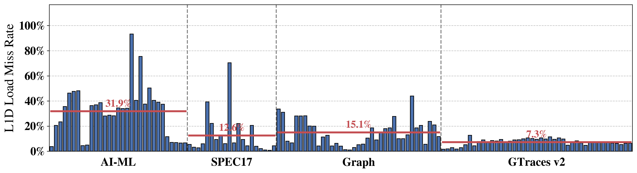
Profiling the baseline (L1 Berti + L2 Pythia)
Miss rate analysis
  High L1D miss rate for AI-ML and Graph workloads
  High L1I miss rate for GTraces v2
Notes:
Firstly, we analyze the L1D load miss rate of the baseline. The figure below lists the results clustered by categories. We noticed that there is a high L1D cache miss rate for AI-ML and Graph workloads. The SPEC17 is well studied in previous championships. The google traces version 2 has a high L1 instruction miss rate and low data miss rate. We will mainly focus on analyzing the AI-ML and Graph workloads.

Slide 4
Profiling the baseline (L1 Berti + L2 Pythia)
L1D memory access trace analysis
  Graph workloads: A[B[i]] accesses due to its CSR graph format
    No load values in the traces and the prefetcher is not allowed to get the values in the Cache
  AI-ML workloads: Stream access pattern (especially llama2.c)
Notes:
We analyze the traces of Graph and AI-ML workloads. We found that Graph workloads show an indirect memory access pattern, which is like an A[B[i]] array access and is well explored by previous researches. However, in the DPC4 traces, there is only load address and no load values of memory accesses. That is, we do not have the value of B[i], which makes it difficult to predict the address of array A accesses. I think the prefetcher is also not allowed to get the values in the Cache. For AI-ML workloads, especially for llama2.c, there is a dominate stream access pattern, which cause a high L1 data miss rate.

Slide 5
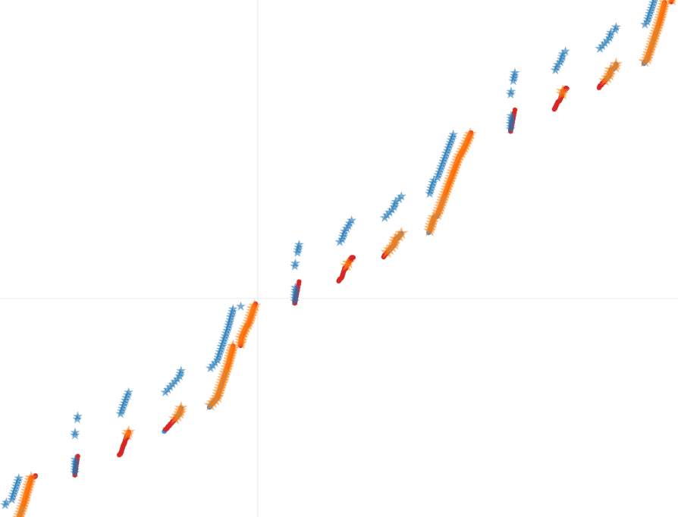
Dive into the DPC3 Berti used in baseline
Address
Accurate in predicting stream accesses
Misses occur every 4K page -> Missing cross-page prefetch opportunities
PF issued
Incorporate stride prefetchers to cover the cross-page misses
Hit & PF useful
Miss
Time
Notes:
Then we dive more into the prefetch and memory access of DPC3 Berti on llama2.c workload. The figure in the right displays a memory access snippet of llama2.c. The x-axis is the Champsim cycle and y-axis is the memory access address. The blue dots represent prefetches and the orange ones represent L1D hit and useful prefetch. Since there is no data reuse, all L1D hits are useful prefetches. The red dots represent L1D misses. From the figure, we can notice that although the Berti can cover most of the stream accesses, a large amount of misses appear every 4KB, which means the Berti can not cover the cross-page patterns well. So we are looking for suitable prefetchers such as stride prefetcher to cover this simple stream pattern and combine it with Berti.

Slide 6
Smart Stride Prefetcher
A stride prefetcher derived from the xs_stride prefetcher in XiangShan
Confidence directed stride pattern detection for accuracy
Depth adjustment based on late detection for timeliness
Strides are detected at multiples of the Delta to mitigate the OoO effect
Notes:
We have tried combining the Berti with other prefetchers such as temporal prefetchers. But we only get better overall results when incorporating a stride prefetcher. This is attributed to the stream access patterns in AI-ML workloads. We use a smart stride prefetcher derived from the xs_stride prefetcher in XiangShan, an open-source high-performance RISC-V core.
The Smart Stride prefetcher utilizes a confidence counter, adjusted by comparing prefetch addresses against demand accesses. Prefetches are issued only when confidence exceeds a specific threshold. To ensure timeliness, the system monitors late prefetches and dynamically adjusts the prefetch depth. Furthermore, strides are detected at multiples of the delta value to adapt to out-of-order access patterns.

Slide 7
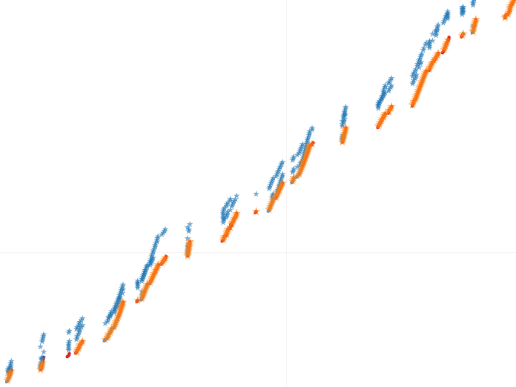
sBerti = Berti + Smart Stride Prefetcher
Useful prefetches: 846 -> 995
PF issued
Hit & PF useful
Miss
Berti in DPC3
sBerti
Notes:
The sBerti prefetcher simply combines the Berti and the smart stride prefetcher, with two components issue prefetches independently. The metadata tables are separate too. The figure below compares the memory access snippets of the DPC3 Berti and sBerti. From the figure, we can observe that the red dots in the left turned into orange ones in the right, which means the sBerti covers the cross-page patterns and turns L1D misses into useful prefetches. The number of useful prefetches in this snippet has increased from 846 to 995. sBerti behaves like a patch on the DPC3 Berti, but not accurate enough, as some of the reviewers have pointed out.

Slide 8
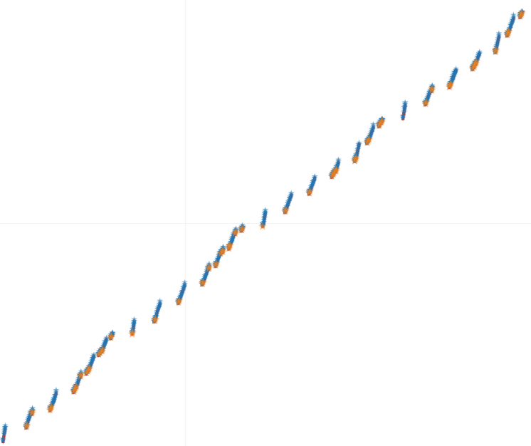
Can vBerti cover the cross-page pattern?
Observation
  Prefetch Queue is full most of the time. Prefetches with large strides (depth) are less likely issued.
  The highest confidence is observed with stride 1.
  Addresses in Prefetch Queue are stall
Still debuging on the issues
PF issued
Hit & PF useful
vBerti
Notes:
As some of the reviewers have asked, since the vBerti published in MICRO prefetches using vitual addresses, can vBerti cover the cross-page pattern? Theoretically, the virtual address used in vBerti can handle this cross-page pattern. However, the vBerti does not work well in our experimental setup. It is unclear whether this is an implementation error or a theoretical flaw.
Here I will show some observations. As the memory access snippet for vBerti on llama2.c workload on the right, the prefetch depth of vBerti is always 1 and the prefetch is not timely. By profiling, we observed that the prefetch queue of vBerti is full most of the time, which makes prefetches with larger stride less likely to be issued. We also observed that stride 1 always has the highest confidence and is close to the maximum threshold. The prefetch requests in the prefetch queue are usually stall, which means late prefetches.
Although we are still debugging vBerti, theoretically, it should be capable of covering cross-page patterns.

Slide 9
sBerti Storage Overhead
Smart Stride Prefetcher: ~4KB
  Stride detection table and a deduplication buffer
Berti: ~28KB
  Reduce the number of the Recorded Pages to satisfy the 32KB budget in total
Notes:
The storage budget for smart stride prefetcher is around 4KB, including the stride detection table and a deduplication buffer. For the Berti in sBerti prefetcher, we reduce the number of Recorded Pages to satisfy the 32KB L1D prefetcher storage budget.

Slide 10
sBerti Coverage in FullBW
Slight L1D coverage increase for AI-ML and SPEC17 workloads
Notes:
We show the coverage comparison of sBerti and baseline for workloads in different categories in the figure below. The sBerti increases the coverage of AI-ML and SPEC17 workloads. The coverage of Graph and Google Traces v2 remains nearly identical. It is as expected since there is mainly indirect memory access in Graph workloads.

Slide 11
sBerti Accuracy in FullBW
Accuracy drop across all categories
Notes:
However, there is an accuracy drop for all categories. We leave it for future work to profile and solve this problem. We suspect it is related to prefetch deduplication.

Slide 12
sBerti Speedup over Berti
IPC speedup on workloads with over 50% stream access patterns
Notes:
We selected multiple applications demonstrating over 50% stream patterns and present their speedups in the figure below. Significant speedups are observed for workloads in the AI-ML and SPEC17 categories.

Slide 13
Speedup over baseline (Berti + Pythia)
Our solution: L1 sBerti + L2 Pythia
Slight performance gains on AI-ML(7%) and SPEC17(2%) workloads under FullBW configuration
Remain identical performance under LimitBW configuration
Notes:
We use sBerti as L1 prefetcher and Pythia as L2 prefetcher for our solution in this contest. We did not use an LLC prefetcher as we failed to find a prefetcher to get performance gains in both the full bandwidth and limit bandwidth configurations. Our solution achieves slight performance gains, around 7% on AI-ML and 2% on SPEC17 workloads under FullBW configuration. sBerti remain nearly identical performance on average under limit bandwidth configuration.

Slide 14
Conclusion
sBerti is a hybrid prefetcher of Berti and a Stride Prefetcher derived from XiangShan
sBerti optimizes the cross-page weakness of Berti in DPC3 and achieves ~7% speedup for AI-ML workloads
Future Work
  Further optimization on sBerti for prefetch accuracy
  Investigating vBerti to solve cross-page boundary problems
Special thanks to the reviewers for their constructive comments and to the DPC-4 organizers for their excellent work
Notes:
To summarize, we introduced sBerti, a hybrid prefetcher that combines the strengths of Berti and the Smart Stride Prefetcher.
Our main goal was to address the cross-page limitations of the DPC3 Berti. In the experiment, sBerti achieves an around 7% speedup in AI and ML workloads.
However, there is still room for improvement. We plan to address the remaining accuracy challenges in future studies. Additionally, we are looking into vBerti as another promising direction to solve cross-page boundary problems.
Finally, we would like to extend our special thanks to the reviewers for their constructive comments, which greatly improved this work, and to the DPC-4 organizers for hosting this excellent competition. Thank you!

Slide 15
sBerti: Enhancing Berti with a Smart Stride Prefetcher for Better Coverage
Jiapeng Zhou, Ben Chen, Kunlin Li and Yun Chen. DPC4.
Thanks for your attention!
Questions?
Notes:
That’s all for my presentation, any questions?

Slide 16
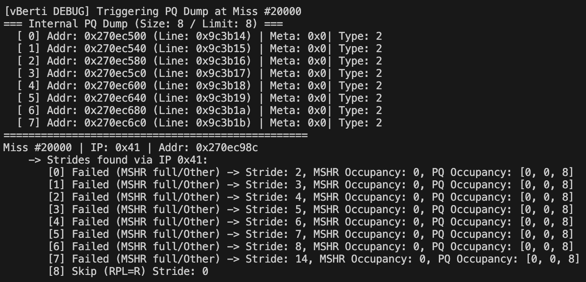
Debug log of vBerti

Slide 17
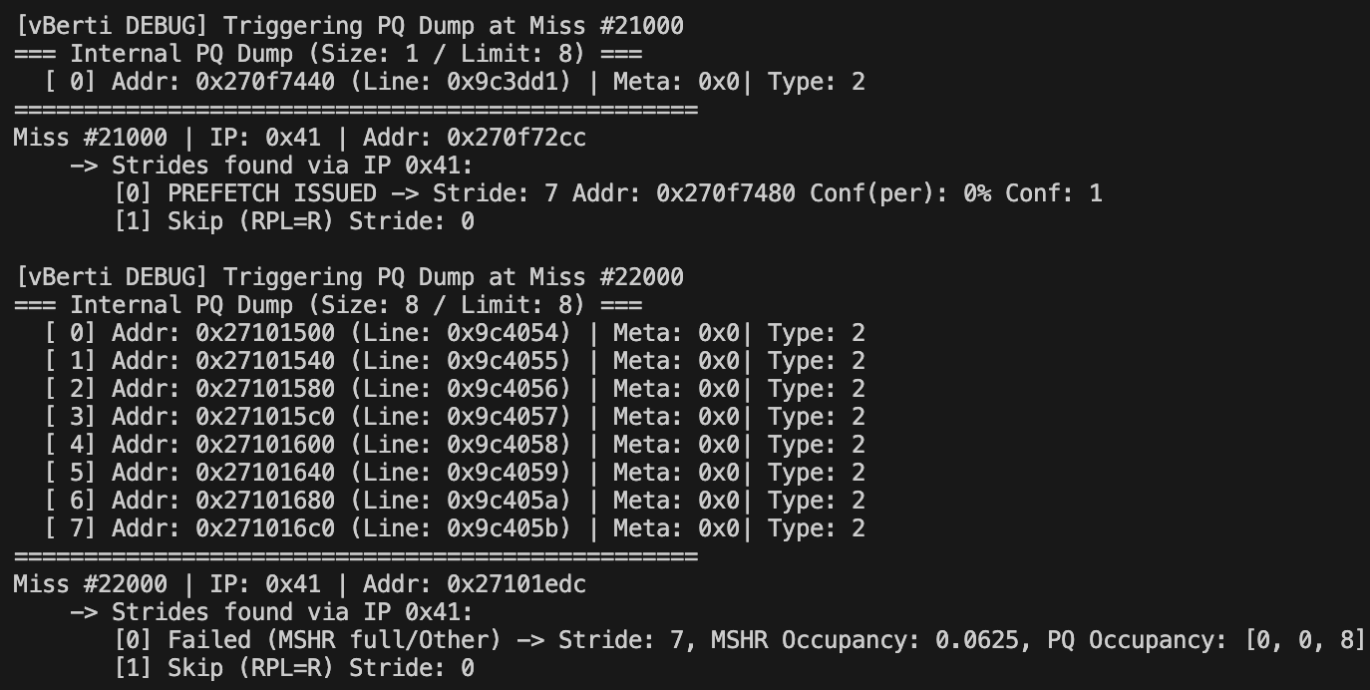
Debug log of vBerti

