Slide 1
MQSim: A Framework for Enabling Realistic Studies of Modern Multi-Queue SSD Devices
Arash Tavakkol, Juan Gómez-Luna, Mohammad Sadrosadati, Saugata Ghose, Onur Mutlu
February 13, 2018

Slide 2

Executive Summary
Solid-state drives (SSDs) are evolving to keep pace with performance, storage density demands
Multi-queue SSDs (MQ-SSDs) use new host protocols (e.g., NVMe)
New SSDs make use of emerging storage technologies (e.g., PCM, 3D XPoint)
Existing simulators have not kept up with these changes
They do not support several major features: multi-queue protocols, efficient steady-state SSD models, full end-to-end request latency
Compared to real MQ-SSDs, best existing simulator has 68–85% error rate
We introduce MQSim, a new open-source simulator
Models all major features of conventional SSDs and newer MQ-SSDs
Available with full-system simulator integration: accurate application modeling
Enables several new research directions
MQSim is highly accurate
Validated against four real MQ-SSDs
Error rate for real workloads: 8–18%
http://github.com/CMU-SAFARI/ MQSim

Slide 3
Outline
Executive Summary
Looking Inside a Modern SSD
Challenges of Modeling Modern Multi-Queue SSDs
MQSim: A New Simulator for Modern SSDs
Evaluating MQSim Accuracy
Research Directions Enabled by MQSim
Conclusion

Slide 4
Internal Components of a Modern SSD
Back End: data storage
Memory chips (e.g., NAND flash memory, PCM, MRAM, 3D XPoint)

Slide 5
Internal Components of a Modern SSD
Back End: data storage
Memory chips (e.g., NAND flash memory, PCM, MRAM, 3D XPoint)
Front End: management and control units
Host–Interface Logic (HIL): protocol used to communicate with host

Slide 6
Internal Components of a Modern SSD
Back End: data storage
Memory chips (e.g., NAND flash memory, PCM, MRAM, 3D XPoint)
Front End: management and control units
Host–Interface Logic (HIL): protocol used to communicate with host
Flash Translation Layer (FTL): manages resources, processes I/O requests

Slide 7
Internal Components of a Modern SSD
Back End: data storage
Memory chips (e.g., NAND flash memory, PCM, MRAM, 3D XPoint)
Front End: management and control units
Host–Interface Logic (HIL): protocol used to communicate with host
Flash Translation Layer (FTL): manages resources, processes I/O requests
Flash Channel Controllers (FCCs): sends commands to, transfers data with memory chips in back end

Slide 8
FTL: Managing the SSD’s Resources
Flash writes can take place only to pages that are erased
Perform out-of-place updates (i.e., write data to a different, free page), mark old page as invalid
Update logical-to-physical mapping (makes use of cached mapping table)
Some time later: garbage collection reclaims invalid physical pages off the critical path of latency

Slide 9
FTL: Managing the SSD’s Resources
Flash writes can take place only to pages that are erased
Perform out-of-place updates (i.e., write data to a different, free page), mark old page as invalid
Update logical-to-physical mapping (makes use of cached mapping table)
Some time later: garbage collection reclaims invalid physical pages off the critical path of latency
Write cache: decreases resource contention, reduces latency

Slide 10
Outline
Executive Summary
Looking Inside a Modern SSD
Challenges of Modeling Modern Multi-Queue SSDs
MQSim: A New Simulator for Modern SSDs
Evaluating MQSim Accuracy
Research Directions Enabled by MQSim
Conclusion

Slide 11
How Well Do Simulators Model Modern SSDs?
State-of-the-art simulators designed for conventional SSDs
We compare the performance of several simulators to four real modern multi-queue SSDs (MQ-SSDs)
Major features missing in most existing simulators
Multi-queue protocols (e.g., NVMe)
Efficient, high-performance model of steady-state behavior
Full model of end-to-end request latency
Simulator | Error Rate vs. Real MQ-SSDs
 | SSD-A | SSD-B | SSD-C | SSD-D
SSDModel | 91% | 155% | 196% | 136%
FlashSim | 99% | 259% | 310% | 138%
SSDSim | 70% | 68% | 74% | 85%
WiscSim | 95% | 277% | 324% | 135%
Why is the error rate so high?

Slide 12
Challenge 1: Support for Multi-Queue Protocols
Conventional host interface (e.g., SATA)
Designed for magnetic hard disk drives: only thousands of IOPS per device
OS handles scheduling, fairness control for I/O requests
Process 1
Process 2
Process 3
OS Block Layer
Software
I/O Request
Queue
I/O Scheduler
Hardware dispatch queue
SSD Device

Slide 13

Challenge 1: Support for Multi-Queue Protocols
Modern host interface (e.g., NVMe)
Takes advantage of SSD throughput: enables millions of IOPS per device
Bypasses OS intervention: SSD must perform scheduling, ensure fairness
Process 1
Process 2
Process 3
Hardware
I/O Request
Queue
No existing SSD simulator models this today
In the paper: studies on how multiple queues in real MQ-SSDs affect performance, fairness
SSD Device

Slide 14
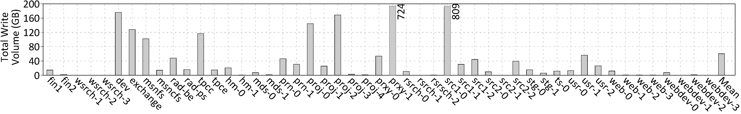
Challenge 2: High-Performance Steady-State Model
SNIA: SSDs should be evaluated in steady state
Fresh, out-of-the-box (FOB) device unlikely to perform garbage collection
Write cache not warmed up for an FOB device
Many previous SSD studies incorrectly simulate FOB devices
Difficult to reach steady state in most simulators
Very slow (e.g., SSDSim execution time increases by up to 80x)
Widely-used traces aren’t large enough for proper warm-up
Total Write
Volume (GB)
Workloads
Existing simulators either don’t model steady state or are slow at reaching steady state

Slide 15
Challenge 3: Complete Model of Request Latency
Request to NAND flash based SSD
Current simulators often model only steps 5 and 6
What if we use a different non-volatile memory (NVM)?
< 1µs
< 1µs
< 1µs
< 1µs
50-110µs
50-110µs
4µs
20µs
20µs

Slide 16
Challenge 3: Complete Model of Request Latency
Request to 3D XPoint based SSD
< 1µs
< 1µs
< 1µs
< 1µs
10-20µs
< 5µs
20µs
< 5µs
50-110µs
4µs
10-20µs
Existing simulators don’t model all of the request latency, causing inaccuracies for new NVMs

Slide 17
Summary: Simulation Challenges of MQ-SSDs
Major features missing in most existing simulators
Multi-queue protocols (e.g., NVMe)
Efficient, high-performance model of steady-state behavior
Full model of end-to-end request latency
Missing features lead to high inaccuracy
OUR GOAL
Develop a new simulator that faithfully models features of both modern MQ-SSDs and conventional SSDs

Slide 18
Outline
Executive Summary
Looking Inside a Modern SSD
Challenges of Modeling Modern Multi-Queue SSDs
MQSim: A New Simulator for Modern SSDs
Evaluating MQSim Accuracy
Research Directions Enabled by MQSim
Conclusion

Slide 19
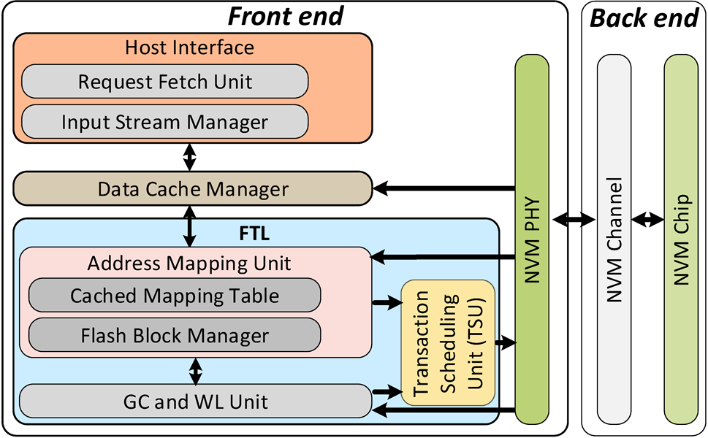
Major Features of MQSim
Accurately models conventional SATA-based SSDs and modern MQ-SSDs
Multi-queue protocols
Support for efficient modeling of steady-state behavior
Full model of end-to-end I/O request latency
Flexible design
Modular components
Integration with gem5 full-system simulator
Ability to support emerging non-volatile memory (NVM) technologies
Open-source release: http://github.com/CMU-SAFARI/MQSim
Written in C++
MIT License
Notes:
SATA: Native Command Queue

Slide 20
Experimental Methodology
Compare MQSim to four real, modern data center SSDs
System config: Intel Xeon E3-1240, 32GB DDR4, Ubuntu 16.04.2
All SSDs use NVMe protocol over PCIe bus
Real SSDs preconditioned by writing to 70% of available logical space
MQSim parameters set to model each SSD
We test using multiple I/O flows (1 flow = 1 application)
Queue depth controls flow greediness (number of simultaneous requests)
We show representative results here; full results in our paper

Slide 21
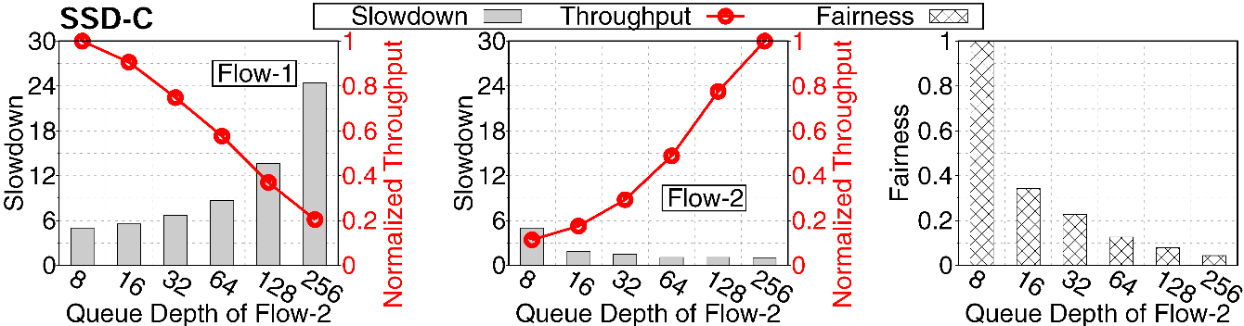
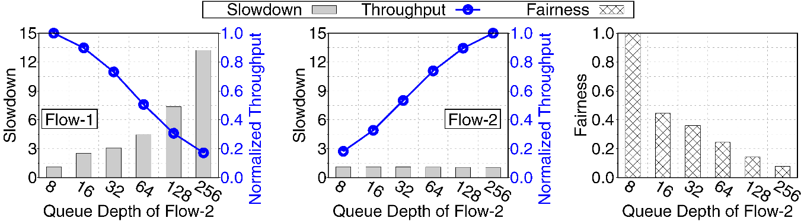
MQSim Multi-Queue Model
Inter-flow interference exists in many state-of-the-art SSDs
Real SSD
Flow 1
Slowdown
Slowdown
Fairness
Norm. Throughput
Norm. Throughput
Flow 2
Flow 2 Queue Depth
Flow 2 Queue Depth
Flow 2 Queue Depth
MQSim
Slowdown
Flow 1
Slowdown
Flow 2
Fairness
Norm. Throughput
Norm. Throughput
MQSim accurately captures inter-flow interference when one of two flows hogs I/O request bandwidth
Flow 2 Queue Depth
Flow 2 Queue Depth
Flow 2 Queue Depth

Slide 22
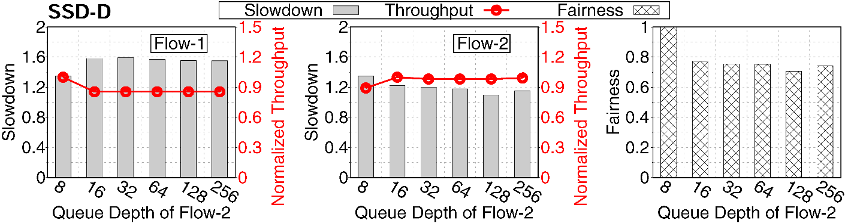
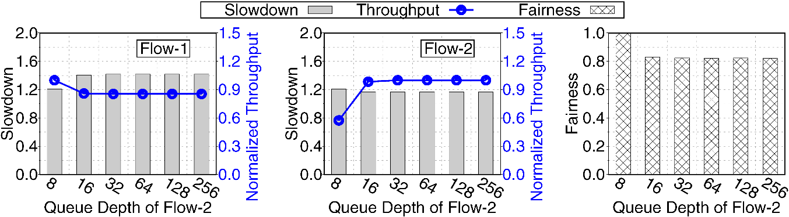
MQSim Multi-Queue Model
Some SSDs have mechanisms to control inter-flow interference
Real SSD
Flow 1
Flow 2
Slowdown
Slowdown
Fairness
Norm. Throughput
Norm. Throughput
Flow 2 Queue Depth
Flow 2 Queue Depth
Flow 2 Queue Depth
MQSim
Flow 1
Flow 2
Slowdown
Slowdown
Fairness
Norm. Throughput
Norm. Throughput
MQSim models the impact of control mechanisms for inter-flow interference in modern MQ-SSDs
Flow 2 Queue Depth
Flow 2 Queue Depth
Flow 2 Queue Depth

Slide 23
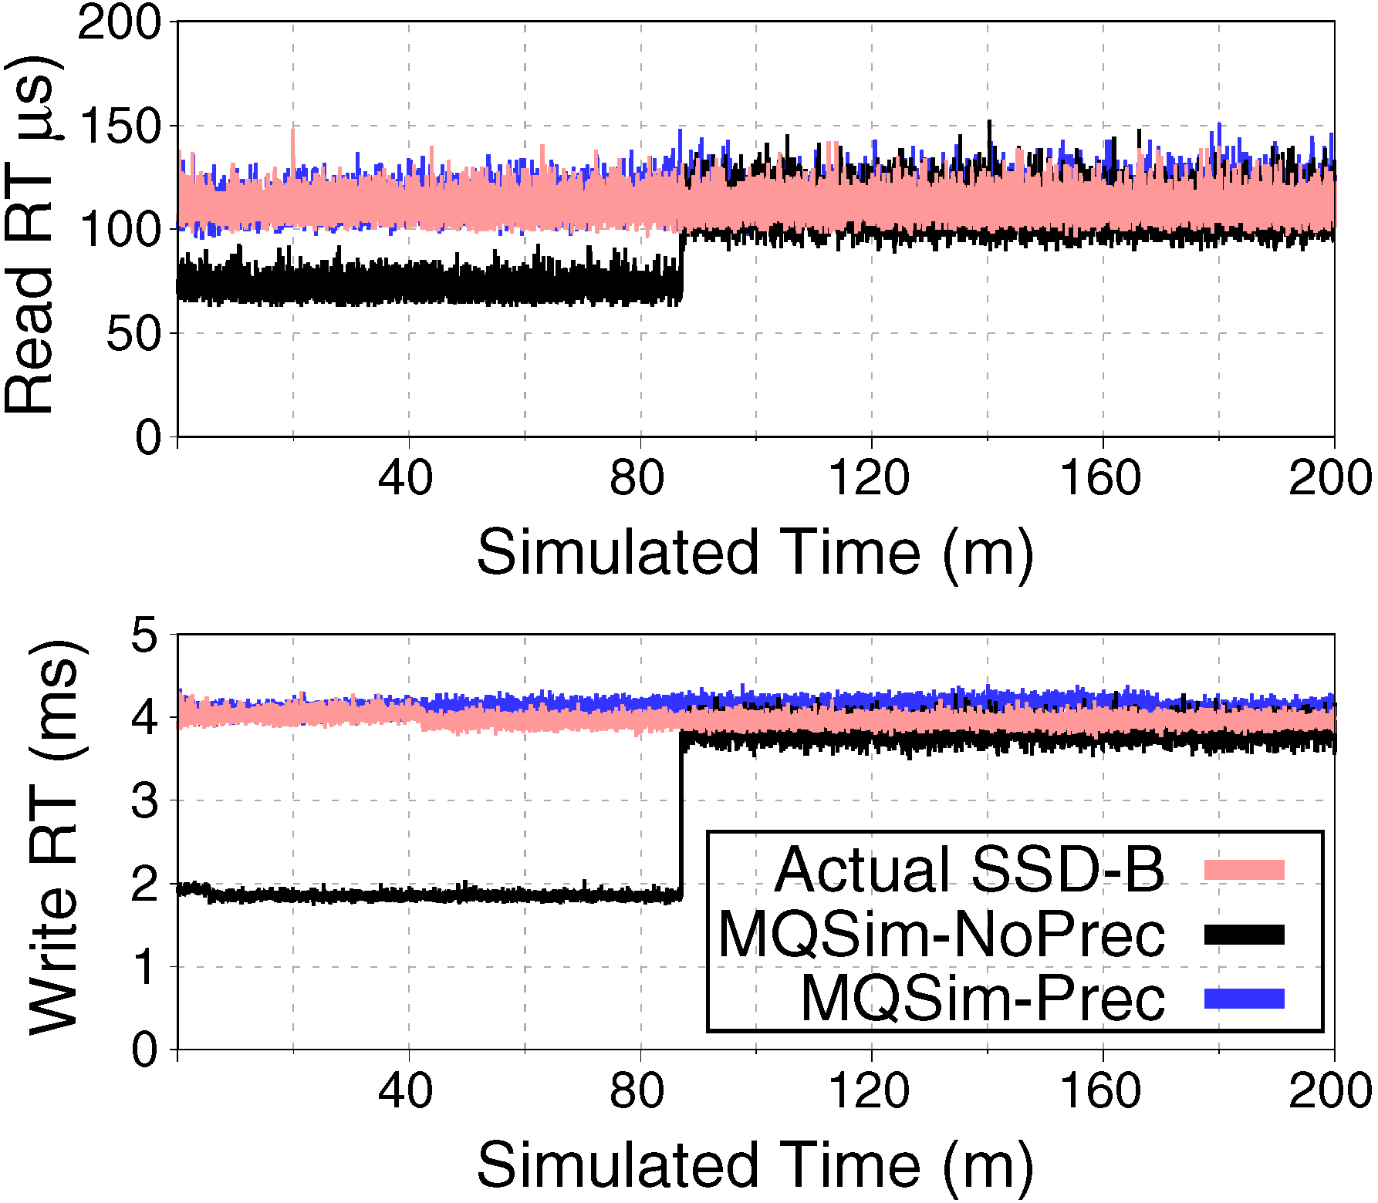
Capturing Steady-State Behavior with MQSim
MQSim includes an efficient SSD preconditioning mechanism
Very fast: does not need to execute actual requests
Can be disabled to simulate fresh, out-of-the-box (FOB) device
Two-pass approach
Read input trace, perform statistical analysis
Scan entire storage space, change status of each physical page based on analysis
Response time (RT) differences between FOB SSDs,
SSDs in steady state
With preconditioning, MQSim accurately captures the behavior of FOB SSDs and steady-state SSDs

Slide 24
Outline
Executive Summary
Looking Inside a Modern SSD
Challenges of Modeling Modern Multi-Queue SSDs
MQSim: A New Simulator for Modern SSDs
Evaluating MQSim Accuracy
Research Directions Enabled by MQSim
Conclusion

Slide 25
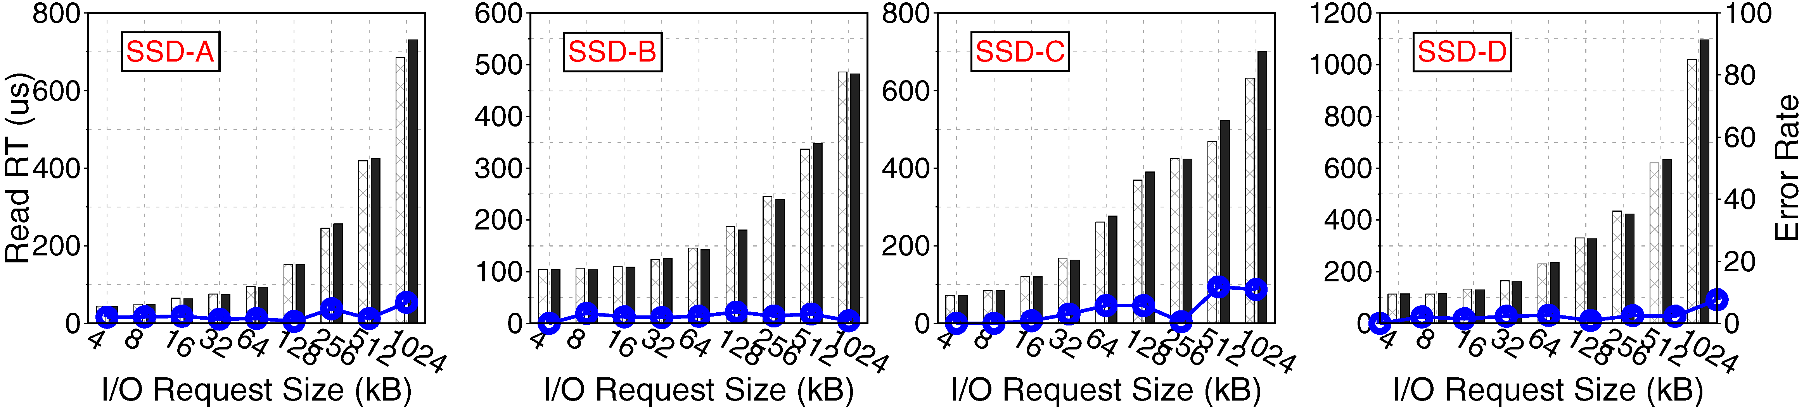
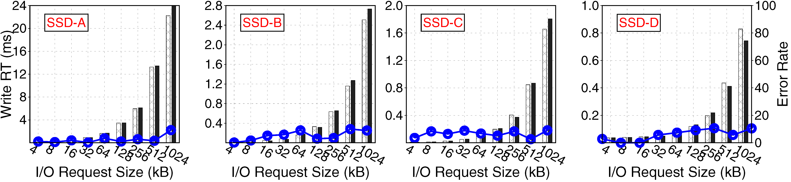
MQSim Accurately Captures Read/Write Latencies
Evaluations using two synthetic flows
Flow A: All Read Requests
Flow B: All Write Requests
Error rate vs. real SSDs, averaged across all four SSDs
Read latency: 2.9% Write latency: 4.9%

Slide 26
MQSim Is More Accurate Than Existing Simulators
Experiments using three real workload traces
Microsoft enterprise traces: TPC-C, TPC-E, Exchange Server
Comparison of total workload execution time
MQSim has a comparable execution time to other simulators
Simulator | Error Rate vs. Real MQ-SSDs
 | SSD-A | SSD-B | SSD-C | SSD-D
SSDModel | 91% | 155% | 196% | 136%
FlashSim | 99% | 259% | 310% | 138%
SSDSim | 70% | 68% | 74% | 85%
WiscSim | 95% | 277% | 324% | 135%
MQSim | 8% | 6% | 18% | 14%
MQSim is an order of magnitude more accurate at modeling MQ-SSDs than state-of-the-art simulators

Slide 27
Outline
Executive Summary
Looking Inside a Modern SSD
Challenges of Modeling Modern Multi-Queue SSDs
MQSim: A New Simulator for Modern SSDs
Evaluating MQSim Accuracy
Research Directions Enabled by MQSim
Conclusion

Slide 28
Research Directions Enabled by MQSim
MQSim’s accurate models enable many new research studies not possible with existing simulators
Fairness and performance effects of inter-flow interference within an SSD
We study three major sources of contention
Write cache
Cached mapping table
Back end memory resources
Using I/O flows designed to isolate impact of contention at a single source

Slide 29
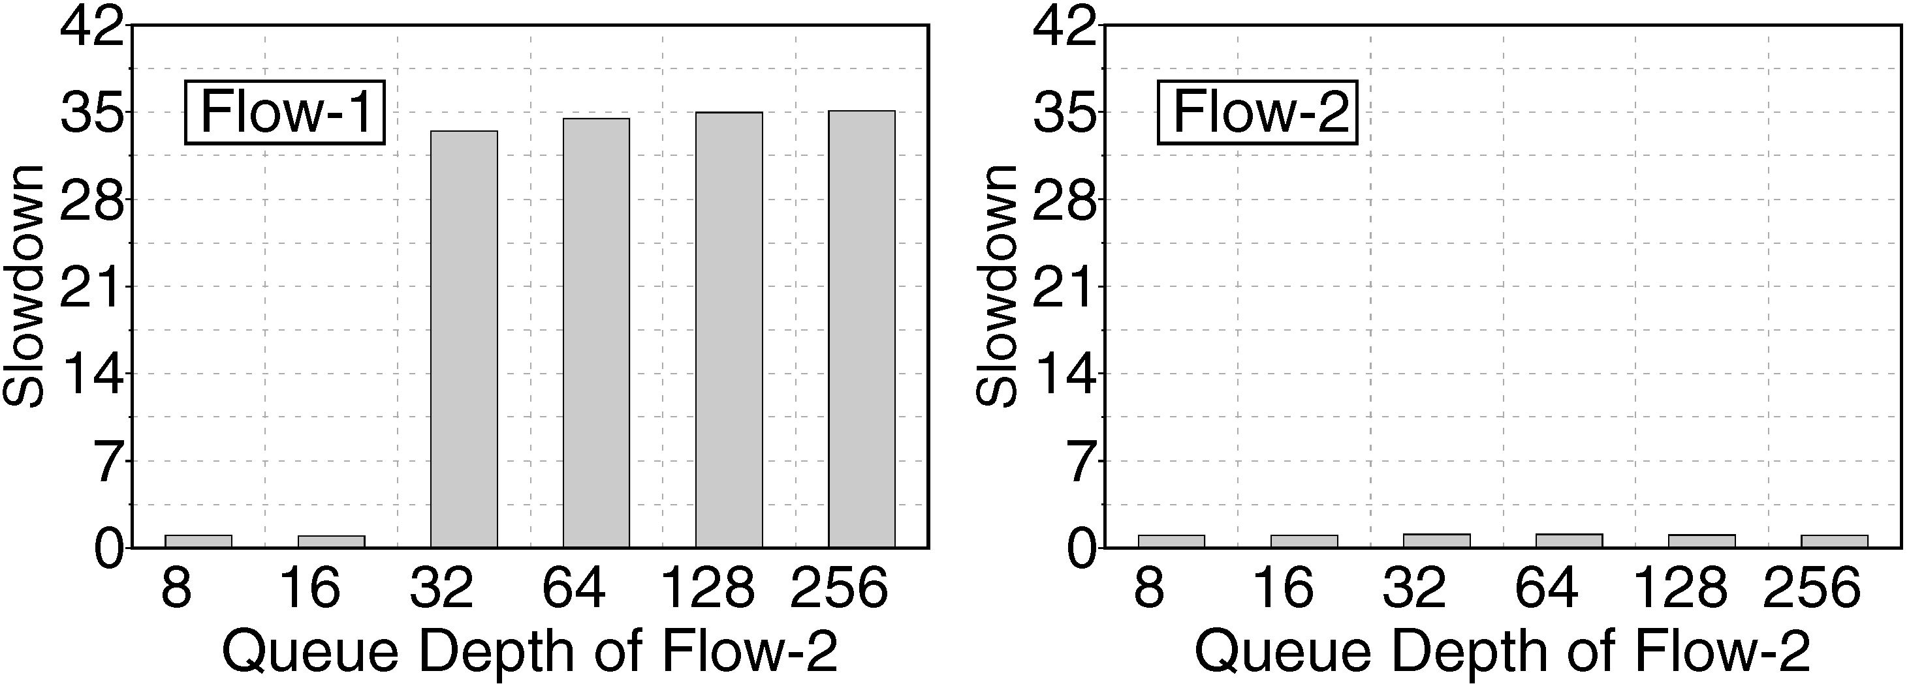
Interference at the Write Cache
Two flows concurrently performing random-access writes
Flow-1 has high cache locality, Flow-2 has poor cache locality
We increase Flow-2 greediness (by adjusting queue depth)
Flow-1
Flow-2
A greedier Flow-2 induces more write cache thrashing, destroying Flow-1’s cache locality

Slide 30
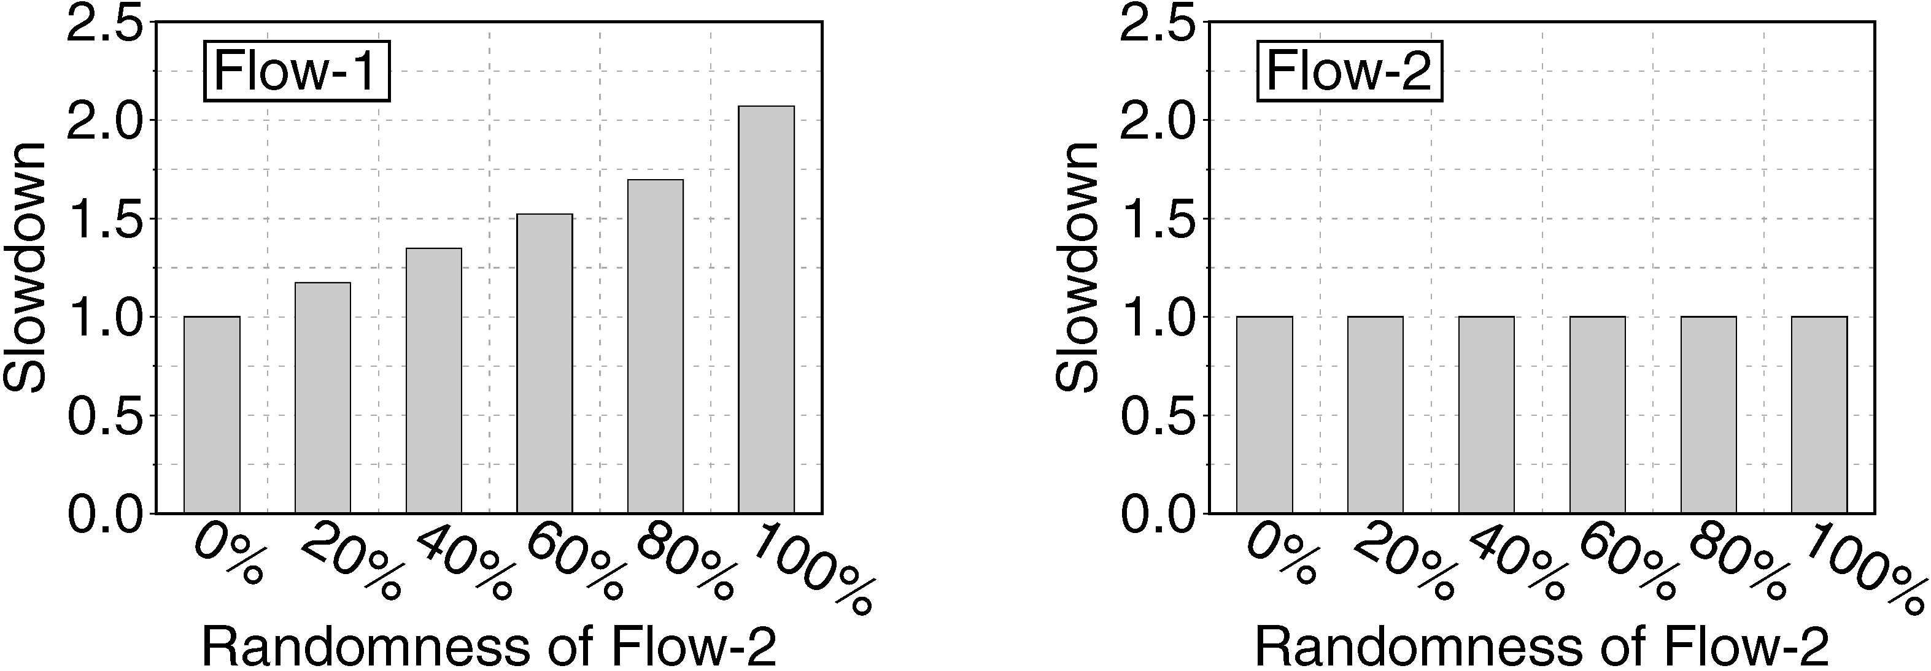
Interference at the Cached Mapping Table (CMT)
Two flows concurrently reading with different access patterns
Flow-1 sequential; Flow-2 split between sequential, random
We increase randomness of Flow-2, affecting misses to CMT
Flow-1
Flow-2
A more random Flow-2 increases CMT thrashing, significantly lowering the CMT hit rate of Flow-1
Notes:
Ask Arash for graphs without hit rate

Slide 31
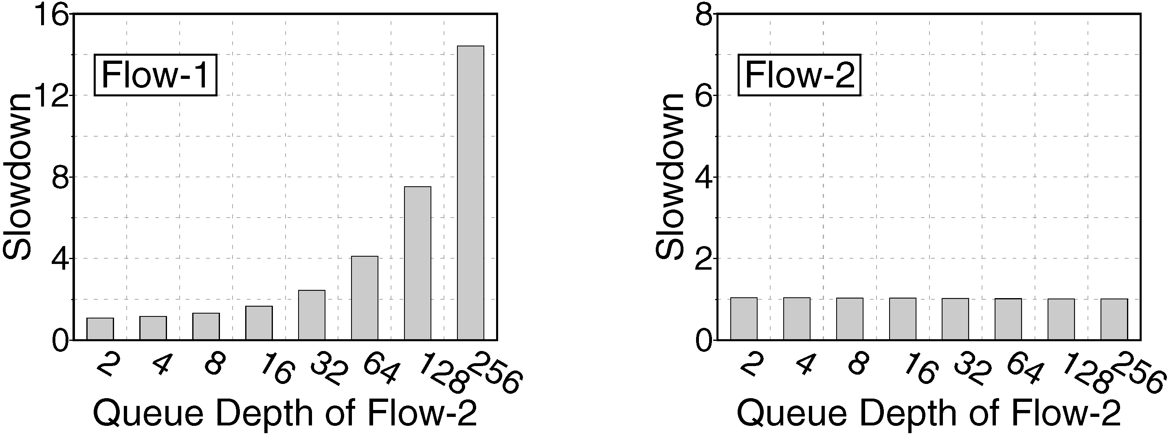
Interference at the Back End
Two flows concurrently performing random-access reads
Flow-1 has low intensity, Flow-2 has higher intenity
We increase Flow-2 greediness (by adjusting queue depth)
Flow-1
Flow-2
When Flow-2 is more intense, chip-level queues back up, causing requests from Flow-1 to wait much longer

Slide 32
Research Directions Enabled by MQSim
MQSim’s accurate models enable many new research studies not possible with existing simulators
Fairness and performance effects of inter-flow interference within an SSD
We study three major sources of contention
Write cache
Cached mapping table
Back end memory resources
Using I/O flows designed to isolate impact of contention at a single source
In the paper: application-level studies
Application-level performance metrics (e.g., IPC, slowdown, fairness)
Using full applications running on MQSim integrated with gem5 full system simulator

Slide 33
Outline
Executive Summary
Looking Inside a Modern SSD
Challenges of Modeling Modern Multi-Queue SSDs
MQSim: A New Simulator for Modern SSDs
Evaluating MQSim Accuracy
Research Directions Enabled by MQSim
Conclusion

Slide 34
Conclusion
Solid-state drives (SSDs) are evolving to keep pace with performance, storage density demands
Multi-queue SSDs (MQ-SSDs) use new host protocols (e.g., NVMe)
New SSDs make use of emerging storage technologies (e.g., PCM, 3D XPoint)
Existing simulators have not kept up with these changes
They do not support several major features: multi-queue protocols, efficient steady-state SSD models, full end-to-end request latency
Compared to real MQ-SSDs, best existing simulator has 68–85% error rate
We introduce MQSim, a new open-source simulator
Models all major features of conventional SSDs and newer MQ-SSDs
Available with full-system simulator integration: accurate application modeling
Enables several new research directions
MQSim is highly accurate
Validated against four real MQ-SSDs
Error rate for real workloads: 8–18%
http://github.com/CMU-SAFARI/ MQSim

Slide 35
MQSim: A Framework for Enabling Realistic Studies of Modern Multi-Queue SSD Devices
Arash Tavakkol, Juan Gómez-Luna, Mohammad Sadrosadati, Saugata Ghose, Onur Mutlu
Download the Simulator:
http://github.com/CMU-SAFARI/MQSim

Slide 36
Backup Slides

Slide 37

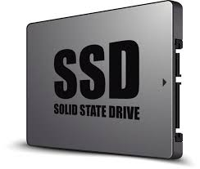
Enabling Higher SSD Performance and Capacity
Solid-state drives (SSDs) are widely used in today’s computer systems
Data centers
Enterprise servers
Consumer devices
I/O demand of both enterprise and consumer applications continues to grow
SSDs are rapidly evolving to deliver improved performance
Host
NAND Flash
SATA
Host Interface
3D XPoint
New NVM

Slide 38
Simulation Challenges for Modern MQ-SSDs
1. Multi-queue support in modern NVMe SSDs
The OS I/O scheduler is eliminated
The device itself is responsible for fairly servicing I/O requests from concurrently-running applications and guaranteeing high responsiveness
No existing SSD simulation tool
supports multi-queue I/O execution
Process 1
Process 2
Process 3
Application-level
queues are directly
exposed to the device
SSD Device

Slide 39
Defining Slowdown and Fairness for I/O Flows
RT_{fi}: response time of Flow f_{i}
S_{fi}: slowdown of Flow f_{i}
F: fairness of slowdowns across multiple flows
0 < F < 1
Higher F means that system is more fair

Slide 40
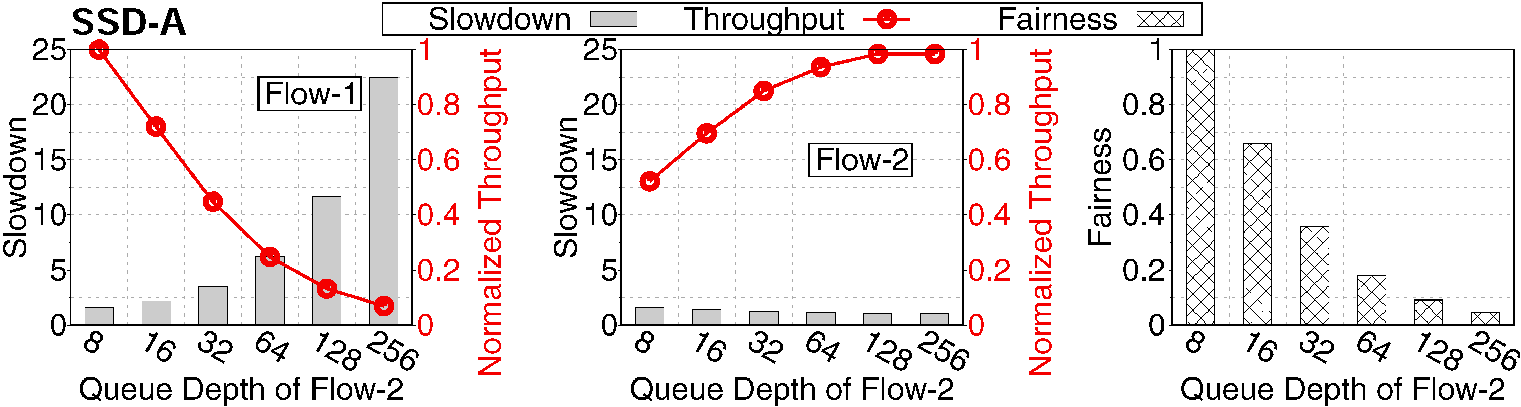
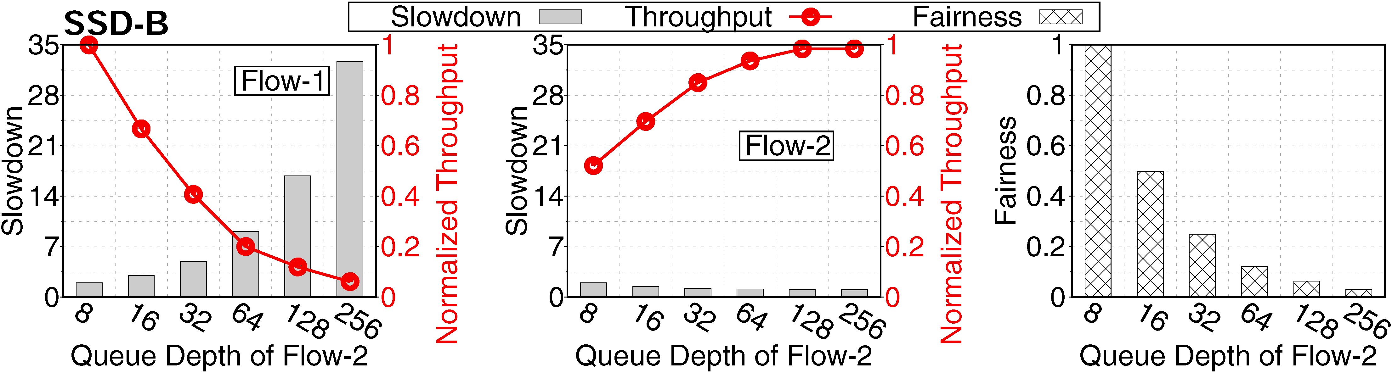
Concurrent Flow Execution in Real Devices

Slide 41

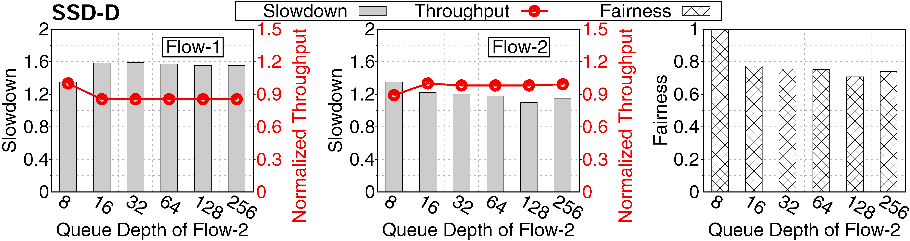
Concurrent Flow Execution in Real Devices

Slide 42
Challenge 3: Complete Model of Request Latency
Request to NAND flash based SSD
Current simulators often model only steps 5 and 6
What if we use a different non-volatile memory (NVM)?
< 1µs
< 1µs
< 1µs
< 1µs
50-110µs
50-110µs
4µs
20µs
20µs
Notes:
Remove text for fast steps, keep full version as backup

Slide 43
Challenge 3: Complete Model of Request Latency
Request to 3D XPoint based SSD
< 1µs
< 1µs
< 1µs
< 1µs
10-20µs
< 5µs
20µs
< 5µs
50-110µs
4µs
10-20µs
Existing simulators don’t model all of the request latency, causing inaccuracies for new NVMs
Notes:
Fix overlap

Slide 44
Challenge 3: Incomplete Models of Request Latency
3. Real end-to-end request processing latency
The current simulators mainly model the latency of and , assuming that they have the highest contribution in latency
Existing simulation tools are
incapable of providing
accurate performance results
< 1µs
Is this a correct assumption?
< 1µs
< 1µs
< 1µs
50-110µs
4µs
20µs
5
6

Slide 45
Simulation Challenges for Modern MQ-SSDs
The research community needs simulation tools that reliably model these features
State-of-the-art SSD simulators fail to model a number of key properties of modern SSDs
They implement only the single queue approach
They do not adequately replicate steady-state behavior → the reported performance values may be far from the long-term results
They capture only the part of the request latency → do not capture the true request performance of SSDs

Slide 46
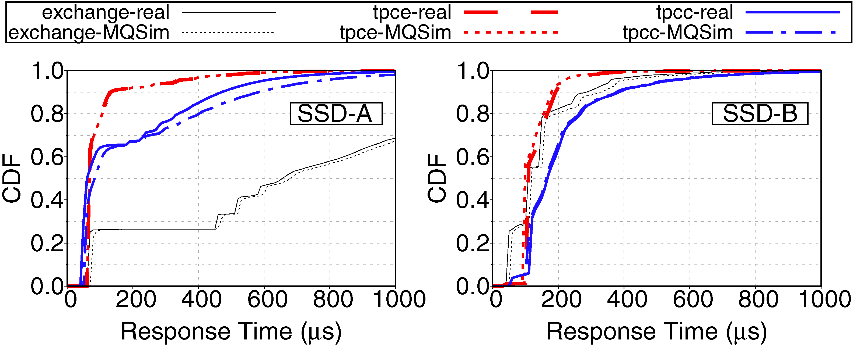
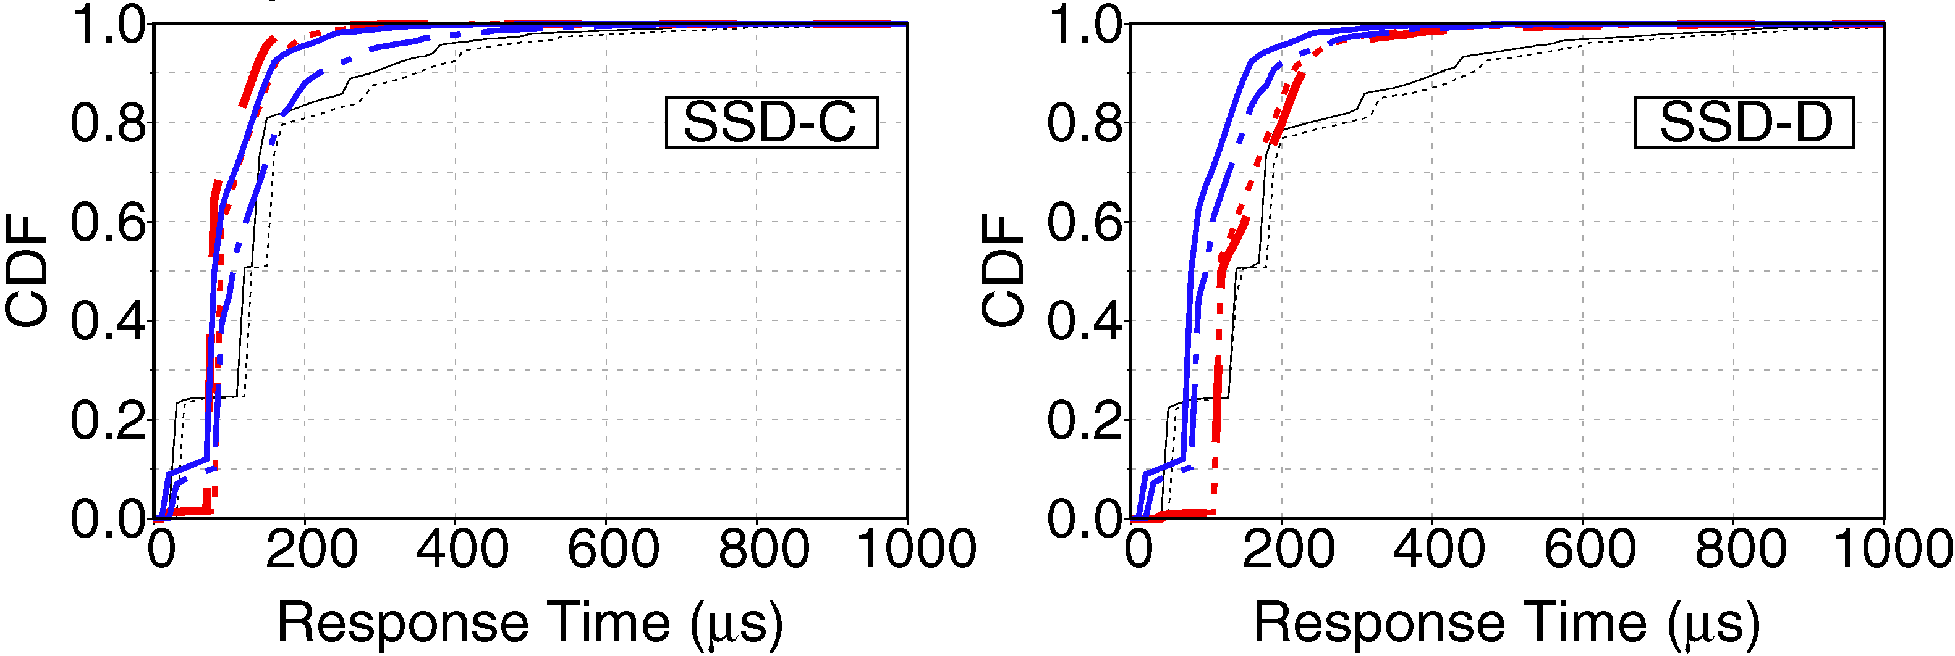
Real Trace Execution Results

Slide 47
Modeling a Modern MQ-SSD with MQSim
MQSim provides a detailed end-to-end latency model
A model for all of the request processing steps in modern SSDs
All of the SSD components are modeled and contributed to the end-to-end latency

Slide 48
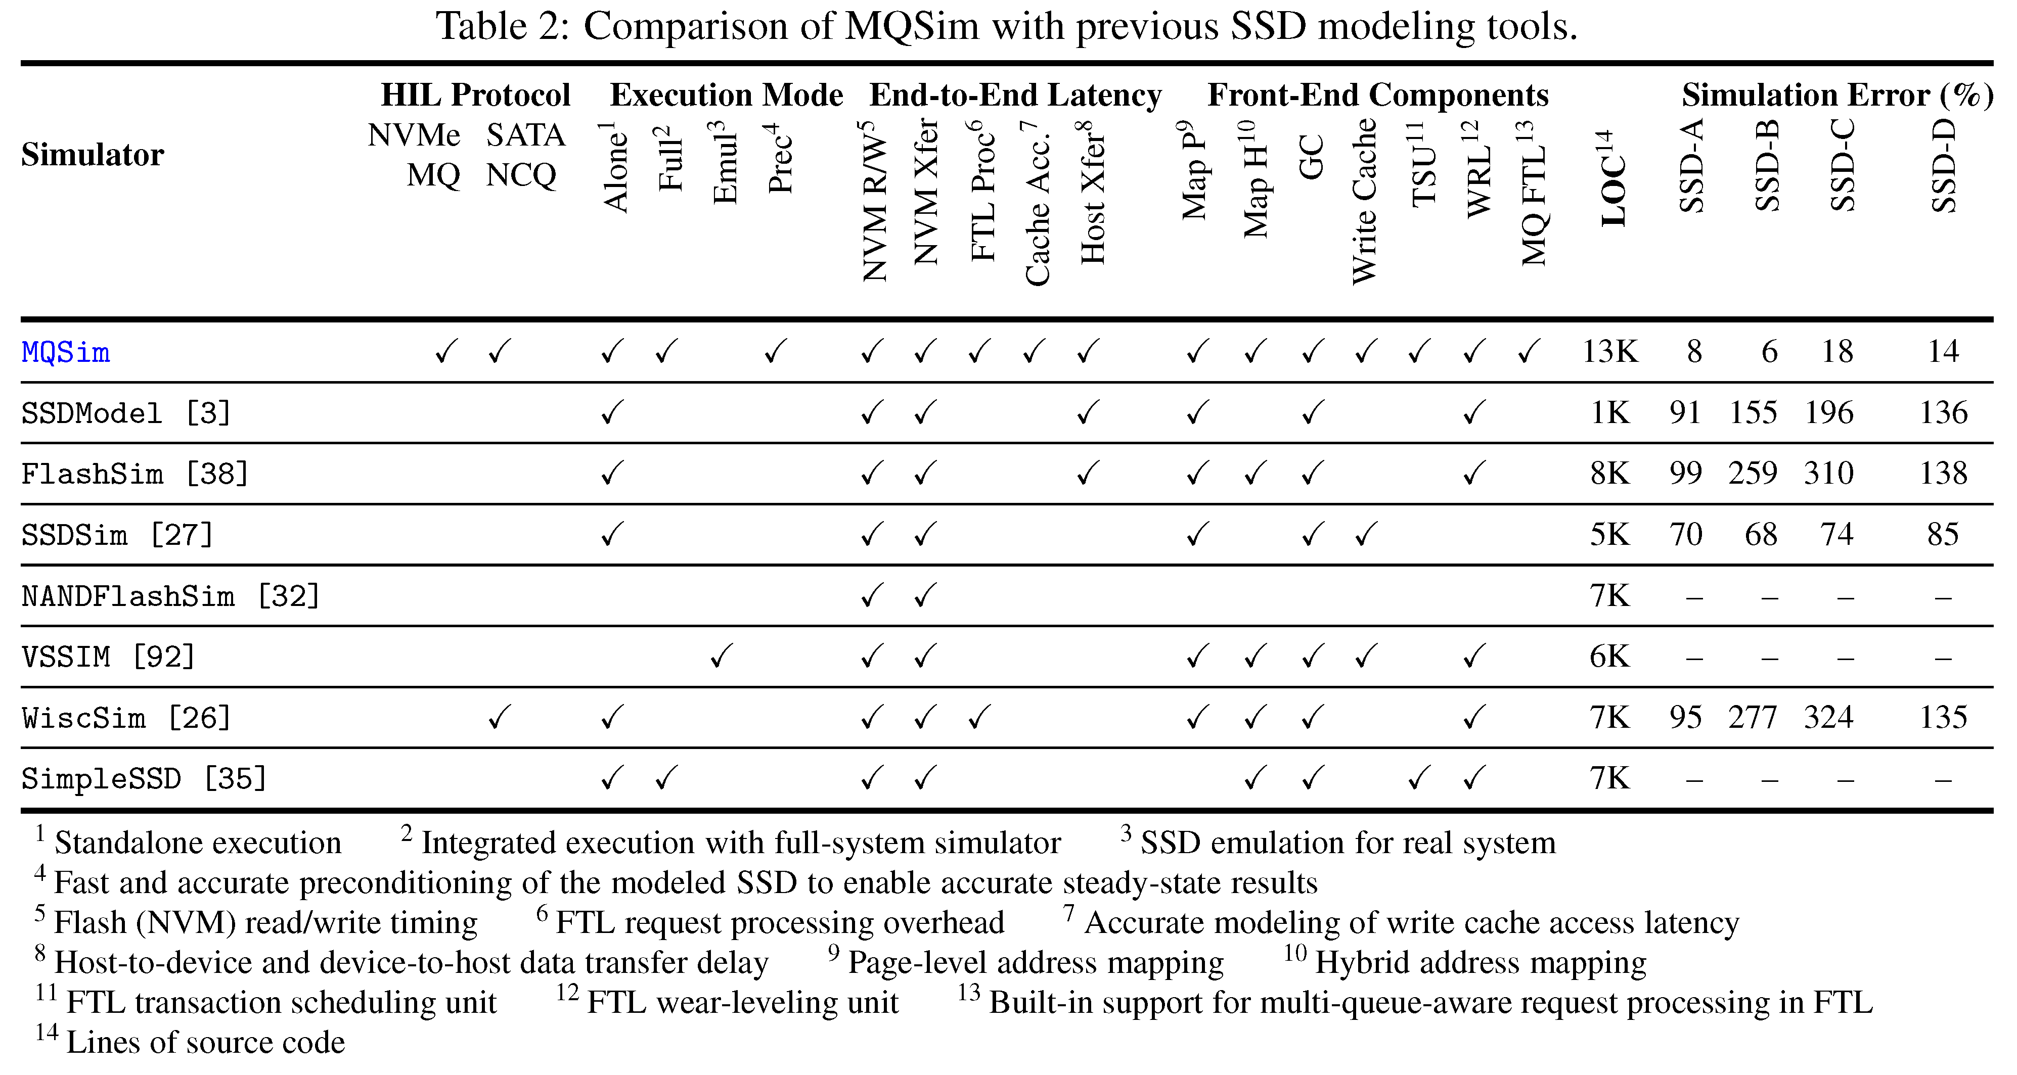
Comparison with Existing Simulators

Slide 49
Fairness Study Methodology

Slide 50
Questions
Do you have any plan to support near data processing?
Yes, we have plans to boost MQSim with support for near data processing
In six months
Major companies are interested in the performance-cost ratio; How can MQSim help them?
MQSim can be augmented with a cost model
Based on the input workload characteristics, MQSim can determine those designs with best performance cost ratio

Slide 51
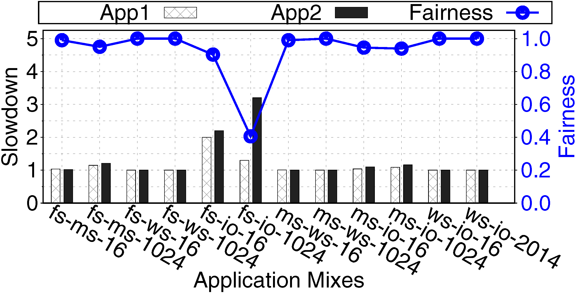
Measuring Impact of Interference on Applications
Execute two-application workload bundles
Applications: file-server (fs), mail-server (ms), web-server (ws), IOzone large file access (io)
Vary queue fetch size (16 vs. 1024) to model fairness control vs. no control
Full methodology in the paper
Compare application slowdown, fairness across entire system
Application-level studies with MQSim capture inter-application interference across the entire stack

Slide 52
Conclusion & Future Work
MQSim: A new simulator that accurately captures the behavior of both modern multi-queue and conventional SATA-based SSDs
MQSim faithfully models a number of critical features absent in existing SSD simulators
MQSim enables a wide range of studies
Future work
Explore the design space of fairness and QoS techniques in MQ-SSDs
Design new management mechanism for modern SSDs based on emerging memory technologies

