Slide 1
P&S Modern SSDs Introduction to MQSim
Rakesh Nadig
Dr. Jisung Park
Prof. Onur Mutlu
ETH Zürich
Spring 2022
8th April 2022

Slide 2

Introduction
Rakesh Nadig
PhD Student @ SAFARI research group since 2021
Senior staff engineer @ Samsung Electronics 2014-2021
MS in Electrical and Computer Engineering from University of California Irvine
Research Area: Memory/Storage Systems | NAND Flash Memory | Near-Storage Processing | Non-Volatile Memory | Machine Learning | Hybrid Memory/Storage Systems
rakesh.nadig@safari.ethz.ch

Slide 3
Outline
Internal Components of a Modern SSD
Introduction to MQSIM
Mechanism
Code structure
Configuring MQSim

Slide 4
Outline
Internal Components of a Modern SSD
Introduction to MQSIM
Mechanism
Code structure
Configuring MQSim

Slide 5
Internal Components of a Modern SSD
Back End: data storage
Memory chips (e.g., NAND flash memory, PCM, MRAM, 3D XPoint)

Slide 6
Internal Components of a Modern SSD
Back End: data storage
Memory chips (e.g., NAND flash memory, PCM, MRAM, 3D XPoint)
Front End: management and control units
Host–Interface Logic (HIL): protocol used to communicate with host

Slide 7
Internal Components of a Modern SSD
Back End: data storage
Memory chips (e.g., NAND flash memory, PCM, MRAM, 3D XPoint)
Front End: management and control units
Host–Interface Logic (HIL): protocol used to communicate with host
Flash Translation Layer (FTL): manages resources, processes I/O requests

Slide 8
Internal Components of a Modern SSD
Back End: data storage
Memory chips (e.g., NAND flash memory, PCM, MRAM, 3D XPoint)
Front End: management and control units
Host–Interface Logic (HIL): protocol used to communicate with host
Flash Translation Layer (FTL): manages resources, processes I/O requests
Flash Channel Controllers (FCCs): sends commands to, transfers data with memory chips in back end

Slide 9
FTL: Managing the SSD’s Resources
Flash writes can take place only to pages that are erased
Perform out-of-place updates (i.e., write data to a different, free page), mark old page as invalid
Update logical-to-physical mapping (makes use of cached mapping table)
Some time later: garbage collection reclaims invalid physical pages off the critical path of latency

Slide 10
FTL: Managing the SSD’s Resources
Flash writes can take place only to pages that are erased
Perform out-of-place updates (i.e., write data to a different, free page), mark old page as invalid
Update logical-to-physical mapping (makes use of cached mapping table)
Some time later: garbage collection reclaims invalid physical pages off the critical path of latency
Write cache decreases resource contention, reduces latency

Slide 11
Outline
Internal Components of a Modern SSD
Introduction to MQSIM
Mechanism
Code structure
Configuring MQSim

Slide 12
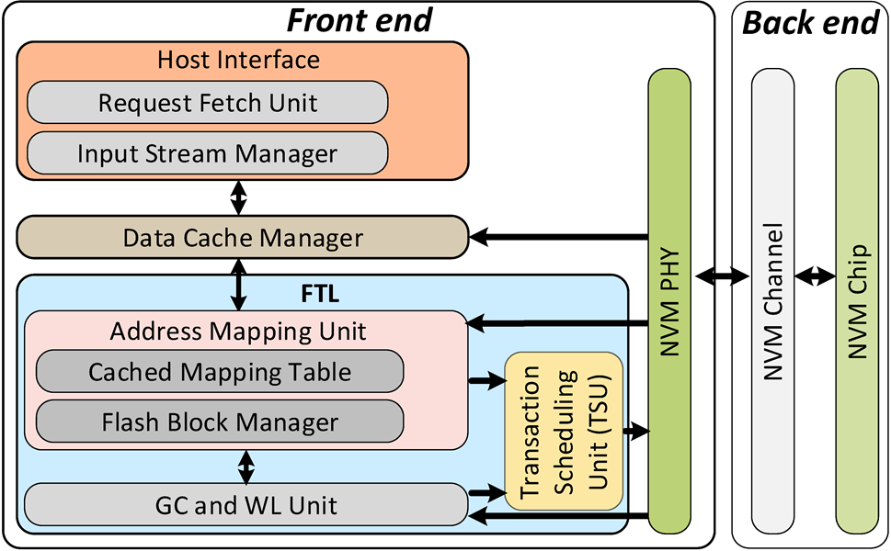
MQSim
Accurately models conventional SATA-based SSDs and modern multi-queue SSDs
Multi-queue protocols
Supports steady-state behavior
with preconditioning
Models end-to-end I/O request latency
Flexible design
Modular components
Ability to support emerging non-volatile memory (NVM) technologies
Open-source release: http://github.com/CMU-SAFARI/MQSim
Written in C++
MIT License
Notes:
SATA: Native Command Queue

Slide 13
Support for Multi-Queue Protocols
Conventional host interface (e.g., SATA)
Designed for magnetic hard disk drives: only thousands of IOPS per device
OS handles scheduling, fairness control for I/O requests
Process 1
Process 2
Process 3
OS Block Layer
Software
I/O Request
Queue
I/O Scheduler
Hardware dispatch queue
SSD Device

Slide 14

Support for Multi-Queue Protocols
Modern host interface (e.g., NVMe)
Takes advantage of SSD throughput: enables millions of IOPS per device
Avoids OS intervention: SSD must perform scheduling, ensure fairness
Process 1
Process 2
Process 3
Hardware
I/O Request
Queue
SSD Device

Slide 15
Complete Model of Request Latency
< 1µs
< 1µs
< 1µs
< 1µs
50-110µs
50-110µs
4µs
20µs
20µs

Slide 16
SSD Back End Model
Three major latency components of the SSD back end
Address and command transfer to the memory chip
Flash memory read/write execution for different NAND technologies (1-bit, 2-bit and 3-bit per cell)
Data transfer to/from memory chips
Die- and plane-level parallelism and advanced command execution
Decouples the sizes of read and write operations
Page-sized write operations
Sub-page read operations

Slide 17
SSD Front End Model
Host-Interface Model
NVMe multi-queue (MQ) and SATA native command queue models for a modern SSD
Different priority classes for host side request queues as per the NVMe standard specification
Data Cache Manager
DRAM-based cache with Least Recently Used (LRU) replacement policy to cache recently accessed data
FTL Components
Address translation unit
Garbage collection and wear-leveling unit
Transaction scheduling unit
Support for multi-flow request processing

Slide 18
Outline
Internal Components of a Modern SSD
Introduction to MQSIM
Mechanism
Code structure
Configuring MQSim

Slide 19
Mechanism
MQSim is a discrete-event based simulator
Each operation performed by MQSim is an event (Command/Address transfer, Read data out etc.)
A red-black (RB) tree maintains the events in the order of their completion times
Each node of the RB tree has a key which indicates the timestamp to finish and, the value is the callback function
For example, at time 5, a data transfer event starts, and the event will execute for another 5 time-units. The simulator will insert a node <5 + 5, callback> into the tree
At each simulation cycle, the simulator will find the node with the smallest time (value), set the timer to that timestamp, execute the callback function
MQSim supports Real disk traces (e.g., MSR Cambridge Block I/O Traces, YCSB etc.) and Synthetic workloads (generated by the simulation engine)

Slide 20
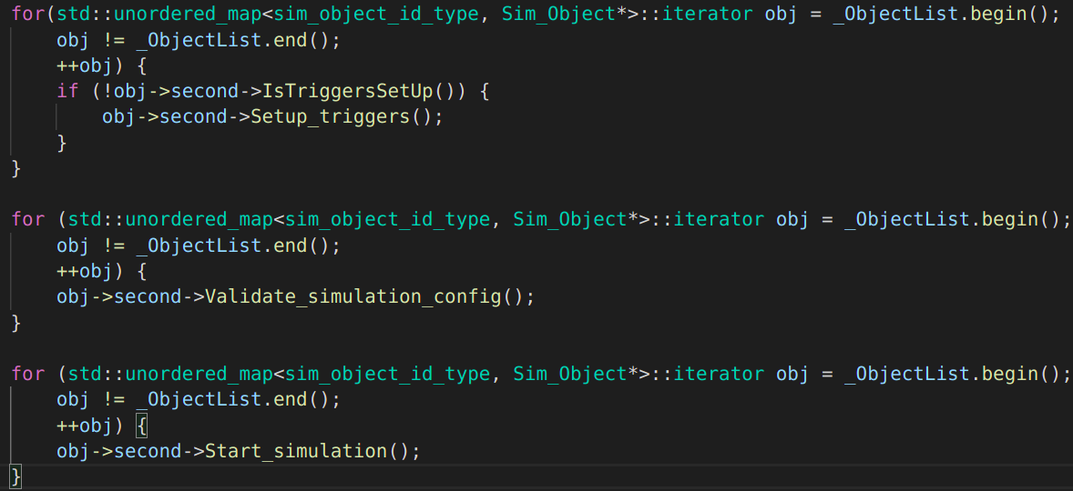
Initialization
MQSim components (FTL, SSD Device, TSU etc.) are represented as objects and maintained in a map
The objects in the map are iterated through and corresponding functions are executed
Each object maintains their own version of setup_triggers, start_simulation etc.

Slide 21
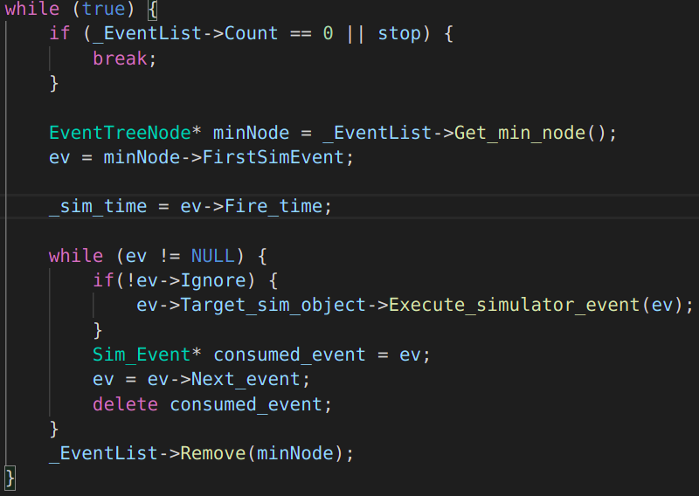
Simulation Engine
Engine.cpp/start_simulation
The callback function is Execute_simulator_event

Slide 22
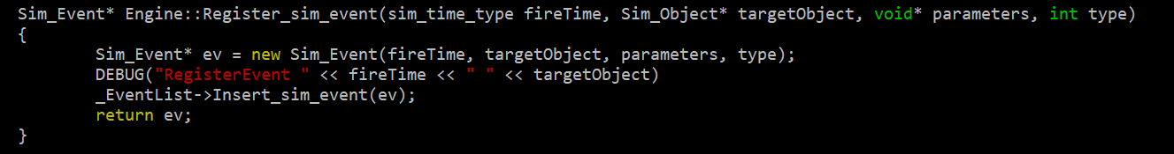
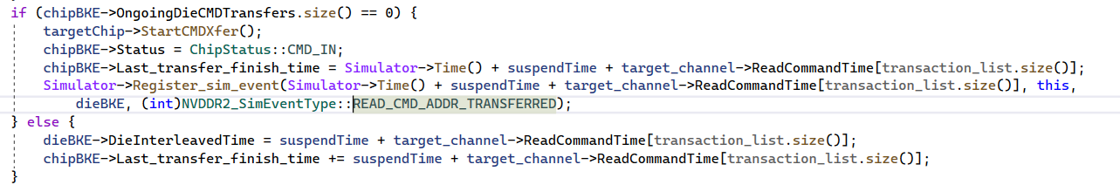
Mechanism of MQSim
A simulator event is registered using the Register_sim_event function
Example: An event is registered for sending the Read command and address

Slide 23
Outline
Internal Components of a Modern SSD
Introduction to MQSIM
Mechanism
Code structure
Configuring MQSim

Slide 24
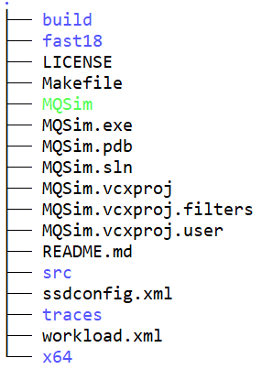
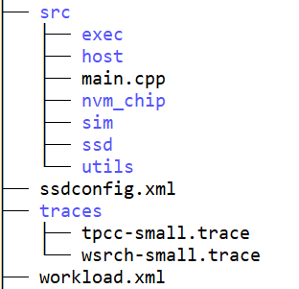
Code Structure
ssdconfig.xml – configuration file that contains the preferred SSD configuration
workload.xml – workload definition file
traces – folder in which the trace files have to be placed
src/sim – contains the files related to the simulation engine
src/nvm_chip – code related to NVM chip. Contains files for die, plane, block and page
src/ssd – contains files related to Flash Translation Layer and Transaction Scheduling Unit
src/host – files related to trace and synthetic workloads, PCIe etc.

Slide 25
Code Structure
Code flow
Host -> Data Cache -> Address Translation Unit -> TSU -> Flash Controller -> NVM_Chip
Some important functions:
Data Cache Manager: process_new_user_requests()
Address Mapping Unit: translate_lpa_to_ppa_and_dispatch()
Transaction Scheduling Unit: Schedule()
Flash Controller: send_command_to_chip()

Slide 26
Outline
Internal Components of a Modern SSD
Introduction to MQSIM
Mechanism
Code structure
Configuring MQSim

Slide 27
SSD Configuration File (ssdconfig.xml)
Host parameters
PCIe_Lane_Bandwidth: the PCIe bandwidth per lane in GB/s
PCIe_Lane_Count: the number of PCIe lanes
Device Parameters
HostInterface_Type: the type of host interface. Range = {NVME, SATA}
IO_Queue_Depth: the length of the host-side I/O queue.
Data_Cache_Capacity: the size of the DRAM data cache in bytes
Ideal_Mapping_Table: if mapping is ideal, all the mapping entries are found in the DRAM and there is no need to read mapping entries from flash
Transaction_Scheduling_Policy: the transaction scheduling policy that is used in the SSD back end. Range = {OUT_OF_ORDER as defined in the Sprinkler (Jung et.al., HPCA 2014), PRIORITY_OUT_OF_ORDER which implements OUT_OF_ORDER and NVMe priorities}

Slide 28
SSD Configuration File (ssdconfig.xml)
Device Parameters
Flash_Channel_Count: the number of flash channels in the SSD back end
Flash_Channel_Width: the width of each flash channel in byte
Channel_Transfer_Rate: the transfer rate of flash channels in the SSD back end in MT/s
Chip_No_Per_Channel: the number of flash chips attached to each channel in the SSD back end
NAND Parameters
Flash_Technology: Range = {SLC, MLC, TLC}.
Page read latency for LSB, CSB and MSB pages (in nanoseconds)
Page program latency (in nanoseconds)
Block_Erase_Latency: erase latency in nanoseconds
Block_PE_Cycles_Limit: the PE limit of each flash block

Slide 29
SSD Configuration File (ssdconfig.xml)
NAND Parameters
Die_No_Per_Chip: the number of dies in each flash chip
Plane_No_Per_Die: the number of planes in each die
Block_No_Per_Plane: the number of flash blocks in each plane
Page_No_Per_Block: the number of physical pages in each flash block
Page_Capacity: the size of each physical flash page in bytes
Page_Metadata_Capacity: the size of the metadata area of each physical flash page in bytes

Slide 30
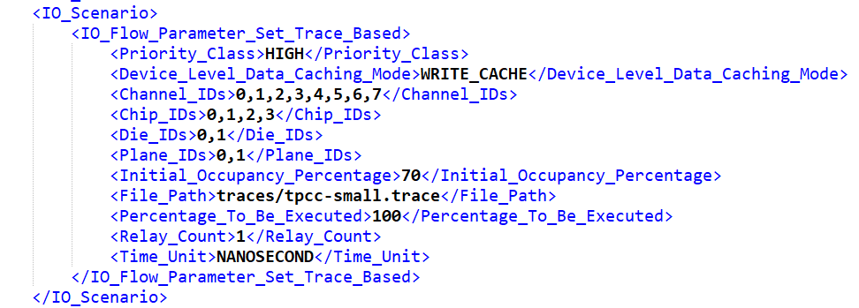
Trace-based workload configuration

Slide 31
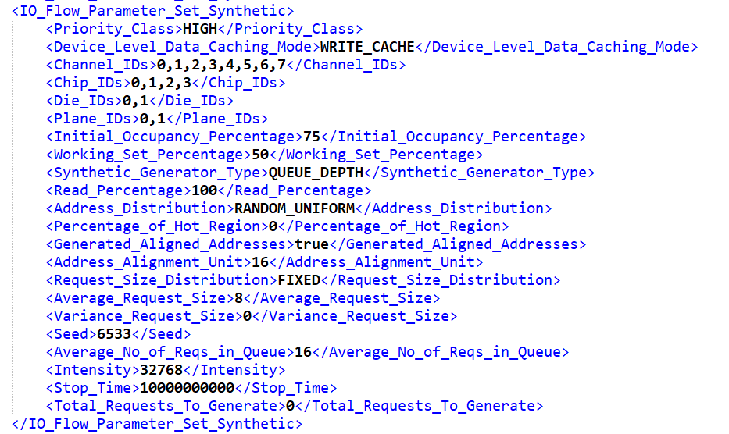
Synthetic workload configuration

Slide 32
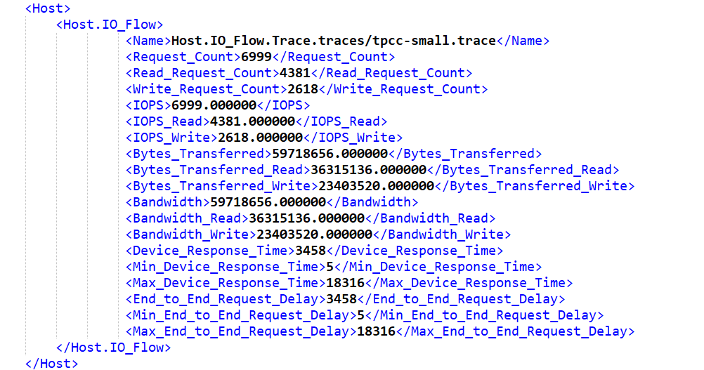
MQSim Output File

Slide 33
MQSim usage
Linux
$ make
$ ./MQSim -i <SSD Configuration File> -w <Workload Definition File>
Windows
Open the MQSim.sln solution file in MS Visual Studio 2017 or later.
Set the Solution Configuration to Release (it is set to Debug by default).
Compile the solution.
Run the generated executable file (e.g., MQSim.exe) either in command line mode or by clicking the MS Visual Studio run button. Please specify the paths to the files containing the 1) SSD configurations, and 2) workload definitions.
$ MQSim.exe -i <SSD Configuration File> -w <Workload Definition File>

Slide 34
P&S Modern SSDs Introduction to MQSIM
Rakesh Nadig
Dr. Jisung Park
Prof. Onur Mutlu
ETH Zürich
Spring 2022
8th April 2022

Slide 35
BACKUP SLIDES

Slide 36
High-Performance Steady-State Model
SSDs should be evaluated in steady state
Fresh, out-of-the-box (FOB) device unlikely to perform garbage collection
Write cache not warmed up for an FOB device
Many previous SSD studies incorrectly simulate FOB devices
Difficult to reach steady state in most simulators
Very slow (e.g., SSDSim execution time increases by up to 80x)
Widely-used traces aren’t large enough for proper warm-up

Slide 37
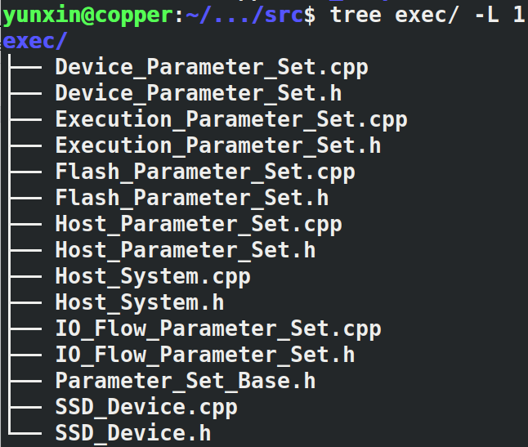
Exec/
exec/: most of the files here are easy to read and understand, treat it as a reference book, not something you need to totally understand at a first glance.

Slide 38
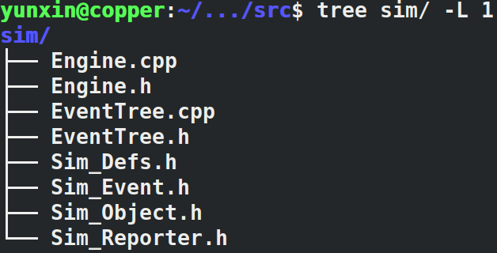
Sim/
sim/: most of the files here are also easy to read and understand, some simulator related definitions could also appear here in Sim_Defs.h.
The most important feature of this subdirectory is implementing the RB tree mentioned above.

Slide 39
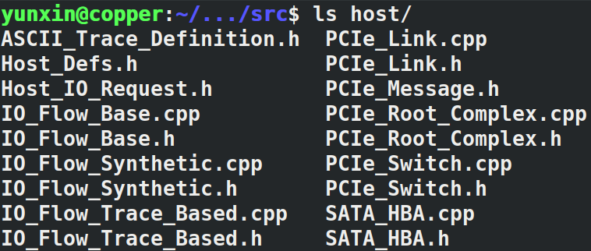
Host/
host/: Definitions of host related objects.
IO_Flow_* is used to generate request, can be ignored as of now.
Note the order: Host -> PCIe_Root_Complex -> PCIe_Link -> PCIe_Switch

Slide 40
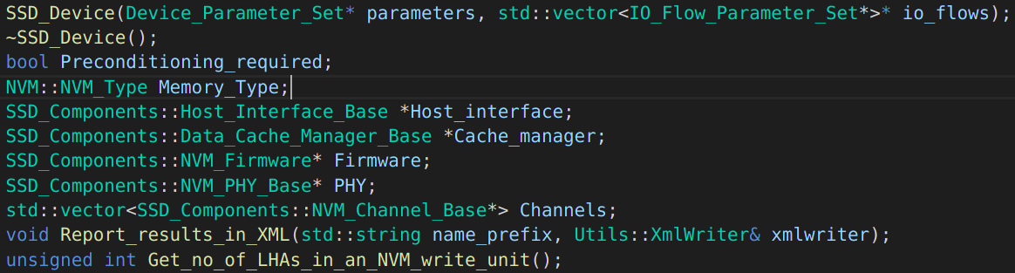
SSD/
ssd/: This is the place where we simulate a SSD(at the device level, not the flash chip level).
The most important subfolder you will want to explore
What does a SSD compose of?

Slide 41
SSD/
What does a SSD compose of?
Host_Interface: interact between the host.
Cache_Manager: manager the cache
Firmware: FTL(SSD controller)
TSU: Transaction Scheduling Unit
Flash_Block_Manager
Address_Mapping_Unit
GC_and_WL_unit: unit for garbage collection and wear leveling
PHY: channel controller
Actual Channels

Slide 42
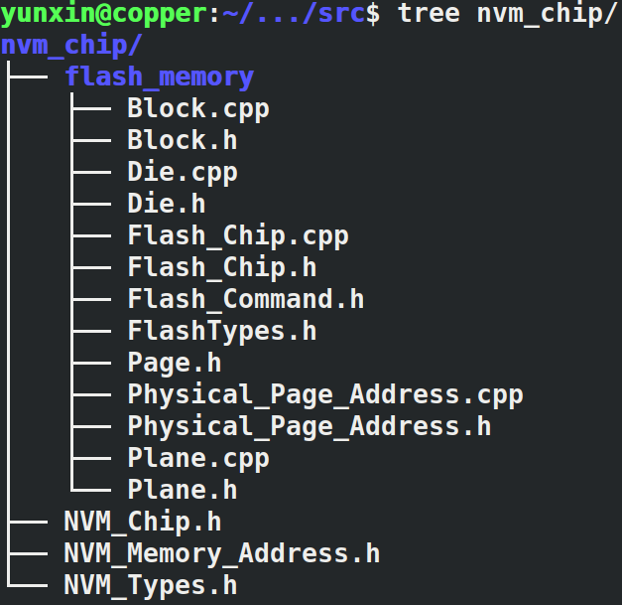
NVM_CHIP/
Data Structures for hierarchical nvm_chip such as page, block, die, plane…
Most are easily to read and understand.

Slide 43
In summary
If you want to find definitions, go to exec/ or sim/Sim_Defs.h or Ssd/Ssd_Defs.h or Host/Host_Defs.h
SSD is composed of the following:
FTL
TSU, AMU, GC_WL, FBM
Cache_Manager
Channels
Channel Controller
Host_Interface

Slide 44
Important workload definitions
Parameter involved in defining an IO flow
Trace Based:
Channel ID: The ID of channels that the trace used
Synthetic Workload:
Synthetic Generator type: generate the IO flow based on the bandwidth on based on the IO queue depth
Address distribution: The distribution of the address the request goes to.
Request_Size_Distribution: The distribution of the request size it generated
Bandwidth: Average bandwidth of the IO requests generated(for the bandwidth mode)
Average IO queue depth: Average number of request in the host-side queues(for the IO queue depth mode)

