Slide 1
Recitation 2
Sep 4, 2026
Yiliang Liang

Slide 2
Announcements
HW2 will be released later today.

Slide 3
Goals
Use semantics rules to derive behaviors of a program.
Do an induction proof for the equivalence between small-step and big-step semantics

Slide 4
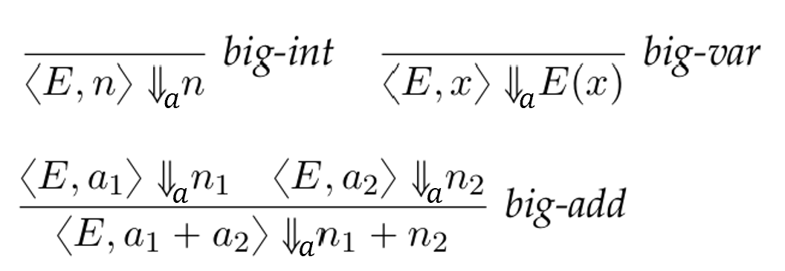
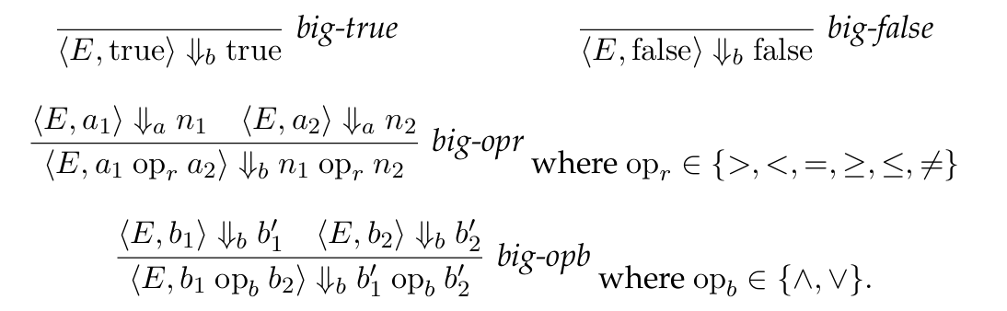




WHILE language big-step rules

