Slide 1
Lecture 3
On the power/limits of dynamic symbolic execution
(from “Higher-order test generation”, Patrice Godefroid PLDI 2011)
Powering up DSE with Satisfiability Modulo Theories
Thanks to Patrice Godefroid, Leonardo de Moura

Slide 3
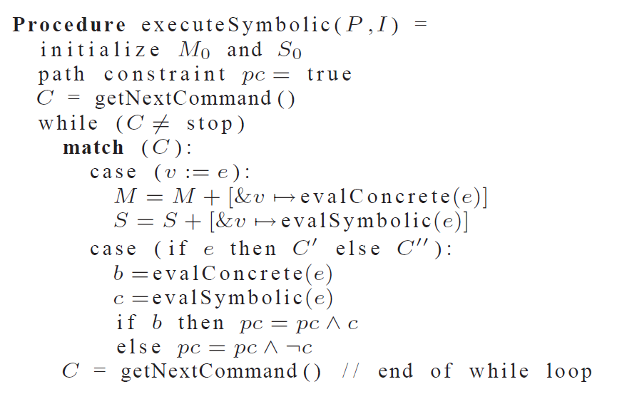

Slide 4
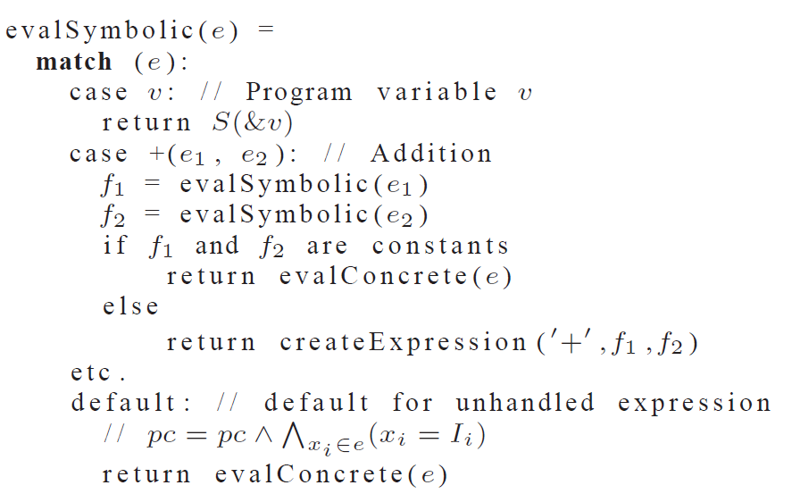

Slide 5
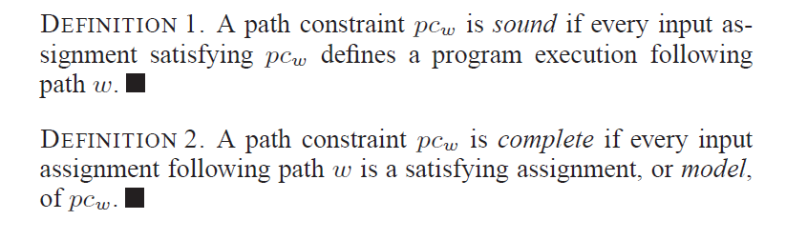

Slide 9
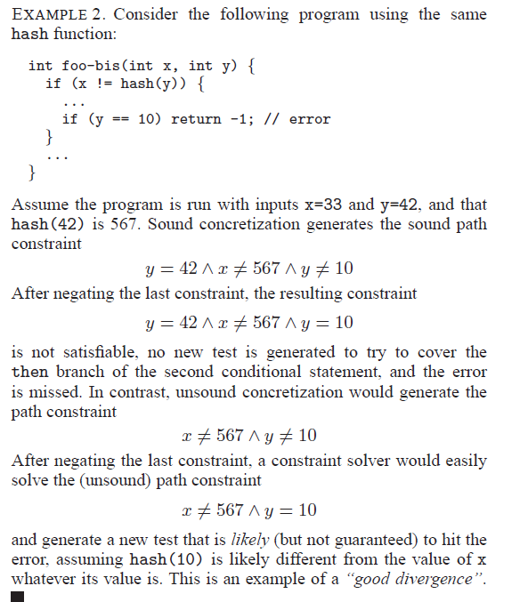

Slide 10
Satisfiability Modulo Theories (SMT)
Is formula F satisfiable modulo theory T ?
SMT solvers have specialized algorithms for T

Slide 11
Satisfiability Modulo Theories (SMT)
b + 2 = c and f(read(write(a,b,3), c-2)) ≠ f(c-b+1)

Slide 12
Satisfiability Modulo Theories (SMT)
b + 2 = c and f(read(write(a,b,3), c-2)) ≠ f(c-b+1)
Arithmetic

Slide 13
Satisfiability Modulo Theories (SMT)
b + 2 = c and f(read(write(a,b,3), c-2)) ≠ f(c-b+1)
Array Theory
Arithmetic

Slide 14
Satisfiability Modulo Theories (SMT)
b + 2 = c and f(read(write(a,b,3), c-2)) ≠ f(c-b+1)
Uninterpreted Functions
Array Theory
Arithmetic

Slide 15
Satisfiability Modulo Theories (SMT)
b + 2 = c and f(read(write(a,b,3), c-2)) ≠ f(c-b+1)
Substituting c by b+2

Slide 16
Satisfiability Modulo Theories (SMT)
b + 2 = c and f(read(write(a,b,3), b+2-2)) ≠ f(b+2-b+1)
Simplifying

Slide 17
Satisfiability Modulo Theories (SMT)
b + 2 = c and f(read(write(a,b,3), b)) ≠ f(3)

Slide 18
Satisfiability Modulo Theories (SMT)
b + 2 = c and f(read(write(a,b,3), b)) ≠ f(3)
Applying array theory axiom
forall a,i,v: read(write(a,i,v), i) = v

Slide 19
Satisfiability Modulo Theories (SMT)
b + 2 = c and f(3) ≠ f(3)
Inconsistent

Slide 20

SMT : Basic Architecture
SAT
Theory
Solvers
SMT
Equality + UF
Arithmetic
Bit-vectors
…
Case Analysis

Slide 21
DPLL
The Davis–Putnam–Logemann–Loveland (DPLL) algorithm tries to find a satisfying assignment for logic formulae in conjunctive normal form (CNF).
DPLL is a complete, backtracking-based search algorithm for deciding the satisfiability of propositional logic formulae in conjunctive normal form.

Slide 22
DPLL (abstract view)
evolving
M | F
Partial model
Set of clauses

Slide 23
DPLL (abstract view)
Guessing
p | p ∨ q, ¬q ∨ r
p, ¬q | p ∨ q, ¬q ∨ r

Slide 24
DPLL (abstract view)
Deducing
p | p ∨ q, ¬p ∨ s
p, s| p ∨ q, ¬p ∨ s

Slide 25
DPLL (abstract view)
Backtracking
p, ¬s, q | p ∨ q, s ∨ q, ¬p∨ ¬q
p, s| p ∨ q, s ∨ q, ¬p∨ ¬q

Slide 26
SAT + Theory solvers
Basic Idea
x ≥ 0, y = x + 1, (y > 2 ∨ y < 1)
Abstract (aka “naming” atoms)
p₁, p₂, (p₃ ∨ p₄)
p₁ ≡ (x ≥ 0), p₂ ≡ (y = x + 1),
p₃ ≡ (y > 2), p₄ ≡ (y < 1)

Slide 27
SAT + Theory solvers
Basic Idea
x ≥ 0, y = x + 1, (y > 2 ∨ y < 1)
Abstract (aka “naming” atoms)
p₁, p₂, (p₃ ∨ p₄)
p₁ ≡ (x ≥ 0), p₂ ≡ (y = x + 1),
p₃ ≡ (y > 2), p₄ ≡ (y < 1)
SAT
Solver

Slide 28
SAT + Theory solvers
Basic Idea
x ≥ 0, y = x + 1, (y > 2 ∨ y < 1)
Abstract (aka “naming” atoms)
p₁, p₂, (p₃ ∨ p₄)
p₁ ≡ (x ≥ 0), p₂ ≡ (y = x + 1),
p₃ ≡ (y > 2), p₄ ≡ (y < 1)
SAT
Solver
Assignment
p₁, p₂, ¬p₃, p₄

Slide 29
SAT + Theory solvers
Basic Idea
x ≥ 0, y = x + 1, (y > 2 ∨ y < 1)
Abstract (aka “naming” atoms)
p₁, p₂, (p₃ ∨ p₄)
p₁ ≡ (x ≥ 0), p₂ ≡ (y = x + 1),
p₃ ≡ (y > 2), p₄ ≡ (y < 1)
SAT
Solver
Assignment
p₁, p₂, ¬p₃, p₄
x ≥ 0, y = x + 1,
¬(y > 2), y < 1

Slide 30
SAT + Theory solvers
Basic Idea
x ≥ 0, y = x + 1, (y > 2 ∨ y < 1)
Abstract (aka “naming” atoms)
p₁, p₂, (p₃ ∨ p₄)
p₁ ≡ (x ≥ 0), p₂ ≡ (y = x + 1),
p₃ ≡ (y > 2), p₄ ≡ (y < 1)
SAT
Solver
Assignment
p₁, p₂, ¬p₃, p₄
x ≥ 0, y = x + 1,
¬(y > 2), y < 1
Unsatisfiable
x ≥ 0, y = x + 1, y < 1
Theory
Solver

Slide 31
SAT + Theory solvers
Basic Idea
x ≥ 0, y = x + 1, (y > 2 ∨ y < 1)
Abstract (aka “naming” atoms)
p₁, p₂, (p₃ ∨ p₄)
p₁ ≡ (x ≥ 0), p₂ ≡ (y = x + 1),
p₃ ≡ (y > 2), p₄ ≡ (y < 1)
SAT
Solver
Assignment
p₁, p₂, ¬p₃, p₄
x ≥ 0, y = x + 1,
¬(y > 2), y < 1
New Lemma
¬p₁∨¬p₂∨¬p₄
Unsatisfiable
x ≥ 0, y = x + 1, y < 1
Theory
Solver

Slide 32
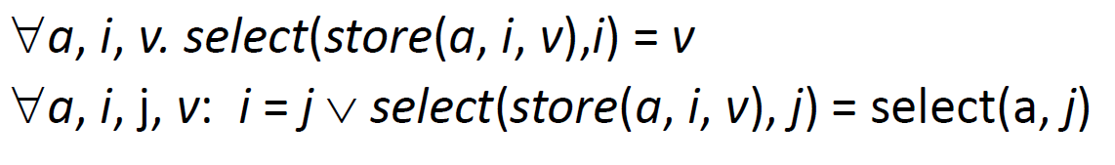
Array Theory
c:\Program Files (x86)\XEmacs\XEmacs-21.4.22\i586-pc-win32\

Slide 33
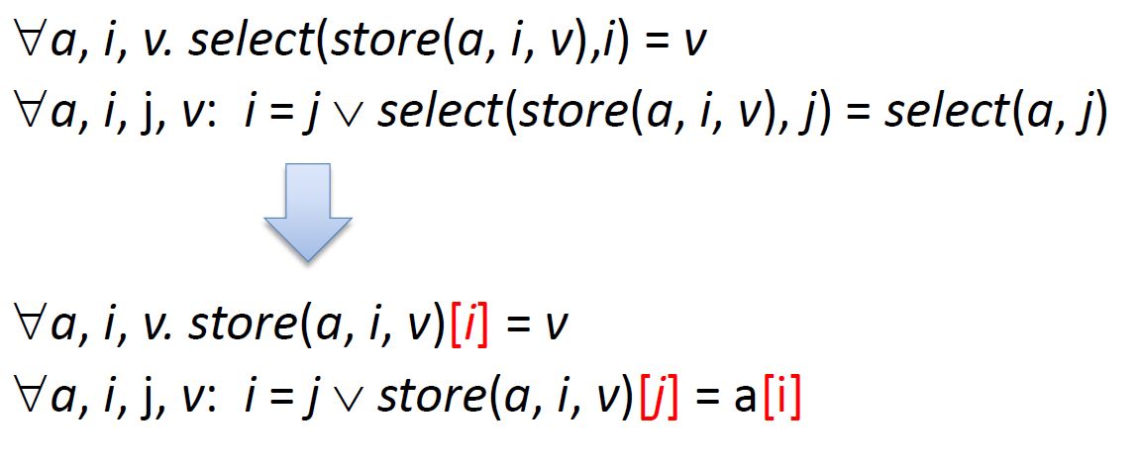
Array Theory: a more familiar notation
c:\Program Files (x86)\XEmacs\XEmacs-21.4.22\i586-pc-win32\

Slide 34
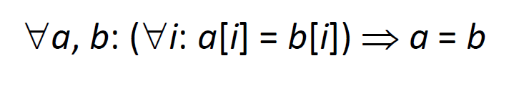
Extentional Array Theory

Slide 35
Arrays are actually “maps”
We have arrays from D to R
D does not need to be the Integers

Slide 36
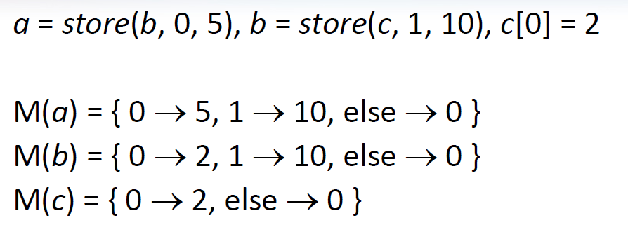
Models for arrays are “finite graphs”

Slide 37
Z3 API for Arrays
Array(name,dom,range)
Select(a,i)
Update(a,i,v)

Slide 38
Assignment
Use Z3’s array theory to support Python’s dictionary (dict), modelling the following operations
Length: __length__(self)
Get: __getitem__(self,key)
Set: __setitem__(self,key,value)
Lookup: __contains__(self,key)
Should support SymbolicInteger as a key and a value
What about?
Delete: __delitem__(self,key)

