Slide 1
Fundamentals of Programming & Computer Science CS 15-112
Sets & Dicts
Dr. Hend Gedawy

Slide 2
Data Structures
A data structure is a way of organizing and storing data in a computer so that it can be accessed and manipulated efficiently
Data Structures seen so far?
Lists
Tuples
Today:
Sets
Dictionaries

Slide 3
Motivational Example
Write the function uniqueWords(text) that takes a string text containing words separated by spaces and returns a list of unique words in the order they first appear in the text.

Slide 4
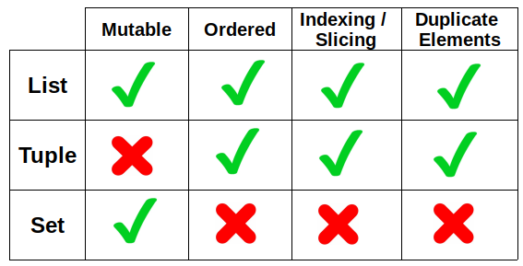
Sets Definition
A set is an unordered collection of unique elements.
Compared to other data structures

Slide 5

Sets Syntax

Slide 6

Sets vs Lists Efficiency

Slide 7
Inserting Elements in a List
LIST
Insert
4
16
74
1
24
39
39
24
1
74
16
4

Slide 8

Inserting Elements in Sets & Hashing
Insertion Steps:
1) Hash (find the bucket)
2) Once in the bucket, perform Equality Testing
Compare the element to each existing element in the bucket
If it doesn’t exist, add it
BUCKETS
0
1
Hash Function
2
def hash(n):
Return n%10
3
4
16
74
1
24
39
4
5
6
Collision
7
8
9

Slide 9
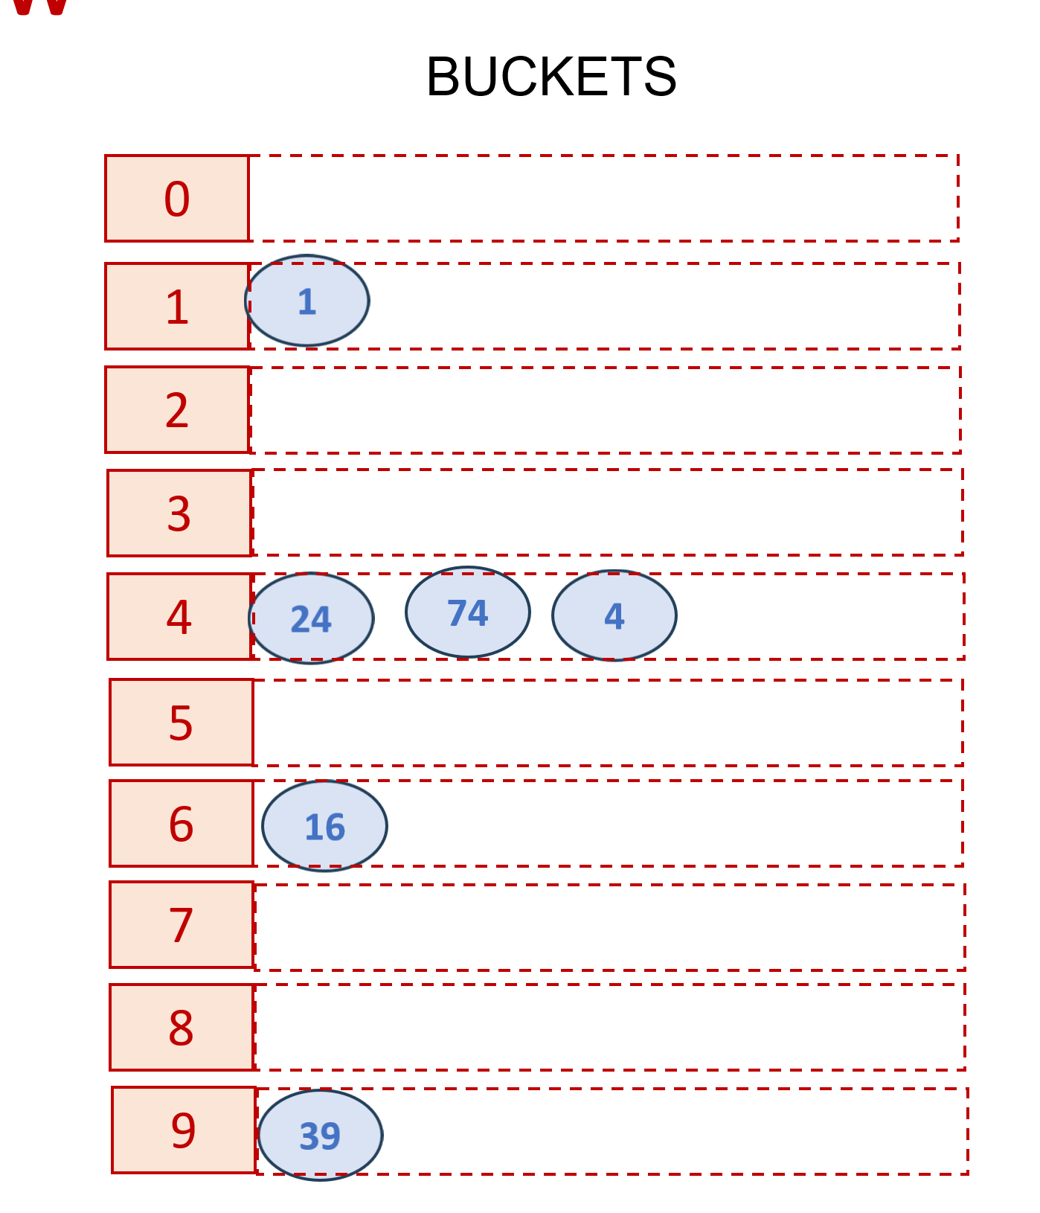
If I try to Insert a duplicate
Insertion Steps:
1) Hash (find the bucket)
2) Once in the bucket, perform Equality Testing
Compare the element to each existing element in the bucket
If it doesn’t exist, add it
Hash Function
Insert
def hash(n):
Return n%10
74

Slide 10
Looking Up an Element in a List
LIST
Lookup
4
39
24
1
74
16
4
My Search Space
Equality Testing
Compare the value to each existing element in the list.
If it found, return it

Slide 11
Looking Up an Element in a Set
Lookup Steps:
1) Hash (find the bucket)
2) Once in the bucket, perform Equality Testing
Compare the value to each existing element in the bucket
If found, return it
Hash Function
Lookup
def hash(n):
Return n%10
4

Slide 12
Looking Up Lists Vs Sets (Search Space)
LIST
39
24
1
74
16
4
All Elements
Lookup
Target
Hash Target value
24
74
4
Elements Inside the bucket with the same hash value
SET

Slide 13

Sets & Bad Hash Functions
BUCKETS
0
1
What If I have a bad hash Function that hashes all elements to one bucket
Hash Function
2
def hash(n):
Return n%10
3
4
39
24
1
74
16
4
5
6
7
8
9

Slide 14
Sets & Bad Hash Functions
Lookup Steps:
1) Hash (find the bucket)
2) Once in the bucket, perform Equality Testing
Compare the value to each existing element in the bucket
If found, return it
BUCKETS
0
1
Hash Function
2
Lookup
def hash(n):
Return n%10
3
4
4
39
24
1
74
16
4
5
This is as inefficient as Lists…
6
7
8
9

Slide 15
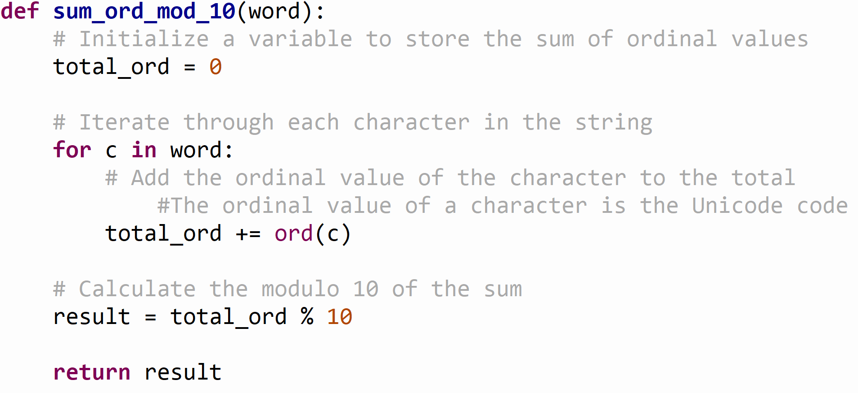
Example Hash Function
Given a string element.
Sums the ordinal values of all the characters in that string
Returns (SUM%10)

Slide 16
More Sets Syntax

Slide 17
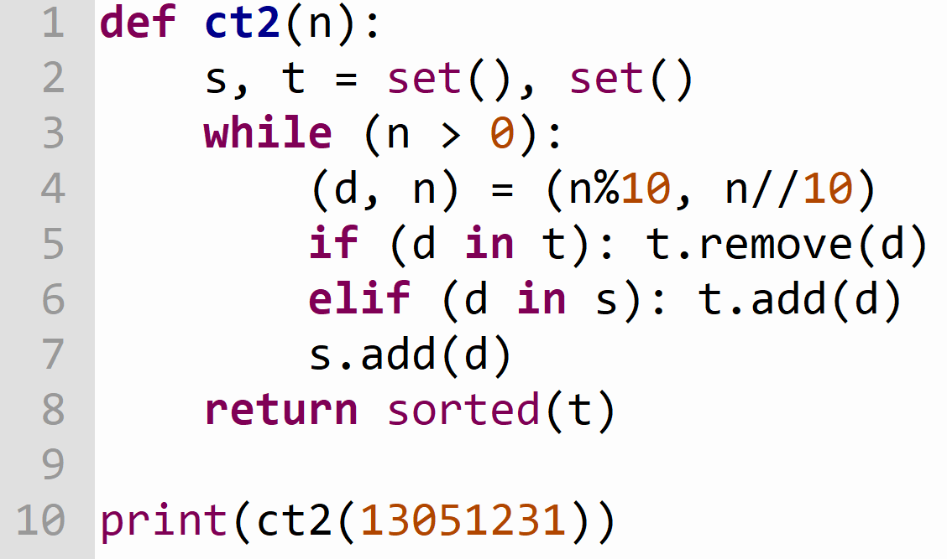
Sets Practice

Slide 18
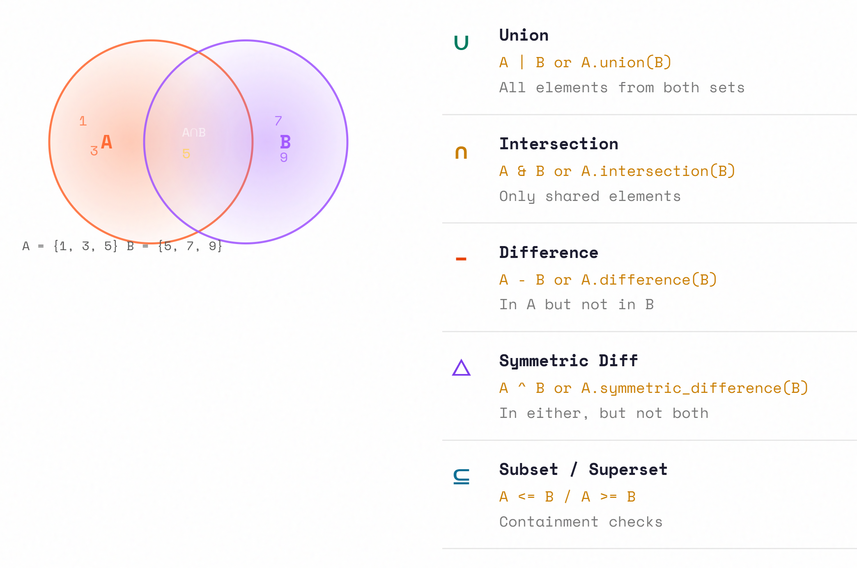
Sets for Set Theory Functions

Slide 19
Set Theory Operations

Slide 20
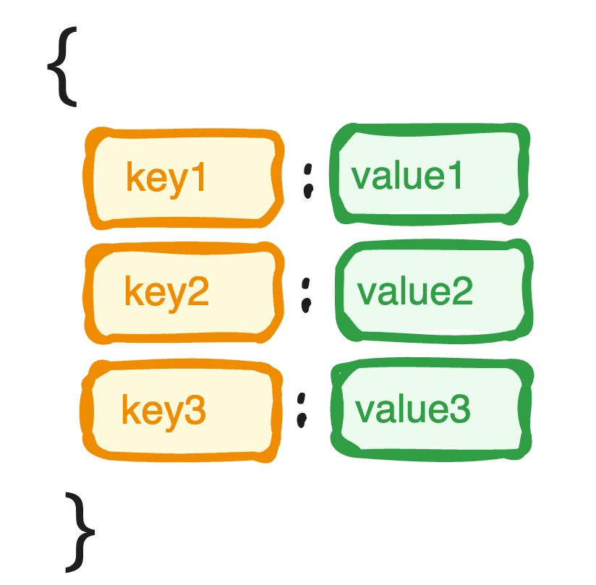
Dictionary

Slide 21
Motivational Example
Write the function calculate_grade_distribution(grades) that takes a list of grades (integers) and maps each grade to its frequency.
In other words, the function returns a list of tuples, where each tuple contains (grade, frequency) representing each unique grade and how many times it appears.

Slide 22

Dicts Definition
Dictionaries are associative data structures that store key-value pairs
A key can only contain immutable data types:
int, float, bool, str, tuple
A value can be of any type
key $↦$ value

Slide 23
Dicts Definition
average_temperatures = {
1: 5, # January
2: 6, # February
3: 10, # March
4: 15, # April
5: 20, # May
6: 25, # June
7: 28, # July
8: 27, # August
9: 23, # September
10: 17, # October
11: 10, # November
12: 6 # December
}
populations = {
"Japan": 125,
"India": 1408,
"China": 1440,
"Bangladesh": 169,
"Brazil": 214,
"Nigeria": 206,
"Ethiopia": 126
"Russia": 143,
"United States": 331,
"Mexico": 128,
}
Collection of pairs of:
<key>, <value>

Slide 24

Recap
Sets
A set is an unordered collection of unique and immutable elements.
Why are sets more efficient than lists?
Hashing in Sets: Hash Function, Hash Values
Creating Sets: set(), set(ierable), {1,2,3}
Set Methods: .add(v), .update(iterable), .discard(v), .remove(v) .clear()
Iterating over sets & membership
Set Theory Functions:
.superset(s2), .subset(s2), .union(s2), .intersection(s2), .difference(s2), .symmetric_difference(s2)
Dicts
Dictionaries are associative data structures that store key-value pairs
Keys are unique and immutable.
Values can be anything
Elements are also hashed based on keys.
That’s why dicts are also efficient
Creating Dicts: dict(), {}, {1:’A’, 2:’B’}
Adding/Modifying elements: d[k] = v
Similar to indexing in lists, but here you index using keys, not positions

Slide 25
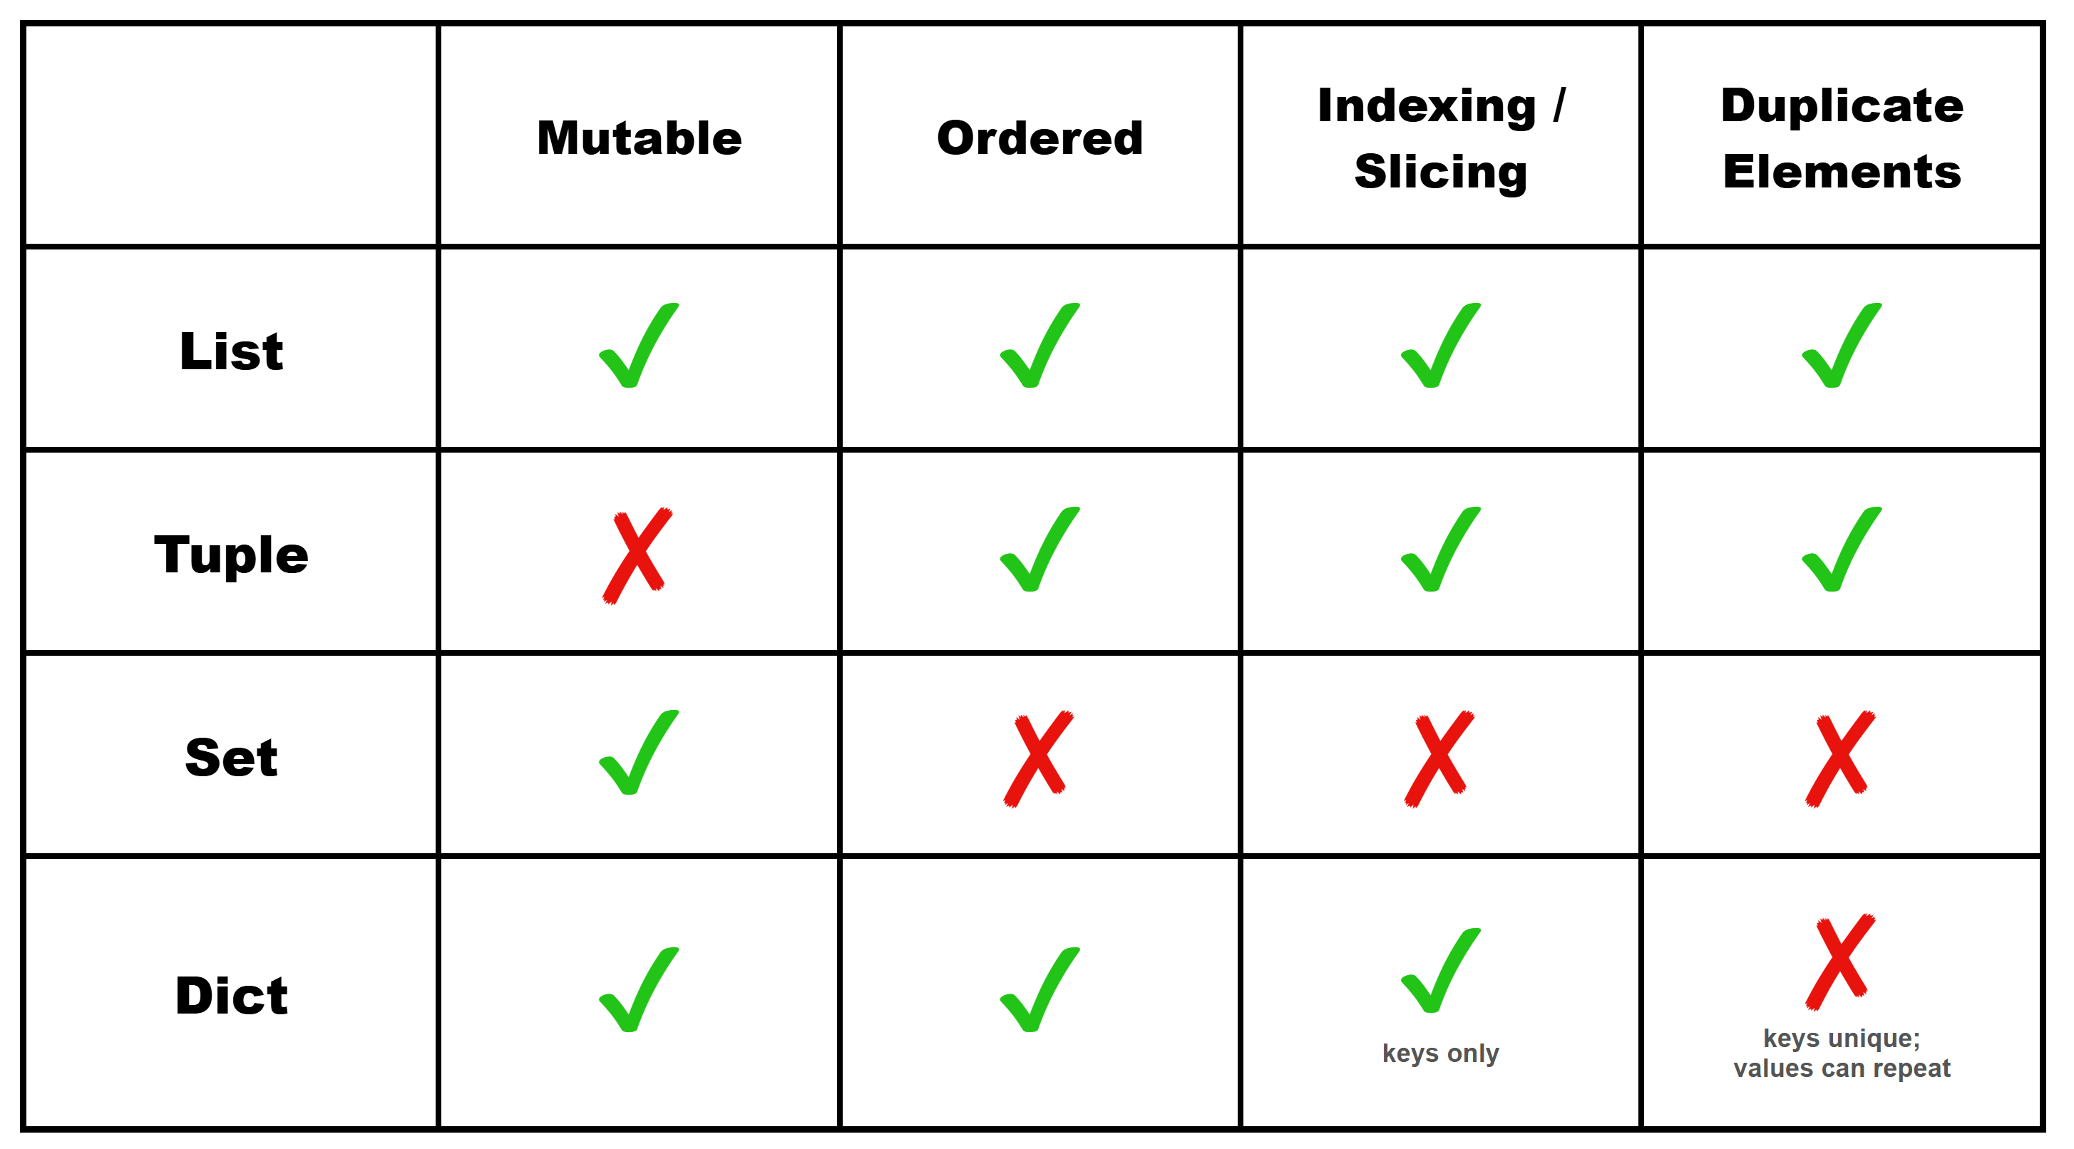
Dicts Definition
Compared to other Data Structures

Slide 26
Dicts Syntax

Slide 27
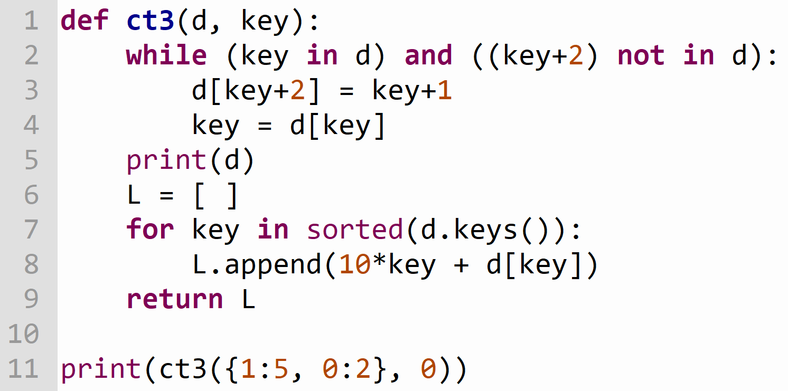
Dicts Practice

Slide 28
More
Dicts Syntax

