Slide 1
Fundamentals of Programming & Computer Science CS 15-112
Efficiency
Dr. Hend Gedawy

Slide 2

There are Many Ways to Solve Any Given Problem
Some are Better or more Efficient than Others !

Slide 3

What is Efficiency?
Efficiency is a measure of how much of a resource an algorithm uses!
Time
Space

Slide 4
What is Efficiency?
Efficiency is a measure of how much of a resource an algorithm uses!
Time

Slide 5


Why Care About Time Efficiency?
An extra half-second in search page generation time
20% decrease in traffic
Every 100 ms of delay in website loading time
(less advertising revenue)
1% decrease in Sales
(billions of dollars)

Slide 6


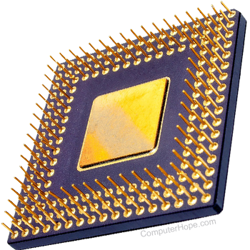


Why Care About Time Efficiency?
User Experience
Business/Commercial Costs
Compute Resources
Battery Lifetime

Slide 7
How to Assess Time Efficiency?
Download from code repo 1Mnumbers.txt and elpasedTime.py
RUN CODE
CHECK TIME
Measure Elapsed Time

Slide 8
Why does elapsed-time vary across different devices?
Hardware Differences:
CPU speed, number of cores, memory (RAM), disk speed, etc.
Operating System:
Different OSs may have different scheduling algorithms, memory management strategies, and other system-level optimizations that can impact runtime.
Resource Utilization:
If the system is under heavy load or if other resource-intensive tasks are running concurrently, the algorithm may experience slower execution times.

Slide 9
How to Assess Time Efficiency?
We want to measure the efficiency of an algorithm independent of the speed of the computer it is run on.
A better alternative is Counting Steps that the code takes
… Given input of size (N) …
Very good proxy to time performance
(but always constant)

Slide 10
Counting Steps
Two rules:
A step takes constant amount of time;
i.e. time doesn’t increase as the input size (called n) increases
Generally, A line of code is a single step if the whole line runs in constant time

Slide 11
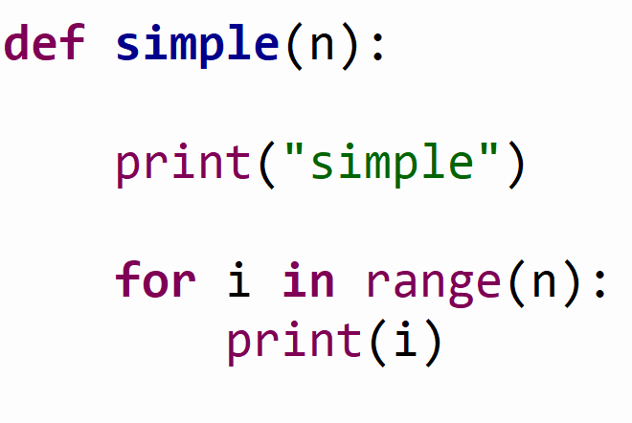
Counting Steps
Input Size (n) is the integer n
Number of iterations with range =
(end - start)/step
1
# 1 step
# 1 step for range
# Loop runs for n iterations
1+
2n
# 1 step
2
# update i -----1 step
Total Number of Steps: 1+1+ 2n = 2n + 2

Slide 12
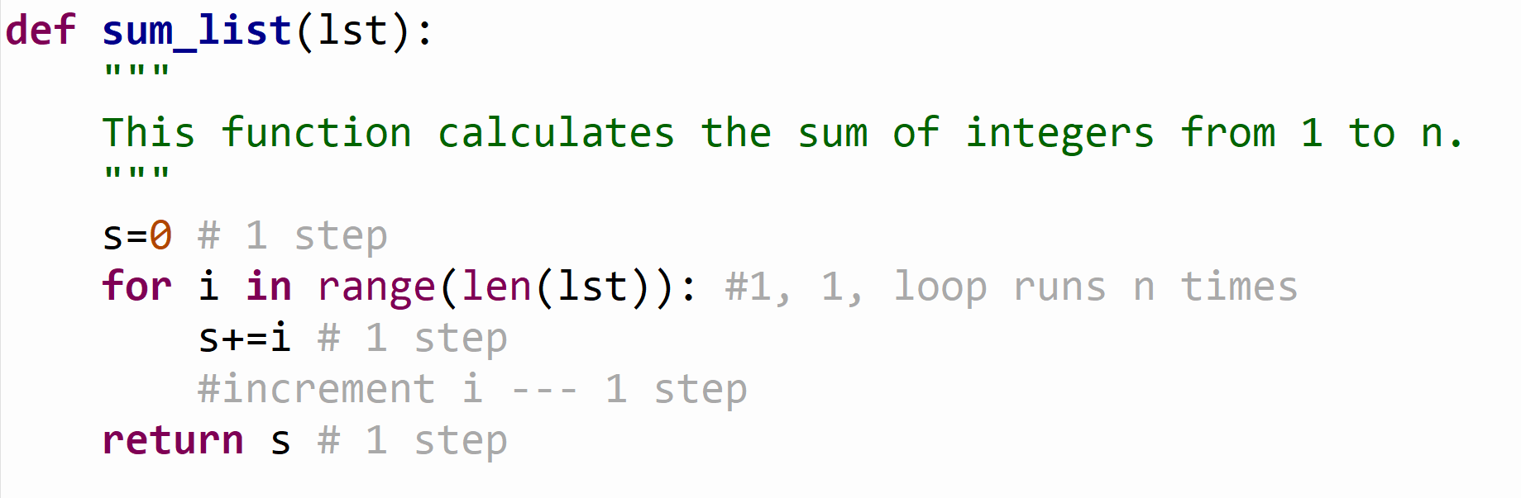
Counting Steps
Input Size (n) is the size of the list
Why does len() take a constant amount of time?

Slide 13
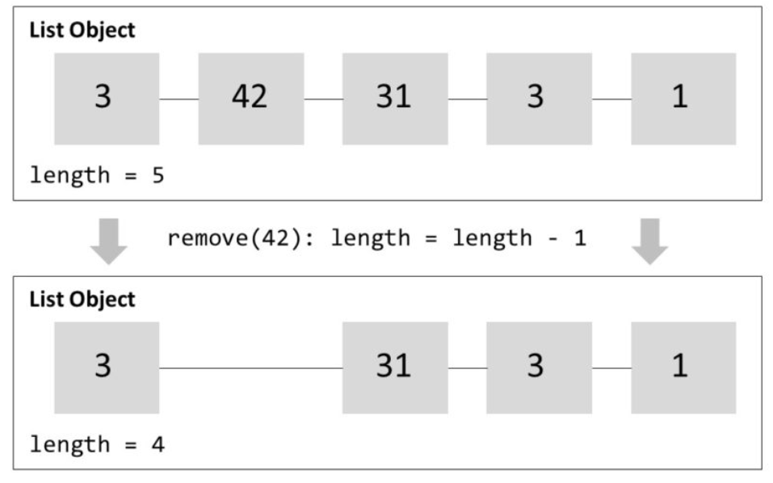
Counting Steps
Why does len() take a constant amount of time (1 step)???
How come it is not affected by List size??
Len() takes constant runtime no matter how many elements are in the list.
Because in Python the list object maintains an integer counter that increases and decreases as you add and remove list elements

Slide 14
Counting Steps
Input Size (n) is the size of the list
1
2 +
2n
1
Total Number of Steps: 1+ 2+ 2n + 1= 2n + 4

Slide 15
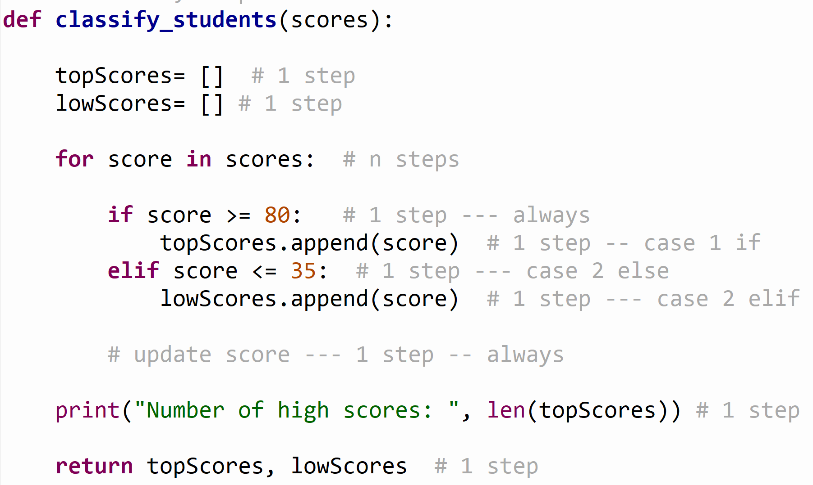
Counting Steps
Input Size (n) is the size of the list
Case 2 is the Worst Case
1
1
n iterations
1 +
2
1
1
In this course, we apply worst case analysis
4n
2
1
1
1
Total Number of Steps: 4n+ 4

Slide 16
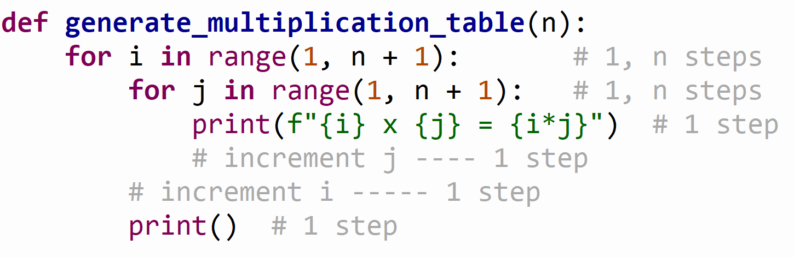
Counting Steps
Input Size (n) is the passed integer value
n iterations
1 +
n (2n+3)
1+2n
1
1
Total Number of Steps: 1+ n (2n+3) = 2n² +3n+1

Slide 17
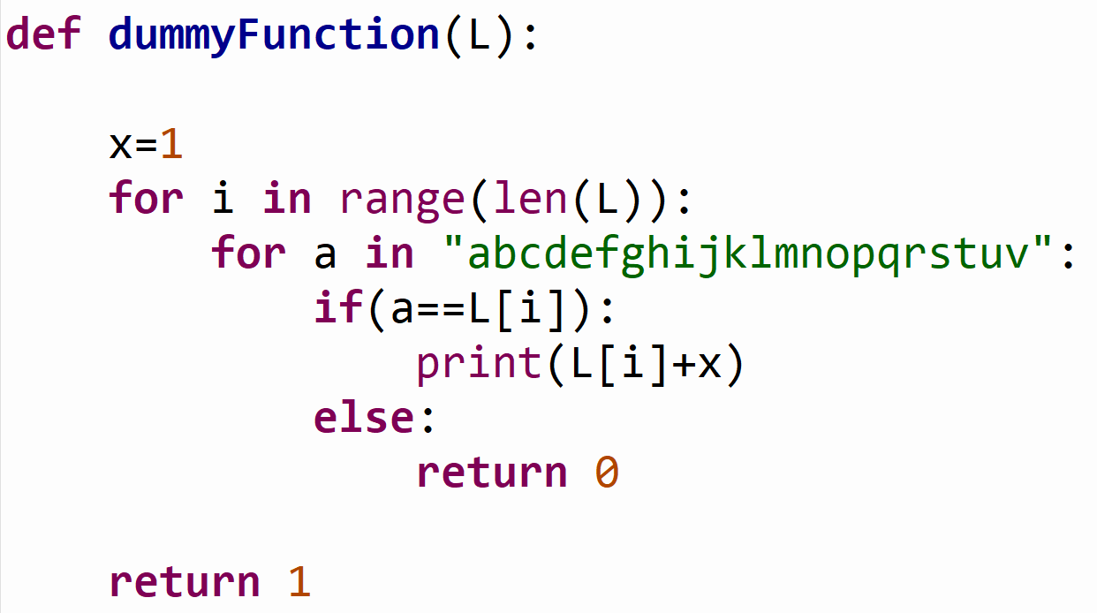
Practice

Slide 18
Practice
Worst Scenario:
- If evaluates to True
We run print(L[i]+x)
Then update a
And iterations continue
The Other Scenario:
If evaluates to False,
Else block will be run and this will return and exit the function
# 1 step
# 1, 1, n iterations
# 22 iterations
# 1 step --- always
66
# 1 step --- case 1 if
# 1 step --- case 2 else
# 1 step --- case 2 else
1
# update a --- 1 step
# update i --- 1 step
# 1 step – case not else
If-else: 2
For a loop: 22* (1+1 +1)= 66
For i loop: 1+ n*67 + 1= 67n+2
Total= 67n+2+2= 67n+4

Slide 19
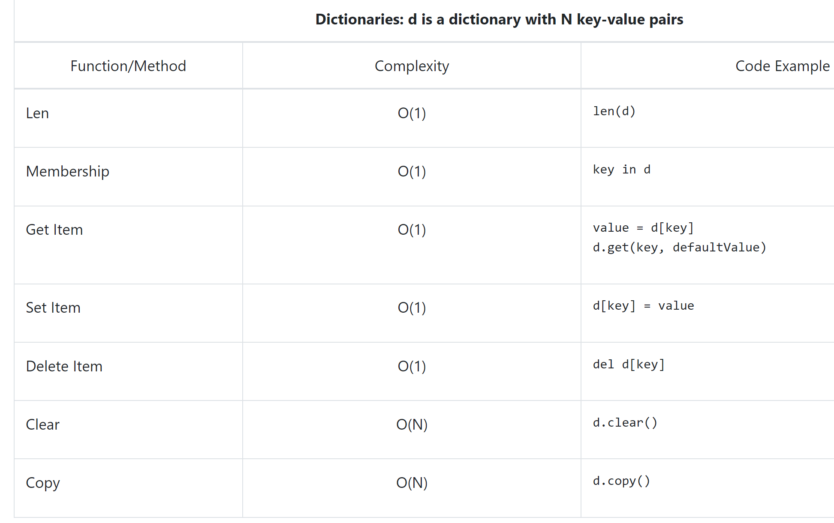
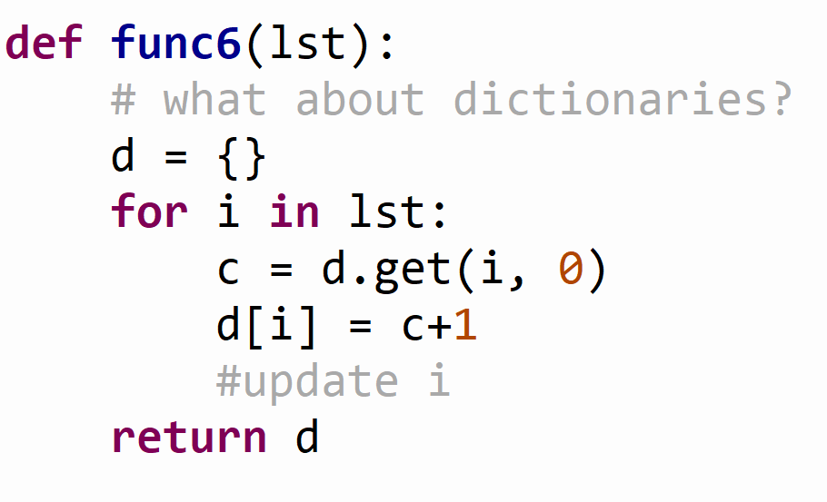
Python Built-Ins Cost
The efficiency of the built-in functions in Python will affect the efficiency of the functions they are used in.
(Built-in Functions Efficiency Table)
Total Steps: 3n + 2
# 1 step
# n iterations
# 1 step
# 1 step
# 1 step
# 1 step

Slide 20
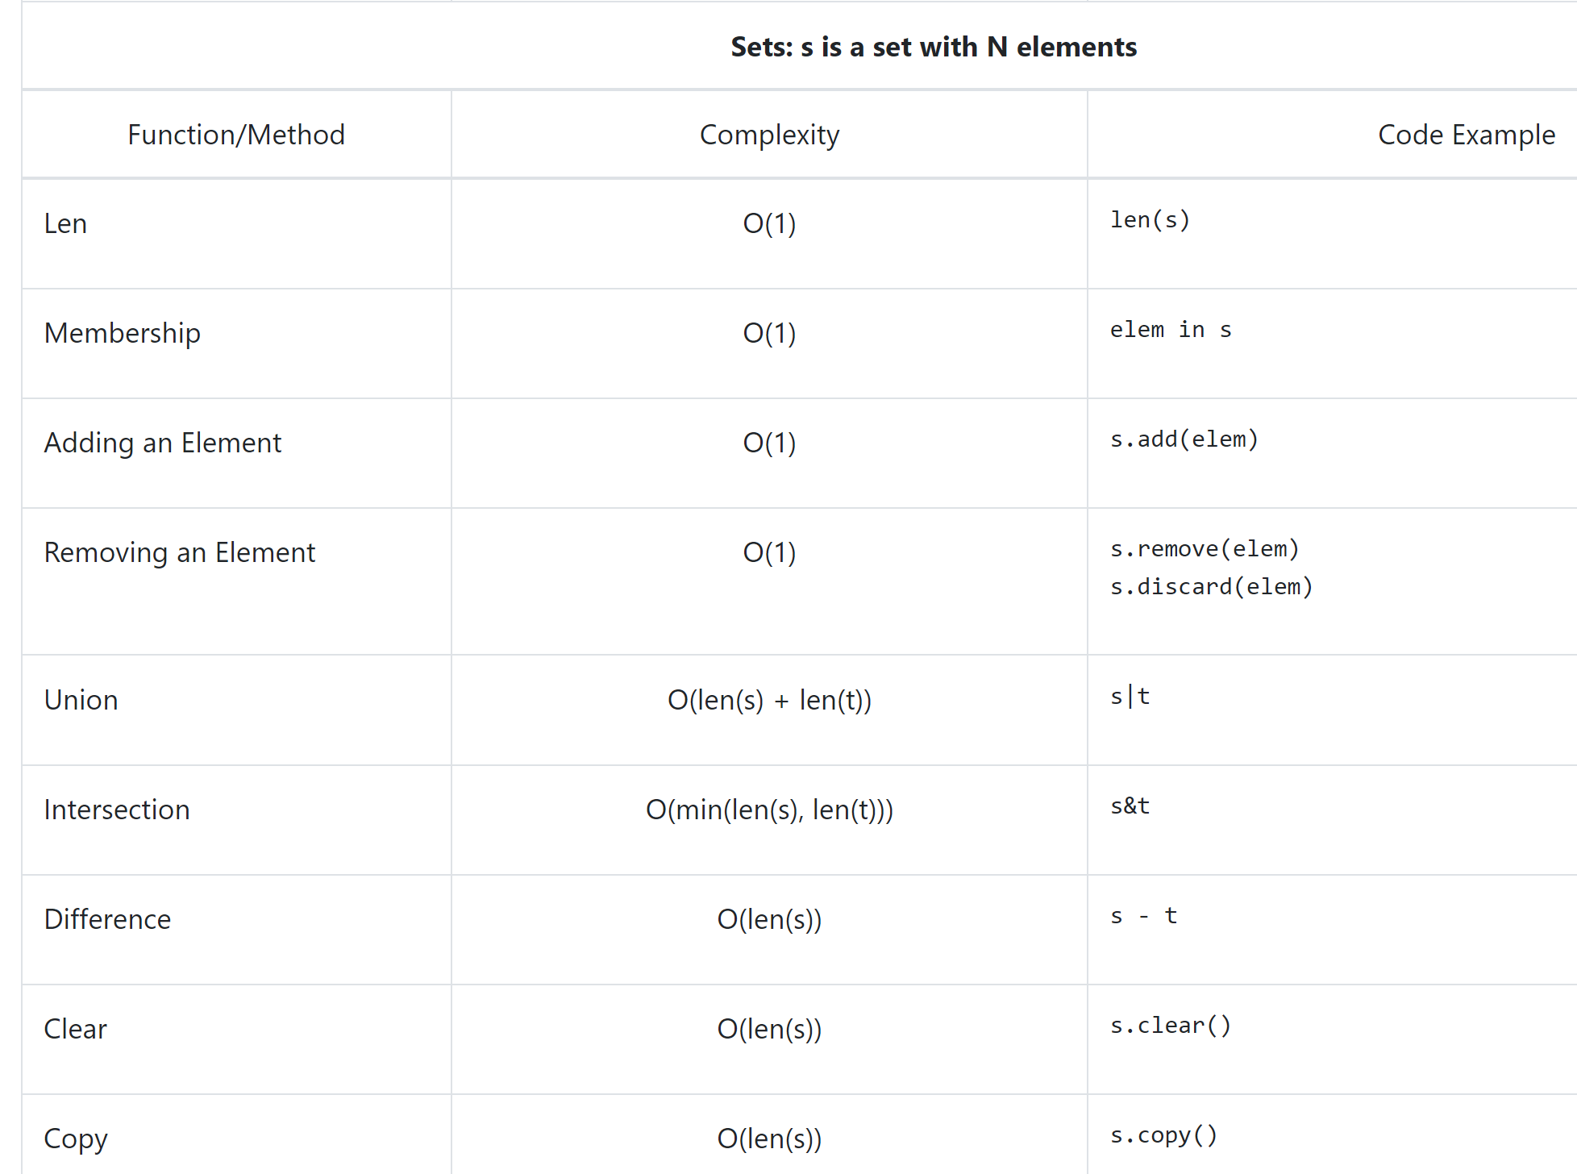
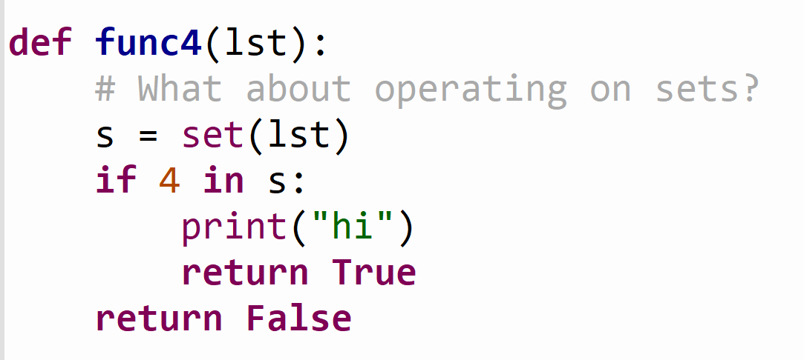
Python Built-Ins Cost
The efficiency of the built-in functions in Python will affect the efficiency of the functions they are used in.
(Built-in Functions Efficiency Table)
Take a guess at the number of steps ??
# n steps
# 1 step -- always
# 1 step – case1
# 1 step – case1
# 1 step – case2
Total steps: n + 3

Slide 21
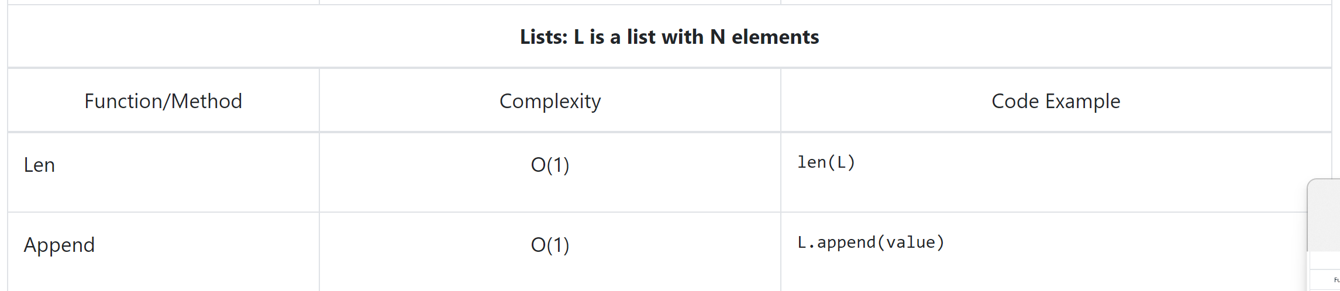
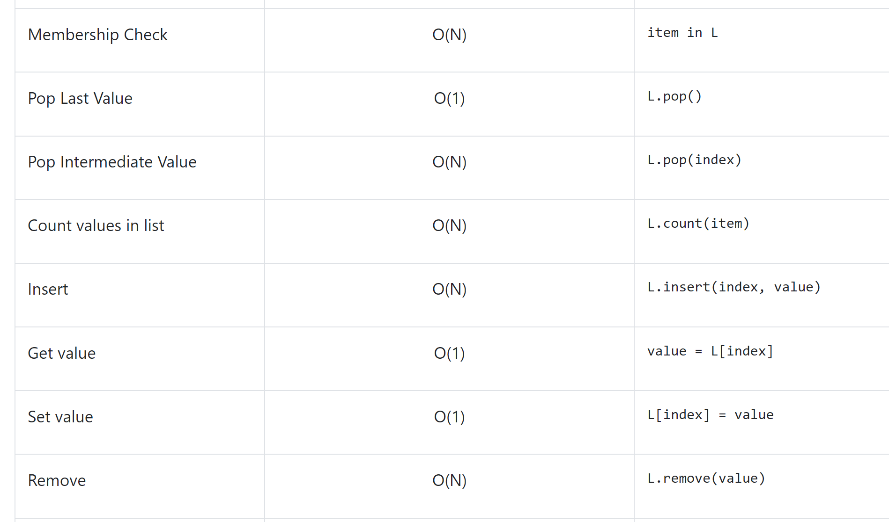
Lists Compared to Sets/Dicts

Slide 22

What is this O that appears with the complexity value

Slide 23
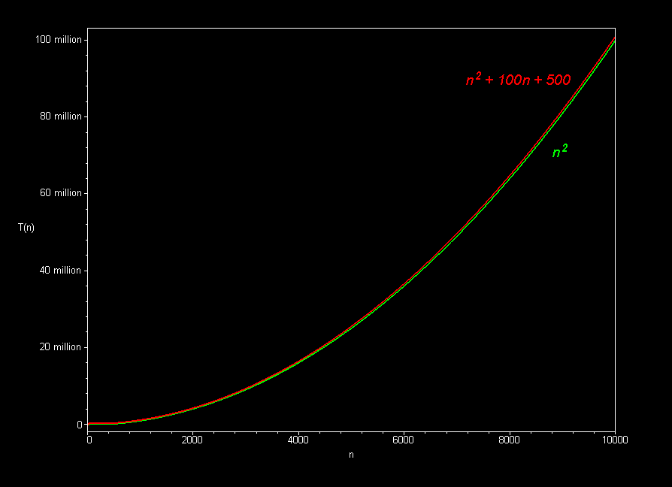
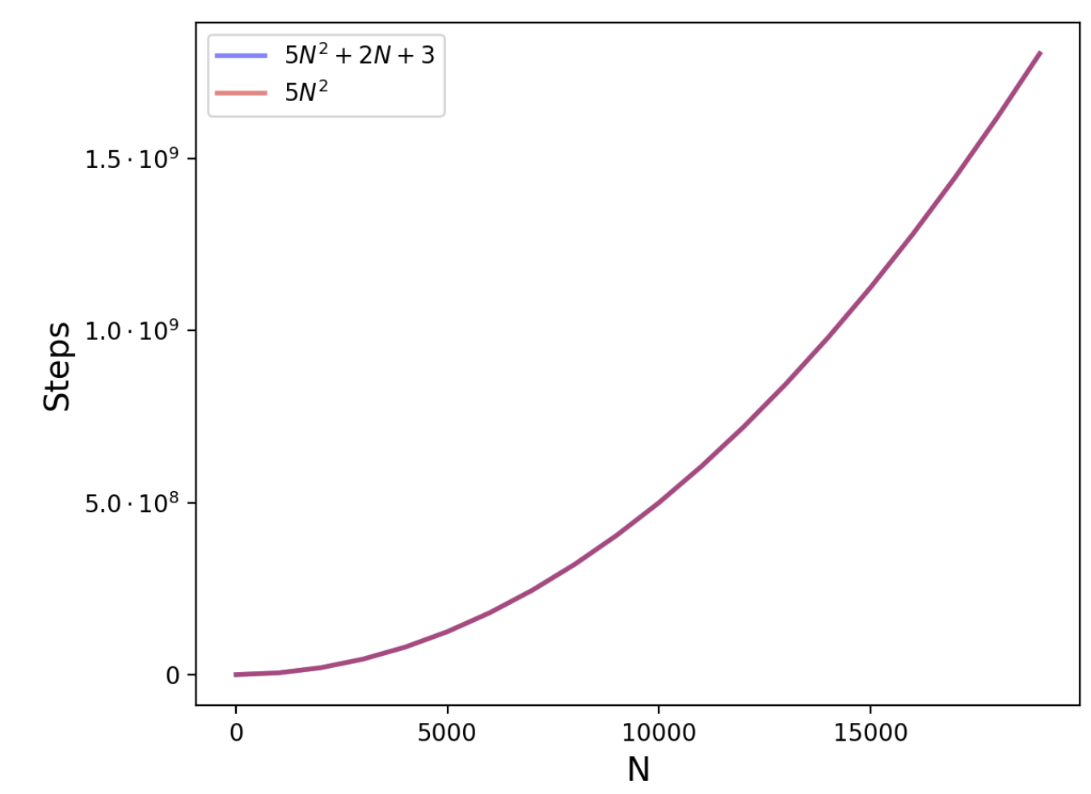
Ignoring Lower Order Terms
Consider the following example complexity (steps count)
N² + 100N + 500
5N² + 2N + 3
We say that N² is the highest order term. This is the term that grows the fastest.
The rest of the terms are called lower order terms
What would happen if we remove lower order Terms?
In general, we ignore lower order terms for efficiency because for large inputs, they make very little difference in the total.

Slide 24
Ignoring Lower Order Terms
We say that N² is the highest order term. This is the term that grows the fastest.
The rest of the terms are called lower order terms
In general, we ignore lower order terms for efficiency because for large inputs, they make very little difference in the total.
This is called BigO
The notion we use to describe the efficiency of a program,
without considering lower order terms or coefficients.

Slide 25
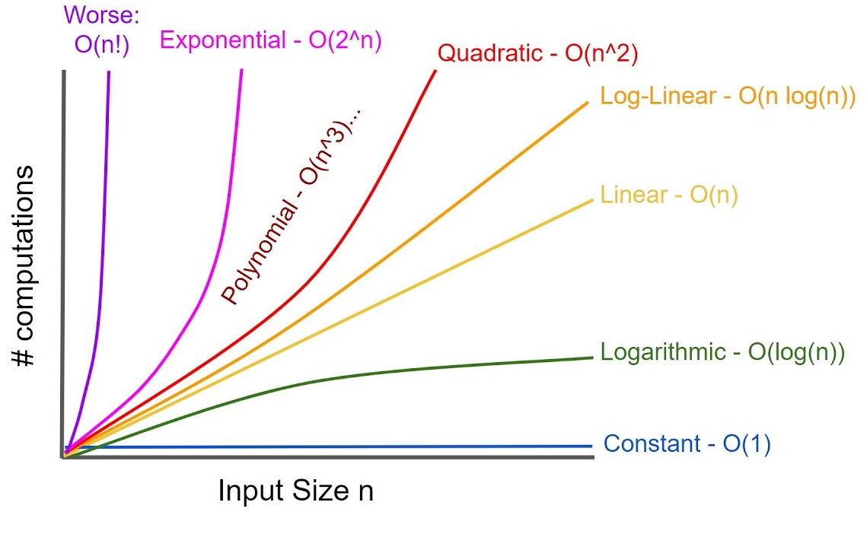
BigO Function Families
We define a function family by the highest order term of a function without any coefficients.
(Steps)
For example, the N² (quadratic) function family, contains all the functions where the highest order term is N².
Example functions that belong to the N² function family
N²+3N+25
3N² +30
100N²+N

Slide 26
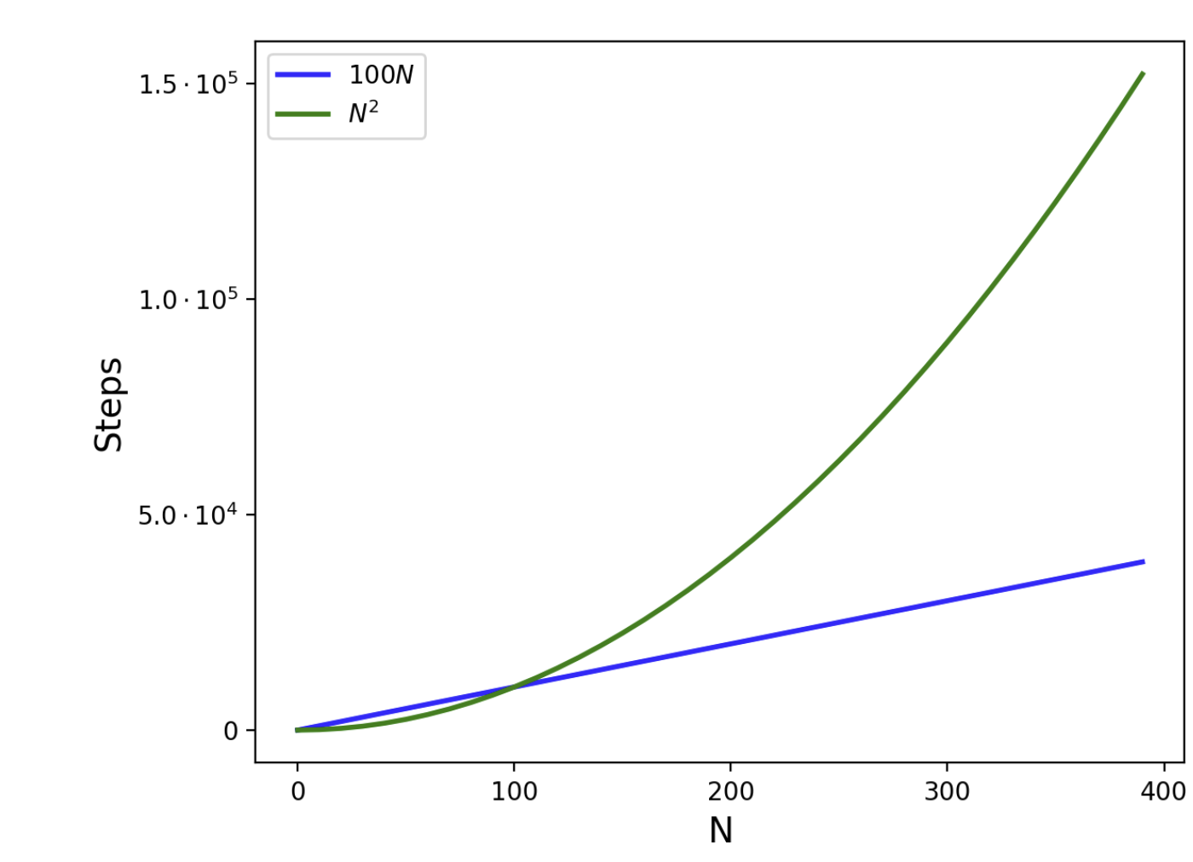

Big O – Ignoring Constants
Multiplying by a constant does not change the relationship between the function families.
A faster growing function family will always eventually overtake a slower growing function family.
This is why we ignore coefficients for efficiency and function families.
Does this mean you can change your algorithm’s function family by just changing the hardware?
Running on a faster machine, can speed up our program by a constant factor.
You will not change your algorithm's function family by changing the hardware

Slide 27
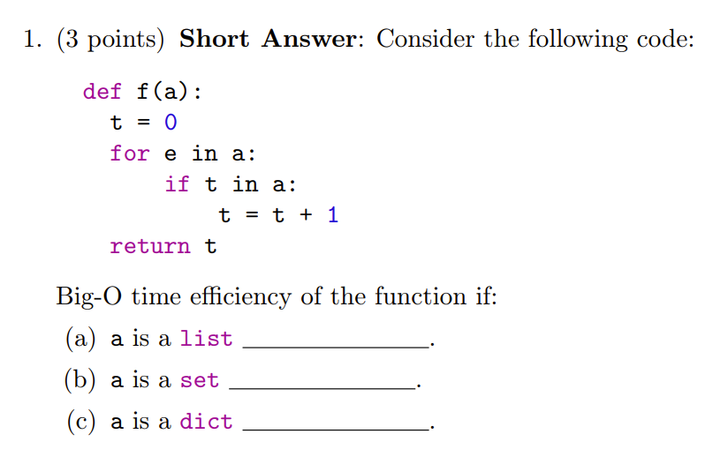
Practice
Which line(s) highlights efficiency difference for these data structures??
S’23 Quiz Question
# 1
# n
# ??
# 1 – case if
# ----------------------------------- -----------update e --- 1 step
# 1
O(N²)
O(N)
O(N)

Slide 28
Looking Up An Element in Lists Vs Sets (As Input Size Increases)
The time difference we saw yesterday in the membership (lookup) time was because these two functions belong to different function families (The difference is bigger as the input size increases)
LIST
SET

Slide 29
What is Log?
L.sort() sorted(L)

Slide 30
Tips for Big-O Analysis
Look for Expensive Operations
operations that are not O(1)
Look for loops
How many Iterations
Look for what happens inside the Loop
Complexity of each iteration
Combine them
Don’t get distracted by constants; O(1)

Slide 31
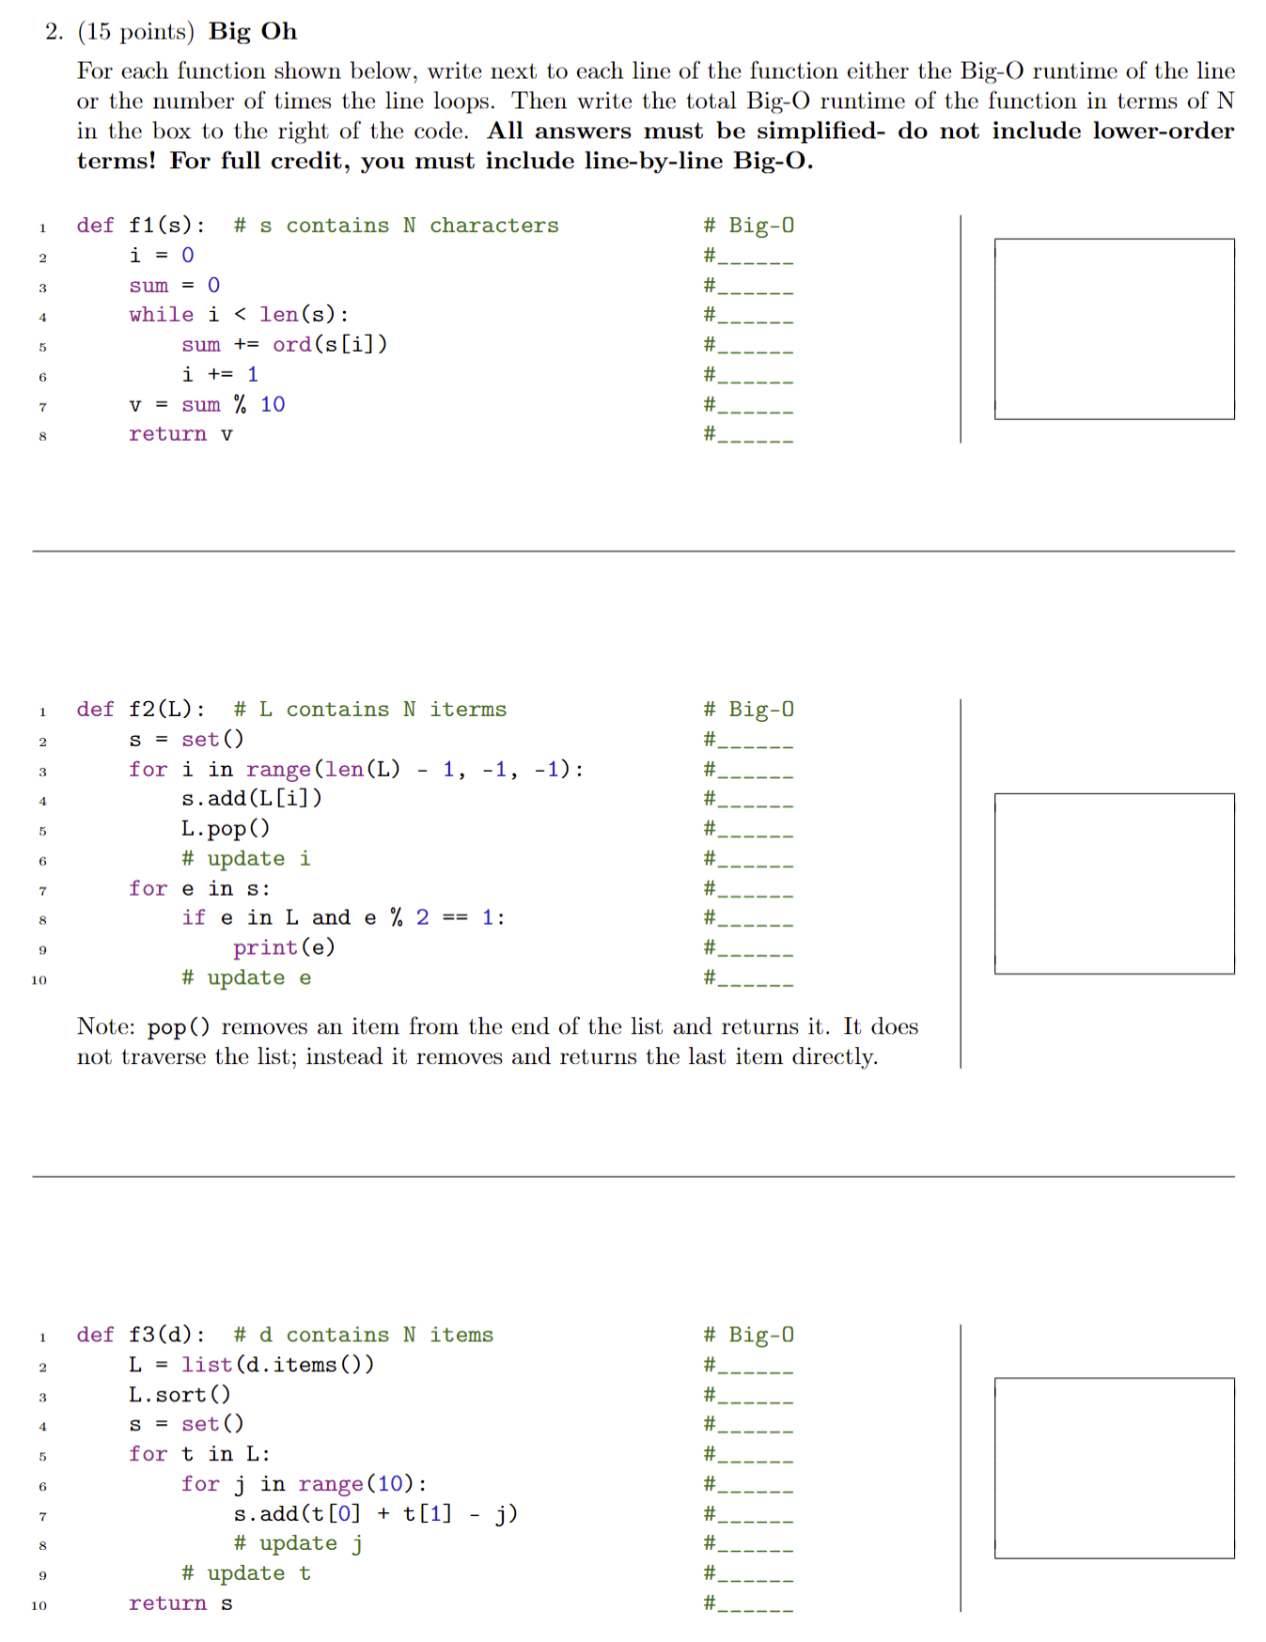
Practice – S24

Slide 32
Practice – free Response
mostCommonName(L)
Write the function mostCommonName, that takes a list of names (such as ["Jane", "Aaron", "Cindy", "Aaron"], and returns the most common name in this list (in this case, "Aaron"). If there is more than one such name, return a set of the most common names. So mostCommonName(["Jane", "Aaron", "Jane", "Cindy", "Aaron"]) returns the set {"Aaron", "Jane"}. If the set is empty, return None. Also, treat names case sensitively, so "Jane" and "JANE" are different names. You should write three different versions, one that runs in O(n**2), O(nlogn) and O(n).
def mostCommonName(L):
return 42 # place your answer here!
def testMostCommonName():
print("Testing mostCommonName()...", end="")
assert(mostCommonName(["Jane", "Aaron", "Cindy", "Aaron"]) == "Aaron")
assert(mostCommonName(["Jane", "Aaron", "Jane", "Cindy", "Aaron"]) == {"Aaron", "Jane"})
assert(mostCommonName(["Cindy"]) == "Cindy")
assert(mostCommonName(["Jane", "Aaron", "Cindy"]) == {"Aaron", "Cindy", "Jane"})
assert(mostCommonName([]) == None) print("Passed!")
testMostCommonName()

Slide 33
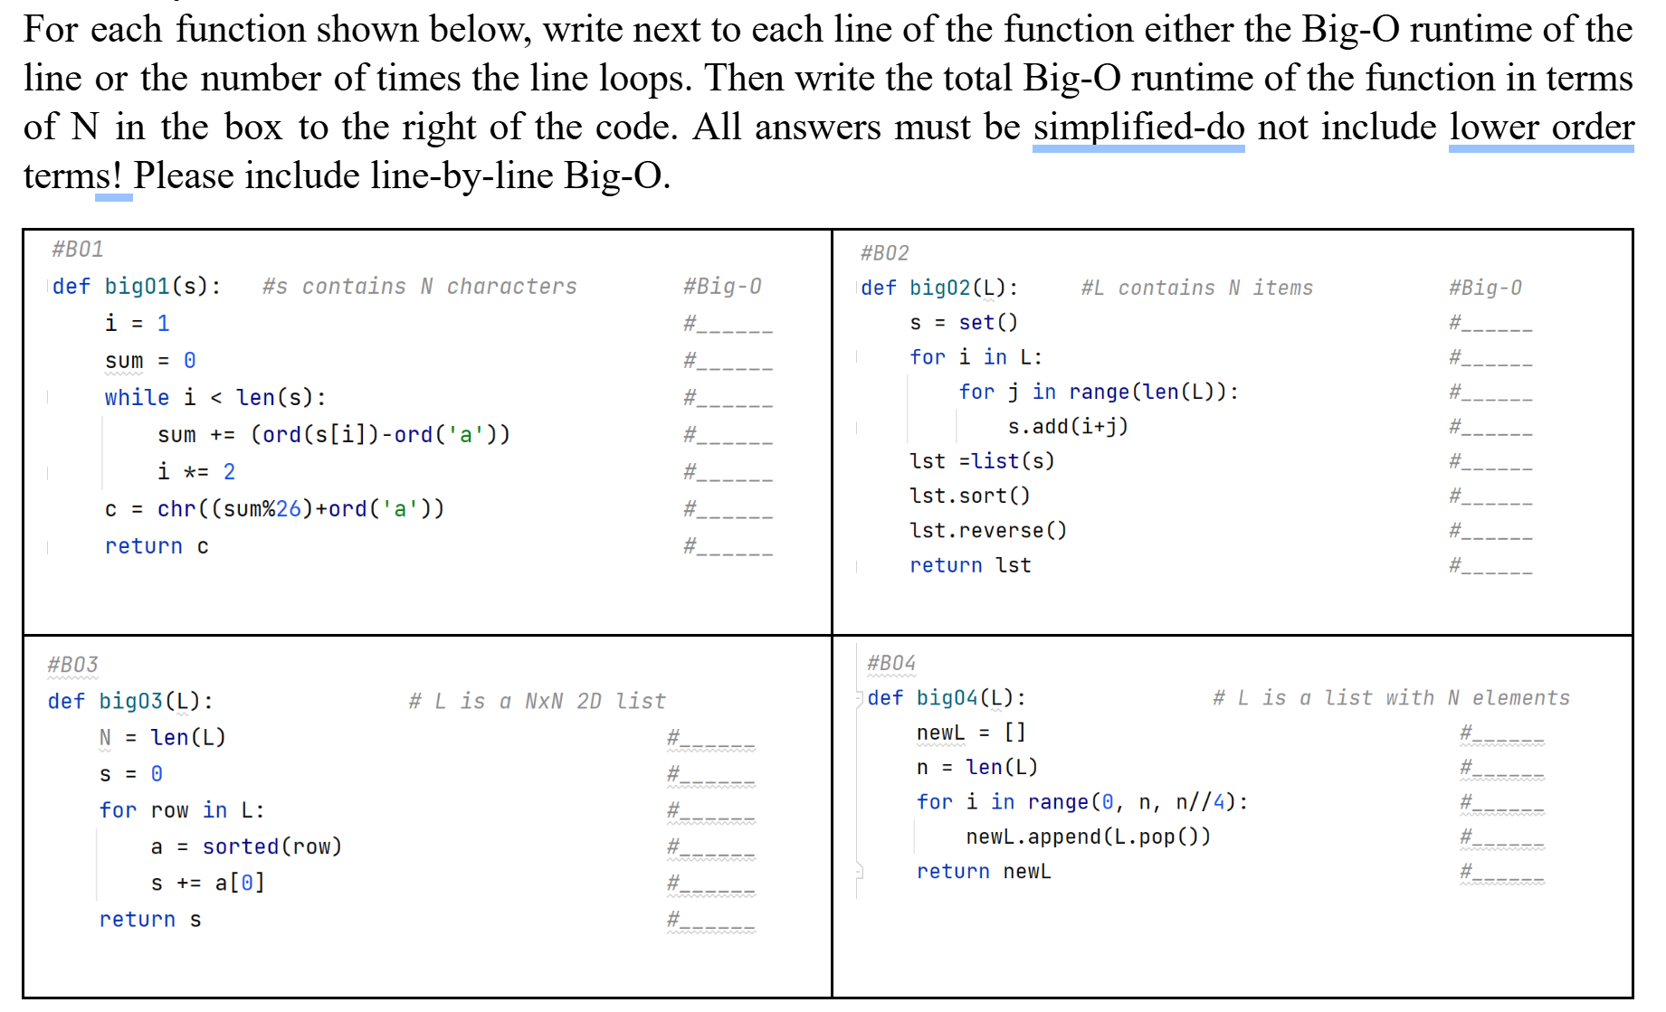
Practice

Slide 34
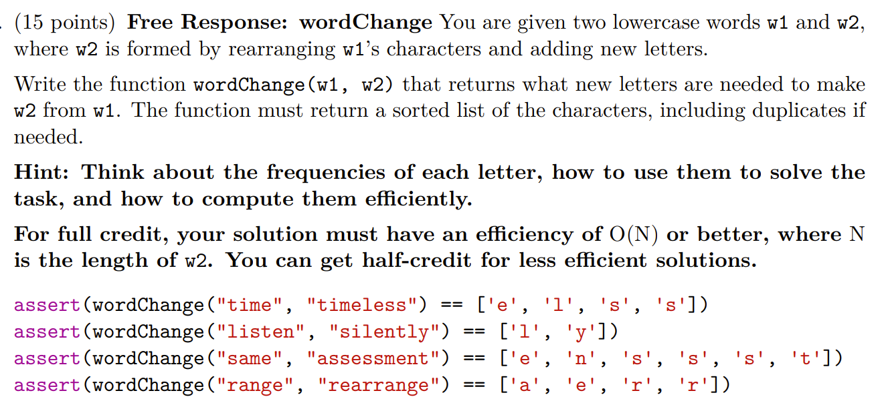
Practice
S’23 Exam Question

