Slide 1
Fundamentals of Programming & Computer Science CS 15-112
Recursion
Dr. Hend Gedawy

Slide 2
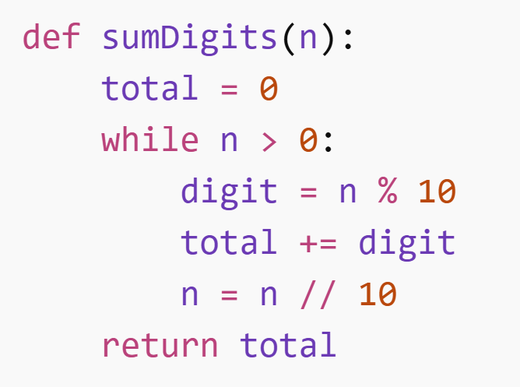
Example: Sum Of Digits
Goal: Add all digits of a number (n).
Example:
n = 1234
1 + 2 + 3 + 4 = 10
Iterative Approach:

Slide 3
Recursive sumDigits(n) Phase 1: The Call Phase
The stack grows first
Call 1
sumDigits(1234)
1234 → 123 → 12 → 1
Each call waits for the next.
= sumDigits(123) + 4
Call 2
▼
sumDigits(123)
= sumDigits(12) + 3
Call 3
▼
Nothing gets computed yet
sumDigits(12)
= sumDigits(1) + 2
Everyone is waiting.
No addition happens during the call phase.
Call 4
▼
Call 4
sumDigits(1)
= 1 ← BASE CASE

Slide 4
Recursive sumDigits(n) Phase 2: The Unwinding Phase
Call 4
sumDigits(1)
The base case unlocks everything
returns → 1
= 1
sumDigits(1) = 1
This is the trigger that starts unwinding.
▲
Call 3
▲
sumDigits(12)
returns → 3
= 1 + 2 = 3
Call 2
▲
sumDigits(123)
returns → 6
Results travel back up
= 3 + 3 = 6
▲
1 → 3 → 6 → 10
Each return adds its digit and passes it up.
Call 1
sumDigits(1234)
FINAL = 10 ✓
= 6 + 4 = 10

Slide 5
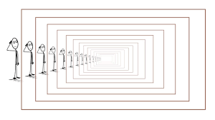
Recursion
Recursion is a programming style where a function solves a problem by calling itself.
Some programming languages are built with recusion (no loops)
Each call works on a smaller version of the same problem.
Two key parts:
Base Case (when to stop)
Recursive Case (the smaller problem)
"Recursion is like asking someone else to solve a smaller version of your problem. Once the smallest problem is solved, the answers travel back up."

Slide 6
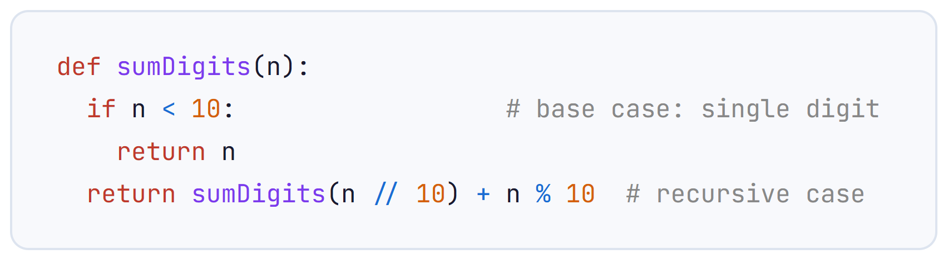
sumDigits(n)
Two parts to define for a recursive function:
Recursive Case (the smaller problem) :
The function does a little bit of work and calls itself on smaller input
Base Case (when to stop):
The simplest situation (subproblem) where the answer can be found instantly/superfast

Slide 7
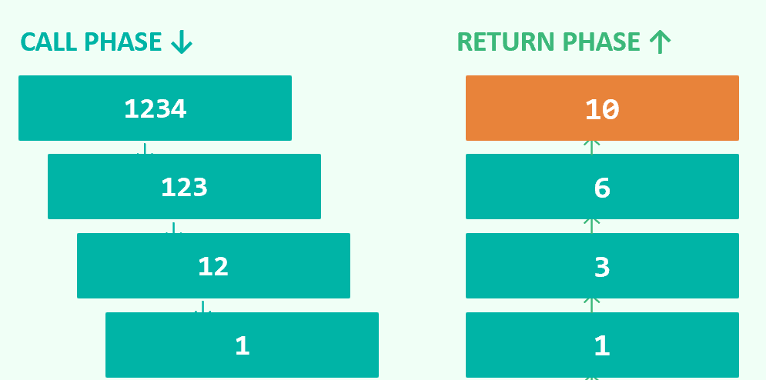
sumDigits(n)
Recursion works by solving a smaller version of the same problem until it reaches a base case, and then the answers build back up.

Slide 8
Tips for defining a recursive function
When designing a recursive function, ask yourself these three questions:
1️⃣ What is a smaller problem that looks exactly like the original problem but is easier to solve?
2️⃣Assume magic: if I already have the answer to the smaller problem, how could I use it to solve the current problem? - In other words, how does the recursive result help me compute the final answer?
3️⃣ What is the simplest possible case of the problem? - This is the base case — the smallest input where the answer is obvious and no recursion is needed.
Make sure every recursive call is strictly closer to the base case than the original. If not, you have infinite recursion.

Slide 9
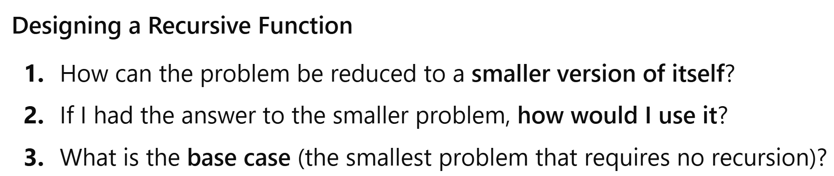
Recursion Practice
Write recursive function sum1ToN(n) that sums all the numbers from 1 to n.

Slide 10
Recursion Practice
Write recursive function maxDigit(n) that returns the largest digit in n.

Slide 11
Recursion Practice
Write recursive function sumList(L) that returns the sum of all elements in L.

Slide 12
Recursion Practice
Write recursive function maxValue(L) that returns the largest number in L.

Slide 13
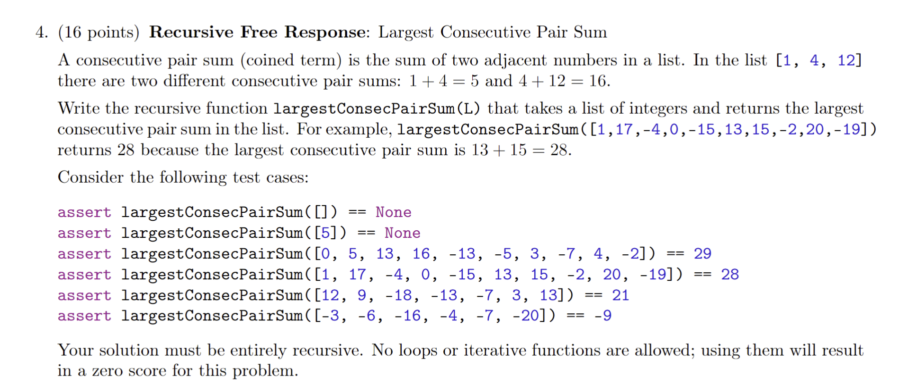
Recursion Practice – Exam2 S24

Slide 14

Last Lecture - Recursion
A different programming style where a function calls itself on a subproblem
Two things to define for a recursive function:
Recursive Case: the function does a little bit of work and calls itself on smaller input
Base Case: the simplest situation (subproblem) where the answer can be found instantly/superfast
Acts like Magic
You assume the function called on the subproblem works
Integrate this answer to find the solution of the main problem
Each function waits for the ones it called to finish before it proceeds
Variables are local to each function
Recursive Functions should be short and contained
Autograder checks if you use loops or use built-in functions that use loops (e.g. sum(L))

Slide 15
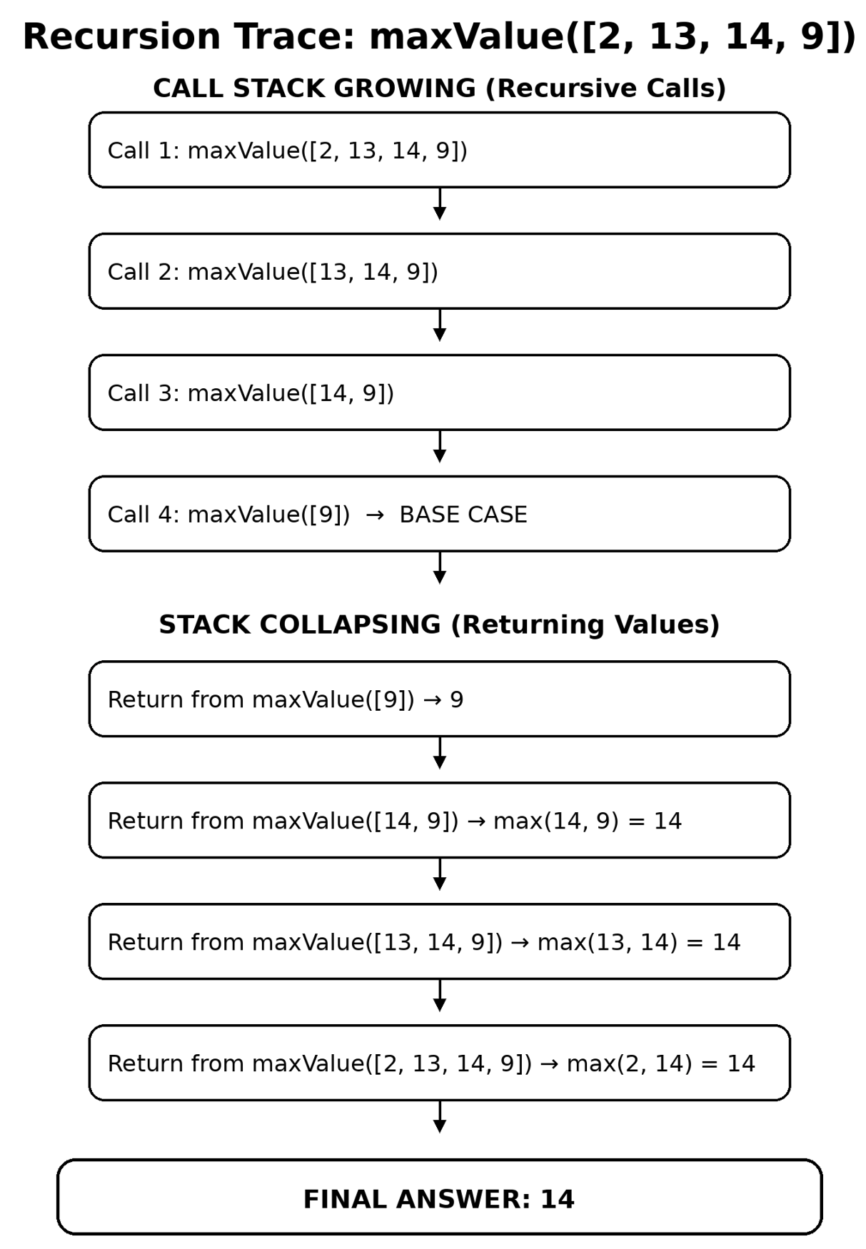
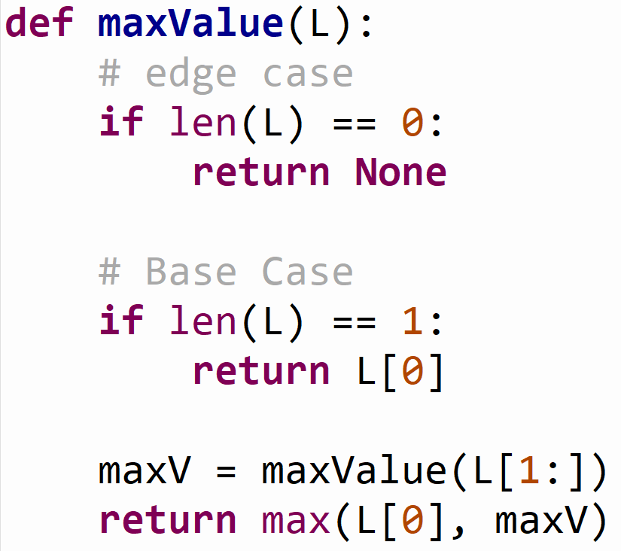
Variables In Recursive Calls
maxV represents: the maximum value of the remaining sublist L[1:]

Slide 16
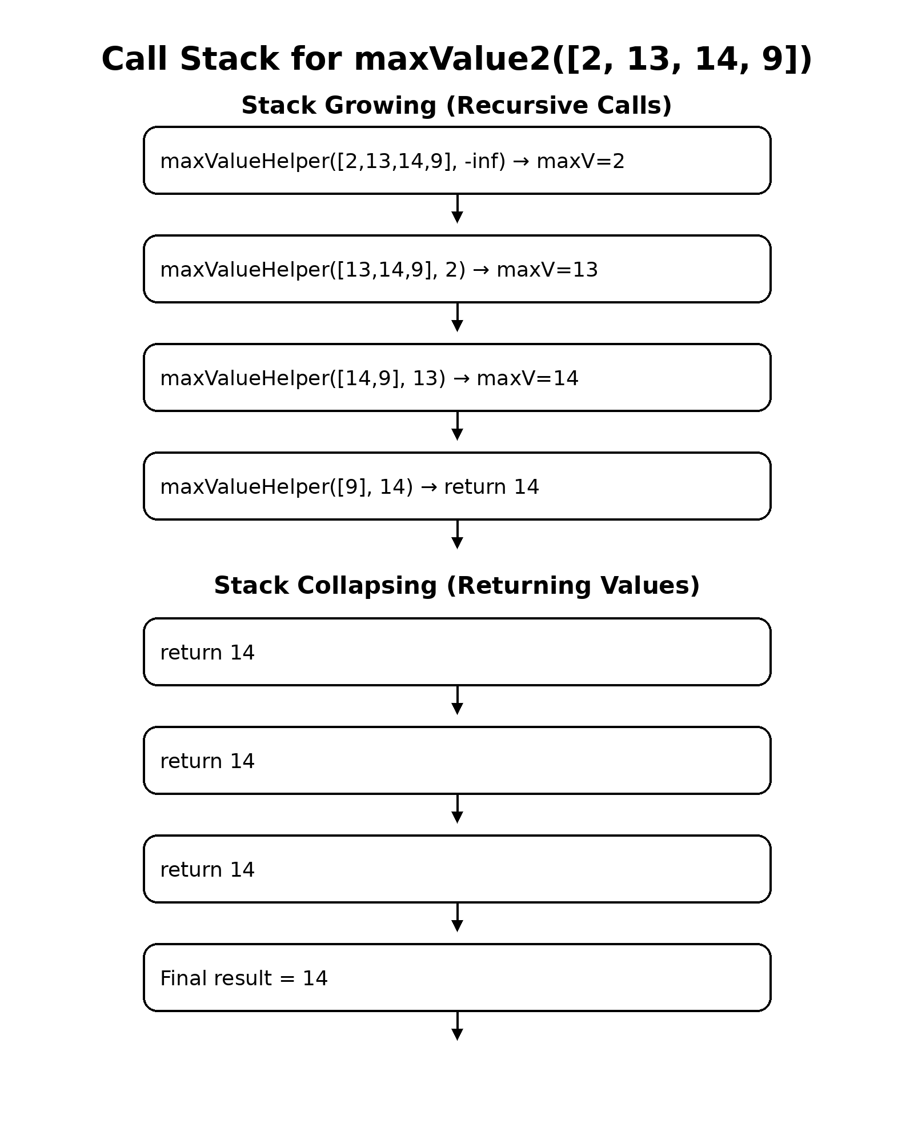
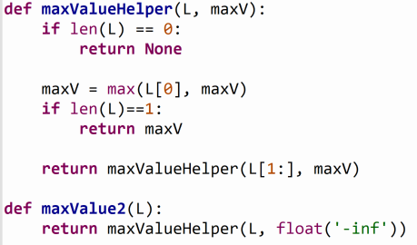
Variables In Recursive Calls
maxV represents: the maximum value seen so far

Slide 17
Variables In Recursive Calls
maxV represents: the maximum value seen so far
Recursion keeps carrying the current maximum forward
Works forwards (information flows down):
carry the current max forward
update as we go
maxV represents: the maximum value of the remaining sublist L[1:]
Works backwards (information flows up):
compute max of smaller list
return it upward

Slide 18
Variables In Recursive Calls
Functions Parameters:
For Immutable data types (e.g. integers),
You can still pass their values to other recursive calls.
This creates new values for each call
You cannot share and mutate the same them across calls.
For Mutable data types (e.g. Lists)
Recursive calls share references to the same mutable object,
The parameters are aliases
Changes are reflected
Every function call gets its own local variables.

Slide 19
Recursion Practice
Write recursive function oddValues(L) that returns a list of only the odd values in L in the same order they appear.
Note: Don’t make a list of odd values, build it in the return

Slide 20
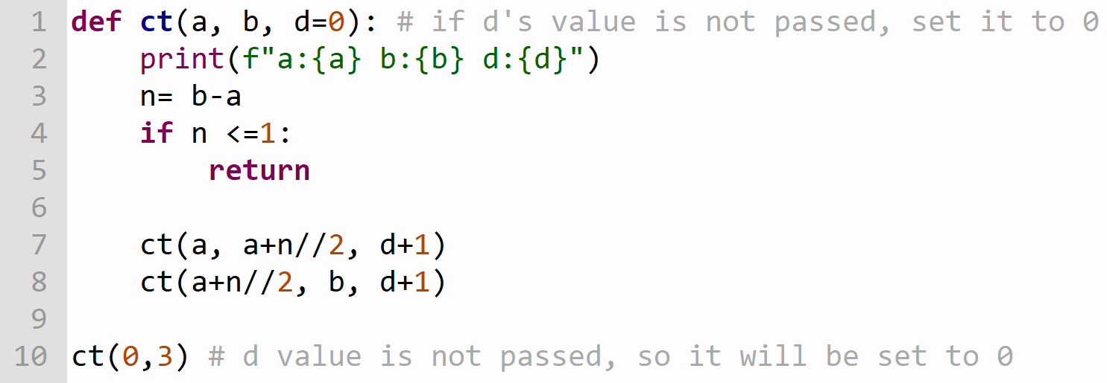
Recursion: CT
With every recursive call, we are not modifying the same d.
- Instead we are creating a new value and passing it to the next call.
- Each call has its own local variable d

Slide 21
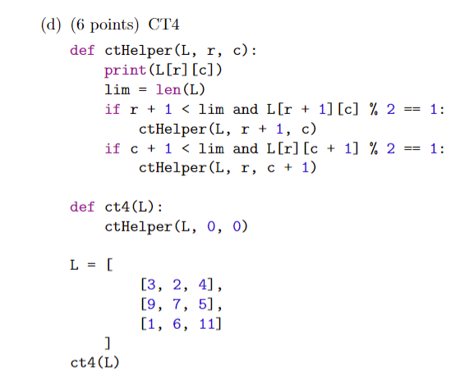
Recursion: CT

Slide 22
Recursion Practice
Write recursive function interleave(L1, L2) that returns a new list where elements from L1 and L2 alternate.
Note: Assuming Lists have the same length

Slide 23
Recursion Practice
Write recursive function interleave(L1, L2) that returns a new list where elements from L1 and L2 alternate.
Note: Assuming Lists have DIFFERENT lengths

Slide 24
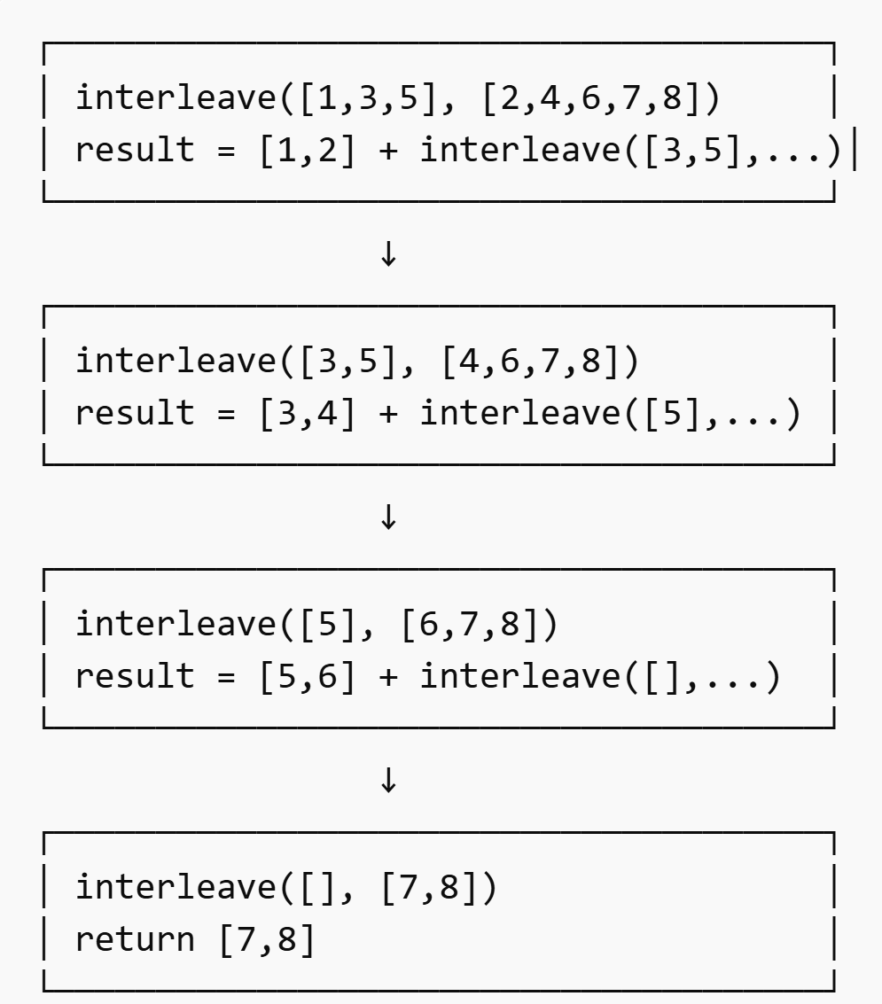
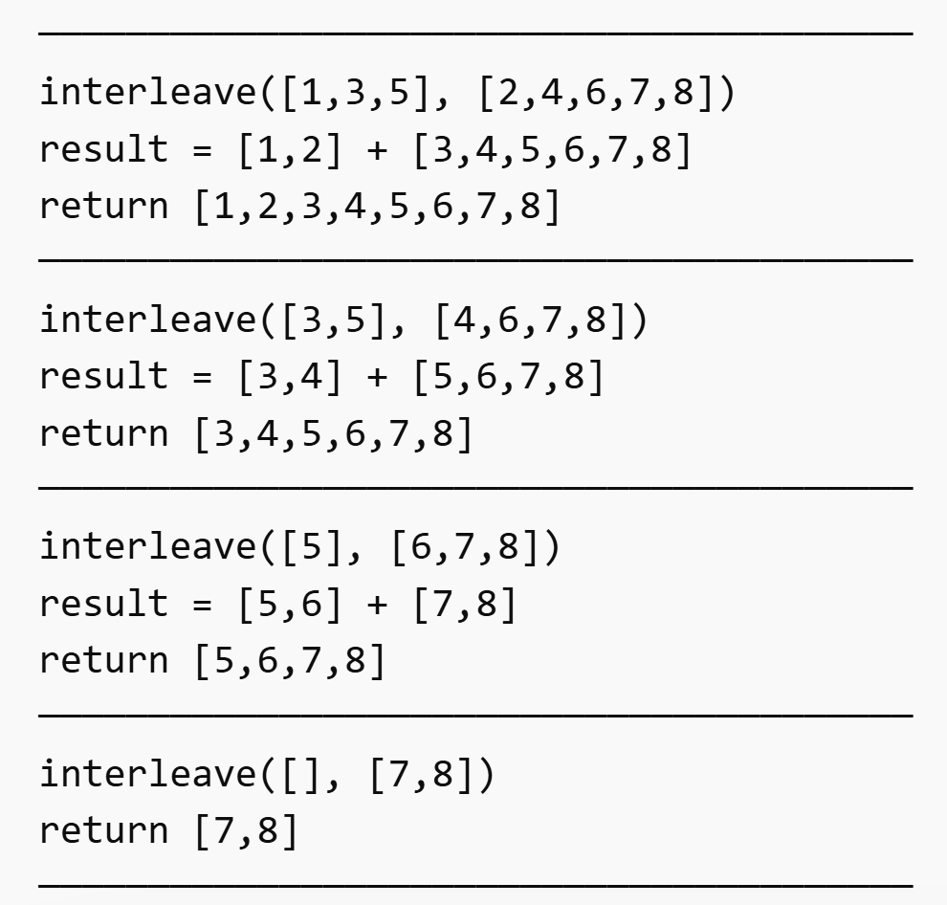
Interleave Call Stack
Stack Growing (Recursive Calls)
Stack Collapsing (Unwinding Phase)

Slide 25
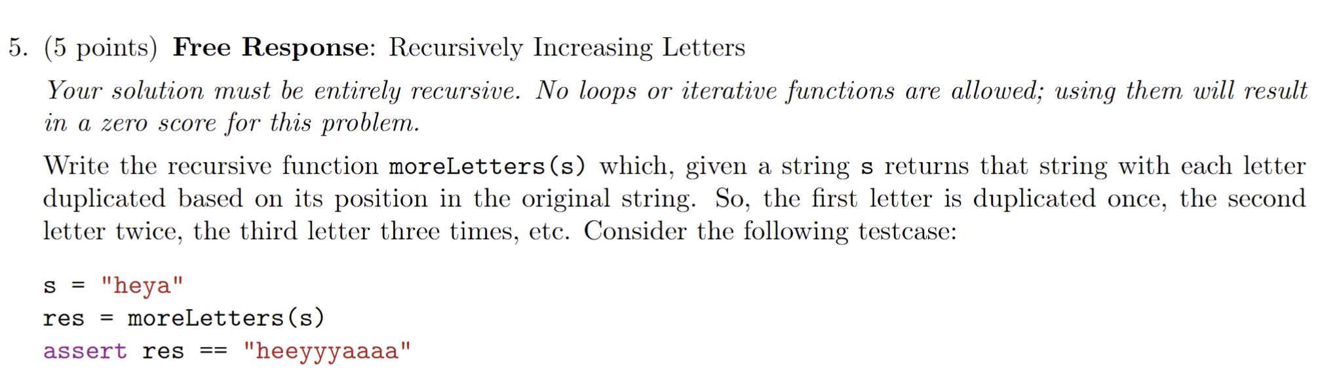
Recursion Practice – Exam2 S24

Slide 26
Recursion Practice
Write recursive function stringReverse(s) that returns a new string where characters of s are reversed.

