Slide 1
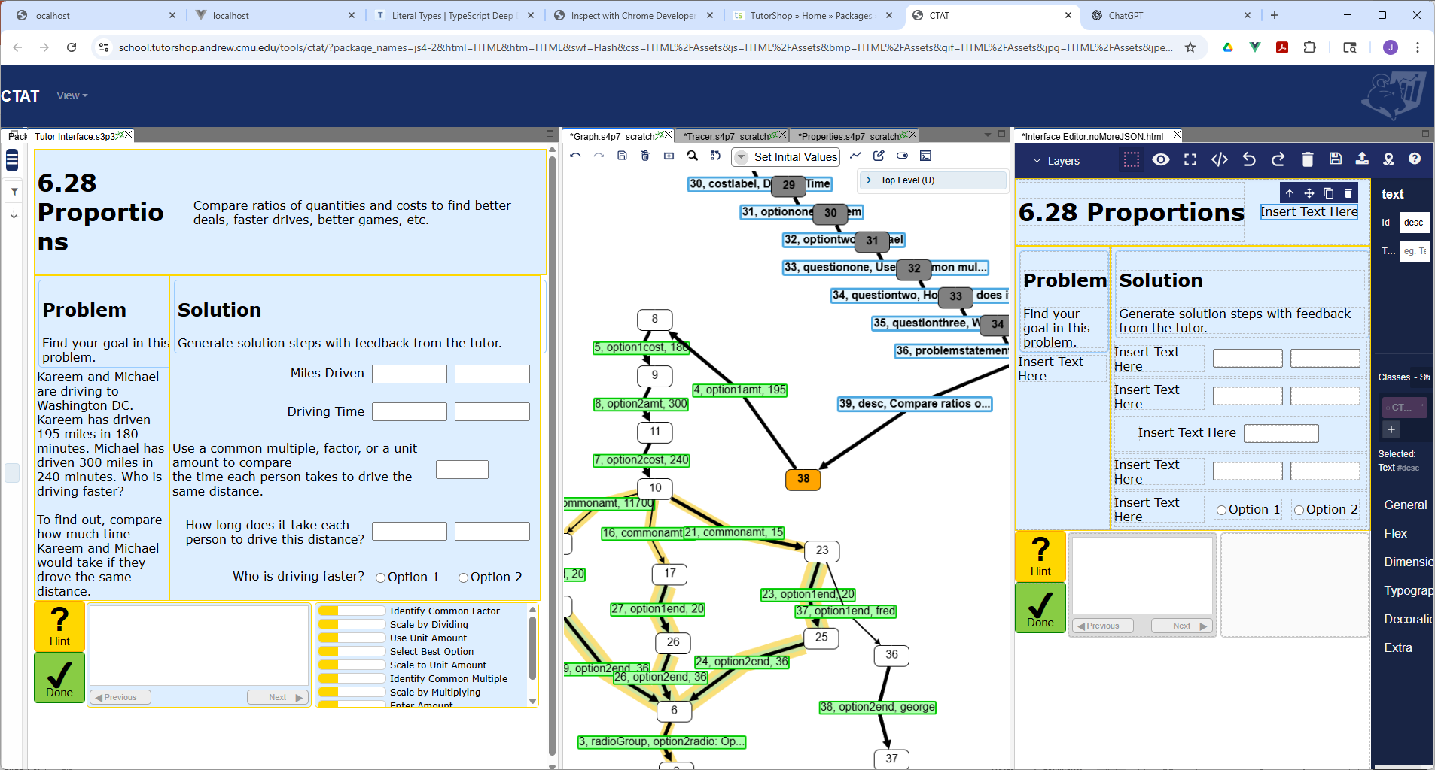
2
3
1
4
Notes:
In the HTML Editor, place a CTATTextField instance onto the page; set its ID to “desc”.
Launch the student interface (.html file) with a behavior graph (.brd file) and choose Set Initial Values mode.
Type the text-you-want for this problem in this CTATTextField instance on the running student interface.
A new link will be added whose (selection, action, input) will be (“desc”, “UpdateTextField”, “text-you-want”). Further edits on the student interface should revise this link

