Slide 1
Comparator

Slide 2
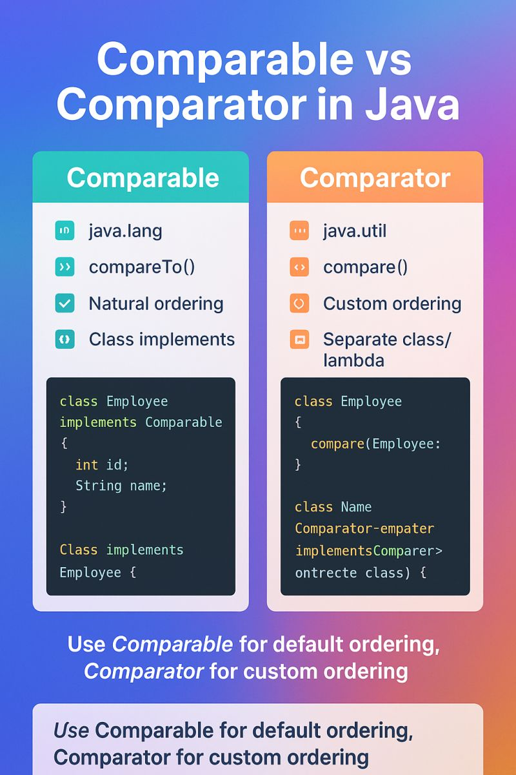

Slide 3
Binary Search Tree

Slide 4
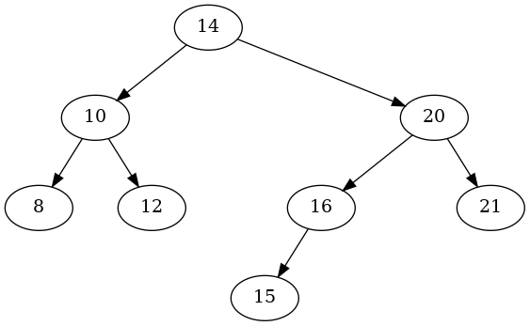
Tree Terminology
edge
root
child
Depth/Level 0
Depth/Level 1
subtree
Height of the Tree
Depth/Level 2
Depth/Level 3
Leaf

Slide 5

Binary Search Tree
For Every Node:
A node can have at most 2 children: left and right.
The left subtree of a node always contains values less than the node.
The right subtree of a node always contains values greater than the node.
Smallest
Largest

Slide 6
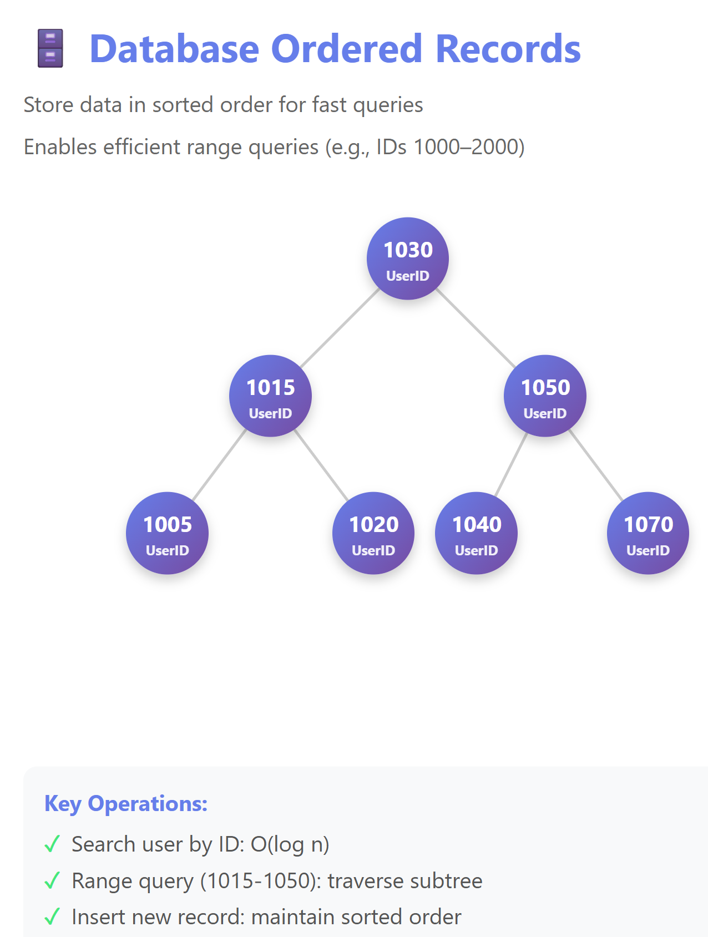
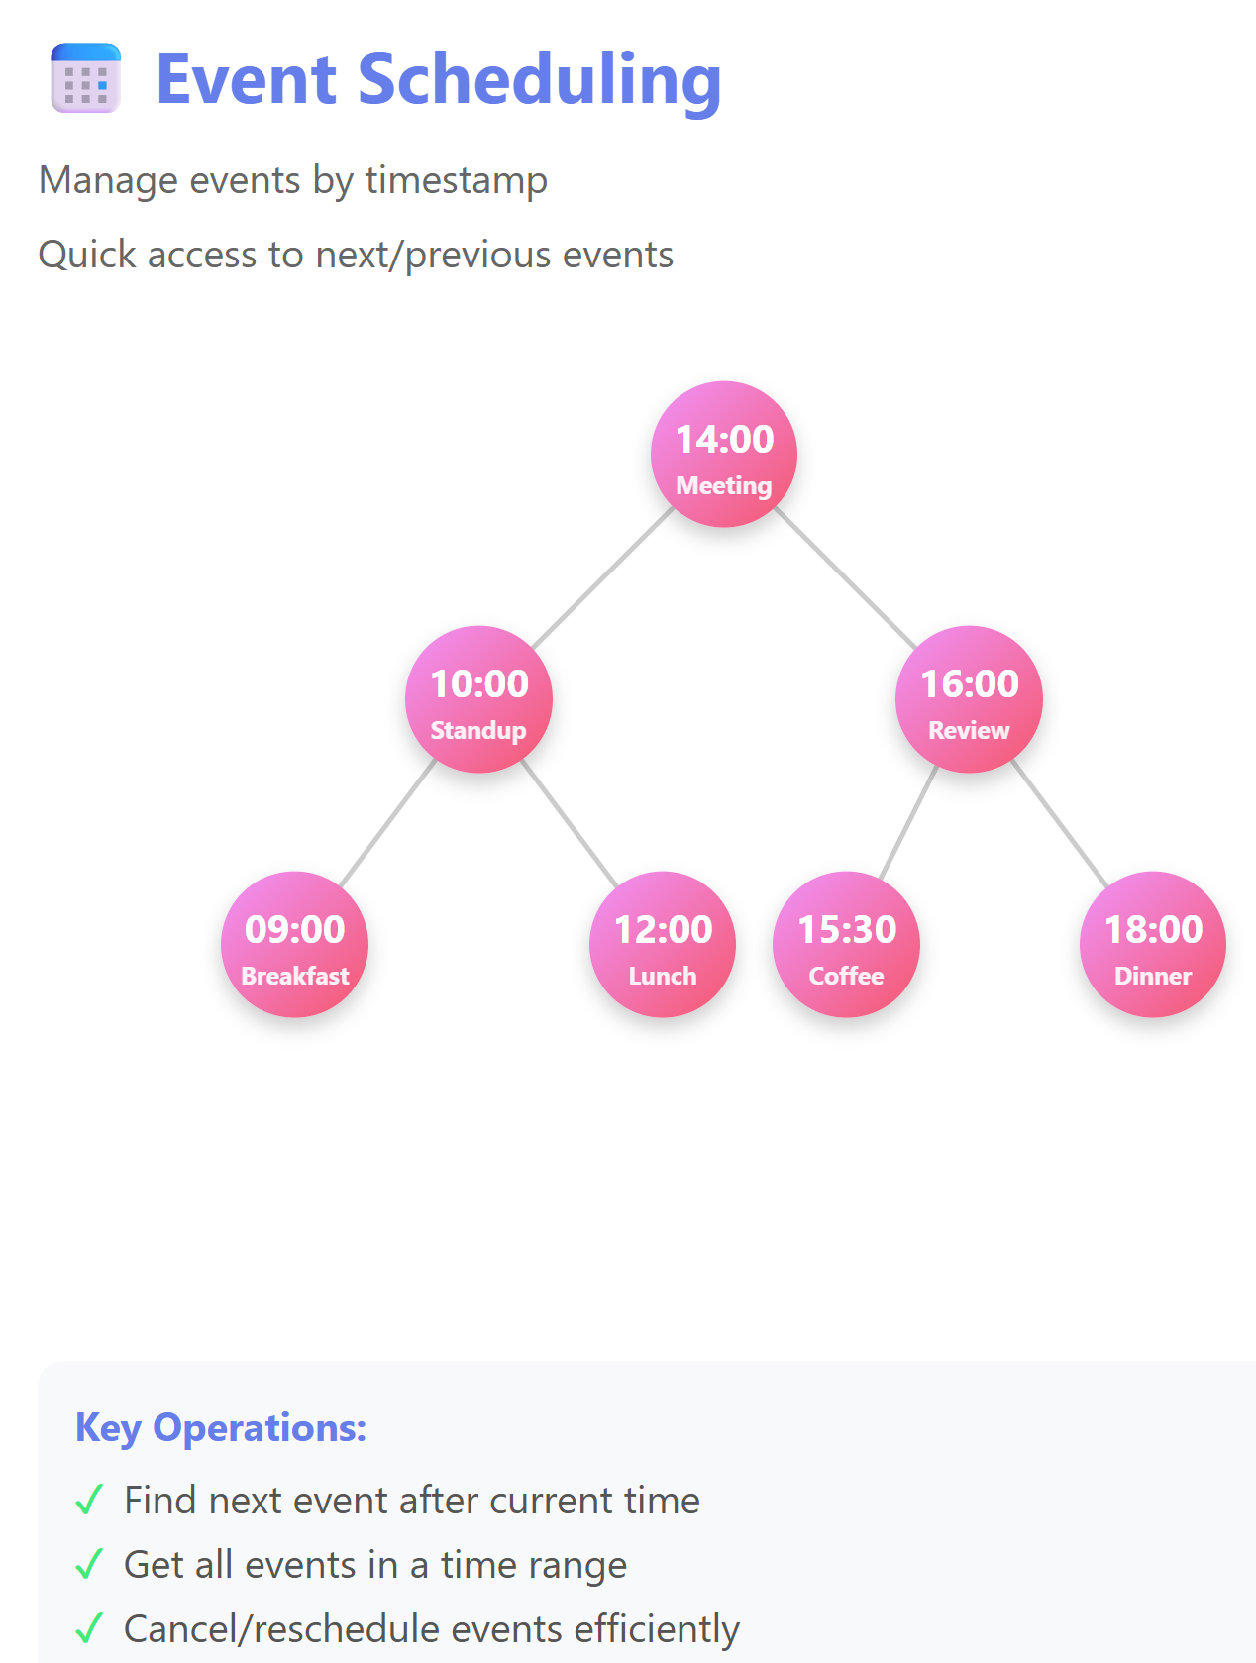
BST Applications

Slide 7
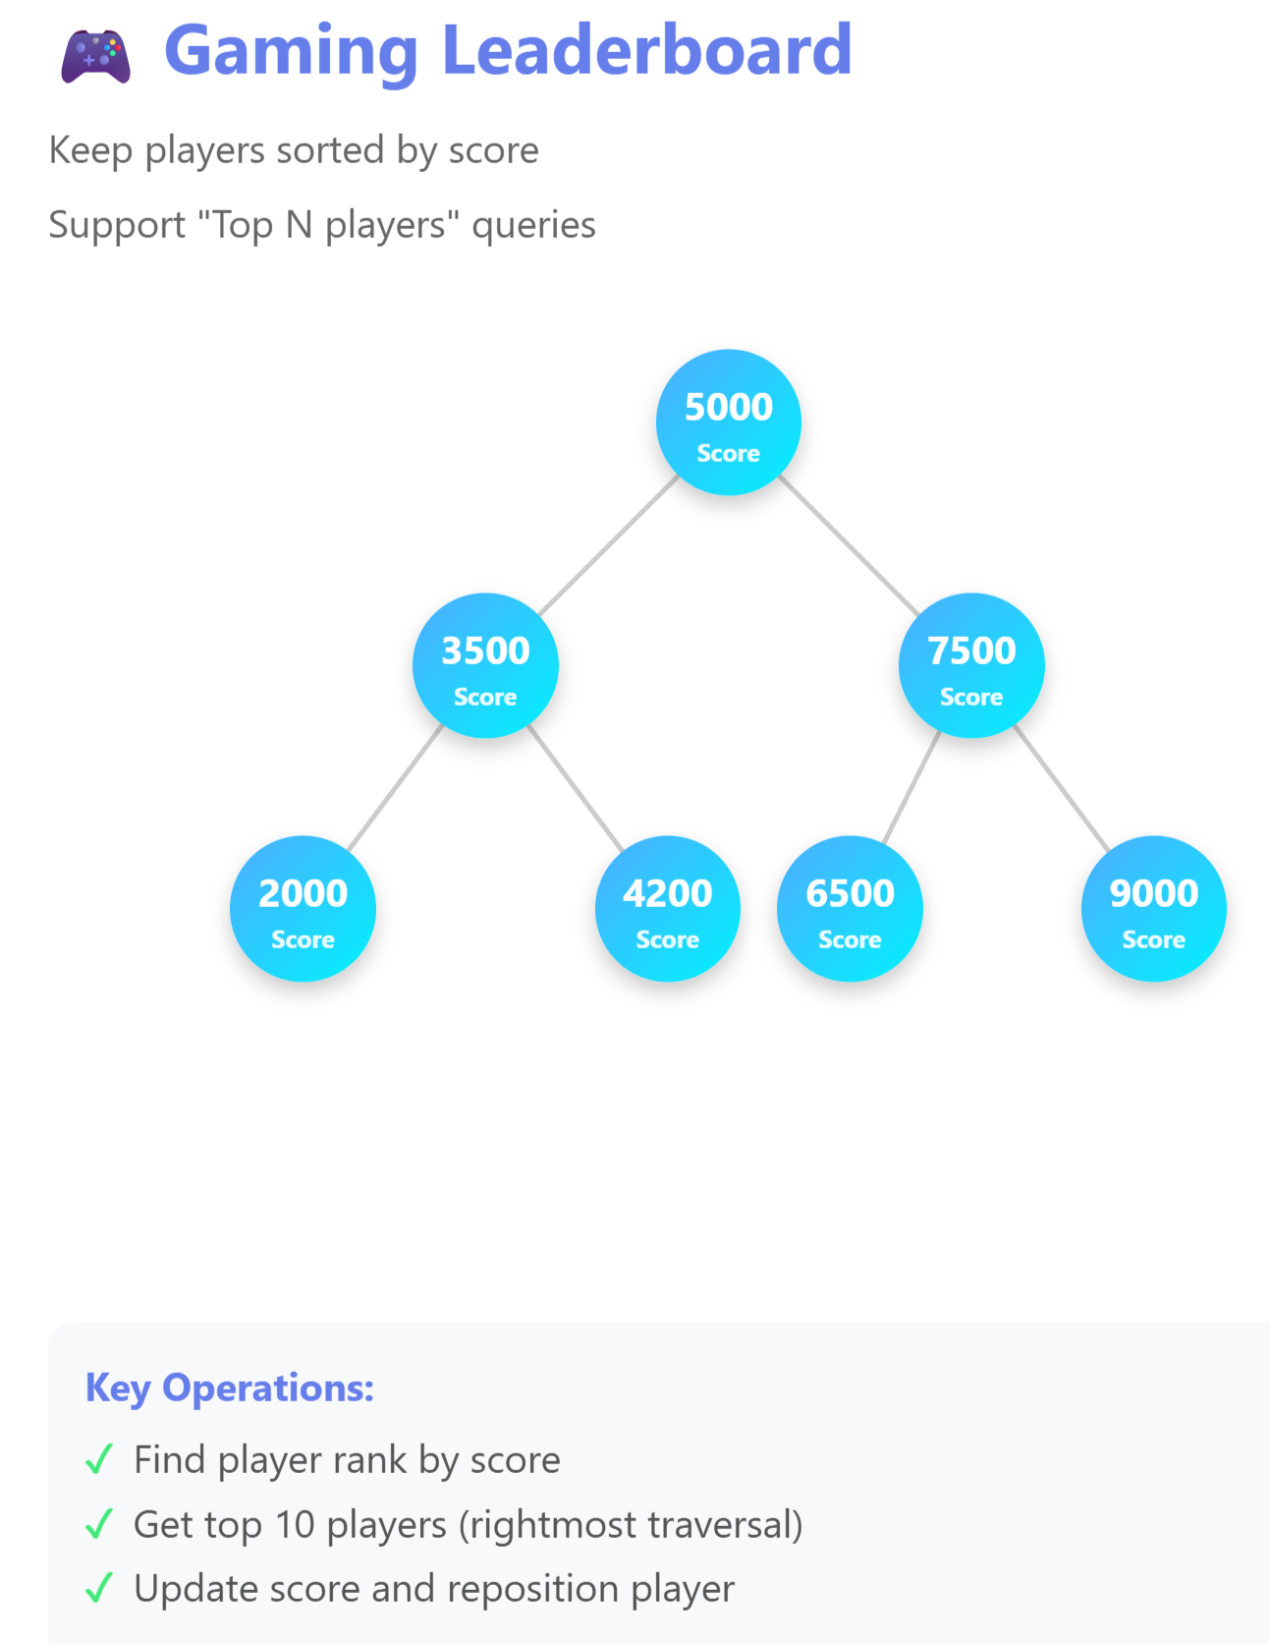
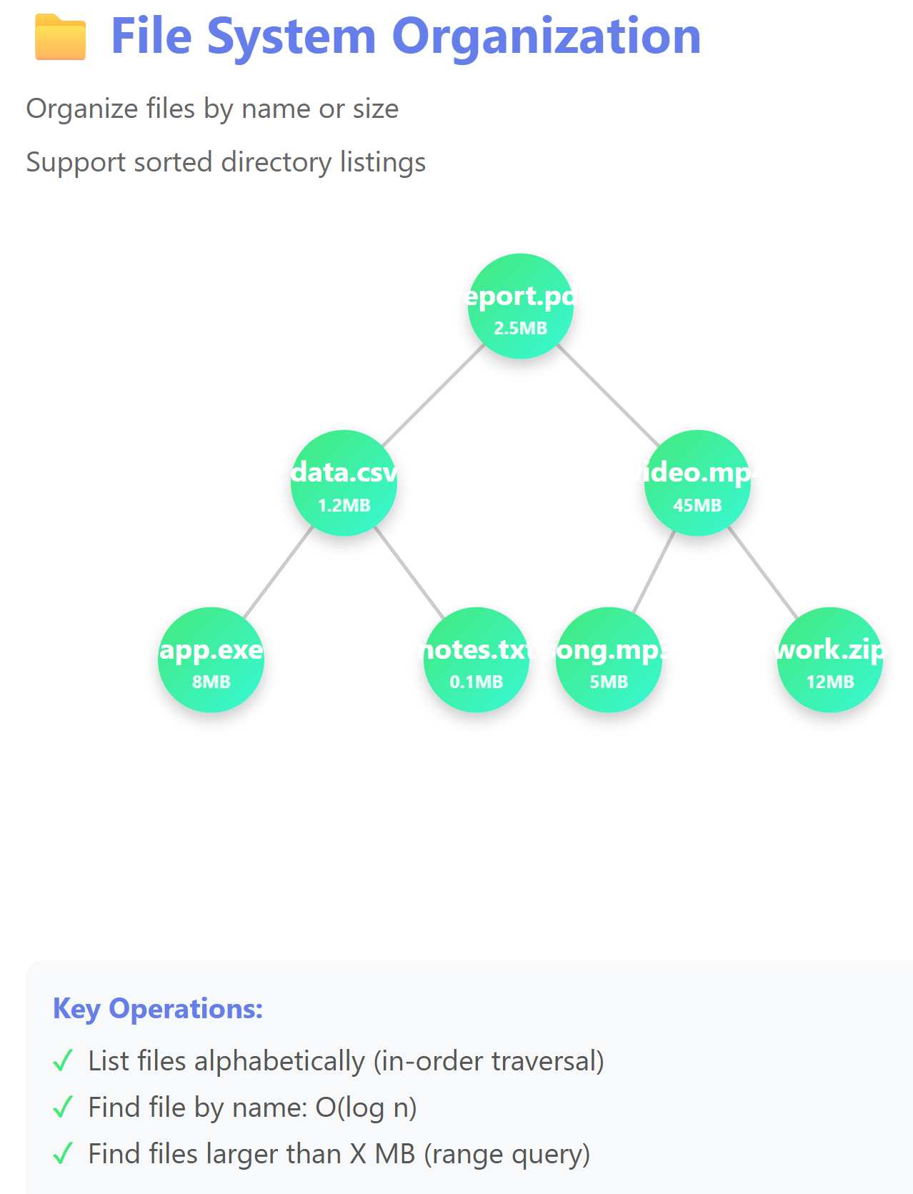
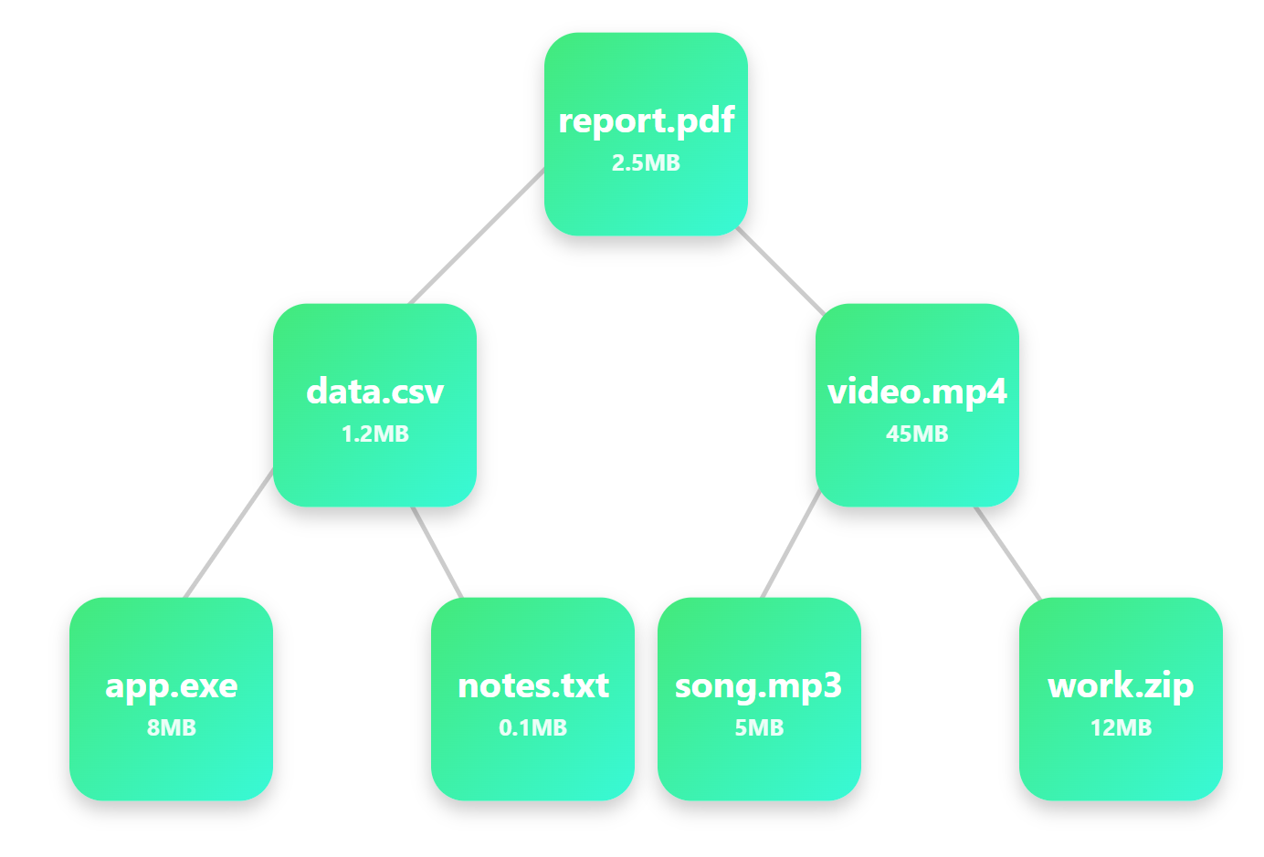
BST Applications

Slide 8
BST Operations: Finding
looking up 19
Leverage the structure of the tree!
empty: the key is not found
non-empty:
Start at the root.
Node contains the key? Found. Exit
If key is smaller than the node’s?
Node has a left child? go left
Else Not Found. Exit
If key is bigger than the node’s?
Node has a right child? go right
Else Not Found. Exit
Go Back to Step 2
12
4
42
0
7
22
-2
19
30


Slide 9

BST Operations: Finding
looking up 10
Leverage the structure of the tree!
empty: the key is not found
non-empty:
Start at the root.
Node contains the key? Found. Exit
If key is smaller than the node’s?
Node has a left child? go left
Else Not Found. Exit
If key is bigger than the node’s?
Node has a right child? go right
Else Not Found. Exit
Go Back to Step 2
12
4
42
0
7
22
-2
19
30

Slide 10
BST Operations: Adding
Do the same steps we would do to search for this entry, and then put it where it should have been
inserting 5
12
4
42
0
7
22
-2
5
19
30

Slide 11
Traversal

Slide 12
Binary Search Tree
For Every Node:
A node can have at most 2 children: left and right.
The left subtree of a node always contains values less than the node.
The right subtree of a node always contains values greater than the node.
Smallest
Largest

Slide 13
In-Order Traversal
(Left – Node – Right)
2) Node
1) Left
3) Right
8
10
12

Slide 14
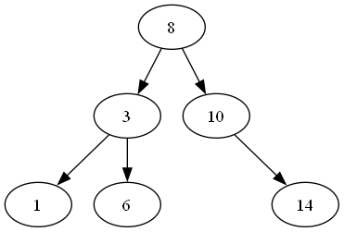
In-Order Traversal
“To traverse a BST in order, do the following at every node: 1️⃣ Traverse the left subtree. 2️⃣ Visit (or print) the current node. 3️⃣ Traverse the right subtree.”

Slide 15
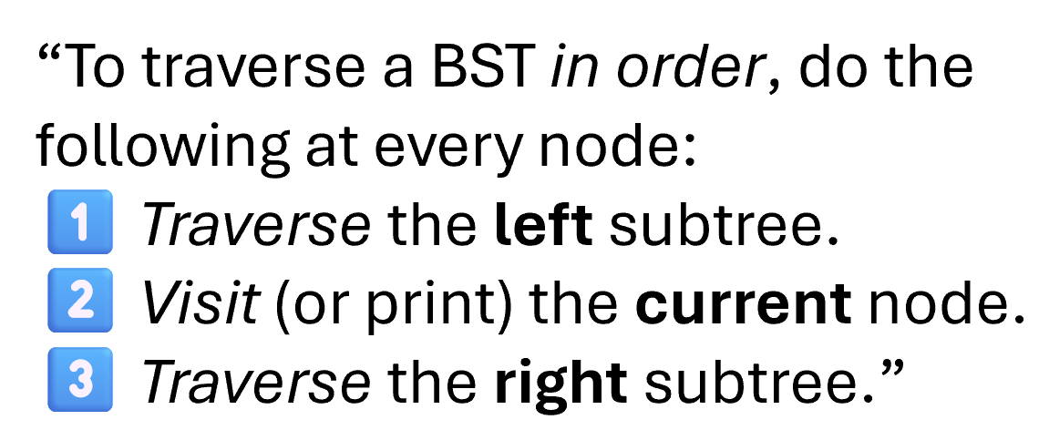
In-Order Traversal
Go left (to 3)
Go left again (to 1) → left is null, so print 1
Back to 3 → print 3
Go right (to 6) → print 6
Back to 8 → print 8
Go right (to 10) → then 14 → print 10, 14
1

Slide 16
In-Order Traversal
Go left (to 3)
Go left again (to 1) → left is null, so print 1
Back to 3 → print 3
Go right (to 6) → print 6
Back to 8 → print 8
Go right (to 10) → then 14 → print 10, 14
1
3
6

Slide 17
In-Order Traversal
Go left (to 3)
Go left again (to 1) → left is null, so print 1
Back to 3 → print 3
Go right (to 6) → print 6
Back to 8 → print 8
Go right (to 10) → then 14 → print 10, 14
1
3
6
8

Slide 18
In-Order Traversal
Go left (to 3)
Go left again (to 1) → left is null, so print 1
Back to 3 → print 3
Go right (to 6) → print 6
Back to 8 → print 8
Go right (to 10) → then 14 → print 10, 14
1
3
6
8
10
14

Slide 19
In-Order Traversal
Go left (to 3)
Go left again (to 1) → left is null, so print 1
Back to 3 → print 3
Go right (to 6) → print 6
Back to 8 → print 8
Go right (to 10) → then 14 → print 10, 14
1
3
6
8
10
14

Slide 20
Pre-Order Traversal
(Node – Left – Right)
1) Node
2) Left
3) Right
10
8
12

Slide 21
Pre-Order Traversal
“To traverse a BST pre order, do the following at every node: 1️⃣ Visit (or print) the current node. 2️⃣ Traverse the left subtree.
3️⃣ Traverse the right subtree.”

Slide 22
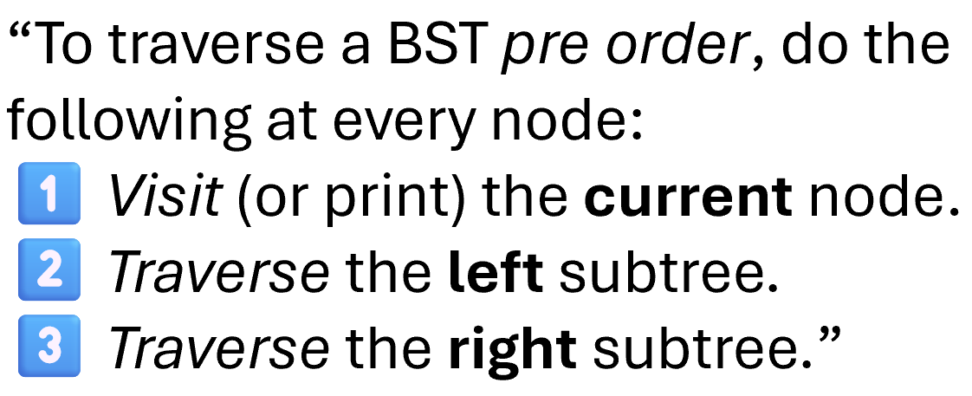
Pre-Order Traversal
Start at 8 → print 8
Go left → 3 → print 3
Go left → 1 → print 1
Back to 3 → right → 6 → print 6
Back to 8 → right → 10 → print 10 → right → 14 → print 14
8
3
1

Slide 23
Pre-Order Traversal
Start at 8 → print 8
Go left → 3 → print 3
Go left → 1 → print 1
Back to 3 → right → 6 → print 6
Back to 8 → right → 10 → print 10 → right → 14 → print 14
8
3
1
6

Slide 24
Pre-Order Traversal
Start at 8 → print 8
Go left → 3 → print 3
Go left → 1 → print 1
Back to 3 → right → 6 → print 6
Back to 8 → right → 10 → print 10 → right → 14 → print 14
8
3
1
6
10
14

Slide 25
Pre-Order Traversal
Start at 8 → print 8
Go left → 3 → print 3
Go left → 1 → print 1
Back to 3 → right → 6 → print 6
Back to 8 → right → 10 → print 10 → right → 14 → print 14
8
3
1
6
10
14

Slide 26
Post-Order Traversal
(Left – Right – Node )
3) Node
1) Left
2) Right
8
12
10

Slide 27
Post-Order Traversal
“To traverse a BST post order, do the following at every node: 1️⃣ Traverse the left subtree. 2️⃣ Traverse the right subtree.”
3️⃣Visit (or print) the current node.

Slide 28
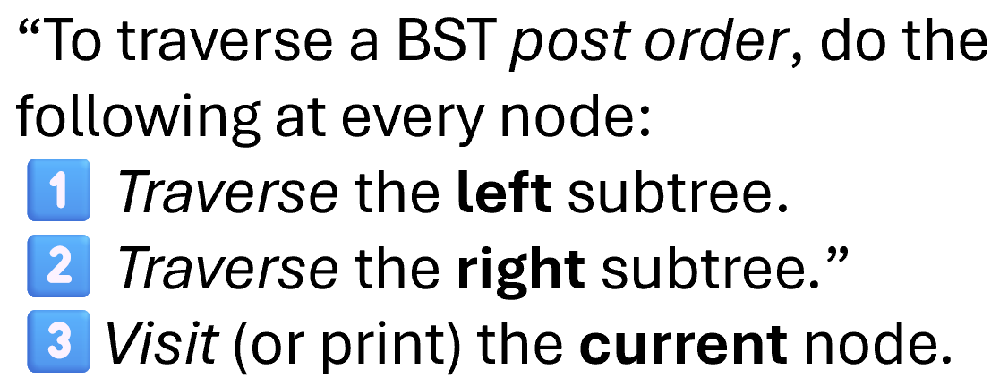
Post-Order Traversal
Go to 8 → go left to 3
Go left to 1 → both left/right null → print 1
Back to 3 → go right to 6 → both left/right null → print 6
Both children of 3 done → print 3
Back to 8 → go right to 10
Go right again to 14 → print 14
Both children of 10 done → print 10
Both children of 8 done → print 8
1

Slide 29
Post-Order Traversal
Go to 8 → go left to 3
Go left to 1 → both left/right null → print 1
Back to 3 → go right to 6 → both left/right null → print 6
Both children of 3 done → print 3
Back to 8 → go right to 10
Go right again to 14 → print 14
Both children of 10 done → print 10
Both children of 8 done → print 8
1
6

Slide 30
Post-Order Traversal
Go to 8 → go left to 3
Go left to 1 → both left/right null → print 1
Back to 3 → go right to 6 → both left/right null → print 6
Both children of 3 done → print 3
Back to 8 → go right to 10
Go right again to 14 → print 14
Both children of 10 done → print 10
Both children of 8 done → print 8
1
6
3
14

Slide 31
Post-Order Traversal
Go to 8 → go left to 3
Go left to 1 → both left/right null → print 1
Back to 3 → go right to 6 → both left/right null → print 6
Both children of 3 done → print 3
Back to 8 → go right to 10
Go right again to 14 → print 14
Both children of 10 done → print 10
Both children of 8 done → print 8
1
6
3
14
10
8

Slide 32
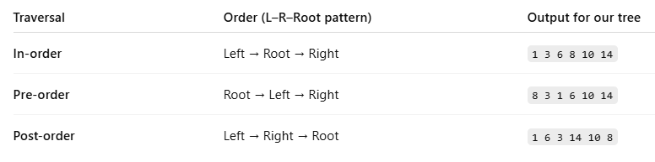
Traversal: Recap

Slide 33
toString

Slide 34
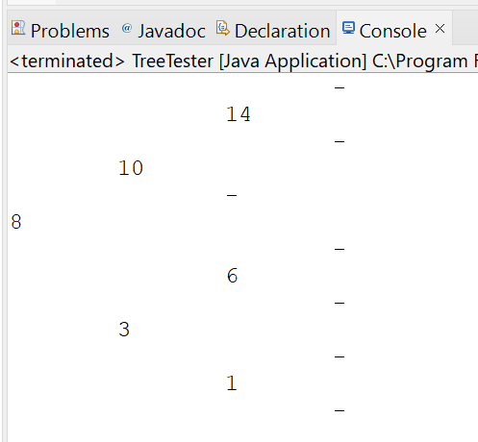
toString

Slide 35
Removal

Slide 36
BST Operations: Removing
Case 1: A Leaf Node
Removing 19
12
4
42
0
7
22
-2
5
19
30

Slide 37
BST Operations: Removing
Case 2: A Parent with One Child
Removing 42
12
4
42
0
7
22
-2
5
19
30

Slide 38
BST Operations: Removing
Case 2: A Parent with One Child
Removing 42
12
4
22
0
7
19
30
-2
5

Slide 39
BST Operations: Removing
The node to promote:
Is it in the left or right subtree?
Is it the smallest value or the largest value in the right subtree?
Where is the smallest value located in the right subtree?
Case 3: A Parent with Two Children
Removing 12
12
4
22
0
7
19
30
-2
5

Slide 40
BST Operations: Removing
Case 3: A Parent with Two Children
Removing 12
19
4
22
0
7
30
-2
5

