Slide 1
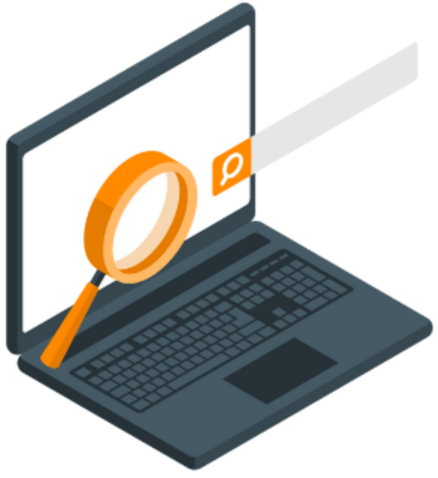
Searching Algorithms

Slide 2
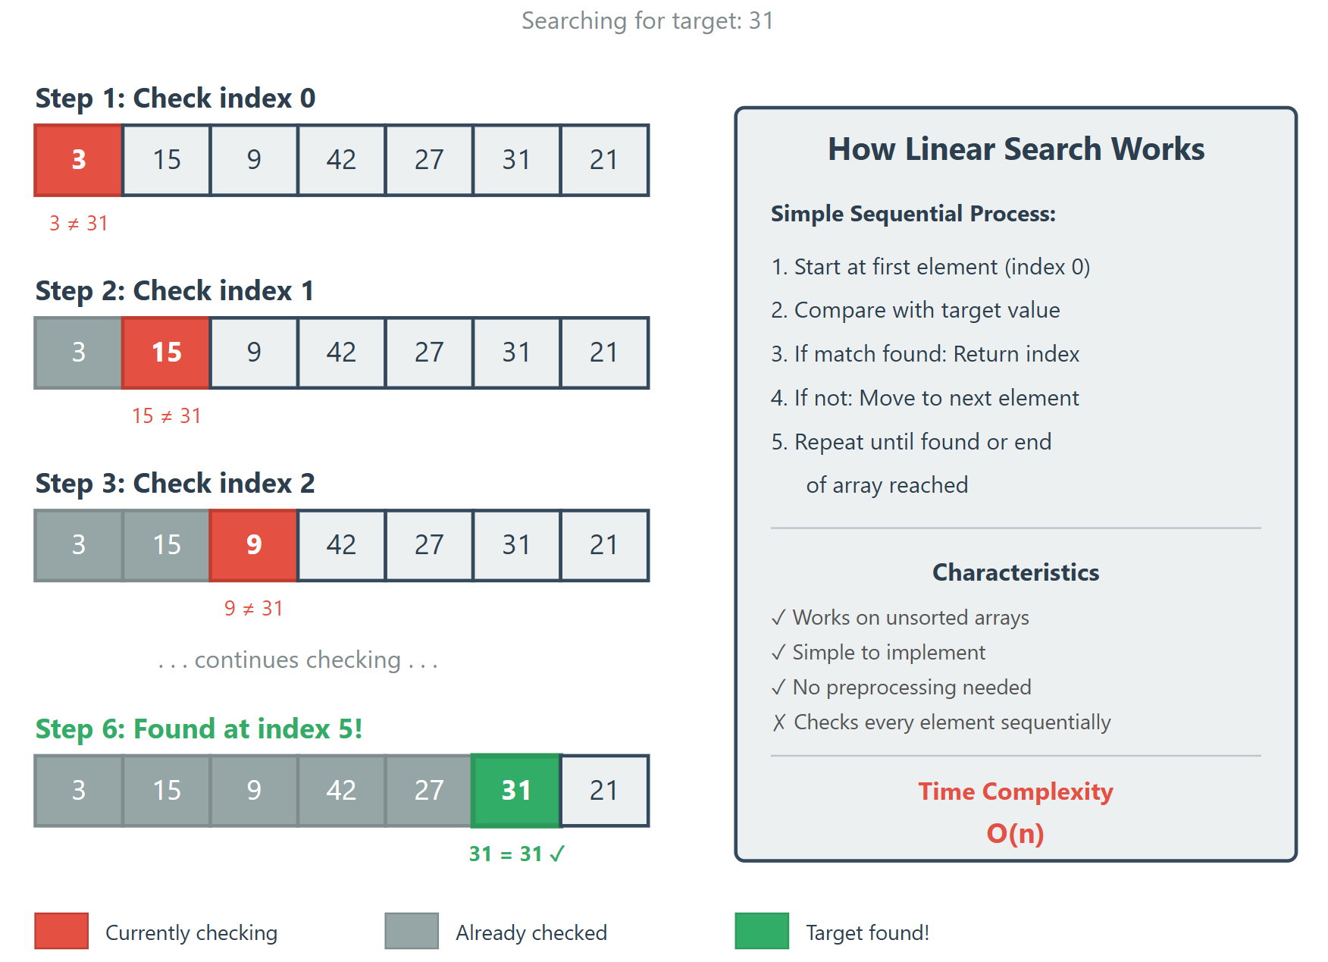
Linear Search

Slide 3
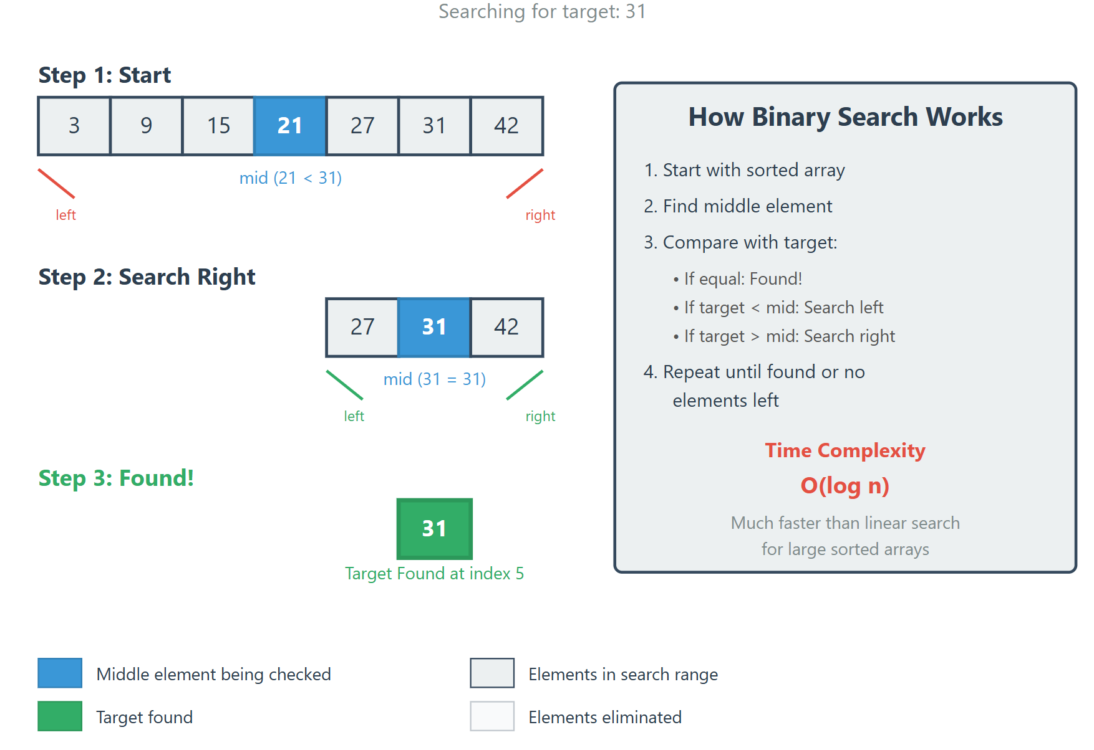
Binary Search (Example 1)
low
high
low
high

Slide 4
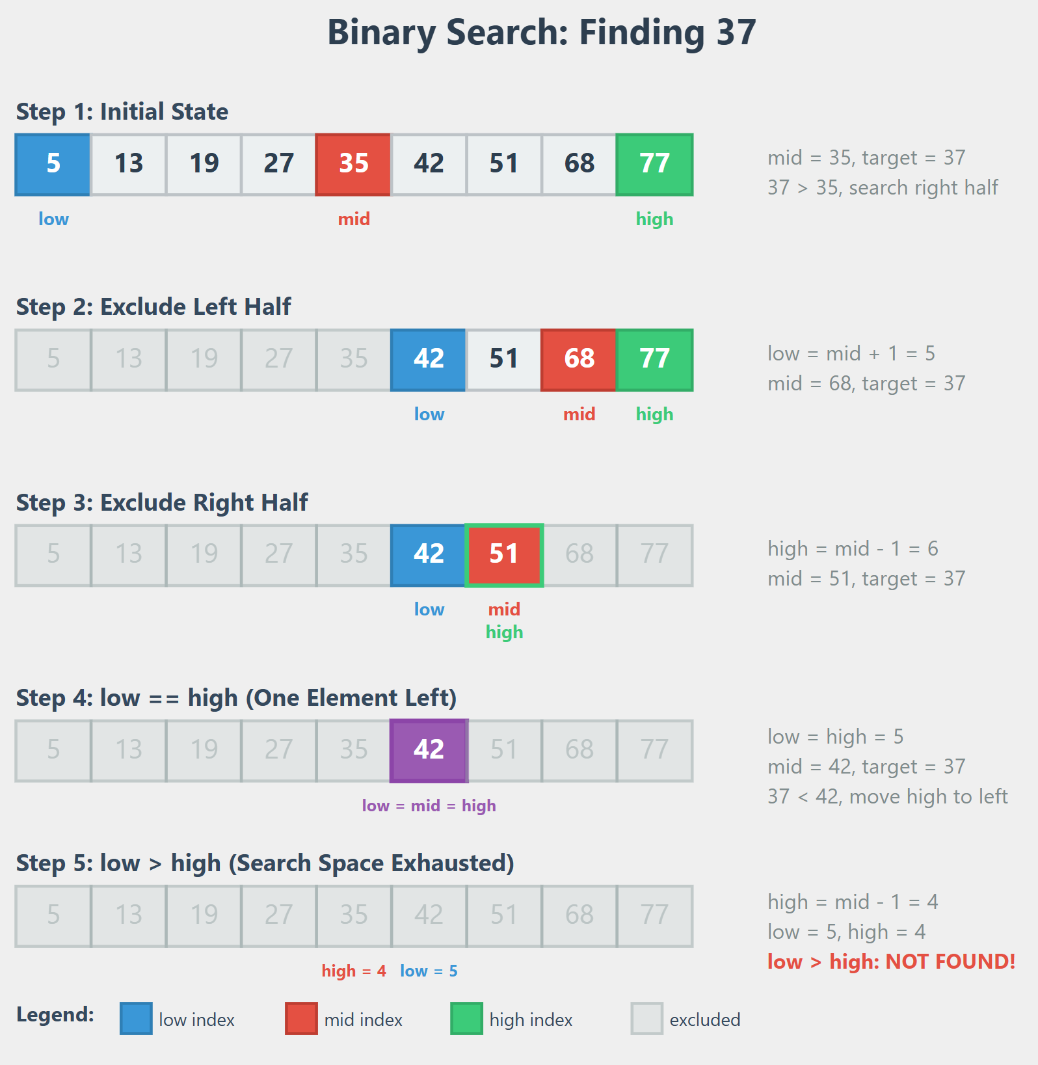
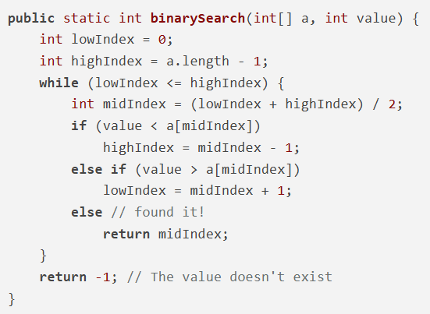
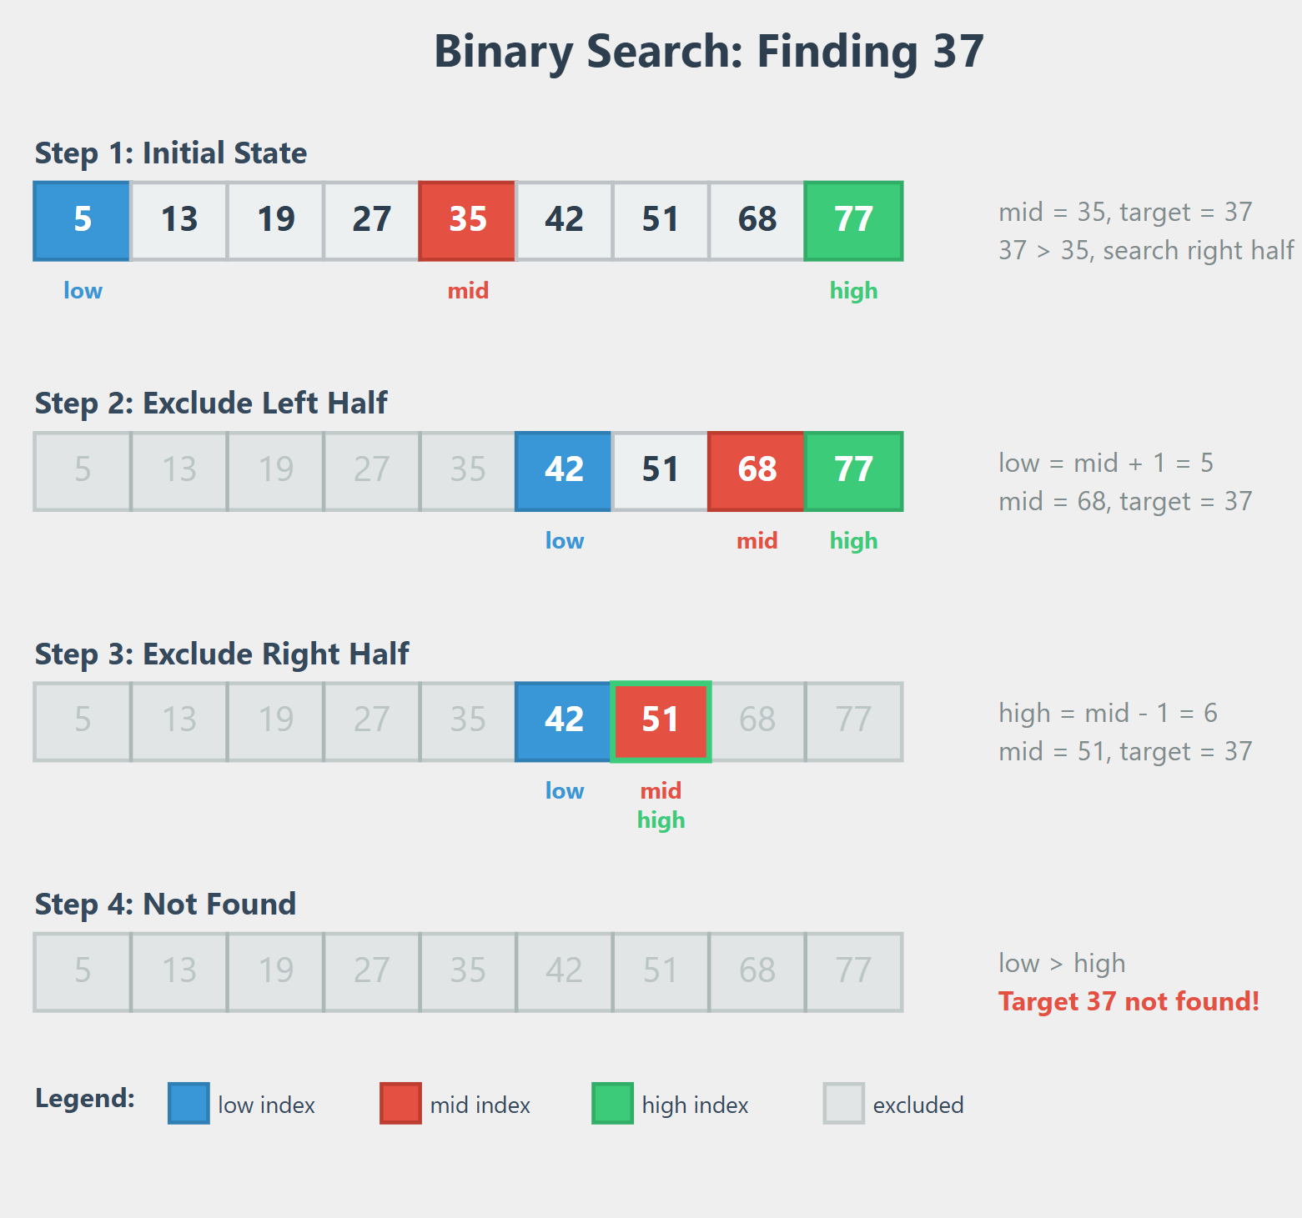


Binary Search (Example 2)
37 > 35
37 < 68
37 < 51
37 < 42

Slide 5
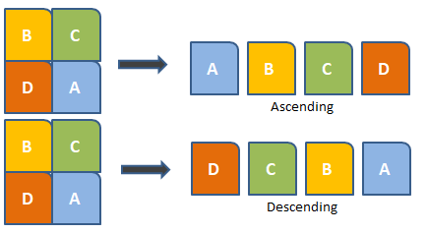
Sorting

Slide 6
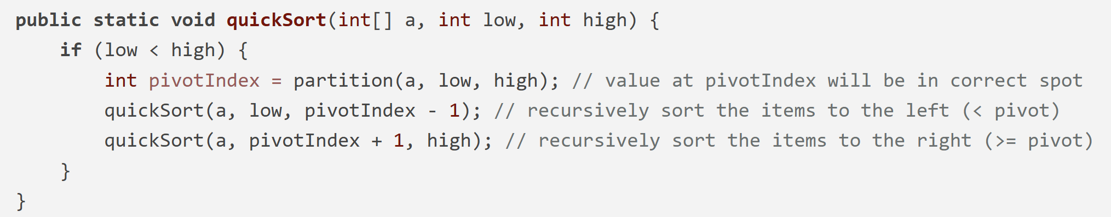
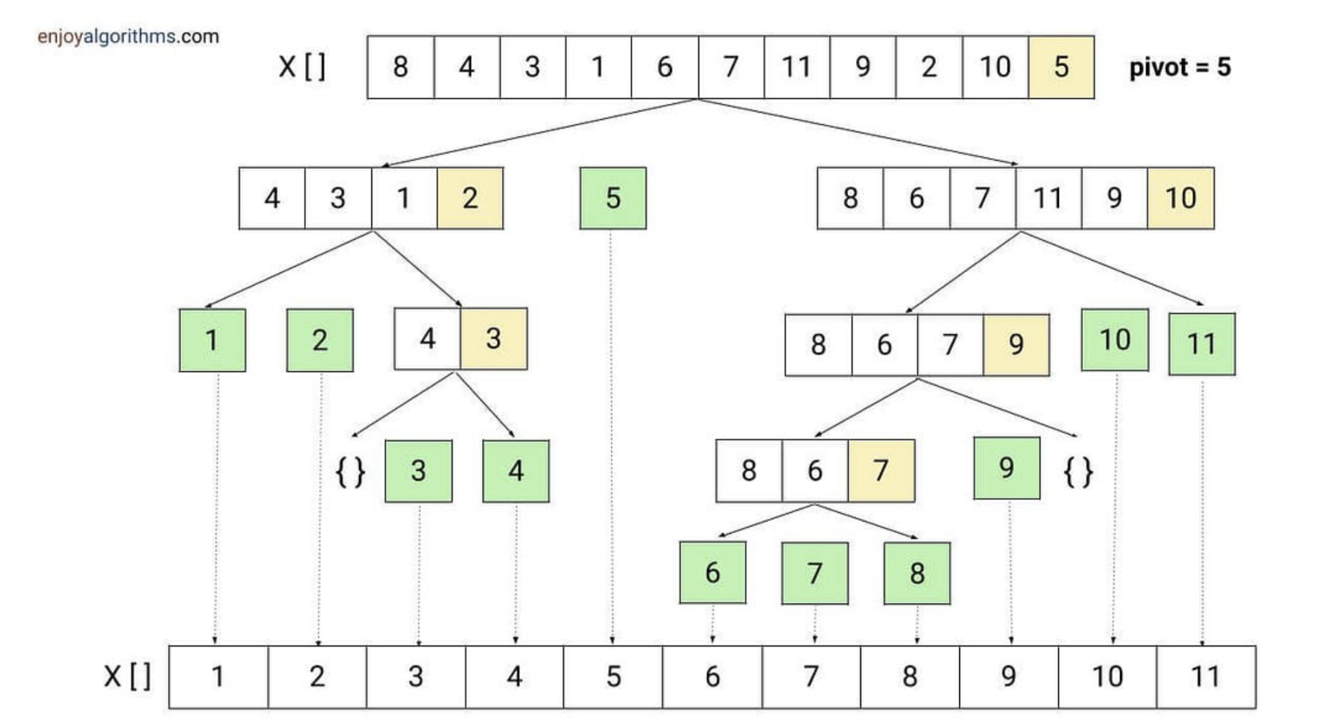
Quick Sort: Example
QuickSort(X, 0, 10)
partition(X, 0, 10) >>
pivot index=4
QuickSort(X, 0, 3)
Partition(X, 0, 3)
pivot index= 1
0
3
5
10
QuickSort(X, 0, 0) -DONE
0
2
3
QuickSort(X, 2, 3)
Partition(X, 2, 3)
PivotIndex= 2
QuickSort(X, 2, 1) - DONE
QuickSort(X, 3, 3)- DONE
2
3
4
5
1
Note: Pivot chosen to be the right most element
Notes:
https://www.enjoyalgorithms.com/blog/quick-sort-algorithm

Slide 7
Quick Sort: Example
QuickSort(X, 0, 10)
QuickSort(X, 5, 10)
partition(X, 0, 10) >>
pivot index=4
Partition(X, 5, 10)
PivotIndex= 9
QuickSort(X, 0, 3)
QuickSort(X, 5, 8)
Partition(X, 0, 3)
pivot index= 1
Partition(X, 5, 8)
PivotIndex= 8
5
10
QuickSort(X, 0, 0) -DONE
QuickSort(X, 5, 7)
5
8
10
QuickSort(X, 2, 3)
Partition(X, 5, 7)
PivotIndex= 6
Partition(X, 2, 3)
PivotIndex= 2
5
7
QuickSort(X, 5, 5) -DONE
QuickSort(X, 2, 1) - DONE
QuickSort(X, 3, 3)- DONE
2
3
4
5
6
7
8
9
10
11
QuickSort(X, 7, 7) -DONE
1
QuickSort(X, 9, 8) -DONE
Note: Pivot chosen to be the right most element
QuickSort(X, 10, 10) -DONE
Notes:
https://www.enjoyalgorithms.com/blog/quick-sort-algorithm

Slide 8
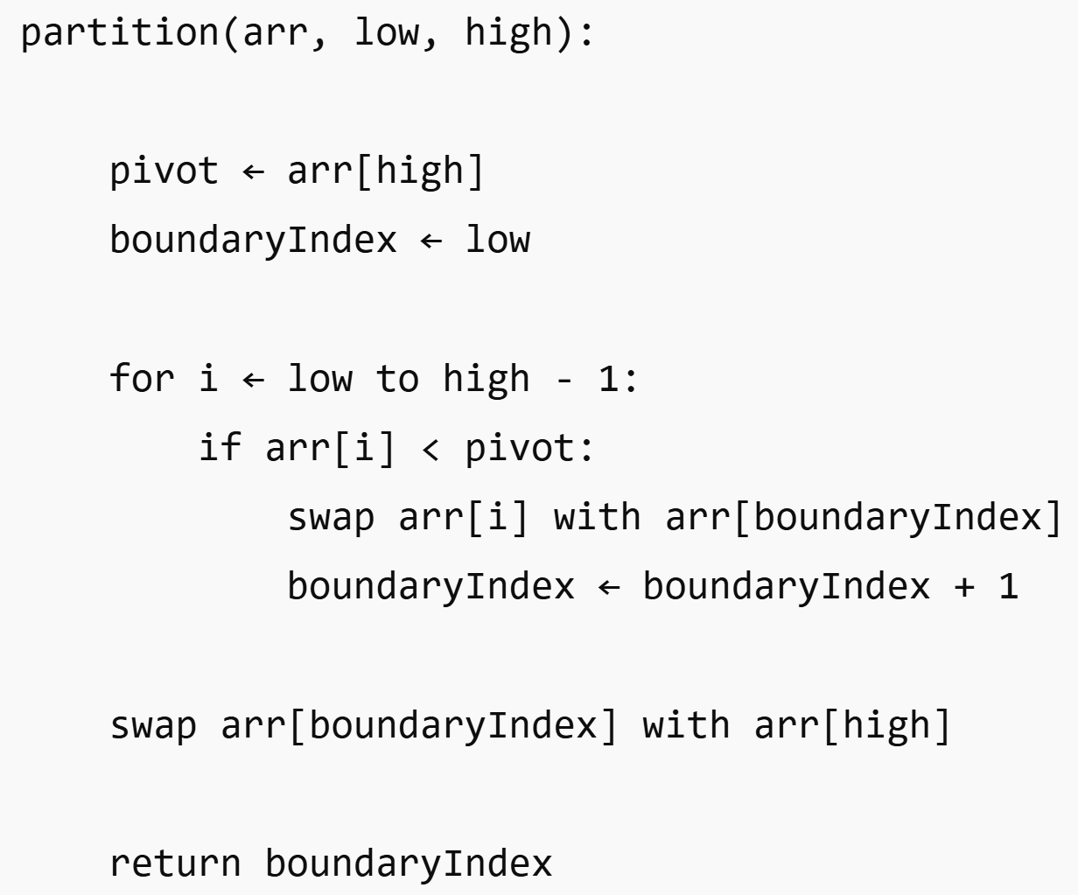
Quick Sort: Partitioning
(Using last element as the Pivot)
Pseudocode
boundaryIndex tracks the start of elements greater than the pivot

Slide 9
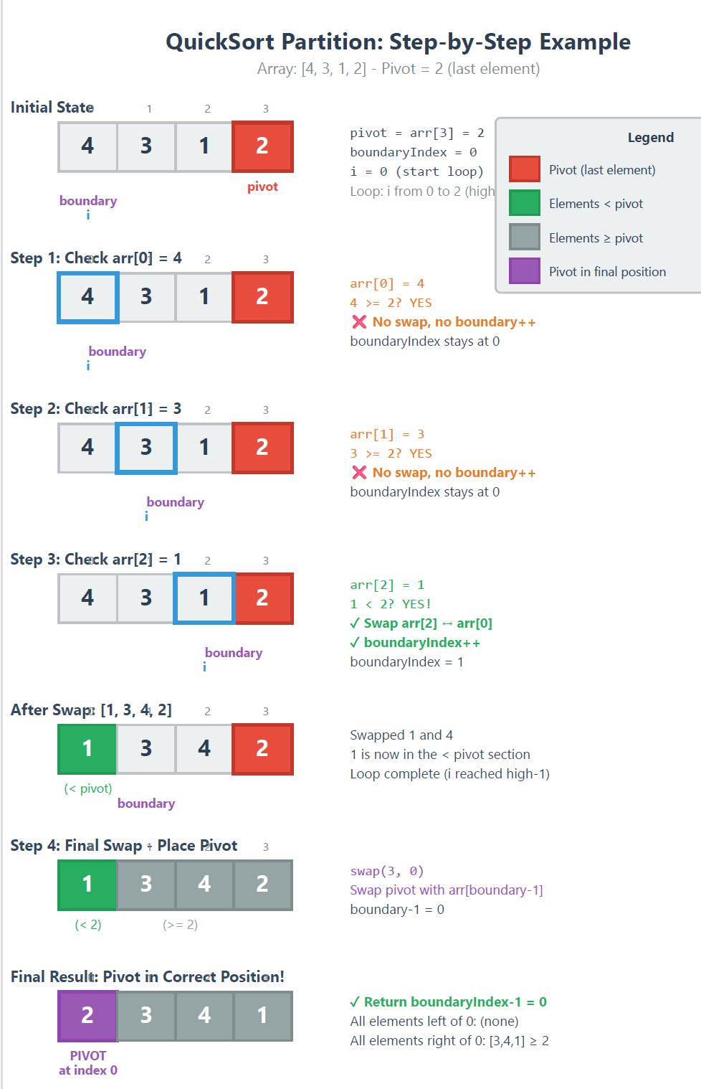

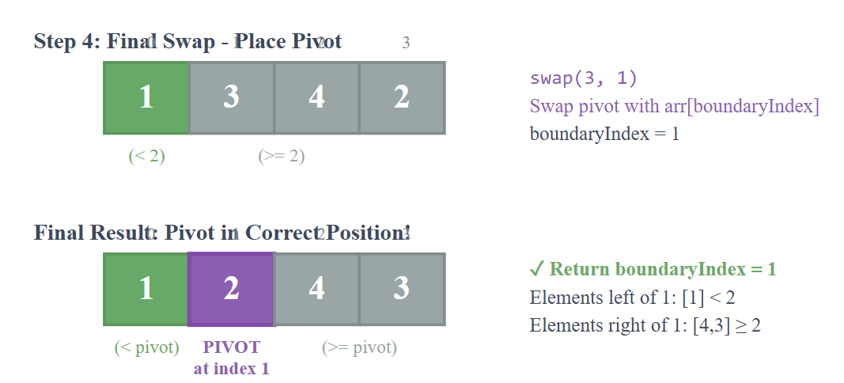

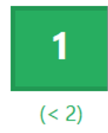
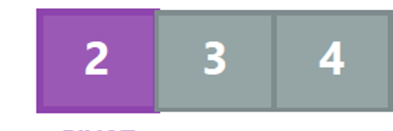
Quick Sort: Partitioning Example1
(Using last element as the Pivot)

Slide 10
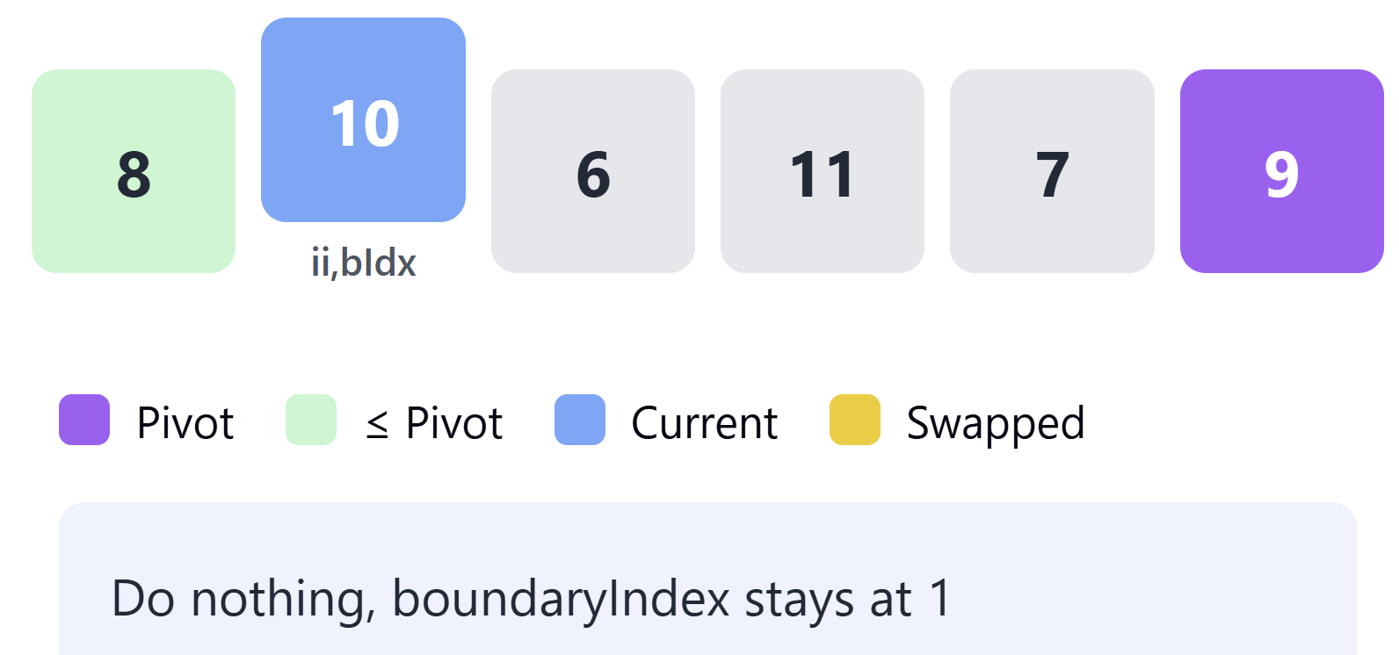
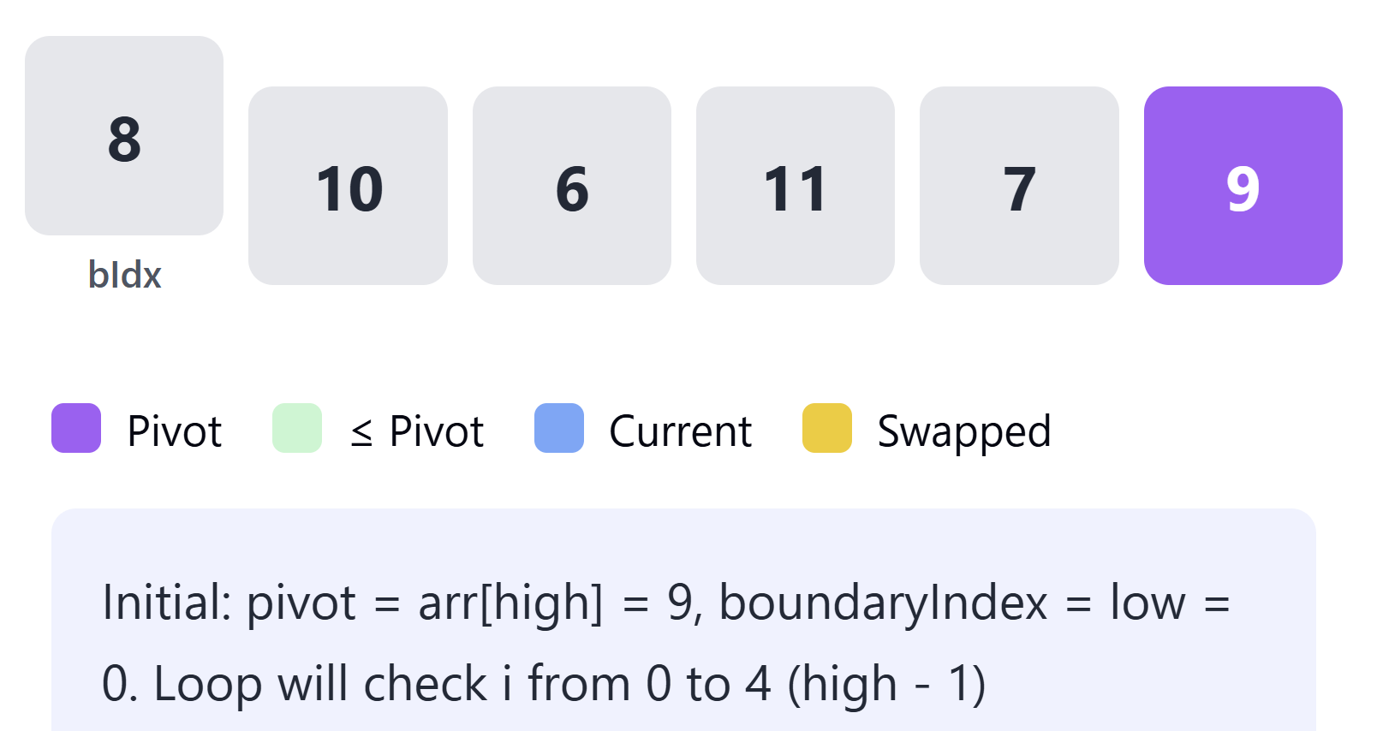
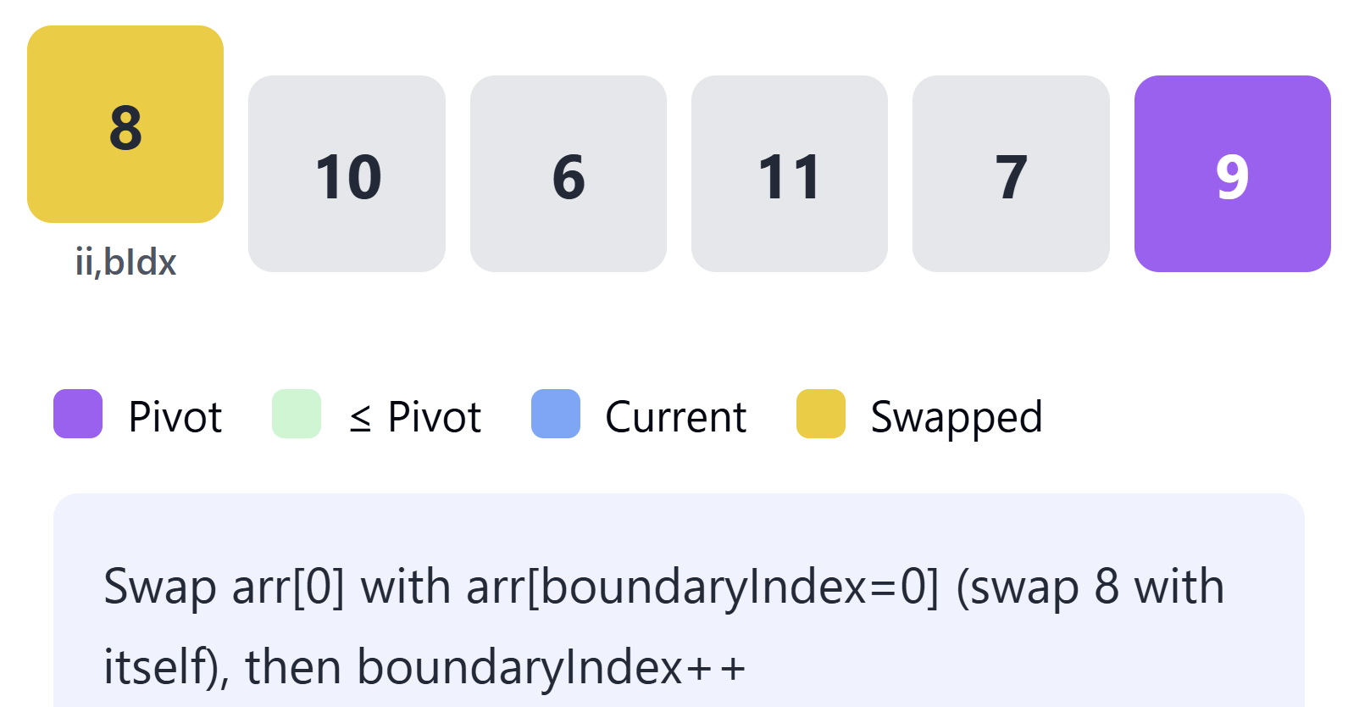
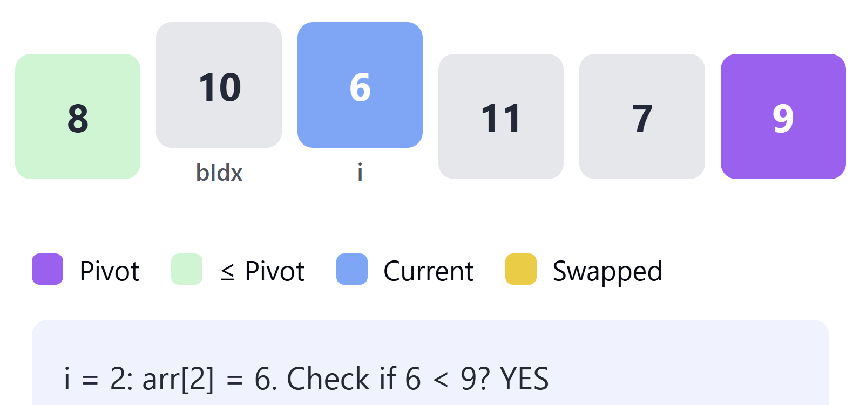
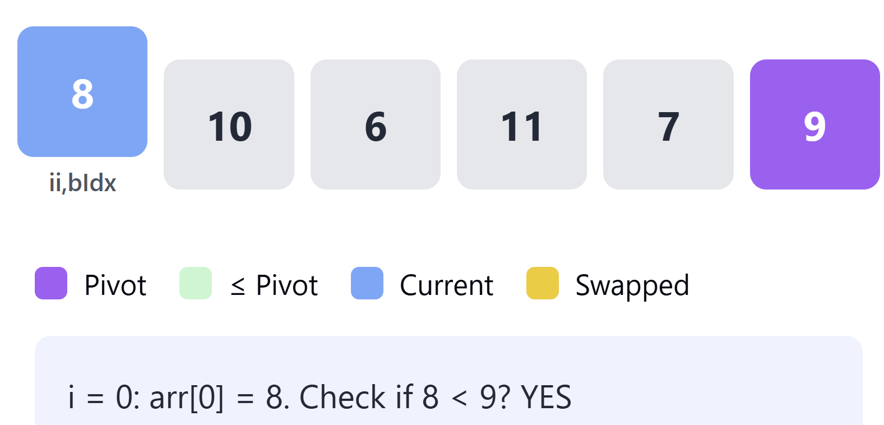
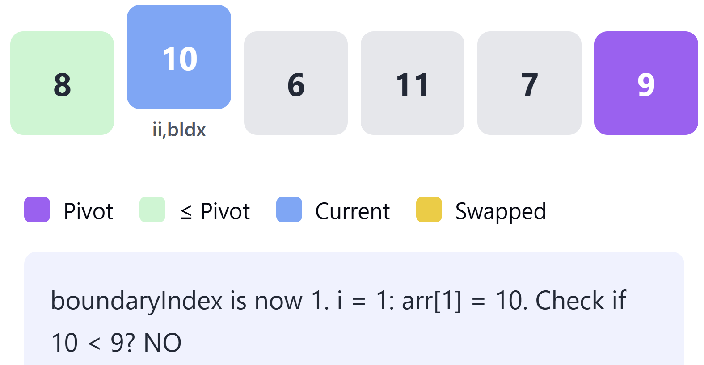
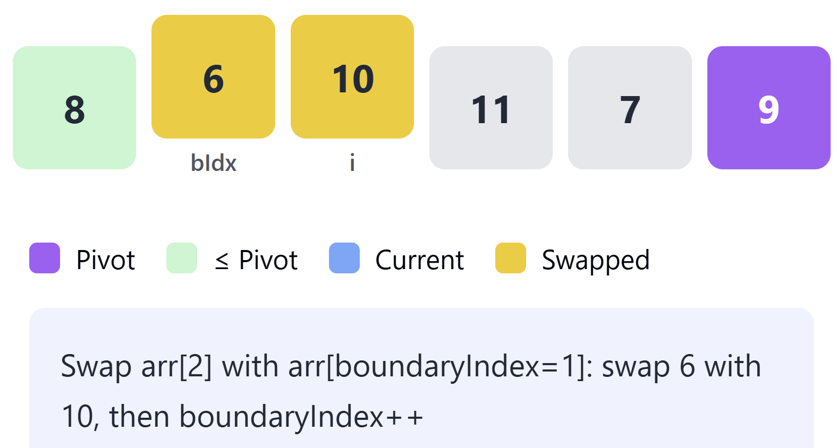
Quick Sort: Partitioning Example2 (Using last element as the Pivot)
5)
1)
3)
6)
2)
4)
7)

Slide 11
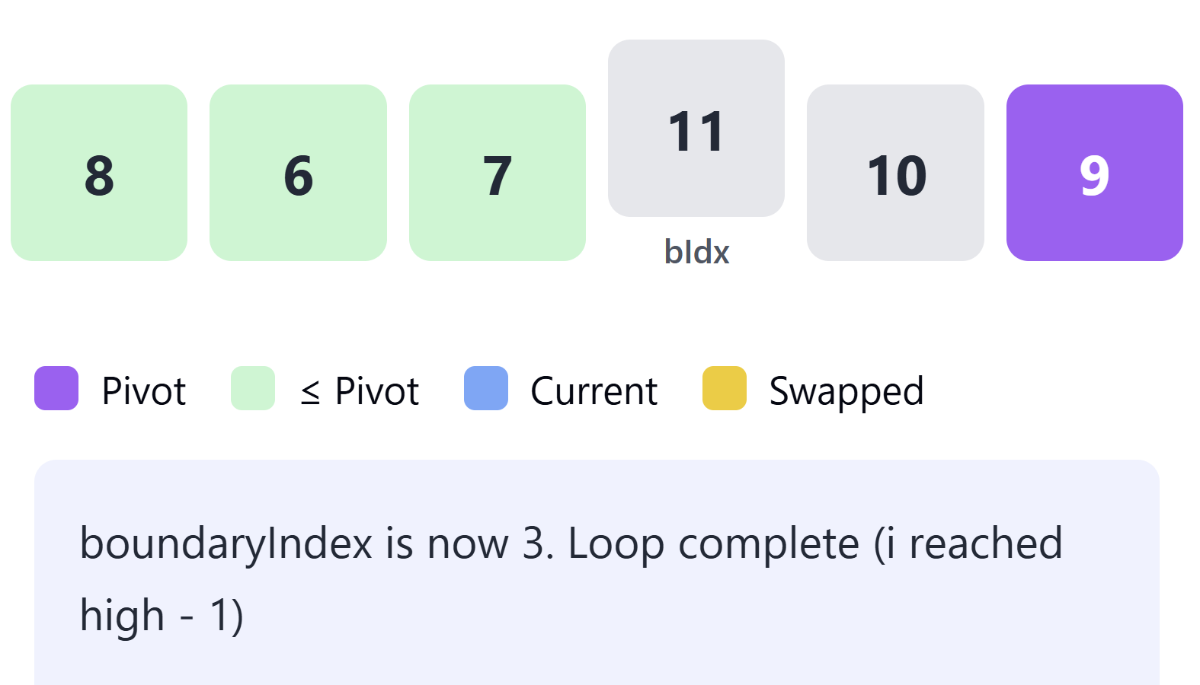
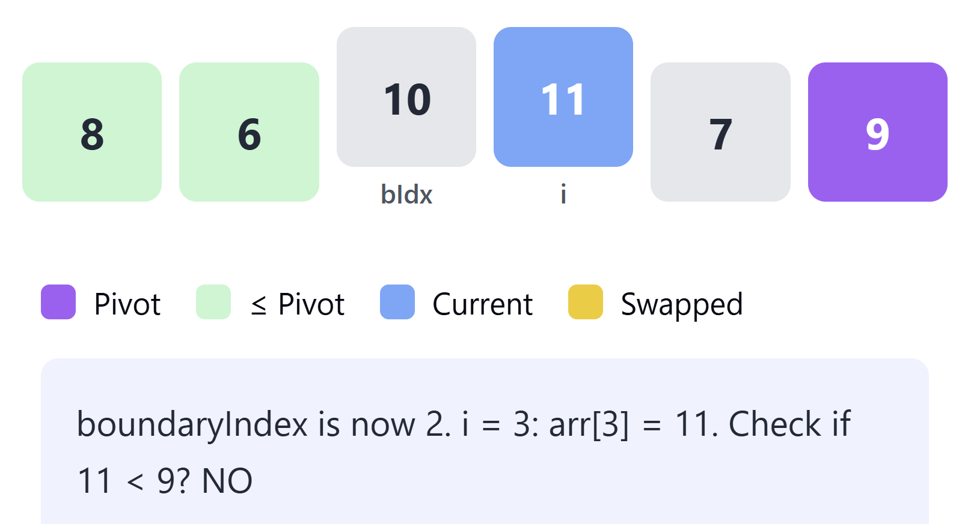
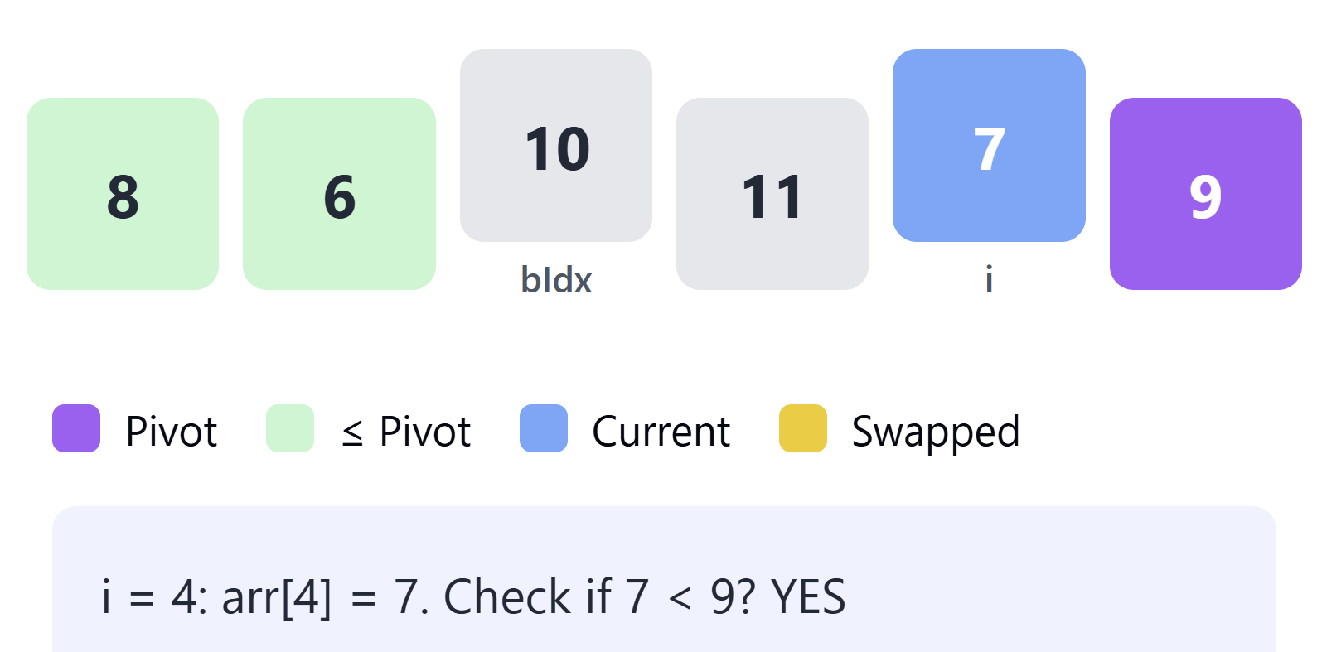
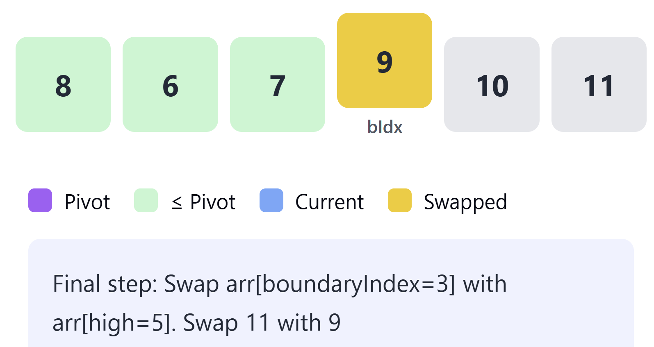
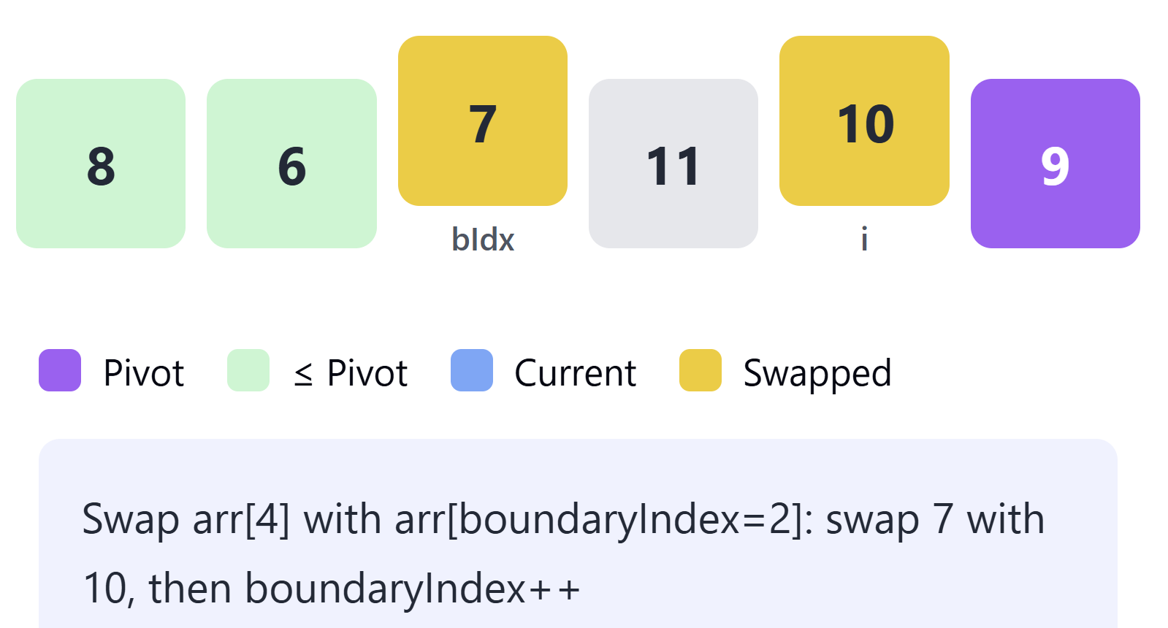
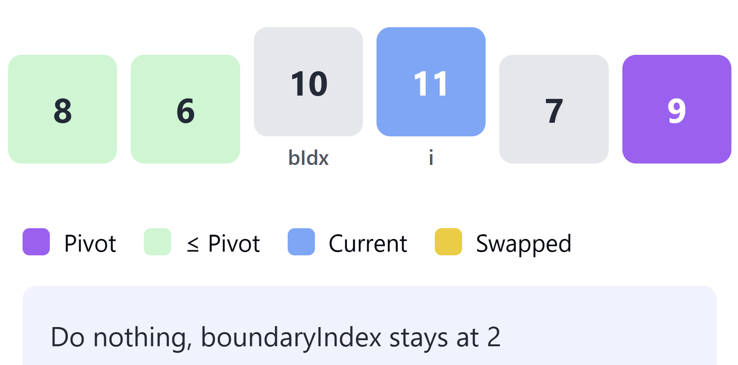
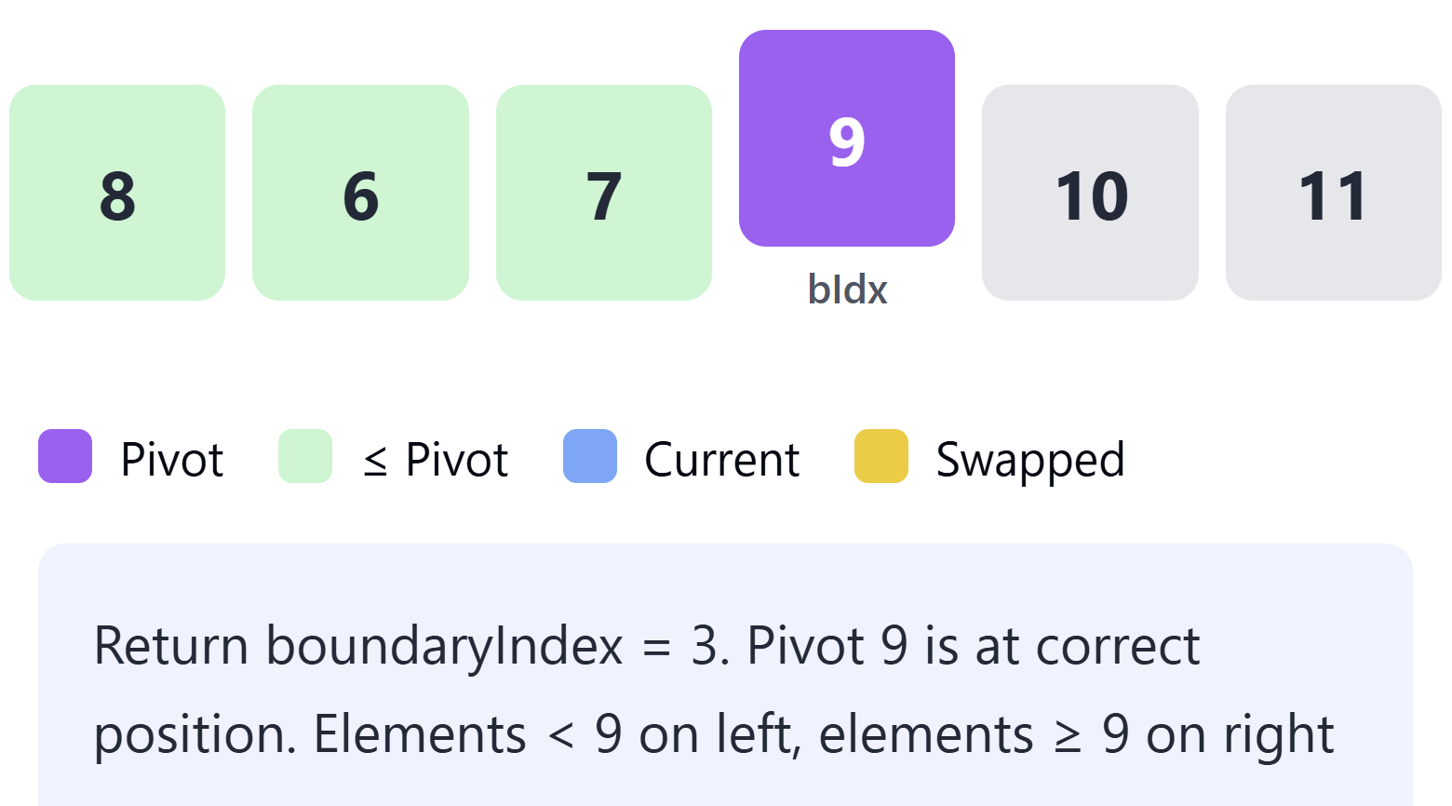
Quick Sort: Partitioning Example2 (Using last element as the Pivot)
12)
8)
10)
13)
9)
11)
14)

Slide 12
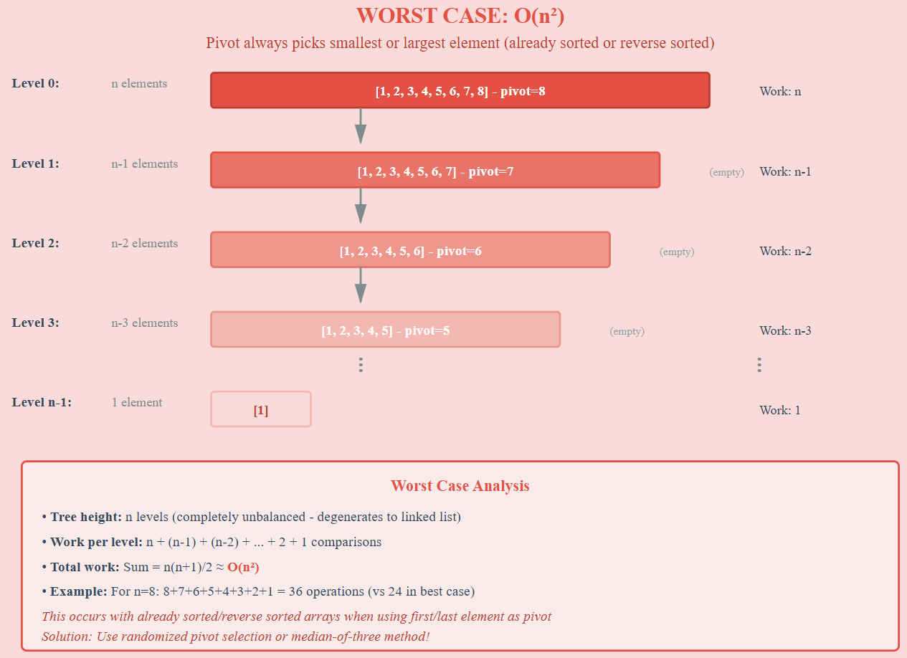
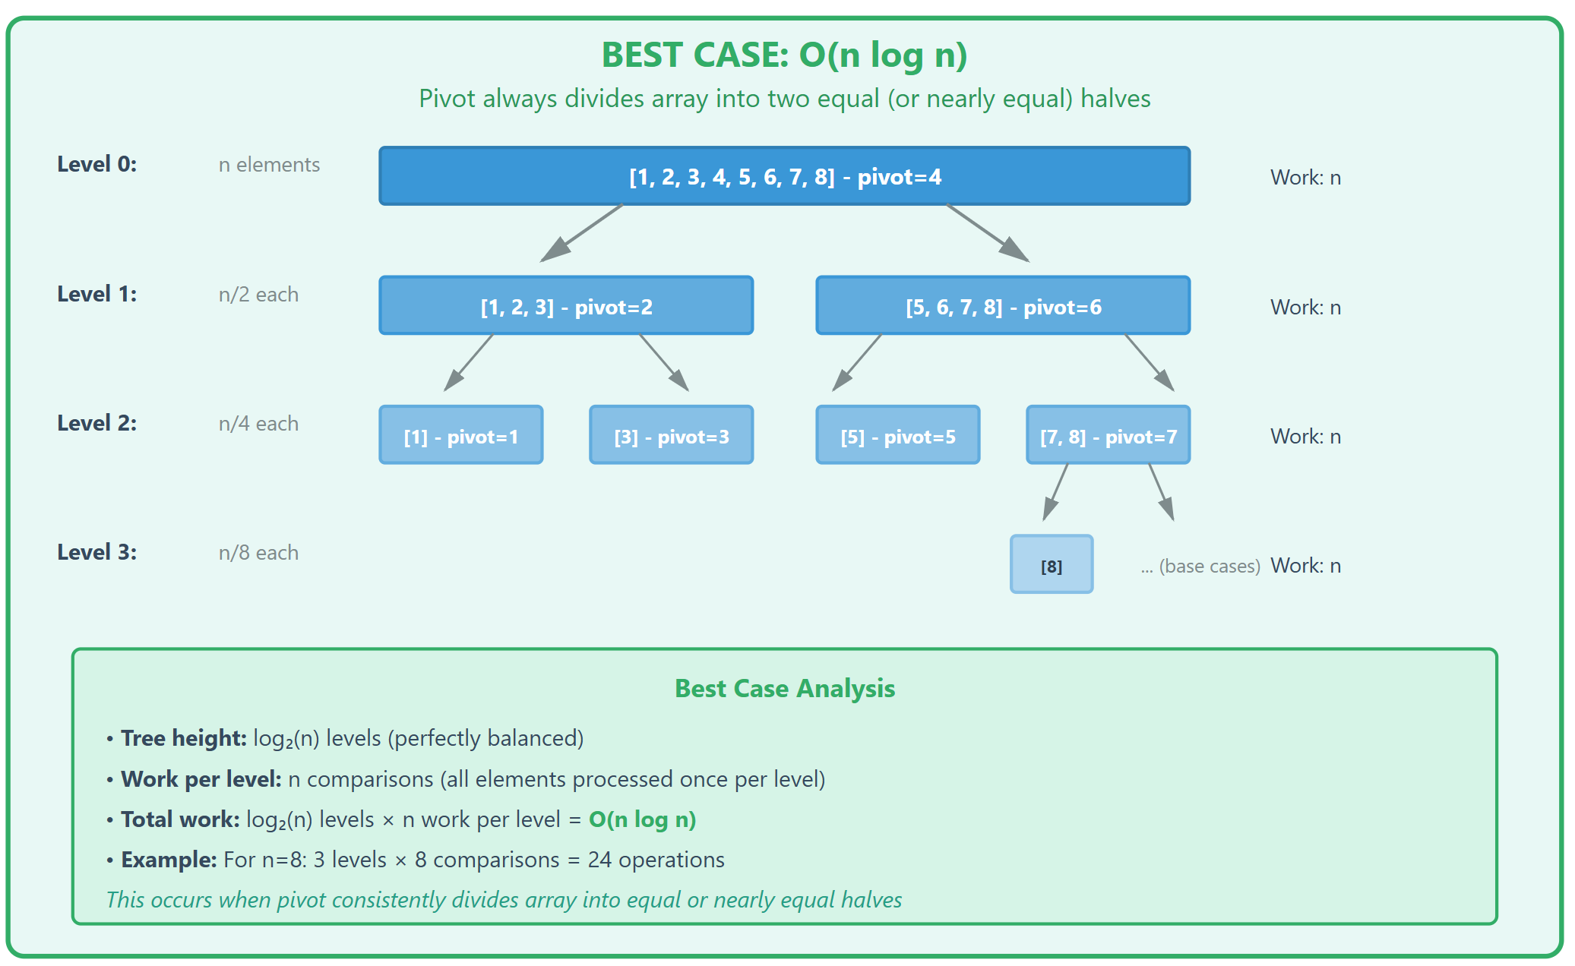
Quick Sort: Theoretical Time Complexity
Best Case
Worst Case
O(n): n comparisons at each iteration/level

