Slide 1
Binary Search Tree

Slide 2
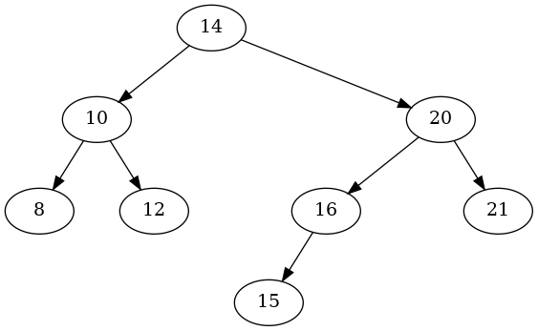
Tree Terminology
edge
root
child
Depth/Level 0
Depth/Level 1
subtree
Height of the Tree
Depth/Level 2
Depth/Level 3
Leaf

Slide 3

Binary Search Tree
For Every Node:
A node can have at most 2 children: left and right.
The left subtree of a node always contains values less than the node.
The right subtree of a node always contains values greater than the node.
Smallest
Largest

Slide 4
Removal

Slide 5
BST Operations: Removing
Case 1: A Leaf Node
Removing 19
12
4
42
0
7
22
-2
5
19
30

Slide 6
BST Operations: Removing
Case 2: A Parent with One Child
Removing 42
12
4
42
0
7
22
-2
5
19
30

Slide 7
BST Operations: Removing
Case 2: A Parent with One Child
Removing 42
12
4
22
0
7
19
30
-2
5

Slide 8
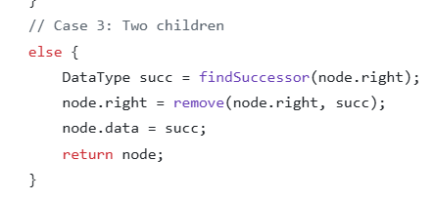
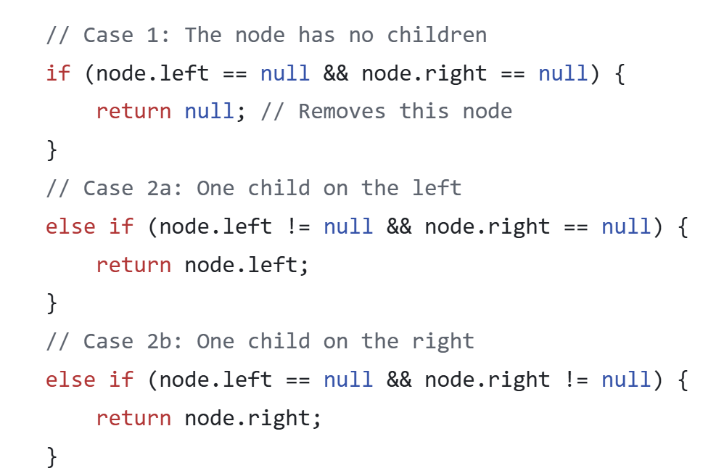
BST Operations: Removing
The node to promote:
Is it in the left or right subtree?
Is it the smallest value or the largest value in the right subtree?
Where is the smallest value located in the right subtree?
Case 3: A Parent with Two Children
Removing 12
12
4
22
0
7
19
30
-2
5
19 is leaf node
(Case 1).

Slide 9
BST Operations: Removing
Case 3: A Parent with Two Children
Removing 12
19
4
22
0
7
30
-2
5

Slide 10
BST Operations: Removing
What if Node (19) had a child?
What will happen to this child?
Case 3: A Parent with Two Children
Removing 12
12
4
22
Node 19 will be removed recursively.
Since it has one child, the child will be promoted to take its place (Case 2)
0
7
19
30
-2
5
20
21

Slide 11
BST Operations: Removing
What if Node (19) had a child?
What will happen to this child?
Case 3: A Parent with Two Children
Removing 12
19
4
22
Node 19 will be removed recursively.
Since it has one child, the child will be promoted to take its place (Case 2)
0
7
20
30
-2
5
21

Slide 12
BST Operations: Removing
Case 3: A Parent with Two Children
If (19) had one left child OR two children
Removing 12
12
it wouldn’t be the in-order successor of (12).
The left-child would be the in-order successor
4
22
0
7
19
30
-2
5
18
20
21

Slide 13
Remove Code Worked Example

Slide 14
Efficiency

Slide 15
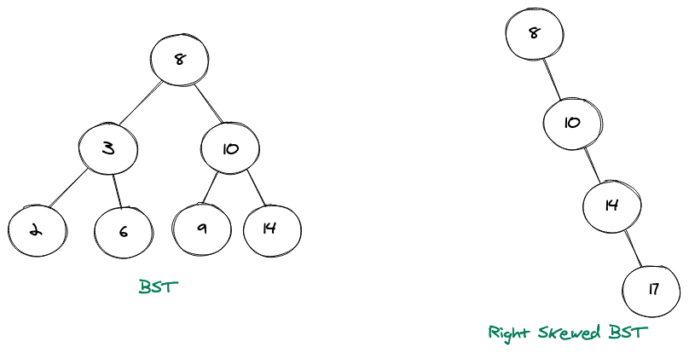
BST Basic Operations Complexity
Find Item: 5
5 < 8
What is the worst case if I try to find an item in the tree?
Item exists in the last level OR doesn’t exist
5 > 3
How about Other Basic Operations?
Remove: Same as find
Add: adding already happens at the last level
5 < 6

Slide 16
BST Basic Operations Complexity
Find Item: 5
What is the worst case if I try to find an item in the tree?
5 < 8
Steps for a tree of height (h):
Traverse h levels (h iterations)
At each level: Compare the item value with the node
O(1): constant; irrelevant of inpt size (i.e. number of nodes)
Apply the operation: add node, remove node, etc.
O(1): constant; irrelevant of input size (i.e. number of nodes)
5 > 3
5 < 6
Complexity: O(h)

Slide 17
BST Basic Ops Complexity: O(h) – What is (h) for a tree with (n) nodes?
Level ID
Total # Levels
# Nodes @ Current Level
Total # of Nodes So far
0
1
1
1
1
2
2
3
2
3
4
7

Slide 18
BST Basic Ops Complexity: O(h) – What is (h) for a tree with (n) nodes?
Level ID
Total # Levels
# Nodes @ Current Level
Total # of Nodes So far
0
1
1
1
1
2
2
3
2
3
4
7
Total Number of Levels (Height) = 3
(i.e. levels 0, 1, 2)

Slide 19
BST Basic Ops Complexity: O(h) – What is (h) for a tree with (n) nodes?
Level ID
Total # Levels
# Nodes @ Current Level
Total # of Nodes So far
0
1
1
1
1
2
2
3
2
h
n
4

Slide 20
BST Basic Ops Complexity: O(h) – What is (h) for a tree with (n) nodes?
Total # Levels
Total # of Nodes So far
1
1
= 2¹ − 1
How does (h) relate to (n)?
2
3
= 2² − 1
h
n
= 2^{h}− 1

Slide 21
BST Basic Ops Complexity: O(h) – What is (h) for a tree with (n) nodes?
2^{h} − 1 =
n
BST Basic Operations Complexity:
O( h ) =
O( log(n) )
2^{h} =
n+1
log₂​(2^{h}) = log₂​(n+1)
h = log₂​(n+1)

Slide 22
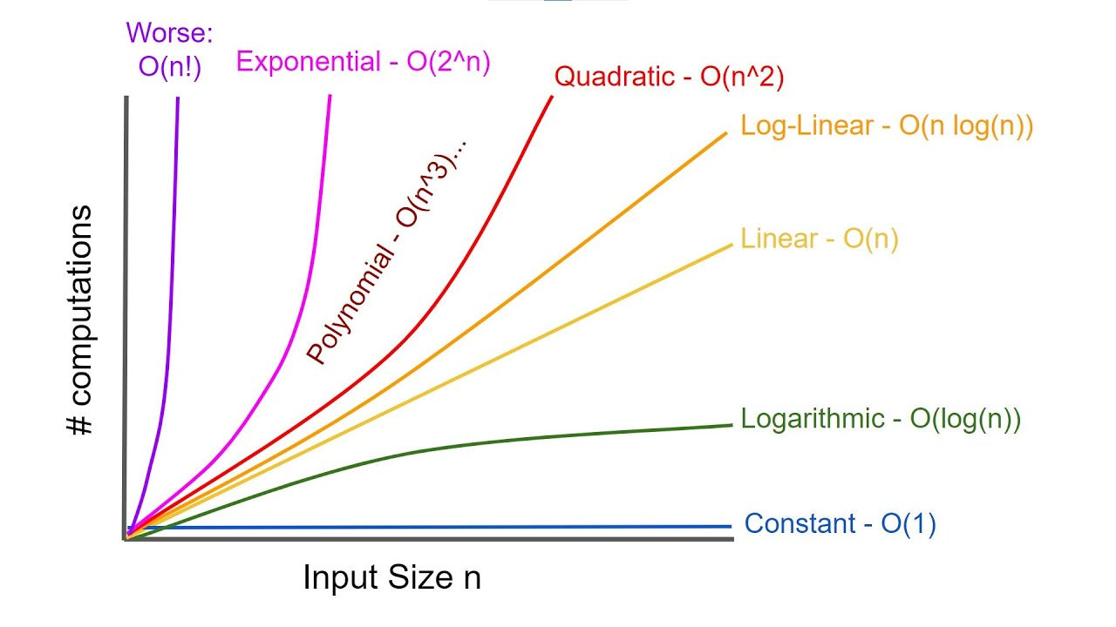
Log(n) Compared to Other Complexity Classes

Slide 23
Balanced BST
The tree has to be balanced for this O(log n) complexity to apply
A BST is balanced if the height of the left and right subtrees of every node differ by at most a small constant (often 1).
This keeps the tree roughly "even" so it doesn’t become skewed.

Slide 24
Complexity: Skewed BST
What does this look like now?
What is the complexity of finding an item in this tree?
How do you end up with such a skewed tree?
At which order where the items inserted?
How to avoid that?

Slide 25
Guaranteeing Balance: Static Construction
Build it in a balanced way: If you already have all the values,
you can guarantee balance by inserting them in a middle-first order
Steps:
Sort the values (if not already sorted).
Pick the middle element → make it the root.
Recursively:
Make the middle of the left half the left child.
Make the middle of the right half the right child.

Slide 26
Guaranteeing Balance: Static Construction
Build it in a balanced way: If you already have all the values,
you can guarantee balance by inserting them in a middle-first order
1. Sort the values: [2, 3, 6, 8, 9, 10, 14]
2. Pick the middle element as the root
There are 7 elements → middle index = 3 (0-based)
Middle value → [8]
3. Build the left subtree from [2, 3, 6]
Middle → [3] → root of left subtree
Left half →[2] → left child
Right half → [6] → right child
4. Build the right subtree from [9, 10, 14]
Middle → [10] → root of right subtree
Left half →[9] → left child
Right half →[14] → right child
5. Combine everything: Attach the left and right subtrees to the main root 8:

Slide 27
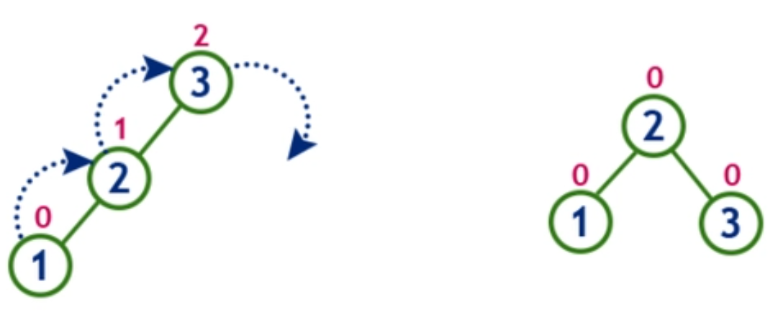
Guaranteeing Balance: Dynamic Construction
B) Use a self-balancing BST : If you’re inserting values one at a time (and don’t know all in advance),
use a self-balancing BST (AVL, Red-Black, etc.) that rebalances automatically after updates.
By performing specific rotations in the tree nodes

Slide 28


Slide 29
Practice

