Slide 1
Comparator

Slide 2
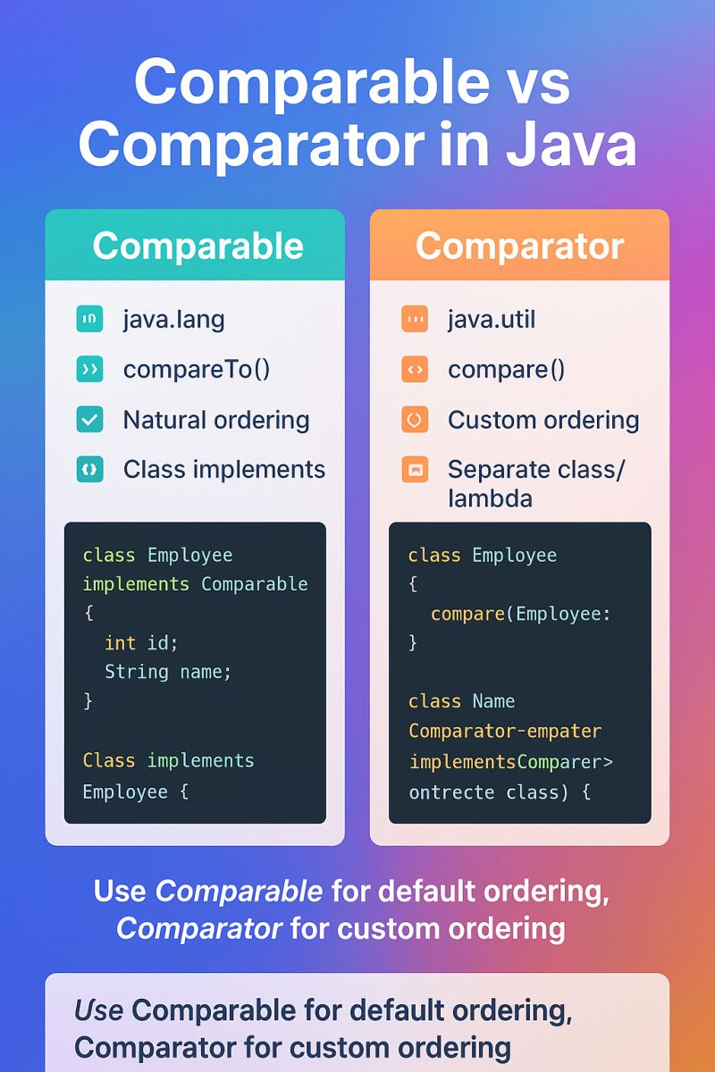

Slide 3
ADT and Data Strcutures
ADT
  List
  Stack
  Queue
Data Structures
  Array
  ArrayList
  LinkedList
  Binary Search Trees

Slide 4
Binary Search Tree

Slide 5
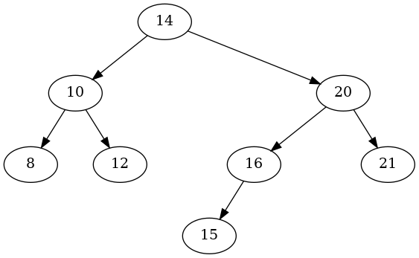
Tree Terminology
edge
root
child
Depth/Level 0
Depth/Level 1
subtree
Height of the Tree
Depth/Level 2
Depth/Level 3
Leaf

Slide 6

Binary Search Tree
For Every Node:
A node can have at most 2 children: left and right.
The left subtree of a node always contains values less than the node.
The right subtree of a node always contains values greater than the node.
Smallest
Largest

Slide 7
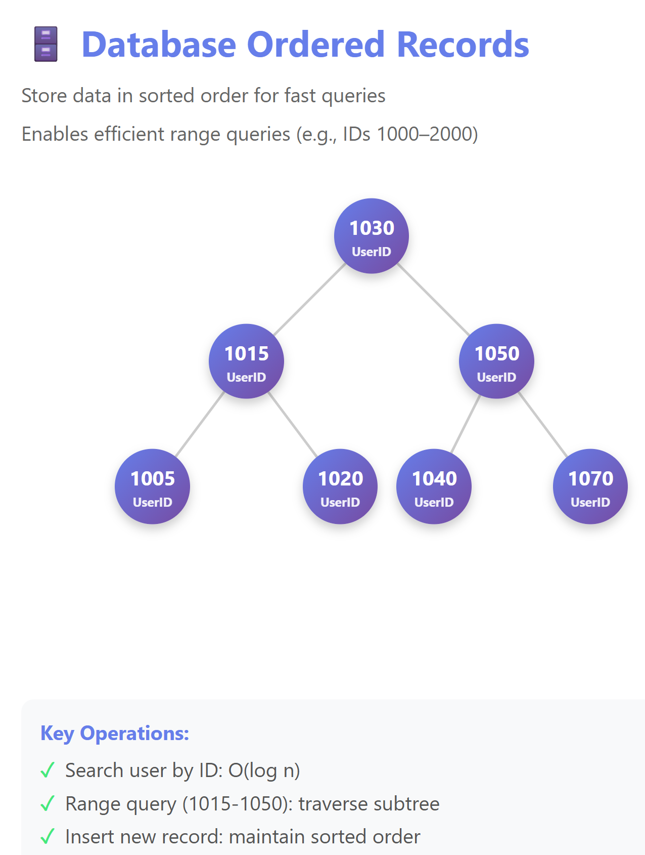
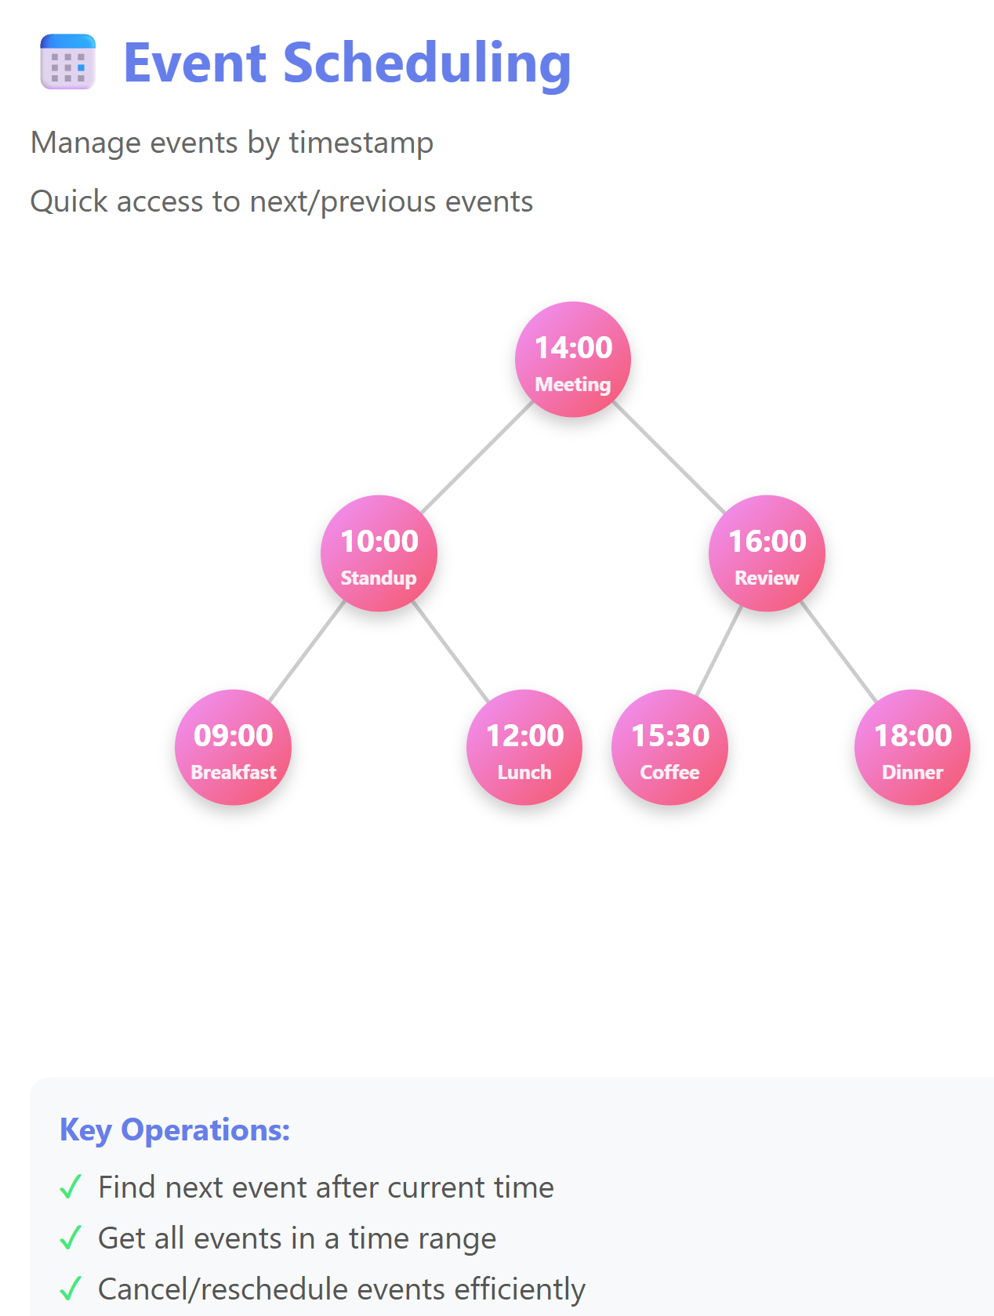
BST Applications

Slide 8
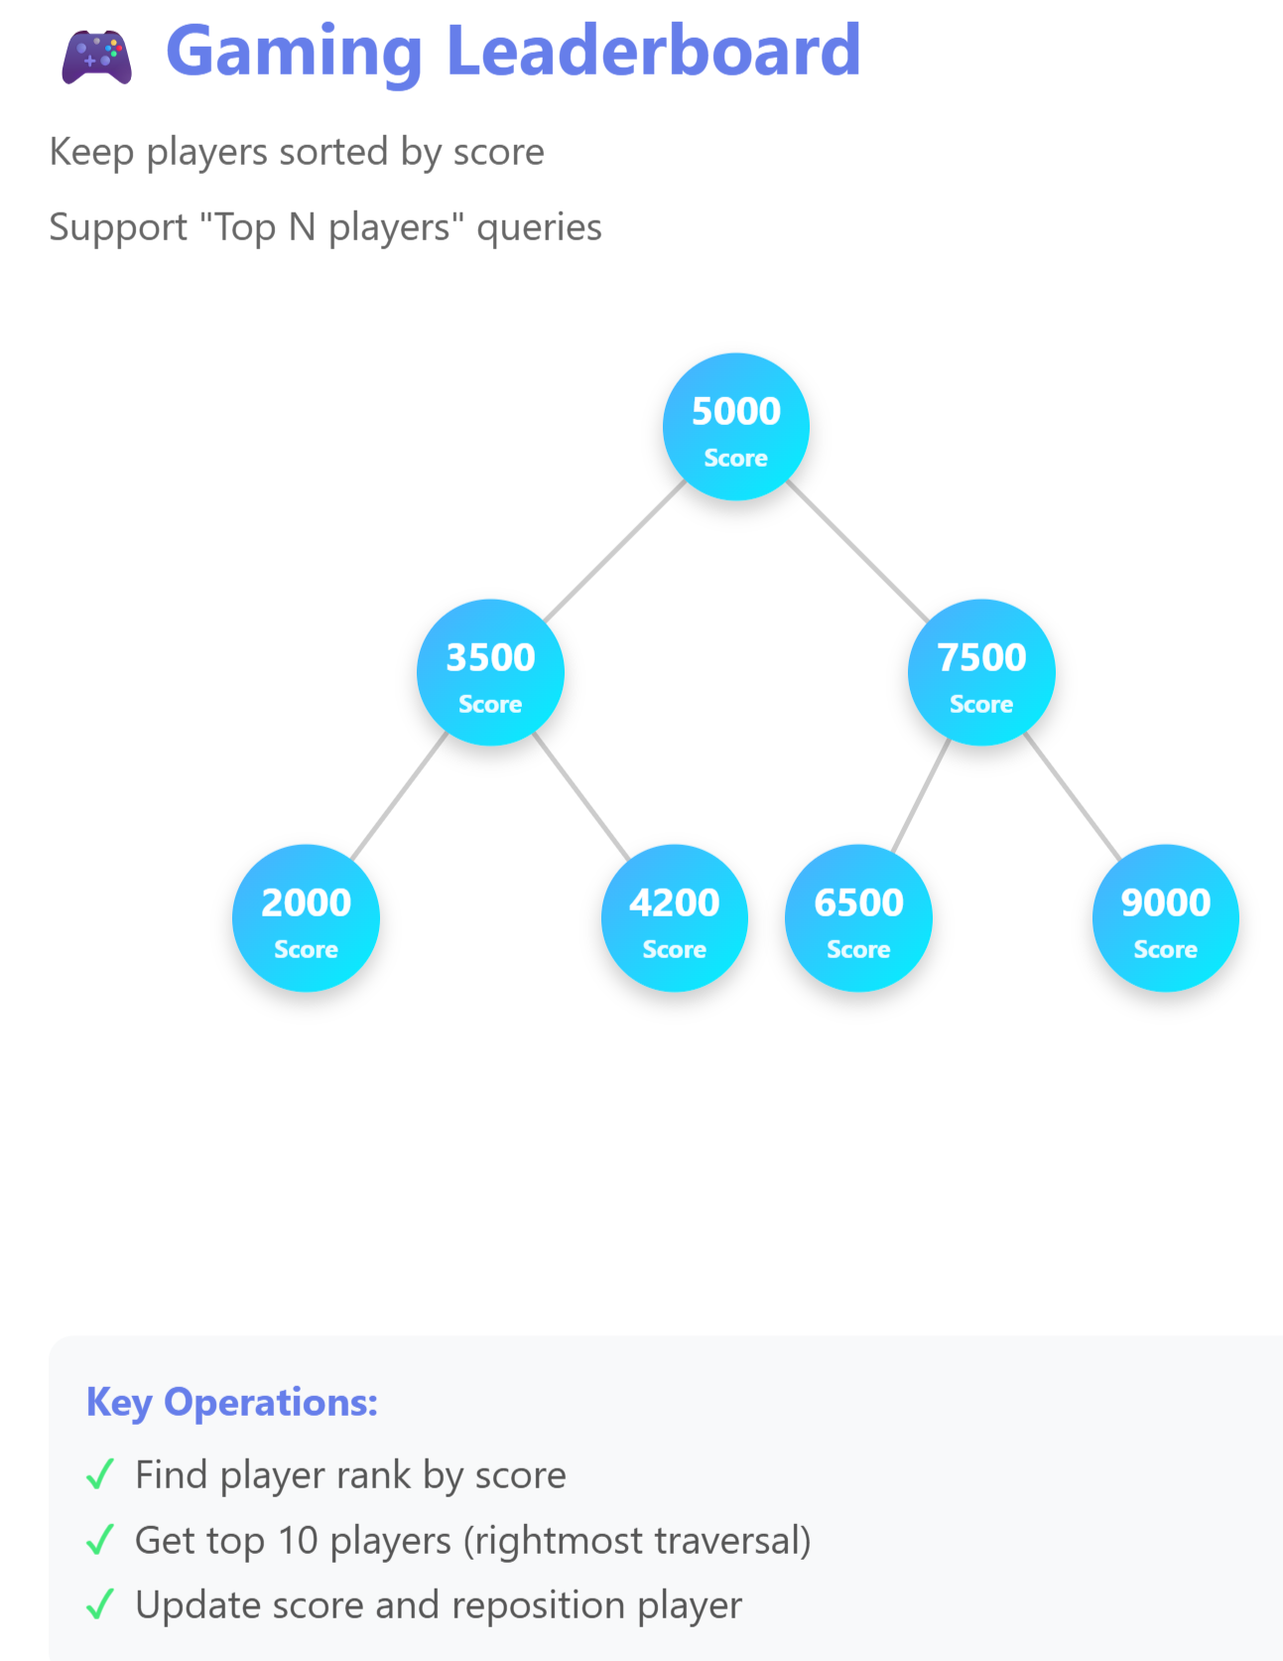
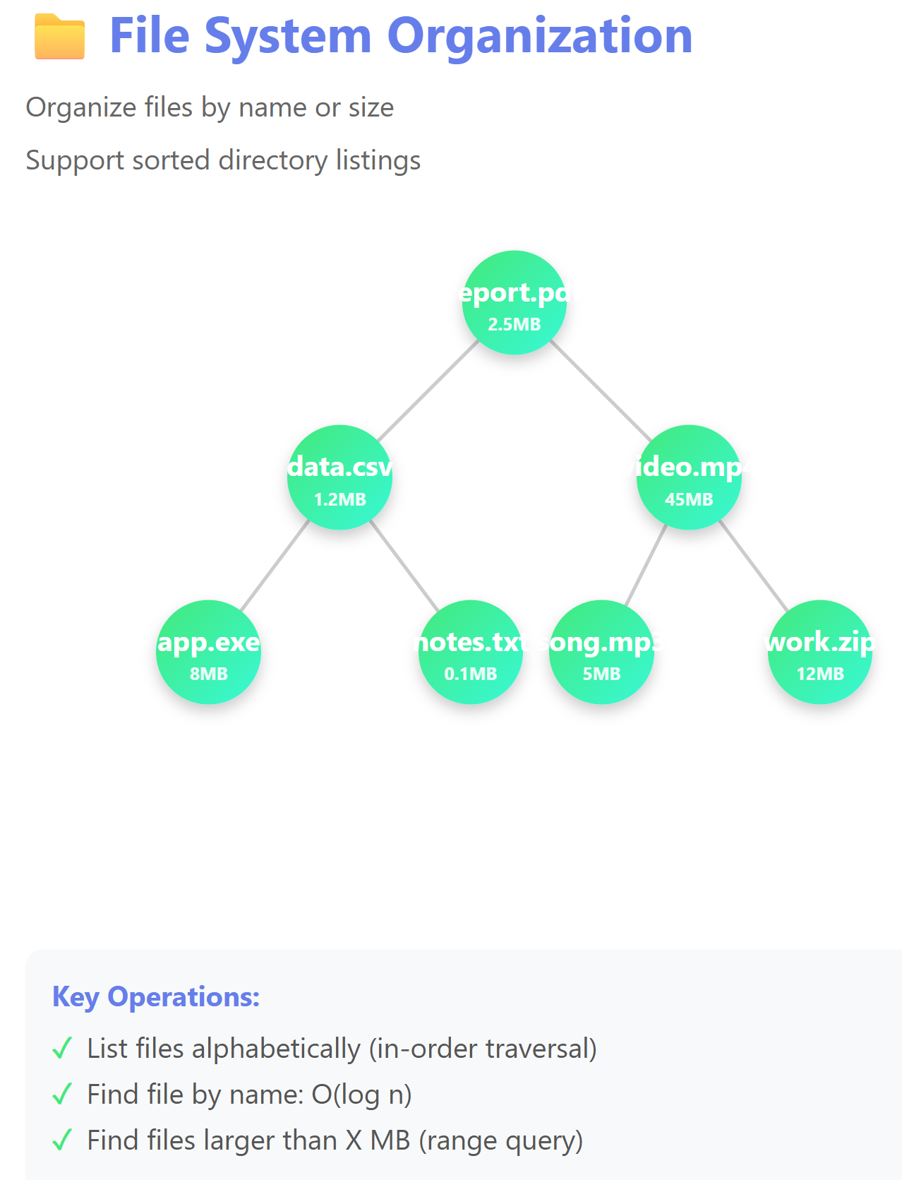
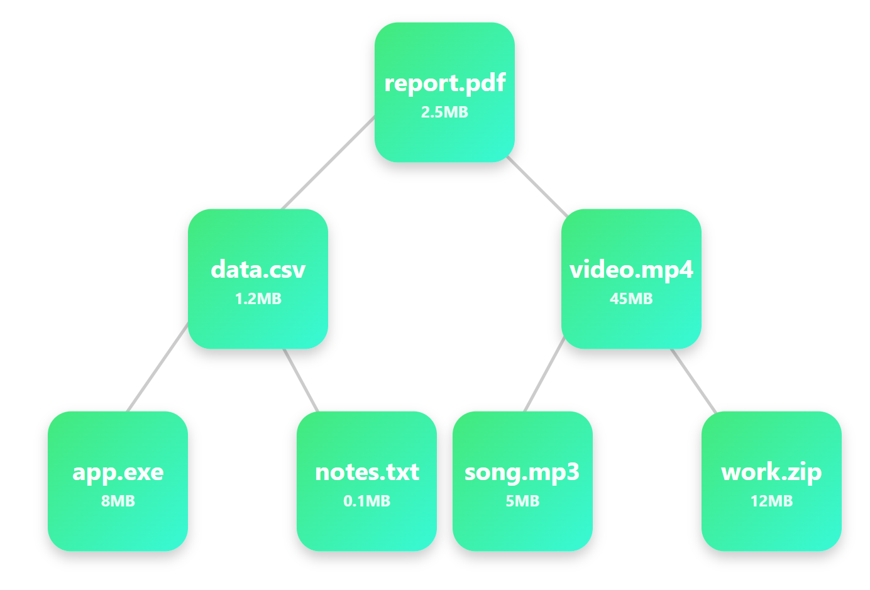
BST Applications

Slide 9
BST Operations: Finding
looking up 19
Leverage the structure of the tree!
  If empty:
    Key is not found. Exit
  Else, tree is non-empty:
    Start at the root.
    Compare Key to current Node’s Key. Three Cases:
      Key is equal to Node’s key: Found. Exit
      Key is smaller than the node’s key:
        Does the Node have a left child?
          Yes: go left. Back to Step 2
          No: Not Found. Exit
      Key is larger than the node’s key:
        Does the Node have a right child?
          Yes: go right. Back to Step 2
          No: Not Found. Exit
12
4
42
0
7
22
-2
19
30


Slide 10

BST Operations: Finding
looking up 10
Leverage the structure of the tree!
  If empty:
    Key is not found. Exit
  Else, tree is non-empty:
    Start at the root.
    Compare Key to current Node’s Key. Three Cases:
      Key is equal to Node’s key: Found. Exit
      Key is smaller than the node’s key:
        Does the Node have a left child?
          Yes: go left. Back to Step 2
          No: Not Found. Exit
      Key is larger than the node’s key:
        Does the Node have a right child?
          Yes: go right. Back to Step 2
          No: Not Found. Exit
12
4
42
0
7
22
-2
19
30

Slide 11
BST Operations: Adding
Do the same steps we would do to search for this entry, and then put it where it should have been
inserting 5
12
4
42
0
7
22
-2
5
19
30
Notes:
Recursive Add Animation:
Linked List Animation:
https://claude.ai/artifact/ASZmeV5eMtivSv4oLFpSsv
BST Animation:
Without Code: https://claude.ai/artifact/TdwBwiDofhjsYD5xy8Qu5V
With Code: https://claude.ai/artifact/EbMz5mhPc6s2Fk3wV4QYiv

Slide 12
Recursive Add Animation
Linked List Animation:
https://claude.ai/artifact/ASZmeV5eMtivSv4oLFpSsv
BST Animation:
  Without Code: https://claude.ai/artifact/TdwBwiDofhjsYD5xy8Qu5V
  With Code: https://claude.ai/artifact/EbMz5mhPc6s2Fk3wV4QYiv

