Slide 1
Binary Search Tree

Slide 2
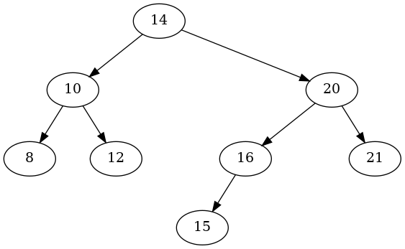
Tree Terminology
edge
root
child
Depth/Level 0
Depth/Level 1
subtree
Height of the Tree
Depth/Level 2
Depth/Level 3
Leaf

Slide 3

Binary Search Tree
For Every Node:
A node can have at most 2 children: left and right.
The left subtree of a node always contains values less than the node.
The right subtree of a node always contains values greater than the node.
Smallest
Largest

Slide 4
Traversal

Slide 5
In-Order Traversal
(Left – Node – Right)
2) Node
1) Left
3) Right
8
10
12

Slide 6
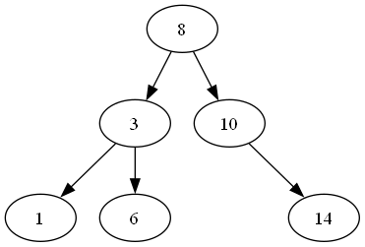
In-Order Traversal
“To traverse a BST in order, do the following at every node:
1️⃣ Traverse the left subtree.
2️⃣ Visit (or print) the current node.
3️⃣ Traverse the right subtree.”

Slide 7
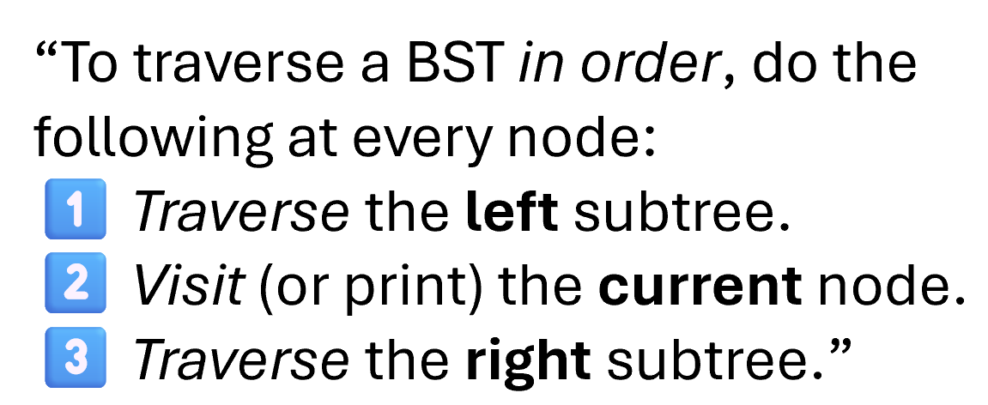
In-Order Traversal
Go left (to 3)
Go left again (to 1) → left is null, so print 1
Back to 3 → print 3
Go right (to 6) → print 6
Back to 8 → print 8
Go right (to 10) → then 14 → print 10, 14
1

Slide 8
In-Order Traversal
Go left (to 3)
Go left again (to 1) → left is null, so print 1
Back to 3 → print 3
Go right (to 6) → print 6
Back to 8 → print 8
Go right (to 10) → then 14 → print 10, 14
1
3
6

Slide 9
In-Order Traversal
Go left (to 3)
Go left again (to 1) → left is null, so print 1
Back to 3 → print 3
Go right (to 6) → print 6
Back to 8 → print 8
Go right (to 10) → then 14 → print 10, 14
1
3
6
8

Slide 10
In-Order Traversal
Go left (to 3)
Go left again (to 1) → left is null, so print 1
Back to 3 → print 3
Go right (to 6) → print 6
Back to 8 → print 8
Go right (to 10) → then 14 → print 10, 14
1
3
6
8
10
14

Slide 11
In-Order Traversal
Go left (to 3)
Go left again (to 1) → left is null, so print 1
Back to 3 → print 3
Go right (to 6) → print 6
Back to 8 → print 8
Go right (to 10) → then 14 → print 10, 14
1
3
6
8
10
14

Slide 12
Pre-Order Traversal
(Node – Left – Right)
1) Node
2) Left
3) Right
10
8
12

Slide 13
Pre-Order Traversal
“To traverse a BST pre order, do the following at every node:
1️⃣ Visit (or print) the current node.
2️⃣ Traverse the left subtree.
3️⃣ Traverse the right subtree.”

Slide 14
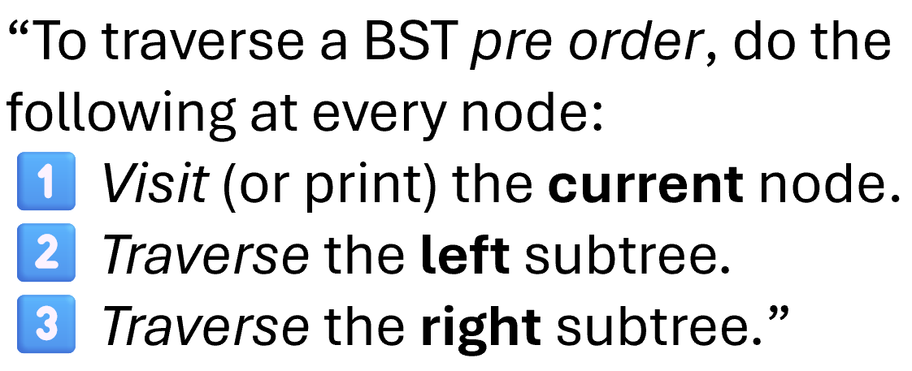
Pre-Order Traversal
Start at 8 → print 8
Go left → 3 → print 3
Go left → 1 → print 1
Back to 3 → right → 6 → print 6
Back to 8 → right → 10 → print 10 → right → 14 → print 14
8
3
1

Slide 15
Pre-Order Traversal
Start at 8 → print 8
Go left → 3 → print 3
Go left → 1 → print 1
Back to 3 → right → 6 → print 6
Back to 8 → right → 10 → print 10 → right → 14 → print 14
8
3
1
6

Slide 16
Pre-Order Traversal
Start at 8 → print 8
Go left → 3 → print 3
Go left → 1 → print 1
Back to 3 → right → 6 → print 6
Back to 8 → right → 10 → print 10 → right → 14 → print 14
8
3
1
6
10
14

Slide 17
Pre-Order Traversal
Start at 8 → print 8
Go left → 3 → print 3
Go left → 1 → print 1
Back to 3 → right → 6 → print 6
Back to 8 → right → 10 → print 10 → right → 14 → print 14
8
3
1
6
10
14

Slide 18
Post-Order Traversal
(Left – Right – Node )
3) Node
1) Left
2) Right
8
12
10

Slide 19
Post-Order Traversal
“To traverse a BST post order, do the following at every node:
1️⃣ Traverse the left subtree.
2️⃣ Traverse the right subtree.”
3️⃣Visit (or print) the current node.

Slide 20
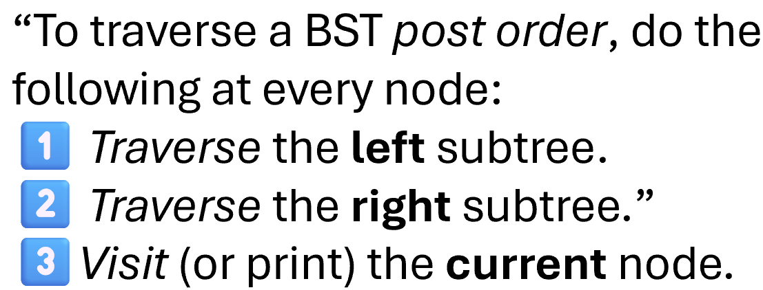
Post-Order Traversal
Go to 8 → go left to 3
Go left to 1 → both left/right null → print 1
Back to 3 → go right to 6 → both left/right null → print 6
Both children of 3 done → print 3
Back to 8 → go right to 10
Go right again to 14 → print 14
Both children of 10 done → print 10
Both children of 8 done → print 8
1

Slide 21
Post-Order Traversal
Go to 8 → go left to 3
Go left to 1 → both left/right null → print 1
Back to 3 → go right to 6 → both left/right null → print 6
Both children of 3 done → print 3
Back to 8 → go right to 10
Go right again to 14 → print 14
Both children of 10 done → print 10
Both children of 8 done → print 8
1
6

Slide 22
Post-Order Traversal
Go to 8 → go left to 3
Go left to 1 → both left/right null → print 1
Back to 3 → go right to 6 → both left/right null → print 6
Both children of 3 done → print 3
Back to 8 → go right to 10
Go right again to 14 → print 14
Both children of 10 done → print 10
Both children of 8 done → print 8
1
6
3
14

Slide 23
Post-Order Traversal
Go to 8 → go left to 3
Go left to 1 → both left/right null → print 1
Back to 3 → go right to 6 → both left/right null → print 6
Both children of 3 done → print 3
Back to 8 → go right to 10
Go right again to 14 → print 14
Both children of 10 done → print 10
Both children of 8 done → print 8
1
6
3
14
10
8

Slide 24
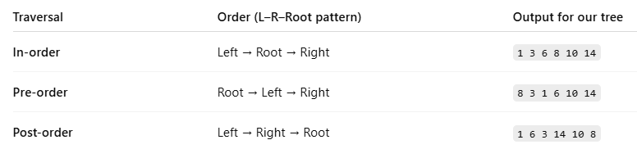
Traversal: Recap

Slide 25
toString

Slide 26
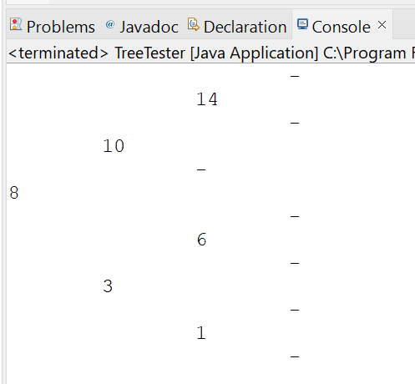
toString

Slide 27
Removal

Slide 28
BST Operations: Removing
Case 1: A Leaf Node
Removing 19
12
4
42
0
7
22
-2
5
19
30

Slide 29
BST Operations: Removing
Case 2: A Parent with One Child
Removing 42
12
4
42
0
7
22
-2
5
19
30

Slide 30
BST Operations: Removing
Case 2: A Parent with One Child
Removing 42
12
4
22
0
7
19
30
-2
5

Slide 31
BST Operations: Removing
The node to promote:
Is it in the left or right subtree?
Is it the smallest value or the largest value in the right subtree?
Where is the smallest value located in the right subtree?
Case 3: A Parent with Two Children
Removing 12
12
4
22
0
7
19
30
-2
5

Slide 32
BST Operations: Removing
Case 3: A Parent with Two Children
Removing 12
19
4
22
0
7
30
-2
5

Slide 33
Removal

Slide 34
BST Operations: Removing
Case 1: A Leaf Node
Removing 19
12
4
42
0
7
22
-2
5
19
30

Slide 35
BST Operations: Removing
Case 2: A Parent with One Child
Removing 42
12
4
42
0
7
22
-2
5
19
30

Slide 36
BST Operations: Removing
Case 2: A Parent with One Child
Removing 42
12
4
22
0
7
19
30
-2
5

Slide 37
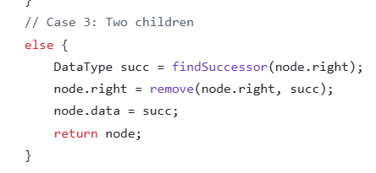
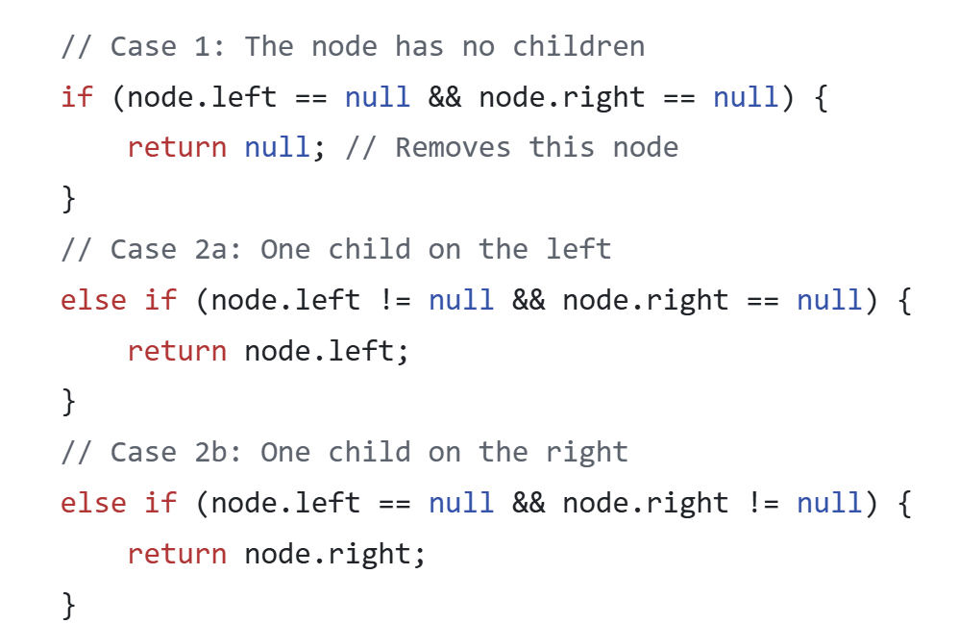
BST Operations: Removing
The node to promote:
Is it in the left or right subtree?
Is it the smallest value or the largest value in the right subtree?
Where is the smallest value located in the right subtree?
Case 3: A Parent with Two Children
Removing 12
12
4
22
0
7
19
30
-2
5
19 is leaf node
(Case 1).

Slide 38
BST Operations: Removing
Case 3: A Parent with Two Children
Removing 12
19
4
22
0
7
30
-2
5

Slide 39
BST Operations: Removing
What if Node (19) had a child?
What will happen to this child?
Case 3: A Parent with Two Children
Removing 12
12
4
22
Node 19 will be removed recursively.
Since it has one child, the child will be promoted to take its place (Case 2)
0
7
19
30
-2
5
20
21

Slide 40
BST Operations: Removing
What if Node (19) had a child?
What will happen to this child?
Case 3: A Parent with Two Children
Removing 12
19
4
22
Node 19 will be removed recursively.
Since it has one child, the child will be promoted to take its place (Case 2)
0
7
20
30
-2
5
21

Slide 41
BST Operations: Removing
Case 3: A Parent with Two Children
If (19) had one left child OR two children
Removing 12
12
it wouldn’t be the in-order successor of (12).
The left-child would be the in-order successor
4
22
0
7
19
30
-2
5
18
20
21

Slide 42
Remove Code
Worked Example

Slide 43
What the Recursive Helper Method Returns
What does our recursive function return? Why does it do that?
e.g. node.left = remove(node.left, item);
or node.right = remove(node.right, item);

Slide 44
What the Recursive Helper Method Returns
Removing 42
this.root = remove( , 42)
12
12
.right = remove( , 42)
4
42
12
42
0
7
22
-2
5
19
30

Slide 45
What the Recursive Helper Method Returns
Case 2: A Parent with One Child
Removing 42
It returns the (possibly changed) root of the subtree we just removed from.
Why does it return that?
Because removing may change which node is at the root of that subtree
The parent must reconnect to whatever the new subtree root is,
this.root = remove( , 42)
12
12
.right = remove( , 42)
4
42
12
22
42
0
7
22
-2
5
19
30

Slide 46
What the Recursive Helper Method Returns
Case 2: A Parent with One Child
Removing 42
this.root = remove( , 42)
12
12
12
4
42
0
7
22
-2
5
19
30

Slide 47
Efficiency

Slide 48
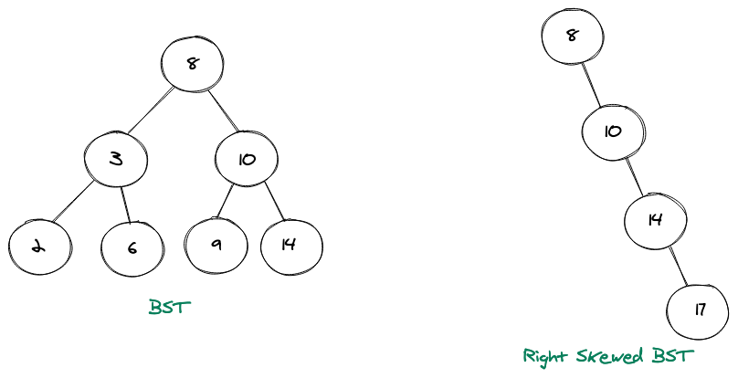
BST Basic Operations Complexity
Find Item: 5
5 < 8
What is the worst case if I try to find an item in the tree?
  Item exists in the last level OR doesn’t exist
5 > 3
How about Other Basic Operations?
  Remove: Same as find
  Add: adding already happens at the last level
5 < 6

Slide 49
BST Basic Operations Complexity
Find Item: 5
What is the worst case if I try to find an item in the tree?
5 < 8
Steps for a tree of height (h):
Traverse h levels (h iterations)
  At each level: Compare the item value with the node
  O(1): constant; irrelevant of inpt size (i.e. number of nodes)
Apply the operation: add node, remove node, etc.
  O(1): constant; irrelevant of input size (i.e. number of nodes)
5 > 3
5 < 6
Complexity: O(h)

Slide 50
BST Basic Ops Complexity: O(h)
– What is (h) for a tree with (n) nodes?
Level ID
Total # Levels
# Nodes @ Current Level
Total # of Nodes So far
0
1
1
1
1
2
2
3
2
3
4
7

Slide 51
BST Basic Ops Complexity: O(h)
– What is (h) for a tree with (n) nodes?
Level ID
Total # Levels
# Nodes @ Current Level
Total # of Nodes So far
0
1
1
1
1
2
2
3
2
3
4
7
Total Number of Levels (Height) = 3
(i.e. levels 0, 1, 2)

Slide 52
BST Basic Ops Complexity: O(h)
– What is (h) for a tree with (n) nodes?
Level ID
Total # Levels
# Nodes @ Current Level
Total # of Nodes So far
0
1
1
1
1
2
2
3
2
h
n
4

Slide 53
BST Basic Ops Complexity: O(h)
– What is (h) for a tree with (n) nodes?
Total # Levels
Total # of Nodes So far
1
1
= 2¹ − 1
How does (h) relate to (n)?
2
3
= 2² − 1
h
n
= 2^{h}− 1

Slide 54
BST Basic Ops Complexity: O(h)
– What is (h) for a tree with (n) nodes?
2^{h} − 1 =
n
BST Basic Operations Complexity:
O( h ) =
O( log(n) )
2^{h} =
n+1
log₂​(2^{h}) = log₂​(n+1)
h = log₂​(n+1)

Slide 55
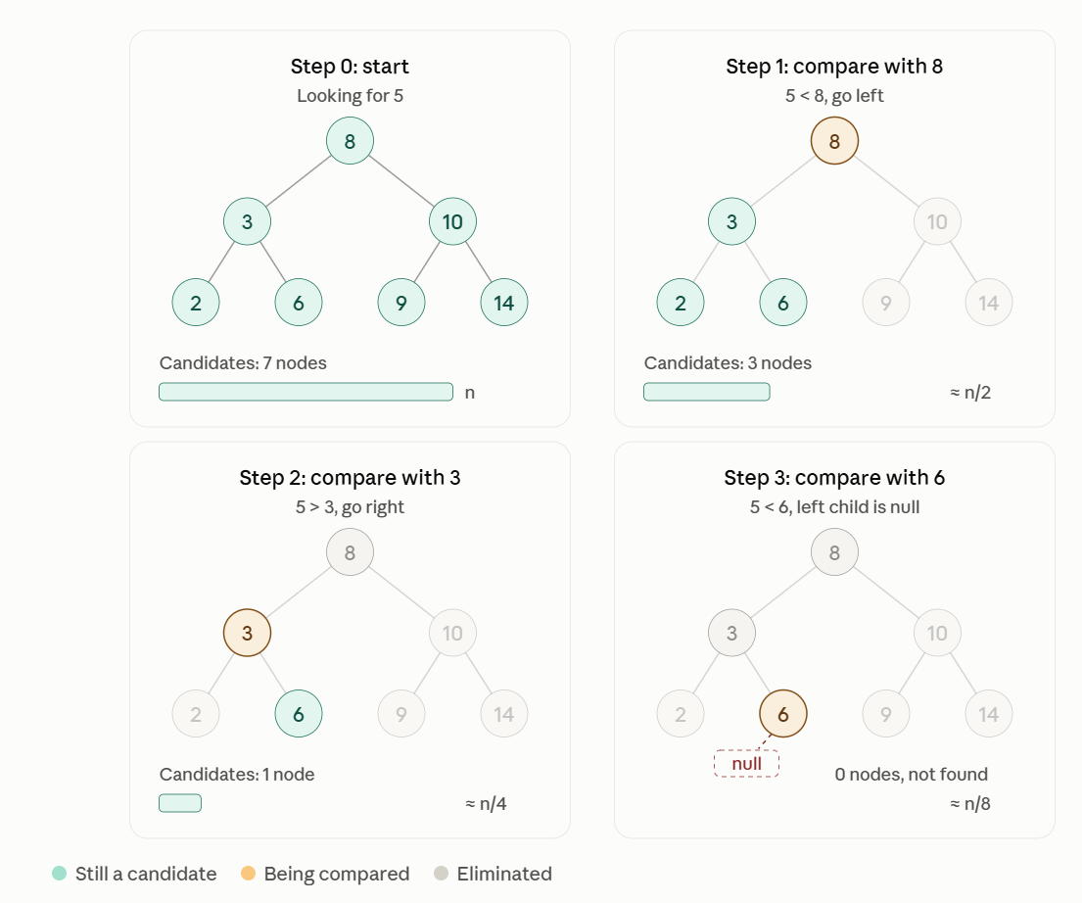
Another Way to Think About It
With every Step, I’m cutting the input size or the search space by half.
I start with n, end with 1.
The number of steps
(i.e. the number times to divide by 2 to get from n to 1),
is (log n)

Slide 56
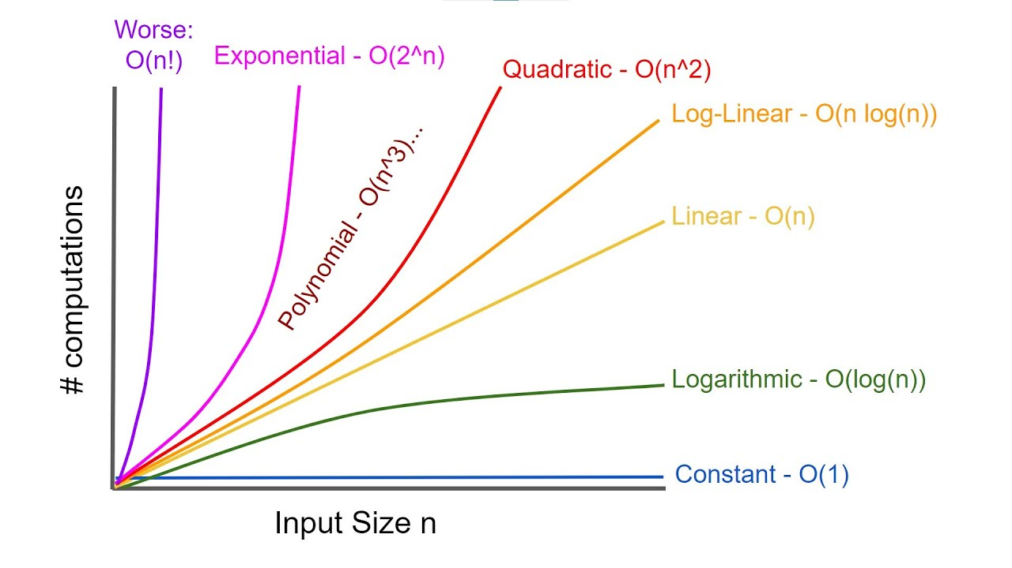
Log(n) Compared to Other Complexity Classes

Slide 57
Balanced BST
The tree has to be balanced for this O(log n) complexity to apply
A BST is balanced if the height of the left and right subtrees of every node differ by at most a small constant (often 1).
This keeps the tree roughly "even" so it doesn’t become skewed.

Slide 58
Complexity: Skewed BST
What does this look like now?
What is the complexity of finding an item in this tree?
How do you end up with such a skewed tree?
  At which order where the items inserted?
How to avoid that?

Slide 59
Guaranteeing Balance: Static Construction
Build it in a balanced way: If you already have all the values,
you can guarantee balance by inserting them in a middle-first order
  Steps:
    Sort the values (if not already sorted).
    Pick the middle element → make it the root.
    Recursively:
      Make the middle of the left half the left child.
      Make the middle of the right half the right child.

Slide 60
Guaranteeing Balance: Static Construction
Build it in a balanced way: If you already have all the values,
you can guarantee balance by inserting them in a middle-first order
1. Sort the values: [2, 3, 6, 8, 9, 10, 14]
2. Pick the middle element as the root
  There are 7 elements → middle index = 3 (0-based)
  Middle value → [8]
3. Build the left subtree from [2, 3, 6]
  Middle → [3] → root of left subtree
  Left half →[2] → left child
  Right half → [6] → right child
4. Build the right subtree from [9, 10, 14]
  Middle → [10] → root of right subtree
  Left half →[9] → left child
  Right half →[14] → right child
5. Combine everything: Attach the left and right subtrees to the main root 8:

Slide 61
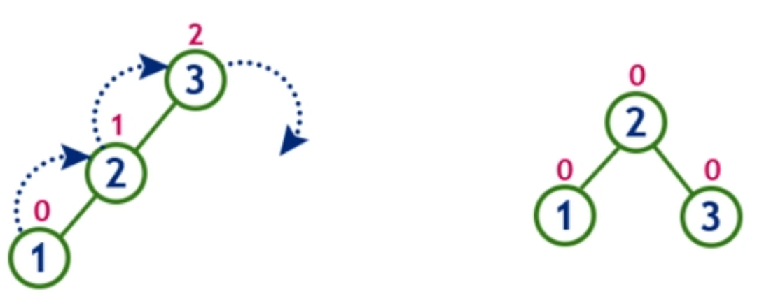
Guaranteeing Balance: Dynamic Construction
B) Use a self-balancing BST : If you’re inserting values one at a time (and don’t know all in advance),
  use a self-balancing BST (AVL, Red-Black, etc.) that rebalances automatically after updates.
    By performing specific rotations in the tree nodes

Slide 62


Slide 63
Results Analysis
The program first inserts 100,000 random integers, then performs 100,000 searches using a new set of random integers
Add Time
ArrayList
  Array was created with enough capacity
  We never had to resize and copy all elements
  So All adds are O(1)
LinkedList
  Similar complexity
  Creates new node and adds with O(1)
BST
  Because the values are random, the tree will probably be reasonably balanced
  For every new value, the BST must compare it with nodes while moving left or right to find its correct position. O(log n)
Contains (Lookup) Time
NOTE: most searches are unsuccessful
BST
  Eliminates half of the remaining nodes after each comparison O(log n)
ArrayList
  With every search, examines all elements O(n)
LinkedList
  With every search, it examines all nodes
  Because nodes are scattered in memory, it takes longer than ArrayList to traverse

Slide 64


