Slide 1
Iterator

Slide 2
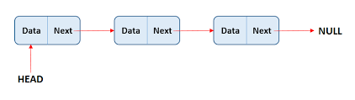
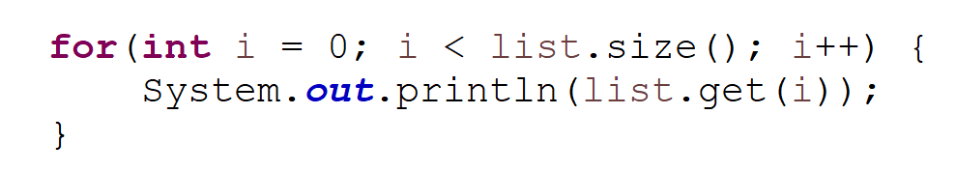
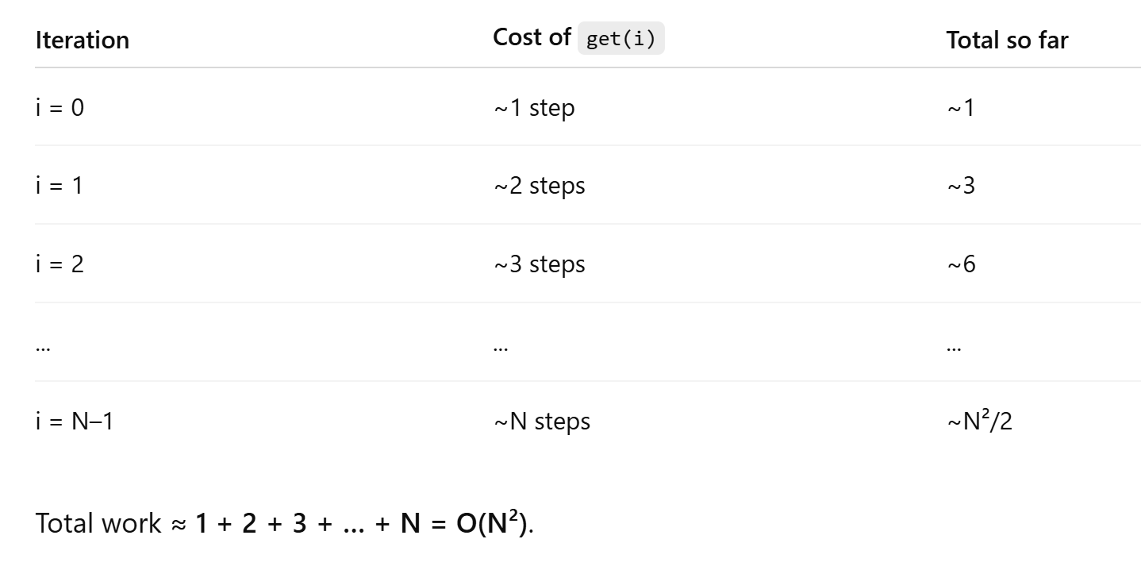

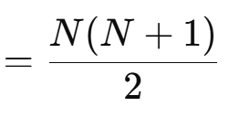

LinkedList Example - Complexity
Each get() starts over from the head.

Slide 3
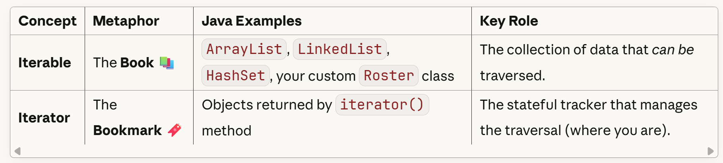
Iterable VS Iterator

Slide 4


Making A Custom Class Work with For-Each
Iterable
(I can be tracked)
Iterator
(I track Position)
Roster Implements Iterable
RosterIterator Implements Iterator
“This data collection can be iterated over”
Usually a Private class
Implements iterator() method; returns an object of the RosterIterator class
Implements hasNext(), next()
Implements how to traverse through the data (one at a time)
How? “This is the tracker to be used to iterate over the data collection”

Slide 5
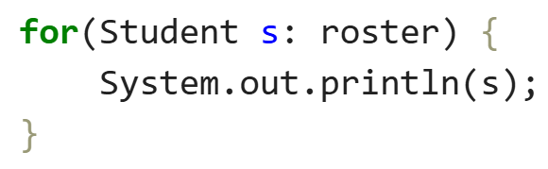
Making A Custom Class Work with For-Each
Iterable
(I can be tracked)
Iterator
(I track Position)
Roster Implements Iterable
RosterIterator Implements Iterator
“This data collection can be iterated over”
Usually a Private class
Implements iterator() method; returns an object of the RosterIterator class
When Java sees for (Student s : roster).
It calls roster.iterator().
It runs hasNext() and next() until done.
Implements hasNext(), next
Implements how to traverse this data collection specifically
How? “This is the tracker to be used to iterate over the data collection”

Slide 6
Hash Tables
Introduction

Slide 7
ADTs DataStructures
List
Add
Remove
Get
Size
Stack
isEmpty
Push
Pop
Peek
Queue
isEmpty
Enqueue
Dequeue
Peek
Priority Queue
Add
removeMax
PeekMax
Array
ArrayList
LinkedList
Binary Search Tree
Binary Heap
  Min Heap
  Max Heap
Hash Table

Slide 8
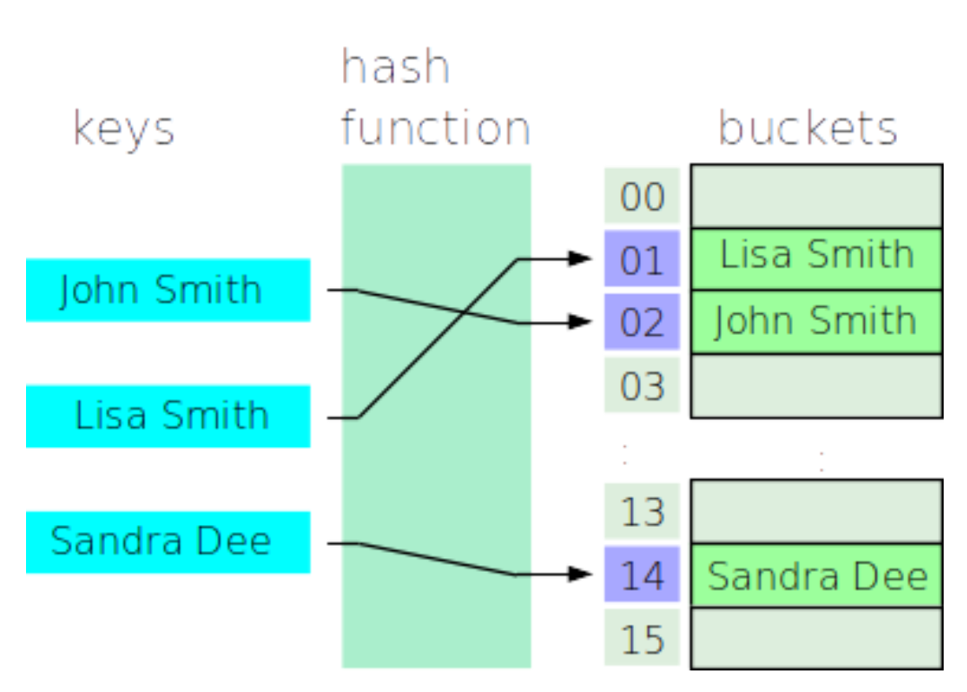
What is a HashTable?
A hash table is data structure that uses a hash function to quickly distribute items into an array of a fixed size.

Slide 9
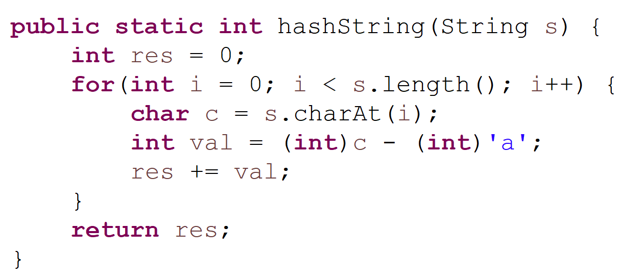
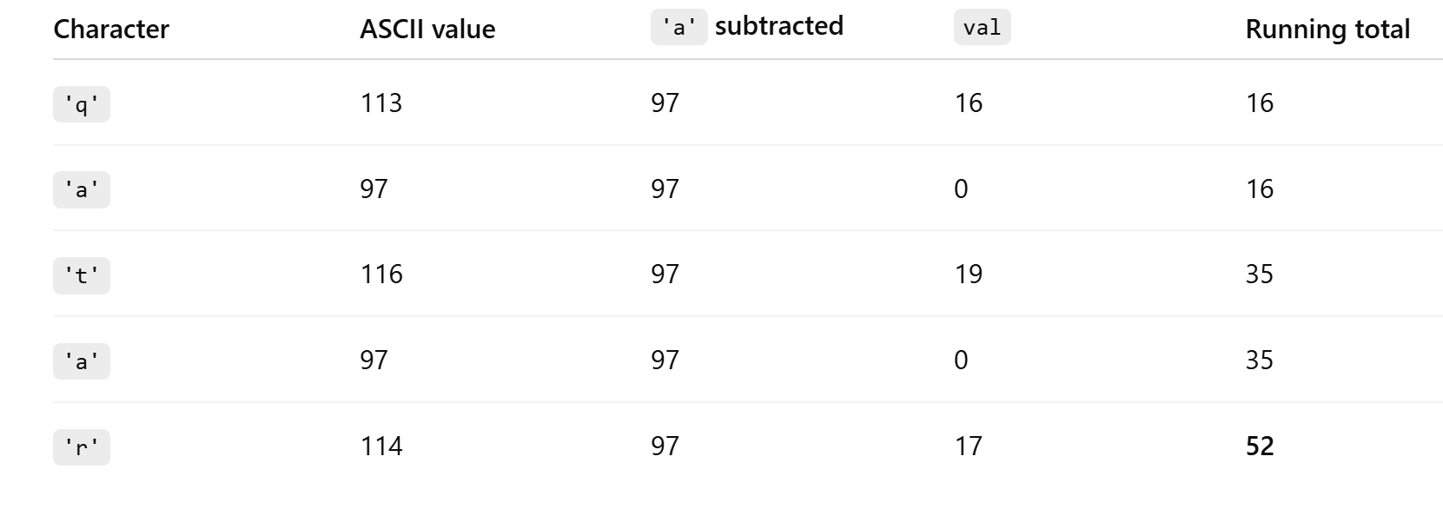
Custom Hash Function For String
“qatar”
52
“taarq”
“qaart”
“raaqt”
“qarat”

Slide 10
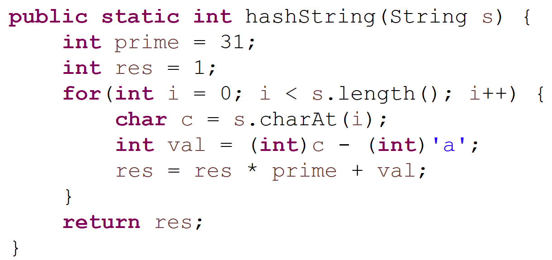
Custom Hash Function For String:
Better Approach
“qatar”
43,366,103
(
(
(
(
(
31 + qv
) * 31 + av
) * 31 + tv
) * 31 + av
) * 31 + rv
Number of times multiplied by 31
1
0
4
3
2

Slide 11
Hash Tables
Handling Collisions and Performance

Slide 12
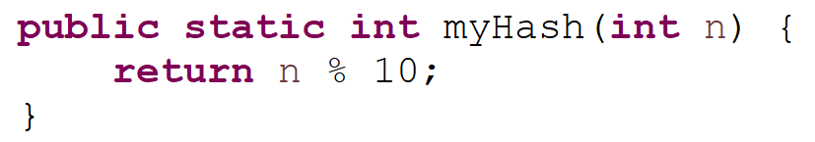
Add - in a HashTable
BUCKETS
0
1
Hash Function
2
def hash(n):
Return n%10
3
4
16
74
1
24
39
4
5
6
33
Collision
7
8
9

Slide 13
Add - in a HashTable
BUCKETS
0
1
1
Hash Function
2
def hash(n):
Return n%10
3
4
16
74
4
24
5
6
33
Collision
7
8
9
39

Slide 14
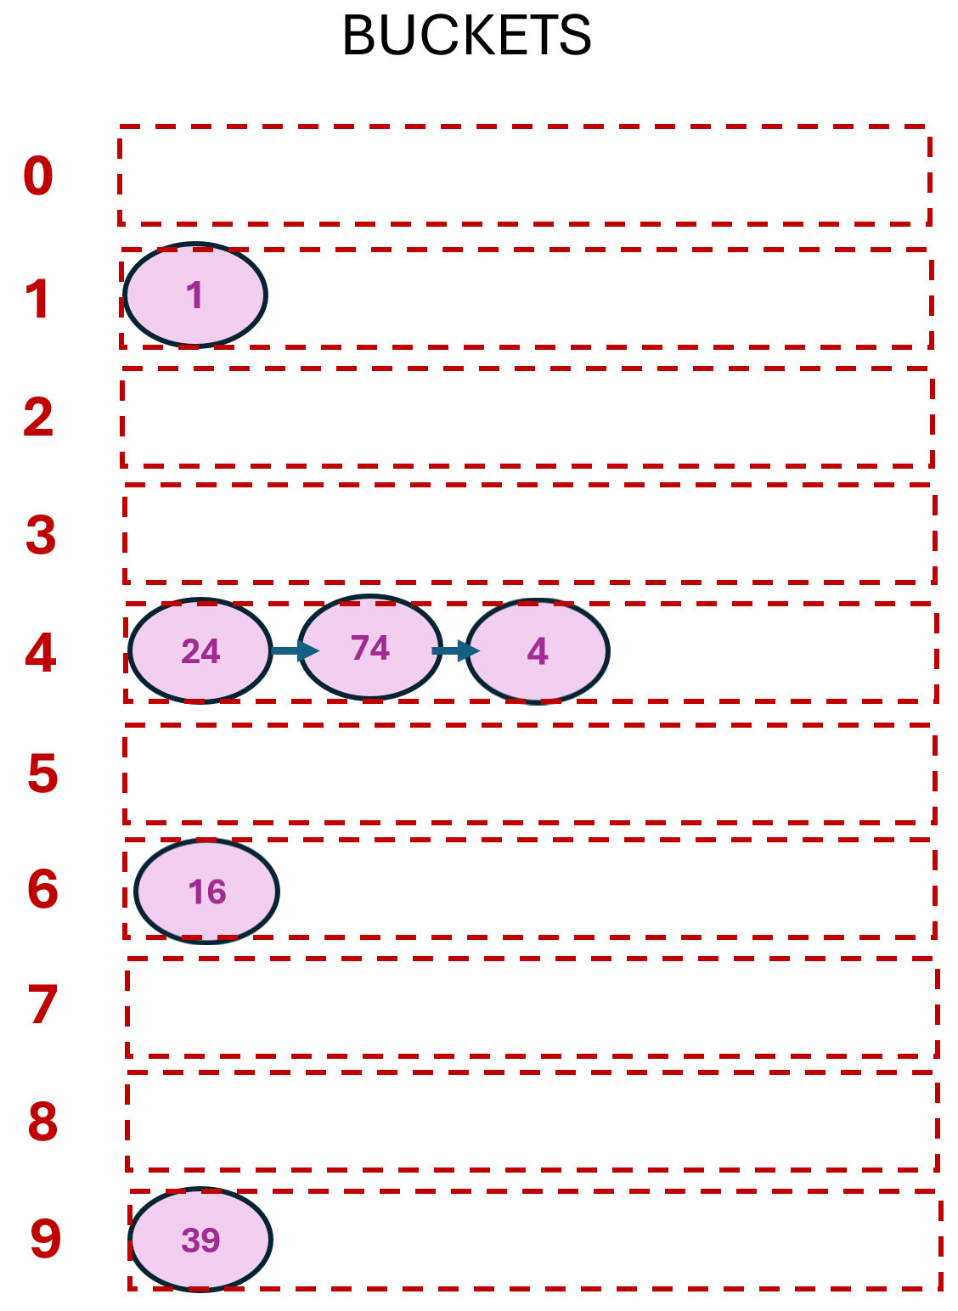
Lookup - in a HashTables
Lookup Steps:
1) Hash (find the bucket)
2) Once in the bucket, perform Equality Testing
  Compare the value to each existing element in the bucket
  If found, return it
Hash Function
Lookup
def hash(n):
Return n%10
4

Slide 15
Bad HashFunctions
BUCKETS
0
What If I have a bad hash Function that hashes all elements to one bucket
1
Hash Function
2
def hash(n):
Return n%10
3
4 ;
4
39
24
1
74
16
4
5
6
7
8
9

Slide 16
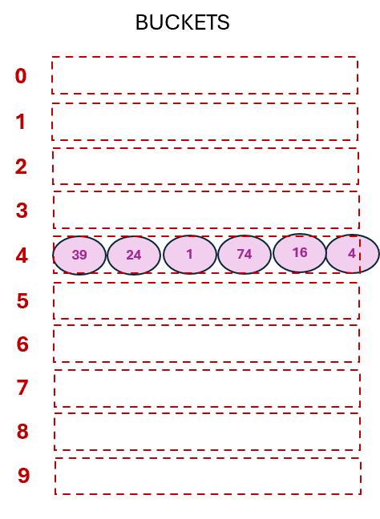
Bad HashFunctions
Hash Function
Lookup
def hash(n):
Return n%10
4
4 ;
This is as inefficient as Lists…

Slide 17
Lookup in ArrayLists Vs HashTables (Search Space)
ArrayList
39
24
1
74
16
4
All Elements
Lookup
Target
Hash Target value
24’
74
4
Elements Inside the bucket with the same hash value
HashTable

Slide 18
Hash Tables
Minimizing Collisions for faster look-up
Is having a good hash function enough to guarantee good performance?

Slide 19
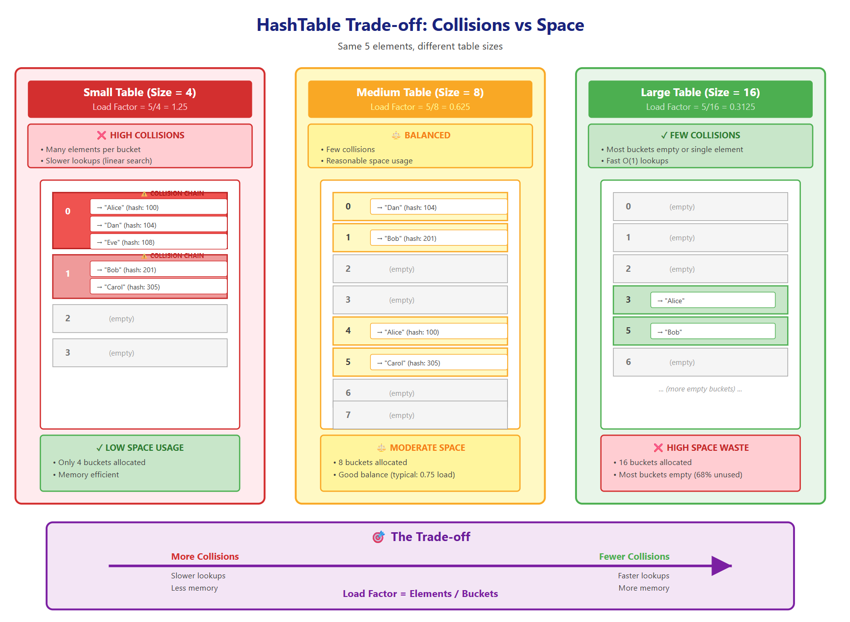
Handling Collisions
500K
Items
Does it seem like a good hash function is used?
500K
Items
Is this HashTable good in terms of performance?
Is this hashtable good in terms of memory usage/utilization?

Slide 20
Handling Collisions
- Does it seem like a good hash function is used?
Is this hashtable good in terms of performance?
Is this hashtable good in terms of memory usage/utilization?
… … … ..
1M

Slide 21
Handling Collisions: Tradeoff
500K
Items
500K
Items
Even with a good hash function,
there is a trade-off between space and collisions –
fewer buckets mean more collisions, which in turn hurt performance.”.
… … … ..
1M

Slide 22
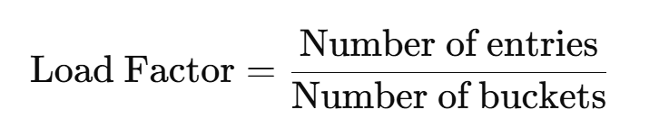
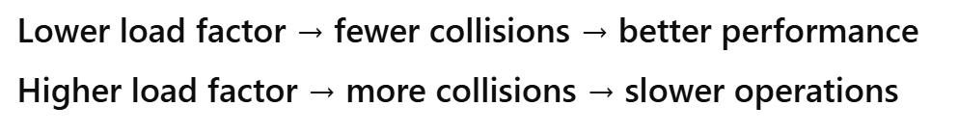
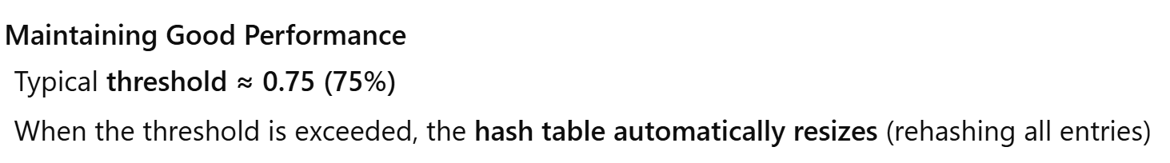
Handling Collisions: Finding the Sweet Spot
Maintaining good performance while using memory efficiently:
Track how occupied/Full the hash table is
Keep Load Factor below a chose Threshold 0.75 (75%)
When the threshold is exceeded,
  The hash table automatically resizes (rehashing all entries)
Although resizing is occasionally expensive, it happens infrequently,
so insertion remains O(1) amortized, while the table avoids wasting excessive memory.

Slide 23
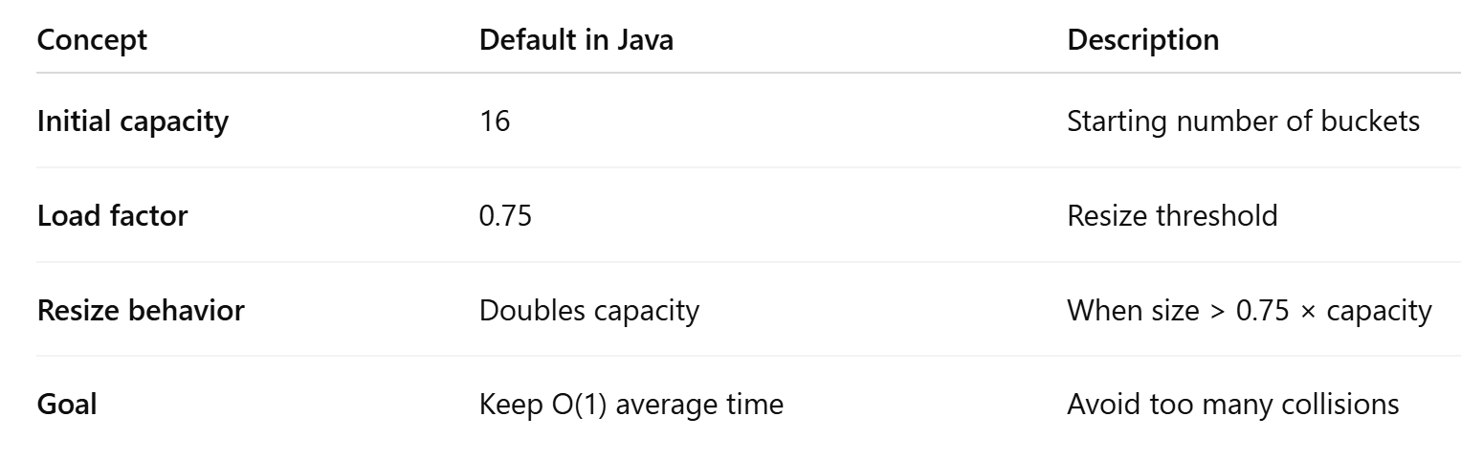
Handling Collisions: Finding the Sweet Spot

Slide 24
Hash Tables
HashCode()

Slide 25
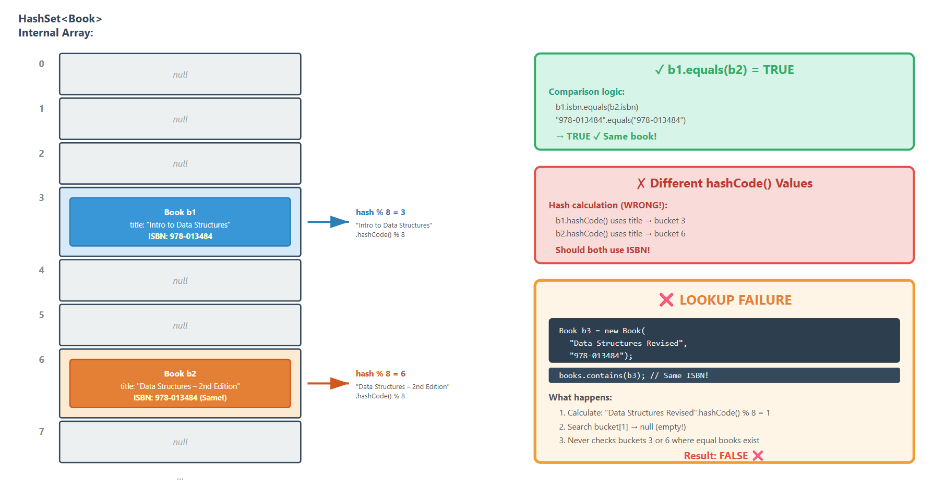
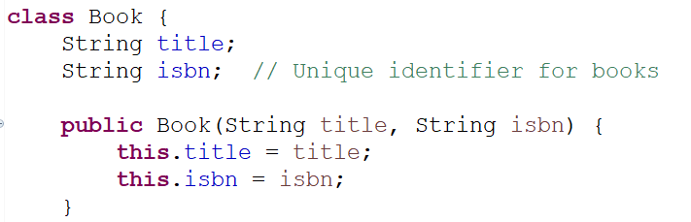
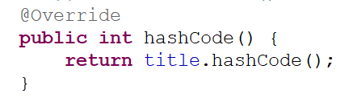
Creating hashCode(), equals() For Custom Class
Example:
hashCode() implemented to hash Book objects based on name

Slide 26
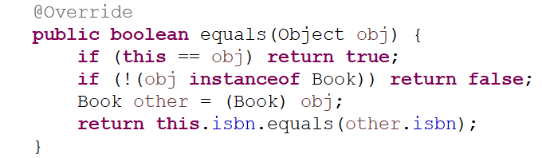
Creating hashCode(), equals() For Custom Class
Look Up:
// same book, new title edition
LookUp fails even though equal book is stored in the hashTable

Slide 27
Creating hashCode(), equals() For Custom Class
We could end up adding a duplicate (an equal) object

Slide 28
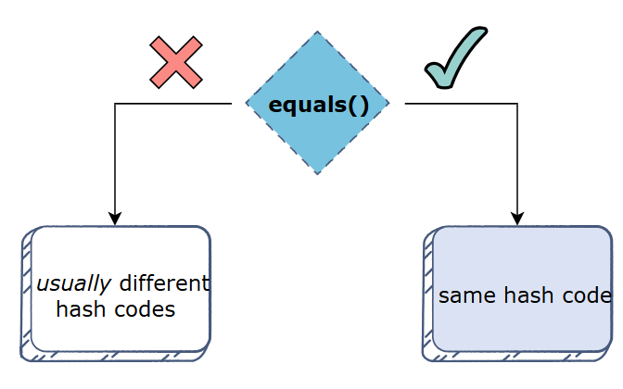
Creating hasCode(), equals()
Why consistency matters in a hash-based structure:
hashCode() decides which bucket the object goes into.
equals() decides if two objects in the same bucket are the same.
If they’re inconsistent, you can break both uniqueness and search reliability.

Slide 29
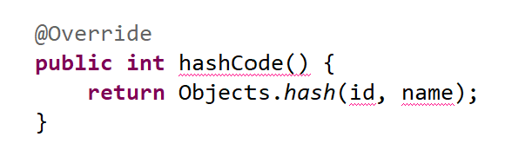
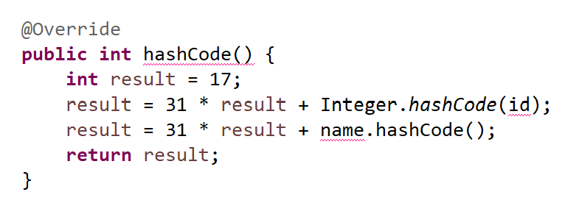
Creating hashCode()
The simplest approach is to use Objects.hash():
A traditional manual implementation uses a prime number such as 31:
    Multiplying by a prime helps mix the attribute hash codes
    and produce a more even distribution.
For nullable fields:

Slide 30
Recap
Java provides a hashCode() for all built-in datatypes
Java provides an initial hashCode() for your custom classes
  By default, equals() and hashCode() use object identity rather than the values of the object’s attributes.
If you override the hashCode() method, consider the following:
  Generate an object’s hash codes based on the hash codes of its attributes.
    Should only use attributes whose values won’t change
  Should be consistent with equals()
    If equals() say that two objects are equal, then their hashes must be the same as well.
  Using Primes as in the SringHashFunction() example helps achieve even distribution
  More Examples on this website.
Java built-in implementations that use a hashtable:
  Take care of initializing the table size and resizing based on load factor
  Mod the hashCode value to be within the bucket values

Slide 31
Sets & Maps
HashSets & HashMaps

Slide 32



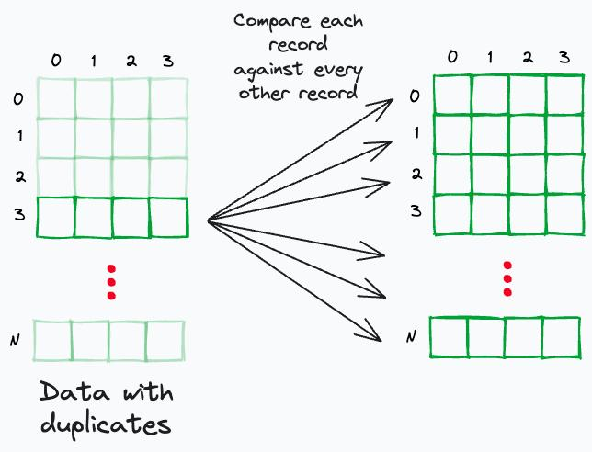
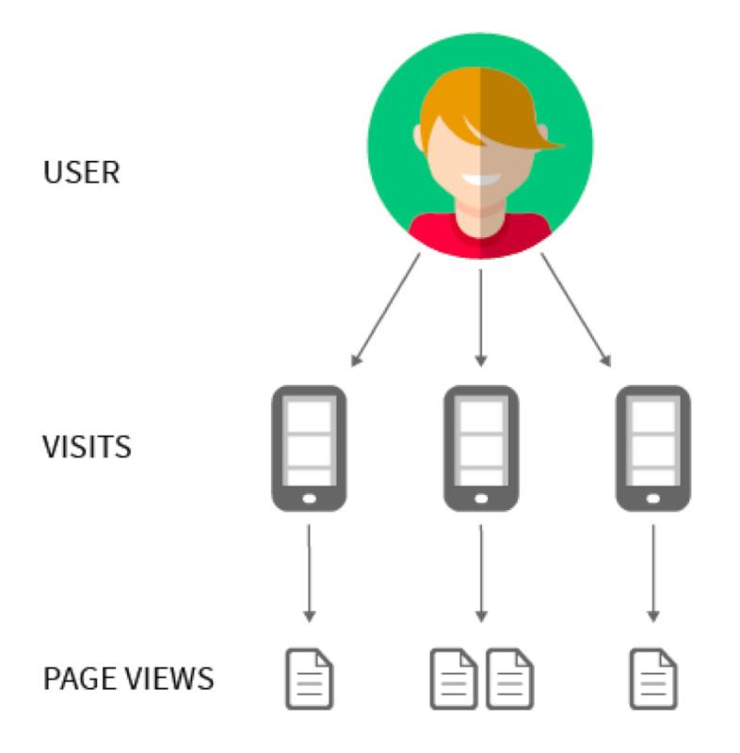



Sets and Maps
A Set is an unordered collection of unique elements.
A Map (or Dictionary) stores key–value pairs.
Sets answer: “Have we already seen this item?”
Maps answer: “What value is associated with this key?”

Slide 33
ADTs DataStructures
List
Add
Remove
Get
Size
Stack
isEmpty
Push
Pop
Peek
Queue
isEmpty
Enqueue
Dequeue
Peek
Priority Queue
Add
removeMax
PeekMax
Set
isEmpty
Size
Add
Contains
Remove
Map
isEmpty
Clear
Size
Put(K,V)
Get(K)
ContainsKey(K)
Remove(K)
KeySet
Array
ArrayList
LinkedList
Binary Search Tree
Binary Heap
  Min Heap
  Max Heap
Hash Table

Slide 34
ADTs DataStructures
List
Add
Remove
Get
Size
Stack
isEmpty
Push
Pop
Peek
Queue
isEmpty
Enqueue
Dequeue
Peek
Priority Queue
Add
removeMax
PeekMax
Set
isEmpty
Size
Add
Contains
Remove
Map
isEmpty
Clear
Size
Put(K,V)
Get(K)
ContainsKey(K)
Remove(K)
KeySet
Array
ArrayList
LinkedList
Binary Search Tree
Binary Heap
  Min Heap
  Max Heap
Hash Table

Slide 35
Sets and Maps in Java
Java’s built-in hash-table classes
Classes such as HashMap and HashSet:
Create and manage the internal bucket array.
Convert hash codes into valid bucket indices.
Handle collisions.
Monitor the load factor.
Resize the table when necessary.

Slide 36
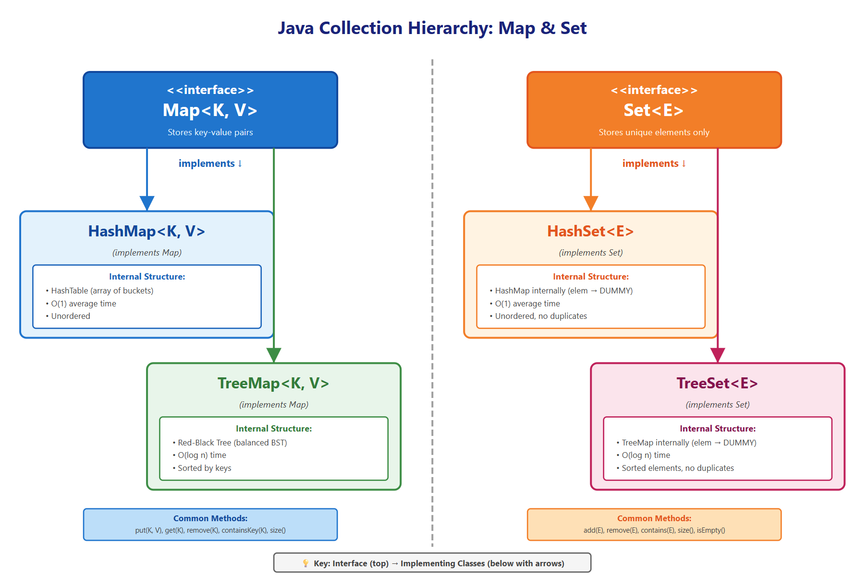
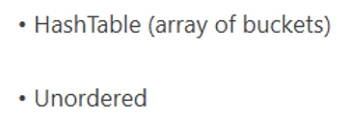
Sets and Maps in Java
Hash Table is the underlying structure often used to implement Sets and Maps in Java.
Called Dictionaries in Python
Called Sets in Python
-
-
Unordered, Each key is unique, values can repeat

Slide 37
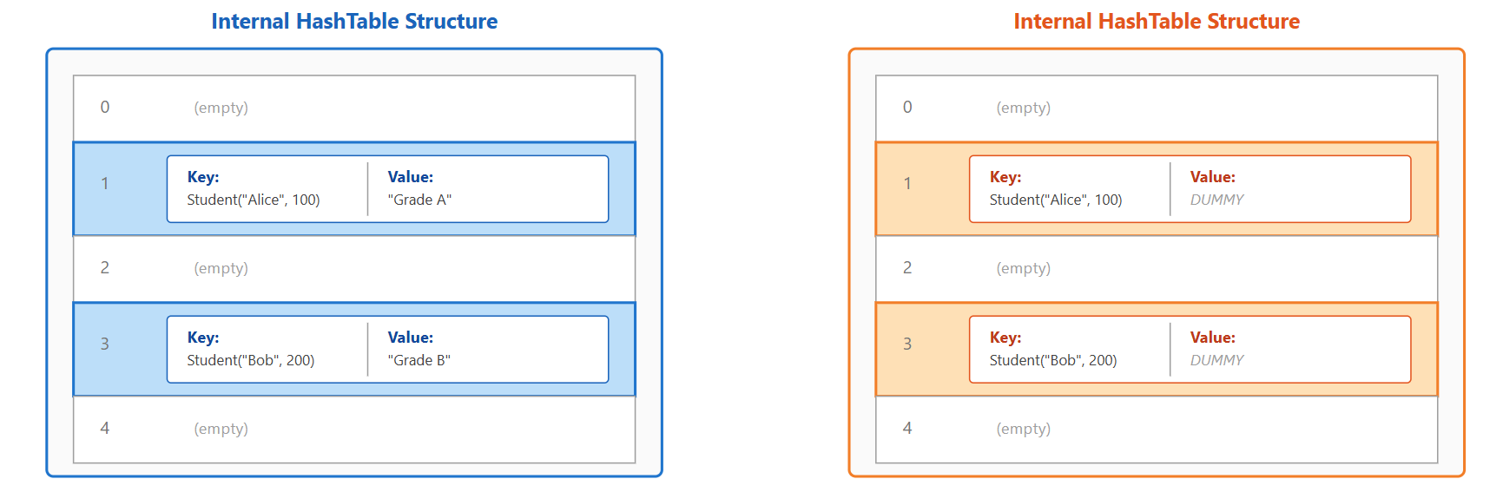
Sets and Maps in Java: Using HashTable
Hashes the key to find the bucket

Slide 38
Sets & Maps
TreeSets & TreeMaps

Slide 39
Sets and Maps in Java
-
-
-
-

Slide 40
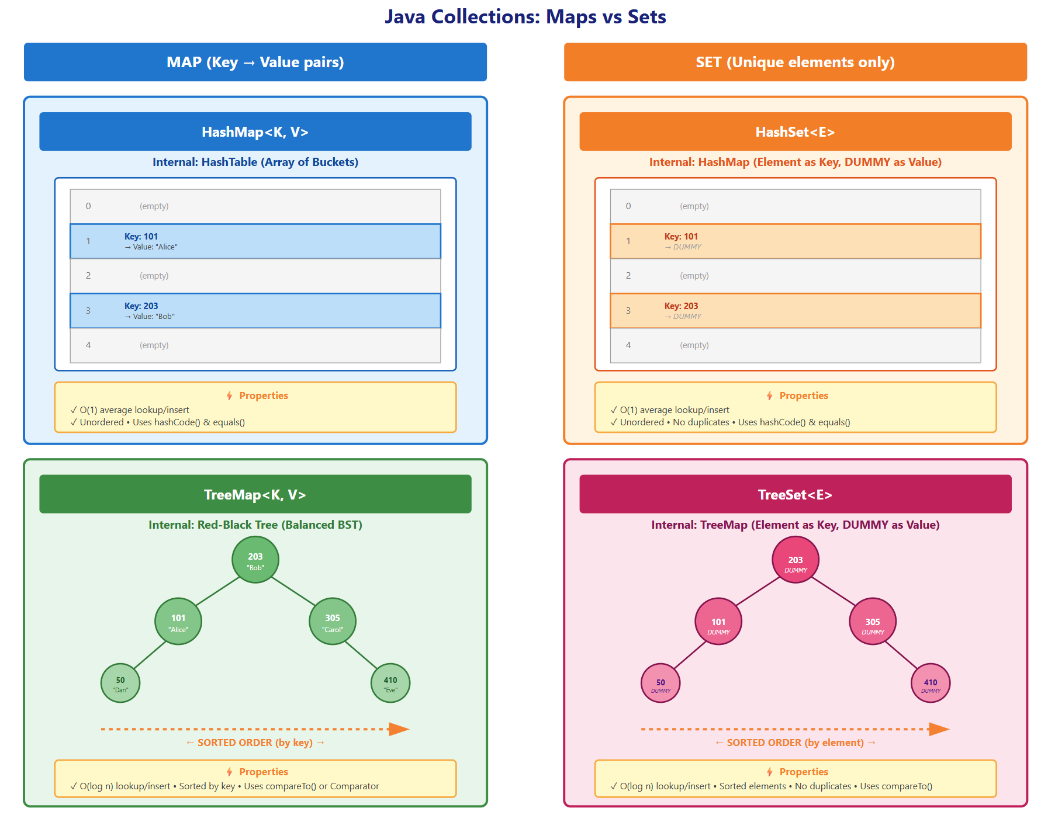
Sets and Maps in Java: Using Trees
Use Red-Black Tree
(Self-Balancing Binary Search Tree)

Slide 41
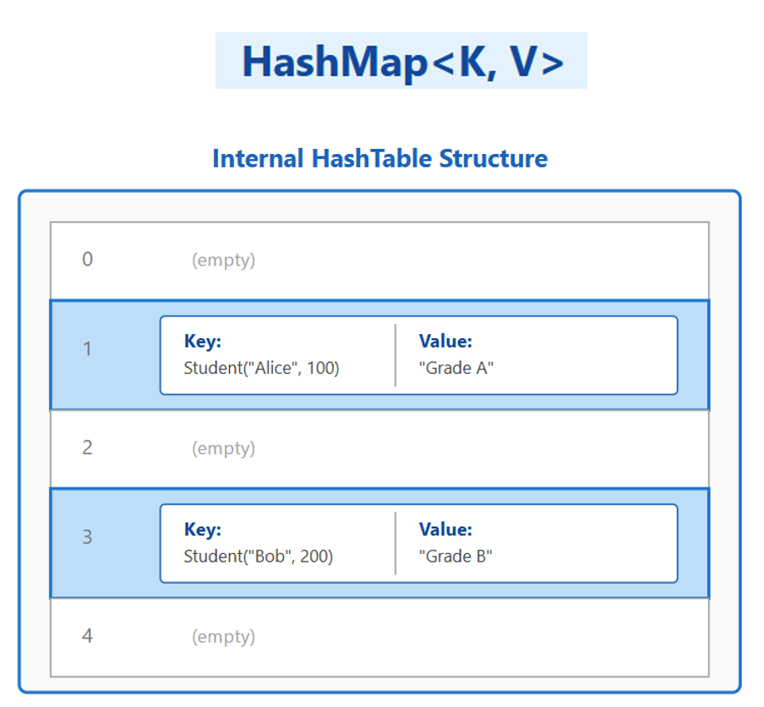
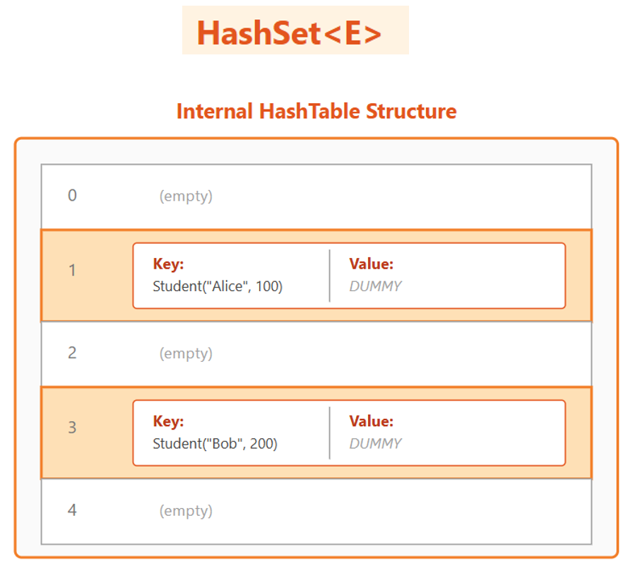
Sets and Maps: Tree-based vs HashTable based
The Pattern:
Hash = Fast (O(1)) but unordered
Tree = Slower (O(log n)) but sorted
The tree structures maintain elements in sorted order
while hash structures provide faster access but no ordering guarantee!

