Slide 1
Binary Heap

Slide 2
Abstract Data Type & Data Structures
Abstract Data Type
List
Queue
Stack
Priority Queue
Contract: formal description of the behavior of a data type
(What Operations The Data Type Has?)
add
isEmpty
isEmpty
add
remove
dequeue
pop
removeMax
get
peek
peek
peekMax
size
enqueue
push
Data Structure
Implementation:
(How Are These Operations Implemented?)
Array
LinkedList
Binary Heap
ArrayList
Binary Search Tree

Slide 3
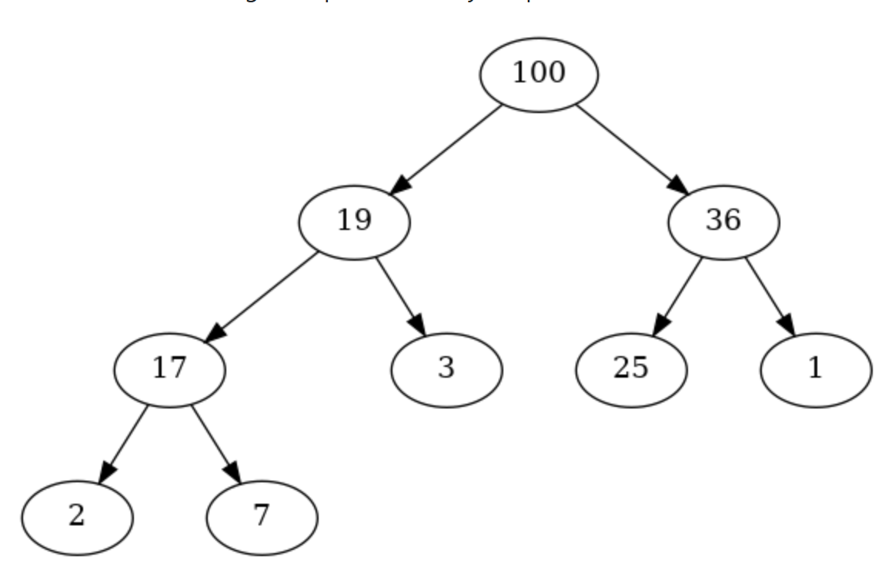
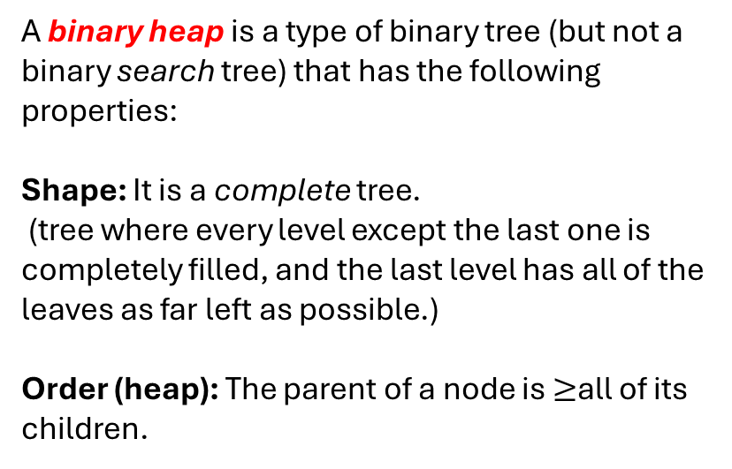
Binary Heap – Properties?
A binary heap is a type of binary tree (but not a binary search tree) that has the following properties:
Shape: It is a complete tree.
(tree where every level except the last one is completely filled, and the last level has all of the leaves as far left as possible.)
Order (heap): The parent of a node is $≥$all of its children.
Why is it good for Priority Queue?

Slide 4
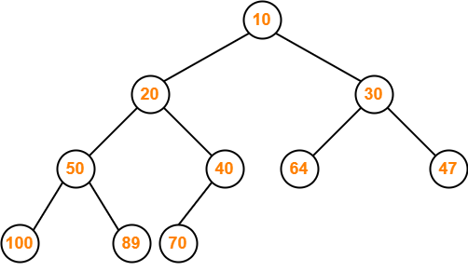
Min Heap

Slide 5
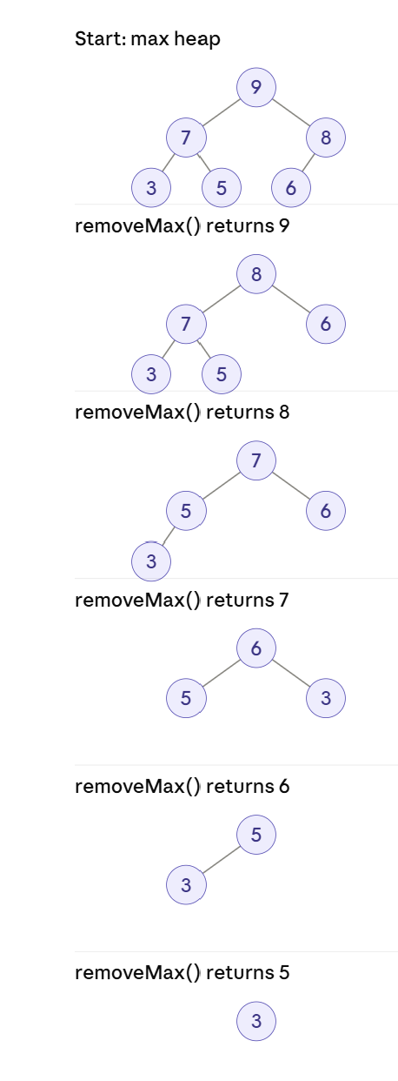
A Cool Consequence…
Heap Sort

Slide 6
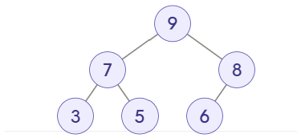
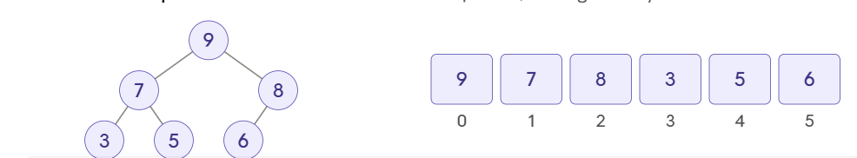

Max Heap- Array Representation
6

Slide 7
Max Heap Operations
For something to be called a valid heap, two things have to be true:
Shape: complete tree. Every level is full except possibly the last one, which is filled from the left. This is what lets us store it in an array with no holes and use the index formulas.
Order: heap property. Every parent ≥ each of its children.
Every Operation should ensure that our two properties are maintained

Slide 8
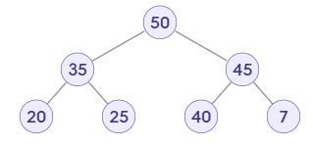
Max Heap Operations - Add
Add 33
What's the best way to add the item so I end up with a valid heap?
Should I aim for completeness first or order first?
If I fix it for one, how to satisfy the other as well?

Slide 9
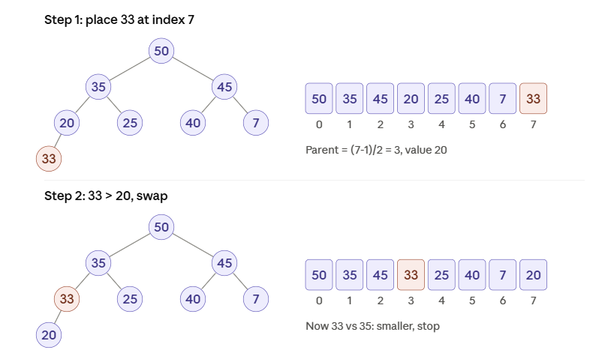
Max Heap Operations - Add
Parent of i is at index
(i - 1) / 2 (integer division)
This is called Heapify Up (Bubble Up)

Slide 10
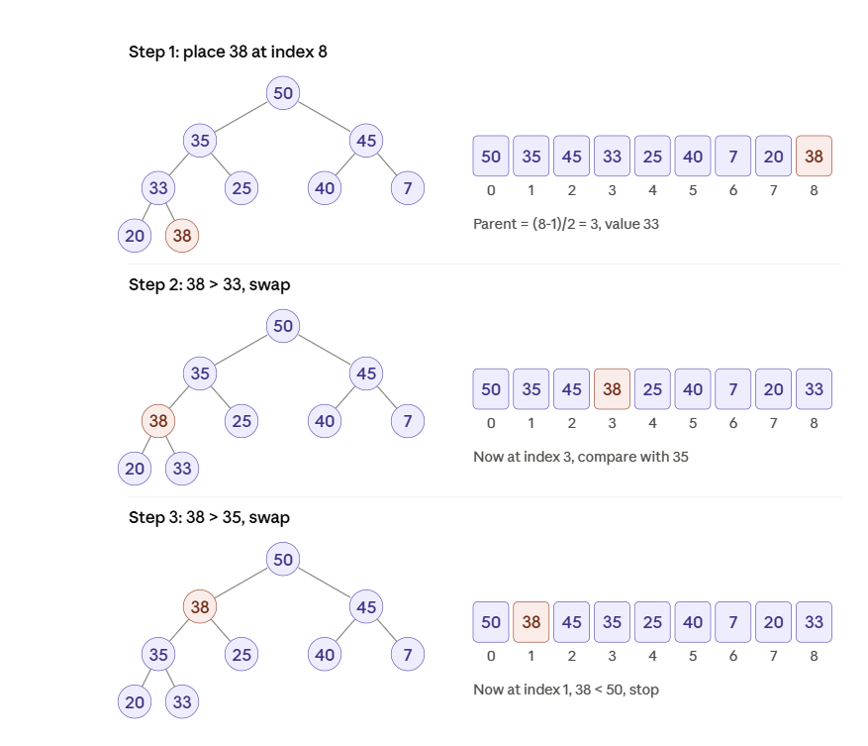
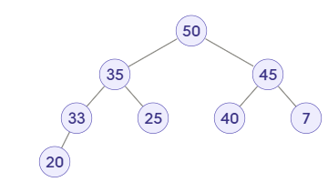
Max Heap Operations - Add
Add 38
What Happens if I add 99?

Slide 11
Max Heap Add - Efficiency
Steps
  Add item at the end
  If needed happify up; at each level
    Find parent’s index
    Compare
    Swap
Why is Balance guaranteed?
    Because we always add in a way that maintains the complete-tree property.
    The heap can't become a stick the way a BST can.
    Balance comes for free.

Slide 12
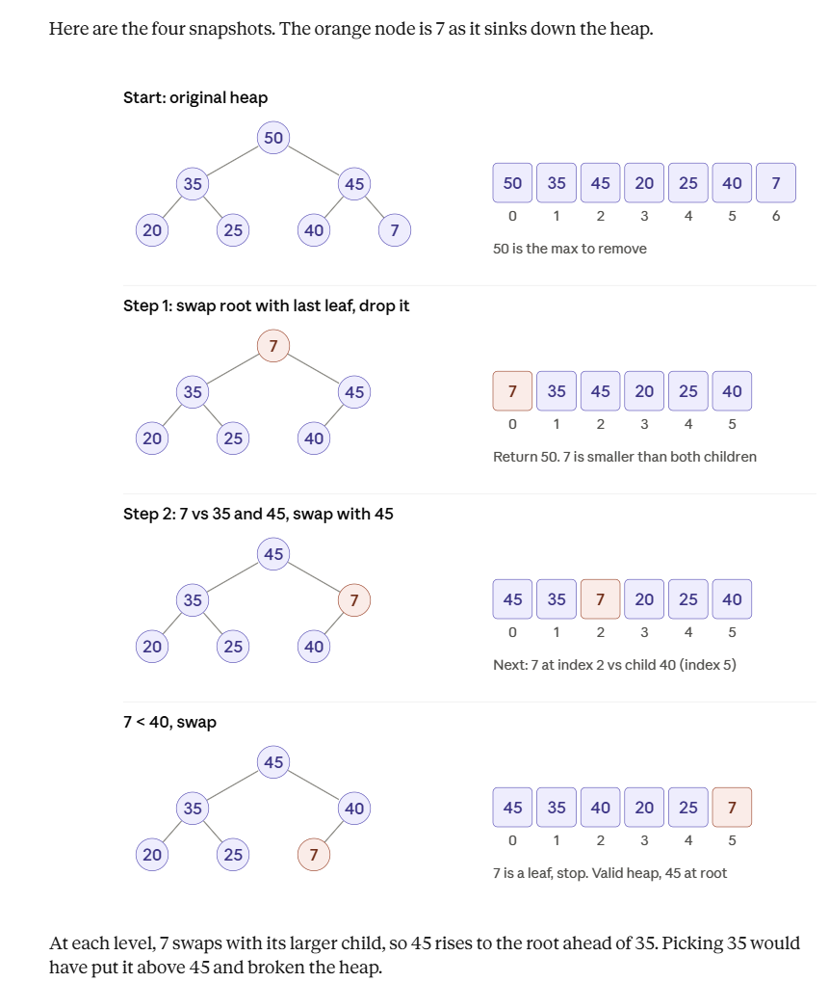
Max Heap Operations - RemoveMax

Slide 13
Max Heap Operations - RemoveMax
Heapify Down
7 can have two children, which one to swap with?
Now Completeness is Satisfied but Heap property is violated

Slide 14
Max Heap RemoveMax - Efficiency
Steps
  Swap root with the leaf node to be removed:
  Remove the last slot
  Heapify down:
    at most one swap per level,
    and each level costs at most 2 comparisons,
    so the number of steps is at most the height.
Guaranteed O(log N), again because the tree is always complete.

Slide 15
Max Heap Operations - PeekMax
Return the root (array[0]) without removing it.
  O(1).
This is the one place where the heap actually wins.
Every other structure that had O(1) peek paid O(N) somewhere else, and the BST pays O(log N) to walk to its rightmost node.
The heap gives you O(1) peek and O(log N) add/remove.

Slide 16
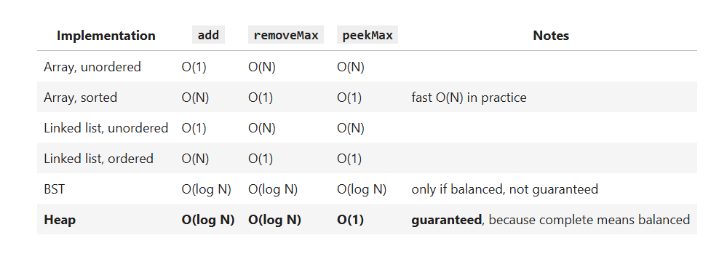
Priority Queue Implementations Summary

