Slide 1
Linguistic diversity in open-source development
Bogdan Vasilescu
Alexander Serebrenik
Mark van den Brand

Slide 2

Motivation
…
…
C++
…
I ‘speak’ Java
C
HTML
Lisp
XML
Java
Python
Unix shell
I ‘speak’ Java
and Python
I ‘speak’ Python

Slide 3
Motivation
If leaves the project, what is the risk of not finding replacement developers that speak Python?
No risk, plenty of other Python
developers to choose from
What about now?

Slide 4
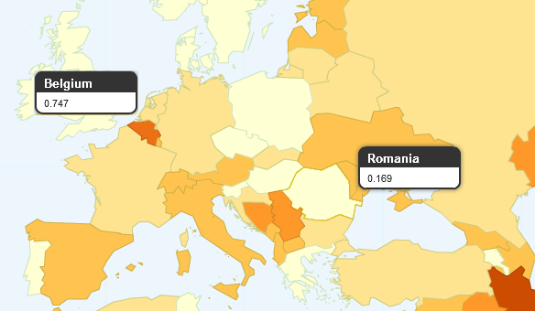
Linguistic diversity
Greenberg (1956)
  compare geographic regions
  probability that two random individuals do not speak the same language

Slide 5
Linguistic diversity
Probability that two random individuals do not speak the same language
Simple model
  everyone speaks exactly one language
  languages are independent

Slide 6
Linguistic diversity
Probability that two random individuals do not speak the same language
Related-languages model
  everyone speaks exactly one language
  languages are similar

Slide 7
Linguistic diversity
Probability that two random individuals do not speak the same language
Polyglot related-languages model
  everyone speaks at least one language
  languages are similar

Slide 8
Our risk measure
Probability that two random individuals do not speak the same language
Risk of not finding developers that ‘speak’

Slide 9
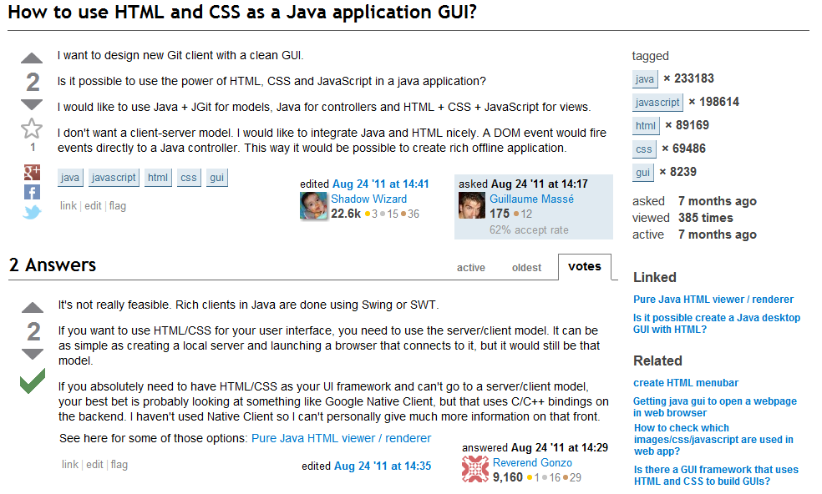
StackOverflow.com

Slide 10
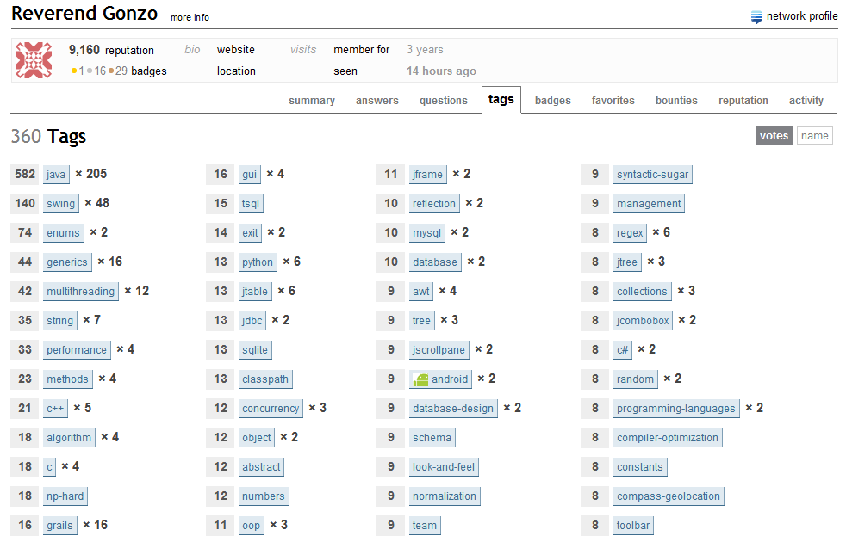
User tags

Slide 11
Similarity measure
Reverend Gonzo: Java, C, C++, C#, Python,…
Alexander Serebrenik: Prolog, SQL, C++,…
Bogdan Vasilescu: Python,…
Jon Skeet: C#, Java, ASP.net, XML,…
… > 400,000
Association rule mining:
  “C => Java”
Java
C

Slide 12
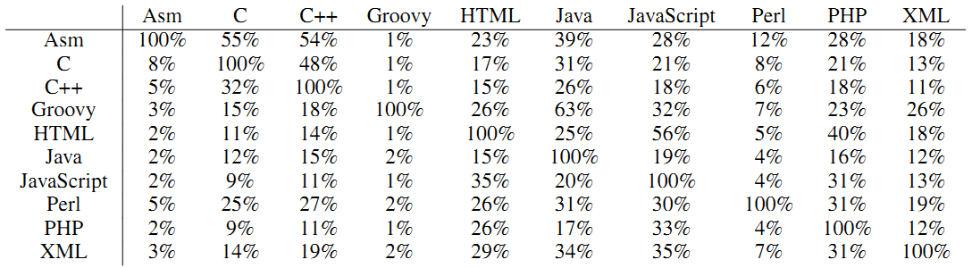
Similarity measure - results
Assembly posts: 44
Assembly + Java developers: > 1000
→ When in need for Java developers, ask Assembly guys

Slide 13
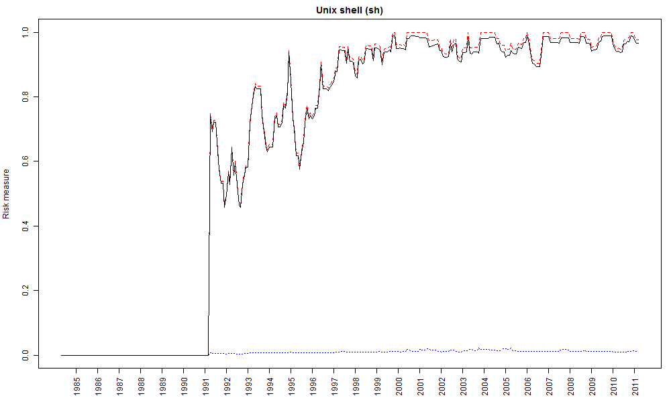
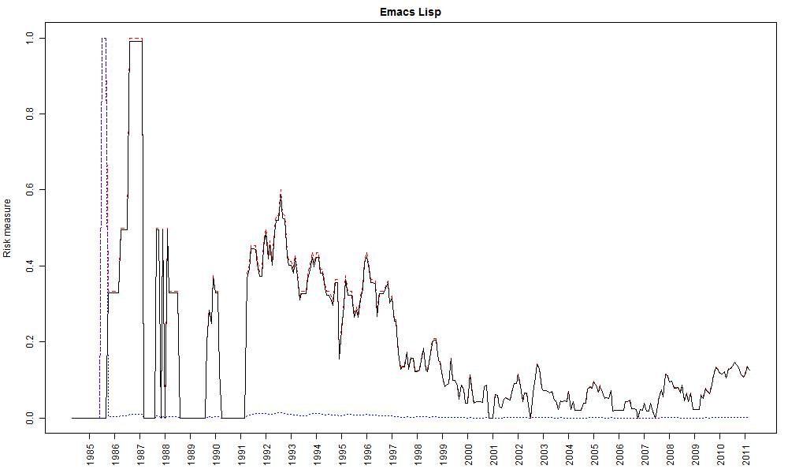
Case study - Emacs
  1985-2012: C, Emacs Lisp, C++, Java, Lisp, Python, M4, … (26)
Exotic languages
→High/low risk

Slide 14
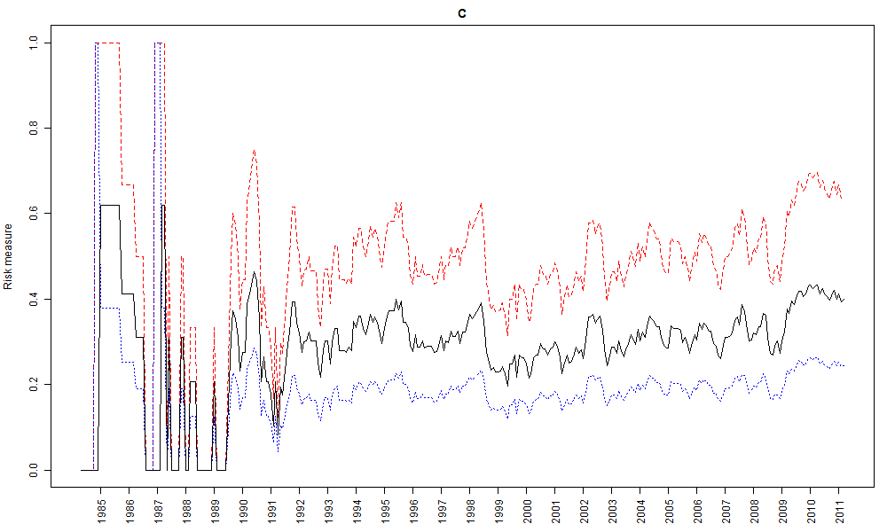
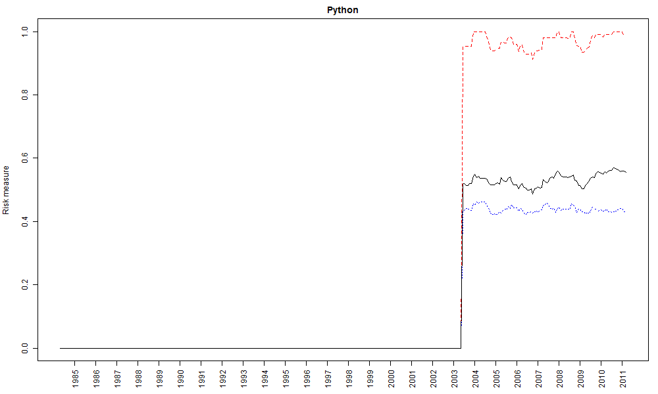
Case study - Emacs
C: spoken by half of the community
+ similar to other languages
→low risk
Python: spoken very sporadically
+ similar to other languages
→ low risk

Slide 15
Conclusions
What is the risk of not finding developers
that speak Python?
Risk measure
Similarity measure (StackOverflow)
  “C => Java”
Low risk
Depends on similarity

Slide 16
Conclusions
If leaves the project, what is the risk of not finding replacement developers that speak Python?
Low/High risk, depending on
how similar the other languages
are to Python.
Low risk, plenty of other Python
developers to choose from.

