Slide 1
Review of HCR
-Handwritten Character Recognition
Lecture 14 -
1
Fei-Fei Li & Justin Johnson & Serena Yeung Lecture 14 - May 23, 2017

Slide 2
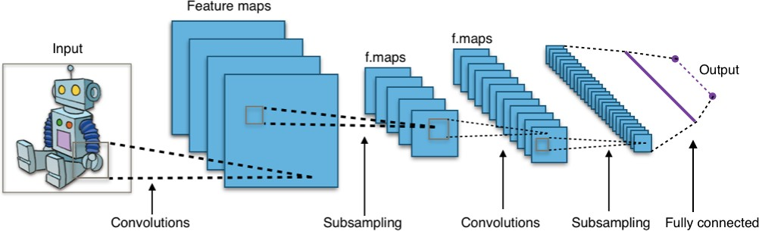
A typical CNN architecture

Slide 3
Preview: ConvNet is a sequence of Convolution Layers, interspersed with activation functions
32
28
CONV, ReLU
e.g. 6 5x5x3 filters
32
28
3
6

Slide 4
Preview: ConvNet is a sequence of Convolutional Layers, interspersed with activation functions
32
28
24
….
CONV, ReLU
e.g. 6 5x5x3 filters
CONV, ReLU
e.g. 10 5x5x6 filters
CONV, ReLU
32
28
24
3
6
10

Slide 5
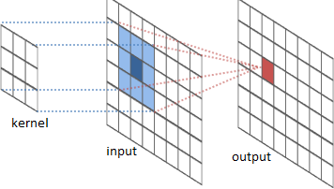
The convolution operation

Slide 6
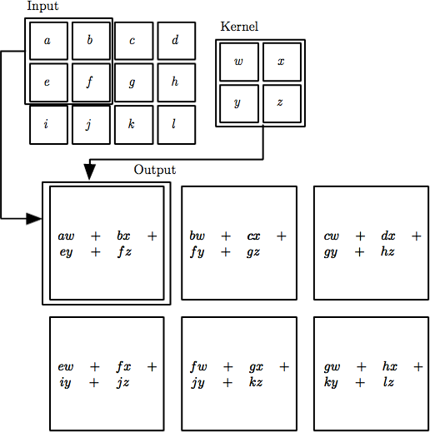

The convolution operation

Slide 7
Convolution Layer
32x32x3 image
32
height
32
depth
width
3

Slide 8
Convolution Layer
32x32x3 image
5x5x3 filter
32
Convolve the filter with the image
i.e. “slide over the image spatially, computing dot products”
32
3

Slide 9
Convolution Layer
Filters always extend the full
32x32x3 image
depth of the input volume
5x5x3 filter
32
Convolve the filter with the image
i.e. “slide over the image spatially, computing dot products”
32
3

Slide 10


Convolution Layer
32x32x3 image 5x5x3 filter
32
1 number:
the result of taking a dot product between the filter and a small 5x5x3 chunk of the image
(i.e. 5*5*3 = 75-dimensional dot product + bias)
32
3

Slide 11
Convolution Layer
activation map
32x32x3 image 5x5x3 filter
32
28
convolve (slide) over all spatial locations
32
28
3
1

Slide 12
Convolution Layer
32x32x3 image 5x5x3 filter
activation maps
32
28
convolve (slide) over all spatial locations
32
28
consider a second, green filter
3
1

Slide 13
For example, if we had 6 5x5 filters, we’ll get 6 separate activation maps:
activation maps
32
28
Convolution Layer
32
28
3
6
We stack these up to get a “new image” of size 28x28x6!

Slide 14
A closer look at spatial dimensions:
activation map
32x32x3 image 5x5x3 filter
32
28
convolve (slide) over all spatial locations
32
28
3
1

Slide 15
A closer look at spatial dimensions:
7
7x7 input (spatially) assume 3x3 filter
7

Slide 16
A closer look at spatial dimensions:
7
7x7 input (spatially) assume 3x3 filter
7

Slide 17
A closer look at spatial dimensions:
7
7x7 input (spatially) assume 3x3 filter
7

Slide 18
A closer look at spatial dimensions:
7
7x7 input (spatially) assume 3x3 filter
7

Slide 19
A closer look at spatial dimensions:
7
7x7 input (spatially) assume 3x3 filter
=> 5x5 output
7

Slide 20
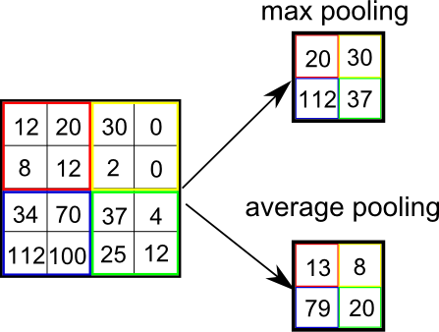
Pooling
Eﬀect = invariance to small translations of the input

Slide 21
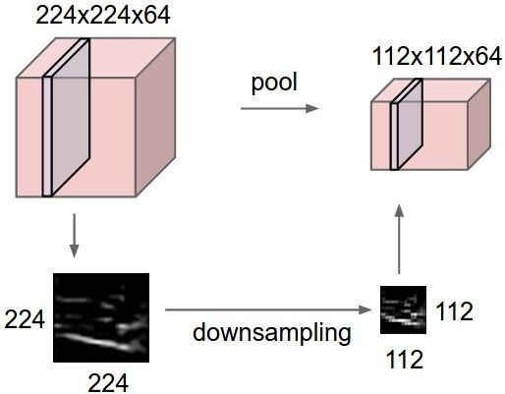
Pooling
makes the representations smaller and more manageable
operates over each activation map independently

Slide 22
Max Pooling
Single depth slice
1 | 1 | 2 | 4
5 | 6 | 7 | 8
3 | 2 | 1 | 0
1 | 2 | 3 | 4
x
max pool with 2x2 filters and stride 2
6 | 8
3 | 4
y

Slide 23
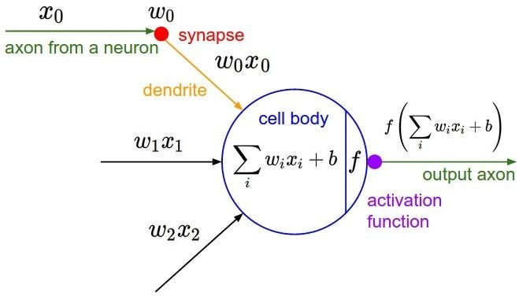
Activation Functions

Slide 24
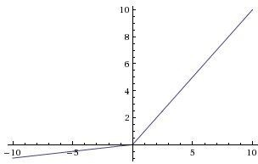
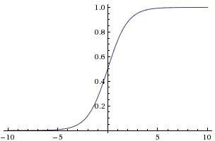

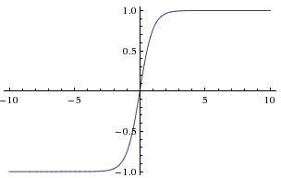


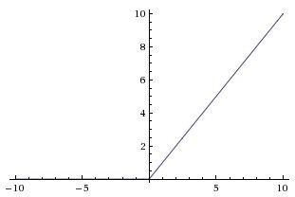
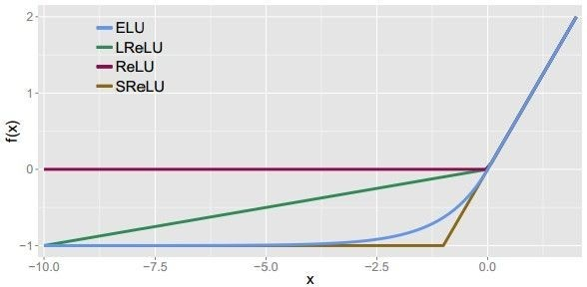
Activation Functions
Sigmoid
Leaky ReLU
Maxout
ELU
tanh
tanh(x)
ReLU
max(0,x)

Slide 25
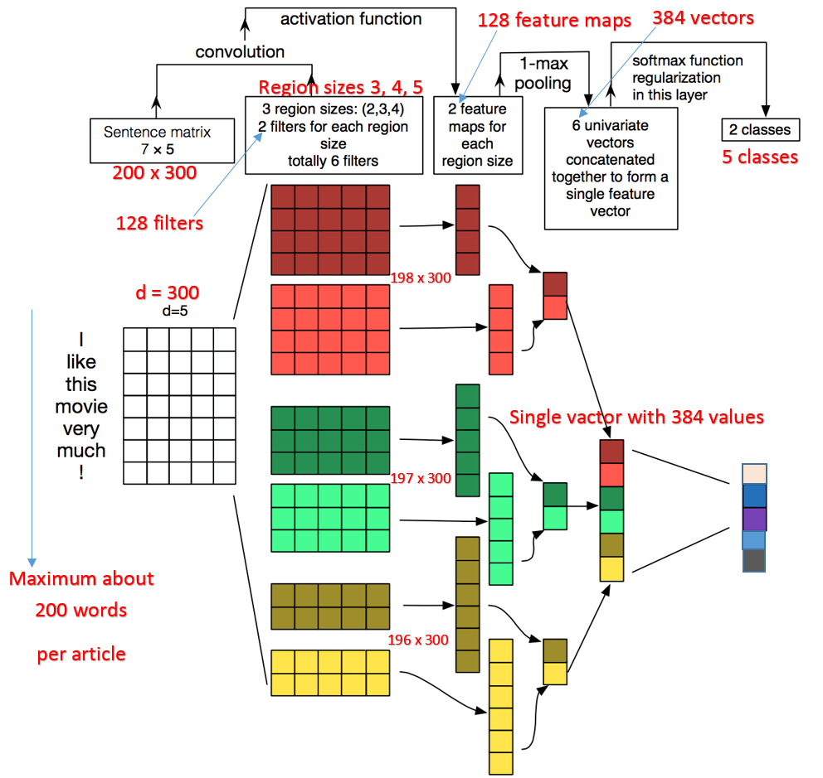
CNN in Text classification

