Slide 1
Instruction
To Build gpu based dnn environment

Slide 2
GPU Information
NVIDIA TITAN X
https://www.nvidia.com/en-us/geforce/products/10series/titan-x-pascal/
Is this a CUDA capable GPU? YES
https://developer.nvidia.com/cuda-gpus
User guide for NVIDIA TITAN X
http://www.nvidia.com/content/geforce-gtx/GTX_TITAN_X_User_Guide.pdf

Slide 3
Install pre-requirement for GPU drivers
Download and Install GCC from source:
https://linuxhostsupport.com/blog/how-to-install-gcc-on-centos-7/

Slide 4
Install GPU drivers
Driver for NVIDIA TITAN X
http://www.nvidia.com/Download/index.aspx?lang=en-us
If failed with warning about “disable Nouveau kernel driver”:
Create config file with
https://askubuntu.com/questions/841876/how-to-disable-nouveau-kernel-driver
And Running this will build initramfs for the running kernel
https://ask.fedoraproject.org/en/question/88140/how-to-make-dracut-regenerate-initramfs-for-only-one-kernel/
Reboot then run NVIDIA installer

Slide 5
Install pre-requirement for GPU drivers
ERROR: you appear to be running an x server: please exit X before installing. sudo
Then can run as following:
./NVIDIAxxxx.run --no-x-check

Slide 6
Install GPU acceleration software CUDA and cuDNN
CUDA for NVIDIA TITAN X
https://developer.nvidia.com/cuda-downloads
cuDNN FOR NVIDIA TITAN X (need to be member of NVIDIA)
https://developer.nvidia.com/rdp/cudnn-archive

Slide 7
Install Python and PIP
CUDA for NVIDIA TITAN X
https://developer.nvidia.com/cuda-downloads
cuDNN FOR NVIDIA TITAN X (need to be member of NVIDIA)
https://developer.nvidia.com/rdp/cudnn-archive

Slide 8
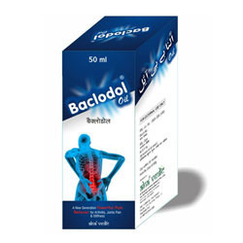


Diagram:
Single Raw Image
Database of all images without text annotation
Database go through CNN-LSTM pretrained model by Tesseract-OCR

Slide 9
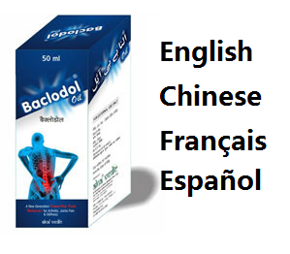

Diagram:
Single Raw Image
Database of all images without text annotation
Database go through CNN-LSTM pretrained model by Tesseract-OCR
Output is Database of all images with text annotation in multi-languages

Slide 10
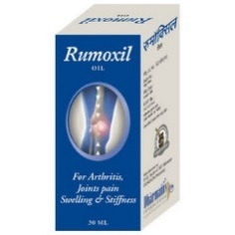
Diagram:
Single Raw Image
Database of all images without text annotation
Test image go through model
Database go through CNN-LSTM pretrained model by Tesseract-OCR
Output is Database of all images with text annotation in multi-languages

Slide 11
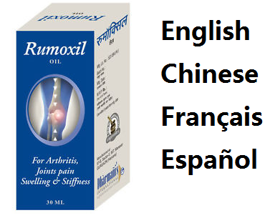
Diagram:
Get annotation
Of test image
Single Raw Image
Database of all images without text annotation
Test image go through model
Database go through CNN-LSTM pretrained model by Tesseract-OCR
Output is Database of all images with text annotation in multi-languages

Slide 12
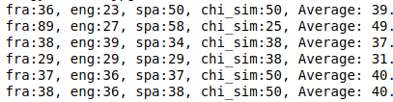
Diagram:
Get annotation
Of test image
Using Partial similarity
Find most similar
One in database
Single Raw Image
Database of all images without text annotation
Test image go through model
Database go through CNN-LSTM pretrained model by Tesseract-OCR
Output is Database of all images with text annotation in multi-languages

Slide 13
Steps:
Build database of 99 raw images without text annotation
Every image go through Tesseract-OCR
Build database of 99 images with text annotation
Input a test image and recognize text
Comparing text of test image with all in database
Get similarity ratio of multi-languages
Output the most similar image in database

Slide 14
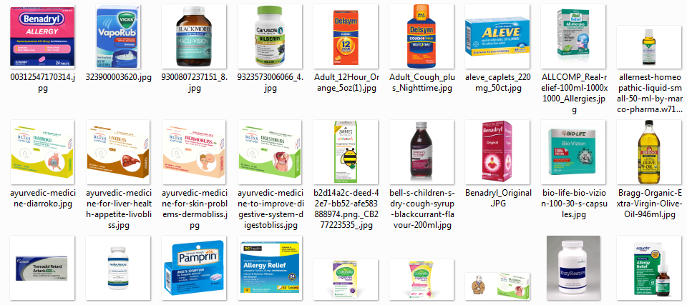
Build database of 99 raw images
We currently have 99 images to build database

Slide 15

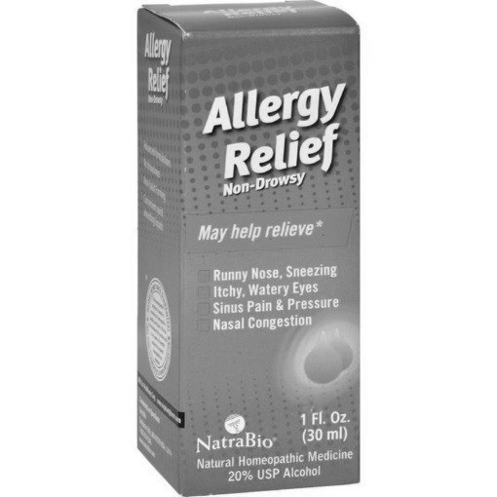
Image go through Tesseract-OCR output is multi-language annotation
French — runny nose, sneezing- itchy, watery eyes© sinus pain & pressurere a c qu[ 1804natrabio (30 ml)rp re an t20% usp alcohol
English --- t al (a r clrlgo c al~ sinus pain & pressureb pr lg[ (n2natrabio (30 ml)natural homeopathic medicine20% usp alcohol
Spanish -- runny nose, sa— ltchy, watery eyes— sinus pain % pressureee5) nanatrabio (enatural homeopathic medicineea
Chinese(sim) --- runny nose, sn6ezing一 ltchy, watery eyes国 eitsedictuuid言 nasal congestiong 0e[20% usp 2

Slide 16
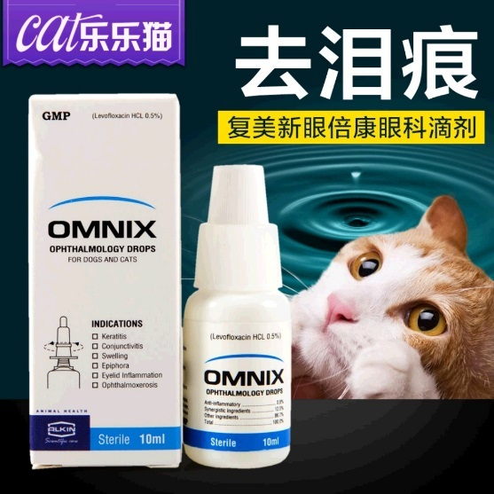
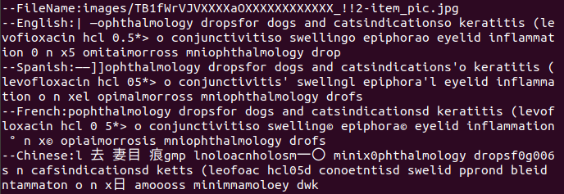
Build database for all images with recognized text annotation
Some sample images with multi-language texts extracted

Slide 17
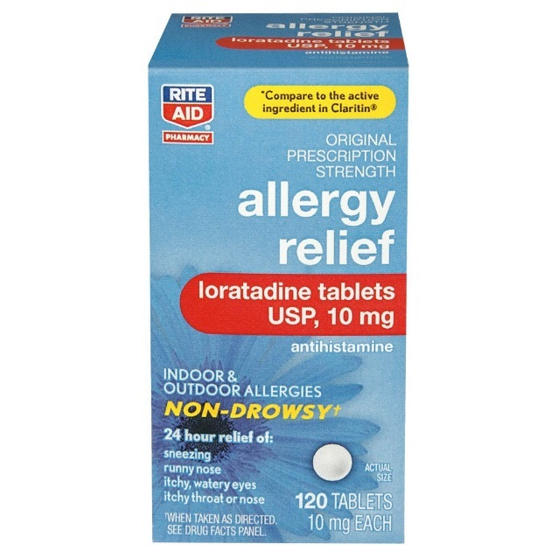

Build database for all images with recognized text annotation
Some sample images with multi-language texts extracted

Slide 18
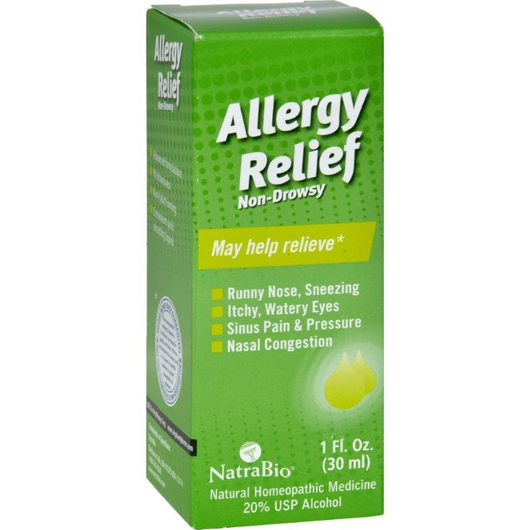
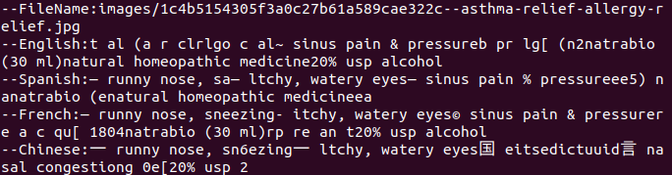
Build database for all images with recognized text annotation
Some sample images with multi-language texts extracted

Slide 19
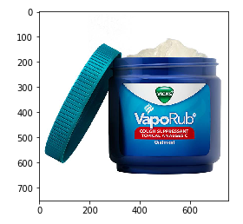
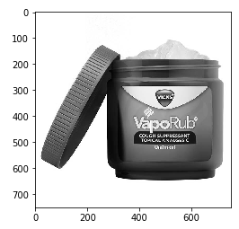
Recognize test image get text annotation
--French: cough suppressant —topical analgesicst
--English: [tv t lt ntopical analgesict
--Spanish: cough suppressant —topical analgesicto
--Chinese: eeointme

Slide 20
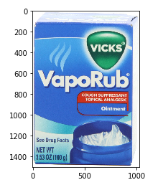
Comparing similarity of input text with database
We comparing extracted text with each records in database.
Get similarity radio (0--100)
Find the Average maximum is 49.75 with the image on the right
fra:89, eng:27, spa:58, chi_sim:25, Average: 49.75
Languages: fra-French, eng-English, spa-Spanish, chi_sim-Chinese

Slide 21
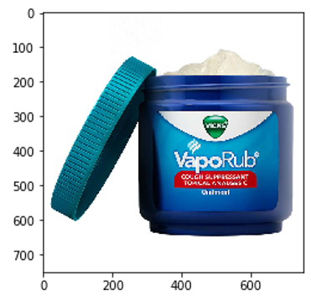
Conclusion
Top 5 with maximum average similarity score
Top 1: Same Brand: VapoRub
Same function: Cough suppressant

Slide 22

Conclusion
Top 5 with maximum average similarity score
Top 1: Same Brand: VapoRub
Same function: Cough suppressant
Top2: Different Brand: Nyquil
Same function: Cough suppressant

Slide 23
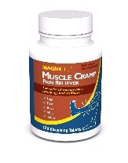
Conclusion
Top 5 with maximum average similarity score
Top 1: Same Brand: VapoRub
Same function: Cough suppressant
Top2: Different Brand: Nyquil
Same function: Cough suppressant
Top3: Different Brand: MAGNILife
Different function: pain relief

Slide 24
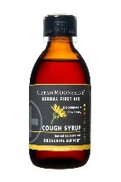
Conclusion
Top 5 with maximum average similarity score
Top 1: Same Brand: VapoRub
Same function: Cough suppressant
Top2: Different Brand: Nyquil
Same function: Cough suppressant
Top3: Different Brand: MAGNILife
Different function: pain relief
Top4: Different Brand: Urban Moonshine
Same function: Cough syrup

Slide 25
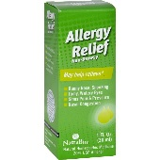
Conclusion
Top 5 with maximum average similarity score
Top 1: Same Brand: VapoRub
Same function: Cough suppressant
Top2: Different Brand: Nyquil
Same function: Cough suppressant
Top3: Different Brand: MAGNILife
Different function: pain relief
Top4: Different Brand: Urban Moonshine
Same function: Cough syrup
Top5: Different Brand: Natra bio
Different function: Allergy relief

Slide 26
Conclusion
Top 5 with maximum average similarity score
Languages: fra-French, eng-English, spa-Spanish, chi_sim-Chinese
fra:89, eng:27, spa:58, chi_sim:25, Average: 49.75
fra:38, eng:36, spa:38, chi_sim:50, Average: 40.5
fra:36, eng:23, spa:50, chi_sim:50, Average: 39.75
fra:38, eng:39, spa:34, chi_sim:38, Average: 37.25
fra:32, eng:36, spa:39, chi_sim:38, Average: 36.25

