Slide 1
Introduction to deep learning in Optical Character Recognition (OCR)
Xiangwen & Leihong & Joshua
FDA/NCTR
June 26, 2018

Slide 2
Index
Background
CNN-LSTM network in OCR modeling
Implementing Tesseract: A pre-trained OCR model
Internal Tests
Take Home Messages

Slide 3
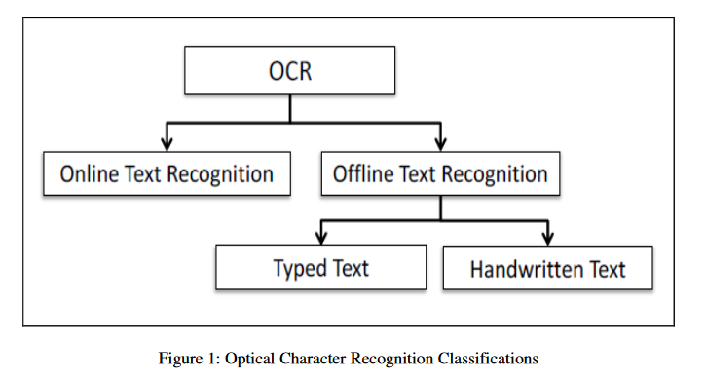
Background
OCR (Optical Character Recognition) is a general technique to extract handwritten or types texts from digitizing pictures.

Slide 4
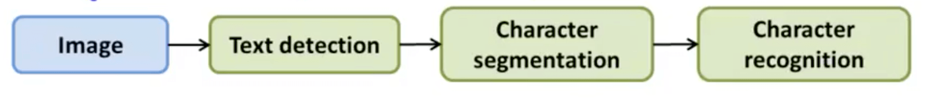
OCR Pipeline
Text detection
Character segmentation
Character classification
CNN-LSTM Architecture

Slide 5
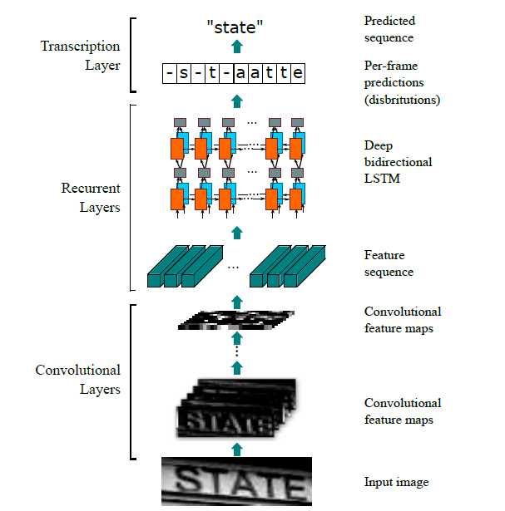
CNN-LSTM Architecture
Convolutional layers, which extract a feature sequence from the input image;
Recurrent layers, which predict a label distribution for each frame;
Transcription layers, which transform raw prediction to final, human-readable text documents

Slide 6
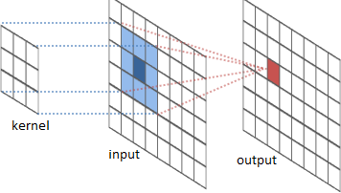
Convolutional neural network (CNN)
Essentially neural networks that use convolution in place of general matrix multiplication in at least one of their layers.

Slide 7
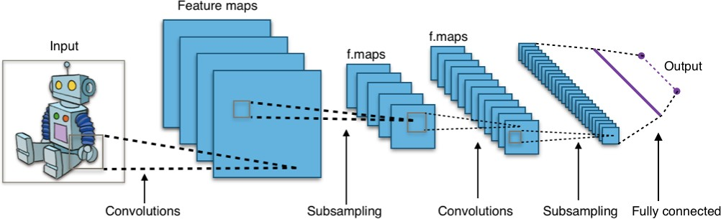
Convolutional neural network (CNN)
A typical CNN architecture uses several CNN modules (Conv filter + pooling layer) followed by several dense (fully connected) layers:

Slide 8
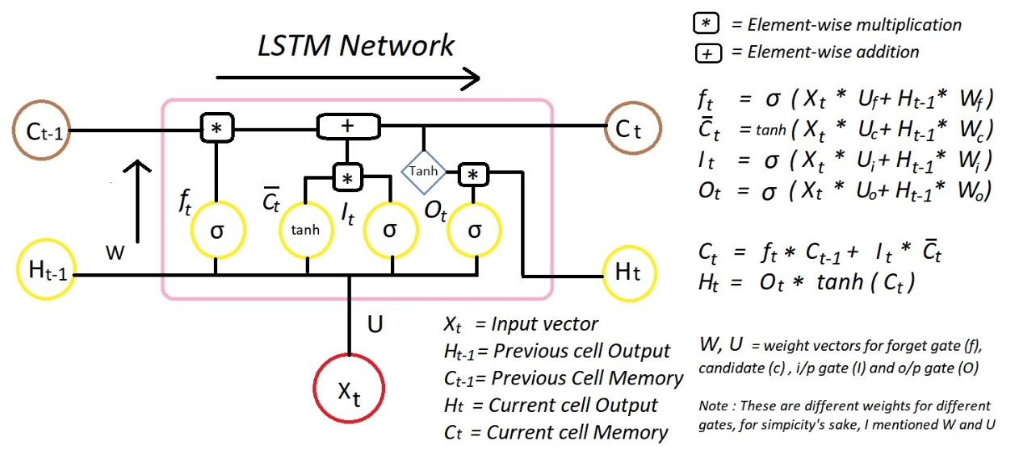
Recurrent Neural Net (RNN)
Long Short Term Memory (LSTM) is one of the mostly known RNN kernel in text mining;
The sequence of words define their meaning:
Will you do it?
Do you will it?

Slide 9
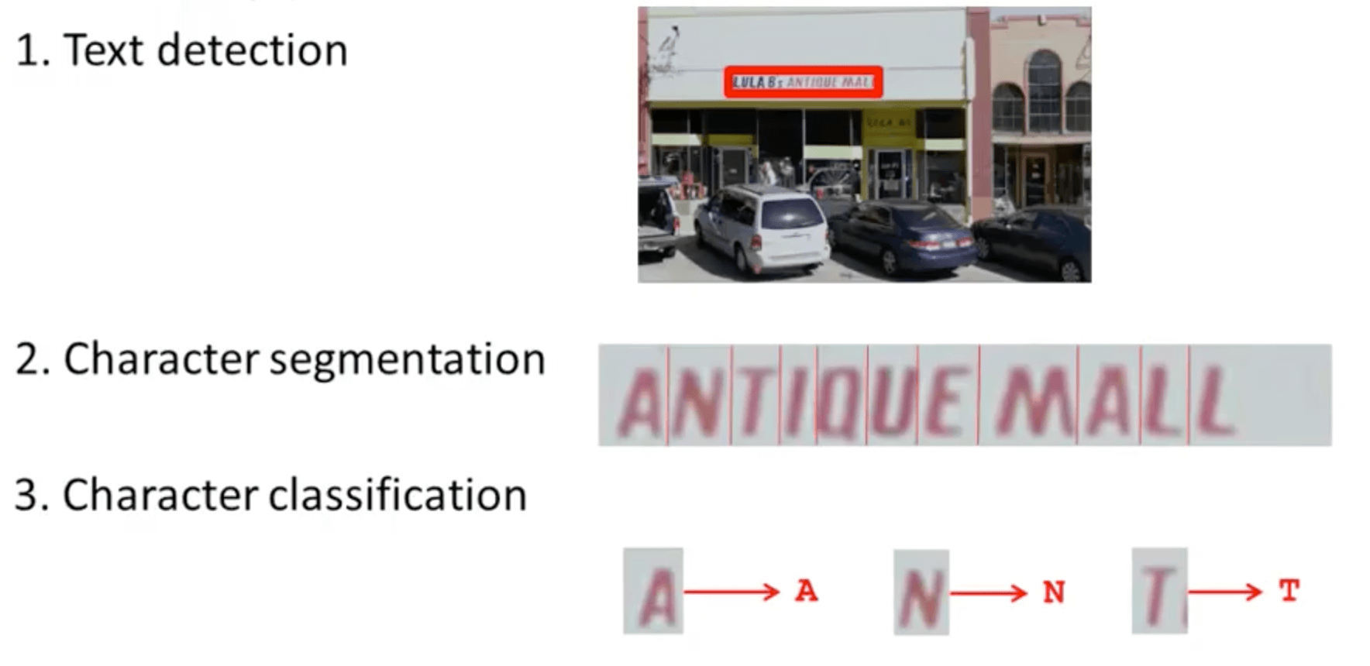
Modeling workflow

Slide 10
OCR engines
Tesseract - The definitive Open Source OCR engine Apache 2.0
ocropus - OCR engine based on LSTM, Apache 2.0
kraken - Ocropus fork with sane defaults
Ocrad - The GNU OCR. GPL
digit - OCR for numbers in meter displays, such as a power meter, using caffe
ocular - Machine-learning OCR for historic documents
SwiftOCR - fast and simple OCR library written in Swift
attention-ocr - OCR engine using visual attention mechanisms
RWTH-OCR - The RWTH Aachen University Optical Character Recognition System
simple-ocr-opencv - A simple pythonic OCR engine using opencv and numpy
Etc.

Slide 11
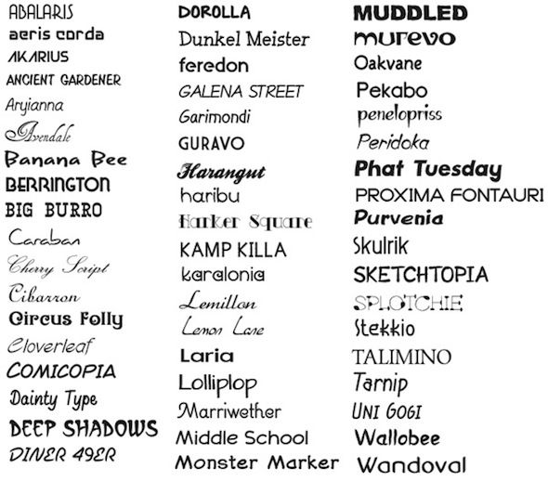
Tesseract
Sourced by HP since 1985
Developed by Google. Since 2006
Open source text recognizer (OCR) Engine
under the Apache 2.0 license.
Trained by typed printed text
On about 400,000 text-lines spanning about 4,500 fonts

Slide 12
Tesseract
It is open source, available on Github
Installed on my Linux machine using command line
Test my example image
Depandencies
sudo apt install tesseract-ocr
tesseract myscan.png out -l eng
A compiler for C and C++: GCC or Clang
GNU Autotools: autoconf, automake, libtool
autoconf-archive
pkg-config
Leptonica
libpng, libjpeg, libtiff

Slide 13
Tesseract
The pre-trained English model
Trained on 400,000 textlines spanning about 4500 fonts
Takes about 1 week for training,
Takes a few seconds for test on single image.
How to train our model?
Fine tune. Starting with an existing trained language, train on your specific additional data
Cut off the top layer from the network and retrain a new top layer using the new data
Retrain from scratch

Slide 14
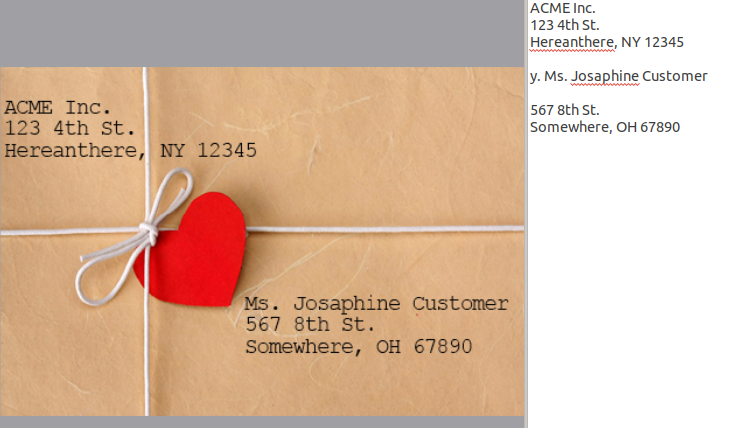
Test results (Printed text)
Output:

Slide 15
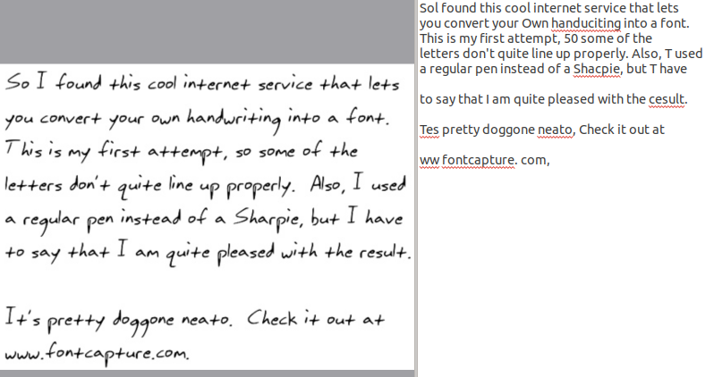
Test results (Hand-written text)
Output:

Slide 16
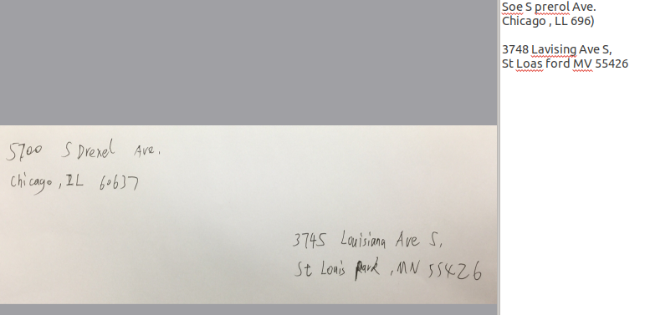
Test results (Mail Envelope text)
Output:

Slide 17
Take Home Messages
Current model performs better on typed text.
Less feature designing needed in CNN-LSTM model.
Robust and data driven.
Need to be further trained for handwritten text recognition.
Need to be fine-tuned based on ORA pilot datasets.
both printed and hand-written samples.

Slide 18
Thanks!
References
[1] Alex Graves, Santiago FeLSTMdez, Faustino Gomez Jrgen Schmidhuber, Connectionist temporal classification: labelling unsegmented sequence data with Long short-term memorys, Proceedings of the 23rd international conference on Machine learning. 2006
[2] Convolutional Neural Network Benchmarks: https://github.com/jcjohnson/cnn-benchmarks
[3] Elie Krevat, Elliot Cuzzillo. Improving Off-line Handwritten Character Recognition with Hidden Markov Models.
[4] Fabian Tschopp. Efficient Convolutional Neural Networks for Pixelwise Classification on Heterogeneous Hardware Systems
[5] George Nagy. Document processing applications.
[6] Mail encoding and processing system patent: https://www.google.com/patents/US5420403
[7] Kurzweil Computer Products. http://www.kurzweiltech.com/kcp.html
[8] H. Bunke1, M. Roth1, E.G. Schukat-Talamazzini. Offline Cursive Handwriting Recognition using Hidden Markov Models.

