Slide 1
Introduction to Deep Learning in Optical Character Recognition (OCR)
Xiangwen & Leihong & Joshua
FDA/NCTR
June 26, 2018

Slide 2
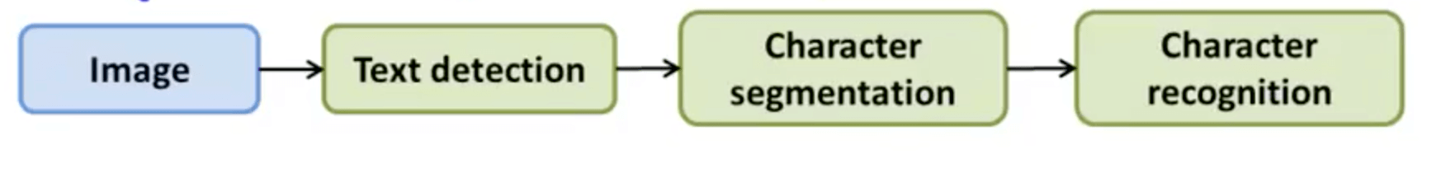
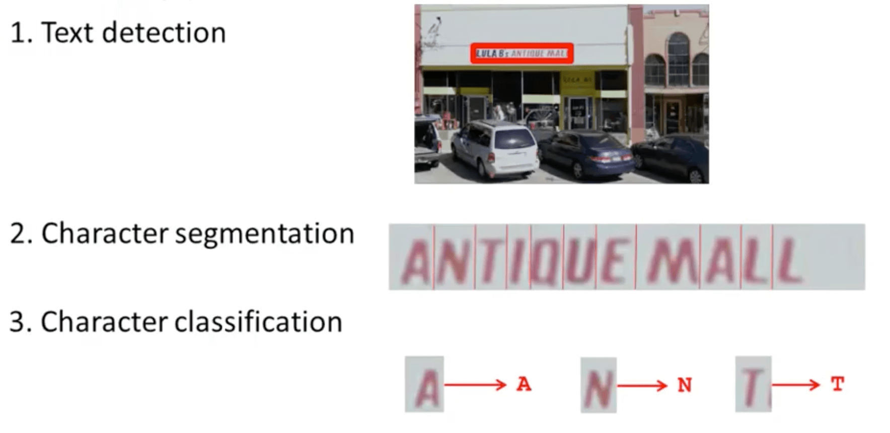
Modeling Workflow

Slide 3
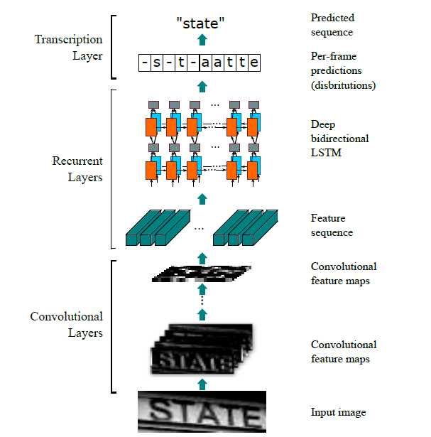
CNN-LSTM Architecture
Convolutional layers extract a feature sequence from the input image
Recurrent layers predict a label distribution for each frame
Transcription layer transforms raw prediction to final, human-readable text documents

Slide 4
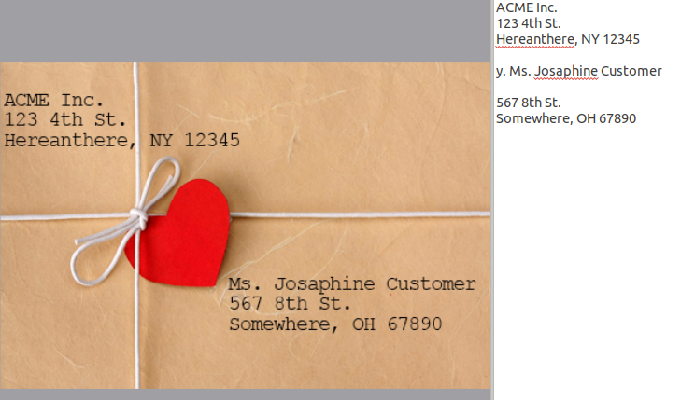
Test Results with Printed Texts
Output:

Slide 5
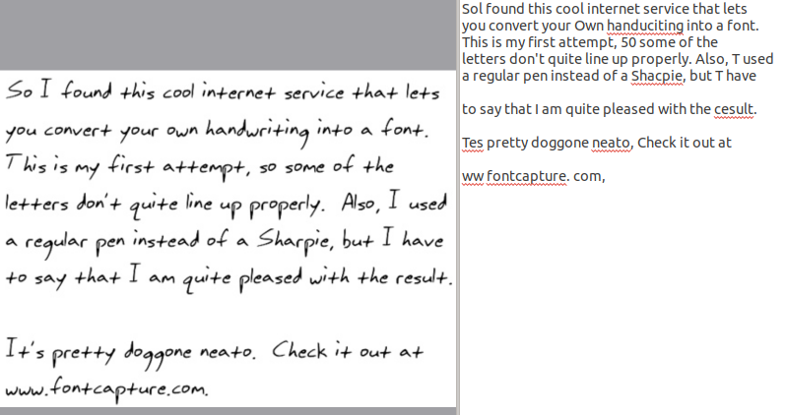
Test Results with Hand-written Texts
Output:

Slide 6
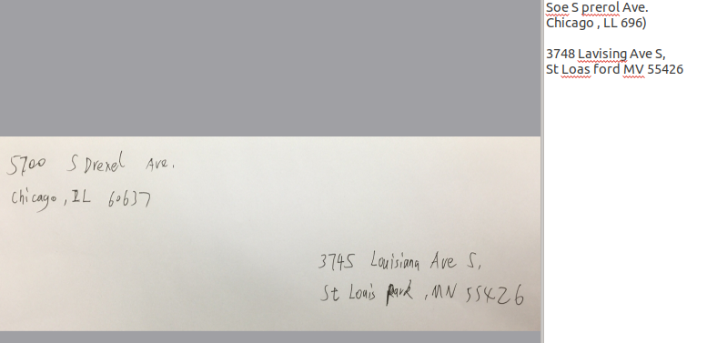
Test Results with Mail Envelope Texts
Output:

Slide 7
Summary
Advantages of CNN-LSTM model over traditional OCR model
Better accuracy
Robust and data driven (less feature designing needed)
Need to be further trained for handwritten text recognition
Need to be fine-tuned based on ORA pilot datasets
Both printed and hand-written samples

