Slide 1
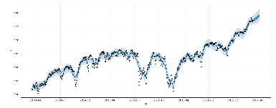
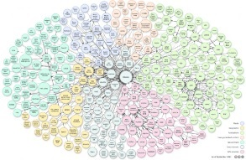
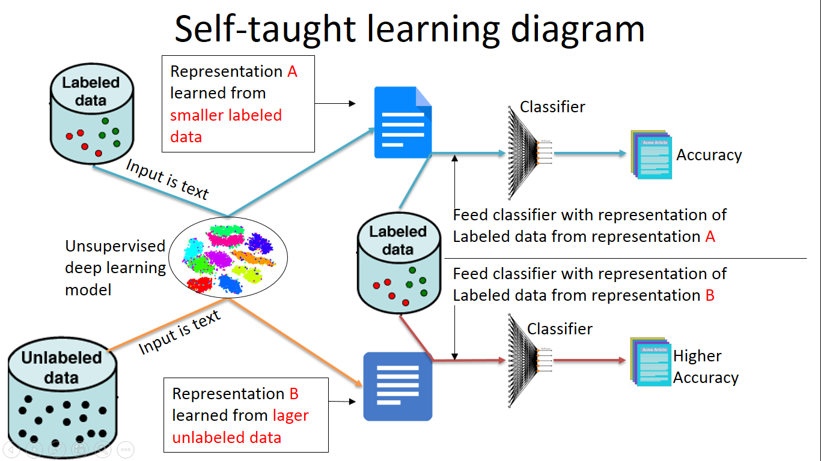
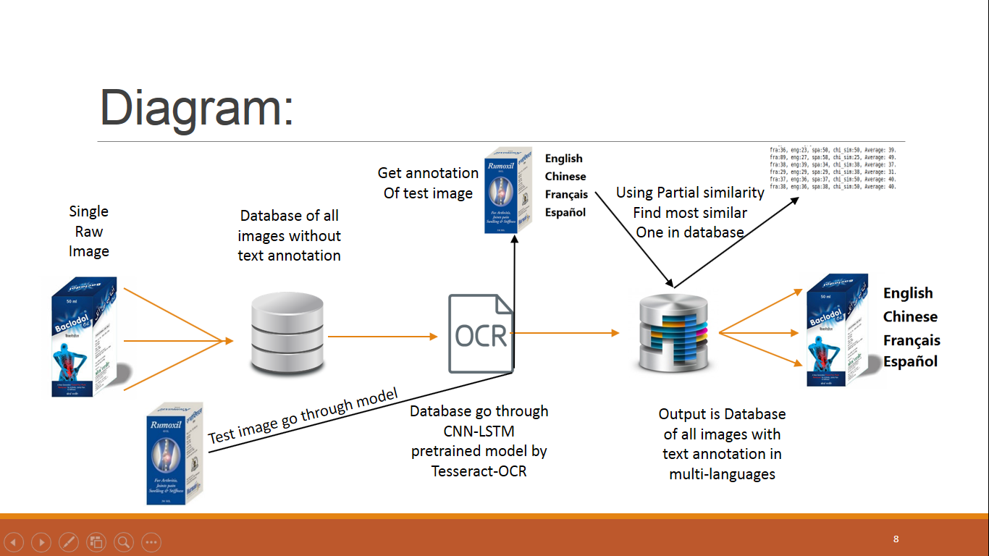
Selected machine learing project by Xiangwen
Linear regression, logistic regression for sales forecasting-Siemens(Shanghai) 2010
Entity resolution for personal information-UALR 2016
Neural network based self-taught learning for text classification-UALR 2017
OCR for text detection, recognition and identification-FDA 2018
Xiangwen Liu
UALR

Slide 2
OCR for text detection recognition and identification
Xiangwen Liu
UALR

Slide 3
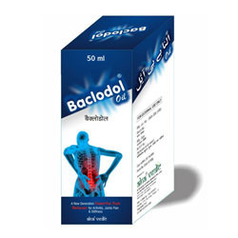

Diagram:
Single Raw Image
Database of all images without text annotation

Slide 4

Diagram:
Single Raw Image
Database of all images without text annotation
Database go through CNN-LSTM pretrained model by Tesseract-OCR

Slide 5
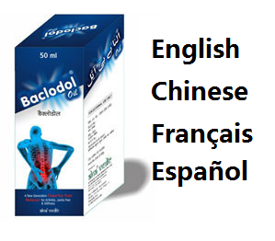

Diagram:
Single Raw Image
Database of all images without text annotation
Database go through CNN-LSTM pretrained model by Tesseract-OCR
Output is Database of all images with text annotation in multi-languages

Slide 6
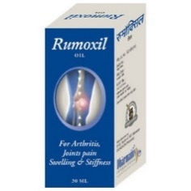
Diagram:
Single Raw Image
Database of all images without text annotation
Test image go through model
Database go through CNN-LSTM pretrained model by Tesseract-OCR
Output is Database of all images with text annotation in multi-languages

Slide 7
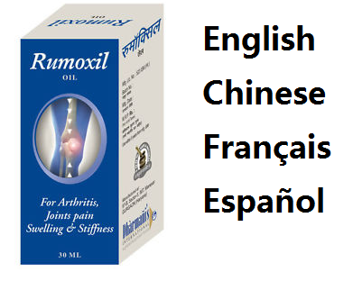
Diagram:
Get annotation
Of test image
Single Raw Image
Database of all images without text annotation
Test image go through model
Database go through CNN-LSTM pretrained model by Tesseract-OCR
Output is Database of all images with text annotation in multi-languages

Slide 8
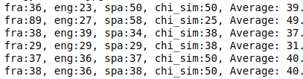
Diagram:
Get annotation
Of test image
Using Partial similarity
Find most similar
One in database
Single Raw Image
Database of all images without text annotation
Test image go through model
Database go through CNN-LSTM pretrained model by Tesseract-OCR
Output is Database of all images with text annotation in multi-languages

Slide 9
Steps:
Build database of 99 raw images without text annotation
Every image go through Tesseract-OCR
Build database of 99 images with text annotation
Input a test image and recognize text
Comparing text of test image with all in database
Get similarity ratio of multi-languages
Output the most similar image in database

Slide 10
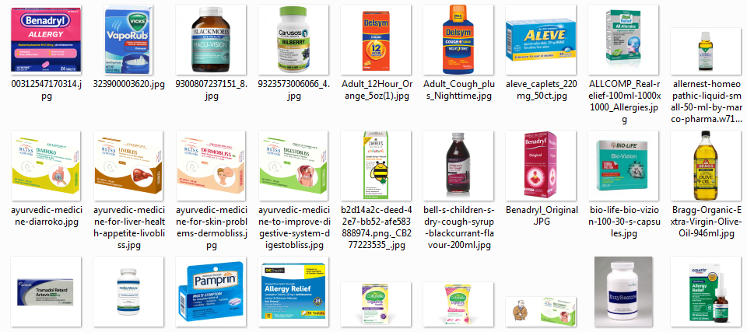
Build database of 99 raw images
We currently have 99 images to build database

Slide 11
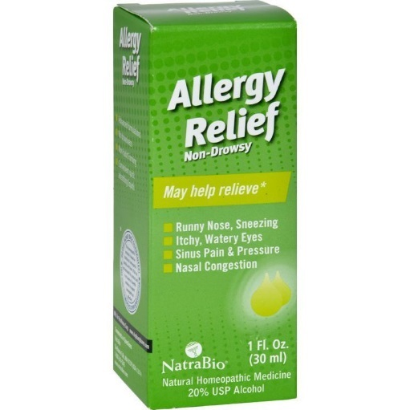
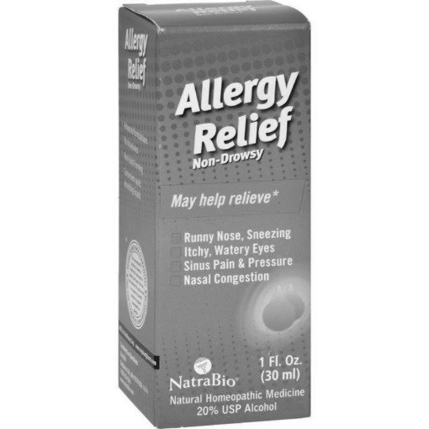
Image go through Tesseract-OCR output is multi-language annotation
French — runny nose, sneezing- itchy, watery eyes© sinus pain & pressurere a c qu[ 1804natrabio (30 ml)rp re an t20% usp alcohol
English --- t al (a r clrlgo c al~ sinus pain & pressureb pr lg[ (n2natrabio (30 ml)natural homeopathic medicine20% usp alcohol
Spanish -- runny nose, sa— ltchy, watery eyes— sinus pain % pressureee5) nanatrabio (enatural homeopathic medicineea
Chinese(sim) --- runny nose, sn6ezing一 ltchy, watery eyes国 eitsedictuuid言 nasal congestiong 0e[20% usp 2

Slide 12
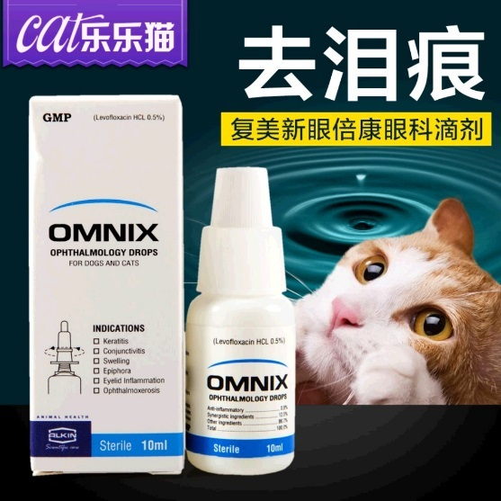
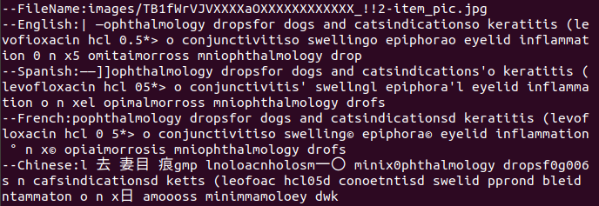
Build database for all images with recognized text annotation
Some sample images with multi-language texts extracted

Slide 13
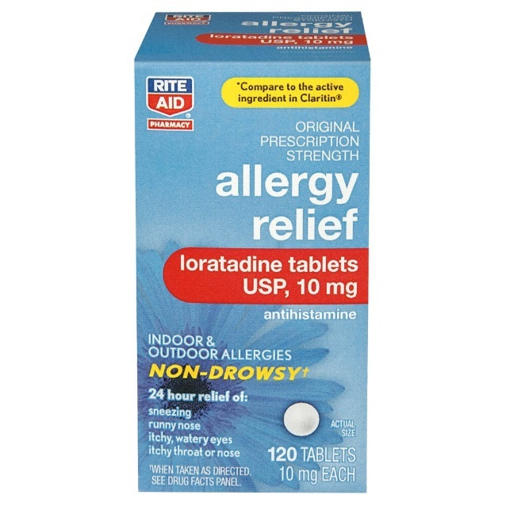

Build database for all images with recognized text annotation
Some sample images with multi-language texts extracted

Slide 14
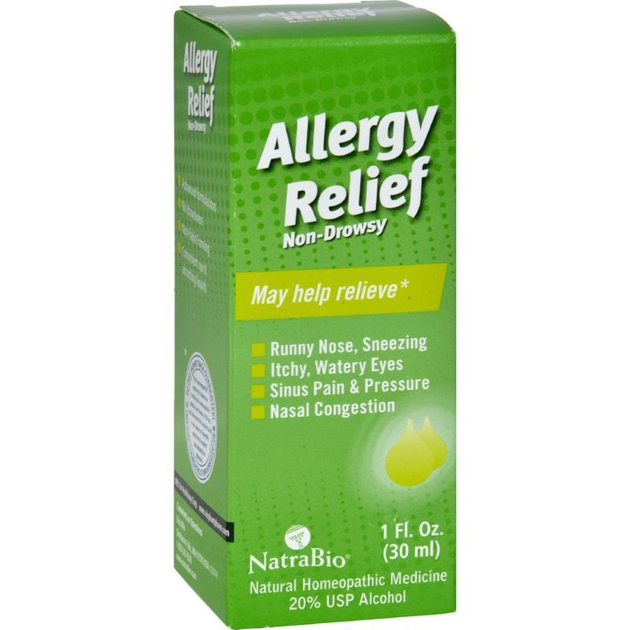
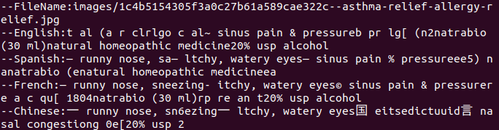
Build database for all images with recognized text annotation
Some sample images with multi-language texts extracted

Slide 15
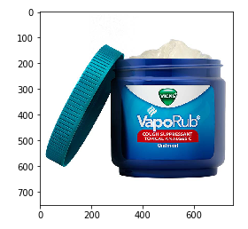
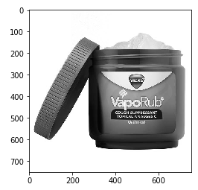
Recognize test image get text annotation
--French: cough suppressant —topical analgesicst
--English: [tv t lt ntopical analgesict
--Spanish: cough suppressant —topical analgesicto
--Chinese: eeointme

Slide 16
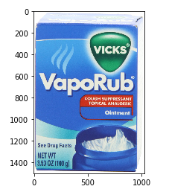
Comparing similarity of input text with database
We comparing extracted text with each records in database.
Get similarity radio (0--100)
Find the Average maximum is 49.75 with the image on the right
fra:89, eng:27, spa:58, chi_sim:25, Average: 49.75
Languages: fra-French, eng-English, spa-Spanish, chi_sim-Chinese

Slide 17
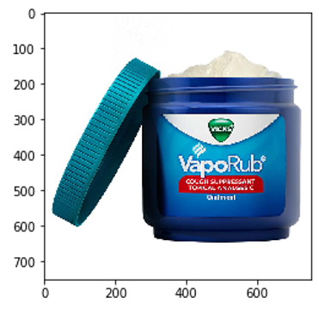
Conclusion
Top 5 with maximum average similarity score
Top 1: Same Brand: VapoRub
Same function: Cough suppressant

Slide 18
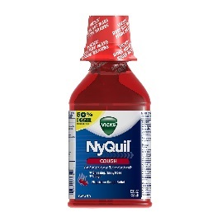
Conclusion
Top 5 with maximum average similarity score
Top 1: Same Brand: VapoRub
Same function: Cough suppressant
Top2: Different Brand: Nyquil
Same function: Cough suppressant

Slide 19
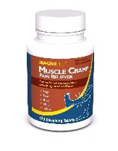
Conclusion
Top 5 with maximum average similarity score
Top 1: Same Brand: VapoRub
Same function: Cough suppressant
Top2: Different Brand: Nyquil
Same function: Cough suppressant
Top3: Different Brand: MAGNILife
Different function: pain relief

Slide 20
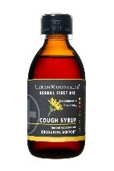
Conclusion
Top 5 with maximum average similarity score
Top 1: Same Brand: VapoRub
Same function: Cough suppressant
Top2: Different Brand: Nyquil
Same function: Cough suppressant
Top3: Different Brand: MAGNILife
Different function: pain relief
Top4: Different Brand: Urban Moonshine
Same function: Cough syrup

Slide 21

Conclusion
Top 5 with maximum average similarity score
Top 1: Same Brand: VapoRub
Same function: Cough suppressant
Top2: Different Brand: Nyquil
Same function: Cough suppressant
Top3: Different Brand: MAGNILife
Different function: pain relief
Top4: Different Brand: Urban Moonshine
Same function: Cough syrup
Top5: Different Brand: Natra bio
Different function: Allergy relief

Slide 22
Conclusion
Top 5 with maximum average similarity score
Languages: fra-French, eng-English, spa-Spanish, chi_sim-Chinese
fra:89, eng:27, spa:58, chi_sim:25, Average: 49.75
fra:38, eng:36, spa:38, chi_sim:50, Average: 40.5
fra:36, eng:23, spa:50, chi_sim:50, Average: 39.75
fra:38, eng:39, spa:34, chi_sim:38, Average: 37.25
fra:32, eng:36, spa:39, chi_sim:38, Average: 36.25

