Slide 1
Self-taught Learning on Text Data

Slide 2
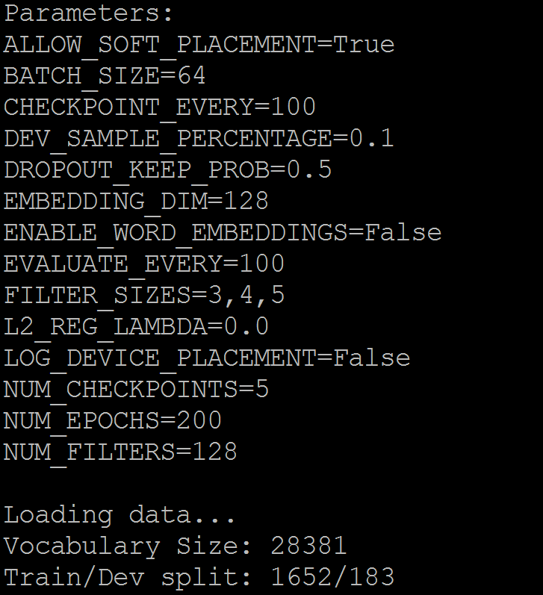
Parameters

Slide 3
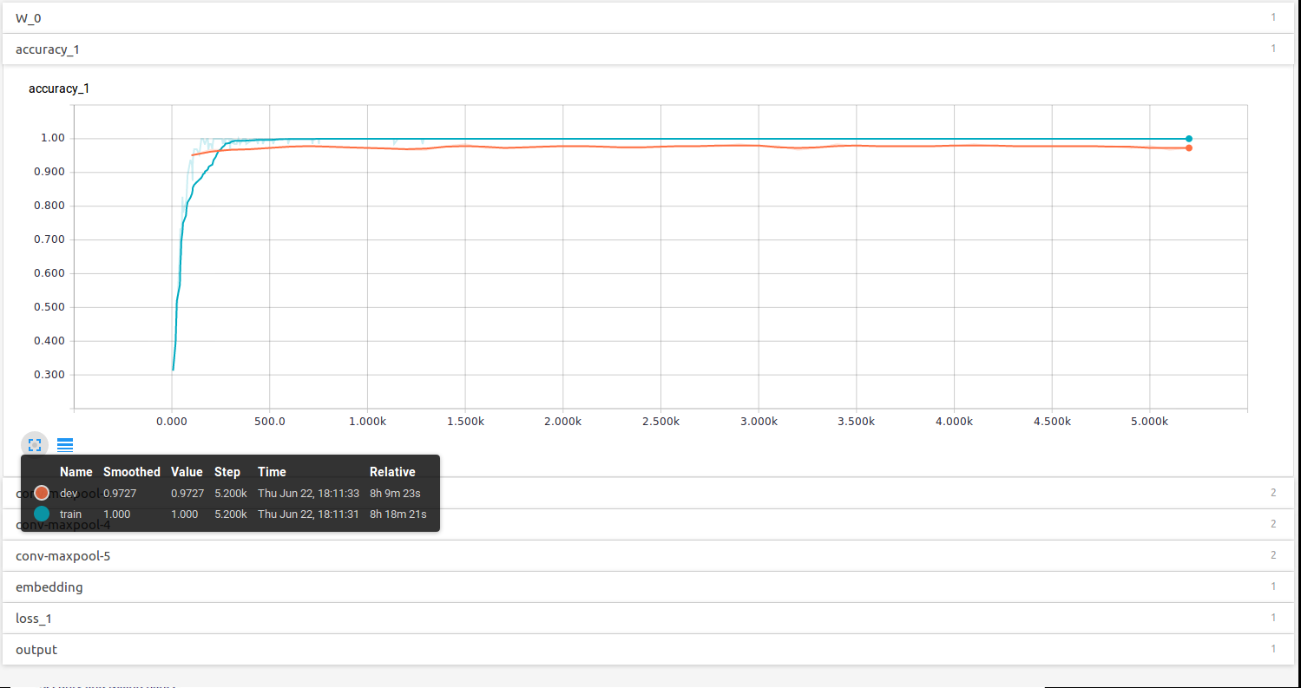
Using pre-trained Word2Vector for word embedding

Slide 4
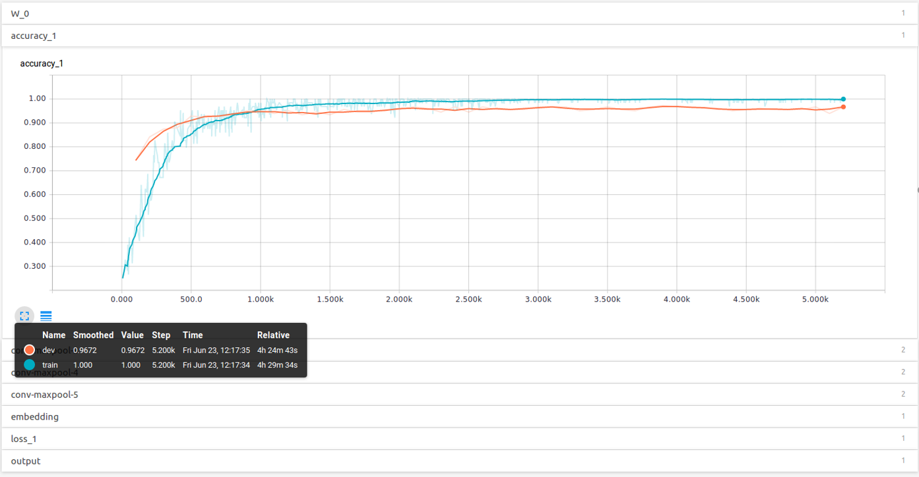
Learn embeddings from scratch

Slide 5
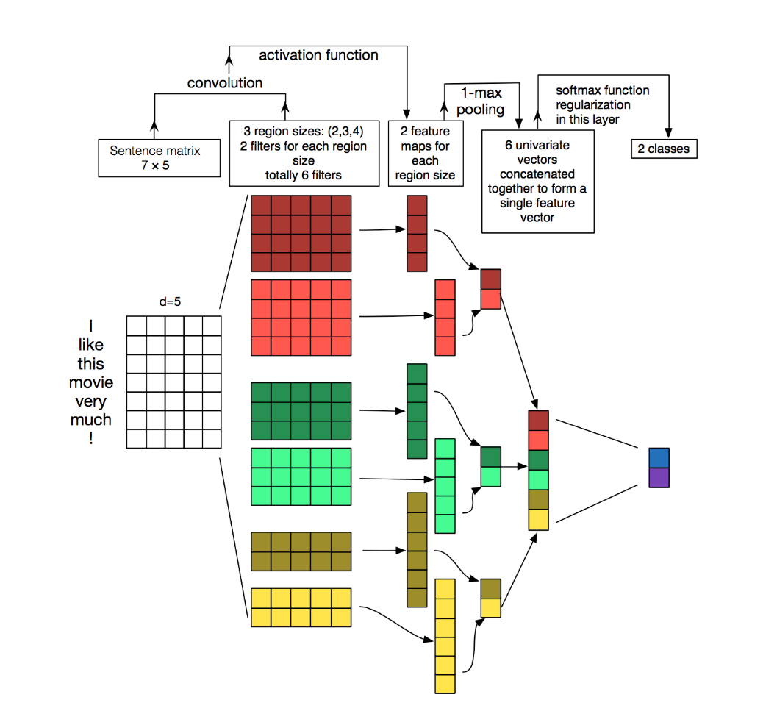
Example

Slide 6
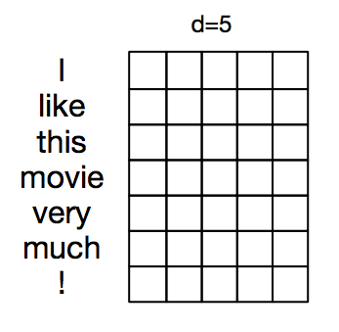
Articles Representation
Each row of the matrix corresponds to one token(word)
Each row is vector that represents a word. Typically, these vectors are word embedding
For our data d = 300 (pre-trained Google News corpus word vector model

Slide 7
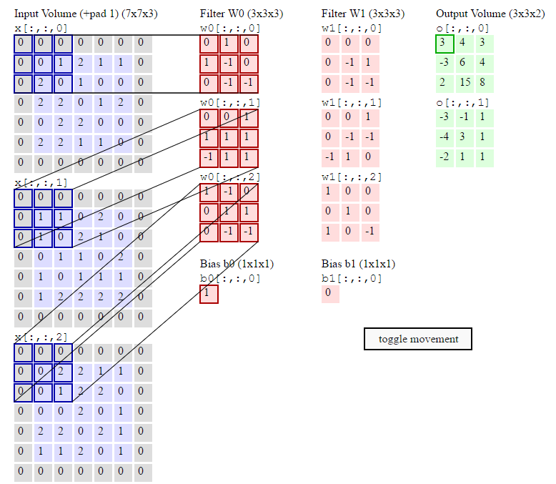
Convolutional Neural Networks
filters slide over local patches of an image
NLP we typically use filters that slide over full rows of the matrix (words).
The height, or region size, may vary, but sliding windows over 2-5 words at a time is typical.
Animation of the sliding window:

Slide 8
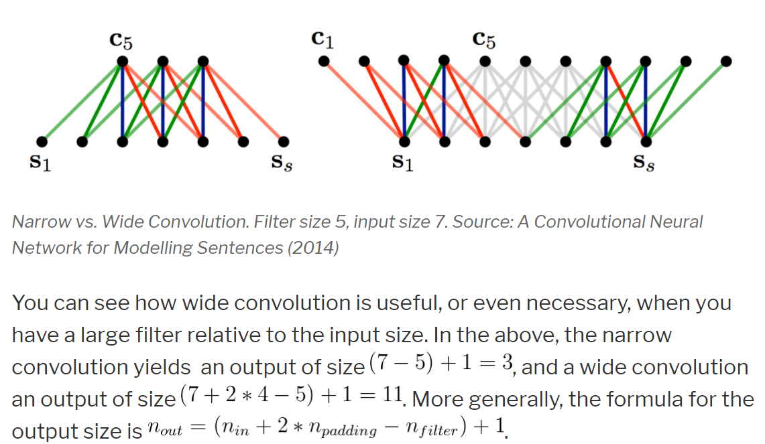
Narrow vs. Wide convolution

Slide 9
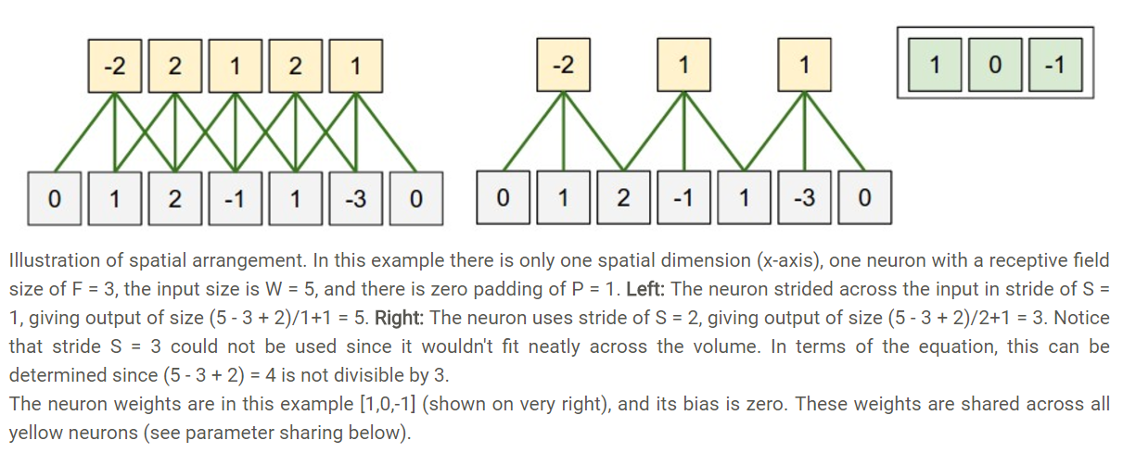
Stride size

Slide 10
Parameters
D: Depth, number of filters
S: Stride, move the filters how many pixels at a time
P: Zero-padding, zeros around the boarder
W: input volume size
O = (W-F + 2P)/S +1

Slide 11
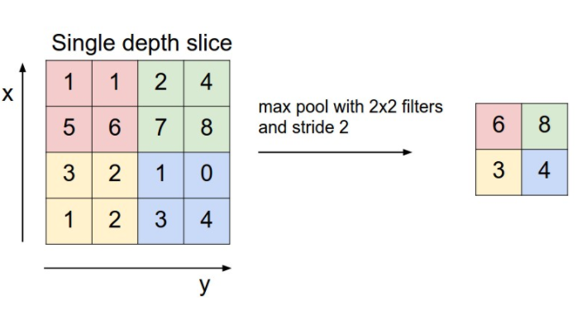
Max pooling

Slide 12
BBC News data architecture

Slide 13
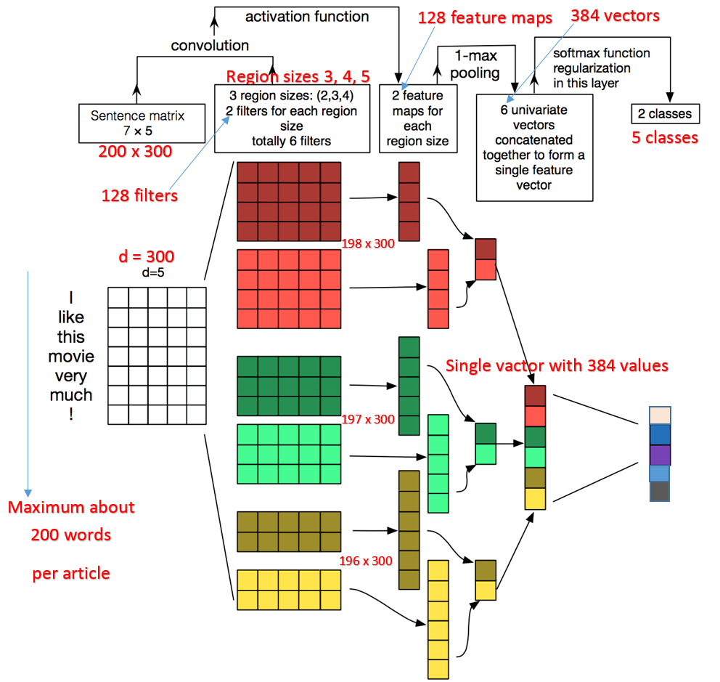
BBC news architecture

Slide 14
Next is for DBN embedding test

Slide 15
Embedding comparing
Categories | Glove | DBN
business.txt | 2189 | 2189
enter.txt | 856 | 856
politics.txt | 1073 | 1073
sport.txt | 2160 | 2160
tech.txt | 676 | 676
total | 6954 | 6954
Document length | 40-400 | 15
Total Words | 1,765,293 | 104,310 | 17/1
Unique words | 46116 (2.6%) | 78626 (75%) | 1/1.7

Slide 16
Cross validation Training Result
Glove | Training | 1 | 1 | 1 | 1 | 1 | 1 | 1 | 1 | 1 | 1 | 1
 | Test | 0.93 | 0.93 | 0.93 | 0.93 | 0.93 | 0.93 | 0.92 | 0.93 | 0.93 | 0.93 | 0.929
 |  | 1 | 2 | 3 | 4 | 5 | 6 | 7 | 8 | 9 | 10 | Ave
DBN | Training | 1 | 1 | 0.98 | 0.98 | 1 | 0.96 | 0.94 | 1 | 1 | 1 | 0.986
 | Test | 0.29 | 0.31 | 0.16 | 0.33 | 0.34 | 0.34 | 0.27 | 0.31 | 0.34 | 0.34 | 0.303

Slide 17
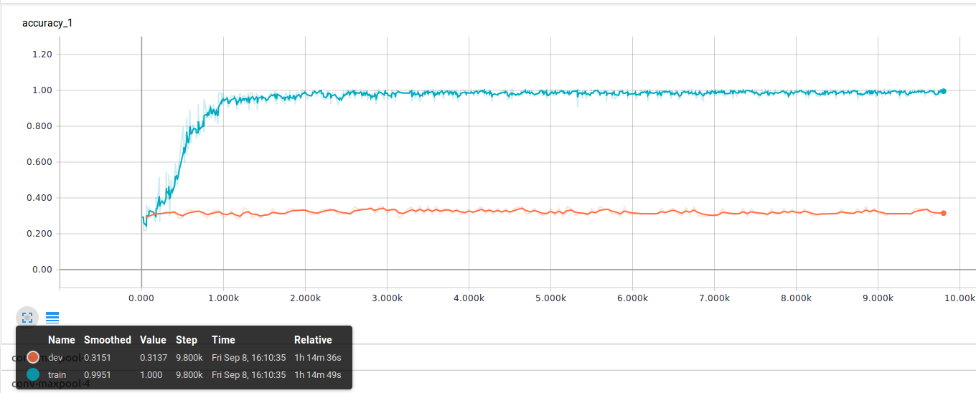
DBN result embedding test

Slide 18
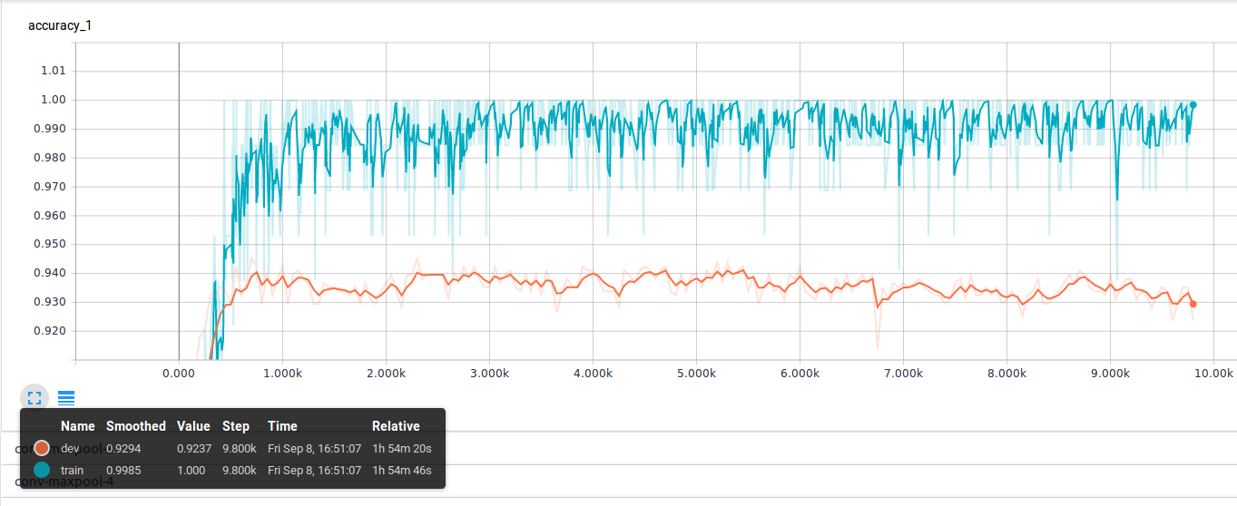
Glove embedding test

Slide 19
DBN test using different vocabulary size
 |  | Train | Dev
DBN test using different vocabulary size | 78626 (75% of total words 104310) | 0.986 | 0.303
 | 8889 (8.5% of total words 104310) | 0.843 | 0.333

Slide 20
DBN test in big vocabulary size
 |  | Train | Dev
DBN test in big vocabulary size(75% of total words 104310) | dbn embedding | 0.986 | 0.303
 | non embedding | 0.98 | 0.23

Slide 21
DBN test in small vocabulary size
 |  | Train | Dev
DBN test in small vocabulary size (8.5% of total words 104310) | dbn embedding | 0.843 | 0.333
 | non embedding | 1 | 0.343

Slide 22
Test results for pre-trained and self-trained word2vector
 | glove-wikipedia-100d | Googlenews-300d | self-trained-25d
All 6000 news data | 0.981 | 0.983 | 0.936

Slide 23
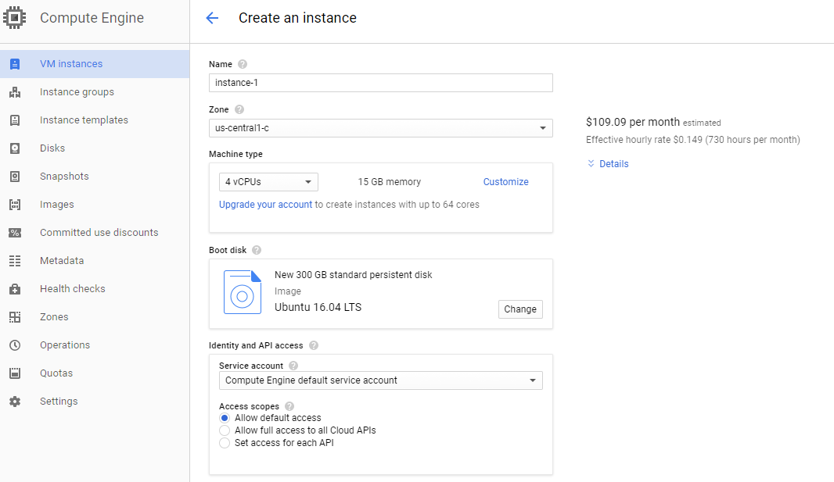
Google Could Cost estimate 4-vCPU, 15G-Mem, 300G-disk $109/Mon

Slide 24
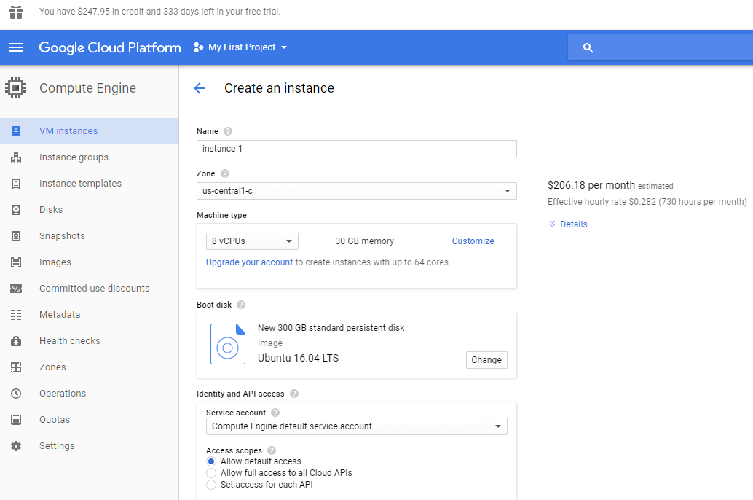
Google Could Cost estimate 8-vCPU, 30G-Mem, 300G-disk $206/Mon

Slide 25
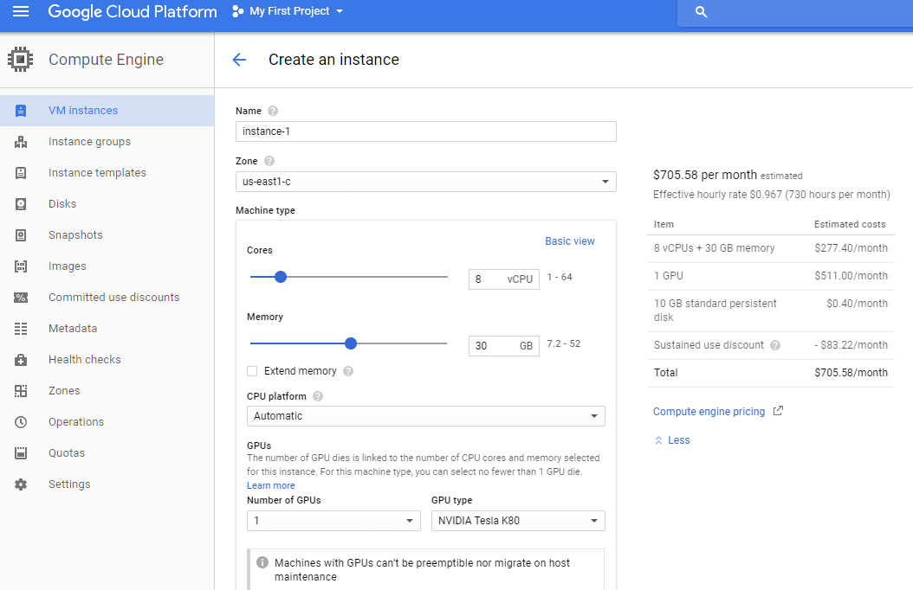
Google Could Cost estimate 8-vCPU, 30G-Mem, 1-GPU $706/Mon

Slide 26
Comparing of different prob rate
Comparing of different prob rate
 | prob0.5 | prob0.4 | prob0.3 | prob0.2 | prob0.1 | Diff
training | 0.986 | 0.985 | 0.978 | 0.959 | 0.927 | 0.013
test | 0.931 | 0.919 | 0.914 | 0.921 | 0.914
Origin parameters: prob = 0.5 filters = 128 window_size = 3, 4, 5

Slide 27
Comparing of different number of filters
Comparing of different number of filters
 | filters_128 | filters_80 | filters_64 | filters_32 | filters_16 | Diff
training | 0.986 | 0.985 | 0.98 | 0.973 | 0.957 | 0.037
test | 0.931 | 0.931 | 0.92 | 0.922 | 0.92
Origin parameters: prob = 0.5 filters = 128 window_size = 3, 4, 5

Slide 28
Comparing of different window size
Comparing of different window size
 | win345 | win34 | win45 | win5 | win4 | win3 | Diff
training | 0.986 | 0.984 | 0.987 | 0.983 | 0.977 | 0.977 | 0.047
test | 0.931 | 0.917 | 0.921 | 0.925 | 0.921 | 0.93
Origin parameters: prob = 0.5 filters = 128 window_size = 3, 4, 5

Slide 29
Final test with filters_80 win34 prob0.2
Origin parameters: prob = 0.5 filters = 128 window_size = 3, 4, 5
Final test with filters_80 win34 prob0.2
training | 0.941 | 0.027
test | 0.914

Slide 30
Self-taught learning on text: BBC Datasets
Datasets:
Collected news Data (Unlabeled)
Total: 28,726 documents
BBC news Data (Labeled)
Business | 502 docs
Entertainment | 364 docs
Politics | 399 docs
Sports | 497 docs
Technology | 336 docs
Total | 2098 docs
Go to Autoencoder
Go to Skip-gram

Slide 31
Large movie review datasets_ by Stanford
Binary sentiment polarity labels
Set 1: 25,000 Labeled
Half positive
Half negative
Set 2: 25,000 Labeled
Half positive
Half negative
Set 3: 50,000
Unlabeled
For Classification
For Learning representation
Go to Autoencoder
Go to Skip-gram

Slide 32
Self-taught learning on text: workflow
Preprocessing
Docs embedding
Autoencoder
Model
Unlabeled Data
Workflow:
Labeled Data (Before Model)
Representation
Classifier
Labeled Data (After Model)
Representation
Classifier

Slide 33
Self-taught learning on text: Classification
Classification:
BBC news Data (Labeled)
Total 5 categories
2098 documents (balanced)
Training data 1888 (90%)
Untouched Test data 210 (10%)
Training set | Validation set
1688 (85%) | 200(10%)
Result
Softmax Classifier
10 f cross validation
Back

Slide 34
Self-taught learning on text data: preprocessing
Preprocessing:
Collected news Data (Unlabeled)
Total: 28726 articles
Collected news Data (Unlabeled)
Total: 28726 articles
Remove Stop words & Stemming
Keep top frequency words (2000)
Vocabulary size: 2000
BBC news Data (Labeled)
BBC news Data (Labeled)
Business | 502
Entertainment | 364
Politics | 399
Sports | 497
Technology | 336
Total | 2098
Business | 502
Entertainment | 364
Politics | 399
Sports | 497
Technology | 336
Total | 2098
Back

Slide 35
Docs Embedding for unlabeled data:
Collected news Data (Unlabeled)
Total: 28726 documents
Index words
1 | word1
2 | word2
3 | word3
4 | word4
5 | word5
…
……
2000 | word2000
word1 word2 word3 word4 word5 … …… word2000
Doc_1 | 7 | 0 | 5 | 5 | 0 | … | …… | 9
Doc_2 | 9 | 0 | 0 | 7 |  | … | …… | 5
Doc_3 | 5 | 4 | 3 | 12 |  | … | …… | 0
Doc_4 | 0 | 5 | 5 | 0 |  | … | …… | 0
Doc_5 | 5 | 2 | 6 | 5 |  | … | …… | 3
Doc_n | 2 | 4 | 0 | 6 |  | … | …… | 4
BBC news Data (Labeled)
Business | 502
Entertainment | 364
Politics | 399
Sports | 497
Technology | 336
Total | 2098
Normalization
Word Count representation
Back

Slide 36
Docs Embedding for labeled data:
Index words
BBC news Data (Labeled)
1 | word1
2 | word2
3 | word3
4 | word4
5 | word5
…
……
2000 | word2000
word1 word2 word3 word4 word5 … …… word2000
Business | 502
Entertainment | 364
Politics | 399
Sports | 497
Technology | 336
Total | 2098
Doc_1 | 7 | 0 | 5 | 5 | 0 | … | …… | 9
Doc_2 | 9 | 0 | 0 | 7 |  | … | …… | 5
Doc_3 | 5 | 4 | 3 | 12 |  | … | …… | 0
Doc_4 | 0 | 5 | 5 | 0 |  | … | …… | 0
Doc_5 | 5 | 2 | 6 | 5 |  | … | …… | 3
Doc_n | 2 | 4 | 0 | 6 |  | … | …… | 4
Normalization
Word Count representation
Back

Slide 37
Docs Embedding: normalized word count vector
word1 word2 word3 word4 word5 … …… word2000
Doc_1 | 0.27 | 0 | 0.53 | 0.45 | 0 | … | …… | 0.33
Doc_2 | 0.29 | 0 | 0 | 0.17 |  | … | …… | 0.25
Doc_3 | 0.55 | 0.4 | 0.13 | 0.12 |  | … | …… | 0.03
Doc_4 | 0 | 0.5 | 0.25 | 0 |  | … | …… | 0
Doc_5 | 0.35 | 0.12 | 0.6 | 0.25 |  | … | …… | 0.3
Doc_n | 0.2 | 0.14 | 0 | 0.06 |  | … | …… | 0.4
Normalization
Back

Slide 38
Autoencoder: KATE : K-competitive Autoencoder
Accepted paper by KDD 2017
Good performance in following tasks:
Document Classification Task
Regression Task
Document Retrieval Task
Comparing with these models:
DBN: Deep belief network
Word2Vec
Doc2Vec
AE: plain shallow autoencoder, without any competition
DAE: denoising autoencoder
CAE: contractive autoencoder
VAE: generative autoencoder inspired by variational inference
KSAE: competitive autoencoder which explicitly enforces sparsity
Paper link ……
Back

Slide 39
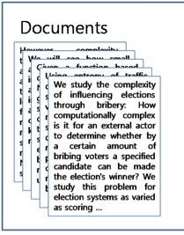
Docs representation: after autoencoder
Every document is a vector in certain dimensionality
Dimensionality varies from 300 to 5500
Doc_1 | 0.27 | 0 | 0.53 | 0.45 | 0 | … | …… | 0.33
Doc_2 | 0.29 | 0 | 0 | 0.17 |  | … | …… | 0.25
Doc_3 | 0.55 | 0.4 | 0.13 | 0.12 |  | … | …… | 0.03
Doc_4 | 0 | 0.5 | 0.25 | 0 |  | … | …… | 0
Doc_5 | 0.35 | 0.12 | 0.6 | 0.25 |  | … | …… | 0.3
Doc_n | 0.2 | 0.14 | 0 | 0.06 |  | … | …… | 0.4
Back

Slide 40
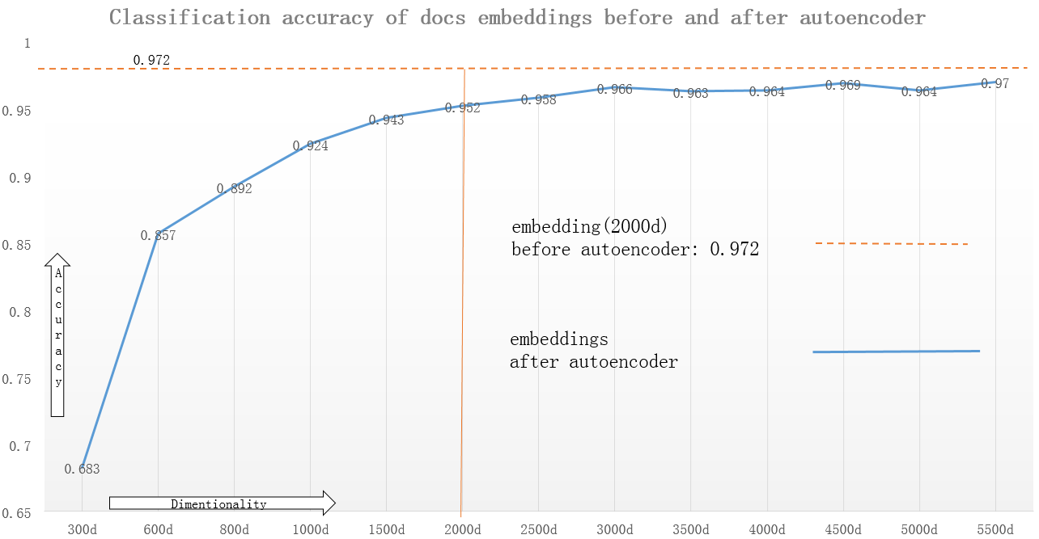
Self-taught learning on text: Result
Back

Slide 41
Self-taught learning on BBC News data from Collected News
Skip-gram
model
bbc news
Skip-gram
model
28k
MK news
Skip-gram
model
bbc news
28k
MK news
Skip-gram
model
100B
Google news
Words in vectors
Words in vectors
Words in vectors
Words in vectors
bbc news
bbc news
bbc news
bbc news
CNN Model
CNN Model
CNN Model
CNN Model
Accuracy : 0.89
Accuracy : 0.96
Accuracy : 0.97
Accuracy : 0.974

Slide 42
Self-taught learning on BBC News data from 3M tweets
Skip-gram
model
bbc news
Skip-gram
model
3M Tweets
Data
Skip-gram
model
bbc news
3M Tweets Data
Skip-gram
model
100B
Google news
Words in vectors
Words in vectors
Words in vectors
Words in vectors
bbc news
bbc news
bbc news
bbc news
CNN Model
CNN Model
CNN Model
CNN Model
Accuracy : 0.89
Accuracy : 0.97
Accuracy : 0.95
Accuracy: 0.974

Slide 43
Self-taught learning on BBC News data
Learn from MK Collected News
Learn from 3M Tweets
Skip-gram
model
bbc news
Skip-gram
model
28k
MK news
Skip-gram
model
bbc news
Skip-gram
model
3M Tweets
Data
Words in vectors
Words in vectors
Words in vectors
Words in vectors
bbc news
bbc news
bbc news
bbc news
CNN Model
CNN Model
CNN Model
CNN Model
Accuracy : 0.89
Accuracy : 0.96
Accuracy : 0.89
Accuracy : 0.97

Slide 44
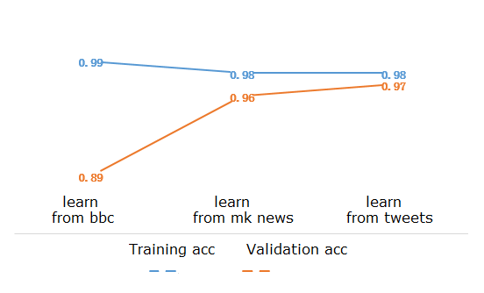
Training accuracy and validation accuracy

Slide 45
Self-taught learning on Large movie review data
Learn from 75k movie reviews
Learn from products reviews
Skip-gram
model
25k Movie reviews
Skip-gram
model
75k Movie reviews
Skip-gram
model
25k Movie reviews
Skip-gram
model
Product reviews
Words in vectors
Words in vectors
Words in vectors
Words in vectors
25k movie reviews
25k movie reviews
25k movie reviews
25k movie reviews
CNN Model
CNN Model
CNN Model
CNN Model
Accuracy : 0.89
Accuracy : 0.94
Accuracy : running
Accuracy : running

Slide 46
Skip-gram model
word2vec model by Mikolov et al.
1 Given a specific word
2 Define nearby word
Window size = 1
The quick brown fox jumps over the lazy dog
Window size = 2

Slide 47
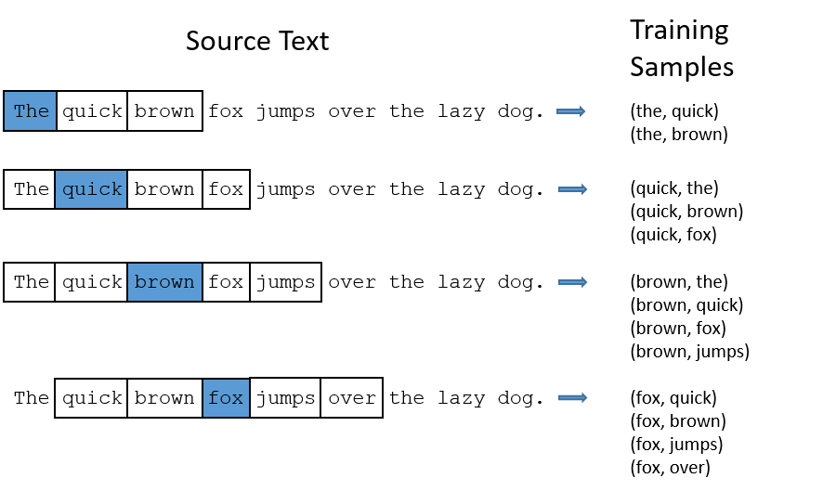
Skip-gram model

Slide 48
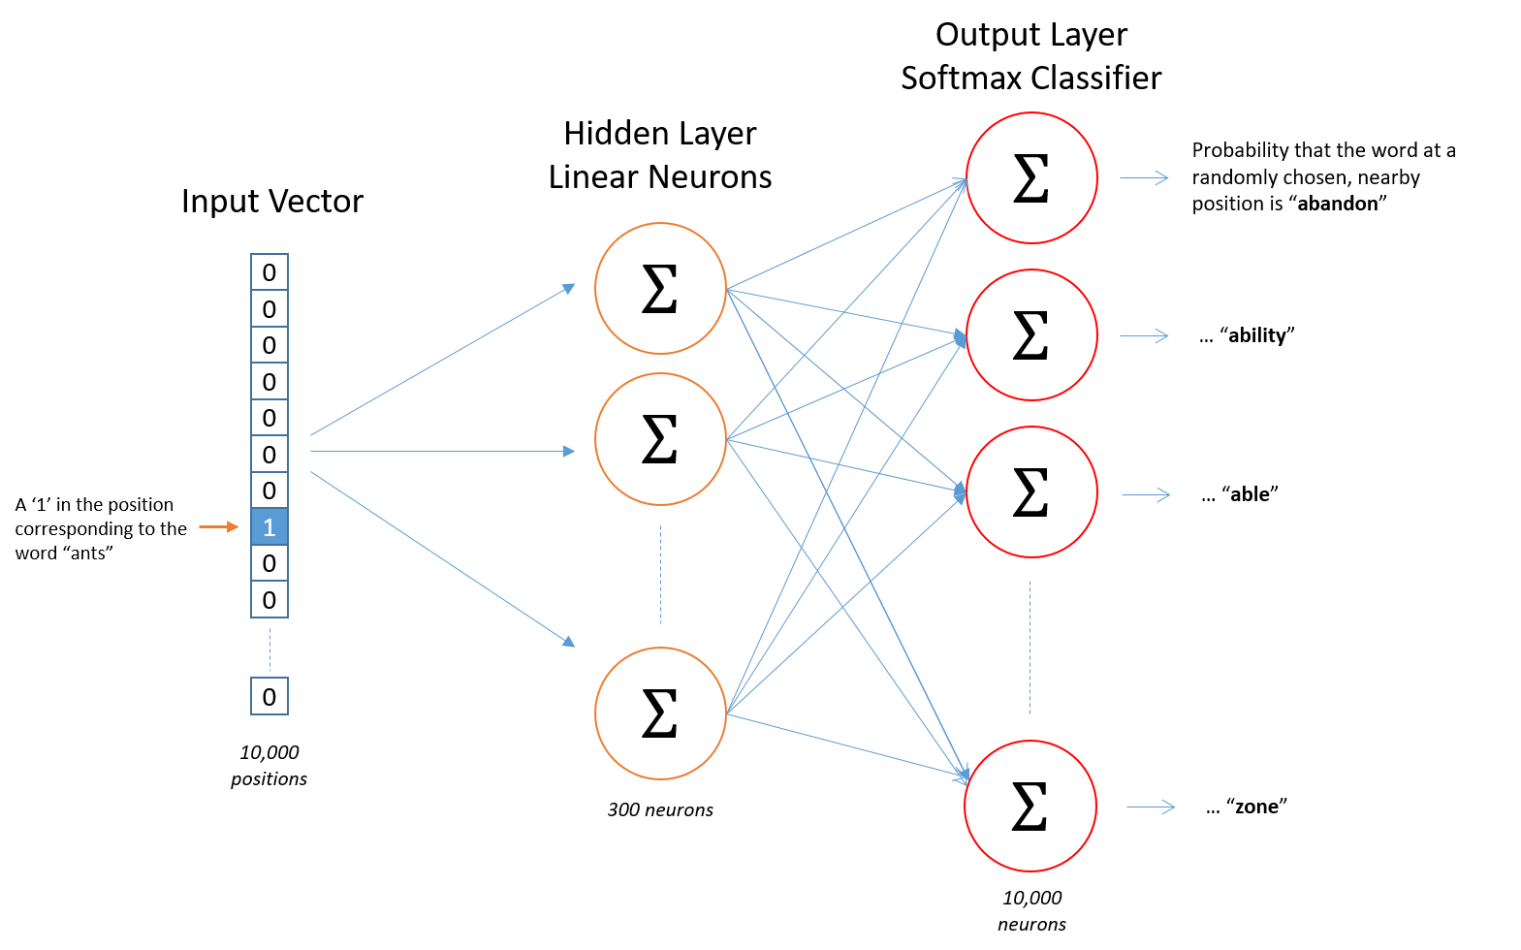
Skip-gram model

Slide 49
 | News Data | Movie Review Data | Large Movie Review | Amazon Food Review
Without Transfer | 0.947 | 0.718 | 0.832 | 0.876
Transfer Features | 0.971 | 0.764 | 0.843 | 0.887

Slide 50
 | News Data | Movie Review Data | Large Movie Review | Amazon Food Review
Without Transfer | 0.573 | 0.622 | 0.811 | 0.823
Transfer Features | 0.752 | 0.656 | 0.833 | 0.856

Slide 52
About the Datasets
Datasets | Data for classification |  | Total | Datasets for unsupervised learning |  | Total
News Datasets | Business | 502 | 2,098 | Business | 5,444 | 28,726
 | Entertainment | 364 |  | Entertainment | 4,011
 | Politics | 399 |  | Politics | 5,188
 | Sports | 497 |  | Sports | 6,138
 | Tech | 336 |  | Tech | 7,945
Movie Review Datasets(From Cornell) | Negative | 5,331 | 10,662 | Negative | 12,500 | 25,000
 | Positive | 5,331 |  | Positive | 12,500
Large Movie review datasets(From Stanford) | Negative | 4,500 | 9,000 | Negative | 12,500 | 25,000
 | Positive | 4,500 |  | Positive | 12,500
Amazon food review Datasets | Negative | 5,000 | 10,000 | Negative | 30,000 | 60,000
 | Positive | 5,000 |  | Positive | 30,000

