Slide 1
Welcome to TensorFlow!
Thanks Danijar Hafner for the logo!

Slide 2
Contents
Overview of TensorFlow
Build TensorFlow environment
Graphs and Sessions
TensorFlow for basic image process
TensorFlow for liner regression
TensorFlow for neural network
CNN(Convolutional neural network)

Slide 3
Overview of TensorFlow
What is TensorFlow
Why TensorFlow

Slide 4
What’s TensorFlow™?
Open source software library for numerical computation using data flow graphs
developed by the Google Brain Team within Google's Machine Intelligence research organization for machine learning and deep neural networks research

Slide 5
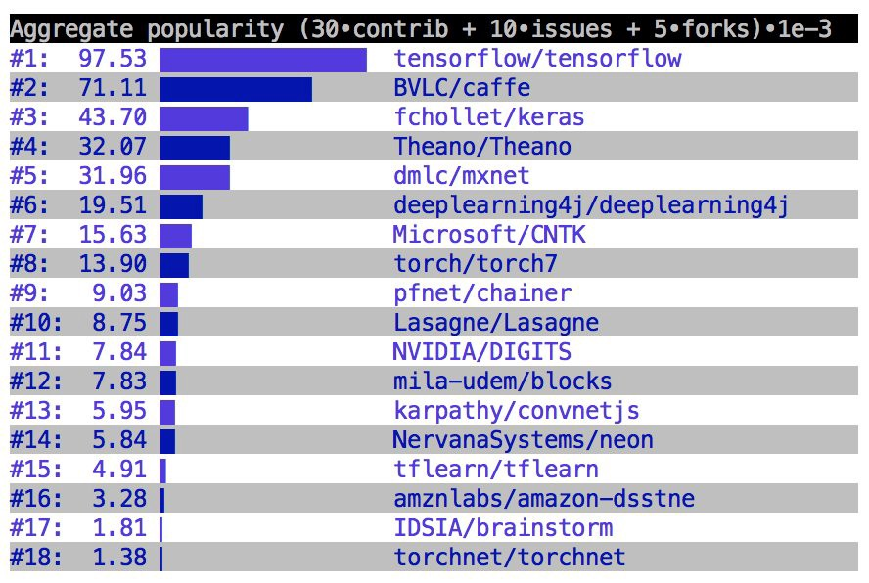
Why TensorFlow?
Flexibility + Scalability Originally developed by Google as a single infrastructure for machine learning in both production and research
Deep Learning libraries/frameworks as per popularity(Source : Google)
Notes:
For a framework to be useful in production, it needs to be efficient, scalable, and maintainable. For research, the framework needs to have flexible operations that can be combined in novel ways. Alternative frameworks are either flexible enough for research but less scalable, such as Chainer and PyTorch, or scalable but less flexible, such as Caffe and MXNet. TensorFlow are both flexible and scalable, allowing users to streamline from research into production.

Slide 6
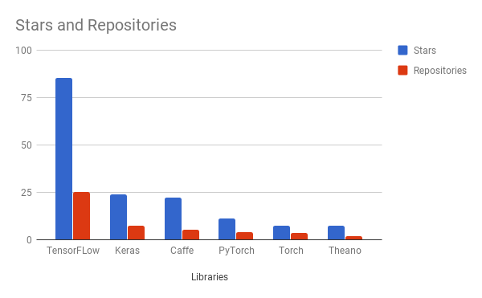
Why TensorFlow?
Flexibility + Scalability
Popularity

Slide 7
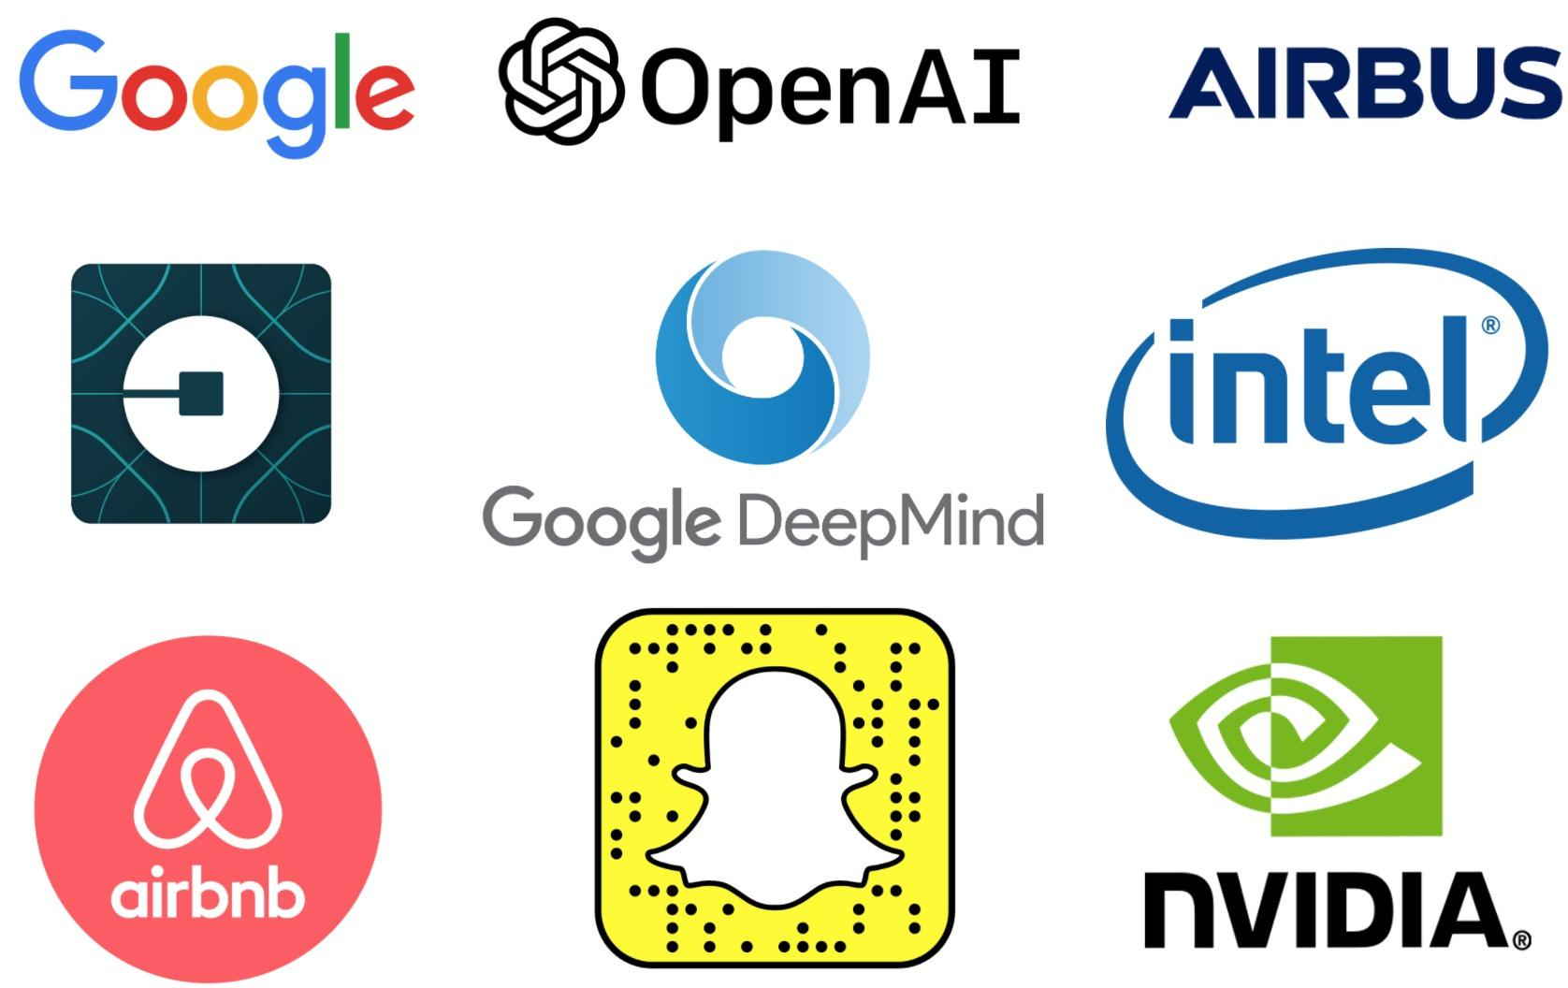
Companies using TensorFlow

Slide 8
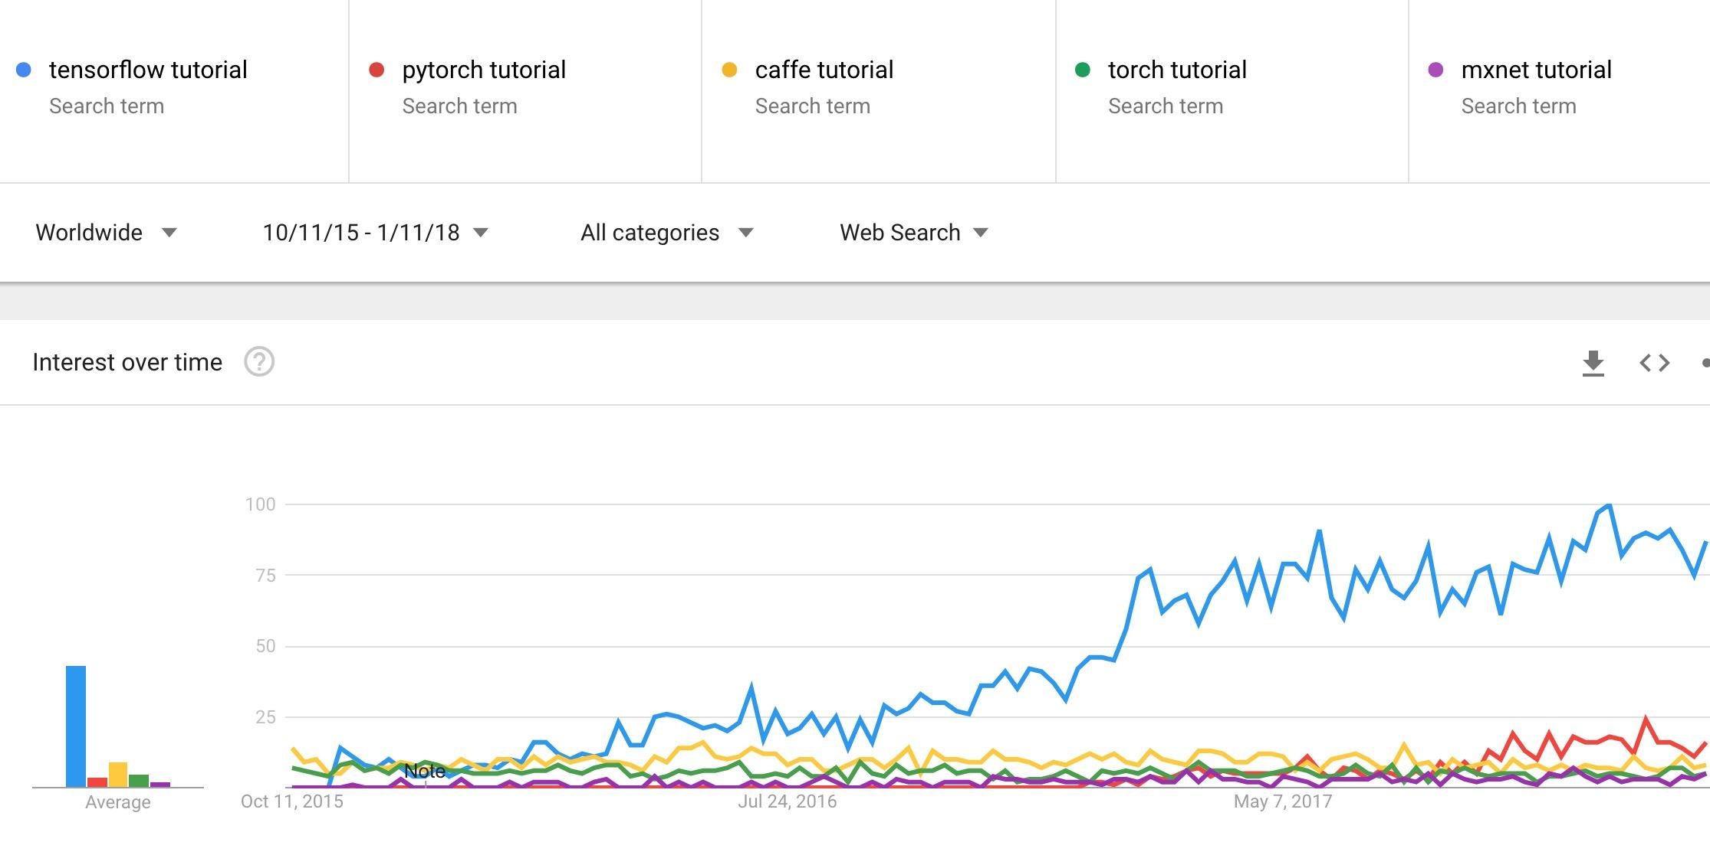
Demand for tutorials on TensorFlow

Slide 9
Resources
The official documentations
TensorFlow’s official sample models
Books
Aurélien Géron’s Hands-On Machine Learning with Scikit-Learn and TensorFlow (O’Reilly, March 2017)
François Chollet’s Deep Learning with Python (Manning Publications, November 2017)
Nishant Shukla’s Machine Learning with TensorFlow (Manning Publications, January 2018)
Lieder et al.’s Learning TensorFlow A Guide to Building Deep Learning Systems (O’Reilly, August 2017)

Slide 10
Build TensorFlow environment
Build through pip
Build through Conda distribution(Easiest Way)
Next show the steps to build through Conda

Slide 11
Build TensorFlow environment
Install Anaconda
Install necessary packages
Install TensorFlow
First TensorFlow program

Slide 12
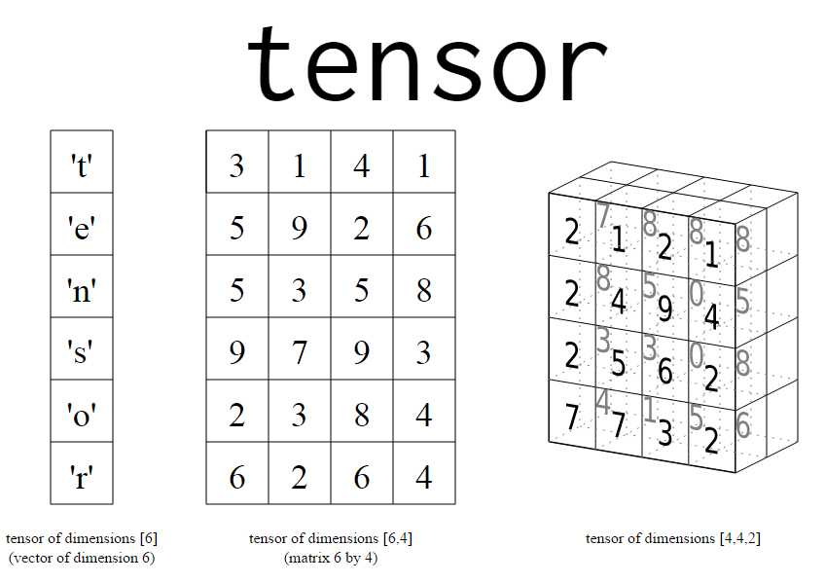
What’s a tensor?
An n-dimensional array
0-d tensor: scalar (number)
1-d tensor: vector
2-d tensor: matrix
3-d tensor: cube
and so on

Slide 13
Data Flow Graphs
Step 1: Assemble a graph
Calculate: 5x3 + (5+3) = ?
15 8
23
Notes:
How does it do so? By using graphs and sessions

Slide 14
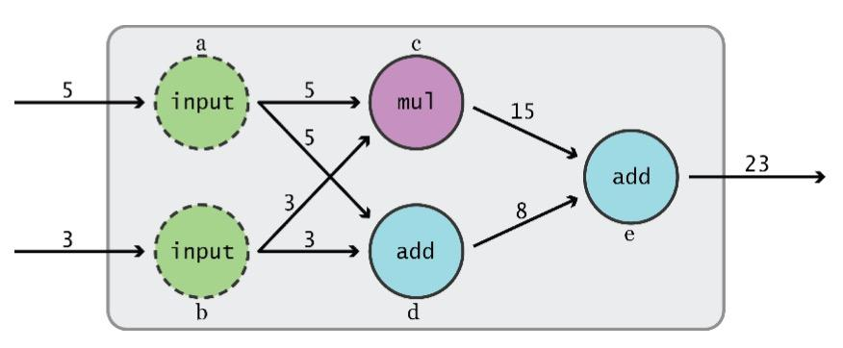
Data Flow Graphs
TensorFlow separates definition of computations from their execution
5x3 + (5+3)
Graph from TensorFlow for Machine Intelligence
Notes:
How does it do so? By using graphs and sessions

Slide 15
Data Flow Graphs
Step 2: use a session to execute operations in the graph.
Graph from TensorFlow for Machine Intelligence

Slide 16
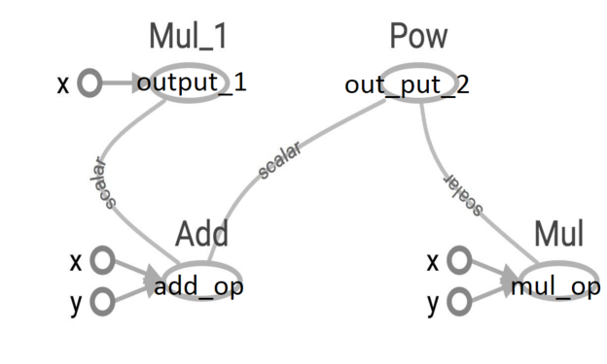
Data Flow Graphs
x = 2
y = 3
output_1 = x * (x + y)
output_2 = (x+y)^{(x*y)}
add_op = x + y
mul_op = x * y
output_1 = x * add_op
output_2 = add_op^{mul_op}
tf.Session.run(fetches,
feed_dict=None,
options=None,
run_metadata=None)
fetches is a list of tensors whose values you want

Slide 17
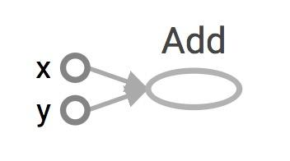
Data Flow Graphs
import tensorflow as tf Nodes: operators, variables, and constants
Edges: tensors
= tf.add(3, 5)
Visualized by TensorBoard
Notes:
More about naming them in the next module

Slide 18
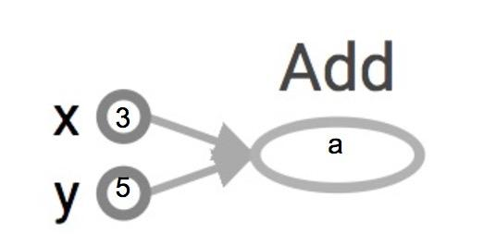
How to get the value of a?
Create a session, assign it to variable sess so we can call it later
Within the session, evaluate the graph to fetch the value
import tensorflow as tf a = tf.add(3, 5) sess = tf.Session() print(sess.run(a)) sess.close()
>> 8
8
The session will look at the graph, trying to think: hmm, how can I get the value of a,
then it computes all the nodes that leads to a.

Slide 19
tf.Session()
A Session object encapsulates the environment in which Operation objects are executed, and Tensor objects are evaluated.
Session will also allocate memory to store the current values of variables.
Notes:
Note that sessions deal with memory allocation

Slide 20
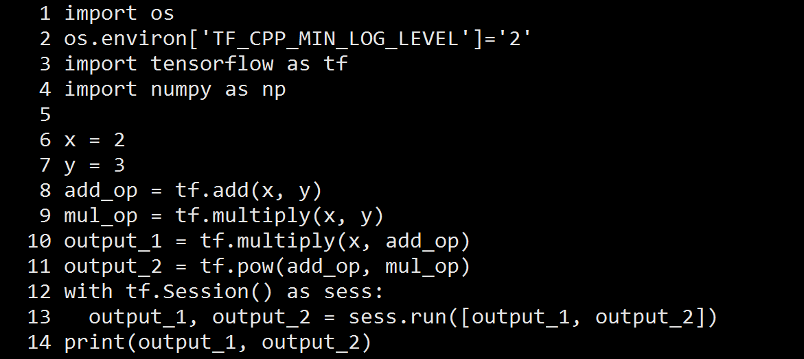
Data Flow Graphs

Slide 21
TensorFlow for basic image process

Slide 22
TensorFlow for liner regression

Slide 23
TensorFlow for neural network

Slide 24
CNN(Convolutional neural network)

