Slide 1
Deep Reinforcement Learning
Lecture 14 -
1
Fei-Fei Li & Justin Johnson & Serena Yeung Lecture 14 - May 23, 2017

Slide 2
Contents
Machine Learning types
What is Reinforcement Learning
Markov Decision Processes
Q-Learning
Policy Gradients
Lecture 14 -
2

Slide 3
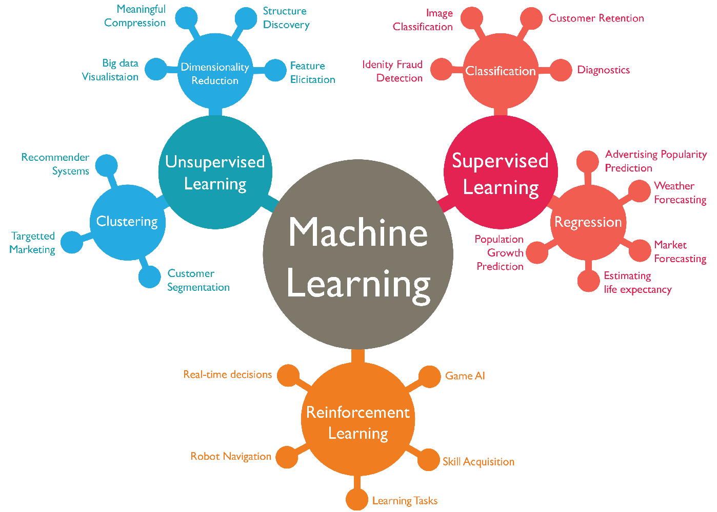
Machine Learning types
Supervised Learning
Unsupervised Learning
Reinforcement Learning
Lecture 14 -
3

Slide 4
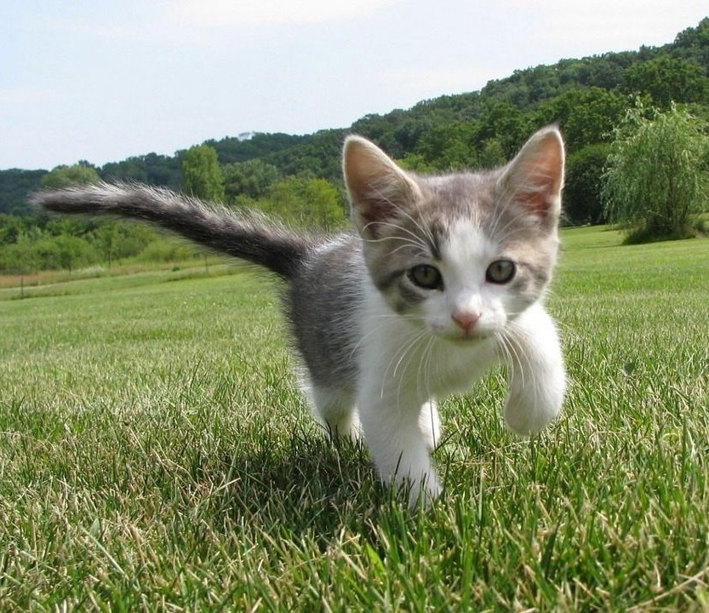
Supervised Learning
Data: (x, y)
x is data, y is label
Goal: Learn a function to map x -> y
Cat
Examples: Classification, regression, object detection, semantic segmentation, image captioning, etc.
Classification
Lecture 14 -
4

Slide 5
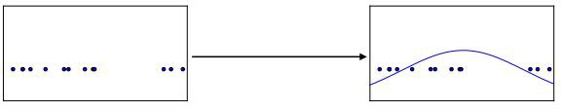
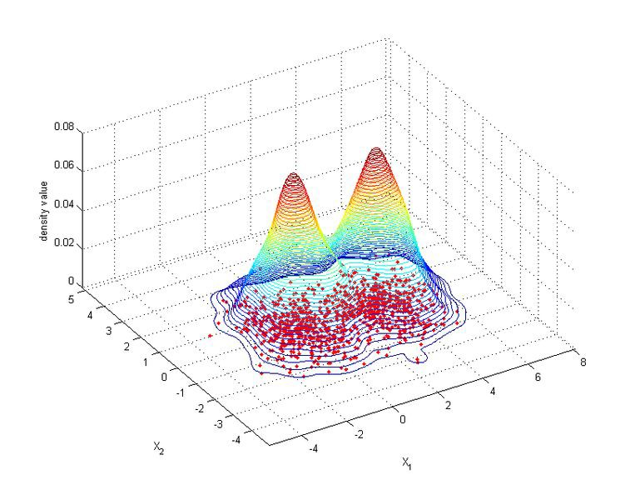
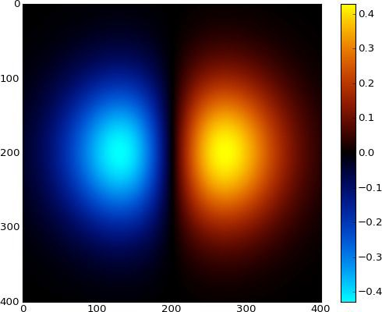
Unsupervised Learning
Data: x
Just data, no labels!
Goal: Learn some underlying hidden structure of the data
Examples: Clustering, dimensionality reduction, feature learning, density estimation, etc.
1-d density estimation
2-d density estimation
2-d density images left and right are CC0 public domain
5

Slide 6
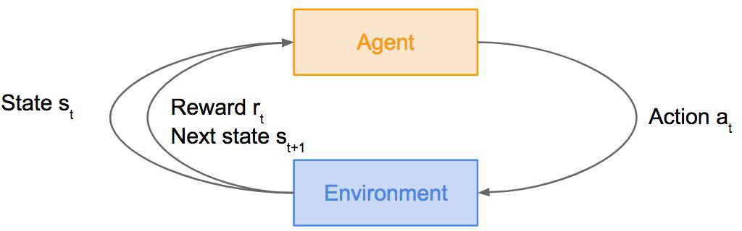
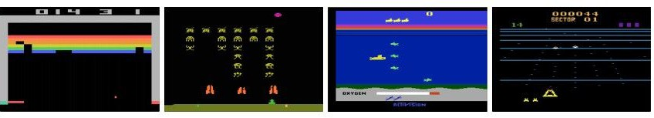
Reinforcement Learning
Problems involving an agent interacting with an environment, which provides numeric reward signals
Goal: Learn how to take actions in order to maximize reward
Lecture 14 -
6

Slide 7
What is Reinforcement Learning
Agent
Environment
Lecture 14 - 7

Slide 8
What is Reinforcement Learning
Agent
State s_{t}
Environment
Lecture 14 - 8

Slide 9
What is Reinforcement Learning
Agent
State s_{t}
Action a_{t}
Environment
Lecture 14 - 9

Slide 10
What is Reinforcement Learning
Agent
State s_{t}
Reward r_{t}
Action a_{t}
Environment
Lecture 14 - 10

Slide 11
What is Reinforcement Learning
Agent
State s_{t}
Reward r_{t} Next state s
Action a
t
t+1
Environment
Lecture 14 - 11

Slide 12
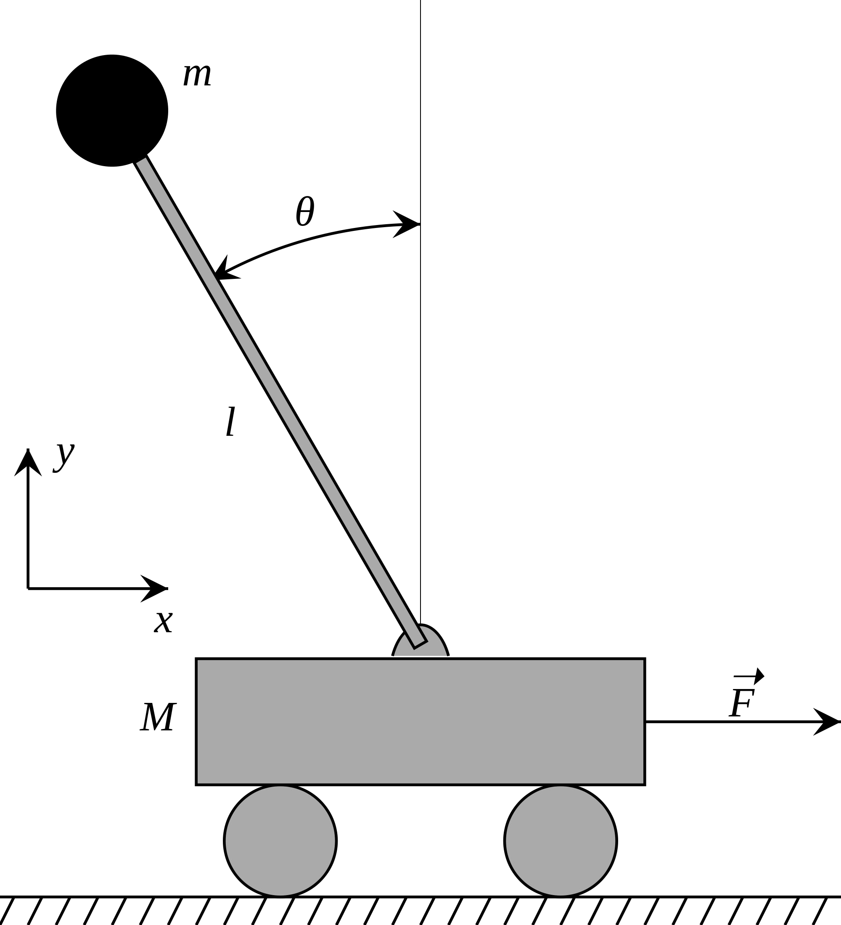
Cart-Pole Problem
Objective: Balance a pole on top of a movable cart
State: angle, angular speed, position, horizontal velocity
Action: horizontal force applied on the cart
Reward: 1 at each time step if the pole is upright
This image is CC0 public domain
Lecture 14 -

Slide 13
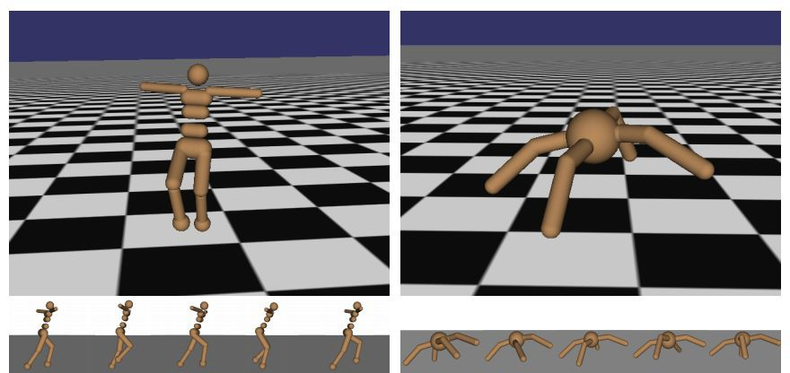
Robot Locomotion
Objective: Make the robot move forward
State: Angle and position of the joints Action: Torques applied on joints Reward: 1 at each time step upright + forward movement
Lecture 14 -

Slide 14
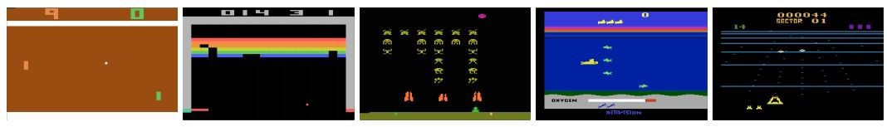
Atari Games
Objective: Complete the game with the highest score
State: Raw pixel inputs of the game state
Action: Game controls e.g. Left, Right, Up, Down
Reward: Score increase/decrease at each time step
Lecture 14 -

Slide 15
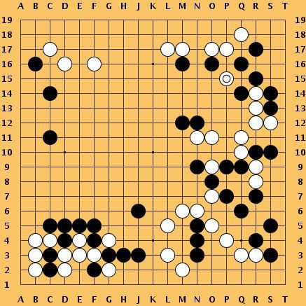
Go
Objective: Win the game!
State: Position of all pieces
Action: Where to put the next piece down
Reward: 1 if win at the end of the game, 0 otherwise
This image is CC0 public domain
Lecture 14 -

Slide 16
How can we mathematically formalize the RL problem?
Agent
State s_{t}
Reward r_{t} Next state s
Action a
t
t+1
Environment

Slide 17

Markov Decision Process
Mathematical formulation of the RL problem
Markov property: Current state completely characterises the state of the world
Defined by:
: set of possible states
: set of possible actions
: distribution of reward given (state, action) pair
: transition probability i.e. distribution over next state given (state, action) pair
: discount factor

Slide 18
Markov Decision Process
Mathematical formulation of the RL problem
Markov property: Current state completely characterises the state of the world
Defined by:
: set of possible states
: set of possible actions
: distribution of reward given (state, action) pair
: transition probability i.e. distribution over next state given (state, action) pair
: discount factor

Slide 19

Markov Decision Process
At time step t=0, environment samples initial state s₀ ~ p(s₀)
Then, for t=0 until done:
  Agent selects action a_{t}
  Environment samples reward r_{t} ~ R( . | s_{t}, a_{t})
  Environment samples next state s_{t+1} ~ P( . | s_{t}, a_{t})
  Agent receives reward r_{t} and next state s_{t+1}
A policy n is a function from S to A that specifies what action to take in each state
Objective: find policy n* that maximizes cumulative discounted reward:

Slide 20
A simple MDP: Grid World
states
actions = {
right
left
up
down
★
 |  |  | ★
Set a negative “reward” for each transition
(e.g. r = -1)
}
Objective: reach one of terminal states (greyed out) in least number of actions

Slide 21



A simple MDP: Grid World
★
 |  |  | ★
★
 |  |  | ★
Random Policy
Optimal Policy

Slide 22
The optimal policy π*
We want to find optimal policy π * that maximizes the sum of rewards.
How do we handle the randomness (initial state, transition probability…)?

Slide 23

The optimal policy π *
We want to find optimal policy π * that maximizes the sum of rewards.
How do we handle the randomness (initial state, transition probability…)? Maximize the expected sum of rewards!
Formally:
with

Slide 24
Definitions: Value function and Q-value function
Following a policy produces sample trajectories (or paths) s₀, a₀, r₀, s₁, a₁, r₁, …

Slide 25

Definitions: Value function and Q-value function
Following a policy produces sample trajectories (or paths) s₀, a₀, r₀, s₁, a₁, r₁, …
How good is a state?
The value function at state s, is the expected cumulative reward from following the policy from state s:

Slide 26

Definitions: Value function and Q-value function
Following a policy produces sample trajectories (or paths) s₀, a₀, r₀, s₁, a₁, r₁, …
How good is a state?
The value function at state s, is the expected cumulative reward from following the policy from state s:
How good is a state-action pair?
The Q-value function at state s and action a, is the expected cumulative reward from taking action a in state s and then following the policy:

Slide 27
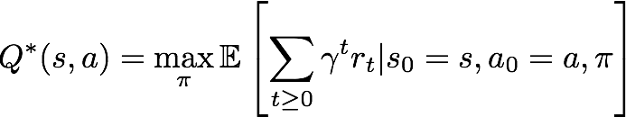
Bellman equation
The optimal Q-value function Q* is the maximum expected cumulative reward achievable from a given (state, action) pair:

Slide 28


Bellman equation
The optimal Q-value function Q* is the maximum expected cumulative reward achievable from a given (state, action) pair:
Q* satisfies the following Bellman equation:
Intuition: if the optimal state-action values for the next time-step Q*(s’,a’) are known, then the optimal strategy is to take the action that maximizes the expected value of

Slide 29
Bellman equation
The optimal Q-value function Q* is the maximum expected cumulative reward achievable from a given (state, action) pair:
Q* satisfies the following Bellman equation:
Intuition: if the optimal state-action values for the next time-step Q*(s’,a’) are known, then the optimal strategy is to take the action that maximizes the expected value of
The optimal policy n* corresponds to taking the best action in any state as specified by Q*

Slide 30

Solving for the optimal policy
Value iteration algorithm: Use Bellman equation as an iterative update
Q_{i} will converge to Q* as i -> infinity

Slide 31
Solving for the optimal policy
Value iteration algorithm: Use Bellman equation as an iterative update
Q_{i} will converge to Q* as i -> infinity
What’s the problem with this?

Slide 32
Solving for the optimal policy
Value iteration algorithm: Use Bellman equation as an iterative update
Q_{i} will converge to Q* as i -> infinity
What’s the problem with this?
Not scalable. Must compute Q(s,a) for every state-action pair. If state is e.g. current game state pixels, computationally infeasible to compute for entire state space!

Slide 33
Solving for the optimal policy
Value iteration algorithm: Use Bellman equation as an iterative update
Q_{i} will converge to Q* as i -> infinity
What’s the problem with this?
Not scalable. Must compute Q(s,a) for every state-action pair. If state is e.g. current game state pixels, computationally infeasible to compute for entire state space!
Solution: use a function approximator to estimate Q(s,a). E.g. a neural network!

Slide 34

Solving for the optimal policy: Q-learning
Q-learning: Use a function approximator to estimate the action-value function

Slide 35
Solving for the optimal policy: Q-learning
Q-learning: Use a function approximator to estimate the action-value function
If the function approximator is a deep neural network => deep q-learning!

Slide 36
Solving for the optimal policy: Q-learning
Q-learning: Use a function approximator to estimate the action-value function
function parameters (weights)
If the function approximator is a deep neural network => deep q-learning!

Slide 37
Solving for the optimal policy: Q-learning
Remember: want to find a Q-function that satisfies the Bellman Equation:

Slide 38

Solving for the optimal policy: Q-learning
Remember: want to find a Q-function that satisfies the Bellman Equation:
Forward Pass Loss function:
where

Slide 39
Solving for the optimal policy: Q-learning
Remember: want to find a Q-function that satisfies the Bellman Equation:
Forward Pass Loss function:
where
Backward Pass
Gradient update (with respect to Q-function parameters θ):

Slide 40
Solving for the optimal policy: Q-learning
Remember: want to find a Q-function that satisfies the Bellman Equation:
Forward Pass Loss function:
Iteratively try to make the Q-value
where
close to the target value (y ) it
should have, if Q-function
i
Backward Pass
Gradient update (with respect to Q-function parameters θ):
corresponds to optimal Q* (and optimal policy n*)

Slide 41
Case Study: Playing Atari Games
[Mnih et al. NIPS Workshop 2013; Nature 2015]
Objective: Complete the game with the highest score
State: Raw pixel inputs of the game state
Action: Game controls e.g. Left, Right, Up, Down
Reward: Score increase/decrease at each time step

Slide 42

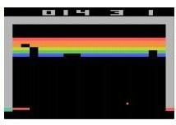
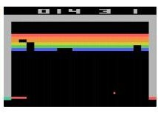
Q-network Architecture
[Mnih et al. NIPS Workshop 2013; Nature 2015]
:
neural network with weights
FC-4 (Q-values)
FC-256
32 4x4 conv, stride 2
16 8x8 conv, stride 4
Current state s_{t}: 84x84x4 stack of last 4 frames
(after RGB->grayscale conversion, downsampling, and cropping)

Slide 43
Q-network Architecture
[Mnih et al. NIPS Workshop 2013; Nature 2015]
:
neural network with weights
FC-4 (Q-values)
FC-256
32 4x4 conv, stride 2
16 8x8 conv, stride 4
Input: state s_{t}
Current state s_{t}: 84x84x4 stack of last 4 frames
(after RGB->grayscale conversion, downsampling, and cropping)

Slide 44
Q-network Architecture
[Mnih et al. NIPS Workshop 2013; Nature 2015]
:
neural network with weights
FC-4 (Q-values)
FC-256
Familiar conv layers, FC layer
32 4x4 conv, stride 2
16 8x8 conv, stride 4
Current state s_{t}: 84x84x4 stack of last 4 frames
(after RGB->grayscale conversion, downsampling, and cropping)

Slide 45
Q-network Architecture
[Mnih et al. NIPS Workshop 2013; Nature 2015]
:
neural network with weights
Last FC layer has 4-d
output (if 4 actions), corresponding to Q(s_{t}, a₁), Q(s_{t}, a₂), Q(s_{t}, a₃), Q(s_{t},a₄)
FC-4 (Q-values)
FC-256
32 4x4 conv, stride 2
16 8x8 conv, stride 4
Current state s_{t}: 84x84x4 stack of last 4 frames
(after RGB->grayscale conversion, downsampling, and cropping)

Slide 46
Q-network Architecture
[Mnih et al. NIPS Workshop 2013; Nature 2015]
:
neural network with weights
Last FC layer has 4-d
output (if 4 actions), corresponding to Q(s_{t}, a₁), Q(s_{t}, a₂), Q(s_{t}, a₃), Q(s_{t},a₄)
FC-4 (Q-values)
FC-256
32 4x4 conv, stride 2
16 8x8 conv, stride 4
Number of actions between 4-18 depending on Atari game
Current state s_{t}: 84x84x4 stack of last 4 frames
(after RGB->grayscale conversion, downsampling, and cropping)

Slide 47
Q-network Architecture
[Mnih et al. NIPS Workshop 2013; Nature 2015]
:
neural network with weights
Last FC layer has 4-d
output (if 4 actions), corresponding to Q(s_{t}, a₁), Q(s_{t}, a₂), Q(s_{t}, a₃), Q(s_{t},a₄)
FC-4 (Q-values)
FC-256
32 4x4 conv, stride 2
A single feedforward pass to compute Q-values for all actions from the current state => efficient!
16 8x8 conv, stride 4
Number of actions between 4-18 depending on Atari game
Current state s_{t}: 84x84x4 stack of last 4 frames
(after RGB->grayscale conversion, downsampling, and cropping)

Slide 48
Training the Q-network: Loss function (from before)
[Mnih et al. NIPS Workshop 2013; Nature 2015]
Remember: want to find a Q-function that satisfies the Bellman Equation:
Forward Pass Loss function:
Iteratively try to make the Q-value
where
close to the target value (y ) it
should have, if Q-function
i
Backward Pass
Gradient update (with respect to Q-function parameters θ):
corresponds to optimal Q* (and optimal policy n*)

Slide 49
Training the Q-network: Experience Replay
[Mnih et al. NIPS Workshop 2013; Nature 2015]
Learning from batches of consecutive samples is problematic:
Samples are correlated => inefficient learning
Current Q-network parameters determines next training samples (e.g. if maximizing action is to move left, training samples will be dominated by samples from left-hand size) => can lead to bad feedback loops

Slide 50
Training the Q-network: Experience Replay
[Mnih et al. NIPS Workshop 2013; Nature 2015]
Learning from batches of consecutive samples is problematic:
Samples are correlated => inefficient learning
Current Q-network parameters determines next training samples (e.g. if maximizing action is to move left, training samples will be dominated by samples from left-hand size) => can lead to bad feedback loops
Address these problems using experience replay
Continually update a replay memory table of transitions (s_{t}, a_{t}, r_{t}, s_{t+1}) as game (experience) episodes are played
Train Q-network on random minibatches of transitions from the replay memory, instead of consecutive samples

Slide 51
Training the Q-network: Experience Replay
[Mnih et al. NIPS Workshop 2013; Nature 2015]
Learning from batches of consecutive samples is problematic:
Samples are correlated => inefficient learning
Current Q-network parameters determines next training samples (e.g. if maximizing action is to move left, training samples will be dominated by samples from left-hand size) => can lead to bad feedback loops
Address these problems using experience replay
Continually update a replay memory table of transitions (s_{t}, a_{t}, r_{t}, s_{t+1}) as game (experience) episodes are played
Train Q-network on random minibatches of transitions from the replay memory,
instead of consecutive samples
Each transition can also contribute to multiple weight updates
=> greater data efficiency

Slide 52
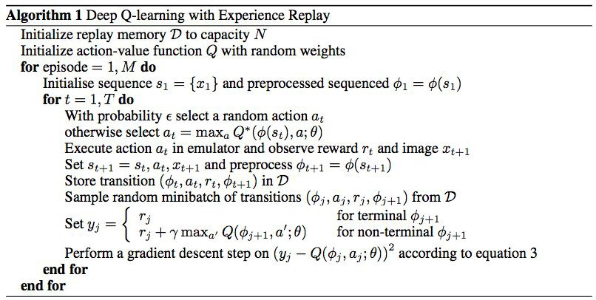
[Mnih et al. NIPS Workshop 2013; Nature 2015]
Putting it together: Deep Q-Learning with Experience Replay

Slide 53
Putting it together: Deep Q-Learning with Experience Replay
[Mnih et al. NIPS Workshop 2013; Nature 2015]
Initialize replay memory, Q-network

Slide 54
Putting it together: Deep Q-Learning with Experience Replay
[Mnih et al. NIPS Workshop 2013; Nature 2015]
Play M episodes (full games)

Slide 55
Putting it together: Deep Q-Learning with Experience Replay
[Mnih et al. NIPS Workshop 2013; Nature 2015]
Initialize state (starting game screen pixels) at the beginning of each episode

Slide 56
Putting it together: Deep Q-Learning with Experience Replay
[Mnih et al. NIPS Workshop 2013; Nature 2015]
For each timestep t of the game

Slide 57
Putting it together: Deep Q-Learning with Experience Replay
[Mnih et al. NIPS Workshop 2013; Nature 2015]
With small probability, select a random action (explore), otherwise select greedy action from current policy

Slide 58
Putting it together: Deep Q-Learning with Experience Replay
[Mnih et al. NIPS Workshop 2013; Nature 2015]
Take the action (a_{t}), and observe the reward r_{t} and next state s_{t+1}

Slide 59
Putting it together: Deep Q-Learning with Experience Replay
[Mnih et al. NIPS Workshop 2013; Nature 2015]
Store transition in
replay memory

Slide 60
Putting it together: Deep Q-Learning with Experience Replay
[Mnih et al. NIPS Workshop 2013; Nature 2015]
Experience Replay:
Sample a random minibatch of transitions from replay memory and perform a gradient descent step

Slide 61
https://www.youtube.com/watch?v=V1eYniJ0Rnk
Video by Károly Zsolnai-Fehér. Reproduced with permission.

Slide 62
Policy Gradients
What is a problem with Q-learning?
The Q-function can be very complicated!
Example: a robot grasping an object has a very high-dimensional state => hard to learn exact value of every (state, action) pair

Slide 63
Policy Gradients
What is a problem with Q-learning?
The Q-function can be very complicated!
Example: a robot grasping an object has a very high-dimensional state => hard to learn exact value of every (state, action) pair
But the policy can be much simpler: just close your hand
Can we learn a policy directly, e.g. finding the best policy from a collection of policies?

Slide 64

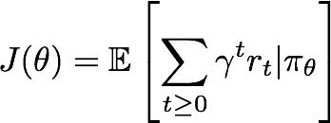
Policy Gradients
Formally, let’s define a class of parametrized policies:
For each policy, define its value:

Slide 65

Policy Gradients
Formally, let’s define a class of parametrized policies:
For each policy, define its value:
We want to find the optimal policy
How can we do this?

Slide 66
Policy Gradients
Formally, let’s define a class of parametrized policies:
For each policy, define its value:
We want to find the optimal policy
How can we do this?
Gradient ascent on policy parameters!

Slide 67
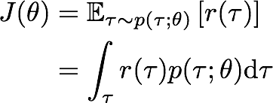

REINFORCE algorithm
Mathematically, we can write:
Where r(r) is the reward of a trajectory

Slide 68
REINFORCE algorithm
Expected reward:

Slide 69

REINFORCE algorithm
Expected reward:
Now let’s differentiate this:

Slide 70
REINFORCE algorithm
Expected reward:
Now let’s differentiate this:
Intractable! Gradient of an expectation is problematic when p depends on θ

Slide 71

REINFORCE algorithm
Expected reward:
Now let’s differentiate this:
However, we can use a nice trick:
Intractable! Gradient of an expectation is problematic when p depends on θ

Slide 72
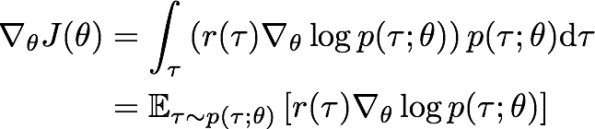
REINFORCE algorithm
Expected reward:
Now let’s differentiate this:
However, we can use a nice trick: If we inject this back:
Intractable! Gradient of an expectation is problematic when p depends on θ
Can estimate with Monte Carlo sampling

Slide 73

REINFORCE algorithm
Can we compute those quantities without knowing the transition probabilities?
We have:

Slide 74

REINFORCE algorithm
Can we compute those quantities without knowing the transition probabilities?
We have: Thus:

Slide 75

REINFORCE algorithm
Can we compute those quantities without knowing the transition probabilities?
We have: Thus:
Doesn’t depend on transition probabilities!
And when differentiating:

Slide 76

REINFORCE algorithm
Can we compute those quantities without knowing the transition probabilities?
We have: Thus:
Doesn’t depend on transition probabilities!
And when differentiating:
Therefore when sampling a trajectory r, we can estimate J(0) with

Slide 77
Intuition
Gradient estimator:
Interpretation:
If r(r) is high, push up the probabilities of the actions seen
If r(r) is low, push down the probabilities of the actions seen

Slide 78
Intuition
Gradient estimator:
Interpretation:
If r(r) is high, push up the probabilities of the actions seen
If r(r) is low, push down the probabilities of the actions seen
Might seem simplistic to say that if a trajectory is good then all its actions were good. But in expectation, it averages out!

Slide 79
Intuition
Gradient estimator:
Interpretation:
If r(r) is high, push up the probabilities of the actions seen
If r(r) is low, push down the probabilities of the actions seen
Might seem simplistic to say that if a trajectory is good then all its actions were good. But in expectation, it averages out!
However, this also suffers from high variance because credit assignment is really hard. Can we help the estimator?

Slide 80
Variance reduction
Gradient estimator:

Slide 81
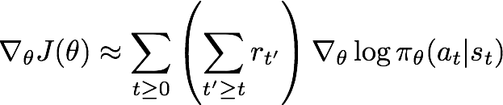
Variance reduction
Gradient estimator:
First idea: Push up probabilities of an action seen, only by the cumulative future reward from that state

Slide 82
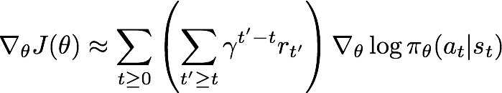
Variance reduction
Gradient estimator:
First idea: Push up probabilities of an action seen, only by the cumulative future reward from that state
Second idea: Use discount factor y to ignore delayed effects

Slide 83
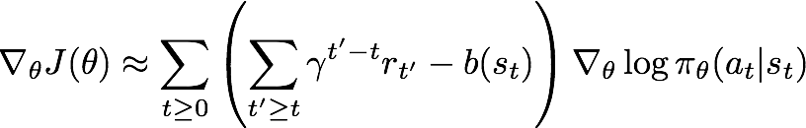
Variance reduction: Baseline
Problem: The raw value of a trajectory isn’t necessarily meaningful. For example, if rewards are all positive, you keep pushing up probabilities of actions.
What is important then? Whether a reward is better or worse than what you expect to get
Idea: Introduce a baseline function dependent on the state. Concretely, estimator is now:

Slide 84
How to choose the baseline?
A simple baseline: constant moving average of rewards experienced so far from all trajectories

Slide 85
How to choose the baseline?
A simple baseline: constant moving average of rewards experienced so far from all trajectories
Variance reduction techniques seen so far are typically used in “Vanilla REINFORCE”

Slide 86
How to choose the baseline?
A better baseline: Want to push up the probability of an action from a state, if this action was better than the expected value of what we should get from that state.
Q: What does this remind you of?

Slide 87
How to choose the baseline?
A better baseline: Want to push up the probability of an action from a state, if this action was better than the expected value of what we should get from that state.
Q: What does this remind you of? A: Q-function and value function!

Slide 88

How to choose the baseline?
A better baseline: Want to push up the probability of an action from a state, if this action was better than the expected value of what we should get from that state.
Q: What does this remind you of? A: Q-function and value function!
Intuitively, we are happy with an action a_{t} in a state s_{t} if
is large. On the contrary, we are unhappy with an action if it’s small.

Slide 89

How to choose the baseline?
A better baseline: Want to push up the probability of an action from a state, if this action was better than the expected value of what we should get from that state.
Q: What does this remind you of? A: Q-function and value function!
Intuitively, we are happy with an action a_{t} in a state s_{t} if
is large. On the contrary, we are unhappy with an action if it’s small.
Using this, we get the estimator:

Slide 90
Actor-Critic Algorithm
Problem: we don’t know Q and V. Can we learn them?
Yes, using Q-learning! We can combine Policy Gradients and Q-learning by training both an actor (the policy) and a critic (the Q-function).
The actor decides which action to take, and the critic tells the actor how good its action was and how it should adjust
Also alleviates the task of the critic as it only has to learn the values of (state, action) pairs generated by the policy
Can also incorporate Q-learning tricks e.g. experience replay
Remark: we can define by the advantage function how much an action was better than expected

Slide 91



Actor-Critic Algorithm
Initialize policy parameters 0, critic parameters ¢
For iteration=1, 2 … do
Sample m trajectories under the current policy
For i=1, …, m do
For t=1, ... , T do
End for

Slide 92
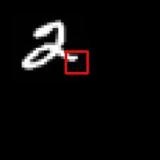
REINFORCE in action: Recurrent Attention Model (RAM)
Objective: Image Classification
Take a sequence of “glimpses” selectively focusing on regions of the image, to predict class
Inspiration from human perception and eye movements
Saves computational resources => scalability
Able to ignore clutter / irrelevant parts of image
State: Glimpses seen so far
Action: (x,y) coordinates (center of glimpse) of where to look next in image
Reward: 1 at the final timestep if image correctly classified, 0 otherwise
glimpse
[Mnih et al. 2014]
Lecture 14 -

Slide 93
REINFORCE in action: Recurrent Attention Model (RAM)
Objective: Image Classification
Take a sequence of “glimpses” selectively focusing on regions of the image, to predict class
Inspiration from human perception and eye movements
Saves computational resources => scalability
Able to ignore clutter / irrelevant parts of image
State: Glimpses seen so far
Action: (x,y) coordinates (center of glimpse) of where to look next in image
Reward: 1 at the final timestep if image correctly classified, 0 otherwise
glimpse
Glimpsing is a non-differentiable operation => learn policy for how to take glimpse actions using REINFORCE Given state of glimpses seen so far, use RNN to model the state and output next action
[Mnih et al. 2014]
Lecture 14 -

Slide 94
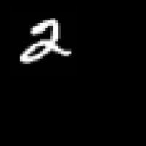
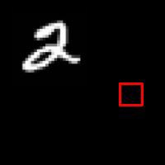
REINFORCE in action: Recurrent Attention Model (RAM)
(x₁, y₁)
Input image
NN
[Mnih et al. 2014]
Lecture 14 -

Slide 95
REINFORCE in action: Recurrent Attention Model (RAM)
(x₁, y₁)
(x₂, y₂)
Input image
NN
NN
[Mnih et al. 2014]
Lecture 14 -

Slide 96
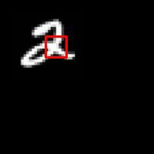
REINFORCE in action: Recurrent Attention Model (RAM)
(x₁, y₁)
(x₂, y₂)
(x₃, y₃)
Input image
NN
NN
NN
[Mnih et al. 2014]
Lecture 14 -

Slide 97
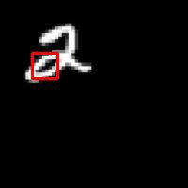
REINFORCE in action: Recurrent Attention Model (RAM)
(x₁, y₁)
(x₂, y₂)
(x₃, y₃)
(x₄, y₄)
Input image
NN
NN
NN
NN
[Mnih et al. 2014]
Lecture 14 -

Slide 98
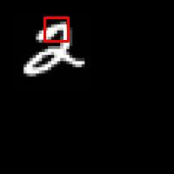
REINFORCE in action: Recurrent Attention Model (RAM)
(x₁, y₁)
(x₂, y₂)
(x₃, y₃)
(x₄, y₄)
(x₅, y₅)
Softmax
Input image
NN
NN
NN
NN
NN
y=2
[Mnih et al. 2014]
Lecture 14 -

Slide 99
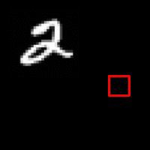
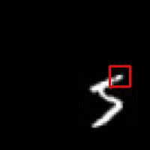
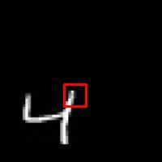
REINFORCE in action: Recurrent Attention Model (RAM)
Has also been used in many other tasks including fine-grained image recognition, image captioning, and visual question-answering!
[Mnih et al. 2014]
10
0
Lecture 14 -

Slide 100
More policy gradients: AlphaGo
Overview:
Mix of supervised learning and reinforcement learning
Mix of old methods (Monte Carlo Tree Search) and recent ones (deep RL)
How to beat the Go world champion:
Featurize the board (stone color, move legality, bias, …)
Initialize policy network with supervised training from professional go games, then continue training using policy gradient (play against itself from random previous iterations, +1 / -1 reward for winning / losing)
Also learn value network (critic)
Finally, combine combine policy and value networks in a Monte Carlo Tree Search algorithm to select actions by lookahead search
[Silver et al., Nature 2016]
This image is CC0 public domain
10
1
Lecture 14 -

Slide 101
Summary
Policy gradients: very general but suffer from high variance so requires a lot of samples. Challenge: sample-efficiency
Q-learning: does not always work but when it works, usually more sample-efficient. Challenge: exploration
Guarantees:
  Policy Gradients: Converges to a local minima of J(0), often good enough!
  Q-learning: Zero guarantees since you are approximating Bellman
equation with a complicated function approximator
10
2
Lecture 14 -

Slide 102
Next Time
Guest Lecture: Song Han
Energy-efficient deep learning
Deep learning hardware
Model compression
Embedded systems
And more...
10
3
Lecture 14 -

