Slide 1
RNN(Recurrent Neural Network)
Why need RNN
What is RNN
Architecture of RNN
Understand RNN - Forward Propagation
Understand RNN - Back propagation
Implementation of RNN in TensorFlow
Notes:
For a framework to be useful in production, it needs to be efficient, scalable, and maintainable. For research, the framework needs to have flexible operations that can be combined in novel ways. Alternative frameworks are either flexible enough for research but less scalable, such as Chainer and PyTorch, or scalable but less flexible, such as Caffe and MXNet. TensorFlow are both flexible and scalable, allowing users to streamline from research into production.

Slide 2
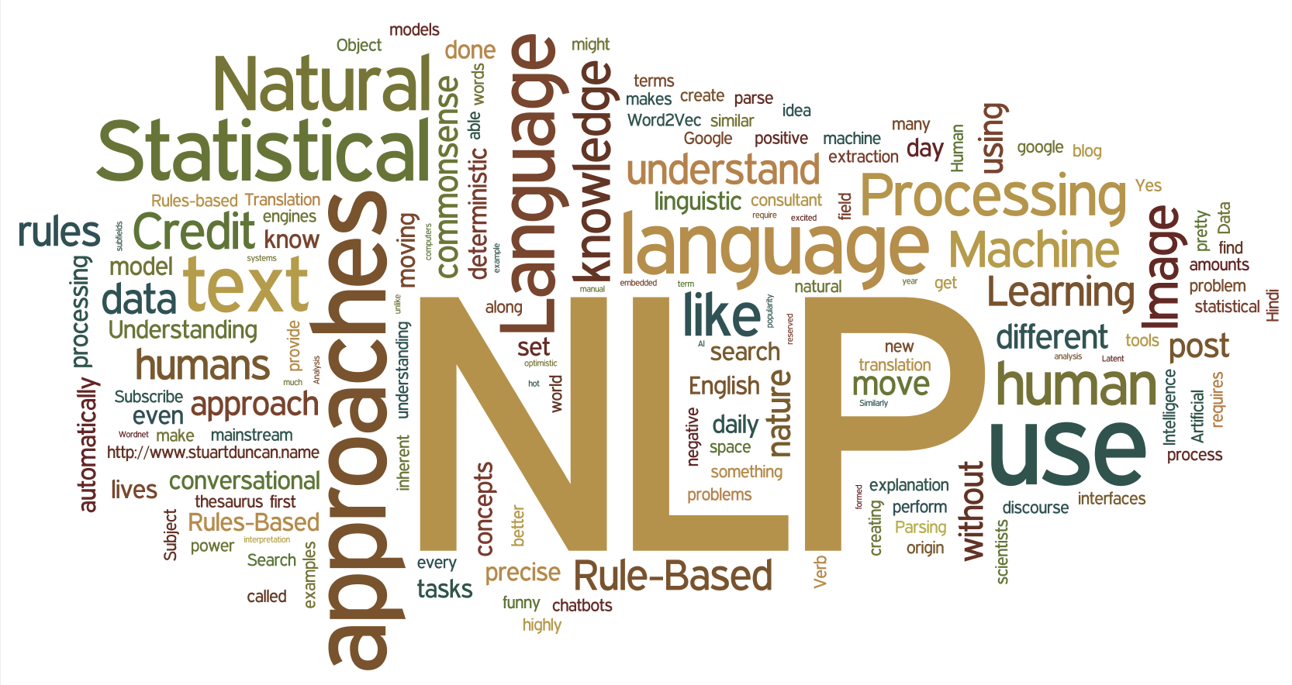
Why need RNN
In Natural language processing:
The sequence of words define their meaning
Will you do it?
Do you will it?
Woman, without her man, is helpless.
Woman! Without her, man is helpless!
The dragon swallowed the knight.
The knight swallowed the dragon.
Notes:
For a framework to be useful in production, it needs to be efficient, scalable, and maintainable. For research, the framework needs to have flexible operations that can be combined in novel ways. Alternative frameworks are either flexible enough for research but less scalable, such as Chainer and PyTorch, or scalable but less flexible, such as Caffe and MXNet. TensorFlow are both flexible and scalable, allowing users to streamline from research into production.

Slide 3
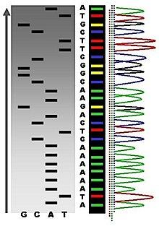
Why need RNN
In Bioinformatics:
Genome sequence define nucleotides even life
Order of As, Cs, Gs, and Ts that make up an organism's DNA. The human genome is made up of over 3 billion of these genetic letters.
DNA sequence that has been translated from life's chemical alphabet into our alphabet of written letters might look like this:
Notes:
For a framework to be useful in production, it needs to be efficient, scalable, and maintainable. For research, the framework needs to have flexible operations that can be combined in novel ways. Alternative frameworks are either flexible enough for research but less scalable, such as Chainer and PyTorch, or scalable but less flexible, such as Caffe and MXNet. TensorFlow are both flexible and scalable, allowing users to streamline from research into production.

Slide 4
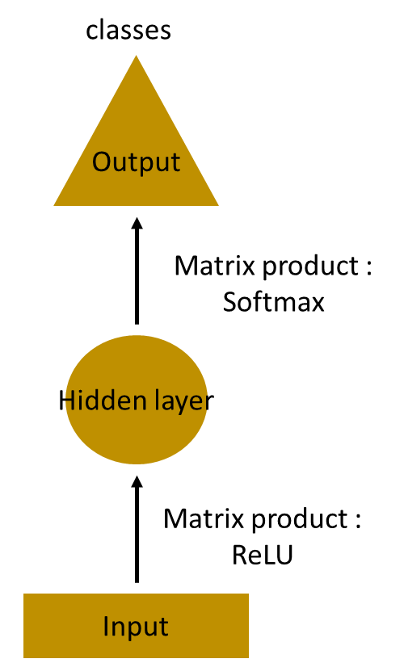
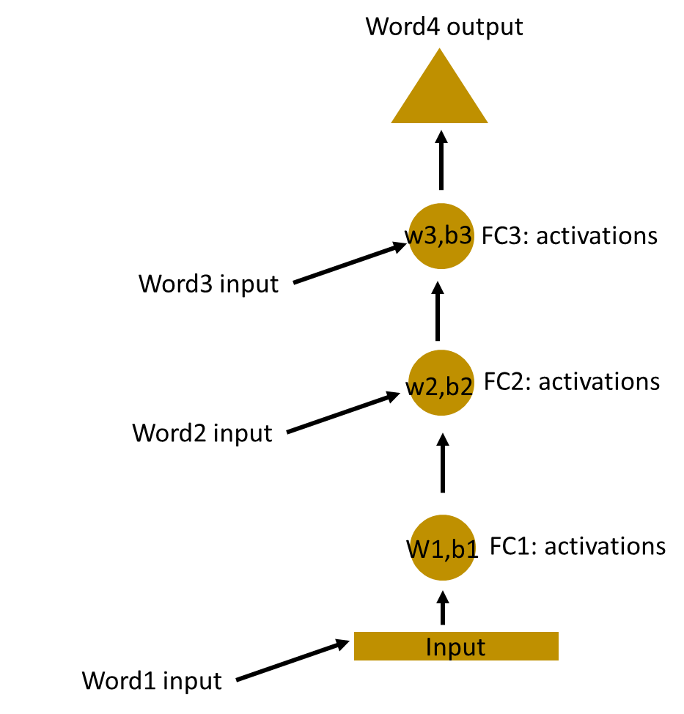
What is RNN
How to predict the next word in a sentence?
Simplest MLP(Multilayer Perceptron)
Multilayer MLP
The input layer receives the input, the hidden layer activations are applied and then we finally receive the output.
Notes:
For a framework to be useful in production, it needs to be efficient, scalable, and maintainable. For research, the framework needs to have flexible operations that can be combined in novel ways. Alternative frameworks are either flexible enough for research but less scalable, such as Chainer and PyTorch, or scalable but less flexible, such as Caffe and MXNet. TensorFlow are both flexible and scalable, allowing users to streamline from research into production.

Slide 5
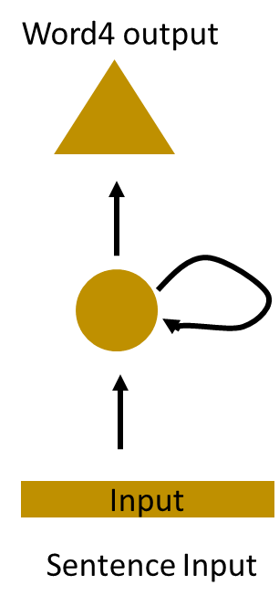
What is RNN
Here, the weights and bias of these hidden layers are different.
And hence each of these layers behave independently and cannot be combined together.
To combine these hidden layers together, we shall have the same weights and bias for these hidden layers.
Notes:
For a framework to be useful in production, it needs to be efficient, scalable, and maintainable. For research, the framework needs to have flexible operations that can be combined in novel ways. Alternative frameworks are either flexible enough for research but less scalable, such as Chainer and PyTorch, or scalable but less flexible, such as Caffe and MXNet. TensorFlow are both flexible and scalable, allowing users to streamline from research into production.

Slide 6


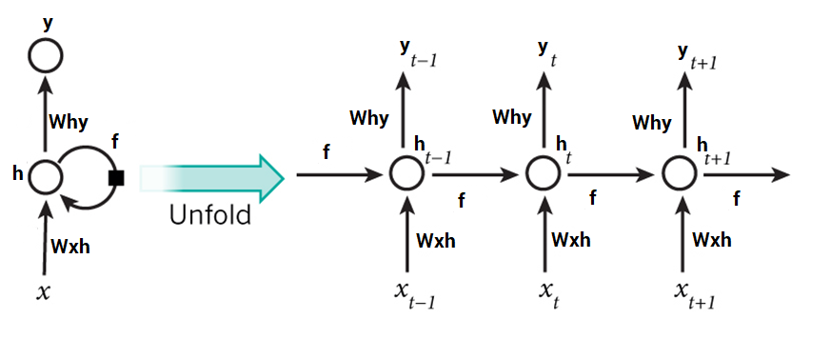

Architecture of RNN
Unfold the RNN, we can see the architecture of RNN
Notes:
For a framework to be useful in production, it needs to be efficient, scalable, and maintainable. For research, the framework needs to have flexible operations that can be combined in novel ways. Alternative frameworks are either flexible enough for research but less scalable, such as Chainer and PyTorch, or scalable but less flexible, such as Caffe and MXNet. TensorFlow are both flexible and scalable, allowing users to streamline from research into production.

Slide 7
Understand RNN - Steps
Steps in a recurrent neural network:
If you feel confused for my following example,
please review these steps again
A single time step of the input is supplied to the network i.e. x_{t} is supplied to the network
Calculate current state using a combination of the current input and the previous state i.e. we calculate h_{t}
The current h_{t} becomes h_{t-1} for the next time step
Go as many time steps as the problem demands and combine the information from all the previous states
Notes:
For a framework to be useful in production, it needs to be efficient, scalable, and maintainable. For research, the framework needs to have flexible operations that can be combined in novel ways. Alternative frameworks are either flexible enough for research but less scalable, such as Chainer and PyTorch, or scalable but less flexible, such as Caffe and MXNet. TensorFlow are both flexible and scalable, allowing users to streamline from research into production.

Slide 8
Understand RNN - Steps
Steps in a recurrent neural network:
If you feel confused for my following example,
please review these steps again
Once all the time steps are completed, the final current state is used to calculate the output y_{t}
The output is then compared to the actual output and the error is generated
The error is then backpropagated to the network to update the and the network is trained
Notes:
For a framework to be useful in production, it needs to be efficient, scalable, and maintainable. For research, the framework needs to have flexible operations that can be combined in novel ways. Alternative frameworks are either flexible enough for research but less scalable, such as Chainer and PyTorch, or scalable but less flexible, such as Caffe and MXNet. TensorFlow are both flexible and scalable, allowing users to streamline from research into production.

Slide 9
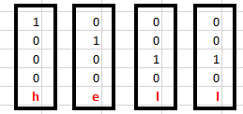

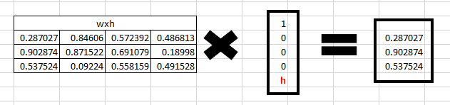
Understand RNN - Forward Propagation
To understand RNN, let’s see how Forward Propagation works:
For the word ‘hello’, we predict the last letter ‘o’ from ‘h’, ‘e’ and ‘l’
Input
Initialization
One hot encoded Input
Randomly initialized weights
Step 1:
Calculate
W_{xh}*X_{t}
Randomly initialized weights
First input x_{t}
W_{xh}*X_{t}
Notes:
For a framework to be useful in production, it needs to be efficient, scalable, and maintainable. For research, the framework needs to have flexible operations that can be combined in novel ways. Alternative frameworks are either flexible enough for research but less scalable, such as Chainer and PyTorch, or scalable but less flexible, such as Caffe and MXNet. TensorFlow are both flexible and scalable, allowing users to streamline from research into production.

Slide 10
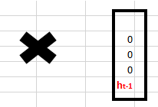
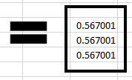



Understand RNN - Forward Propagation
To understand RNN, let’s see how Forward Propagation works:
For the word ‘hello’, we predict the last letter ‘o’ from ‘h’, ‘e’, and ‘l’
Step 2:
calculate
(w_{hh}*h_{t-1}+bias)
Randomly initialized
W_{hh}
Randomly initialized bias
H_{t-1}
previous state is [0,0,0] since there is no letter prior to it.
Result of
(w_{hh}*h_{t-1}+bias)
Notes:
For a framework to be useful in production, it needs to be efficient, scalable, and maintainable. For research, the framework needs to have flexible operations that can be combined in novel ways. Alternative frameworks are either flexible enough for research but less scalable, such as Chainer and PyTorch, or scalable but less flexible, such as Caffe and MXNet. TensorFlow are both flexible and scalable, allowing users to streamline from research into production.

Slide 11
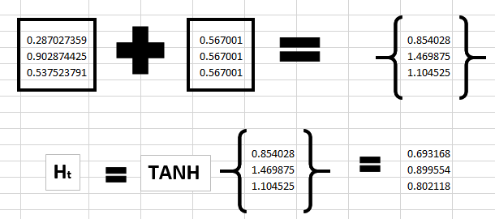
Understand RNN - Forward Propagation
To understand RNN, let’s see how Forward Propagation works:
For the word ‘hello’, we predict the last letter ‘o’ from h, e, l and l
Step 3: Get current State
W_{xh}*X_{t}
w_{hh}*h_{t-1}+bias
Notes:
For a framework to be useful in production, it needs to be efficient, scalable, and maintainable. For research, the framework needs to have flexible operations that can be combined in novel ways. Alternative frameworks are either flexible enough for research but less scalable, such as Chainer and PyTorch, or scalable but less flexible, such as Caffe and MXNet. TensorFlow are both flexible and scalable, allowing users to streamline from research into production.

Slide 12
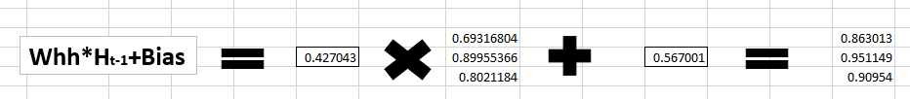
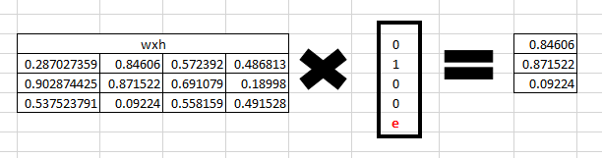
Understand RNN - Forward Propagation
To understand RNN, let’s see how Forward Propagation works:
For the word ‘hello’, we predict the last letter ‘o’ from h, e, l and l
Step 4: h_{t} become h_{t-1} and ‘e’ is supplied
W_{xh}*X_{t}
Notes:
For a framework to be useful in production, it needs to be efficient, scalable, and maintainable. For research, the framework needs to have flexible operations that can be combined in novel ways. Alternative frameworks are either flexible enough for research but less scalable, such as Chainer and PyTorch, or scalable but less flexible, such as Caffe and MXNet. TensorFlow are both flexible and scalable, allowing users to streamline from research into production.

Slide 13
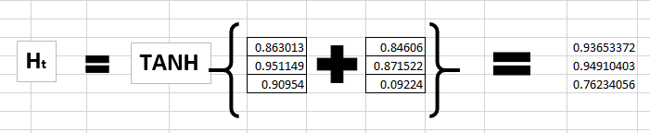
Understand RNN - Forward Propagation
To understand RNN, let’s see how Forward Propagation works:
For the word ‘hello’, we predict the last letter ‘o’ from h, e, l and l
Step 5: calculating h_{t} for the letter “e”,
Notes:
For a framework to be useful in production, it needs to be efficient, scalable, and maintainable. For research, the framework needs to have flexible operations that can be combined in novel ways. Alternative frameworks are either flexible enough for research but less scalable, such as Chainer and PyTorch, or scalable but less flexible, such as Caffe and MXNet. TensorFlow are both flexible and scalable, allowing users to streamline from research into production.

Slide 14
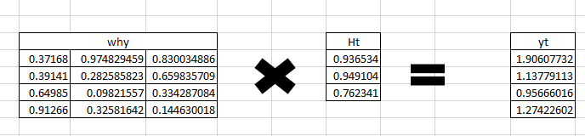
Understand RNN - Forward Propagation
To understand RNN, let’s see how Forward Propagation works:
For the word ‘hello’, we predict the last letter ‘o’ from h, e, l and l
Step 6: calculate y_{t} for the letter ‘e’
Notes:
For a framework to be useful in production, it needs to be efficient, scalable, and maintainable. For research, the framework needs to have flexible operations that can be combined in novel ways. Alternative frameworks are either flexible enough for research but less scalable, such as Chainer and PyTorch, or scalable but less flexible, such as Caffe and MXNet. TensorFlow are both flexible and scalable, allowing users to streamline from research into production.

Slide 15
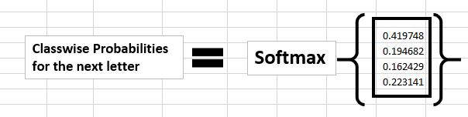
Understand RNN - Forward Propagation
To understand RNN, let’s see how Forward Propagation works:
For the word ‘hello’, we predict the last letter ‘o’ from h, e, l and l
Step 7: Calculate probability using soft-max function
Notes:
For a framework to be useful in production, it needs to be efficient, scalable, and maintainable. For research, the framework needs to have flexible operations that can be combined in novel ways. Alternative frameworks are either flexible enough for research but less scalable, such as Chainer and PyTorch, or scalable but less flexible, such as Caffe and MXNet. TensorFlow are both flexible and scalable, allowing users to streamline from research into production.

Slide 16
Understand RNN - Back propagation
To understand RNN, let’s see how Forward Propagation works:
For the word ‘hello’, we predict the last letter ‘o’ from h, e, l and l
If we convert these probabilities to understand the prediction, we see that the model says that the letter after “e” should be h,
since the highest probability is for the letter “h”. Does this mean we have done something wrong?
No, so here we have hardly trained the network. We have just shown it two letters. So it pretty much hasn’t learnt anything yet.
Now the next BIG question that faces us is how does Back propagation work in case of a Recurrent Neural Network. How are the weights updated while there is a feedback loop?
Notes:
For a framework to be useful in production, it needs to be efficient, scalable, and maintainable. For research, the framework needs to have flexible operations that can be combined in novel ways. Alternative frameworks are either flexible enough for research but less scalable, such as Chainer and PyTorch, or scalable but less flexible, such as Caffe and MXNet. TensorFlow are both flexible and scalable, allowing users to streamline from research into production.

Slide 17
Understand RNN - Back propagation
To understand RNN, let’s see how Forward Propagation works:
For the word ‘hello’, we predict the last letter ‘o’ from h, e, l and l
y_{t} is the predicted value
ȳ_{t} is the actual value
The error is calculated as a cross entropy loss
E_{t}(ȳ_{t},y_{t}) = – ȳ_{t} log(y_{t})
E(ȳ,y) = – ∑ ȳ_{t} log(y_{t})
Notes:
For a framework to be useful in production, it needs to be efficient, scalable, and maintainable. For research, the framework needs to have flexible operations that can be combined in novel ways. Alternative frameworks are either flexible enough for research but less scalable, such as Chainer and PyTorch, or scalable but less flexible, such as Caffe and MXNet. TensorFlow are both flexible and scalable, allowing users to streamline from research into production.

Slide 18
Understand RNN - Back propagation
To understand RNN, let’s see how Forward Propagation works:
For the word ‘hello’, we predict the last letter ‘o’ from h, e, l and l
The steps of back propagation:
The cross entropy error is computed using the current output and the actual output
Network is unrolled for all the time steps
For the unrolled network, the gradient is calculated for each time step with respect to the weight parameter
Weight is the same for all the time steps the gradients can be combined together for all time steps
The weights are then updated for both recurrent neuron and the dense layers
Notes:
For a framework to be useful in production, it needs to be efficient, scalable, and maintainable. For research, the framework needs to have flexible operations that can be combined in novel ways. Alternative frameworks are either flexible enough for research but less scalable, such as Chainer and PyTorch, or scalable but less flexible, such as Caffe and MXNet. TensorFlow are both flexible and scalable, allowing users to streamline from research into production.

Slide 19

RNN(Recurrent Neural Network)
This is the end
Notes:
For a framework to be useful in production, it needs to be efficient, scalable, and maintainable. For research, the framework needs to have flexible operations that can be combined in novel ways. Alternative frameworks are either flexible enough for research but less scalable, such as Chainer and PyTorch, or scalable but less flexible, such as Caffe and MXNet. TensorFlow are both flexible and scalable, allowing users to streamline from research into production.

