Slide 1
Review of HCR
-Handwritten Character Recognition
Lecture 14 -
1
Fei-Fei Li & Justin Johnson & Serena Yeung Lecture 14 - May 23, 2017

Slide 2
Contents
Introduction
OCR Working Flow
OCR Using deep learning
OCR Pipeline
CNN-LSTM Architecture
CNN-Convolutional neural network
LSTM-Long short-term memory
Tesseract Engine
Tests on typed text pre-trained model
Conclusion
Lecture 14 -
2

Slide 3

Introduction
What is OCR
OCR (Optical Character Recognition )
is a general technique to extract handwritten texts or digitizing pictures
Lecture 14 -
3

Slide 4
Introduction
Two Types of OCR
Online text recognition:
words and characters are recognized at run time as quickly as they are
written, and consequently, have temporal information
Offline text recognition:
processes a static representation of an article. Recognition offline text is partitioned in two sub categories o
f Typed and Handwritten articles.
Lecture 14 -
4

Slide 5
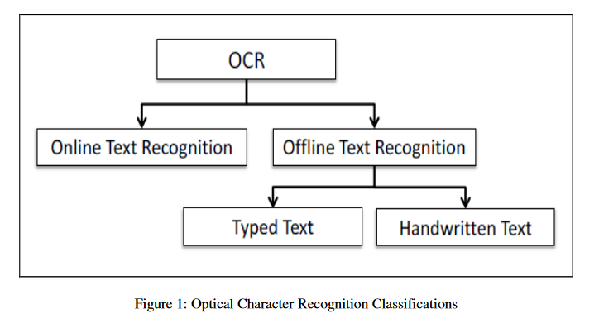
Introduction
In Summary
HCR
Lecture 14 -
5

Slide 6
Workflow
OCR consist of four major stages :
Pre-processing
Segmentation
Feature Extraction
Classification
Post-processing
Lecture 14 -
6

Slide 7
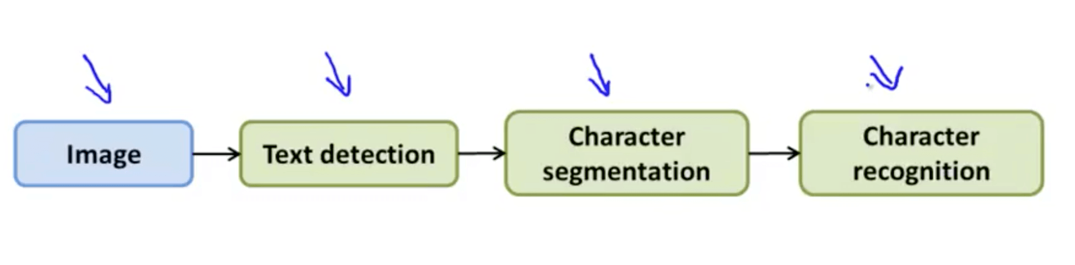
OCR using Deep Learning
OCR Pipeline
Text detection
Character segmentation
Character classification
Lecture 14 -
7

Slide 8
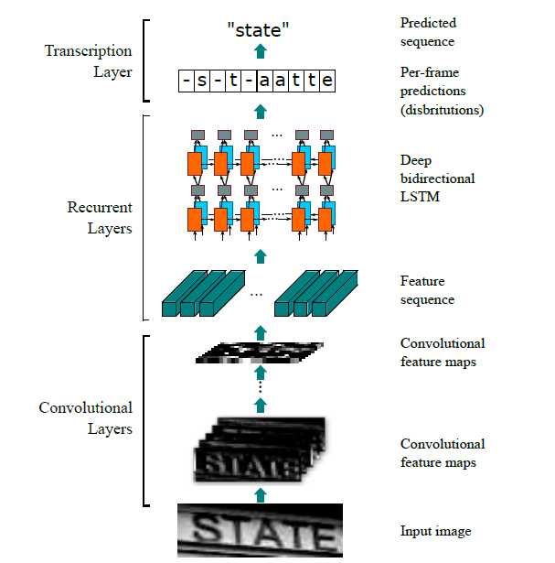
OCR using Deep Learning
CNN-LSTM Architecture
Transcription layer, which
translates the per-frame predictions into the final label sequence
Recurrent layers, which predict
a label distribution for each frame
Convolutional layers, which extract a feature sequence
from the input image
Lecture 14 -
8

Slide 9
OCR using Deep Learning
What is CNN(Convolutional neural network)?
Essentially neural networks that use convolution in place of general matrix multiplication in at least one of their layers.
Lecture 14 -
9

Slide 10
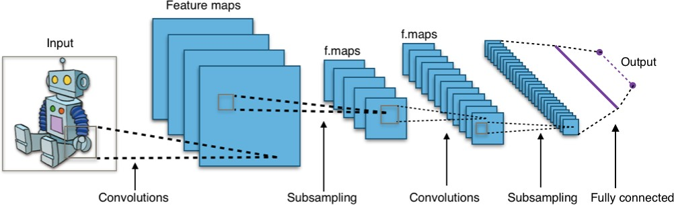
A typical CNN architecture

Slide 11
Preview: ConvNet is a sequence of Convolution Layers, interspersed with activation functions
32
28
CONV, ReLU
e.g. 6 5x5x3 filters
32
28
3
6

Slide 12
Preview: ConvNet is a sequence of Convolutional Layers, interspersed with activation functions
32
28
24
….
CONV, ReLU
e.g. 6 5x5x3 filters
CONV, ReLU
e.g. 10 5x5x6 filters
CONV, ReLU
32
28
24
3
6
10

Slide 13
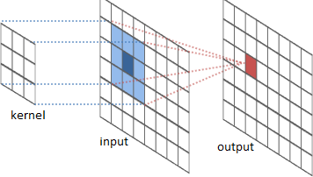
The convolution operation

Slide 14
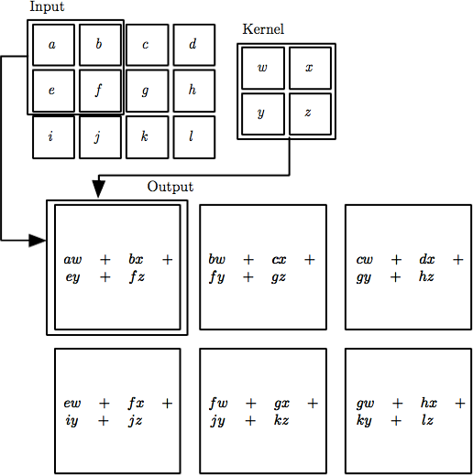

The convolution operation

Slide 15
Convolution Layer
32x32x3 image
32
height
32
depth
width
3

Slide 16
Convolution Layer
32x32x3 image
5x5x3 filter
32
Convolve the filter with the image
i.e. “slide over the image spatially, computing dot products”
32
3

Slide 17
Convolution Layer
Filters always extend the full
32x32x3 image
depth of the input volume
5x5x3 filter
32
Convolve the filter with the image
i.e. “slide over the image spatially, computing dot products”
32
3

Slide 18


Convolution Layer
32x32x3 image 5x5x3 filter
32
1 number:
the result of taking a dot product between the filter and a small 5x5x3 chunk of the image
(i.e. 5*5*3 = 75-dimensional dot product + bias)
32
3

Slide 19
Convolution Layer
activation map
32x32x3 image 5x5x3 filter
32
28
convolve (slide) over all spatial locations
32
28
3
1

Slide 20
Convolution Layer
32x32x3 image 5x5x3 filter
activation maps
32
28
convolve (slide) over all spatial locations
32
28
consider a second, green filter
3
1

Slide 21
For example, if we had 6 5x5 filters, we’ll get 6 separate activation maps:
activation maps
32
28
Convolution Layer
32
28
3
6
We stack these up to get a “new image” of size 28x28x6!

Slide 22
A closer look at spatial dimensions:
activation map
32x32x3 image 5x5x3 filter
32
28
convolve (slide) over all spatial locations
32
28
3
1

Slide 23
A closer look at spatial dimensions:
7
7x7 input (spatially) assume 3x3 filter
7

Slide 24
A closer look at spatial dimensions:
7
7x7 input (spatially) assume 3x3 filter
7

Slide 25
A closer look at spatial dimensions:
7
7x7 input (spatially) assume 3x3 filter
7

Slide 26
A closer look at spatial dimensions:
7
7x7 input (spatially) assume 3x3 filter
7

Slide 27
A closer look at spatial dimensions:
7
7x7 input (spatially) assume 3x3 filter
=> 5x5 output
7

Slide 28
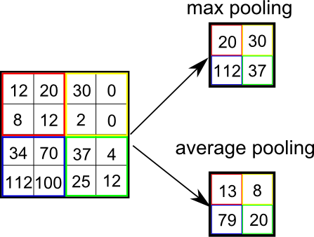
Pooling
Eﬀect = invariance to small translations of the input

Slide 29
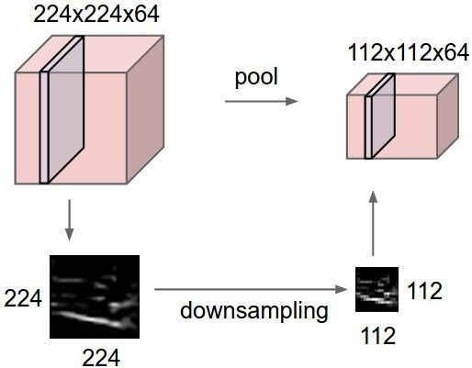
Pooling
makes the representations smaller and more manageable
operates over each activation map independently

Slide 30
Max Pooling
Single depth slice
1 | 1 | 2 | 4
5 | 6 | 7 | 8
3 | 2 | 1 | 0
1 | 2 | 3 | 4
x
max pool with 2x2 filters and stride 2
6 | 8
3 | 4
y

Slide 31
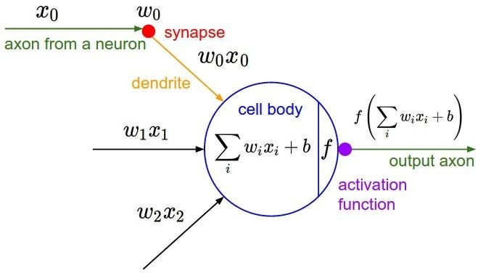
Activation Functions

Slide 32
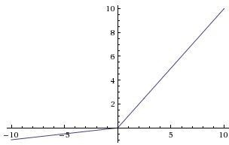
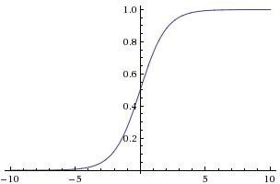

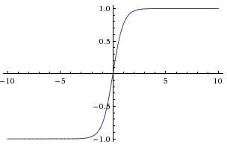


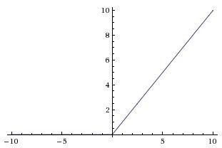
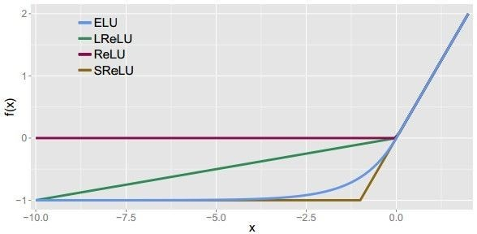
Activation Functions
Sigmoid
Leaky ReLU
Maxout
ELU
tanh
tanh(x)
ReLU
max(0,x)

Slide 33
LSTM(Long short-term memory)
Why need LSTM
What is LSTM
Architecture of LSTM
Understand LSTM - Forward Propagation
Understand LSTM - Back propagation
Implementation of LSTM in TensorFlow
Notes:
For a framework to be useful in production, it needs to be efficient, scalable, and maintainable. For research, the framework needs to have flexible operations that can be combined in novel ways. Alternative frameworks are either flexible enough for research but less scalable, such as Chainer and PyTorch, or scalable but less flexible, such as Caffe and MXNet. TensorFlow are both flexible and scalable, allowing users to streamline from research into production.

Slide 34
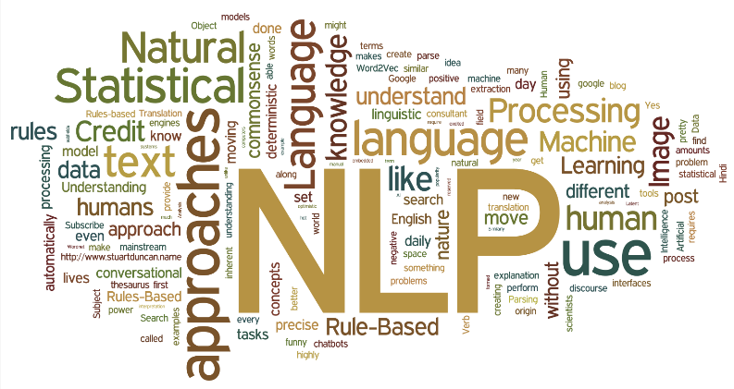
Why need LSTM
In Natural language processing:
The sequence of words define their meaning
Will you do it?
Do you will it?
Woman, without her man, is helpless.
Woman! Without her, man is helpless!
The dragon swallowed the knight.
The knight swallowed the dragon.
Notes:
For a framework to be useful in production, it needs to be efficient, scalable, and maintainable. For research, the framework needs to have flexible operations that can be combined in novel ways. Alternative frameworks are either flexible enough for research but less scalable, such as Chainer and PyTorch, or scalable but less flexible, such as Caffe and MXNet. TensorFlow are both flexible and scalable, allowing users to streamline from research into production.

Slide 35
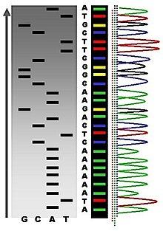
Why need LSTM
In Bioinformatics:
Genome sequence define nucleotides even life
Order of As, Cs, Gs, and Ts that make up an organism's DNA. The human genome is made up of over 3 billion of these genetic letters.
DNA sequence that has been translated from life's chemical alphabet into our alphabet of written letters might look like this:
Notes:
For a framework to be useful in production, it needs to be efficient, scalable, and maintainable. For research, the framework needs to have flexible operations that can be combined in novel ways. Alternative frameworks are either flexible enough for research but less scalable, such as Chainer and PyTorch, or scalable but less flexible, such as Caffe and MXNet. TensorFlow are both flexible and scalable, allowing users to streamline from research into production.

Slide 36
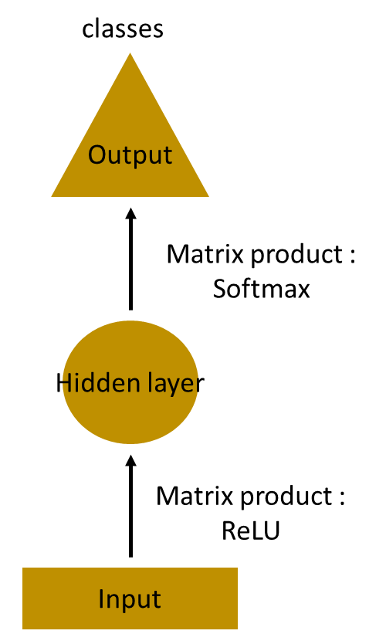
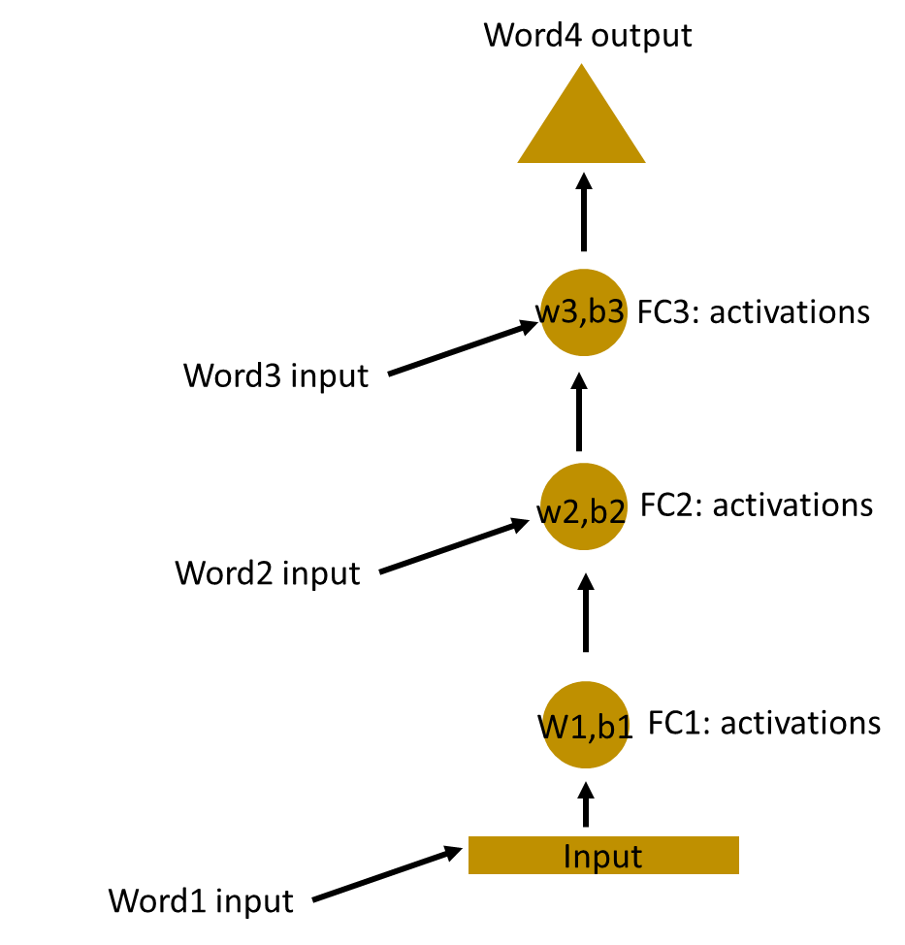
What is LSTM
How to predict the next word in a sentence?
Simplest MLP(Multilayer Perceptron)
Multilayer MLP
The input layer receives the input, the hidden layer activations are applied and then we finally receive the output.
Notes:
For a framework to be useful in production, it needs to be efficient, scalable, and maintainable. For research, the framework needs to have flexible operations that can be combined in novel ways. Alternative frameworks are either flexible enough for research but less scalable, such as Chainer and PyTorch, or scalable but less flexible, such as Caffe and MXNet. TensorFlow are both flexible and scalable, allowing users to streamline from research into production.

Slide 37
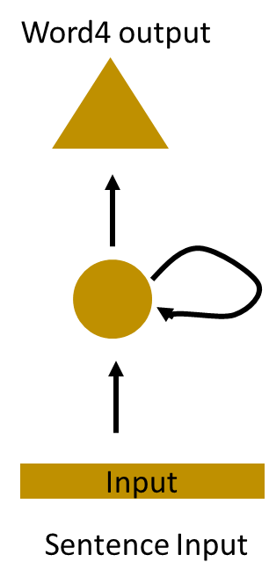
What is LSTM
Here, the weights and bias of these hidden layers are different.
And hence each of these layers behave independently and cannot be combined together.
To combine these hidden layers together, we shall have the same weights and bias for these hidden layers.
Notes:
For a framework to be useful in production, it needs to be efficient, scalable, and maintainable. For research, the framework needs to have flexible operations that can be combined in novel ways. Alternative frameworks are either flexible enough for research but less scalable, such as Chainer and PyTorch, or scalable but less flexible, such as Caffe and MXNet. TensorFlow are both flexible and scalable, allowing users to streamline from research into production.

Slide 38


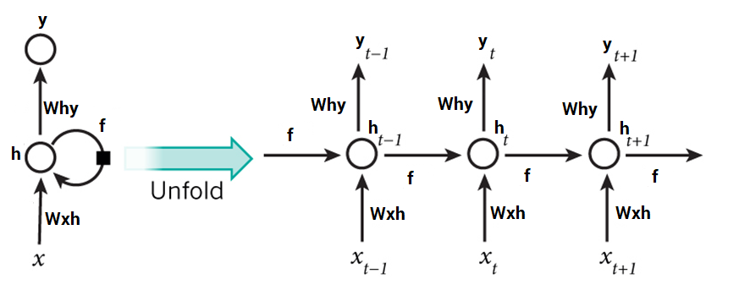

Architecture of LSTM
Unfold the LSTM, we can see the architecture of LSTM
Notes:
For a framework to be useful in production, it needs to be efficient, scalable, and maintainable. For research, the framework needs to have flexible operations that can be combined in novel ways. Alternative frameworks are either flexible enough for research but less scalable, such as Chainer and PyTorch, or scalable but less flexible, such as Caffe and MXNet. TensorFlow are both flexible and scalable, allowing users to streamline from research into production.

Slide 39
Understand LSTM - Steps
Steps in a Long short-term memory:
If you feel confused for my following example,
please review these steps again
A single time step of the input is supplied to the network i.e. x_{t} is supplied to the network
Calculate current state using a combination of the current input and the previous state i.e. we calculate h_{t}
The current h_{t} becomes h_{t-1} for the next time step
Go as many time steps as the problem demands and combine the information from all the previous states
Notes:
For a framework to be useful in production, it needs to be efficient, scalable, and maintainable. For research, the framework needs to have flexible operations that can be combined in novel ways. Alternative frameworks are either flexible enough for research but less scalable, such as Chainer and PyTorch, or scalable but less flexible, such as Caffe and MXNet. TensorFlow are both flexible and scalable, allowing users to streamline from research into production.

Slide 40
Understand LSTM - Steps
Steps in a Long short-term memory:
If you feel confused for my following example,
please review these steps again
Once all the time steps are completed, the final current state is used to calculate the output y_{t}
The output is then compared to the actual output and the error is generated
The error is then backpropagated to the network to update the and the network is trained
Notes:
For a framework to be useful in production, it needs to be efficient, scalable, and maintainable. For research, the framework needs to have flexible operations that can be combined in novel ways. Alternative frameworks are either flexible enough for research but less scalable, such as Chainer and PyTorch, or scalable but less flexible, such as Caffe and MXNet. TensorFlow are both flexible and scalable, allowing users to streamline from research into production.

Slide 41
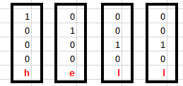

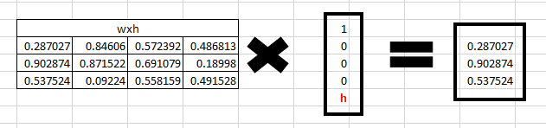
Understand LSTM - Forward Propagation
To understand LSTM, let’s see how Forward Propagation works:
For the word ‘hello’, we predict the last letter ‘o’ from ‘h’, ‘e’ and ‘l’
Input
Initialization
One hot encoded Input
Randomly initialized weights
Step 1:
Calculate
W_{xh}*X_{t}
Randomly initialized weights
First input x_{t}
W_{xh}*X_{t}
Notes:
For a framework to be useful in production, it needs to be efficient, scalable, and maintainable. For research, the framework needs to have flexible operations that can be combined in novel ways. Alternative frameworks are either flexible enough for research but less scalable, such as Chainer and PyTorch, or scalable but less flexible, such as Caffe and MXNet. TensorFlow are both flexible and scalable, allowing users to streamline from research into production.

Slide 42
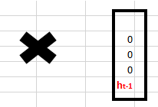
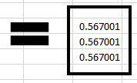



Understand LSTM - Forward Propagation
To understand LSTM, let’s see how Forward Propagation works:
For the word ‘hello’, we predict the last letter ‘o’ from ‘h’, ‘e’, and ‘l’
Step 2:
calculate
(w_{hh}*h_{t-1}+bias)
Randomly initialized
W_{hh}
Randomly initialized bias
H_{t-1}
previous state is [0,0,0] since there is no letter prior to it.
Result of
(w_{hh}*h_{t-1}+bias)
Notes:
For a framework to be useful in production, it needs to be efficient, scalable, and maintainable. For research, the framework needs to have flexible operations that can be combined in novel ways. Alternative frameworks are either flexible enough for research but less scalable, such as Chainer and PyTorch, or scalable but less flexible, such as Caffe and MXNet. TensorFlow are both flexible and scalable, allowing users to streamline from research into production.

Slide 43
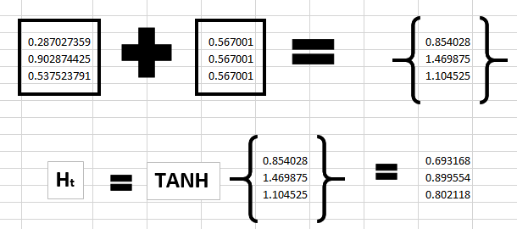
Understand LSTM - Forward Propagation
To understand LSTM, let’s see how Forward Propagation works:
For the word ‘hello’, we predict the last letter ‘o’ from h, e, l and l
Step 3: Get current State
W_{xh}*X_{t}
w_{hh}*h_{t-1}+bias
Notes:
For a framework to be useful in production, it needs to be efficient, scalable, and maintainable. For research, the framework needs to have flexible operations that can be combined in novel ways. Alternative frameworks are either flexible enough for research but less scalable, such as Chainer and PyTorch, or scalable but less flexible, such as Caffe and MXNet. TensorFlow are both flexible and scalable, allowing users to streamline from research into production.

Slide 44
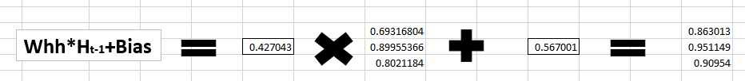
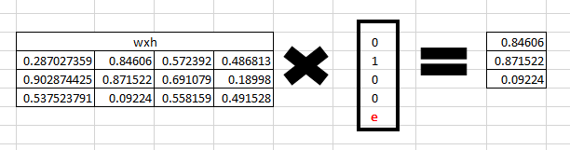
Understand LSTM - Forward Propagation
To understand LSTM, let’s see how Forward Propagation works:
For the word ‘hello’, we predict the last letter ‘o’ from h, e, l and l
Step 4: h_{t} become h_{t-1} and ‘e’ is supplied
W_{xh}*X_{t}
Notes:
For a framework to be useful in production, it needs to be efficient, scalable, and maintainable. For research, the framework needs to have flexible operations that can be combined in novel ways. Alternative frameworks are either flexible enough for research but less scalable, such as Chainer and PyTorch, or scalable but less flexible, such as Caffe and MXNet. TensorFlow are both flexible and scalable, allowing users to streamline from research into production.

Slide 45
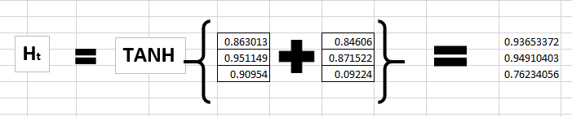
Understand LSTM - Forward Propagation
To understand LSTM, let’s see how Forward Propagation works:
For the word ‘hello’, we predict the last letter ‘o’ from h, e, l and l
Step 5: calculating h_{t} for the letter “e”,
Notes:
For a framework to be useful in production, it needs to be efficient, scalable, and maintainable. For research, the framework needs to have flexible operations that can be combined in novel ways. Alternative frameworks are either flexible enough for research but less scalable, such as Chainer and PyTorch, or scalable but less flexible, such as Caffe and MXNet. TensorFlow are both flexible and scalable, allowing users to streamline from research into production.

Slide 46
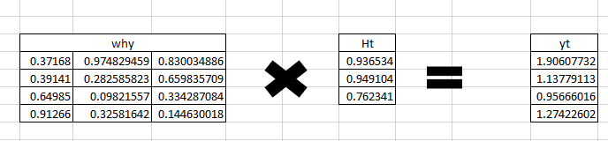
Understand LSTM - Forward Propagation
To understand LSTM, let’s see how Forward Propagation works:
For the word ‘hello’, we predict the last letter ‘o’ from h, e, l and l
Step 6: calculate y_{t} for the letter ‘e’
Notes:
For a framework to be useful in production, it needs to be efficient, scalable, and maintainable. For research, the framework needs to have flexible operations that can be combined in novel ways. Alternative frameworks are either flexible enough for research but less scalable, such as Chainer and PyTorch, or scalable but less flexible, such as Caffe and MXNet. TensorFlow are both flexible and scalable, allowing users to streamline from research into production.

Slide 47
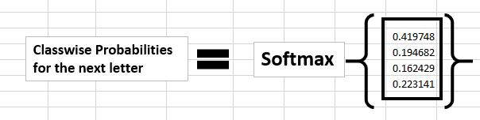
Understand LSTM - Forward Propagation
To understand LSTM, let’s see how Forward Propagation works:
For the word ‘hello’, we predict the last letter ‘o’ from h, e, l and l
Step 7: Calculate probability using soft-max function
Notes:
For a framework to be useful in production, it needs to be efficient, scalable, and maintainable. For research, the framework needs to have flexible operations that can be combined in novel ways. Alternative frameworks are either flexible enough for research but less scalable, such as Chainer and PyTorch, or scalable but less flexible, such as Caffe and MXNet. TensorFlow are both flexible and scalable, allowing users to streamline from research into production.

Slide 48
Understand LSTM - Back propagation
To understand LSTM, let’s see how Forward Propagation works:
For the word ‘hello’, we predict the last letter ‘o’ from h, e, l and l
If we convert these probabilities to understand the prediction, we see that the model says that the letter after “e” should be h,
since the highest probability is for the letter “h”. Does this mean we have done something wrong?
No, so here we have hardly trained the network. We have just shown it two letters. So it pretty much hasn’t learnt anything yet.
Now the next BIG question that faces us is how does Back propagation work in case of a Long short-term memory. How are the weights updated while there is a feedback loop?
Notes:
For a framework to be useful in production, it needs to be efficient, scalable, and maintainable. For research, the framework needs to have flexible operations that can be combined in novel ways. Alternative frameworks are either flexible enough for research but less scalable, such as Chainer and PyTorch, or scalable but less flexible, such as Caffe and MXNet. TensorFlow are both flexible and scalable, allowing users to streamline from research into production.

Slide 49
Understand LSTM - Back propagation
To understand LSTM, let’s see how Forward Propagation works:
For the word ‘hello’, we predict the last letter ‘o’ from h, e, l and l
y_{t} is the predicted value
ȳ_{t} is the actual value
The error is calculated as a cross entropy loss
E_{t}(ȳ_{t},y_{t}) = – ȳ_{t} log(y_{t})
E(ȳ,y) = – ∑ ȳ_{t} log(y_{t})
Notes:
For a framework to be useful in production, it needs to be efficient, scalable, and maintainable. For research, the framework needs to have flexible operations that can be combined in novel ways. Alternative frameworks are either flexible enough for research but less scalable, such as Chainer and PyTorch, or scalable but less flexible, such as Caffe and MXNet. TensorFlow are both flexible and scalable, allowing users to streamline from research into production.

Slide 50
Understand LSTM - Back propagation
To understand LSTM, let’s see how Forward Propagation works:
For the word ‘hello’, we predict the last letter ‘o’ from h, e, l and l
The steps of back propagation:
The cross entropy error is computed using the current output and the actual output
Network is unrolled for all the time steps
For the unrolled network, the gradient is calculated for each time step with respect to the weight parameter
Weight is the same for all the time steps the gradients can be combined together for all time steps
The weights are then updated for both recurrent neuron and the dense layers
Notes:
For a framework to be useful in production, it needs to be efficient, scalable, and maintainable. For research, the framework needs to have flexible operations that can be combined in novel ways. Alternative frameworks are either flexible enough for research but less scalable, such as Chainer and PyTorch, or scalable but less flexible, such as Caffe and MXNet. TensorFlow are both flexible and scalable, allowing users to streamline from research into production.

Slide 51
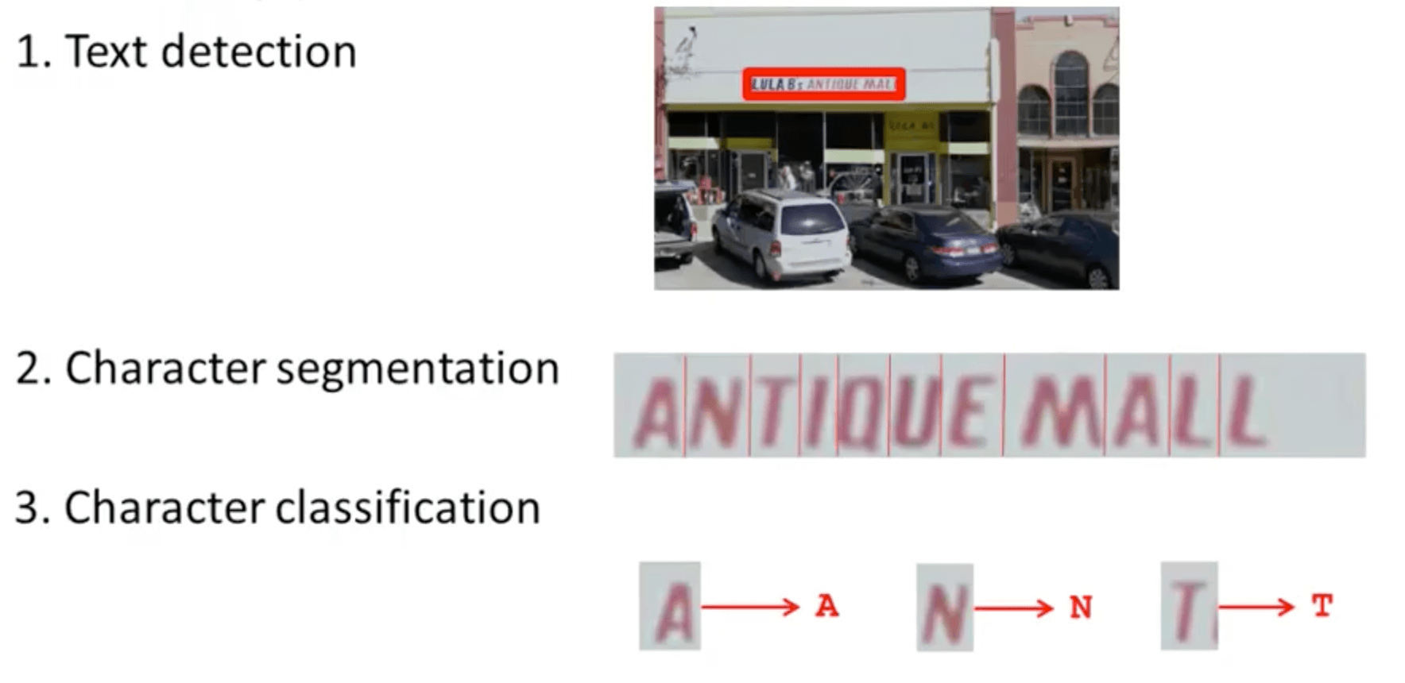
OCR using Deep Learning
OCR Pipeline
Lecture 14 -
51

Slide 52
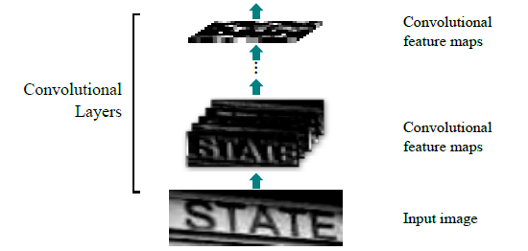
OCR using Deep Learning
CNN-LSTM Architecture-Convolutional Layer
Lecture 14 -
52

Slide 53
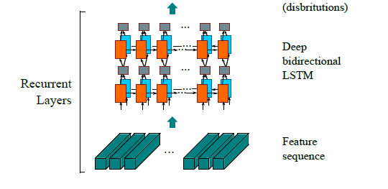
OCR using Deep Learning
CNN-LSTM Architecture-Recurrent layer
Lecture 14 -
53

Slide 54
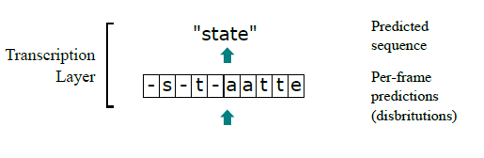
OCR using Deep Learning
CNN-LSTM Architecture-Transcription layer
Lecture 14 -
54

Slide 55
OCR using Deep Learning
CNN-LSTM Architecture
Transcription layer, which
translates the per-frame predictions into the final label sequence
Recurrent layers, which predict
a label distribution for each frame
Convolutional layers, which extract a feature sequence
from the input image
Lecture 14 -
55

Slide 56
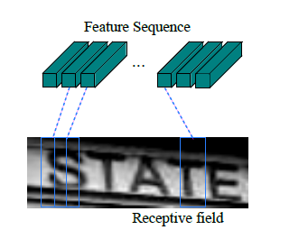
OCR using Deep Learning
CNN-LSTM Architecture-Feature sequence
The receptive field.
Each vector in the extracted feature sequence is associated with a receptive field on the input image
Vector can be considered as the feature vector of that field.
Lecture 14 -
56

Slide 57
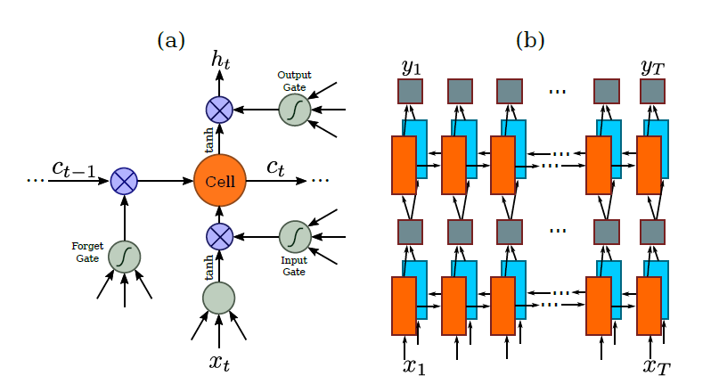
OCR using Deep Learning
CNN-LSTM Architecture-LSTM Unit
3 Gates
Left to Right
Right to Left
Lecture 14 -
57

Slide 58
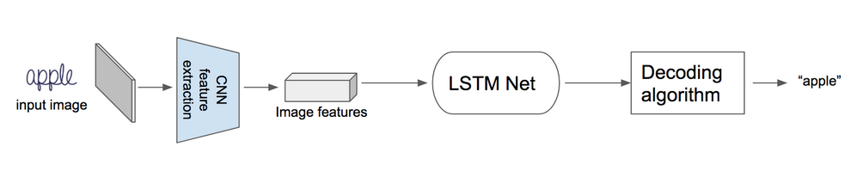
OCR using Deep Learning
CNN-LSTM Architecture
A small demo for explanation
Lecture 14 -
58

Slide 59
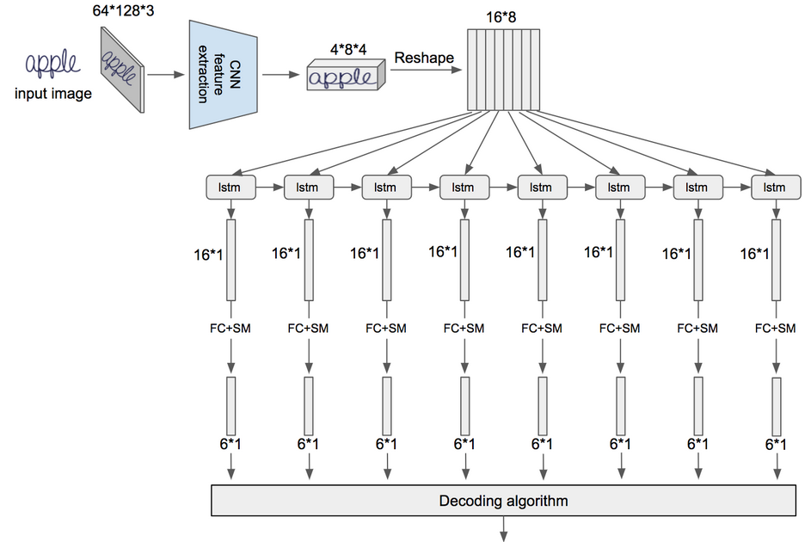
OCR using Deep Learning
1 Step: Image is feed to CNN to extract image features
FC -fully connected layer,
SM- softmax layer.
Lecture 14 -
59

Slide 60
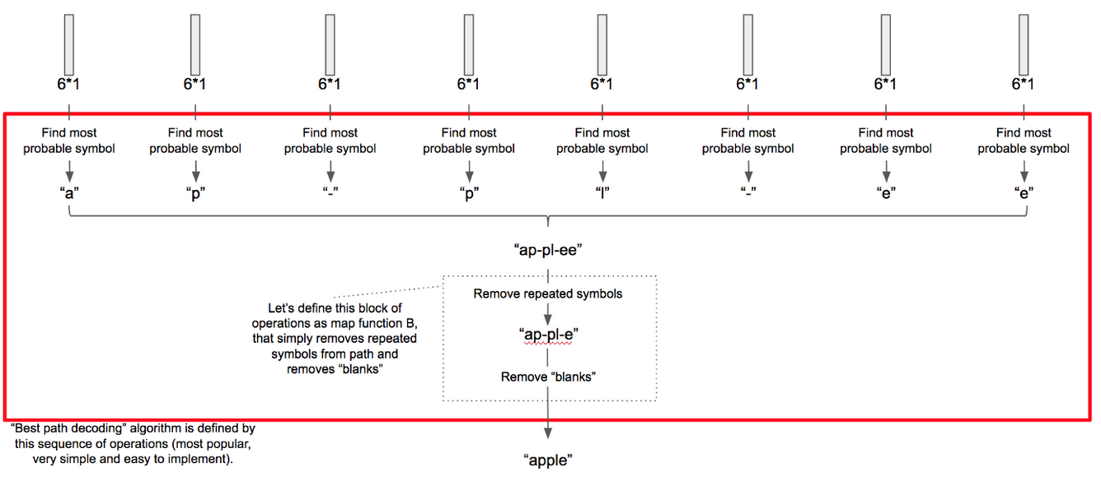
OCR using Deep Learning
CNN-LSTM Architecture
2 Step: Apply Long short-term memory to these features followed by decoding algorithm
Lecture 14 -
60

Slide 61
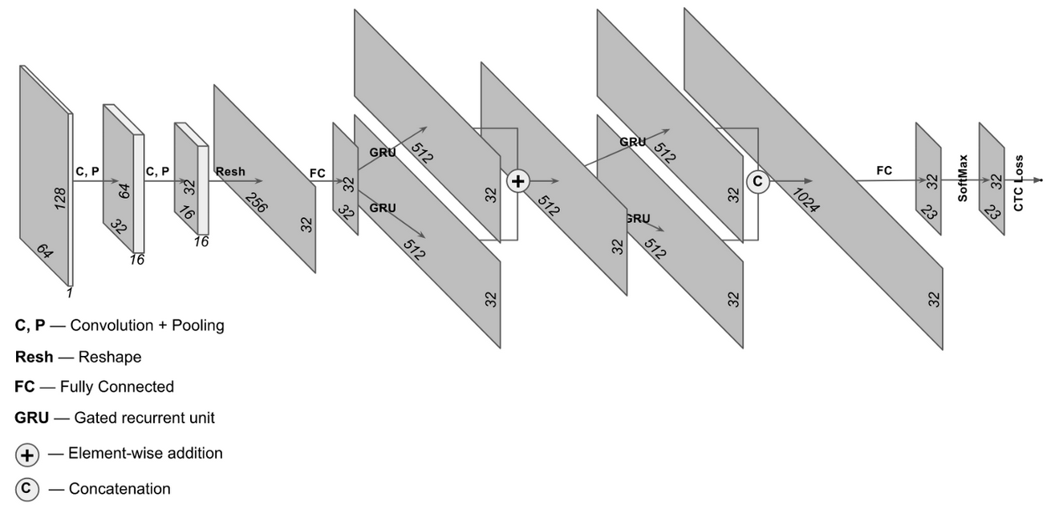
OCR using Deep Learning
CNN-LSTM Architecture
Lecture 14 -
61

Slide 62
OCR using Deep Learning
Comparative Evaluation – Public datasets
IC03: test dataset contains 251 scene images with labeled text bounding boxes.
IC13: test dataset inherits most of its data from IC03. It contains 1,015 ground truths cropped word images.
IIIT5k: contains 3,000 cropped word test images collected from the Internet. Each image has been associated to a 50-words lexicon and a 1k-words lexicon.
SVT: test dataset consists of 249 street view images collected from Google Street View. From them 647 word images are cropped. Each word image has a 50 words lexicon defined by Wang et al.
Lecture 14 -
62

Slide 63
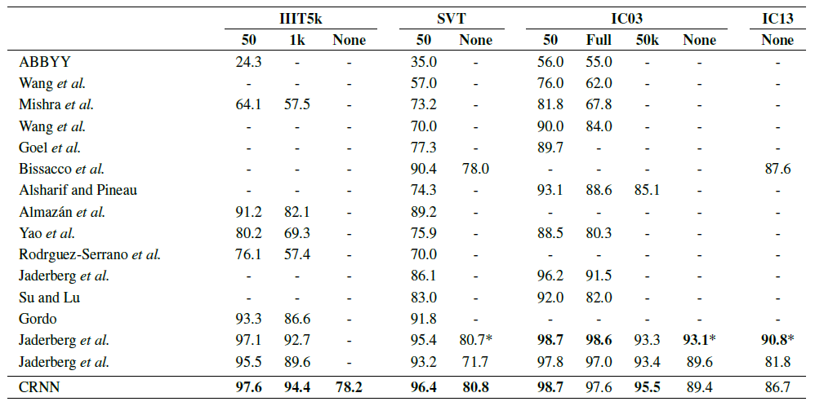
OCR using Deep Learning
Recognition accuracies (%) on four datasets
“50”, “1k”, “50k” and “Full” denote the lexicon
“None” denotes recognition without a lexicon
* is not lexicon-free in the strict sense
Comparative Evaluation – Result
Lecture 14 -
63

Slide 64
OCR using Deep Learning
Popular OCR Engines:
tesseract - The definitive Open Source OCR engine Apache 2.0
ocropus - OCR engine based on LSTM, Apache 2.0
ocropus 0.4 - Older v0.4 state of Ocropus, with tesseract 2.04 and iulib, C++
kraken - Ocropus fork with sane defaults
Ocrad - The GNU OCR. GPL
digit - OCR for numbers in meter displays, such as a power meter, using caffe
ocular - Machine-learning OCR for historic documents
SwiftOCR - fast and simple OCR library written in Swift
attention-ocr - OCR engine using visual attention mechanisms
RWTH-OCR - The RWTH Aachen University Optical Character Recognition System
simple-ocr-opencv and its fork - A simple pythonic OCR engine using opencv and numpy
Comparison of optical character recognition software
14 -
64

Slide 65
OCR using Deep Learning
Brief introduction of Tesseract Engine
Sourced by HP since 1985
Developed by Google. Since 2006
Open source text recognizer (OCR) Engine
under the Apache 2.0 license.
~100 Languages available
Lecture 14 -
65

Slide 66
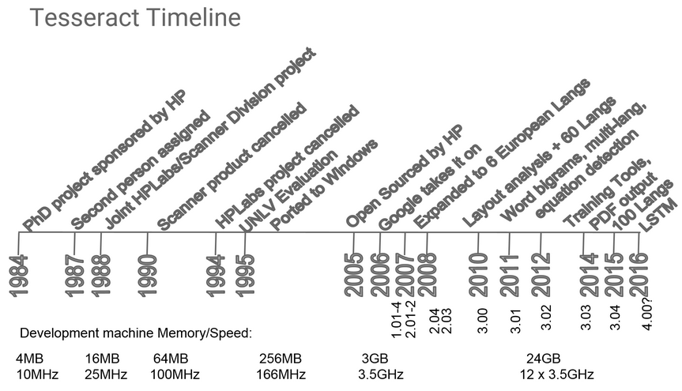
OCR using Deep Learning
Tesseract Engine History:
Lecture 14 -
66

Slide 67
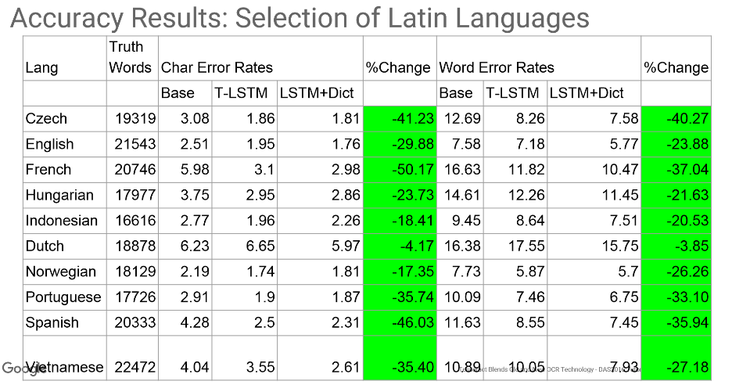
OCR using Deep Learning
Compare to 1995 result
Tesseract Performance
Lecture 14 -
67

Slide 68
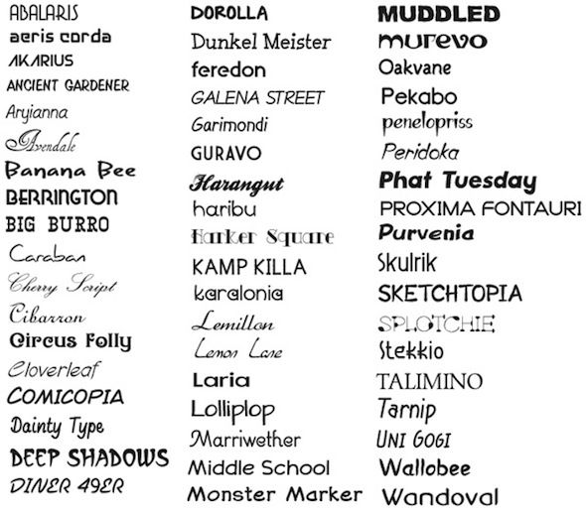
Tesseract pre-trained model
Trained by typed printed text
On about 400000 text-lines spanning about 4500 fonts.
Lecture 14 -
68

Slide 69
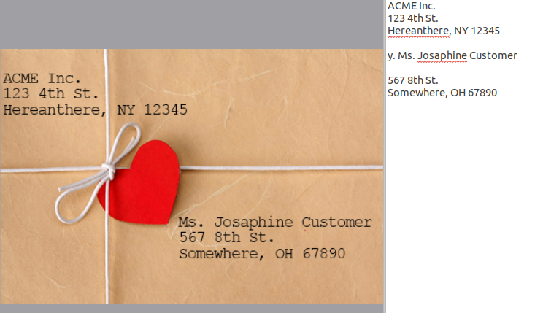
Test results
Tesseract pre-trained model, Trained by typed printed text
On about 400000 text-lines spanning about 4500 fonts.
Test result on
typed text
Lecture 14 -
69

Slide 70
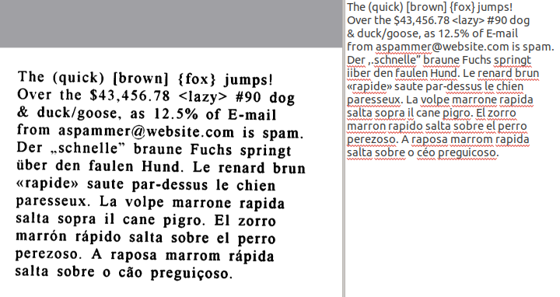
Test results
Tesseract pre-trained model, Trained by typed printed text
On about 400000 text-lines spanning about 4500 fonts.
Test result on
typed text
Lecture 14 -
70

Slide 71

Test results
Tesseract pre-trained model, Trained by typed printed text
On about 400000 text-lines spanning about 4500 fonts.
Test result on
typed text
Lecture 14 -
71

Slide 72
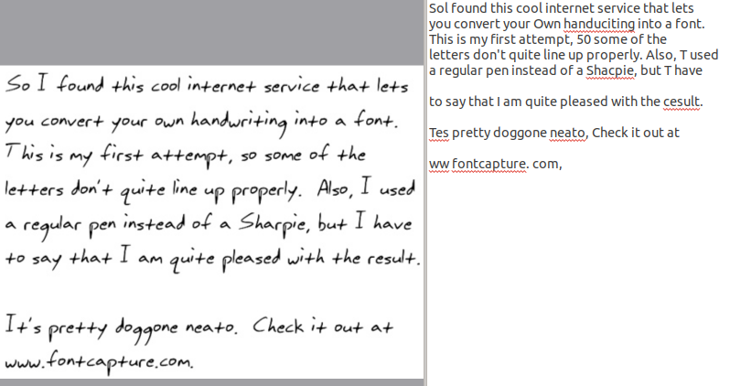
Test results
Tesseract pre-trained model, Trained by typed printed text
On about 400000 text-lines spanning about 4500 fonts.
Test result on
Hand-written text
Lecture 14 -
72

Slide 73
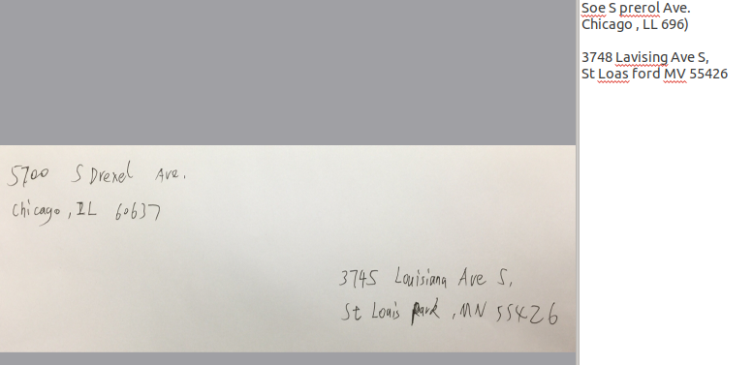
Test results
Tesseract pre-trained model, Trained by typed printed text
On about 400000 text-lines spanning about 4500 fonts.
Test result on
Hand-written text
Lecture 14 -
73

Slide 74
OCR using Deep Learning
Conclusion:
Typed text trained model performs almost 100% accuracy on typed text
Need handwritten text data to train model for handwritten text recognition
Better accuracy on neural network model
Less feature designing needed in CNN-LSTM model
Robust and data driven
Trainable for multi-language available
Lecture 14 -
74

Slide 75
References
[1] Alex Graves, Santiago FeLSTMdez, Faustino Gomez Jrgen Schmidhuber, Connectionist temporal classification: labelling unsegmented sequence data with Long short-term memorys, Proceedings of the 23rd international conference on Machine learning. 2006
[2] Convolutional Neural Network Benchmarks: https://github.com/jcjohnson/cnn-benchmarks
[3] Elie Krevat, Elliot Cuzzillo. Improving Off-line Handwritten Character Recognition with Hidden Markov Models.
[4] Fabian Tschopp. Efficient Convolutional Neural Networks for Pixelwise Classification on Heterogeneous Hardware Systems
[5] George Nagy. Document processing applications.
[6] Mail encoding and processing system patent: https://www.google.com/patents/US5420403
[7] Kurzweil Computer Products. http://www.kurzweiltech.com/kcp.html
[8] H. Bunke1, M. Roth1, E.G. Schukat-Talamazzini. Offline Cursive Handwriting Recognition using Hidden Markov Models.
Lecture 14 -
75

