Slide 1
Week 22

Slide 2
Warm-up (10 minutes)
Write a function that takes a list and removes all duplicate values from the list while preserving the order of the values. Try NOT to use Google. Things like this are super common interview questions.
Input:[13125432]
Output: [13254]

Slide 3
Today's Activities
Warmup (15 mins)
Review Homework (30 mins)
Web scraping (30 mins)
Selenium reading (15 mins)
Break (15 mins)
Final Project Breakout (30 mins)
Group Exercise (45 mins)

Slide 4
Review Homework

Slide 5
Web Scraping
What is web scraping (from the Data Camp)?
Web scraping – pulling information out of websites in an automated manner
You need to understand the structure of the website and the website code in order to pull necessary data out of the site
All sites are different!
Sites change over time
Many sites block tools like beautiful soup, so you must get creative with other libraries.

Slide 6
Questions from Reading
What is the shortcut to open dev tools and highlight the element you want to scrape? Try it! Does it work for you?
What do you do if an element you want to scrape takes time to load on the page?
Notes:
https://www.scrapingbee.com/blog/selenium-python/

Slide 7
Break (15 Minutes)
Attendance word:MachineMagician

Slide 8
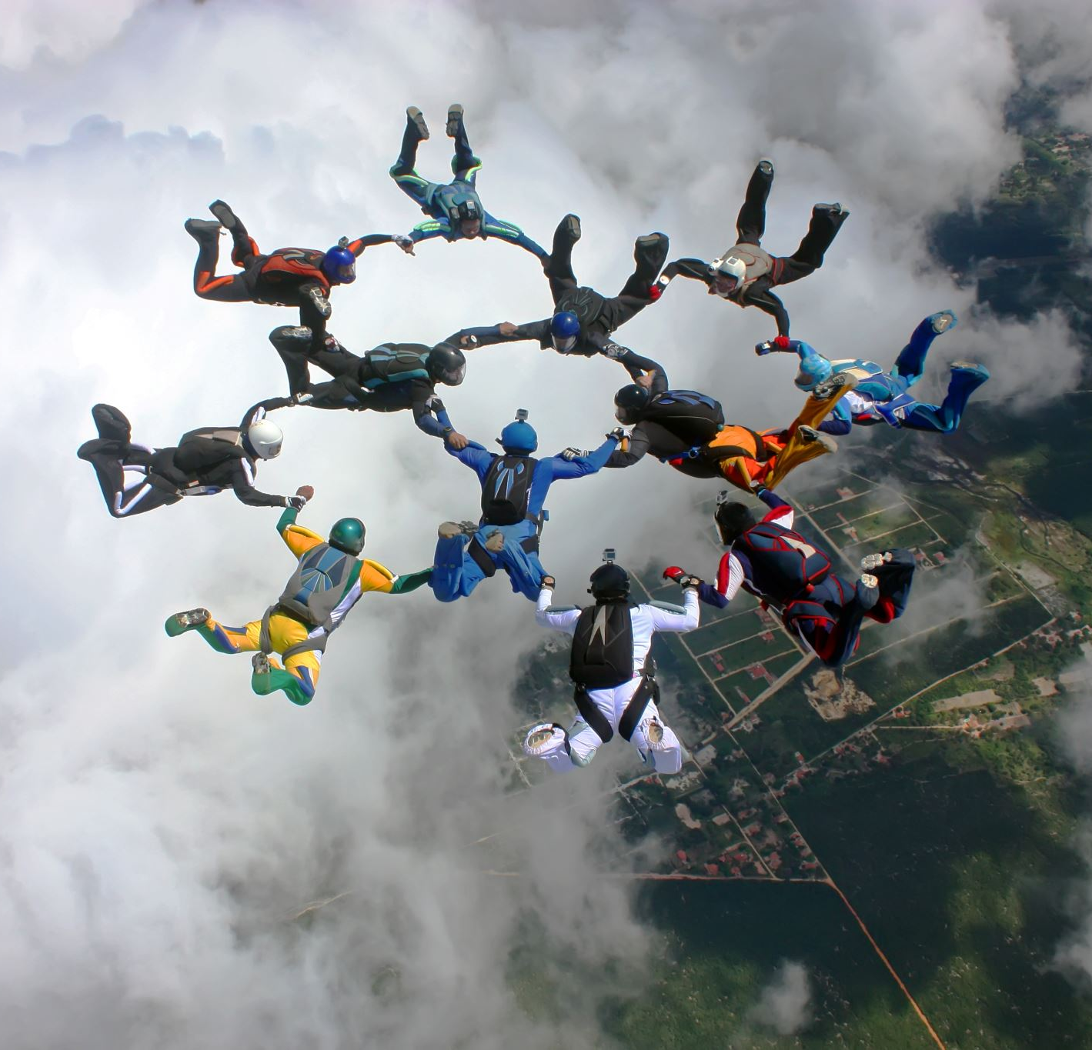
Group Project Work (30 mins)

Slide 9
Week 22 Group Exercise
Once you finish and have submitted your exercise in Canvas via a github link, use the remaining time to work on your homework.

