Slide 1

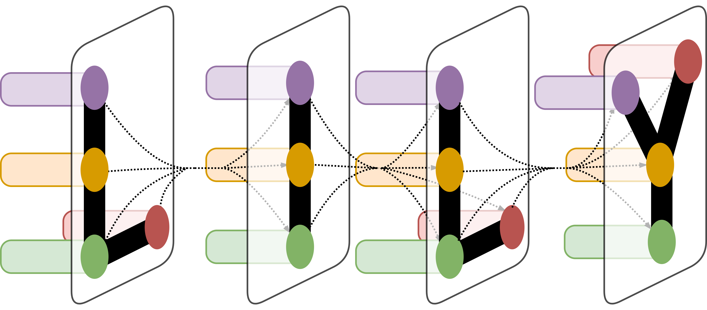

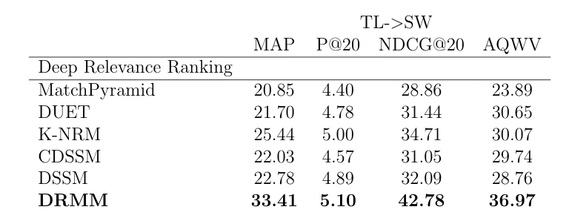
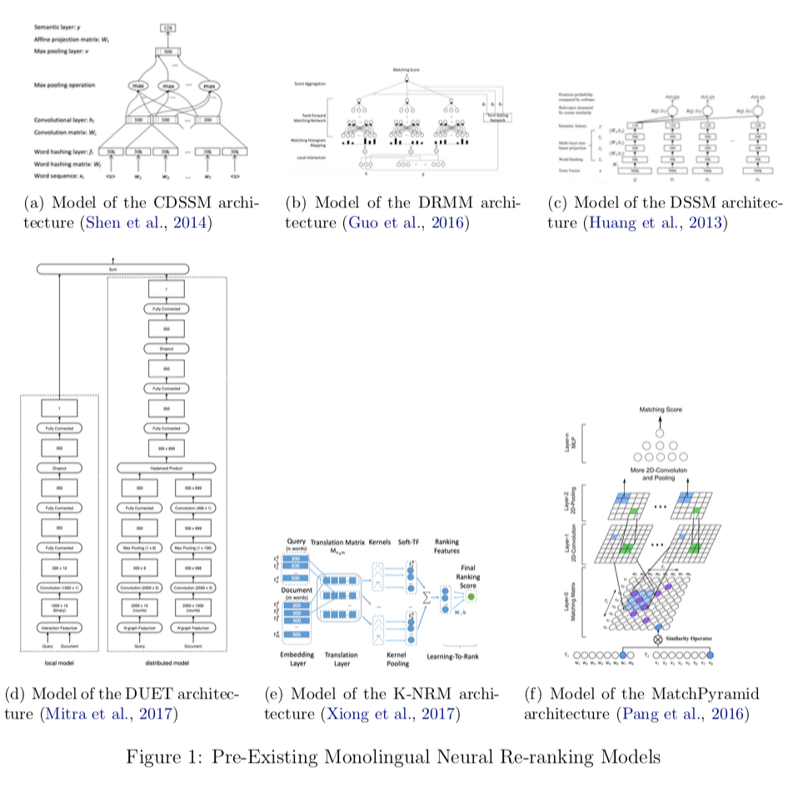
Using Multilingual Neural Re-ranking Models for Low Resource Target Languages in Cross-lingual Document Detection
Using Multilingual Neural Re-ranking Models for Low Resource Target Languages in Cross-lingual Document Retrieval
Caitlin Westerfield¹
Caitlin Westerfield¹
LILY Lab
LILY Lab
¹Language Information and Learning Lab, Yale University, New Haven, CT
¹Language Information and Learning Lab, Yale University, New Haven, CT
Abstract
Abstract
Results
Low-resource target languages introduce many challenges for cross-lingual document retrieval and detection (CLDD), as well as re-ranking. First, while CLDD can be reduced to monolingual information retrieval by document translation using machine translation (MT) systems, such MT systems suffer from the lack of parallel data for low-resource target languages. Second, recent neural retrieval models that outperform traditional language modeling approaches suffer from the scarcity of relevance judgments in low-resource target languages. Due to these constraints, it is necessary to find ways to optimize the document retrieval process in ways that are not bound by the restraints on training data. This project focuses on exploring a variety of existing monolingual neural re-ranking models and applying them to the task of multilingual document retrieval.
Results
Low-resource target languages introduce many challenges for cross-lingual document detection (CLDD) and re-ranking. First, while CLDD can be reduced to monolingual information retrieval by document translation using machine translation (MT) systems, such MT systems suffer from the lack of parallel data for low-resource target languages. Second, recent neural retrieval models that outperform traditional language modeling approaches suffer from the scarcity of relevance judgments in low-resource target languages. Due to these constraints, it is necessary to find ways to optimize the document retrieval process in ways that are not bound by the restraints on training data. This project focuses on exploring a variety of existing monolingual neural re-ranking models and applying them to the task of multilingual document retrieval.
The results displayed in Table 1 show that the implementation of DRMM drastically outperforms other methods in the MAP, NDCG@20, and AQWV metrics. These results indicate that training on the original pre-translated document text for information retrieval tasks is highly beneficial because it assigns relevance scores that more closely match the accurate relevance scores and thus makes cutoff learning more beneficial.
It is clear that overall DRMM produces the net best outcome for multilingual systems, which indicates that the features that are critical to DRMM also are most important for multilingual tasks. Since DRMM does not rely on location of terms within the document, this indicates that for multilingual tasks term location is not critical for predicting relevance to a query. Additionally, DRMM’s signal matching approach using histograms is something to explore further as a potentially good structure for multilingual CLIR tasks.
The results displayed in Table 1 show that the implementation of DRMM drastically outperforms other methods in the MAP, NDCG@20, and AQWV metrics. These results indicate that training on the original pre-translated document text for information retrieval tasks is highly beneficial because it assigns relevance scores that more closely match the accurate relevance scores and thus makes cutoff learning more beneficial.
It is clear that overall DRMM produces the net best outcome for multilingual systems, which indicates that the features that are critical to DRMM also are most important for multilingual tasks. Since DRMM does not rely on location of terms within the document, this indicates that for multilingual tasks term location is not critical for predicting relevance to a query. Additionally, DRMM’s signal matching approach using histograms is something to explore further as a potentially good structure for multilingual CLIR tasks.
Table 1. MATERIAL Results by Re-Ranking System
Table 1. MATERIAL Results by Re-Ranking System
Materials and Methods
Materials and Methods
To go about determining the best neural re-ranking system to use on multilingual systems, I relied heavily on the MatchZoo pre-existing implementations of the CDSSM, DRMM, DSSM, DUET, K-NRM, and MatchPyramid models (Fan et al., 2017). While these models were already structured for monolingual systems, I altered the implementation to use English queries to train on Swahili documents and test on Tagalog documents, as well as train on Tagalog documents and test on Swahili documents. I then calculated necessary evaluation metrics using scripts found in MatchZoo as well as in the TREC dataset that is associated with MATERIAL 1. The output of the evaluation provided the necessary information to compare the re-ranking system and MT system pairs.
The re-ranking systems were trained on the filtered outputs of the machine translation systems. This was beneficial because the systems such as DBQT, PSQ, SMT, and NMT filter out any documents that they deem extraordinarily irrelevant which means that the training data was not primarily negatively labeled documents.
To go about determining the best neural re-ranking system to use on multilingual systems, I relied heavily on the MatchZoo pre-existing implementations of the CDSSM, DRMM, DSSM, DUET, K-NRM, and MatchPyramid models (Fan et al., 2017). While these models were already structured for monolingual systems, I altered the implementation to use English queries to train on Swahili documents and test on Tagalog documents, as well as train on Tagalog documents and test on Swahili documents. I then calculated necessary evaluation metrics using scripts found in MatchZoo as well as in the TREC dataset that is associated with MATERIAL 1. The output of the evaluation provided the necessary information to compare the re-ranking system and MT system pairs.
The re-ranking systems were trained on the filtered outputs of the machine translation systems. This was beneficial because the systems such as DBQT, PSQ, SMT, and NMT filter out any documents that they deem extraordinarily irrelevant which means that the training data was not primarily negatively labeled documents.
Conclusion
Conclusion
This work proved that using neural re-ranking models significantly alters performance of CLIR systems for English Queries on Swahili Documents. Additionally, DRMM is the pre- existing monolingual re-ranking system that performs the best in a multilingual setting. The systems that work for re-ranking are also representative of what representation techniques could work on other CLIR tasks. Thus, due to the success of DRMM, it is likely that other tasks could benefit from focusing on signal-based matching using histograms and the discarding of term location information.
This work proved that using neural re-ranking models significantly alter performance of CLIR systems for English Queries on Swahili Documents. Additionally, DRMM is the pre- existing monolingual re-ranking system that performs the best in a multilingual setting. The systems that work for re-ranking are also representative of what representation techniques could work on other CLIR tasks. Thus, due to the success of DRMM, it is likely that other tasks could benefit from focusing on signal-based matching using histograms and the discarding of term location information.
Acknowledgement
Thank you to Dragomir Radev, Rui Zhang, and others on the MATERIAL project for their guidance and support on this project.
Acknowledgement
Thank you to Dragomir Radev, Rui Zhang, and others on the MATERIAL project for their guidance and support on this project.
Figure 1. Pre-Existing Monolingual Neural Re-ranking Models
Figure 4. Pre-Existing Monolingual Neural Re-ranking Models

Slide 2
Cross-Lingual Document Detection
Purpose of Cross-Lingual Document Detection
Purpose of Incorporating Re-ranking systems

Slide 3
Cross-Lingual Document Detection
Purpose of Cross-Lingual Document Detection
Purpose of Incorporating Re-ranking systems
MatchPyramid
K-NRM
DUET
DSSM
CDSSM
DRMM

Slide 4
Materials and Methods
MATERIAL Dataset: QUERY 1 and DEV 1 (Tagalog and Swahili)
GloVe Word Embeddings

Slide 5
Evaluation Metrics
MAP
Precision@20
NDCG@3, @5, @20
AQWV

Slide 6
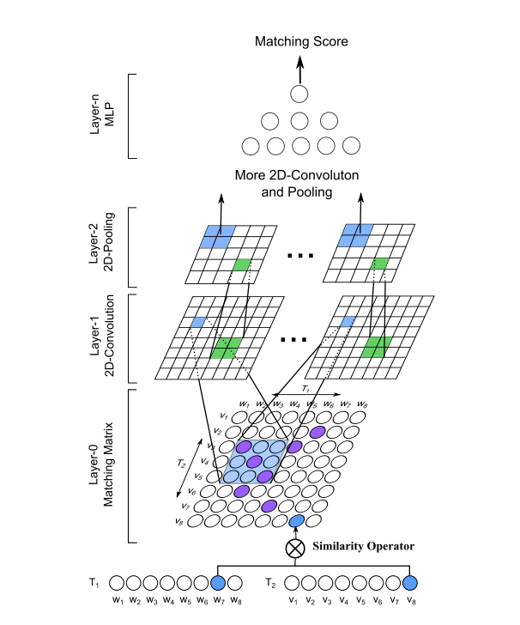
Existing Re-Ranking Models: MatchPyramid
Notes:
The most basic method is MatchPyramid which was introduced in Pang et al. (2016). This method constructs a word level similarity matrix and uses meaningful matching patterns to determine word level matching signals.

Slide 7
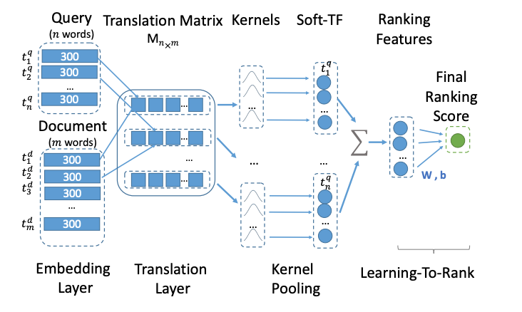
Existing Re-Ranking Models: K-NRM
Notes:
K-NRM, or the kernal based neural ranking model, is another method that uses a translation matrix to compute word-level similarities (Xiong et al., 2017). In the original implementation, the translation matrix indicates the ”translation” between words in the query and words in the document, however this can also be applied to a multilingual system. This model uses kernals to extract multi-level soft match features which then use learning to rank to determine a final score.

Slide 8
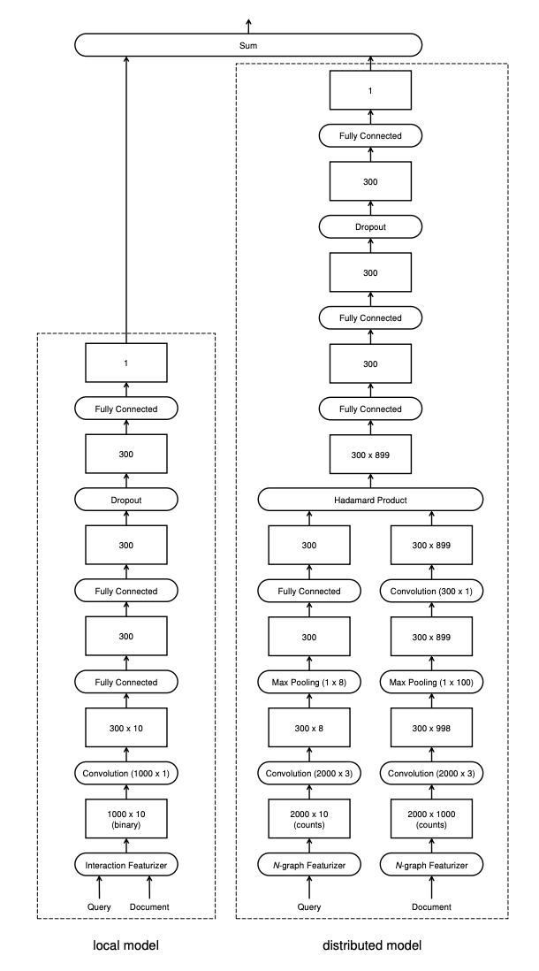
Existing Re-Ranking Models: DUET
Notes:
Another model is the DUET model which was introduced in Mitra et al. (2017). This re- ranking system uses a dual approach to match the query to the document based on both a local and distributed representation of the text. The purpose of this ”duet” is for the local model to capture properties such as proximity and position of relevant terms within the document while the distributed model detects related terms, synonyms, and other term- specific properties. This model takes into consideration location within the document in order to appropriately manage longer documents that may contain a mixture of many different sub-documents of varying topics.

Slide 9
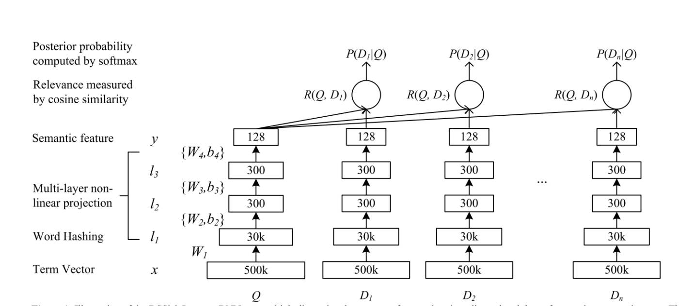
Existing Re-Ranking Models: DSSM
Notes:
The Deep Structured Semantic Model (DSSM) introduced in Huang et al. (2013) is another neural re-ranking model that has been widely regarded favorably due to its use of a word hashing method. DSSM takes high-dimensional term vectors of queries and documents and projects them into low-dimensional letter-based n-gram concept vectors in a semantic feature space. Word hashing uses less space since it only has to store n-grams, thus allowing for large vocabularies – a trait that is useful for tasks such as document detection within large corpora. However, the original implementation of the DSSM model in Huang et al. (2013) only based re-ranking decisions on document titles rather than document text.

Slide 10
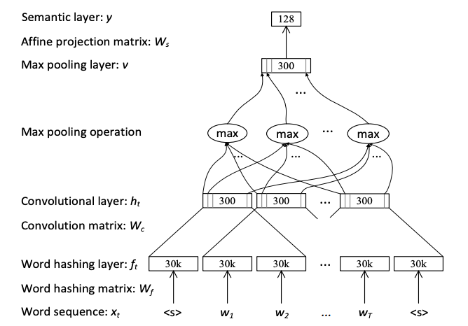
Existing Re-Ranking Models: CDSSM
Notes:
Similarly, CDSSM is an implementation of the DSSM model that includes a convolution layer (Shen et al., 2014).

Slide 11
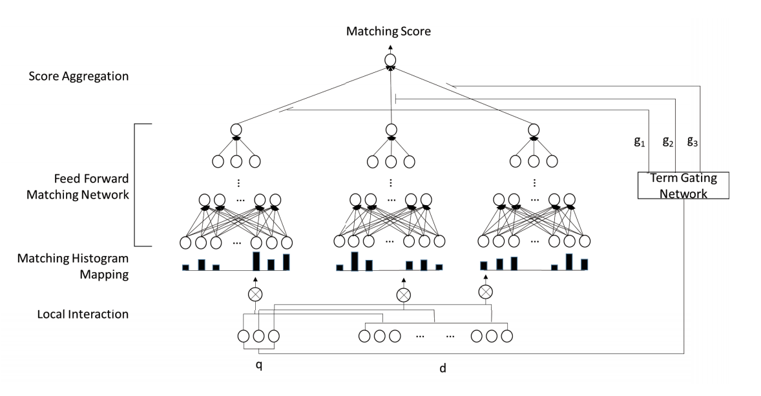
Existing Re-Ranking Models: DRMM
Notes:
In contrast to DUET and DSSM, the Deep Relevance Matching Model (DRMM) Guo et al. (2016) disregards the location of terms within the document and trains on the text of the document rather than the title. DRMM relies on relevance matching by comparing the term embeddings of each pair of terms within the query and the document in order to build local interactions. These are then used to generate fixed-length matching histograms that are employed in a feed forward matching network to learn the hierarchical matching patterns and return a score for the current query and document. The DRMM model is similar to other interaction-focused models such as MatchPyramid since it is based on matching signals. However, the histograms represent different levels of signal strengths rather than positions within the document.

Slide 12
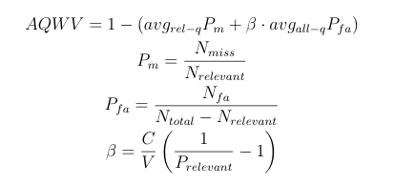
Evaluation Metrics
MAP
Precision@20
NDCG@3, @5, @20
AQWV

Slide 13
Results

Slide 14
Future Research
Training “in-house” so training on Swahili and testing on Swahili
Expanding to other languages including Tagalog and Somali
Combination of re-ranking systems

Slide 15
Acknowledgements
Dragomir Radev
Rui Zhang
Trevor Shim
Garrett Bingham
And all others who have contributed to the overarching MATERIAL project

Slide 16
Thank You!

