Slide 1

Data Science Salary Trends for US Workers – 1Q2023
Rutgers Data Visualization Bootcamp – Group 3
June 2023

Slide 2



Agenda
Introduction
Data Cleaning
Data Analysis
Modeling
Predictions
Lessons Learned

Slide 3




Introduction
The aim of this project was to create a model and app to predict salary based on job title,
Data source
Hypothesis or questions this analysis can visualize or questions the model can answer

Slide 4

Introduction
Subtitle

Slide 5





Tools Used
 | Pandas | Path | Tableau | Scikit-learn | Flask | pickle | HTML | CSS
Cleaning | X | X | X
Analysis | X | X | X
Visualization |  |  | X |  |  |  | X
Modeling | X | X |  | X
Website design |  |  |  |  | X | X | X | X
Predictions |  |  |  | X | X | X | X

Slide 6





Team
Calogera McCormick
Sana Ayubzai
Minta Burke
Aaron Lilleoien
Tawn Scotton
Project Manager
Data Scientist
Data Engineer
Data Architect
Data Analyst

Slide 7
Timeline
Select Dataset
Identify Question
Select Dataset
Data Cleaning
Brief text about data cleaning in Tableau and Pandas
Data Analysis
Brief text about data visualizations in Tableau.
Describe the data.
Data Modeling
Data Predictions
Using the model. What questions can we answer. Show examples
Brief text about model build

Slide 8

Data Cleaning
With PowerPoint, you can create presentations and share your work with others, wherever they are. Type the text you want here to get started. You can also add images, art, and videos on this template. Save to OneDrive and access your presentations from your computer, tablet, or phone.

Slide 11
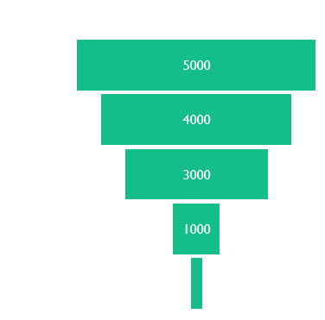
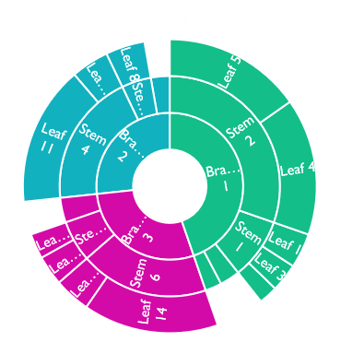
Show graphs like Tableau dashboard

Slide 12
Content
Subtitle
Subtitle
Add text, images, art, and videos.
Add transitions, animations, and motion.
Save to OneDrive, to get to your presentations from your computer, tablet, or phone.
Open the Design Ideas pane for instant slide makeovers.
When we have design ideas, we’ll show them to you right there.

Slide 13
Data Analysis
With PowerPoint, you can create presentations and share your work with others, wherever they are. Type the text you want here to get started. You can also add images, art, and videos on this template. Save to OneDrive and access your presentations from your computer, tablet, or phone.

Slide 14
Content 2
Subtitle
subtitle
subtitle
Add text, images, art, and videos.
Add transitions, animations, and motion.
Save to OneDrive, to get to your presentations from your computer, tablet, or phone.
Open the Design Ideas pane for instant slide makeovers.
When we have design ideas, we’ll show them to you right there.
Add text, images, art, and videos.
Add transitions, animations, and motion.
Save to OneDrive, to get to your presentations from your computer, tablet, or phone.
Open the Design Ideas pane for instant slide makeovers.
When we have design ideas, we’ll show them to you right there.
Add text, images, art, and videos.
Add transitions, animations, and motion.
Save to OneDrive, to get to your presentations from your computer, tablet, or phone.
Open the Design Ideas pane for instant slide makeovers.
When we have design ideas, we’ll show them to you right there.

Slide 15
Data Modeling
With PowerPoint, you can create presentations and share your work with others, wherever they are. Type the text you want here to get started. You can also add images, art, and videos on this template. Save to OneDrive and access your presentations from your computer, tablet, or phone.

Slide 16
Content 2
Subtitle
subtitle
subtitle
Add text, images, art, and videos.
Add transitions, animations, and motion.
Save to OneDrive, to get to your presentations from your computer, tablet, or phone.
Open the Design Ideas pane for instant slide makeovers.
When we have design ideas, we’ll show them to you right there.
Add text, images, art, and videos.
Add transitions, animations, and motion.
Save to OneDrive, to get to your presentations from your computer, tablet, or phone.
Open the Design Ideas pane for instant slide makeovers.
When we have design ideas, we’ll show them to you right there.
Add text, images, art, and videos.
Add transitions, animations, and motion.
Save to OneDrive, to get to your presentations from your computer, tablet, or phone.
Open the Design Ideas pane for instant slide makeovers.
When we have design ideas, we’ll show them to you right there.

Slide 17
Data Predictions
With PowerPoint, you can create presentations and share your work with others, wherever they are. Type the text you want here to get started. You can also add images, art, and videos on this template. Save to OneDrive and access your presentations from your computer, tablet, or phone.

Slide 18
Content 2
Subtitle
subtitle
subtitle
Add text, images, art, and videos.
Add transitions, animations, and motion.
Save to OneDrive, to get to your presentations from your computer, tablet, or phone.
Open the Design Ideas pane for instant slide makeovers.
When we have design ideas, we’ll show them to you right there.
Add text, images, art, and videos.
Add transitions, animations, and motion.
Save to OneDrive, to get to your presentations from your computer, tablet, or phone.
Open the Design Ideas pane for instant slide makeovers.
When we have design ideas, we’ll show them to you right there.
Add text, images, art, and videos.
Add transitions, animations, and motion.
Save to OneDrive, to get to your presentations from your computer, tablet, or phone.
Open the Design Ideas pane for instant slide makeovers.
When we have design ideas, we’ll show them to you right there.

Slide 19
Summary
With PowerPoint, you can create presentations and share your work with others, wherever they are. Type the text you want here to get started. You can also add images, art, and videos on this template. Save to OneDrive and access your presentations from your computer, tablet, or phone.

Slide 20
Lessons Learned
A few lessons learned here
And here
Refine scope of our questions based on time constraints. Model built to predict salary based on inputs. We did not complete the additional models to predict job title or experience level based on salary.

Slide 21

Ready to negotiate salary for your new data science position… this app is here to help. Know your worth. You are your best advocate.

Slide 22


Thank You
Presenter name
Email address
Github address

