Slide 1

The Technology Value Stream
Lead Time, Processing Time, and DevOps Delivery Goals
By: Cameron Mendez
CSD-380: DevOps
01/18/2026

Slide 2
What is a Technology Value Stream?
Definition: A technology value stream is the end-to-end flow of activities required to deliver software or technology products to customers. Encompassing everything from idea inception to deployment, including development, testing, and delivery.
Why it matters: It helps teams see bottlenecks, reduce waster, and optimize their delivery flow. IBM Think - “What Is Value Stream Management”

Slide 3

Lead Time vs Processing Time
Lead Time:
The total time from when a request is made until it's delivered to the customer.
Includes waiting, queuing, and everything that slows delivery.
Processing Time:
Actual time spent working on the request, being productive.
Doesn't include wait times or handoffs.
The DevOps Handbook 2nd Ed. - page 9

Slide 4
The Common Scenario: Deployment Lead Times Requiring Months
Before DevOps practices, organizations often experienced:
Long release cycles
Isolated teams
Heavy manual processes
These factors resulted in deployments taking weeks to months.
The DevOps Handbook 2nd Ed. - page 10

Slide 5

Our DevOps Ideal: Deployment Lead Times of Minutes
DevOps aims for:
Frequent releases
Automated pipelines
Fast feedback loops
This supports rapid delivery of value and improved quality.
The DevOps Handbook 2nd Ed. - page 10

Slide 6
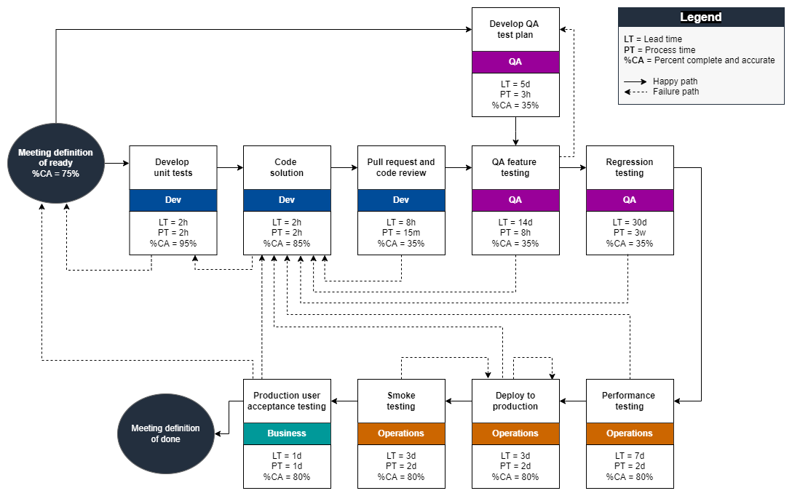
Value Stream Visual

Slide 7
Benefits of Focusing of Lead Time
Faster delivery
Better alignment with business goals
Higher quality and reliability
Increased customer satisfaction

Slide 8
References:
Kim, G., Humble, J., Debois, P., Willis, J., & Forsgren, N. (2021). The DevOps Handbook: How to create world‑class agility, reliability, & security in technology organizations (2nd ed.). IT Revolution Press.
IBM. (n.d.). What is value stream management? IBM. Retrieved January 18, 2026, from https://www.ibm.com/think/topics/value-stream-management
Prakash, S. (n.d.). Value stream management: Explained in plain English. DevOps Institute. Retrieved January 18, 2026, from https://www.devopsinstitute.com/value-stream-management-explained-in-plain-english/
Amazon Web Services. (2023). Using development value stream mapping to identify constraints to DevOps outcomes [Development value stream map example]. AWS Prescriptive Guidance. Retrieved January 18, 2026, from https://docs.aws.amazon.com/prescriptive-guidance/latest/strategy-devops-value-stream-mapping/introduction.html
https://app.grammarly.com/

