Slide 1
fMRI Quality Assessment Report
sub001 Complete Analysis - 3 Acquisitions

Slide 2
QA Summary Overview
Acquisition Summary:
1. 1.5mm Isotropic
• Matrix: 256×256×76 × 200 timepoints
• TR: 2.2s (Ernst scaling: 1.000)
• tSNR: 11.9 | iSNR: 2189
2. 2mm Resolution
• Matrix: 128×128×57 × 200 timepoints
• TR: 1.4s (Ernst scaling: 0.575)
• tSNR: 10.1 | iSNR: 2889
3. 2mm × 1.5mm
• Matrix: 128×128×76 × 200 timepoints
• TR: 2s (Ernst scaling: 1.000)
• tSNR: 16.4 | iSNR: 3822

Slide 3
1.5mm Isotropic Resolution Acquisition
TR: 2.2s | Matrix: 256×256×76×200 | tSNR: 11.9 | iSNR: 2189

Slide 4
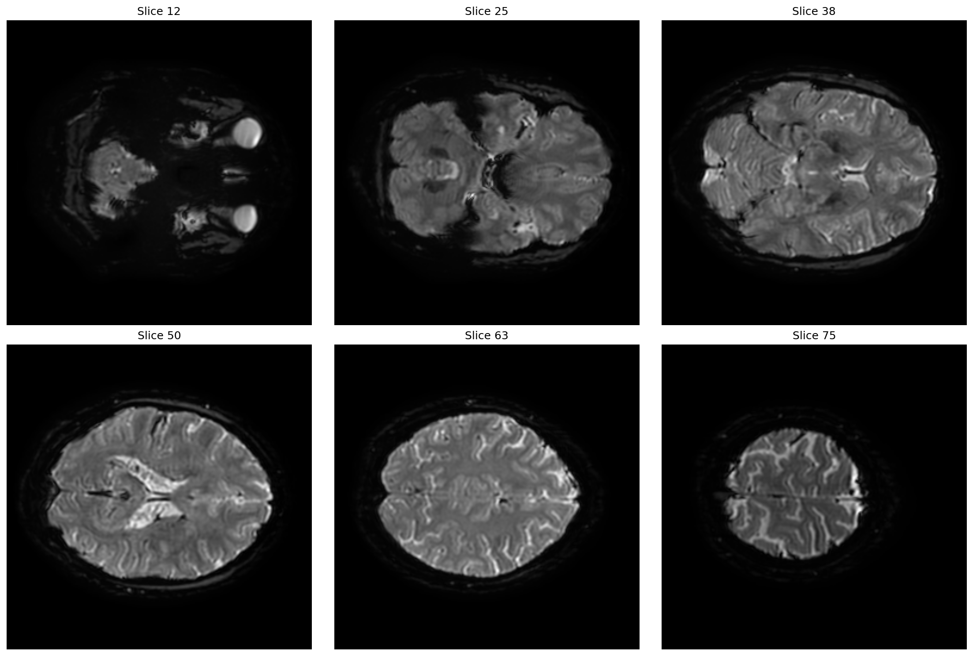
1.5mm Isotropic Resolution Acquisition: Mean Signal Intensity

Slide 5
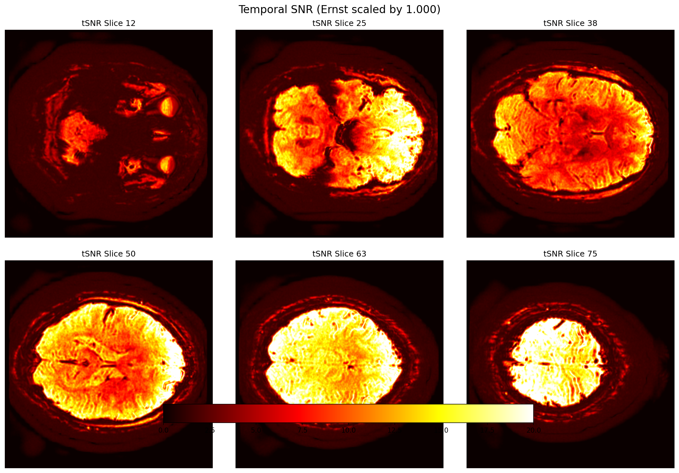
1.5mm Isotropic Resolution Acquisition: Temporal SNR (tSNR)
Mean Temporal SNR: 11.92 (Ernst scaling: 1.000)

Slide 6
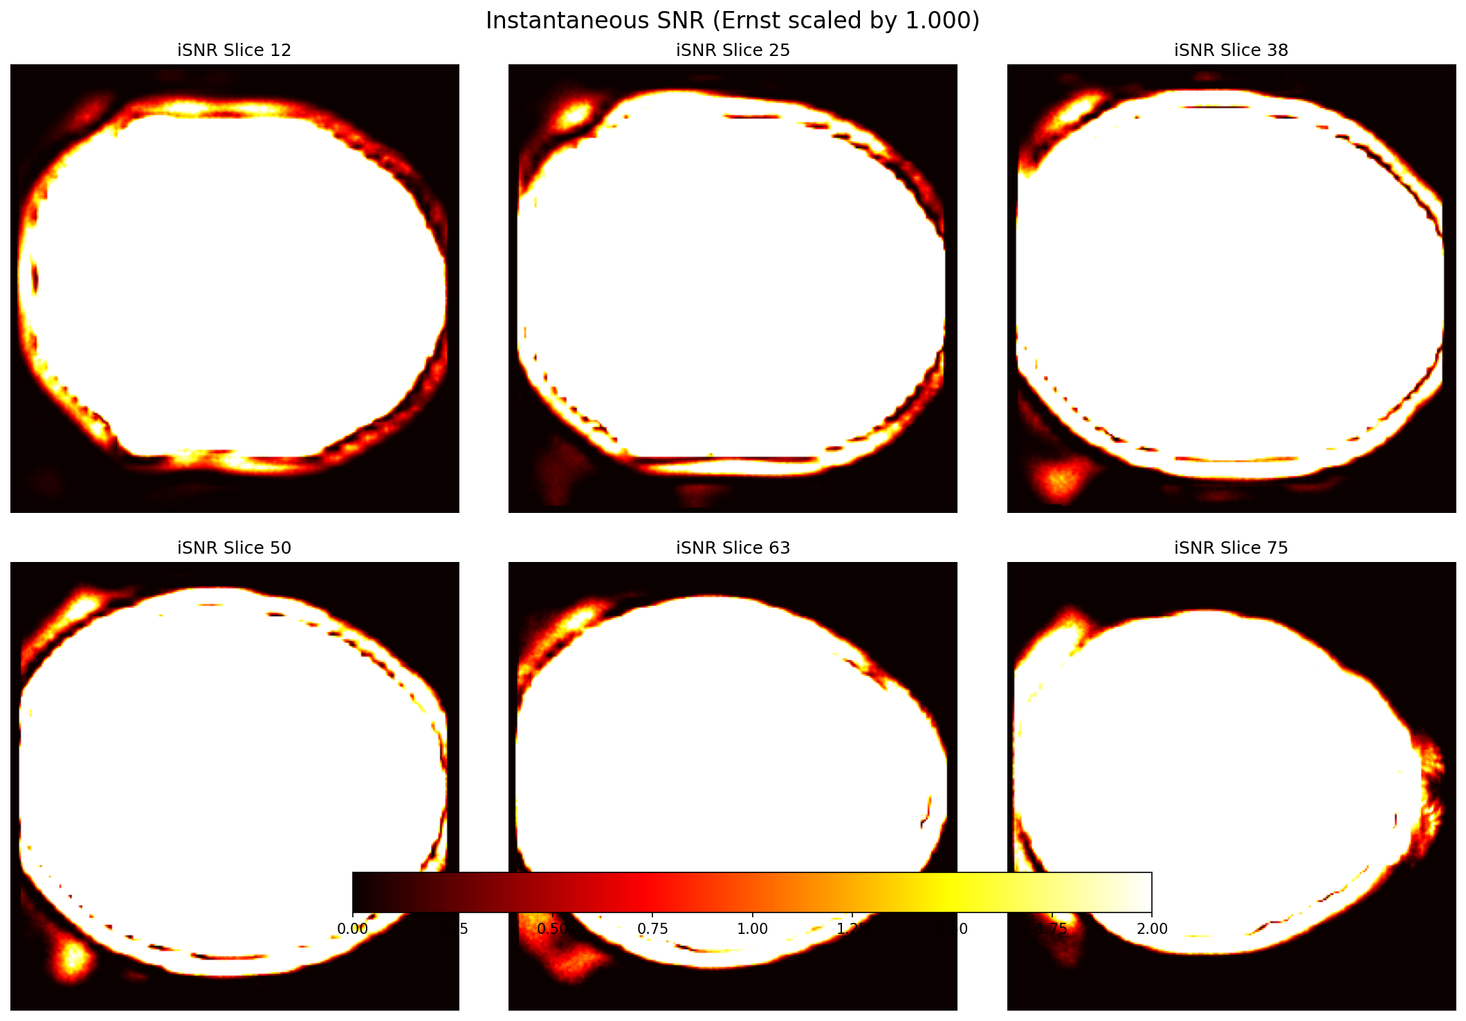
1.5mm Isotropic Resolution Acquisition: Instantaneous SNR (iSNR)
Mean Instantaneous SNR: 2189 (Ernst scaling: 1.000)

Slide 7
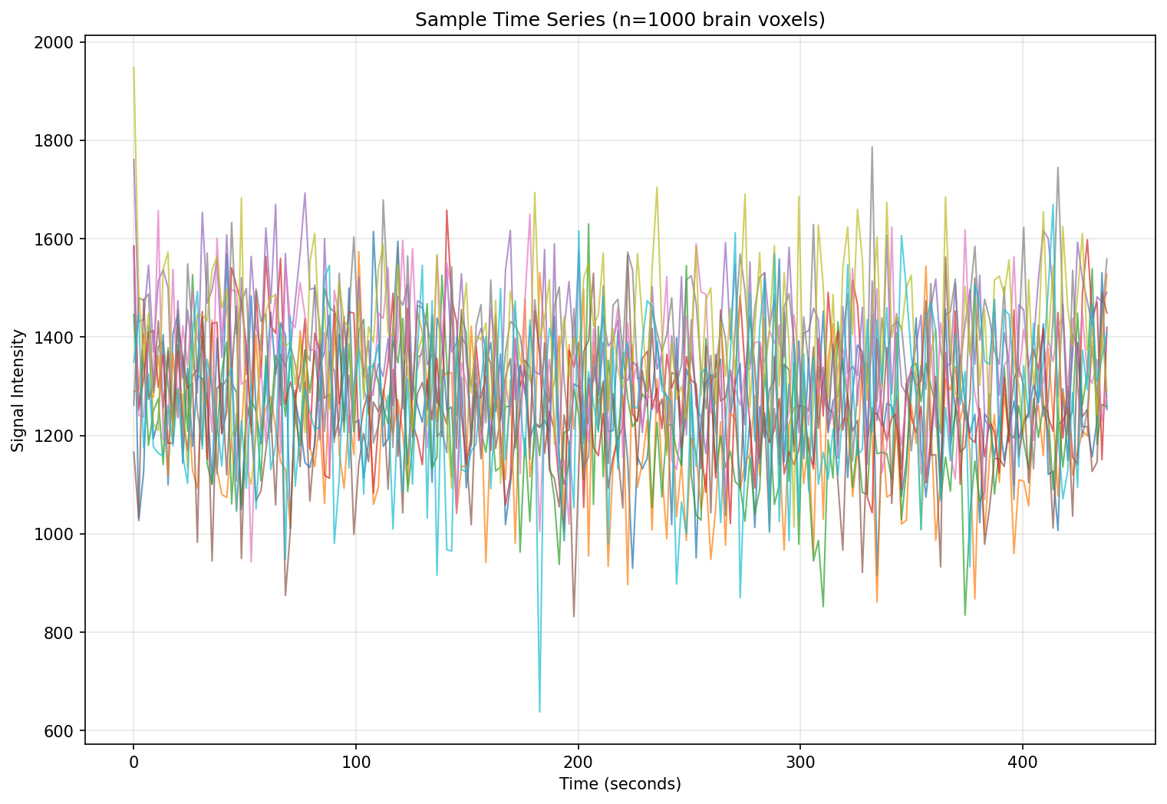
1.5mm Isotropic Resolution Acquisition: Time Series Analysis

Slide 8
2mm Resolution Acquisition
TR: 1.4s | Matrix: 128×128×57×200 | tSNR: 10.1 | iSNR: 2889

Slide 9
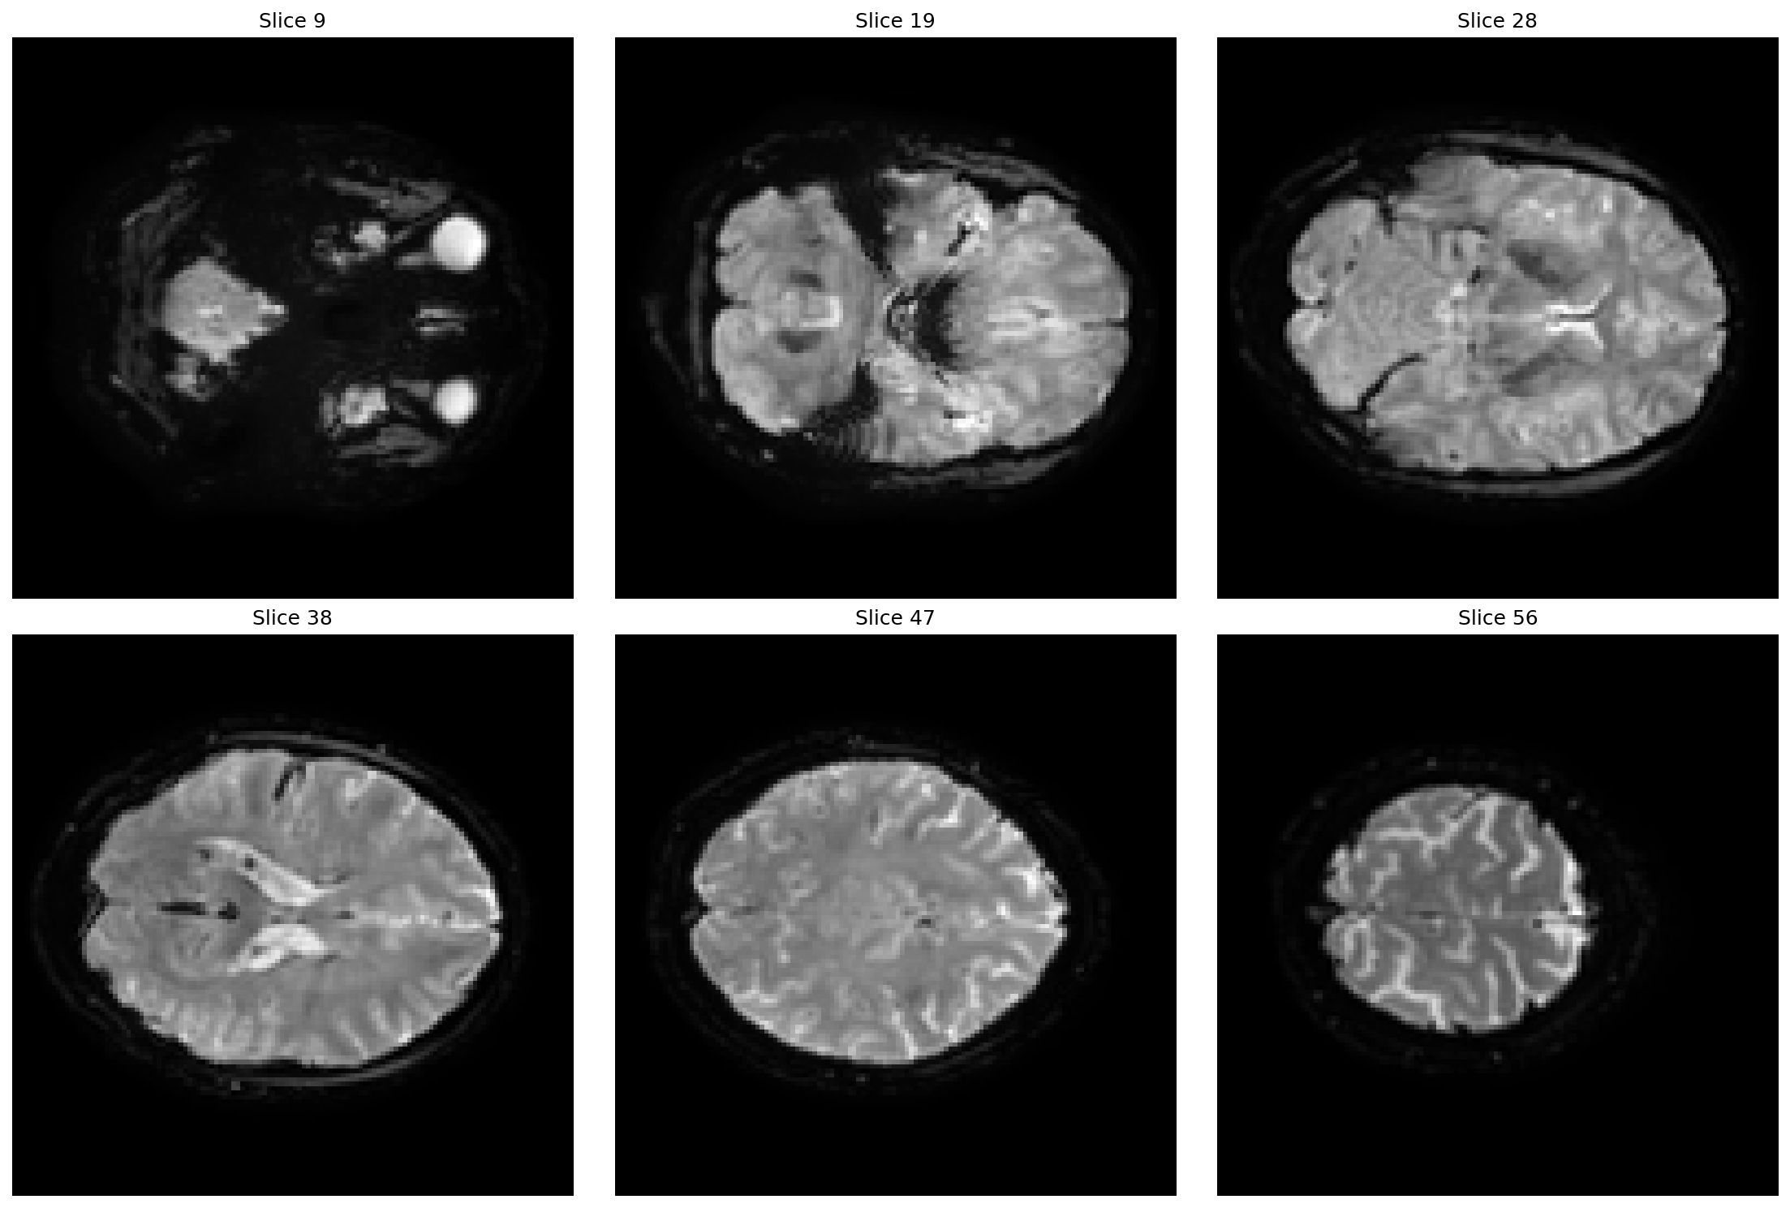
2mm Resolution Acquisition: Mean Signal Intensity

Slide 10
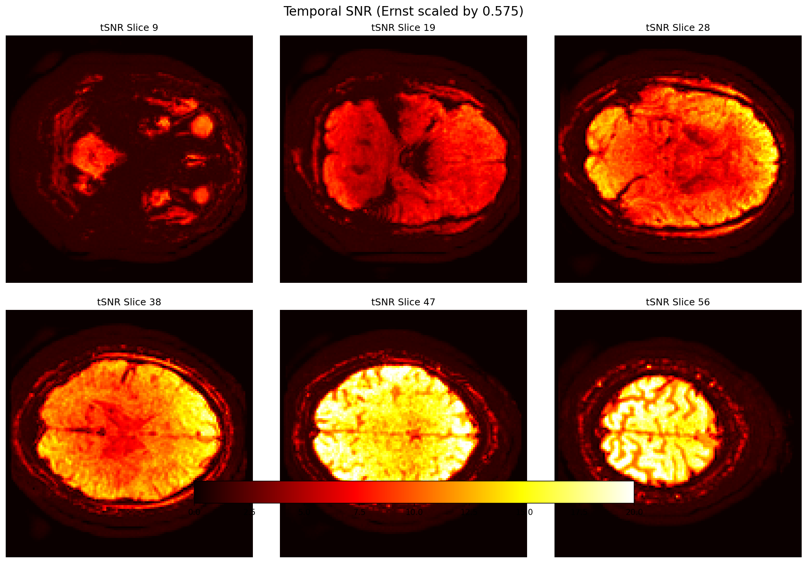
2mm Resolution Acquisition: Temporal SNR (tSNR)
Mean Temporal SNR: 10.12 (Ernst scaling: 0.575)

Slide 11
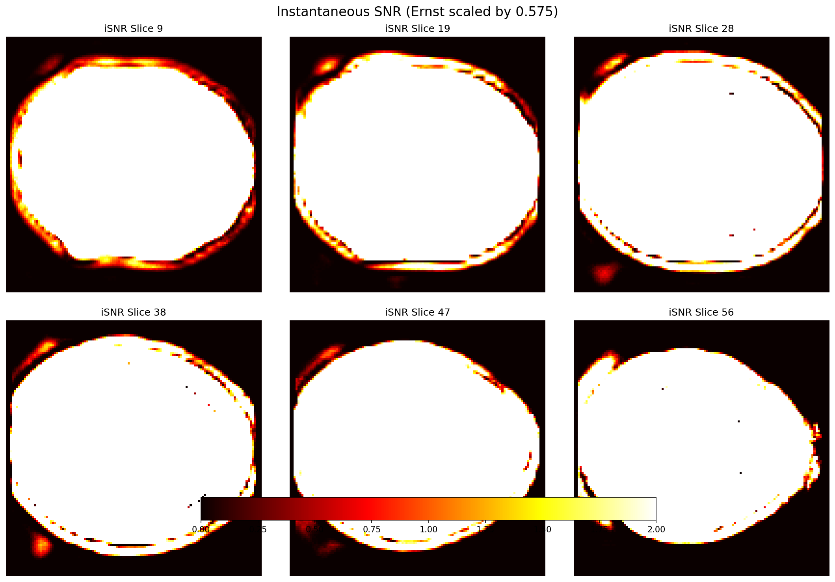
2mm Resolution Acquisition: Instantaneous SNR (iSNR)
Mean Instantaneous SNR: 2889 (Ernst scaling: 0.575)

Slide 12
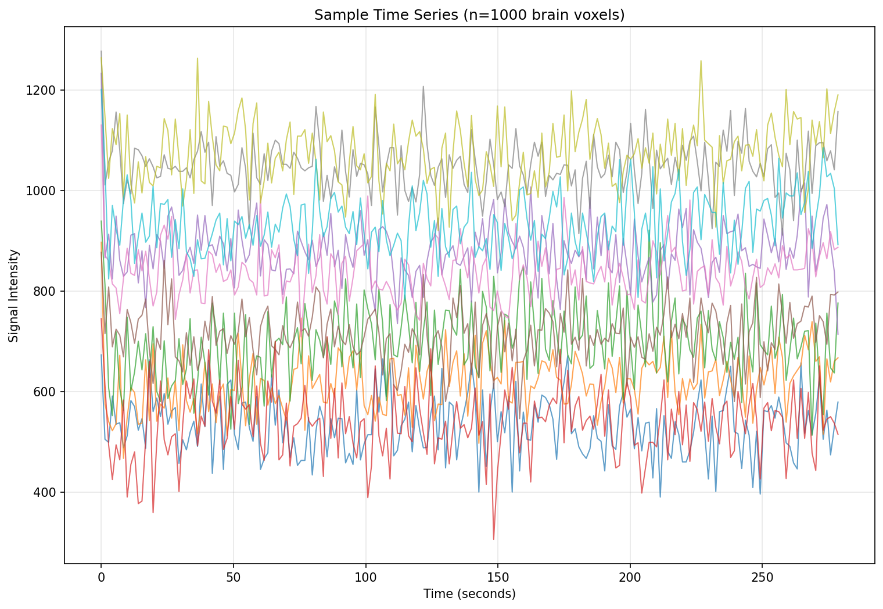
2mm Resolution Acquisition: Time Series Analysis

Slide 13
2mm × 1.5mm Resolution Acquisition
TR: 2s | Matrix: 128×128×76×200 | tSNR: 16.4 | iSNR: 3822

Slide 14
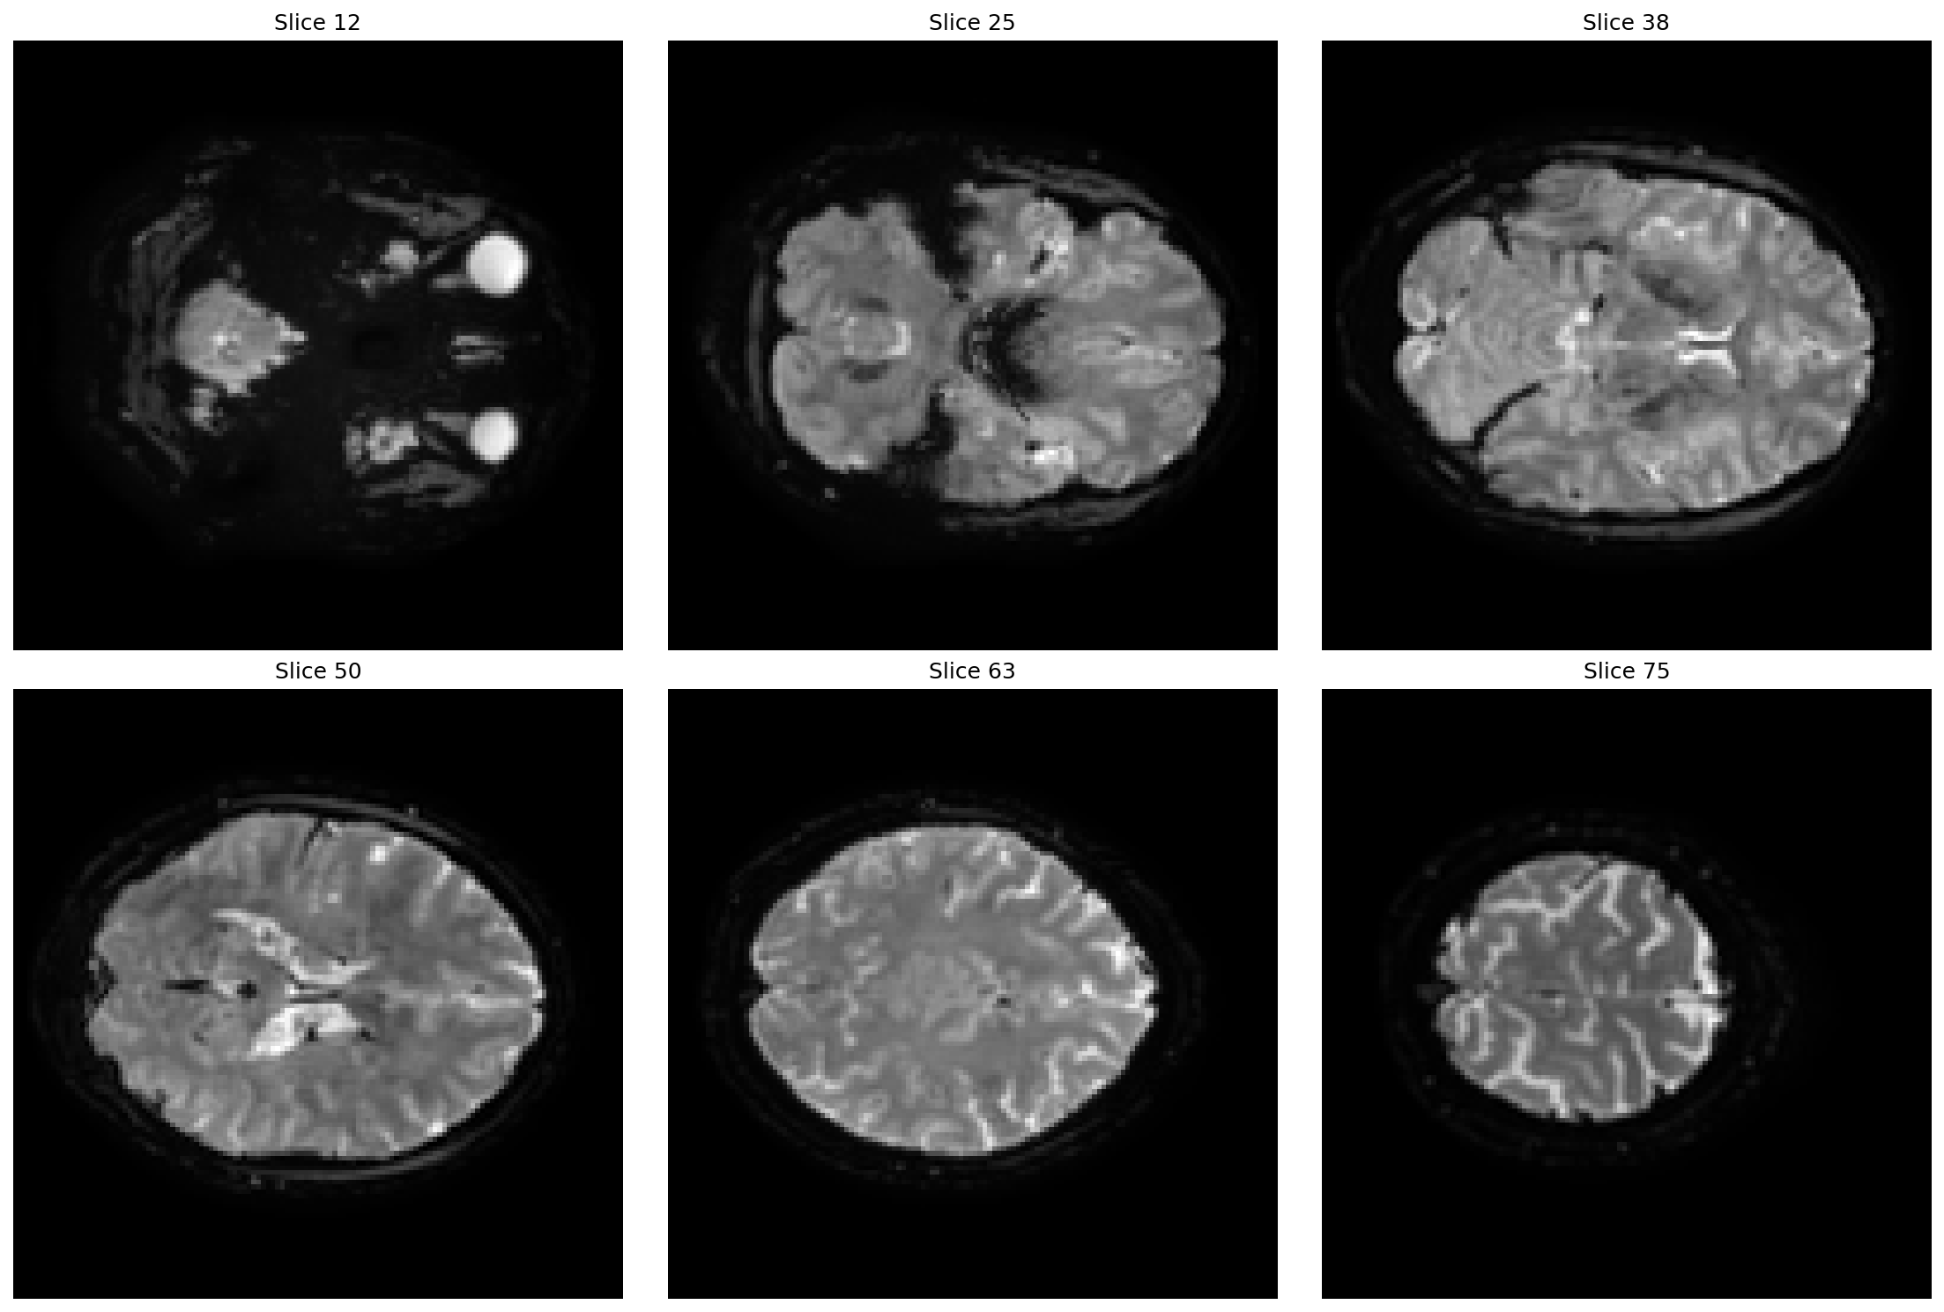
2mm × 1.5mm Resolution Acquisition: Mean Signal Intensity

Slide 15
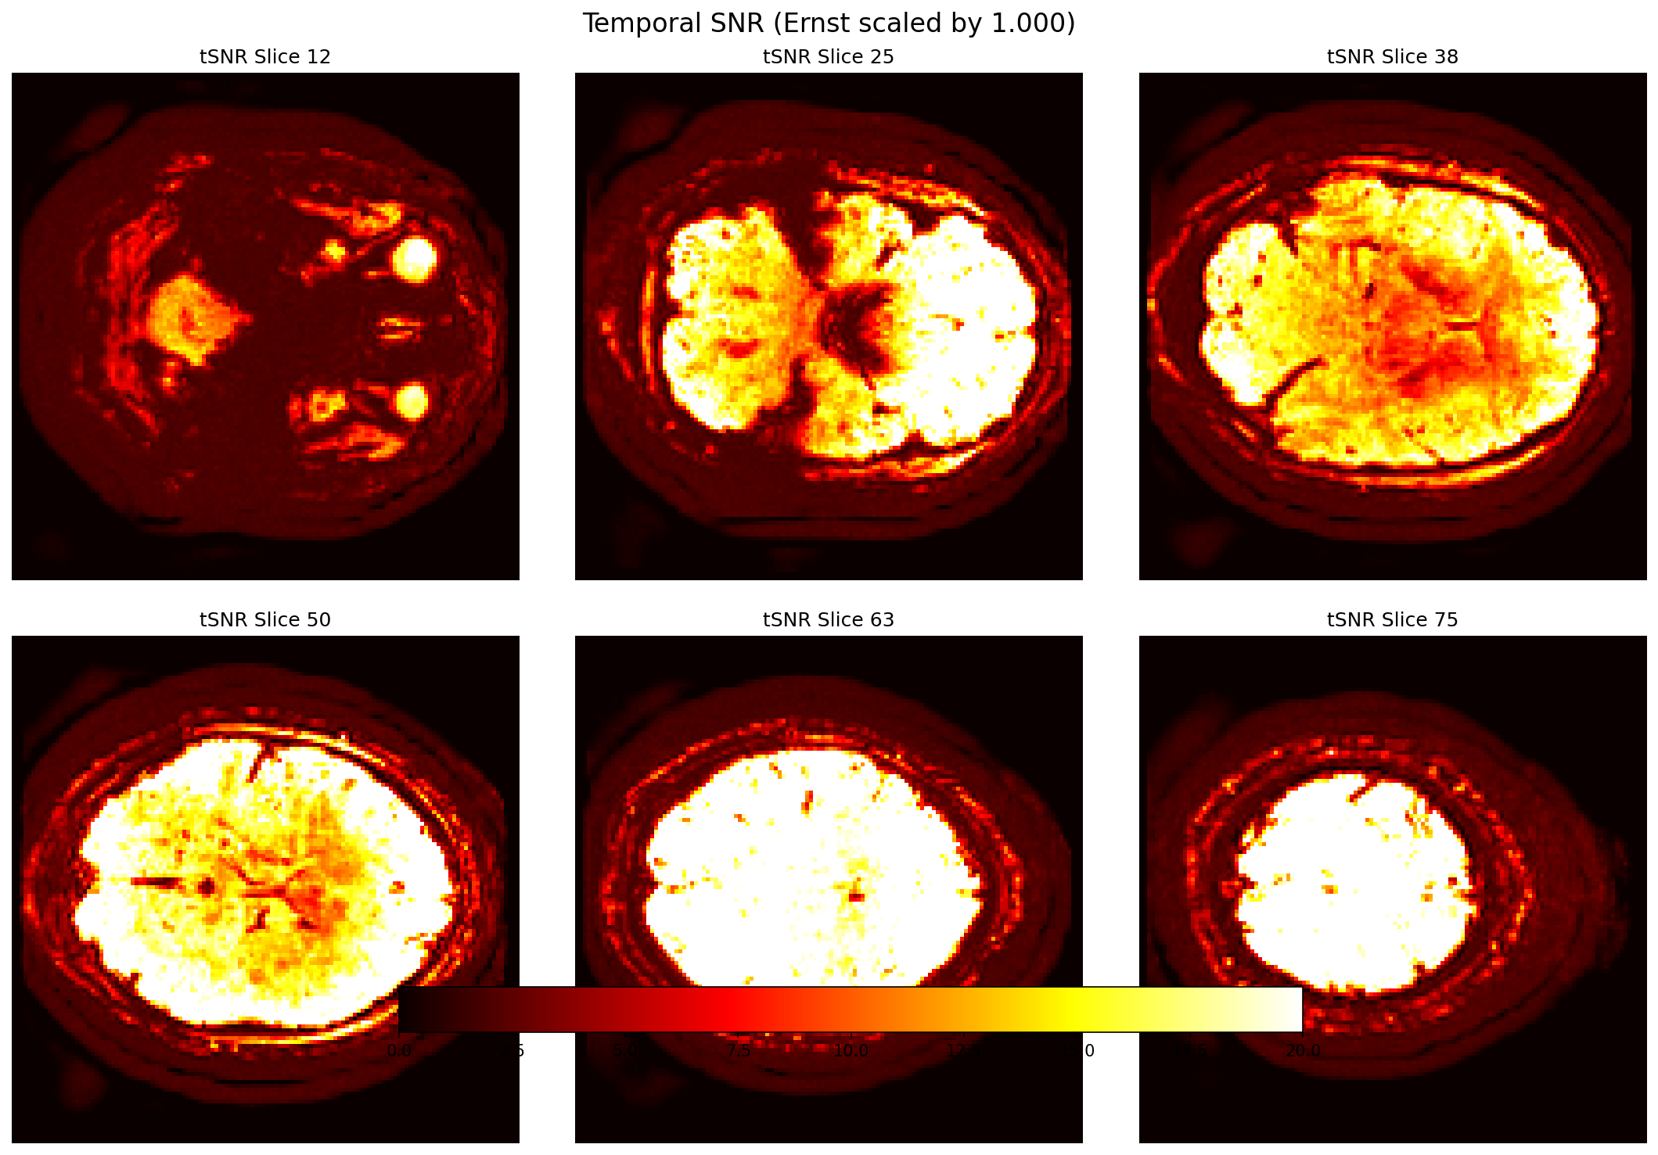
2mm × 1.5mm Resolution Acquisition: Temporal SNR (tSNR)
Mean Temporal SNR: 16.42 (Ernst scaling: 1.000)

Slide 16
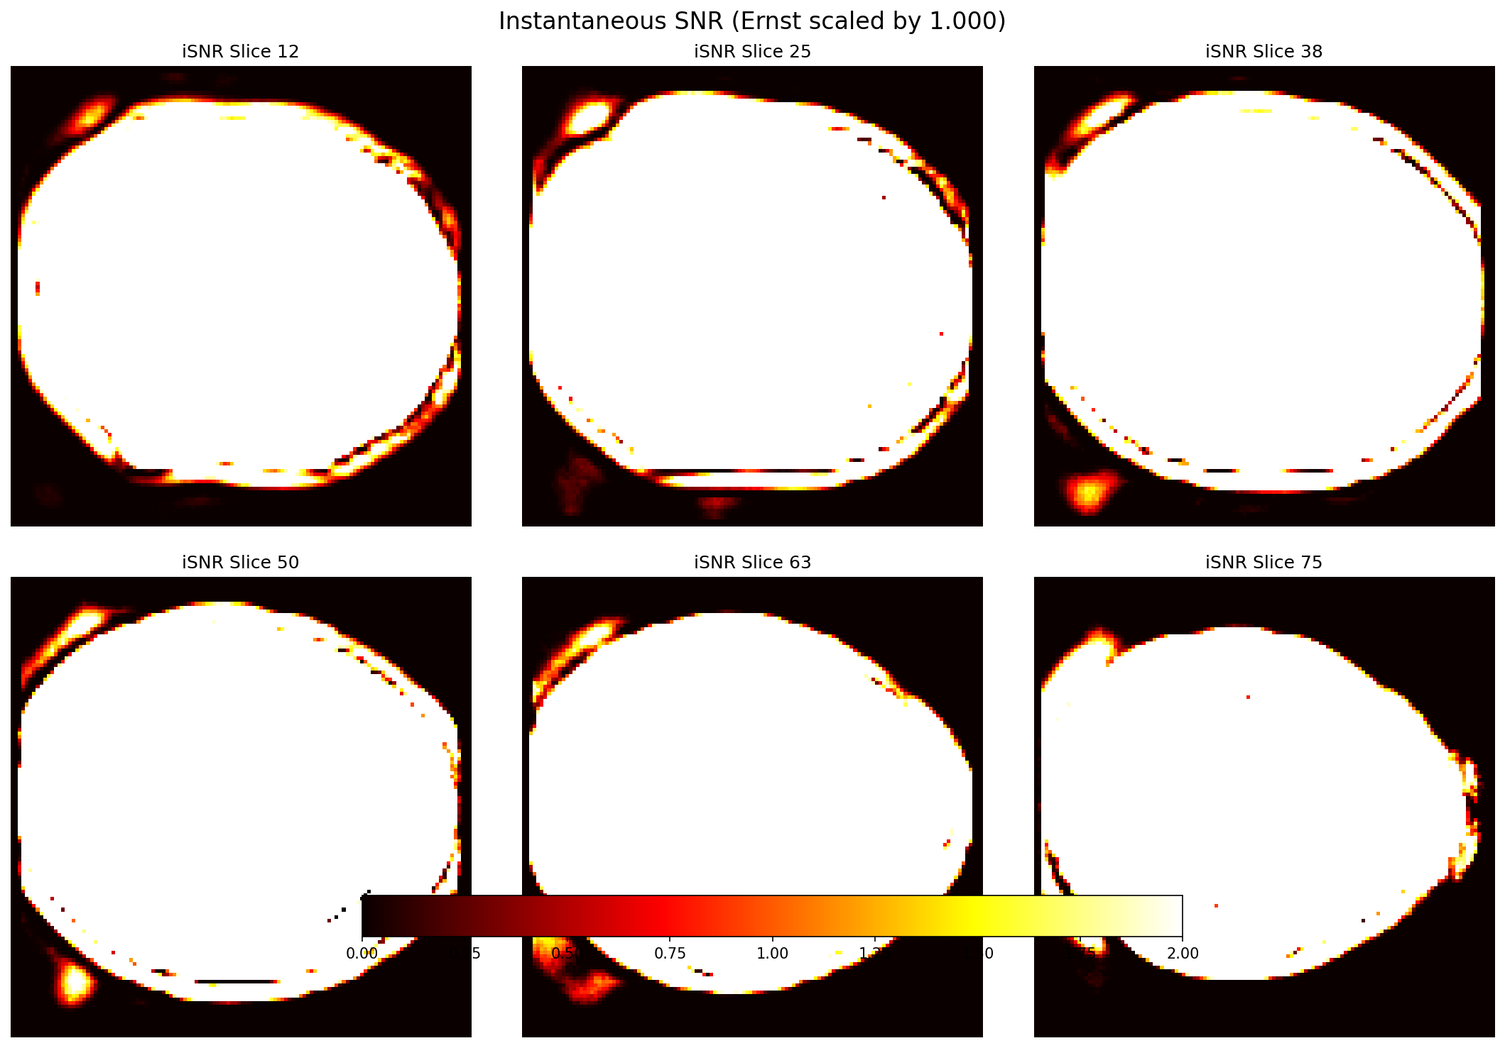
2mm × 1.5mm Resolution Acquisition: Instantaneous SNR (iSNR)
Mean Instantaneous SNR: 3822 (Ernst scaling: 1.000)

Slide 17
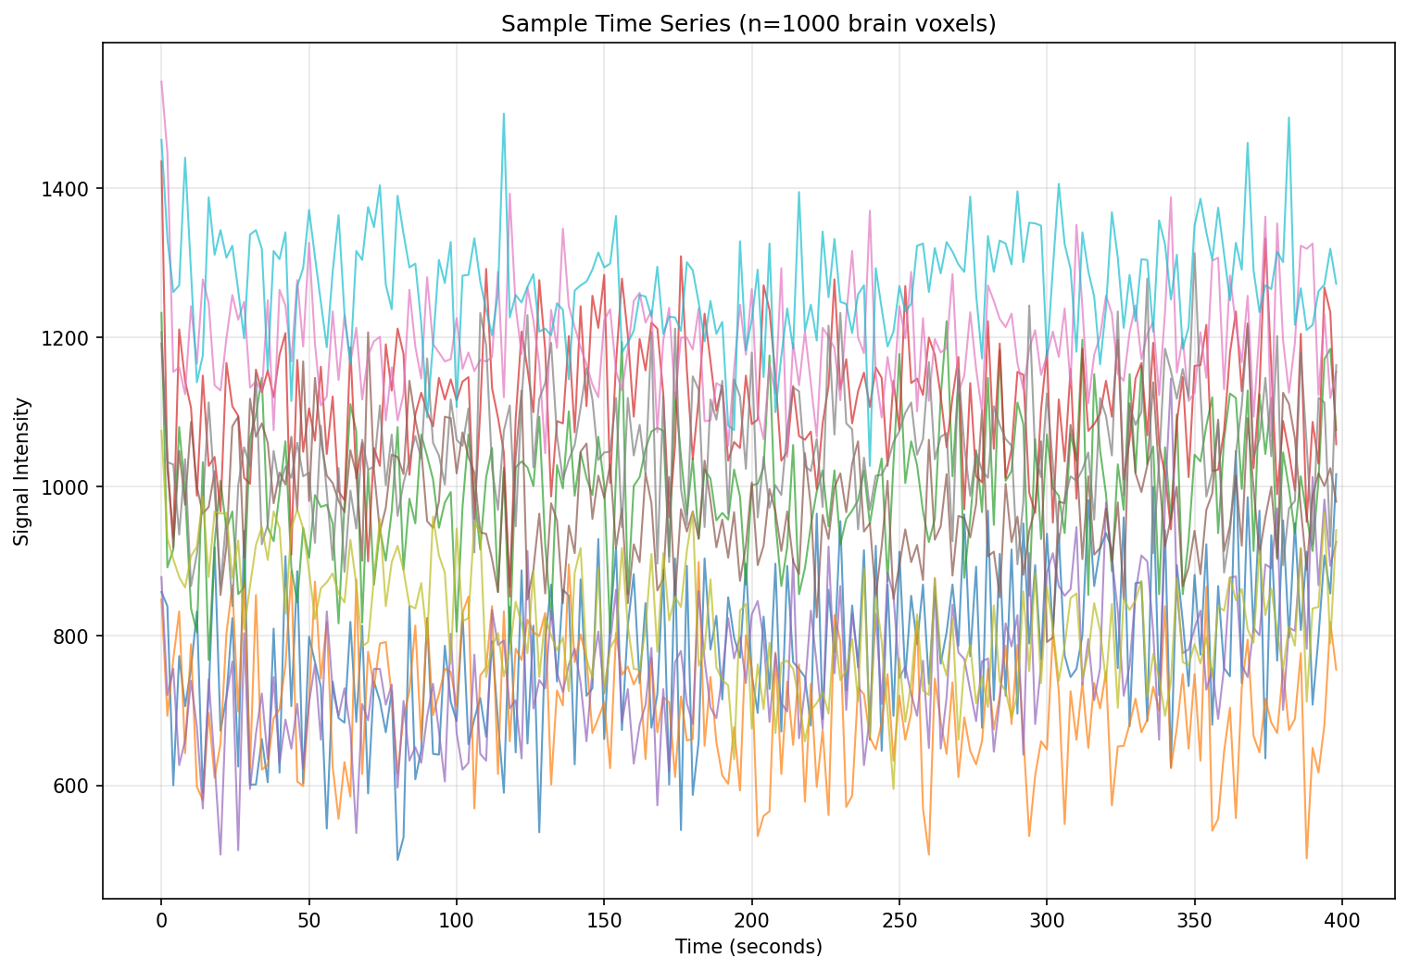
2mm × 1.5mm Resolution Acquisition: Time Series Analysis

