Slide 1
NIFTI Data Visualization Report
(Sub009 - nodummies)

Slide 2
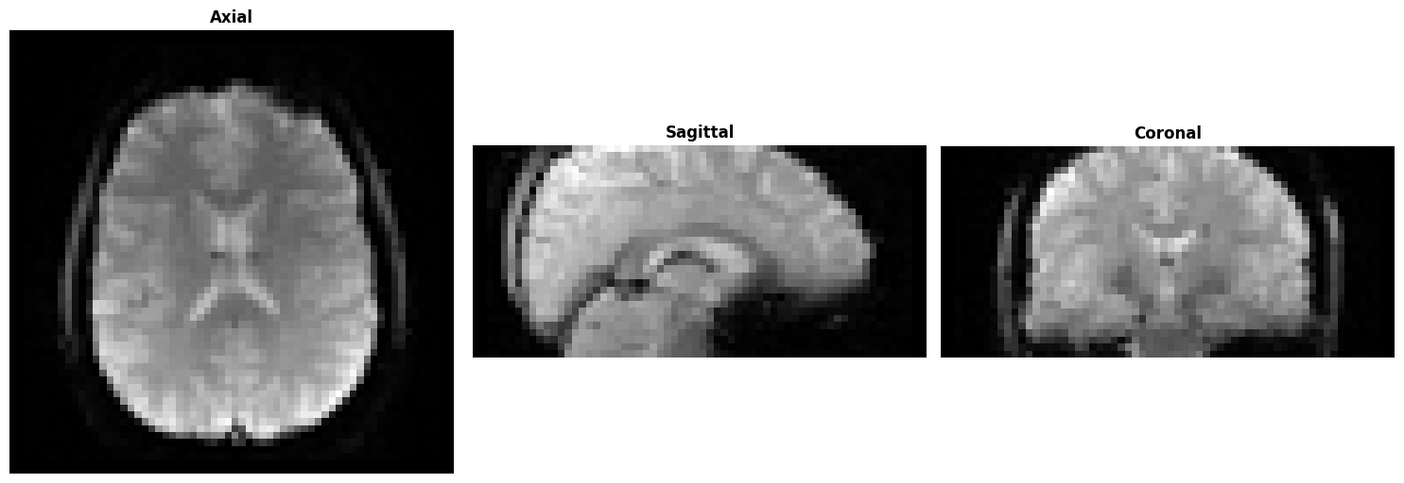
Scan: sub009_10_Sweet_20260130_tsnr_dev_20260130133041_10_I_MB1_As2_epiSPMIC
TR: N/A | Shape: 64 × 64 × 30 × 38

Slide 3
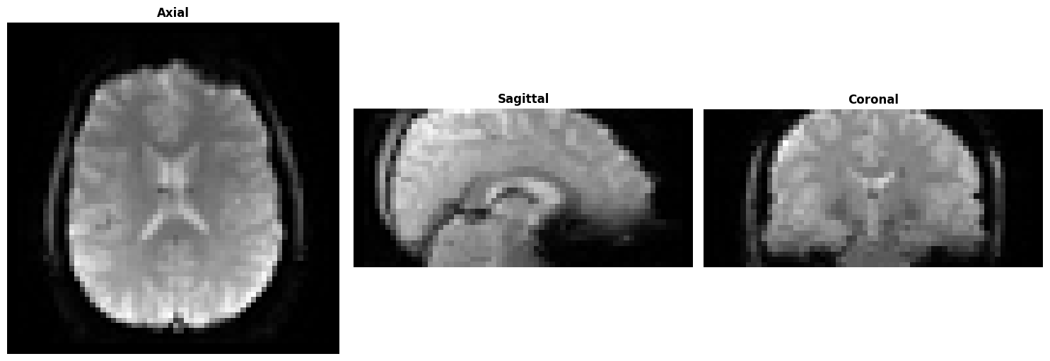
Scan: sub009_11_Sweet_20260130_tsnr_dev_20260130133041_11_J_MB1_noAs_epiSPMIC
TR: N/A | Shape: 64 × 64 × 30 × 38

Slide 4

Scan: sub009_12_Sweet_20260130_tsnr_dev_20260130133041_12_K_MB2_ARC2_epiSPMIC
TR: N/A | Shape: 64 × 64 × 30 × 38

Slide 5
Scan: sub009_12_Sweet_20260130_tsnr_dev_20260130133041_12_K_MB2_ARC2_epiSPMICa
TR: N/A | Shape: 64 × 64 × 30 × 38

Slide 6

Scan: sub009_13_Sweet_20260130_tsnr_dev_20260130133041_13_L_MB2_noARC_epiSPMIC
TR: N/A | Shape: 64 × 64 × 30 × 38

Slide 7
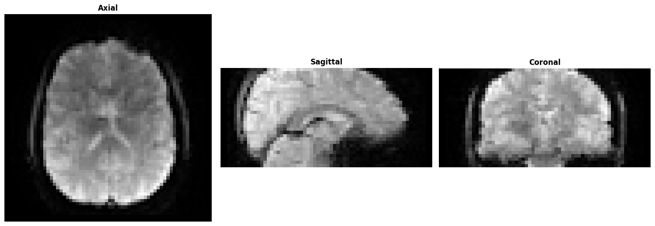
Scan: sub009_14_Sweet_20260130_tsnr_dev_20260130133041_14_M_MB3_ARC2_epiSPMIC
TR: N/A | Shape: 64 × 64 × 30 × 38

Slide 8

Scan: sub009_15_Sweet_20260130_tsnr_dev_20260130133041_15_N_MB3_noARC_epiSPMIC
TR: N/A | Shape: 64 × 64 × 30 × 38

Slide 9

Scan: sub009_16_Sweet_20260130_tsnr_dev_20260130133041_16_O_MB4_ARC2_epiSPMIC
TR: N/A | Shape: 64 × 64 × 30 × 38

Slide 10

Scan: sub009_17_Sweet_20260130_tsnr_dev_20260130133041_17_P_MB4_noARC_epiSPMIC
TR: N/A | Shape: 64 × 64 × 30 × 38

Slide 11

Scan: sub009_18_Sweet_20260130_tsnr_dev_20260130133041_18_Q_MB1_Ass2_epiRT
TR: N/A | Shape: 64 × 64 × 30 × 38

Slide 12

Scan: sub009_19_Sweet_20260130_tsnr_dev_20260130133041_19_R_MB1_noAs_epiRT
TR: N/A | Shape: 64 × 64 × 30 × 38

Slide 13

Scan: sub009_20_Sweet_20260130_tsnr_dev_20260130133041_20_S_MB2_ARC2_epiRT
TR: N/A | Shape: 64 × 64 × 30 × 38

Slide 14

Scan: sub009_21_Sweet_20260130_tsnr_dev_20260130133041_21_T_MB2_noARC_epiRT
TR: N/A | Shape: 64 × 64 × 30 × 38

Slide 15

Scan: sub009_22_Sweet_20260130_tsnr_dev_20260130133041_22_U_MB3_ARC2_epiRT
TR: N/A | Shape: 64 × 64 × 30 × 38

Slide 16

Scan: sub009_23_Sweet_20260130_tsnr_dev_20260130133041_23_V_MB3_noARC_epiRT
TR: N/A | Shape: 64 × 64 × 30 × 38

Slide 17
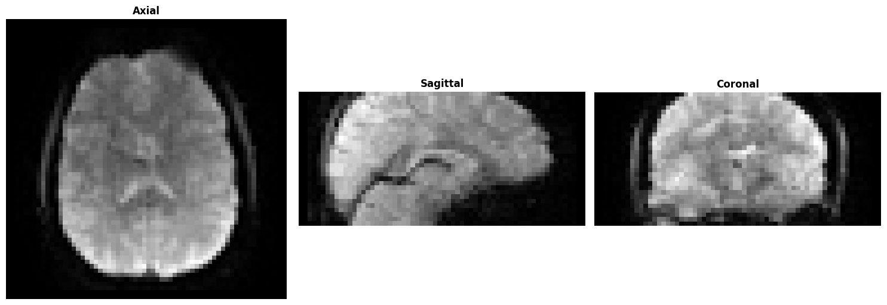
Scan: sub009_24_Sweet_20260130_tsnr_dev_20260130133041_24_W_MB4_ARC2_epiRT
TR: N/A | Shape: 64 × 64 × 30 × 38

Slide 18

Scan: sub009_25_Sweet_20260130_tsnr_dev_20260130133041_25_X_MB4_noARC_epiRT
TR: N/A | Shape: 64 × 64 × 30 × 38

Slide 19

Scan: sub009_26_Sweet_20260130_tsnr_dev_20260130133041_26_I_RF_test_Q2P_MB1_As2_epiSPMIC
TR: N/A | Shape: 64 × 64 × 30 × 38

Slide 20

Scan: sub009_27_Sweet_20260130_tsnr_dev_20260130133041_27_J_RF_test_Q2P_MB1_noAs_epiSPMIC
TR: N/A | Shape: 64 × 64 × 30 × 38

Slide 21

Scan: sub009_28_Sweet_20260130_tsnr_dev_20260130133041_28_K_RF_test_Q2P_MB4_ARC2_epiSPMIC
TR: N/A | Shape: 64 × 64 × 30 × 38

Slide 22

Scan: sub009_29_Sweet_20260130_tsnr_dev_20260130133041_29_L_RF_test_shL_Q2P_MB4_noARC_epiSPMIC
TR: N/A | Shape: 64 × 64 × 30 × 38

Slide 23
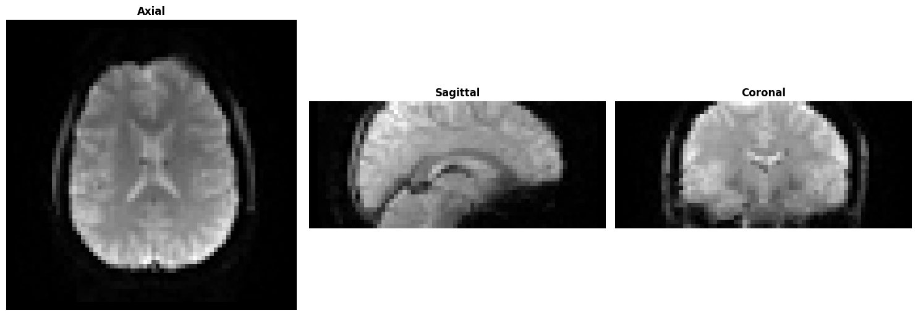
Scan: sub009_2_Sweet_20260130_tsnr_dev_20260130133041_2_A_MB1_As2_epiRTSPMIC
TR: N/A | Shape: 70 × 70 × 30 × 38

Slide 24

Scan: sub009_30_Sweet_20260130_tsnr_dev_20260130133041_30_K_RF_test_shimOFF_MB4_ARC2_epiSPMIC
TR: N/A | Shape: 64 × 64 × 30 × 38

Slide 25

Scan: sub009_31_Sweet_20260130_tsnr_dev_20260130133041_31_K_RF_test_shimOFF_MB4_ARC2_epiSPMIC
TR: N/A | Shape: 64 × 64 × 30 × 38

Slide 26
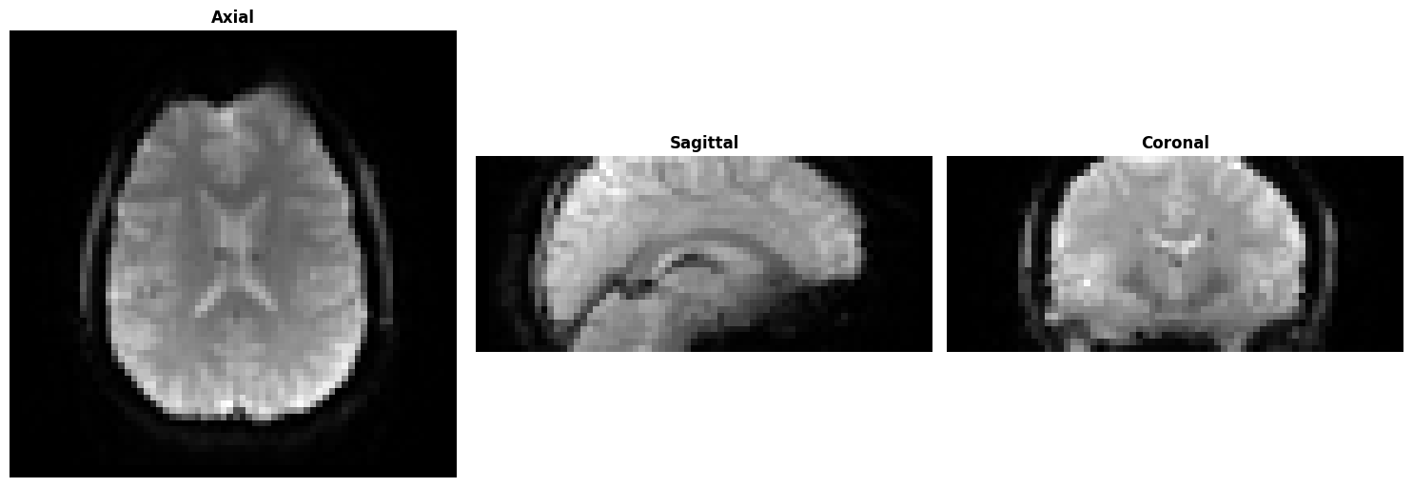
Scan: sub009_3_Sweet_20260130_tsnr_dev_20260130133041_3_B_MB1_noAs_epiRTSPMIC
TR: N/A | Shape: 70 × 70 × 30 × 38

Slide 27
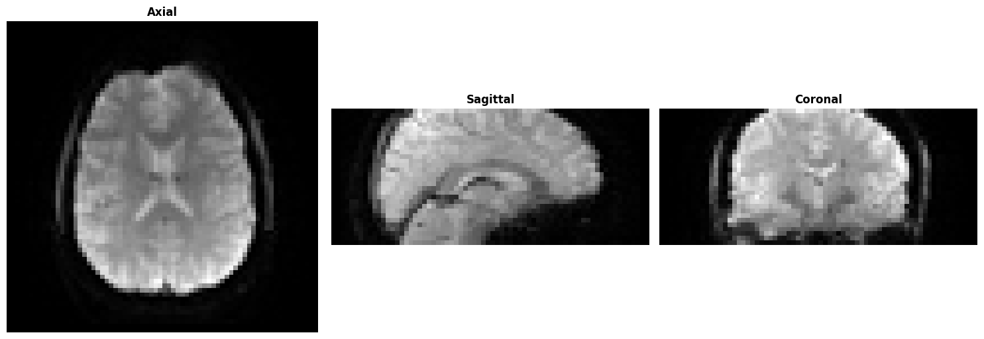
Scan: sub009_4_Sweet_20260130_tsnr_dev_20260130133041_4_C_MB2_As2_epiRTSPMIC
TR: N/A | Shape: 70 × 70 × 30 × 38

Slide 28

Scan: sub009_5_Sweet_20260130_tsnr_dev_20260130133041_5_D_MB2_noAs_epiRTSPMIC
TR: N/A | Shape: 70 × 70 × 30 × 38

Slide 29
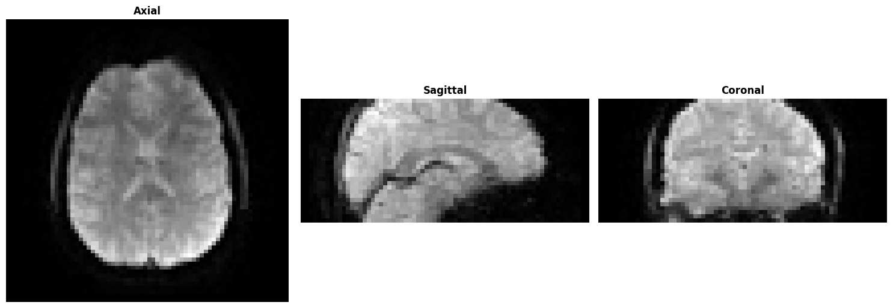
Scan: sub009_6_Sweet_20260130_tsnr_dev_20260130133041_6_E_MB3_ARC2_epiRTSPMIC
TR: N/A | Shape: 70 × 70 × 30 × 38

Slide 30

Scan: sub009_7_Sweet_20260130_tsnr_dev_20260130133041_7_F_MB3_noARC_epiRTSPMIC
TR: N/A | Shape: 70 × 70 × 30 × 38

Slide 31
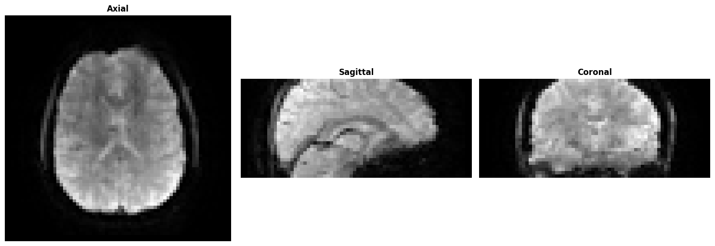
Scan: sub009_8_Sweet_20260130_tsnr_dev_20260130133041_8_G_MB4_ARC2_epiRTSPMIC
TR: N/A | Shape: 70 × 70 × 30 × 38

Slide 32

Scan: sub009_9_Sweet_20260130_tsnr_dev_20260130133041_9_H_MB4_noARC_epiRTSPMIC
TR: N/A | Shape: 70 × 70 × 30 × 38

Slide 33
Scan Metrics Summary
Scan Name | TR (s) | Shape | File
sub009_10_Sweet_20260130_tsnr_dev_202601 | N/A | 64×64×30 | sub009_10_Sweet_20260130_tsnr_
sub009_11_Sweet_20260130_tsnr_dev_202601 | N/A | 64×64×30 | sub009_11_Sweet_20260130_tsnr_
sub009_12_Sweet_20260130_tsnr_dev_202601 | N/A | 64×64×30 | sub009_12_Sweet_20260130_tsnr_
sub009_12_Sweet_20260130_tsnr_dev_202601 | N/A | 64×64×30 | sub009_12_Sweet_20260130_tsnr_
sub009_13_Sweet_20260130_tsnr_dev_202601 | N/A | 64×64×30 | sub009_13_Sweet_20260130_tsnr_
sub009_14_Sweet_20260130_tsnr_dev_202601 | N/A | 64×64×30 | sub009_14_Sweet_20260130_tsnr_
sub009_15_Sweet_20260130_tsnr_dev_202601 | N/A | 64×64×30 | sub009_15_Sweet_20260130_tsnr_
sub009_16_Sweet_20260130_tsnr_dev_202601 | N/A | 64×64×30 | sub009_16_Sweet_20260130_tsnr_
sub009_17_Sweet_20260130_tsnr_dev_202601 | N/A | 64×64×30 | sub009_17_Sweet_20260130_tsnr_
sub009_18_Sweet_20260130_tsnr_dev_202601 | N/A | 64×64×30 | sub009_18_Sweet_20260130_tsnr_
sub009_19_Sweet_20260130_tsnr_dev_202601 | N/A | 64×64×30 | sub009_19_Sweet_20260130_tsnr_
sub009_20_Sweet_20260130_tsnr_dev_202601 | N/A | 64×64×30 | sub009_20_Sweet_20260130_tsnr_
sub009_21_Sweet_20260130_tsnr_dev_202601 | N/A | 64×64×30 | sub009_21_Sweet_20260130_tsnr_
sub009_22_Sweet_20260130_tsnr_dev_202601 | N/A | 64×64×30 | sub009_22_Sweet_20260130_tsnr_
sub009_23_Sweet_20260130_tsnr_dev_202601 | N/A | 64×64×30 | sub009_23_Sweet_20260130_tsnr_
sub009_24_Sweet_20260130_tsnr_dev_202601 | N/A | 64×64×30 | sub009_24_Sweet_20260130_tsnr_
sub009_25_Sweet_20260130_tsnr_dev_202601 | N/A | 64×64×30 | sub009_25_Sweet_20260130_tsnr_
sub009_26_Sweet_20260130_tsnr_dev_202601 | N/A | 64×64×30 | sub009_26_Sweet_20260130_tsnr_
sub009_27_Sweet_20260130_tsnr_dev_202601 | N/A | 64×64×30 | sub009_27_Sweet_20260130_tsnr_
sub009_28_Sweet_20260130_tsnr_dev_202601 | N/A | 64×64×30 | sub009_28_Sweet_20260130_tsnr_
sub009_29_Sweet_20260130_tsnr_dev_202601 | N/A | 64×64×30 | sub009_29_Sweet_20260130_tsnr_
sub009_2_Sweet_20260130_tsnr_dev_2026013 | N/A | 70×70×30 | sub009_2_Sweet_20260130_tsnr_d
sub009_30_Sweet_20260130_tsnr_dev_202601 | N/A | 64×64×30 | sub009_30_Sweet_20260130_tsnr_
sub009_31_Sweet_20260130_tsnr_dev_202601 | N/A | 64×64×30 | sub009_31_Sweet_20260130_tsnr_
sub009_3_Sweet_20260130_tsnr_dev_2026013 | N/A | 70×70×30 | sub009_3_Sweet_20260130_tsnr_d
sub009_4_Sweet_20260130_tsnr_dev_2026013 | N/A | 70×70×30 | sub009_4_Sweet_20260130_tsnr_d
sub009_5_Sweet_20260130_tsnr_dev_2026013 | N/A | 70×70×30 | sub009_5_Sweet_20260130_tsnr_d
sub009_6_Sweet_20260130_tsnr_dev_2026013 | N/A | 70×70×30 | sub009_6_Sweet_20260130_tsnr_d
sub009_7_Sweet_20260130_tsnr_dev_2026013 | N/A | 70×70×30 | sub009_7_Sweet_20260130_tsnr_d
sub009_8_Sweet_20260130_tsnr_dev_2026013 | N/A | 70×70×30 | sub009_8_Sweet_20260130_tsnr_d
sub009_9_Sweet_20260130_tsnr_dev_2026013 | N/A | 70×70×30 | sub009_9_Sweet_20260130_tsnr_d

