Slide 2
SOFTWARE PROCESS
Ing. Svatopluk Štolfa, Ph.D.

Slide 3
Software Process
Software Processes is a coherent set of activities for specifying, designing, implementing and testing software systems
Many different software processes but all involve
Specification – defining what the system should do;
Design and implementation (development) – defining the organization of the system and implementing the system;
Validation – checking that it does what the customer wants;
Evolution – changing the system in response to changing customer needs.

Slide 4
Software Processes
From specific prescriptive steps
that can be used directly by an organization in day-to-day work,
to flexible frameworks
that an organization uses to generate a custom set of steps tailored to the needs of a specific project or group.

Slide 5
General Models
The waterfall approach: This takes the above activities and produces them as separate process phases such as requirements specification, software design, implementation, testing, and so on. After each stage is defined, it is "signed off" and development goes onto the following stage.
Evolutionary development: This method interleaves the activities of specification, development, and validation. An initial system is rapidly developed from a very abstract specification.
Formal transformation: This method is based on producing a formal mathematical system specification and transforming this specification, using mathematical methods to a program. These transformations are 'correctness preserving.' This means that you can be sure that the developed programs meet its specification.
System assembly from reusable components: This method assumes the parts of the system already exist. The system development process target on integrating these parts rather than developing them from scratch.

Slide 6
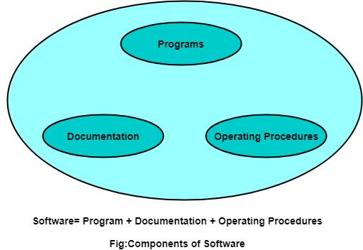
Software vs Program

Slide 7
Software Development Lifecycle Models (SDLC)
One of the basic notions of the software development process is SDLC models
Waterfall
RAD (Rapid Application Development)
Spiral Model
V-Model
Incremental Model
Agile Model
Iterative Model
Big-Bang Model
Prototype Model
DevOps
…

Slide 8
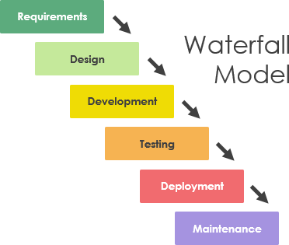
Waterfall Model

Slide 9
Waterfall Model
Linear sequential phases
When to use SDLC Waterfall Model?
Some Circumstances where the use of the Waterfall model is most suited are:
When the requirements are constant and not changed regularly.
A project is short
The situation is calm
Where the tools and technology used is consistent and is not changing
When resources are well prepared and are available to use.

Slide 10
Waterfall Model
+ Advantages of Waterfall model
This model is simple to implement also the number of resources that are required for it is minimal.
The requirements are simple and explicitly declared; they remain unchanged during the entire project development.
The start and end points for each phase is fixed, which makes it easy to cover progress.
The release date for the complete product, as well as its final cost, can be determined before development.
It gives easy to control and clarity for the customer due to a strict reporting system.

Slide 11
Waterfall Model
- Disadvantages of Waterfall model
In this model, the risk factor is higher, so this model is not suitable for more significant and complex projects.
This model cannot accept changes in requirements during development.
It becomes tough to go back to the phase. For example, if the application has now shifted to the coding phase, and there is a change in requirement, It becomes tough to go back and change it.
Since the testing is done at a later stage, it does not allow identifying the challenges and risks in the earlier phase, so the risk reduction strategy is difficult to prepare.

Slide 12
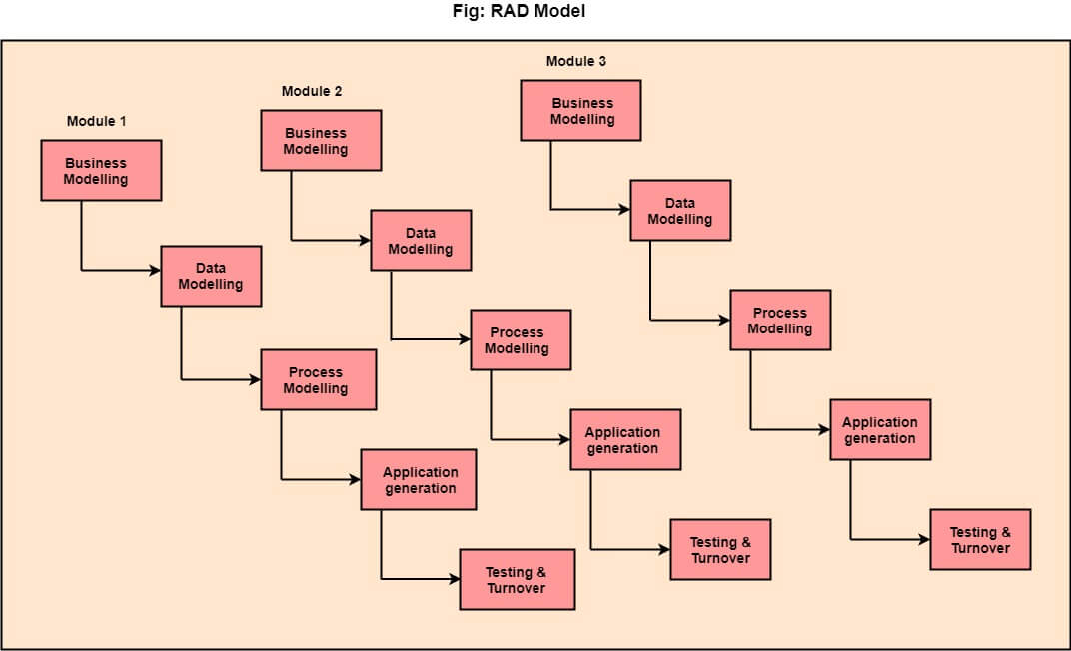
RAD (Rapid Application Development) Model

Slide 13
RAD (Rapid Application Development) Model
Linear sequential software development process model that emphasizes a concise development cycle using an element-based construction approach. If the requirements are well understood and described, and the project scope is a constraint, the RAD process enables a development team to create a fully functional system within a concise time period.
RAD (Rapid Application Development) is a concept that products can be developed faster and of higher quality through:
Gathering requirements using workshops or focus groups
Prototyping and early, reiterative user testing of designs
The re-use of software components
A rigidly paced schedule that refers to design improvements to the next product version
Less formality in reviews and other team communication

Slide 14
RAD (Rapid Application Development) Model
1.Business Modelling: The information flow among business functions is defined by answering questions like what data drives the business process, what data is generated, who generates it, where does the information go, who process it and so on.
2. Data Modelling: The data collected from business modeling is refined into a set of data objects (entities) that are needed to support the business. The attributes (character of each entity) are identified, and the relation between these data objects (entities) is defined.
3. Process Modelling: The information object defined in the data modeling phase are transformed to achieve the data flow necessary to implement a business function. Processing descriptions are created for adding, modifying, deleting, or retrieving a data object.
4. Application Generation: Automated tools are used to facilitate construction of the software; even they use the 4th GL techniques.
5. Testing & Turnover: Many of the programming components have already been tested since RAD emphasis reuse. This reduces the overall testing time. But the new part must be tested, and all interfaces must be fully exercised.

Slide 15
RAD (Rapid Application Development) Model
When to use RAD Model?
When the system should need to create the project that modularizes in a short span time (2-3 months).
When the requirements are well-known.
When the technical risk is limited.
When there's a necessity to make a system, which modularized in 2-3 months of period.
It should be used only if the budget allows the use of automatic code generating tools.

Slide 16
RAD (Rapid Application Development) Model
Advantage of RAD Model
This model is flexible for change.
In this model, changes are adoptable.
Each phase in RAD brings highest priority functionality to the customer.
It reduced development time.
It increases the reusability of features.

Slide 17
RAD (Rapid Application Development) Model
Disadvantage of RAD Model
It required highly skilled designers.
All applications are not compatible with RAD.
For smaller projects, we cannot use the RAD model.
On the high technical risk, it's not suitable.
Required user involvement.

Slide 18
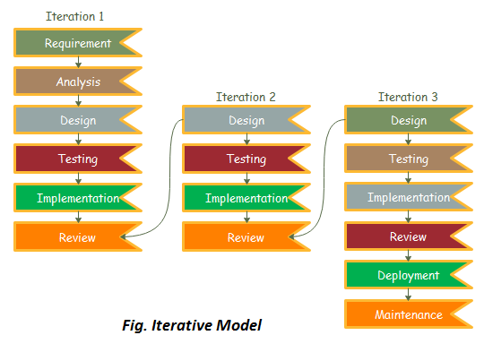
Iterative Model

Slide 19
Iterative Model
In this Model, you can start with some of the software specifications and develop the first version of the software.
After the first version if there is a need to change the software, then a new version of the software is created with a new iteration.
Every release of the Iterative Model finishes in an exact and fixed period that is called iteration.

Slide 20
Iterative Model
The various phases of the Iterative model are as follows:
1. Requirement gathering & analysis: In this phase, requirements are gathered from customers and checked by an analyst whether requirements will be fulfilled or not. The analyst checks whether the need will be achievable within budget or not. After all of this, the software team skips to the next phase.
2. Design: In the design phase, the team designs the software by the different diagrams like a Data Flow diagram, activity diagram, class diagram, state transition diagram, etc.
3. Implementation: In the implementation, requirements are written in the coding language and transformed into computer programmes which are called Software.
4. Testing: After completing the coding phase, software testing starts using different test methods. There are many test methods, but the most common are white box, black box, and grey box test methods.

Slide 21
Iterative Model
The various phases of the Iterative model are as follows:
5. Deployment: After completing all the phases, the software is deployed to its work environment.
6. Review: In this phase, after the product deployment, the review phase is performed to check the behaviour and validity of the developed product. And if there is any error found then the process starts again from the requirement gathering.
7. Maintenance: In the maintenance phase, after deployment of the software in the working environment there may be some bugs, errors or new updates are required. Maintenance involves debugging and new additional options.

Slide 22
Iterative Model
When to use the Iterative Model?
When requirements are defined clearly and easy to understand.
When the software application is large.
When there is a requirement for changes in future.

Slide 23
Iterative Model
Advantages of Iterative Model:
Testing and debugging during smaller iterations is easy.
A Parallel development can plan.
It is easily acceptable to the ever-changing needs of the project.
Risks are identified and resolved during iteration.
Limited time spent on documentation and extra time on designing.

Slide 24
Iterative Model
Disadvantage(Cons) of Iterative Model:
It is not suitable for smaller projects.
More Resources may be required.
Design can be changed again and again because of imperfect requirements.
Requirement changes can cause over budget.
Project completion date not confirmed because of changing requirements.

Slide 25
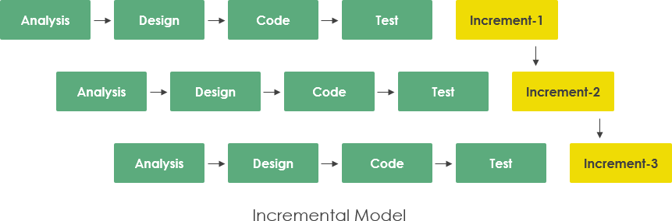
Incremental Model

Slide 26
Incremental Model
Incremental Model is a process of software development where requirements are divided into multiple standalone modules of the software development cycle = waterfall + prototyping
Each module goes through the requirements, design, implementation and testing phases.
Every subsequent release of the module adds a function to the previous release.
The process continues until the complete system is achieved.

Slide 27
Incremental Model
The various phases of the incremental model are as follows:
1. Requirement analysis: In the first phase of the incremental model, the product analysis expertise identifies the requirements. And the system’s functional requirements are understood by the requirement analysis team to develop the software under the incremental model, this phase performs a crucial role.
2. Design & Development: In this phase of the Incremental model of SDLC, the design of the system functionality and the development method are finished with success. When software develops new practicality, the incremental model uses style and development phase.
3. Implementation: The implementation phase enables the coding phase of the development system. It involves the final coding that design in the designing and development phase and tests the functionality in the testing phase. After completion of this phase, the number of the product working is enhanced and upgraded up to the final system product
4. Testing: In the incremental model, the testing phase checks the performance of each existing function as well as additional functionality. In the testing phase, various methods are used to test the behaviour of each task.

Slide 28
Incremental Model
When we use the Incremental Model?
When the requirements are superior.
A project has a lengthy development schedule.
When the software team is not very well skilled or trained.
When the customer demands a quick release of the product.
You can develop prioritized requirements first.

Slide 29
Incremental Model
Advantages of Incremental Model
Errors are easy to be recognized.
Easier to test and debug
More flexible.
Simple to manage risk because it is handled during its iteration.
The Client gets important functionality early.
Disadvantages of Incremental Model
Need for good planning
Total Cost is high.
Well-defined module interfaces are needed.

Slide 30
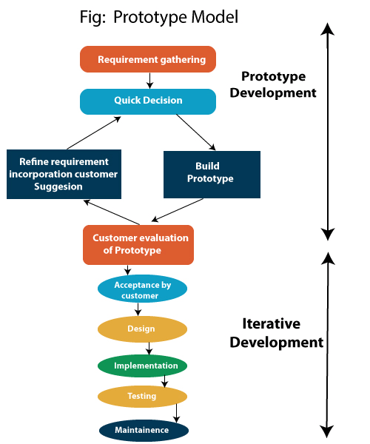
Prototype Model

Slide 31
Prototype Model
Before carrying out the development of actual software, a working prototype of the system should be built.
A prototype is a toy implementation of the system.
A prototype usually turns out to be a very crude version of the actual system, possible exhibiting limited functional capabilities, low reliability, and inefficient performance as compared to the actual software.
In many instances, the client only has a general view of what is expected from the software product. In such a scenario where there is an absence of detailed information regarding the input to the system, the processing needs, and the output requirement, the prototyping model may be employed.

Slide 32
Prototype Model
Steps of Prototype Model
Requirement Gathering and Analyst
Quick Decision
Build a Prototype
Assessment or User Evaluation
Prototype Refinement
Engineer Product

Slide 33
Prototype Model
Advantage of Prototype Model
Reduce the risk of incorrect user requirement
Good where requirements are changing/uncommitted
Regular visible process aids management
Support early product marketing
Reduce Maintenance cost.
Errors can be detected much earlier as the system is made side by side.

Slide 34
Prototype Model
Disadvantage of Prototype Model
An unstable/badly implemented prototype often becomes the final product.
Requires extensive customer collaboration
Costs customer money
Needs committed customer
Difficult to finish if customer withdraw
May be too customer-specific, no broad market
Difficult to know how long the project will last.
Easy to fall back into the code and fix without proper requirement analysis, design, customer evaluation, and feedback.
Prototyping tools are expensive.
Special tools & techniques are required to build a prototype.
It is a time-consuming process.

Slide 35
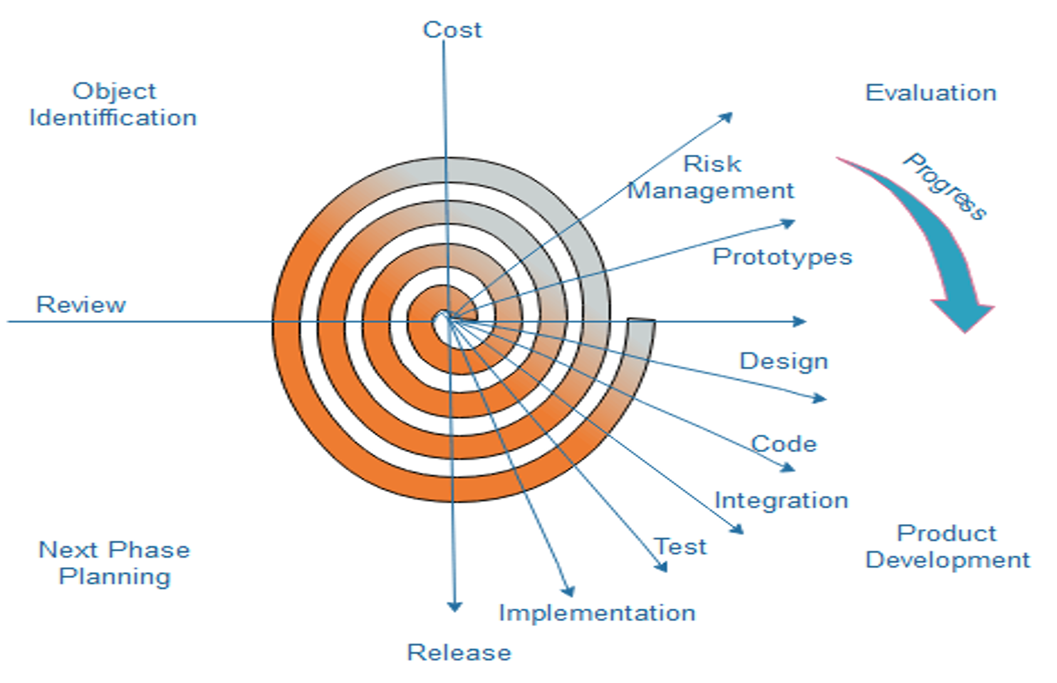
Spiral Model

Slide 36
Spiral Model
Evolutionary software process model that couples the iterative feature of prototyping with the controlled and systematic aspects of the linear sequential model.
It implements the potential for rapid development of new versions of the software.
Using the spiral model, the software is developed in a series of incremental releases.
During the early iterations, the additional release may be a paper model or prototype.
During later iterations, more and more complete versions of the engineered system are produced.

Slide 37
Spiral Model
Each cycle in the spiral is divided into four parts:
Objective setting: Each cycle in the spiral starts with the identification of the purpose for that cycle, the various alternatives that are possible for achieving the targets, and the constraints that exist.
Risk Assessment and reduction: The next phase in the cycle is to calculate these various alternatives based on the goals and constraints. The focus of evaluation in this stage is located on the risk perception for the project.
Development and validation: The next phase is to develop strategies that resolve uncertainties and risks. This process may include activities such as benchmarking, simulation, and prototyping.
Planning: Finally, the next step is planned. The project is reviewed, and a choice is made on whether to continue with a further period of the spiral. If it is determined to keep, plans are drawn up for the next step of the project.

Slide 38
Spiral Model
The development phase depends on the remaining risks.
The risk-driven feature of the spiral model allows it to accommodate any mixture of a specification-oriented, prototype-oriented, simulation-oriented, or another type of approach.
An essential element of the model is that each period of the spiral is completed by a review that includes all the products developed during that cycle, including plans for the next cycle. The spiral model works for development as well as enhancement projects.

Slide 39
Spiral Model
When to use Spiral Model?
When deliverance is required to be frequent.
When the project is large
When requirements are unclear and complex
When changes may require at any time
Large and high budget projects

Slide 40
Spiral Model
Advantages
High amount of risk analysis
Useful for large and mission-critical projects.
Disadvantages
Can be a costly model to use.
Risk analysis needed highly particular expertise
Doesn't work well for smaller projects.

Slide 41
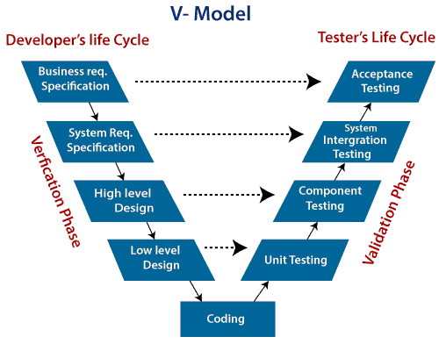
V-Model

Slide 42
V-Model
Verification: It involves a static analysis method (review) done without executing code. It is the process of evaluation of the product development process to find whether specified requirements meet.
Validation: It involves a dynamic analysis method (functional, non-functional), testing is done by executing code. Validation is the process to classify the software after the completion of the development process to determine whether the software meets the customer’s expectations and requirements.

Slide 43
V-Model
There are the various phases of the Verification Phase of the V-model:
Business requirement analysis: This is the first step where product requirements are understood from the customer's side. This phase contains detailed communication to understand customer's expectations and exact requirements.
System Design: In this stage system engineers analyze and interpret the business of the proposed system by studying the user requirements document.
Architecture Design: The baseline in selecting the architecture is that it should understand all which typically consists of the list of modules, brief functionality of each module, their interface relationships, dependencies, database tables, architecture diagrams, technology detail, etc. The integration testing model is carried out in a particular phase.
Module Design: In the module design phase, the system breaks down into small modules. The detailed design of the modules is specified, which is known as Low-Level Design
Coding Phase: After designing, the coding phase is started. Based on the requirements, a suitable programming language is decided. There are some guidelines and standards for coding. Before checking in the repository, the final build is optimized for better performance, and the code goes through many code reviews to check the performance.

Slide 44
V-Model
There are the various phases of Validation Phase of V-model:
Unit Testing: In the V-Model, Unit Test Plans (UTPs) are developed during the module design phase. These UTPs are executed to eliminate errors at code level or unit level. A unit is the smallest entity which can independently exist, e.g., a program module. Unit testing verifies that the smallest entity can function correctly when isolated from the rest of the codes/ units.
Integration Testing: Integration Test Plans are developed during the Architectural Design Phase. These tests verify that groups created and tested independently can coexist and communicate among themselves.
System Testing: System Tests Plans are developed during System Design Phase. Unlike Unit and Integration Test Plans, System Tests Plans are composed by the client?s business team. System Test ensures that expectations from an application developer are met.
Acceptance Testing: Acceptance testing is related to the business requirement analysis part. It includes testing the software product in a user atmosphere. Acceptance tests reveal compatibility problems with the different systems, which are available within the user atmosphere. It conjointly discovers the non-functional problems like load and performance defects within the real user atmosphere.

Slide 45
V-Model
When to use V-Model?
When the requirement is well-defined and not ambiguous.
The V-shaped model should be used for small to medium-sized projects where requirements are clearly defined and fixed.
The V-shaped model should be chosen when sample technical resources are available with essential technical expertise.

Slide 46
V-Model
Advantages of V-Model:
Easy to Understand.
Testing Methods like planning and test designing happen well before coding.
This saves a lot of time. Hence a higher chance of success over the waterfall model.
Avoids the downward flow of the defects.
Works well for small plans where requirements are easily understood.
Disadvantages of V-Model:
Very rigid and least flexible.
Not good for a complex project.
Software is developed during the implementation stage, so no early prototypes of the software are produced.
If any changes happen in the midway, then the test documents along with the required documents have to be updated.

Slide 47
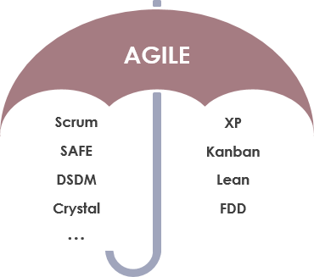
Agile Model

Slide 48
Agile Model
Agile Methods:
Scrum
Crystal
Dynamic Software Development Method(DSDM)
Feature Driven Development(FDD)
Lean Software Development
eXtreme Programming(XP)
…

Slide 49
Agile Model
Scrum
SCRUM is an agile development process focused primarily on ways to manage tasks in team-based development conditions.
There are three roles in it, and their responsibilities are:
Scrum Master: The scrum can set up the master team, arrange the meeting and remove obstacles for the process
Product owner: The product owner makes the product backlog, prioritizes the delay and is responsible for the distribution of functionality on each repetition.
Scrum Team: The team manages its work and organizes the work to complete the sprint or cycle.

Slide 50
Agile Model
eXtreme Programming(XP)
This type of methodology is used when customers are constantly changing demands or requirements, or when they are not sure about the system's performance.
12 principles
Pair programming

Slide 51
Agile Model
Crystal:
There are three concepts of this method-
Chartering: Multi activities are involved in this phase such as making a development team, performing feasibility analysis, developing plans, etc.
Cyclic delivery: under this, two more cycles consist, these are:
Team updates the release plan.
Integrated product delivers to the users.
Wrap up: According to the user environment, this phase performs deployment, and post-deployment.

Slide 52
Agile Model
When to use the Agile Model?
When frequent changes are required.
When a highly qualified and experienced team is available.
When a customer is ready to have a meeting with a software team all the time.
When project size is small.

Slide 53
Agile Model
Advantages of Agile Method:
Frequent Delivery
Face-to-Face Communication with clients.
Efficient design and fulfils the business requirement.
Anytime changes are acceptable.
It reduces total development time.
Disadvantages of Agile Model:
The shortage of formal documents might create confusion and crucial decisions taken throughout various phases can be misinterpreted at any time by different team members.
Due to the lack of proper documentation, once the project completes and the developers are allotted to another project, maintenance of the finished project can become a difficulty.

Slide 54
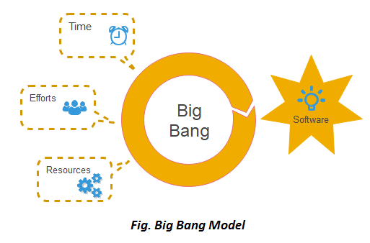
Big Bang Model

Slide 55
Big Bang Model
In this model, developers do not follow any specific process.
Development begins with the necessary funds and efforts in the form of inputs.
And the result may or may not be as per the customer's requirement, because in this model, even the customer requirements are not defined.
This model is ideal for small projects like academic projects or practical projects. One or two developers can work together on this model.

Slide 56
Big Bang Model
When to use Big Bang Model?
Project is small like an academic project or a practical project.
Developer team is small and when requirements are not defined, the release date is not confirmed or given by the customer.

Slide 57
Big Bang Model
Advantages of Big Bang Model:
There is no planning required.
Simple Model.
Few resources are required.
Easy to manage.
Flexible for developers.
Disadvantages of Big Bang Model:
There are high risks and uncertainty.
Not acceptable for a large project.
If requirements are not clear that can cause very expensive.

Slide 58
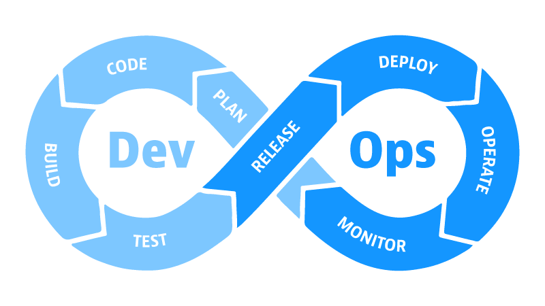
DevOps

Slide 59
DevOps
set of practices that combines software development (Dev) and IT operations (Ops)
aims to shorten the systems development life cycle and provide continuous delivery with high software quality
DevOps is complementary to Agile software development, several DevOps aspects came from the Agile way of working.

Slide 60
DevOps
Automation: Automate everything, such as workflows, testing new code, and how your infrastructure is provisioned to cut down on waste and overwork.
Iteration: Write small chunks of code during a time-box sprint to support releases and sub-releases that increases the speed and frequency of deployments.
Continuous improvement: Continuously test, learn from failures, and act on feedback in order to optimize performance, cost, and time to deployment.
Collaboration: Unite teams, foster communication and breakdown silos between development, IT operations, and quality assurance.

Slide 61
DevOps
Automation: Automate everything, such as workflows, testing new code, and how your infrastructure is provisioned to cut down on waste and overwork.
Iteration: Write small chunks of code during a time-box sprint to support releases and sub-releases that increases the speed and frequency of deployments.
Continuous improvement: Continuously test, learn from failures, and act on feedback in order to optimize performance, cost, and time to deployment.
Collaboration: Unite teams, foster communication and breakdown silos between development, IT operations, and quality assurance.

Slide 62
DevOps
Planning.
This stage is where development and IT operations teams -- along with other stakeholders
determine the set of features desired, accompanied by an iteration value and criteria for each project phase. Developers, system administrators, product management, marketing staff and technical writers all need a seat at the table to collaborate on the development plan.
Project plans should reside in a secure, centralized repository, such as Atlassian Jira or Confluence. And every team member should have access to the project plans at any time from any place.

Slide 63
DevOps
Code and build
Some teams treat code and build as separate phases. Determine what works best for your organization. Don't be afraid to iterate on these elements of your DevOps process, depending on staffing availability and other project factors.
In the code phase, developers perform their assigned coding work. When they complete their tasks, they check their work into a centralized source code repository, such as GitLab or GitHub, which must serve as the single source of truth for code.
The build phase entails software code retrieval from the centralized repository through an automated tool like Chef or Puppet. This automation tool compiles the software code into a binary artifact, executes functional tests and publishes the artifact into a shared centralized repository.

Slide 64
DevOps
Continuous integration
Continuous integration is a practice through which development teams merge code into a central repository. Organizations automate tasks like code reviews, validation and testing.

Slide 65
DevOps
Testing
DevOps testing balances on smart automation -- but it won't replace the human testers on the software development team.
Automation enables developers to achieve continuous testing via tools such as Selenium or JUnit to test multiple codebases in parallel.
An automated testing strategy ensures that there are no flaws in an application's functionality.

Slide 66
DevOps
Continuous deployment
DevOps eliminates the all-hands-on-deck manual process at the end of the development cycle.
Instead, with continuous deployment, every code change goes through the entire pipeline and into production automatically.
An organization can schedule as many deployments per day as it needs, based on the requirements and velocity of its team.

Slide 67
DevOps
Operations.
IT admins manage software during production.
Tools such as Ansible, Puppet, PowerShell, Chef, Salt and Otter provide the necessary management and data collection capabilities, as well as operational views into production applications.

Slide 68
DevOps
Continuous monitoring.
Development and operations teams should continually monitor their production applications. All groups need a view into the application's health.
Additionally, install collaboration and communication channels to alert all teams to production issues as they occur.
Popular monitoring tools for this phase include New Relic, Datadog, Grafana, Wireshark, Splunk and Nagios.

Slide 69
DevOps
Advantages of DevOps
Its focus on collaboration, automation, and agility can have significant benefits, including:
Faster time to market
Higher ROI
Greater user/customer satisfaction
Increased efficiency
Improved collaboration
Early detection and correction of issues

Slide 70
DevOps
Disadvantages of DevOps
Highly volatile feature implementation – not suitable for all applications
Agile development
Continuous integration/deployment might be not suitable for applications with a safety, security, and reliability focus

Slide 71
References
https://www.javatpoint.com/
https://www.visual-paradigm.com/guide/software-development-process/what-is-a-software-process-model/

Slide 72
The Rational Unified Process
The Rational Unified Process® (RUP) is a Software Engineering Process. It provides a disciplined approach to assigning tasks and responsibilities within a development organization. Its goal is to ensure the production of high-quality software that meets the needs of its end-users, within a predictable schedule and budget.
RUP is a process product. It is developed and maintained by Rational Software and integrated with its suite of software development tools available from IBM.
RUP is a process framework that can be adapted and extended to suit the needs of an adopting organization.
RUP captures many of best practices mentioned before (develop software iteratively, manage requirements, use component-based architectures, visually model software, continuously verify software quality, control changes to software).

Slide 73
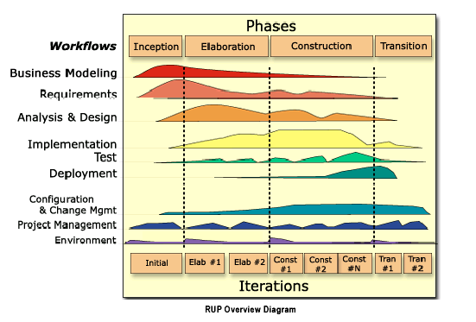
Two Dimensions of the Process
Dynamic aspect of the process as it is enacted: it is expressed in terms of cycles, phases, iterations, and milestones – organization along time
Static aspect of the process: how it is described in terms of activities, artifacts, workers and workflows – organization along content

Slide 74
Process Description
Static structure of the process describes who is doing what, how, and when. The RUP is represented using following primary elements:
Roles: the who
Activities: the how
Artifact: the what
Workflow: the when
A discipline is the collection of above mentioned kinds of elements.

Slide 75
Roles
Role defines the behavior and responsibilities of an individual (designer, analyst, programmer ...), or a group of individuals working together as a team.
The behavior is expressed in terms of activities the role performs, and each role is associated with a set of cohesive activities.
The responsibilities of each role are usually expressed in relation to certain artifact that the role creates, modifies, or control.
Roles are not individuals, nor job titles. One can play several roles in process.

Slide 76
Activities
An activity is a unit of work that an individual in that role may be asked to perform and that produces a meaningful result in the context of the project.
The granularity of an activity may vary from hours to days. It usually involves one person in the associated role and affects one or only small number of artifacts.
Activities may be repeated several times on the same artifact, especially from one iteration to another.

Slide 77
Artifacts
Artifacts are things that are produced, modified, or used by a process (model, document, source code, executables …).
Deliverables are only the subset of other artifacts.
Artifacts are very likely to be subject to version control and configuration management.
Sets of Artifacts:
Management set – planning and operational artifacts
Requirements set – the vision document and requirements in the form of stakeholders’ needs
Design set – the design model and architecture description
Implementation set – the source code and executables, the associated data files
Deployment set – installation instructions, user documentation, and training material

Slide 78
Major Artifacts
Stakeholder Requests
Vision
Business Case
Risk List
Supplementary
Specification
Software Development
Plan
Glossary
Software Architecture
Document
Deployment
Plan
Use-Case
Model
Test
Plan
Software
Requirements
Specification
Product
Analysis
Model
Design
Model
Implementation
Model

Slide 79
Resources, Roles and Activities
Object
design
Architectural
analysis
Architectural
design
Coding
Activities
Architectural
Board
Designer
Programmer
Roles
Resources
Richard
John
Mary
Laura

Slide 80
Workflows
Workflows are sequences of activities that produce results of observable value (business modeling, implementation …).
Core Workflow gives the overall flow of activities for each discipline.
Workflow Details show roles, activities they perform, input artifacts they need, and output artifacts they produce.
Iteration Plan is time-sequenced set of activities and tasks, with assigned resources, and containing task dependencies. A fine-grained plan, one per iteration.

Slide 81
Example of a Core Workflow
[New system]
[Existing System]
[New Input]
[Can’t Do All
the Work]
Workflow Detail
Analyze the
Problem
Understand
Stakeholder Needs
[Incorrect
Problem]
[Addressing Correct Problem]
Manage Changing
Requirements
Define the System
Manage the Scope
of the System
[Work in Scope]
Refine the
System Definition

Slide 82
Iterative Development
Given today’s sophisticated software systems, it is not possible to sequentially first define the entire problem, design the entire solution, build the software and then test the product at the end.
An iterative approach is required that allows an increasing understanding of the problem through successive refinements, and to incrementally grow an effective solution over multiple iterations.
Each iteration ends with an executable release.

Slide 83
The Sequential Process
Many engineering problems are solved using a sequential process:
Understand the problem, its requirements and constraints
Design a solution that satisfies all requirements
Implement the solution using the best engineering techniques
Verify that the implementation satisfies the started requirements
Deliver: Problem solved!
This works perfectly in the area of civil and mechanical engineering where design and construction is based on hundreds of years of experience.
The sequential process is based on two wrong assumptions that jeopardize the success of software projects:
Requirements will be frozen (user changes, problem changes, underlying technology changes, market changes …)
We can get the design right on paper before proceeding (underlying “theories” are week and poorly understood in software engineering, relatively straightforward laws of physics underlie the design of bridge, but there is no strict equivalent in software design – software is “soft”)

Slide 84
Iterative Lifecycle
Requirements
Design
Implementation
R
Testing
D
R
I
D
R
T
D
R
I
I
D
T
T
I
T
Time

Slide 85
Phases and Milestones
The development cycle is divided in four consecutive phases:
Inception: a good idea is developed into a vision of the end product and the business case for the product is presented.
Elaboration: most of the product requirements are specified and the system architecture is designed.
Construction: the product is built – completed software is added to the skeleton (architecture)
Transition: the product is moved to user community (beta testing, training …)
Inception
Elaboration
Construction
Transition
Time
Lifecycle
Objective
Milestone
Lifecycle
Architecture
Milestone
Initial Operation
Capability
Milestone
Product
Release
Milestone

Slide 86
Development Cycle
Each cycle results in a new release of the system, and each is a product ready for delivery. This product has to accommodate the specified needs.
Initial development cycle – a software product is created
Evolution cycles – a product evolves into its next generation by repetition of the sequences of inception, elaboration, construction, and transition phases.
Cycles may overlap slightly: the inception and elaboration phase may begin during the final part of the transition phase of the previous cycle.
I
10%
E
30%
C
50%
T
10%
Typical time line for initial development cycles

Slide 87
Phases and Iterations
Each phase can be further broken down into iterations. An iteration is a complete development loop resulting in a release (internal or external) of an executable product, a subset of the final product under development, which grows incrementally from iteration to iteration to become the final system.
Scope and Business Case agreement
Architecture baselined
Product sufficiently mature for customers to use
Acceptance
or end of life
LCO
LCA
IOC
PR
Inception
Elaboration
Construction
Transition
Time
Preliminary
Iteration
Architecture
Iteration
Architecture
Iteration
Developm.
Iteration
Developm.
Iteration
Developm.
Iteration
Transit.
Iteration
Transit.
Iteration
Internal
Release
Minor Milestone
First External Release (e.g. beta)
Final Release

Slide 88
Duration of an Iteration
An iteration starts with planning and requirements and finishes with an internal or external release.
Ideal duration of an iteration is from two to six weeks, depending on your project size and complexity.
Factors that affect duration of an iteration:
Size, stability and maturity of organization
Familiarity with the iterative process
Size of project
Technical simplicity of project
Level of automation used to manage code, distribute information, perform testing

Slide 89
Number of Iterations
Phase | Low | Medium | High
Inception | 0 | 1 | 1
Elaboration | 1 | 2 | 3
Construction | 1 | 2 | 3
Transition | 1 | 1 | 2
Total | 3 | 6 | 9
“Normal” project has 6 ± 3 iteration.

Slide 90
Conditions that Increase Number of Iterations
Inception - working with new functionality, unknown business environment, highly volatile scope, make-buy decisions …
Elaboration - working with new system environment (new architectural features), untested architectural elements, need for system prototypes …
Construction - lots of code to write and verify, new technology or development tools …
Transition - need for alphas and betas, conversions of customer database, incremental delivery to customers …

Slide 91
Inception Phase: Objectives
Establish project scope and boundary conditions, including operational concepts, and acceptance criteria
Determine the critical use cases and primary scenarios of behavior that drive the system functionality
Demonstrate at least one candidate architecture against some of the primary scenarios
Estimate the overall cost and schedule for the entire project
Identify potential risks (the sources of unpredictability)
Prepare the supporting environment for the project

Slide 92
Milestone: Lifecycle Objective (LCO)
Stakeholder concurrence on scope definition and cost and schedule estimates
Agreement that the right set of requirements has been captured and that there is a shared understanding of these requirements
Credibility of the cost and schedule estimates, priorities, risks, and development process
All risks have been identified and a mitigation strategy exists for each
Actual expenditures versus planned expenditures

Slide 93
Elaboration Phase: Objectives
Define, validate and baseline the architecture as rapidly as is practical
Baseline the vision
Baseline a high-fidelity plan for the construction phase
Refine support environment
Demonstrate that the baseline architecture will support the vision at a reasonable cost in a reasonable time
A baseline is a reviewed and approved release of artifacts that constitutes and agreed-on basis for further evolution or development and that can be changed only through a formal procedure.

Slide 94
Milestone: Lifecycle Architecture (LCA)
Product vision and requirements are stable.
Architecture is stable.
The executable demonstration show that the major risks have been addressed and resolved.
Iteration plans for Construction phase is sufficiently detailed to allow work to proceed, and are supported by credible estimates.
All stakeholders agree that current vision can be achieved if the current plan is executed to develop the complete system, in the context of the current architecture.
Actual resource expenditures versus planned expenditures are acceptable.

Slide 95
Construction Phase: Objectives
Complete the software product for transition to user
Minimize development costs by optimizing resources and avoiding unnecessary scrap and rework
Achieve adequate quality as rapidly as is practical
Achieve useful versions (alpha, beta, and other test releases) as rapidly as possible

Slide 96
Milestone: Initial Operational Capability (IOC)
The product release is stable and mature enough to be deployed in the user community.
All the stakeholders are ready for the product’s transition into the user community.
The actual resource expenditures versus planned are still acceptable.

Slide 97
Transition Phase: Objectives
Achieve user self-supportability
Achieve stakeholder concurrence that deployment baselines are complete and consistent with the evaluation criteria of the vision
Achieve final product baseline as rapidly and cost-effectively as practical

Slide 98
Milestone: Product Release (PR)
The user is satisfied.
Actual resources expenditures versus planned expenditures are acceptable.

Slide 99
Benefits of an Iterative Approach
Risk Mitigation – an iterative process lets developers mitigate risks earlier than a sequential process where the final integration is the only time that risks are discovered or addressed.
Accommodating Changes – an iterative process lets developers take into account requirements, tactical and technological changes continuously.
Learning as You Go – an advantage of the iterative process is that developers can learn along the way, and the various competencies and specialties are employed during the entire lifecycle.
Increased Opportunity for Reuse – an iterative process facilitates reuse of project elements because it is easy to identify common parts as they are partially design and implemented instead of identifying all commonality in the beginning.
Better Overall Quality – the system has been tested several times, improving the quality of testing. The requirements have been refined and are related more closely to the user real needs. At the time of delivery, the system has been running longer.

Slide 100
Architecture-Centric Development
A large part of RUP focuses on modeling. Models help developers understand and shape both the problem and the solution.
Model is a simplification of reality that help us master a large, complex system that cannot be comprehended easily in its entirety. The model is not the reality, but the best models are the ones that stick very close to reality.
Multiple models are needed to address different aspects of the reality. These models must be coordinated to ensure that they are consistent and not too reduntant.

Slide 101
Architecture
Models are complete, consistent representation of the system to be built. These models of complex system can be very large!
Architecture is the skeleton: “Architecture is what remains when you cannot take away any more things and still understand the system and explain how it works.”
Definition: Architecture is the fundamental organization of a system, embodied in its components, their relationships to each other and the environment, and the principles governing its design and evolution.*
* ANSI/IEEE Std 1471-2000, Recommended Practice for Architectural Description of Software-Intensive Systems

Slide 102
Definition of Architecture (RUP)
An architecture is the set of significant decisions about the organization of a software system, the selection of the structural elements and their interfaces by which the system is composed, together with their behavior as specified in the collaborations among those elements, the composition of these structural and behavioral elements into progressively larger subsystems, and the architectural style that guides this organization, these elements and their interfaces, their collaborations, and their composition
Architecture is part of design; it is about making decisions about how system will be built. But it is not all of design. It stops at the major elements – the elements that have a pervasive and long-lasting effect on the qualities of the system.
Architecture is about structure and organization but it also deals with behavior.
Architecture does not look only inward but it also looks at the fit of the system in two contexts: the operational and development. It encompasses not only technical aspects but also its economic and sociological aspects.
Architecture also addresses “soft” issues such as style and aesthetics.

Slide 103
Architecture Representation
The representation of architecture should allow various stakeholders to communicate and discuss the architecture.
The various stakeholders have different concerns and are interested in different aspects of architecture.
Architectural view – simplified description (an abstraction) of a system from particular perspectives (e.g.):
Logical organization of the system
Functionality of the system
Concurrency aspects
Physical distribution of the software on the underlying platform

Slide 104
4+1 View Model of Architecture
Logical View
An abstraction of the
design model that identifies
major design packages,
subsystems and classes
Implementation
View
An organization of static
software modules (source
code, data files, components,
executables, and others …)
Use-Case View
Key use-case and
scenarios
Process View
A description of the concurrent
aspects of the system at
runtime - tasks, threads, or
processes as well as
their interactions
Deployment View
Various executables and
other runtime components
are mapped to the underlying
platforms or computing
nodes

Slide 105
Models and Architectural Views
Models provide complete representation of the system, whereas an architectural view focuses only what is architecturally significant - an architectural view is an abstraction of a model.
Architecturally significant elements include following:
Major classes that model major business entities
Architectural mechanisms that enable persistency and communication
Patterns and frameworks
Layers and subsystems
Interfaces
Major processes, or threads of control
Use-case model
Logical View
Implementation
View
Implementation
model
Design model
Use-Case View
Process View
Deployment
View
Deployment model

Slide 106
Primary Architectural Artifacts
Software Architecture Document (SAD) represents comprehensive overview of the architecture of the software system. It includes the following:
Architectural Views
Requirements and constraints
Size and performance characteristics
Quality, extensibility, and portability targets
The architectural prototype, which is used to validate the architecture (tested via architecturally significant use cases) and which serves as the baseline for the rest of development.

Slide 107
Component-Based Development
A component is a nontrivial, relatively independent, and replaceable part of a system that fulfills a clear function in the context of a well-defined architecture. A component conforms to and provides the realization of a set of interfaces.
Kinds of components:
Application-specific
Business-specific
Middleware
System software

Slide 108
Use-Case-Driven Development
A use case is a sequence of actions a system performs that yields a result of observable value to a particular actor.
An actor is someone or something outside the system that interacts with the system.
Withdraw Money
Customer
Bank System
Check Balance

Slide 109
Use Case
A system functionality is defined by a set of use cases, each of which represents a specific sequence of actions (flow of events).
The use-case flow of events expresses the behavior of the system in a black box view of the system, whereas a use-case realization is the white box view that shows how the use case is actually performed in terms of interaction objects.
A use case is initiated by an actor to invoke a certain functionality in the system.
All use cases constitute all possible ways of using the system.

Slide 110
Scenarios
A scenario is an unique sequence of actions (thread) through a use case – one path through use case.
A scenario is an instance of the use case – using object technology: use case is a class, whereas scenario is the instance of this class.
Obviously, each use case can have many instances (scenarios)
ATM example: one scenario exhibits correct money withdrawal, another scenario show how the process of money withdrawal is canceled because of insufficient balance etc.

Slide 111
Actor
Actors are not part of the system. They represent roles a user of the system can play.
An actor can actively interchange information with the system:
An actor can be a passive recipient of information.
An actor can be a provider of information.
An actor can represent a human, a machine or another system.

Slide 112
Use-Case Model
Use-case model consists of the set of all uses cases together with the set of actors that interact with these use cases. It provides a model of the system intended functions, and can serve as a contract between the customer and the developers.
Use-case model is represented by UML use-case diagrams and activity diagrams to visualize use cases.

Slide 113
Disciplines Produce and Share Models
Business
Modeling
Requirements
Analysis &
Design
Implementation
Test
Business
Use-Case Model
Use-Case
Model
Design
Model
Implementation
Model
Test Suite
Business
Domain Model
Use-Case
Model
Design
Model
Implementation
Model
Use cases defined for a system are the basis for the entire development process.
Business
Process Model
Design
Model

Slide 114
Use Cases in the Process
The use-case model is a result of the requirements discipline. It captures what the system should do from user point of view.
In analysis and design use cases serve as the basis for use case realizations that describe how the use case is performed in terms of interacting objects in design model. All the required behavior is represented in the system design.
Because use cases are the basis for the design model and the design model is the implementation specification, they are implemented in terms of design classes.
During testing, use cases define the basis for identifying test cases and procedures.

Slide 115
Process Disciplines
Business Modeling Requirements Analysis and Design Implementation Testing Deployment Project Management Configuration and Change Management Environment

Slide 116
Disciplines and Artifacts Evolution
B | R | A | I | T | D | P | C | E
Inception
B | R | A | I | T | D | P | C | E
Elaboration
B | R | A | I | T | D | P | C | E
B | R | A | I | T | D | P | C | E
Time
Construction
Transition

Slide 117
Business Modeling
The main goal of the business process modeling is to provide common language for communities of software and business engineers.
The goals are the following:
To understand problems in target organization and identify potential improvements
To ensure customer and end user have common understanding of target organization
To derive system requirements to support target organization
To understand structure and dynamics of organization in which system is to be deployed

Slide 118
Business Modeling and Software Development
Business Modeling acts as:
Input to Requirements
Business Use-Case Model and Business Process Model help to understand the requirements of the system and identify system use cases.
Input to Analysis & Design
Business entities from the Business Domain Model help to identify entity classes in the Analysis Model.

Slide 119
Workflow
[Early Inception]
Assess Business
Status
[Business
Modeling]
[Domain
Modeling
Only]
Identify Business
Processes
Refine Business
Process Definitions
Describe Current
Business
Explore Process
Automation
Develop Domain
Model
Design Business
Process Realizations
Refine Roles and
Responsibilities

Slide 120
Workflow Details
Assess Business Status – the common business vocabulary is captured and target organization is assessed.
Describe Current Business – the business model of the current business processes is built in case that reengineering or improving of those processes is needed.
Identify Business Processes – key business goals are identified as well as business processes. Business architecture is defined.
Refine Business Process Definitions – the business use cases are represented in form of structured business use-case models.
Design Business Process Realizations – complete business model is built. Business workers and entities are identified in class diagrams. Realizations of business processes are described and specified (e.g. in form of activity diagrams).
Refine Roles and Responsibilities – business workers and entities are detailed and business model is reviewed.
Explore Process Automation – the way how the business processes can be automated is discovered and described.
Develop Domain Model – in case that there is no need of full-scale business model only domain model is built.

Slide 121
Roles
Business-Process Analyst leads and coordinates business modeling by outlining the organization being modeled. Business-Process Analyst establishes the business vision, he/she identifies business actors and use case and their interaction.
Business Designer details the specification of business use cases. Business Designer completes the business model that specifies all business processes, workers, and entities.
Stakeholders provide all necessary input information and reviews.
Business Reviewer reviews the resulting artifacts.

Slide 122
Key Artifacts
Business Vision Document defines the objectives and business goals of the business modeling effort.
Business Use-Case Model specifies business functions – business processes. Sometimes this model is called as a process map.
Business Domain Model is the object model that describes business workers and entities and their relationships.
Business Process Model shows the realization of the business use-cases. It shows how the business processes are executed.

Slide 123
Requirements
The main goal of the requirements discipline is to describe what the system should do by specifying its functionality. Requirements modeling allows the developers and the customer to agree on that description.
The goals of the requirements discipline are following:
To establish and maintain agreement with the customers and other stakeholders on what the system should do and why
To provide system developers with a better understanding of the system requirements
To define the boundaries of the system
To provide a basis for planning the technical contents of iterations
To provide a basis for estimating cost and time to develop the system
To define a user-interface for the system, focusing on the needs of the users

Slide 124
Types of Requirements
Functional Requirements (behavioral) are used to express the behavior of a system by specifying both the input and output conditions that are expected to result.
Supplementary Requirements (nonfunctional) exhibits quality attributes:
Usability addresses human factors like aesthetic, easy learning, easy of use, and so on
Reliability addresses frequency and severity of failure, recoverability, and accuracy.
Performance deals with quantities like transaction rate, speed, response time, and so on.
Supportability addresses how difficult is to maintain the system and other qualities required to keep the system up-to-date after its release.

Slide 125
Workflow
[Existing System]
[New System]
[New Input]
Analyze the
Problem
Understand
Stakeholder
Needs
[Incorrect
Problem]
[Addressing
Correct
Problem]
Manage Changing
Requirements
Define the
System
Manage the Scope
of the System
[Can’t Do
All the Work]
[Work in
Scope]
Refine the
System Definition

Slide 126
Workflow Details
Analyze the Problem – the agreement on a statement of the addressed problem is captured. Stakeholders, boundaries and constraints of the system are identified.
Understand Stakeholder Needs – stakeholders requests and clear understanding of the user needs are gathered.
Define the System – the system features required by stakeholders are established. Actors and use cases of the system are identified for each key features.
Manage the Scope of the System – the vision is developed, functional and nonfunctional requirements are collected, the use cases are prioritized so the system can be delivered on expected time and budget.
Refine the System Definition – use cases are detailed as well as the software requirements.
Manage Changing Requirements – the central control authority is employed to control change to the requirements, the agreement with the customer is maintained.

Slide 127
Roles
System Analyst leads and coordinates requirement elicitation and use-case modeling by outlining the system functionality.
Requirements Specifier details all or parts of the system functionality. The goal is to coordinate requirements with other specifiers. System Analyst and Requirement Specifier work closely with the User Interface Designer.
Software Architect ensures the integrity of the architecturally significant use cases.
Requirement Reviewer verifies that the requirements are perceived and interpreted correctly by the development team.

Slide 128
Key Artifacts
Stakeholder Requests are elicited and gathered to get a “wish list”.
Vision Document contains key needs and features of the system. It supports the contract between the funding authority and the development organization.
Use-Cases Model is built to serve as a contract among customers, users and system developers on the system functionality.
Supplementary Specification is a complement to Use-Case Model, because together they capture all software functional and nonfunctional requirements – complete Software Requirements Specification.
Glossary defines a common terminology that is used across the project.
Storyboards associated with use cases serve as the basis for user interface prototypes.

Slide 129
Analysis & Design
The main goal of the analysis & design discipline is to show how the system will be realized in the implementation phase.
The purpose of analysis and design is as follows:
To translate the requirements into a specification that describes how to implement the system
To establish robust architecture so that you can design a system that is easy to understand, build, and evolve

Slide 130
Analysis versus Design
Analysis focuses on ensuring that the system functional requirements are handled. It ignores many of nonfunctional requirements of the system and also abstracts from the implementation environment.
Design further refines the analysis model in light of the actual implementation environment, performance requirements, and so on. It focuses on optimizing the system design while ensuring complete requirements coverage - the complete behavior of a use cases are allocated to collaborating classes.

Slide 131
Workflow
[Early Elaboration
Iteration]
[Inception Iteration
(Optional)]
Define a Candidate
Architecture
Perform Architectural
Synthesis
Refine the
Architecture
Analyze Behavior
[Optional]
Design
Components
Design the
Database

Slide 132
Workflow Details
Define a Candidate Architecture – initial sketch of the architecture of the system is defined.
Perform Architectural Synthesis – architectural proof-of-concept is constructed and its validity is assessed.
Refine the Architecture – new design elements identified for the current iteration are integrated with preexisting elements. The consistency and integrity of the architecture is maintained.
Analyze Behavior – behavioral descriptions specified by the use cases are transformed into the set of elements on which the design can be based. User interfaces are designed and prototyped.
Design Components – classes, interfaces and their relationship as well as their organization into packages and subsystem are specified.
Design the Database – the persistent classes are identified and appropriate database structure to store them is designed. The mechanism for storing and retrieving persistent data is specified. This workflow detail is optional.

Slide 133
Roles
Software Architect leads and coordinates technical activities and artifacts. Software Architect establishes the overall structure for each architectural view including the decomposition of the view, the grouping of elements, and the interfaces between the major grouping.
Designer defines the responsibilities, operations, attributes, and relationships of classes.
Database Designer deals with all issues related to database design.
Architecture and Design Reviewer reviews the key artifacts produced through this workflow.

Slide 134
Key Artifacts
Software Architecture Document captures various architectural views of the system.
Analysis Model provides a rough sketch of the system. It is the abstraction, or the generalization of the design where the implementation dimension is omitted.
Design Model consists of a set of collaborating elements that provide the behavior of the system. This behavior is derived primarily from the use-case model. It consists of classes, which are aggregated into packages (logical grouping of classes) and subsystems (package that act as a single unit to provide specific behavior).
User Interface Design and Prototype deals with the visual shaping of the user interface so that it handles various requirements.

Slide 135
Implementation
The goal of the implementation workflow is to flesh out the designed architecture and the system as a whole.
The implementation discipline has following four purposes:
To implement classes and objects in terms of components and source code
To define the organization of the components in terms of implementation subsystems
To test the developed components as units
To integrate produced units to create an executable system

Slide 136
Builds, Integration, and Prototypes
Build is an operational version of a system or part of a system that demonstrates a subset of the capabilities to be provided in the final product.
Integration refers to a software development activity in which separate software components are combined into a whole.
Prototypes help to build support for the product be showing something concrete and executables to the users, customers, and managers. In many cases prototypes may evolve to the real product. There are the following types of prototype:
Behavioral Prototypes show what the system will do as seen by the users (the “skin”).
Structural Prototypes show the infrastructure of the ultimate system (the “bones”).
Exploratory Prototypes are designed to test a key assumptions that involves functionality or technology or both. Behavioral prototypes tend to be exploratory prototypes.
Evolutionary Prototypes evolve from one iteration to the next. Their code tends to be reworked as the product evolves. Structural prototypes tend to be evolutionary prototypes.

Slide 137
Workflow
Structure the
Implementation Model
Plan the
Integration
[More Components
to Implement
for this Iteration]
Implement
Components
[Components
Implemented and Validated]
[Done]
[More Subsystem Integration
for this Iteration]
Integrate Each
Subsystem
[Subsystems
Implemented and Validated]
[Done]
Integrate the
System
[More System
Builds for this Iteration]
[Done]

Slide 138
Workflow Details
Structure the Implementation Model – the goal is to ensure that the implementation model is properly structured to make development of components conflict-free as possible.
Plan the Integration - which subsystem is going to be implemented, and the order in which the subsystems should be integrated is planned.
Implement Components – components are implemented, analyzed and tested. The plan for their integration into subsystems is prepared.
Integrate Each Subsystem – the subsystems are integrated, developer tests implemented and executed.
Integrate the System – the whole system is integrated.

Slide 139
Roles
Implementer develops the components and all related artifacts and performs unit testing.
Integrator constructs a build.
Software Architect defines the structure of the implementation model including layering and subsystems.
Code Reviewer inspects the code for required quality and conformance to the project standards.

Slide 140
Key Artifacts
Implementation Elements – pieces of the software code like source, binary a executable components as well as various data files (configuration, readme etc.).
Implementation Subsystem – a collection of implementation elements and other implementation subsystems.
Integration Build Plan – a document that defines the order in which the elements and subsystems are built.

Slide 141
Testing
The goal of testing is to evaluate product quality and to find and expose the weakness in the software product.
Testing employs the following core practices
Find and document defects in the software product
Advise management about perceived software quality
Prove the validity of the assumptions made in design and requirement specifications through concrete demonstration
Validate the software product functions as designed
Validate that the requirements are implemented appropriately

Slide 142
Quality Dimension of Testing
The following aspects are generally assessed
Reliability – the software should perform predictably and consistently (no crashing, hanging, memory leaks …)
Functionality – the software should execute required use cases or desired behavior as intended
Performance – the software should execute and response in a timely manner
Usability – the software is suitable for use by its end users.

Slide 143
Levels of Testing
Unit Testing – the smallest testable elements of the system are tested, typically at the same time that those elements are implemented
Integration Testing – the integrated units, components or subsystems are tested
System Testing – the complete application or system (one or more applications) are tested
Acceptance Testing – the complete system is tested by end users to determine readiness for deployment

Slide 144
Regression Testing
Regression testing is a test strategy in which previously executed tests are reexecuted against a new version of the target-of-test to ensure that the quality of the target has not moved back (regressed) when new capabilities have been added.
Purposes of regression testing are following
The defects identified in the previous execution of test have been addressed
The changes made to the code have not caused new or already appeared defects

Slide 145
Workflow
Define Evaluation
Mission
[Another Technique]
Verify Test
Approach
Validate Build
Stability
Test and
Evaluate
Achieve Acceptable
Mission
Improve Test Assets
[Another Test Cycle]

Slide 146
Workflow Details
Define Evaluation Mission – the purpose is to identify appropriate focus of the test effort for the given iteration and to gain agreement with stakeholders on the corresponding goals.
Verify Test Approach – various techniques that will facilitate the planned tests are verified.
Validate Build Stability – the build is tested from point of view of its stability required for the execution of detailed tests.
Test and Evaluate – the process of implementation, execution, and evaluation of specific tests is realized. The corresponding reports of encountered problems are issued.
Achieve Acceptable Mission – the useful evaluation results are delivered to stakeholders. These results are assessed in terms of evaluation mission set up at the beginning.
Improve Test Assets - various test assets like test ideas list, test cases, test data, test scripts etc. are maintained and improved.

Slide 147
Roles
Test Manager is responsible for the testing process. He/She deals with efforts like resource planning and management, resolution of issues and so on.
Test Analyst identifies and defines the required tests, monitors testing progress and results.
Test Designer is responsible for defining the test approach and ensuring its implementation.
Tester executes the system tests. This effort includes activities like setting up and execution of tests, assessment the results, and logging change requests.

Slide 148
Key Artifacts
Test Plan contains schedule of testing effort. It identifies the strategies to be used and the resources necessary to implement and execute testing.
Test Cases specify tests, its conditions for execution and associated Test Data.
Test Scripts are manual or automated procedures needed for the tests execution. These Test Scripts may be assembled into Test Suites.
Test Log is raw data captured during the execution of Test Suites.
Test Results represent filtered output from Test Logs. Test Evaluation Summary is produced as part of the project iteration assessment.

Slide 149
Deployment
The goal is to manage the activities associated with ensuring that the software product is available for its end users
The following types of activities are involved
Testing at the installation and target sites
Packaging the software for delivery
Deployment in custom-built systems
Deployment of shrink-wrapped software
Deployment of software that is downloadable over the Internet
Creating end-user supporting materials
Creating user training materials
Migrating existing software or converting databases

Slide 150
Workflow
Plan Deployment
[Change Requests]
Develop Support
Material
Manage Acceptance Test
(At Development Site)
[Approved]
Produce
Deployment Unit
[Beta Release]
[Customer Release]
Beta Test
Product
[Downloadable Software]
[Custom
Install]
[Shrinkwrap Product]
Manage Acceptance Test
(at Installation Site)
Package Product
Provide Access to
Download Site

Slide 151
Workflow Details
Plan Deployment – deployment plan is developed and bill materials are defined. Deployment plan requires a high degree of customer collaboration and preparation.
Develop Support Material – training and support (installation, maintenance, usage etc.) materials are developed.
Produce Deployment Unit – deployment unit that consists of the software and other artifacts required for successful installation are created.
Manage Acceptance Test (at Development Site) – acceptance testing is executed and evaluated before the software is installed at the target site.
Manage Acceptance Test (at Installation Site) – installation and testing at the target site using actual target hardware is realized.
Beta Test Product – beta testing requires the delivered software to be installed by the end user. Feedback is provided by the user community.
Package Product – optional activities needed to produce “packaged software” product are carried out.
Provide Access to Download Site – the hardware and software infrastructure is developed to enable software product download.

Slide 152
Roles
Deployment Manager plans and organizes deployment. He/She is responsible for beta test feedback program and that the product is packaged and shipped appropriately.
Project Manager is responsible for approving deployment and for the customer acceptance of delivery.
Technical Writer plans and produces end-user support and training material.
Graphic Artist is responsible for all product-related artwork.
Tester runs the acceptance tests.
Implementer creates installation scripts and related artifacts.

Slide 153
Key Artifacts
Executable Software in all cases.
Installation artifacts: scripts, tools, files, guides, licensing information.
Release Notes, describing the main features of the release for the end user.
Support Materials, such as user, operations and maintenance manuals.
Training Materials.
Bill of Materials is complete list of items to be included in the product.
Product Artwork helps with product branding and identification.

Slide 154
Project Management
Software project management is the art of balancing competing objectives, managing risk, and overcoming constraints to deliver a product that meets the needs of the customers (the ones who pay bills) and the end users.
The following three purposes are related to project management
To provide a framework for managing software-intensive projects
To provide practical guidelines for planning, staffing, executing, and monitoring projects
To Provide a framework for managing risk

Slide 155
The Concept of Risk
An ongoing or upcoming concern that has a significant probability of adversely affecting the success of major milestones.
Technical/Architectural risks - unproven technology, uncertain scope, …
Resource risks - people, skills, funding
Business risks - competition, return of investments, supplier interfaces
Schedule risks - project dependencies, only 24 hours in a day

Slide 156
Risk Reduction
Tim Lister: All the risk-free projects have been done.
Early iterations should address the risks of highest magnitude.
Risk assessment is a continuous process; risks change over time.
An updated Risk List is input to the activity Plan for Next Iteration.

Slide 157
The Concept of Measurement
The measurement is used to evaluate how close or far is the project from the plan objectives in terms of completeness, quality, and compliance with requirements.
Completeness - measurements derived under this aspect, either through audits or raw data, are useful in determining the overall completeness status of the project
Quality – measurements describe the state of the product based on the type, number, rate, and severity of defects found and fixed during the course of product development
Measurement is a key technique used to control projects!

Slide 158
Workflow
[Start of Project Only]
[All Subsequent Iterations]
Conceive
New Project
Plan for
Next Iteration
Manage
Iteration
[Project
Canceled]
Canceled
Project
[Iteration
Successful]
Evaluate Project
Scope and Risk
Evaluate Project
Scope and Risk
Plan the
Project
[Initial
Iteration in
Inception]
[Project
End]
[Phase
End]
Close Out
Project
Close Out
Phase
Monitor and Control
Project
[Iteration
End]
[Project
Canceled]
[Project
Complete]
[Project
Canceled]
[Failed
Acceptance]
[Phase
Complete]
Canceled
Project
End
Project
Canceled
Project
Plan for
Next Iteration
Plan the
Project
End Iteration

Slide 159
Workflow Details
Conceive New Project – the project is elaborated from the initial idea to a point at which a reasoned decision can be made to continue or abandon the project.
Evaluate Project Scope and Risk – risks are identified and assessed. The business case is developed.
Plan the Project – the project plan is developed so that it can be reviewed for feasibility and acceptability.
Plan for Next Iteration – the fine-grained plan for the next iteration is created. Adjustments to project plan may be needed based on iteration plan.
Manage Iteration – necessary resource are acquired, the work is allocated and the results of iteration are evaluated.
Close Out Project – the final status assessment is prepared for the project acceptance review.
Close Out Phase – the final phase status assessment is prepared for the lifecycle milestone. Required artifacts are distributed to stakeholders, any deployment problems are addressed.
Monitor and Control Project – change requests are resolved, risks are monitored and the progress is measured. Everyday issues and problems are solved.

Slide 160
Roles
Project Manager is responsible for business case, project plan, iteration plan, works order as well as for assessment of plan and iteration status.
Project Reviewer is responsible for evaluation project planning artifacts and project assessment artifacts.

Slide 161
Key Artifacts
Business Case defines the product and project, including the project justification and the action or business plan as well as development costs estimation. Ideally, it is defined just prior to the "go to development" decision (gate).
Software Development Plan (SDP) consists of product acceptance plan, risk management plan, problem resolution plan and measurement plan.
Iteration plan is a fine-grained plan defined for each iteration. It defines the tasks and their allocation to individuals and teams. A project usually has two iteration plans active – for the current and next iteration. The latter is built and the end of the current iteration.
Iteration and status assessments.

Slide 162
Configuration and Change Management
The goal of the configuration and change management discipline is to track and maintain the integrity of evolving project assets.
Configuration and Change Management (CCM) covers three interdependent aspects
Configuration Management (CM) aspect deals with the product structure. Important artifacts are place under version control. As an artifacts evolves, multiple version exists, and a developer must identify the artifact, its version and its change history.
Change Request Management (CRM) aspect deals with the description of how the change is processed. Change requests have a life represented with states such as new, logged, approved, assigned, and complete. Change request can be raised for variety of reason: to fix defect, to enhance product quality, to add a requirement etc.
Status and Measurement aspect deals with assessment of project progress relative to the changes, number of changes made, age of change requests – how long they have been in a particular state (as above mentioned).

Slide 163
Workflow
Plan Project
Configuration and
Change Control
Manage
Change Requests
Create Project
CM Environment
Monitor and Report
Configuration Status
Change and Deliver
Configuration Items
Manage Baselines
and Releases

Slide 164
Workflow Details
Plan Project Configuration and Change Control – the change control process and configuration management is established. The configuration management plan is developed.
Create Project CM Environment – the work environment where all development artifacts are available is created.
Change and Deliver Configuration Items – within a workspace a role can access project artifacts, make changes to those artifacts, and deliver the changes for inclusion in the overall product.
Manage Baselines and Releases – baselines are created at ends of iterations and at project and delivery milestones. The baseline is a description of all the versions of artifacts that make up the product at a given time.
Monitor and Report Configuration Status – the configuration audits are performed and configuration status reported.
Manage Change Requests – the changes in a project are made in consistent manner and the appropriate stakeholders are informed about state of the product.

Slide 165
Roles
Configuration Manager is responsible for setting up the product structure in the configuration management system, for defining and allocating workspaces for developers, and for integration.
Change Control Manager oversees the change control process. This role is usually played by a board that consists of customers, developers, and users.
Software Architect provides input to the product structure by means of the implementation view.
Implementers access adequate workspaces and the artifacts they need to change.
Integrators accept changes in the integration workspace they manage and build the product.

Slide 166
Key Artifacts
Configuration Management Plan describes policies and practices to be used on the project: versions, variants, workspaces, and procedures for change management, builds, and releases.
Change Requests represent a wide variety of items like changes to requirements, defects documentation and so on. Each change request should be associated with an originator and root cause.

Slide 167
Environment
The goal of the environment discipline is to support development organization with both processes and tools.
This support includes the following
Process configuration and improvement
Tools selection and acquisition, their setup and configuration to suit the organization
Technical services to support the development process: the IT infrastructure, account administration, backup, and so on

Slide 168
Workflow
[Inception Iterations]
Prepare Environment
for Project
Prepare Environment
for an Iteration
Support Environment
during an Iteration

Slide 169
Workflow Details
Prepare Environment for Project – the current development organization is assessed and the process is tailored for a given project. List of candidate tools to use for development is prepared as well as project-specific templates for key artifacts.
Prepare Environment for an Iteration – tools are customized and prepared, the set of project-specific templates are produced. The guidelines for business modeling, requirements and other workflows are prepared.
Support Environment during an Iteration.

Slide 170
Roles
Process Engineer is responsible for the software development process itself. This means configuring the process before project start-up and continuously improving the process during the development.
Tool Specialist selects and acquires tools to support development. He/She sets up and configures the tools to suit the project needs.
System Administrator maintains the hardware and software development environment and performs system administrative tasks like account administration, backups, and so on.

Slide 171
Key Artifacts
Development Case specifies the tailored process for the individual project. It describes, for each process discipline, how the project will apply the process. For each process discipline the decision which artifacts to use and how to use is made.

Slide 172
Thank you for your attention
Ing. Svatopluk Štolfa, Ph.D.
svatopluk.stolfa@vsb.cz
www.vsb.cz

