Slide 1

Prediction of Subway Ridership
CMDA 4654: Intermediate Data Analytics & ML
Christopher J. Mobley
Ryan T. Munz
Subway
CMDA 4654 – Spring 2016
Ridership
1

Slide 2

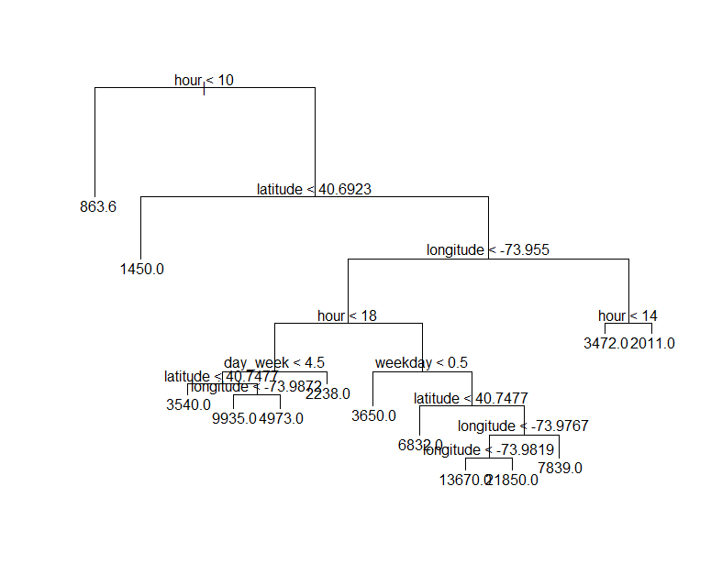
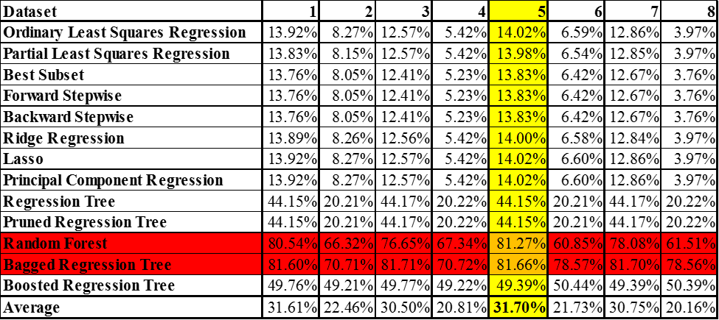
Outline
Background
Regression Models Explored
metro-magazine.com
Results
Subway
CMDA 4654 – Spring 2016
Ridership
2

Slide 3
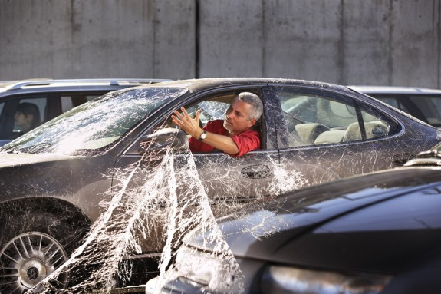
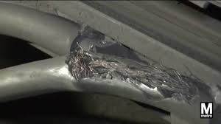
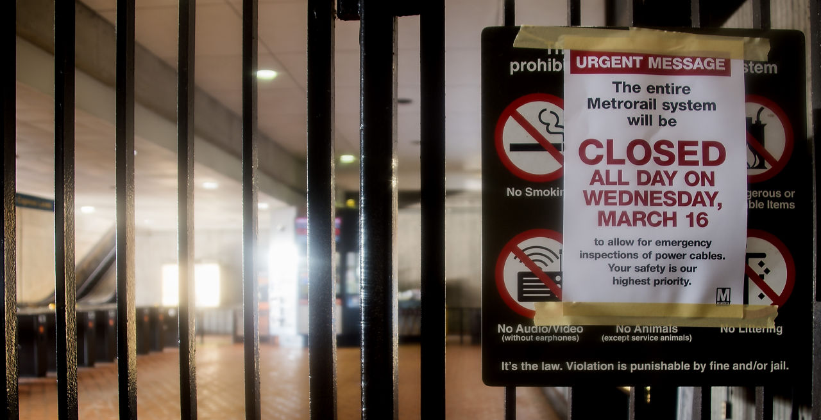
Background
100,000+ Depend Daily on Subways
Current Maintenance and Monitoring Methods Are Inadequate
blogs.kcrw.com
Closing are Inevitable Unless Current Methods are Enhanced
nbcwashington.com
hlntv.com
Subway
CMDA 4654 – Spring 2016
Ridership
3

Slide 4
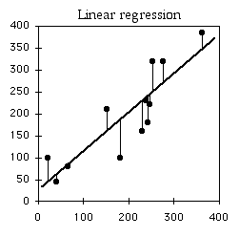
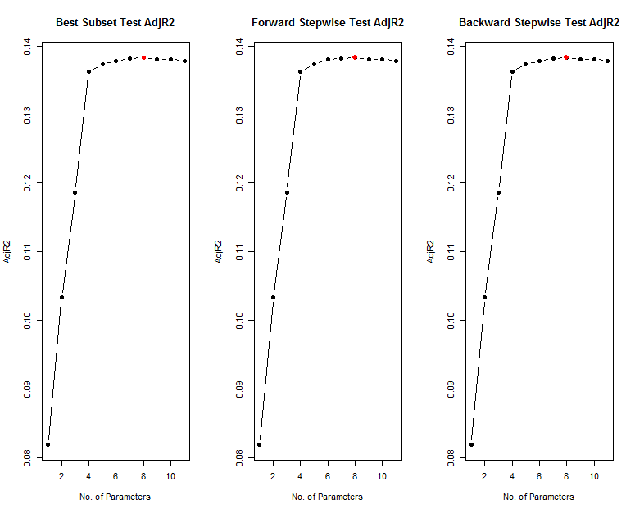
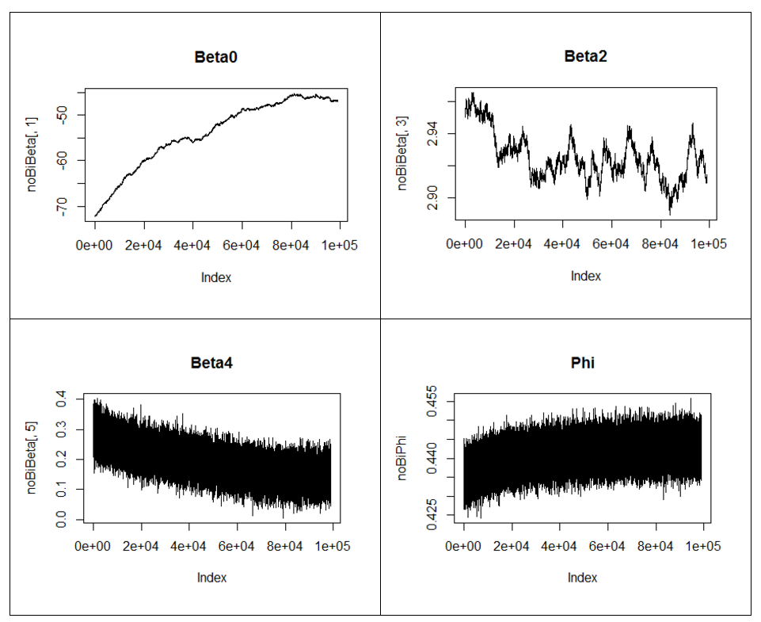
Regression Models Explored
Linear
Tree-Based
Dimensionality Reduction
Bayesian Linear Model and Gaussian Processes
biostathandbook.com
Subway
CMDA 4654 – Spring 2016
Ridership
4

Slide 5
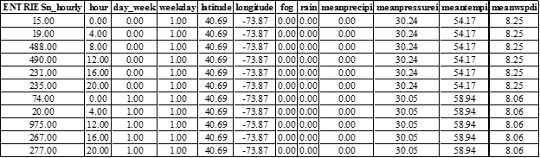
Data
Subway
CMDA 4654 – Spring 2016
Ridership
5

Slide 6
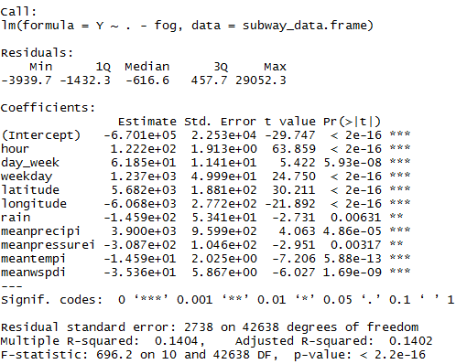
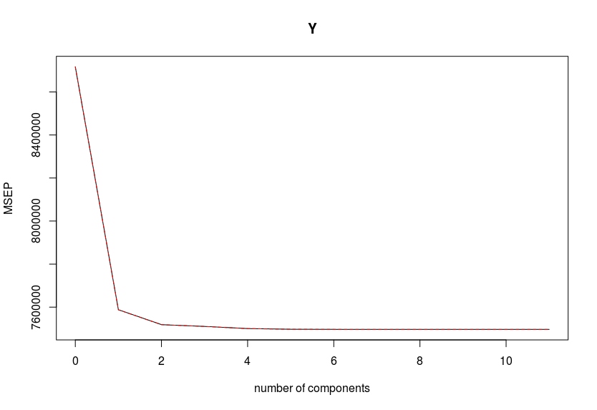
Linear Models
Ordinary Least Squares Regression
Partial Least Squares Regression
R-squared adj = 14.02%
R-squared adj = 13.98%
Subway
CMDA 4654 – Spring 2016
Ridership
6

Slide 7
Dimensionality Reduction Models
Best Subset
R-squared adj = 13.83%
Forward Stepwise
R-squared adj = 13.83%
Backward Stepwise
R-squared adj = 13.83%
Subway
CMDA 4654 – Spring 2016
Ridership
7

Slide 8
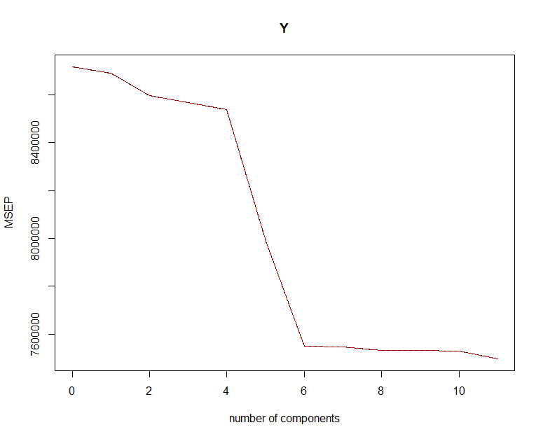
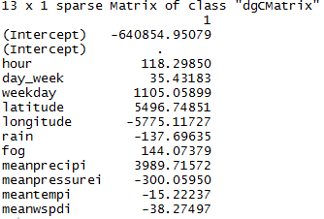
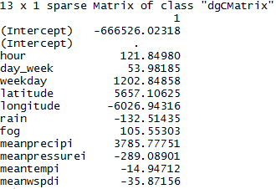
Dimensionality Reduction Models (Cont.)
Principal Component Regression
Ridge Regression
R-squared adj = 14.02%
R-squared adj = 14.00%
Lasso
R-squared adj = 14.02%
Subway
CMDA 4654 – Spring 2016
Ridership
8

Slide 9
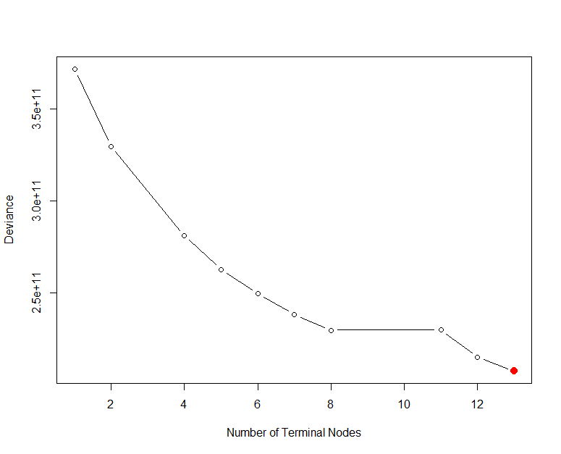
Tree Based Models
Regression Tree
Pruned Regression Tree
R-squared adj = 44.15%
R-squared adj = 44.15%
Subway
CMDA 4654 – Spring 2016
Ridership
9

Slide 10
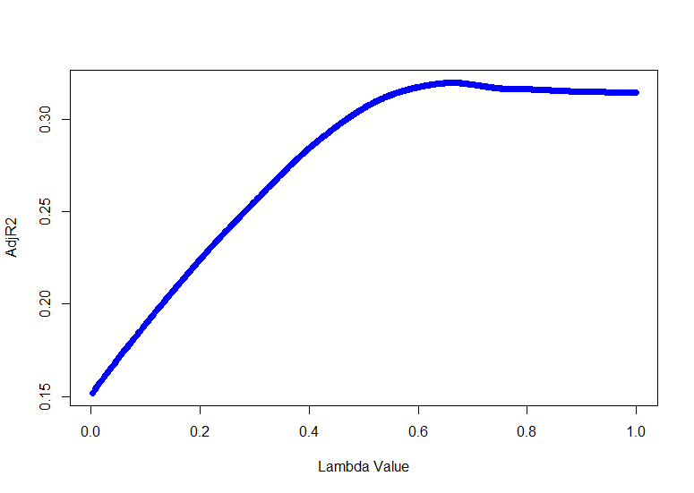
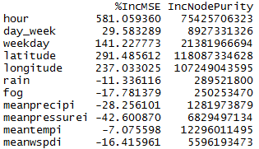
Tree Based Models (Cont.)
Bagged Regression Tree
Random Forest
Boosted Regression Tree
R-squared adj = 81.66%
R-squared adj = 81.27%
R-squared adj = 49.39%
Subway
CMDA 4654 – Spring 2016
Ridership
10

Slide 11


Bayesian Regression
Subway
CMDA 4654 – Spring 2016
Ridership
11

Slide 12
Experimental Results
Subway
CMDA 4654 – Spring 2016
Ridership
12

Slide 13
Conclusion
Background
Regression Models Investigated
www.metro-magazine.com
Results
Subway
CMDA 4654 – Spring 2016
Ridership
13

