Slide 1
PROJECT TITLE
CAPSTONE PROJECT
Presented By:
Student Name : MOHAN RAJ C
College Name & Department : Anand Institute of Higher Technology & Artificial Intelligence and Data Science.

Slide 2
OUTLINE
Problem Statement
Technology used
Wow factor
End users
Result
Conclusion
Git-hub Link
Future scope

Slide 3
Problem Statement
In the digital age, securing sensitive information during transmission is crucial. Traditional encryption methods protect data but often reveal the presence of hidden communication, making them susceptible to attacks. Steganography offers a solution by concealing information within digital media, such as images, to hide the existence of the message itself.
However, challenges remain in ensuring imperceptibility, data capacity, robustness against image processing, and protection from detection techniques. This project aims to develop a secure, efficient, and robust image-based steganographic system to enable covert communication and safeguard sensitive data from unauthorized access.

Slide 4
Technology used
Technologies Used: Python: Main programming language for coding and implementation. Libraries: ~stegano: For hiding and revealing messages in images. ~Pillow (PIL): For image processing tasks. ~Os: To handle file paths and check file existence. Tools:
~Visual Studio Code (VS Code): Code editor for writing and running the project. ~Windows OS: Platform for development and execution.

Slide 5
Wow factors
1.Hidden Communication: Unlike standard encryption, this project hides the existence of the message itself, making it invisible to potential attackers. 2. User-Friendly Interface: Simple input-based interaction makes the tool easy to use, even for non-technical users. 3. High Imperceptibility: Uses Least Significant Bit (LSB) steganography, ensuring the hidden message does not affect the visual quality of the image. 4. Efficient and Lightweight: Uses minimal system resources and processes images quickly without compromising security. 5. Customizable Output: Allows users to choose the output path and file name for better file management.

Slide 6
End users
1. Cybersecurity Professionals- To securely transmit sensitive information without revealing its presence. 2. Government and Defense Agencies- For covert communication and protecting classified data. 3. Journalists and Whistleblowers- To securely share confidential information without detection. 4. Corporate Organizations-
To safeguard intellectual property, sensitive documents, and internal communications. 5. Researchers and Academics- For secure data sharing and protecting research findings. 6. Digital Artists and Content Creators- To embed copyright information or digital signatures into their work.

Slide 7
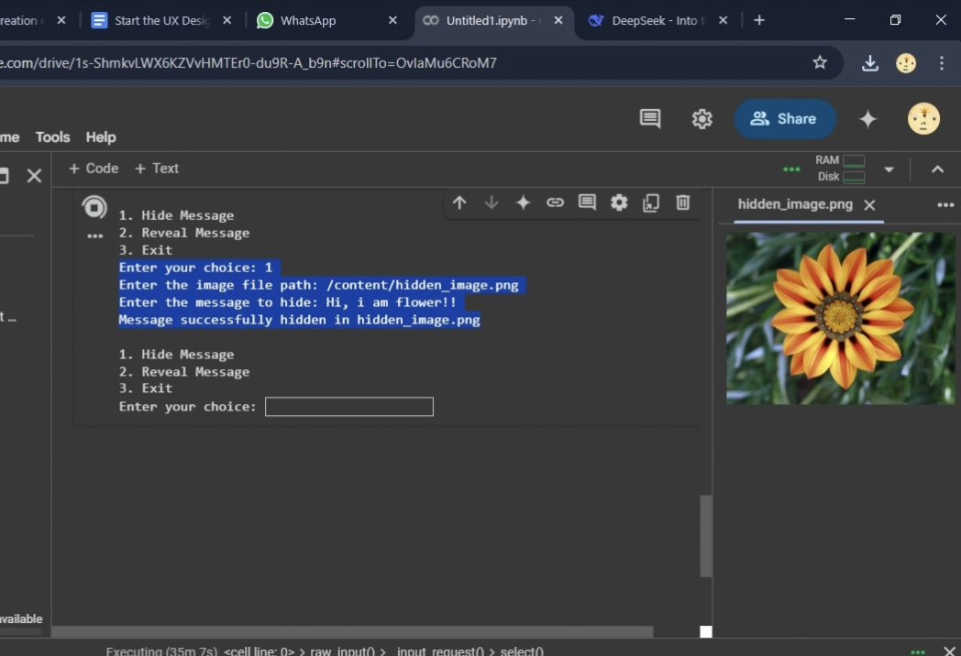
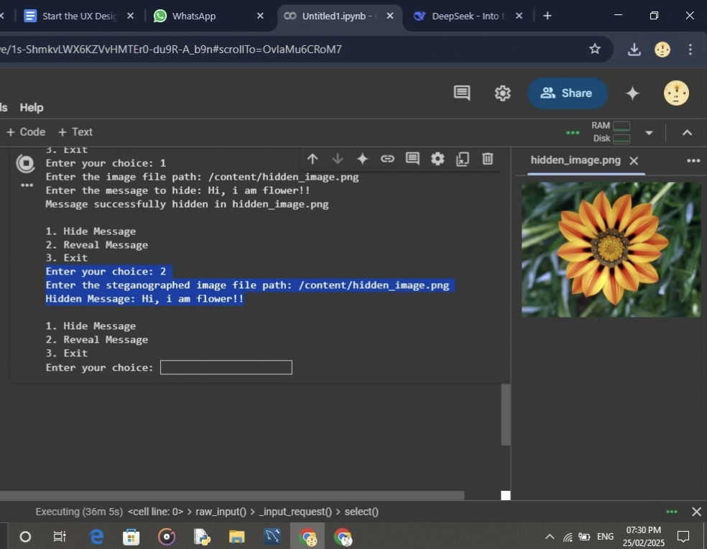
Results

Slide 8
Conclusion
Secure Data Hiding in Image Using Steganography, effectively addresses the challenge of safeguarding sensitive information by not only protecting the content but also concealing the existence of the communication itself. Traditional encryption methods often draw attention, making encrypted data a target for cyber-attacks. In contrast, this project leverages Least Significant Bit (LSB) steganography to discreetly embed secret messages within images, making detection by unauthorized users highly unlikely. The developed system ensures imperceptibility, robustness, and efficiency, allowing users to securely hide and retrieve information without compromising image quality. Additionally, the simple interface makes it accessible to both technical and non-technical users, while the system remains flexible for future enhancements, such as adding encryption or supporting other media formats. Overall, this project provides a practical and effective solution for covert communication, offering a valuable tool for cybersecurity professionals, organizations, and individuals seeking to protect sensitive information from unauthorized access and cyber threats.

Slide 9
GitHub Link
•Make sure to check out readme file.
•GITHUB LINK-
https://github.com/CMohanraj-01/Mohan-C.git

Slide 10
Future scope(optional)
1. Integration of Advanced Encryption- Combine steganography with encryption algorithms (e.g., AES, RSA) for double-layered security, ensuring that even if the message is extracted, it remains unreadable without the decryption key. 2. Support for Multiple Media Formats- Extend data hiding capabilities beyond images to include audio, video, and text files for broader application use. 3. Development of a Graphical User Interface (GUI)- Implement a user-friendly GUI using Tkinter or PyQt to make the tool more accessible for non-technical users. 4. Robustness Against Steganalysis- Enhance the algorithm to resist detection by steganalysis tools and image processing operations like resizing, compression, or filtering.

Slide 11
THANK YOU

