Slide 1
Specification and Placement of Cloud Applications including Chained Virtualized Network Functions Proposal for a master’s thesis
Stefan Schneider
October 7th, 2016
Notes:
Welcome to the presentation of the proposal of my master’s thesis
Title not final. Possible alternatives at the end.

Slide 2
Network Function Virtualization
Physical middleboxes → virtual network functions
VNFs on standard x86-servers → many advantages
Template: Network service descriptor
Automatic scaling → flexibly adapt to situation
Scaling & placement interdependent → 1 step
Notes:
NFs: Firewalls, load balancers, DPI
In SW
Advantages → Challenges
Instead of exact → aut. scaling
→ TEP

Slide 3
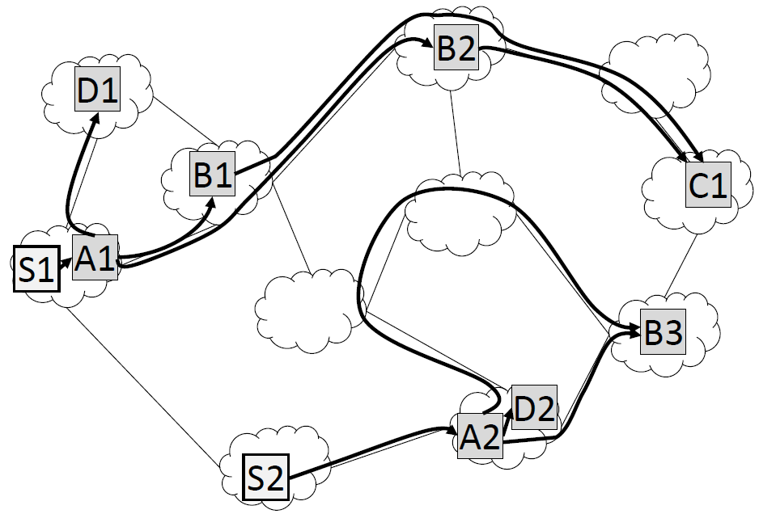
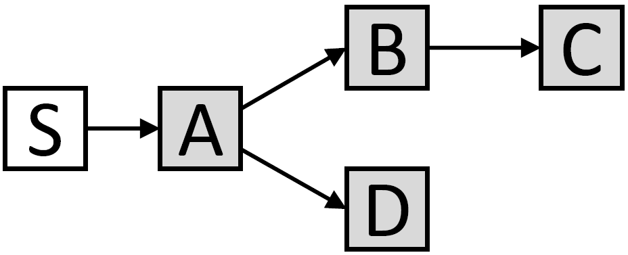
Template Embedding Problem (TEP)
Input:
Substrate network
Template
Data sources
Output
Embedding
Min. capacity violations + secondary objectives
From [1]
From [1]
Notes:
Initially by Keller, Robbert, Karl (2014); Currently improved by Dräxler, Karl, Mann
Substrate: Capacities
Template: Components, interdependencies, req. per load
Data src: Service, location, rate
total delay, total consumption, #started/stopped instances

Slide 4
Extension: Way back
In reality: Traffic usually bidirectional
So far: Only forward direction
Model way back:
Stateful VNFs
Loops in template
Complex templates
S
A
B
B
S
A
?
C
S
A
B
A
S
Notes:
Loops: Mechanism to det. Data rate/resource consp. relies on acyclic graphs
Workaround (Linearize): Difficult with stateful
Complex: Diff #in-/ouputs, functions for data rate etc

Slide 5
Extension: Reuse VNFs
Multiple services in one network
So far: Embedded separately
Allow reuse of VNFs across services
Reuse instances of common components
Fewer instances → reduced costs
Template 1:
S
A
B
Template 2:
S
A
C
Notes:
So far: Each template embeds own set of instances
Template: which components to reuse + with whom

Slide 6
My thesis: Main tasks
Extend TEP model
Formalize optimization problem
Implement & test in solver
Develop heuristic
Good solutions in shorter time
Quickly react to fluctuations (network, data sources, …)
Compare with optimization approach
Notes:
Basis: Dräxler, Karl, Mann
Depending on how difficult/time-consuming: Decide emphasize (improvements or heuristic)

Slide 7
Thesis outline
Introduction
Related work
Model
Existing TEP model
Extensions
Solving the problem
Optimization approach
Heuristic
Evaluation
Test instances
Comparison
Discussion
Conclusion and future work
Notes:
preliminary

Slide 8
Task schedule
Notes:
Preliminary
Vacation: some days off with my family, girlfriend (not like BA)
Questions? Else, possible titles

Slide 9
Possible titles
Specification and Placement of Cloud Applications including Chained Virtualized Network Functions
Specification and Placement of Network Services including Chained Virtual Network Functions
Specifying and optimizing placement of VNFs
Specification of complex network services and optimized scaling & placement in NFV
Making NFV more realistic/applicable: Improved model and placement of network services/VNFs
Flexible specification, scaling, and placement of network services/VNFs
Notes:
Any further ideas?
Improved..: What if, in the end, the improvements actually don’t work?

Slide 10
References
S. Dräxler, H. Karl, Z. A. Mann. “Self-optimizing scaling and placement of virtual composed services”

