Slide 1
SHIFTS 0.2
(Systematic, Hypothesis-free Identification with controlled FDR of ultra-Tolerant Search).

Slide 2
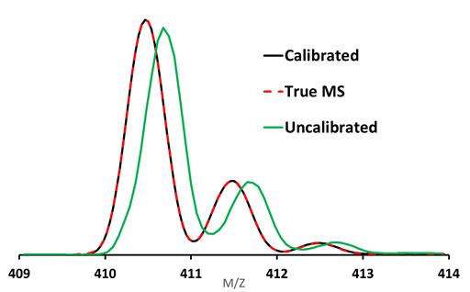
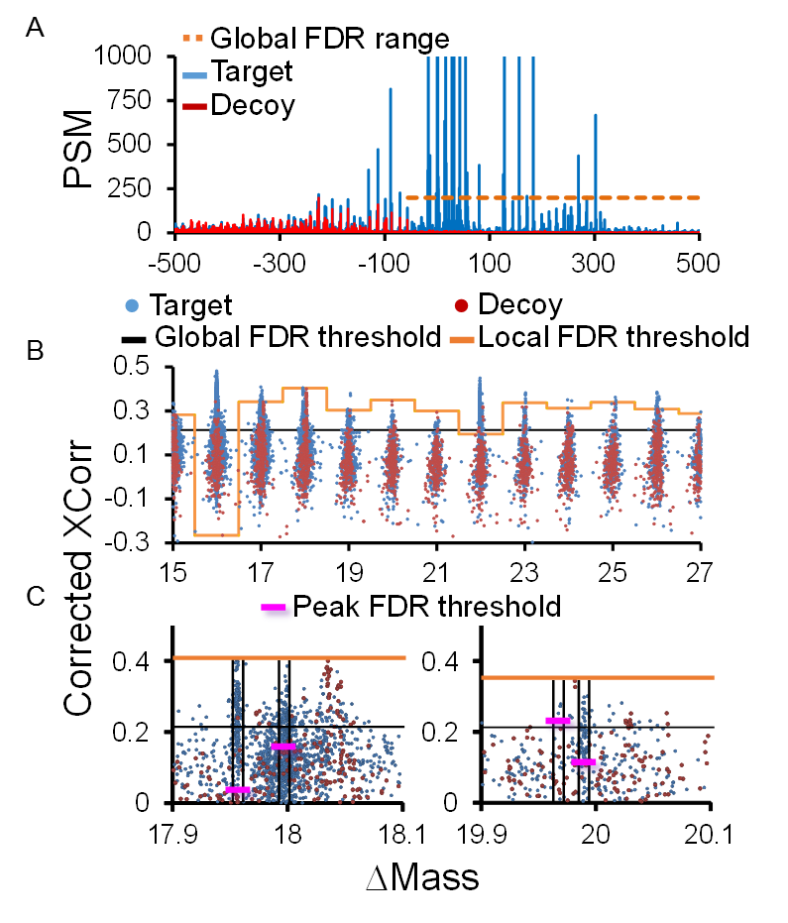
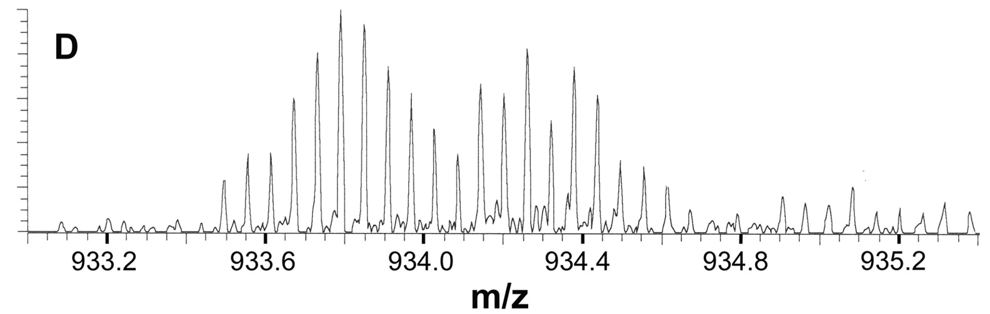

Slide 3
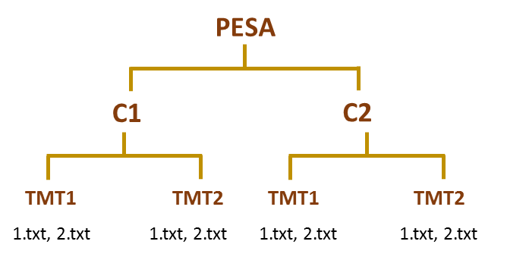
Module1
Vertex.py
-h --help = detailed help
-P --path = Masterfile
-B --bin = Bin for histogram
-X --Xcorr = Xcorr for NM
-f --FDR = Global fdr
-O --name = Out folder name
-w --window = window size
-p --PeakTF = Peak rerun True false
-e --Log file = path to experiment log
-s --prefix = name for peak rerun
Calibration
Calibration log file
Program parameter log file
Experiment path log file
Calibration
Calibration
Calibration
Calibration
Calibration
Calibration
Calibration
Whole Calibrated data
Global FDR log file per experiment
Global FDR log file per experiment
Global FDR log file per experiment
Global FDR log file per experiment
MAD log file
Sigma calculation log file (for orphans)
Gaussian peak modelling (histogram file)

Slide 4
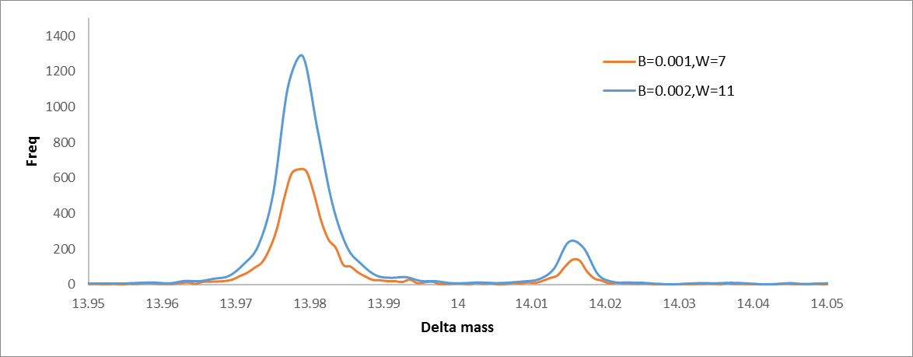
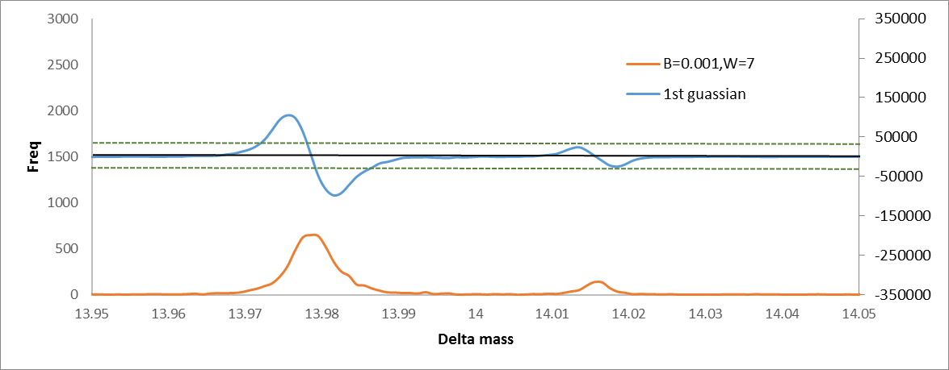
Module1
Vertex.py
-h --help = detailed help
-P --path = Masterfile
-B --bin = Bin for histogram
-X --Xcorr = Xcorr for NM
-f --FDR = Global fdr
-O --name = Out folder name
-w --window = window size
-p --PeakTF = Peak rerun True false
-e --Log file = path to experiment log
-s --prefix = name for peak rerun
vertex.py -P path\MasterFile.txt -B 0.001 -X 0.22 -f 0.01 -O output -w 7 -p 0 -e NA -s NA
vertex.py -P NA -B 0.002 -X NA -f NA -O NA -w 11 -p 1 -e path\expLogFile -s Perfix name
Module1
peakFiltering.py
-h --help = detailed help
-i --path = Histogram file
-a --freq = Frequency filter
-g --Gauss = first Gaussian filter
-s --prefix = prefix name for output
peakFiltering.py -i path/histogram.txt -a 10 -g 2000 -s filter
Vertex.py, will allow to control the slope shape and apex identification
peakPicking.py, will allow to filter the output from previous run, by Gauss and frequency

Slide 5
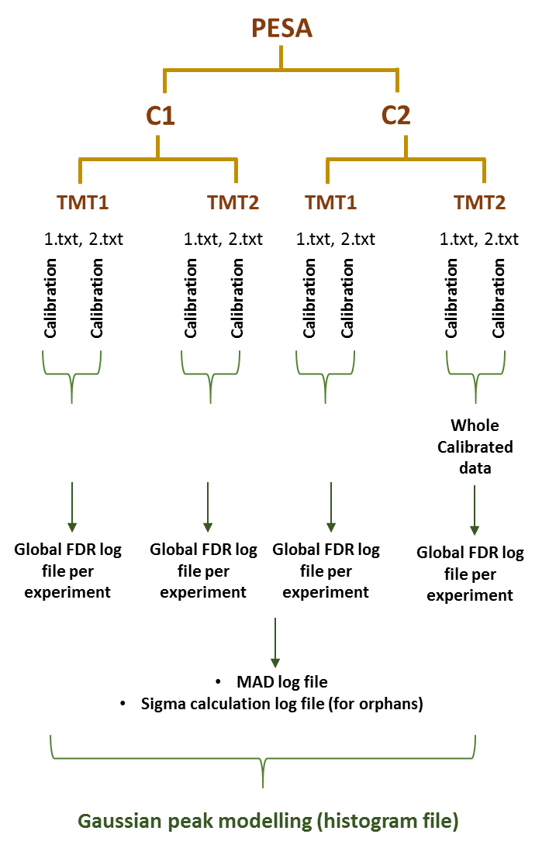
Module2
PTMdesignator.py
-h --help = detailed help
-e --path = path to exp log file
-a --apexlist = path to apex file
-f --fasta = path to fasta file
-l --localFDR = fdr = 0.01 or 0.05
-p --PeakFDR = fdr = 0.01 or 0.05
PTmdesignator.py -e path/expLogFile -a path/apexlist -f path/fasta -l 0.01 -p 0.01
Apex list
FDR data with tags (orphans and non orphans)
FDR data with tags (orphans and non orphans)
FDR data with tags (orphans and non orphans)
FDR data with tags (orphans and non orphans)
AllWithSequence-massTag.txt

Slide 6
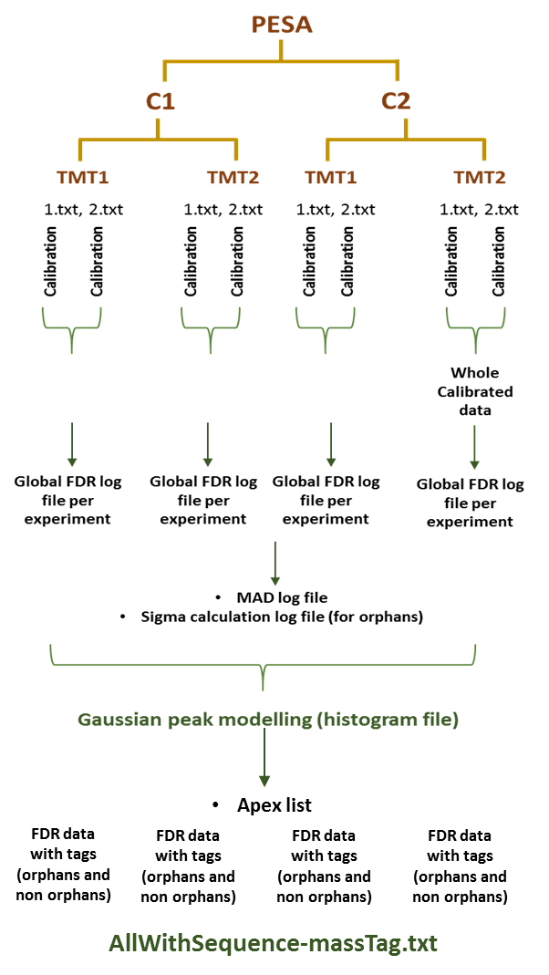
Module3
PTMcorrector.py
-h --help = detailed help
-e --path = path to exp log file
-s --sigmaFile = name of sigma file
-m --MADFile = name of MAD file
-O --OrphanOUT = name for the output file
-I --IsoTarget = name for file as input to isotop correction
-o --isoTF = 1 for TRUE else 0
-I --orphanTF = 1 for TRUE else 0
Example 1: if you want to do orphan classification and isotop correction both in one go.
PTMdesignator.py –e path/exp logfile –s sigmaFile –m madfile –O Orphan.txt –I Orphan.txt –o 1 –I 1
Program first classifies Orphans and creates a output file according to –O parameter. Than it will preform isotop correction, for which it need an inputFile, created after orphan classification, for this reason –I is exactly the same as –O.
Example 2: if you want to do only orphan classification.
PTMdesignator.py –e path/exp logfile –s sigmaFile –m madfile –O Orphan.txt –I NA –o 1 –I 0
Program first classifies Orphans and creates a output file according to –O parameter.
Example 3: if you want to do only Isotopic correction.
PTMdesignator.py –e path/exp logfile –s sigmaFile –m madfile –O NA –I AllWithSequence-massTag.txt –o 0 –I 1
Program will do isotopic correction on file input according to –I parameter.

Slide 7
PESA
C1
C2
TMT1
TMT2
TMT1
TMT2
1.txt, 2.txt
1.txt, 2.txt
1.txt, 2.txt
1.txt, 2.txt
4/3/2019 new programs:
Vertex version 2:
-n<2: old way; else>3, 4, etc would be the window for the frequency smoothing
PTM assignator
FDR local and peak are not parallel
Cambió fue que se usa la MAD de cada experimento y no una misma para todo

