Slide 1
Computer Programming Club
Instructor: Rob Garner

Slide 2
Overview
Concept/Vision
Process/Procedure
Requirements for a Chartered Student Organization
First Game Jam
Technologies to Learn
Next Meeting

Slide 3
Concept/Vision

Slide 4
CNM Programming Club
Student run but I will be the Faculty point of contact.
Purpose will be to improve group members’ collaboration and coding skills by developing computer applications.
It will be open to anyone interested in computer software development. You don't have to be a programmer! Digital media, artist, writers, musicians and many more all have a role in application development.
We will learn to use version control software to manage larger group projects.

Slide 5
Process/Procedure

Slide 6
Initial Process
Initially meet once a month for:
  Iteration planning on a long term game development project.
  Planning for upcoming game jams, innovation james and other competitions
  Presentation on a programming topic.
Other meetings as needed.
Possibly use Fridays in lab as an ad-hoc, do homework then work on games day.

Slide 7
Review Requirements for a Chartered Student Organization

Slide 8
Forming a Chartered Student Organization
Need: President, Vice-President, Secretary or Treasurer;
Draft Charter Packet
  Advisor Contract/Non-exclusionary Statement
  CSO Chartering Application Form
  Active Members List
  Copy of the organization’s governing documents
  Web Page Information

Slide 9
Forming a Chartered Student Organization
Advisor and Officers must attend CSO training session
Minimum of 8 active student members/participants. GPA 2.0 or higher and be completing coursework successfully.
CSOs must have:
  Name
  Mission statement
  Governing document
  Web Page Information

Slide 10
RESPONSIBILITIES OF A CHARTERED STUDENT ORGANIZATION
No Organization may obligate or commit CNM financially or in any other way without the approval of their Advisor, the Student Activities Office and the Dean of Students. The advisor/officers will work with the Student Activities Office to obtain the proper approvals when needed.

Slide 11
RESPONSIBILITIES OF A CHARTERED STUDENT ORGANIZATION
When a CSO gathers for travel, meetings, social events, activities, service projects, etc. they are representing CNM.
Advisors, Officers and members are representatives of CNM and should maintain professional conduct.
CSO officers and members are expected to adhere to the behavioral expectations set forth in CNM’s Student Code of Conduct.
CSO Advisors are expected to adhere to the behavioral expectations set forth in CNM’s Employee Handbook.
Should it ever be necessary to do so, advisors, officers, members and organizations would be disciplined according to the Student Code of Conduct and the CNM Employee Handbook standards and procedures.

Slide 12
RESPONSIBILITIES OF A CHARTERED STUDENT ORGANIZATION
CSOs are responsible for adhering by the policies and procedures found in the CSO Advisor/Officer Manual, the Student Allocation Board Guidelines, the Student Code of Conduct, and CNM Employee Handbook and when appropriate, The Source.

Slide 13
Game Programming

Slide 14
10 Benefits of Game Programming
It’s fun.
You have to learn to solve intricate logic problems.
It’s fun.
You have opportunities to work with others, learn to program in a group and use version control software.
It’s fun.
You learn to think in terms of the user’s experience when designing software.
It’s fun.
A completed game is evidence that you enjoy coding and can develop a complete product.
It’s fun.
If you can code a complex game you probably have the tenacity to code anything.

Slide 15
First (third?) Game Jam

Slide 16
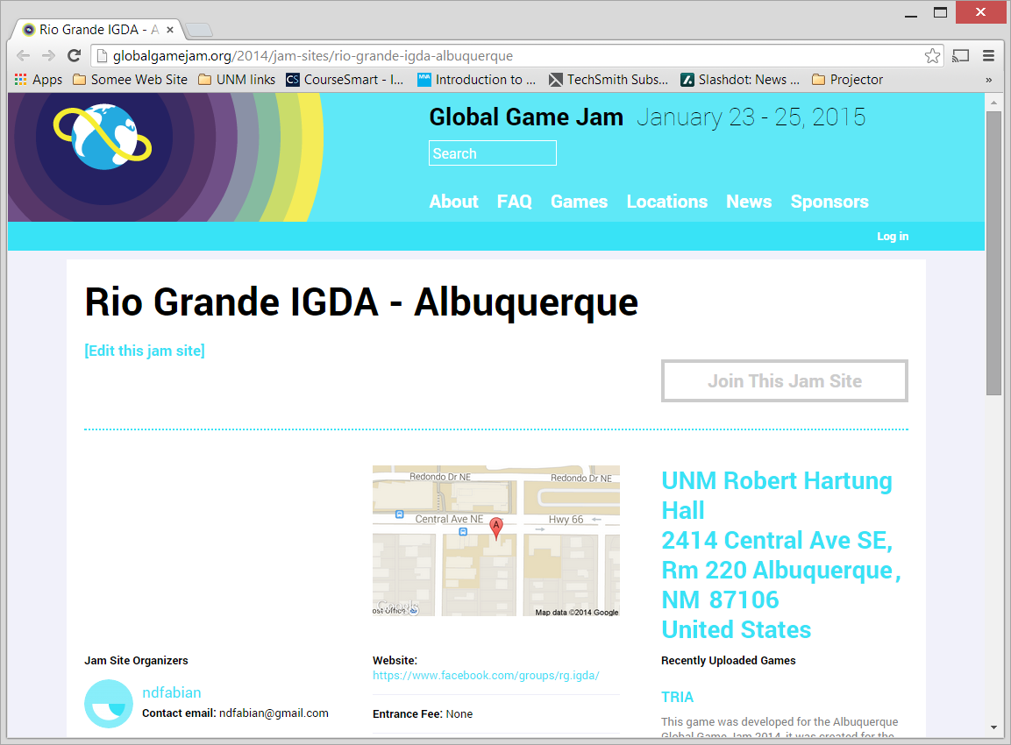
Rio Grande IGDA
http://globalgamejam.org/2014/jam-sites/rio-grande-igda-albuquerque

Slide 17
Game Jam
Email rgarner7@cnm.edu if you are interested in participating.
Tell me:
  What languages you have programmed in?
  Have you used GitHub before?
  Have you used Blender or other 3d Modeling software?
  Have you used GIMP or Photoshop?
  Have you used any sound/music software?
  Have you programed Unity or other Game Framework?
I will form one or more teams (depending on number of participants)

Slide 18
Initial Technologies to Learn

Slide 19
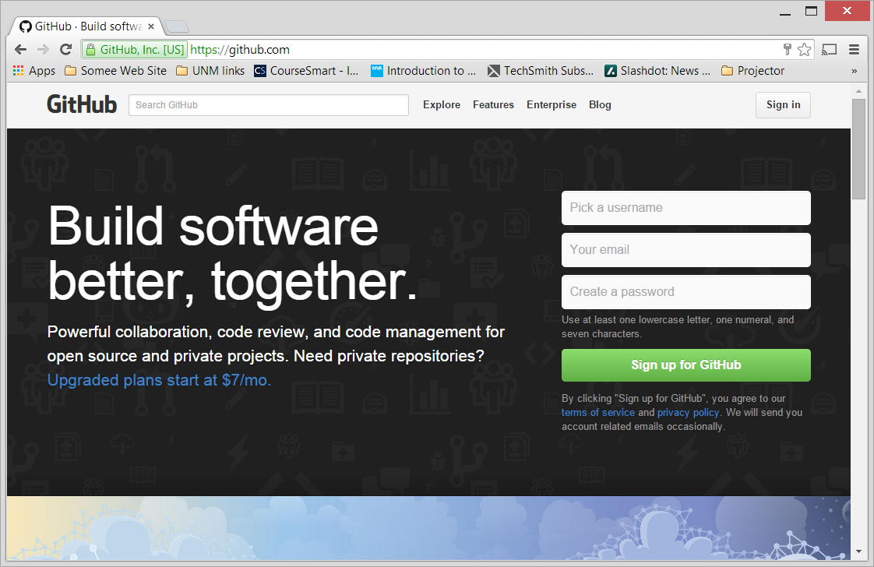
GIT and GITHUB
https://github.com/

Slide 20
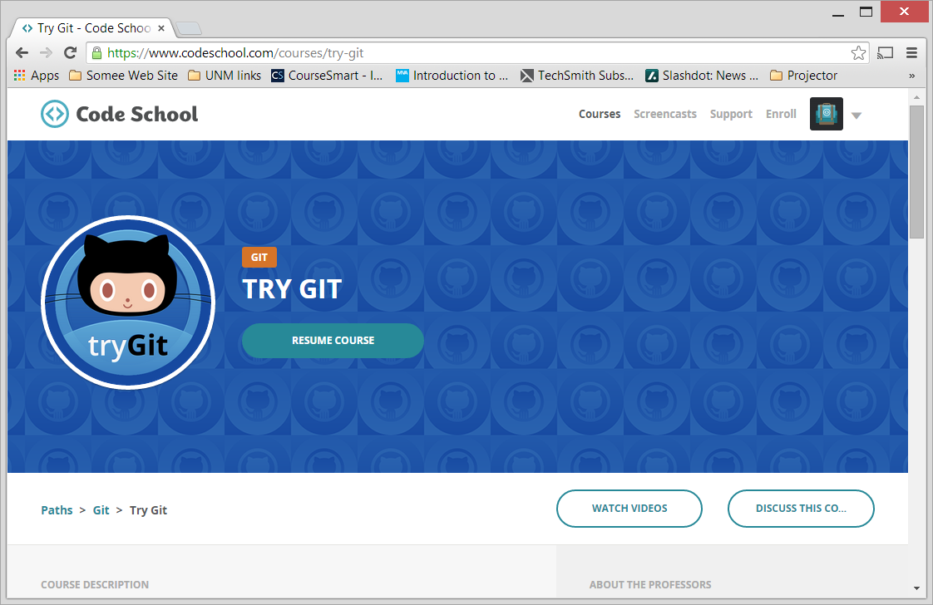
Learn GIT
https://www.codeschool.com/courses/try-git

Slide 21
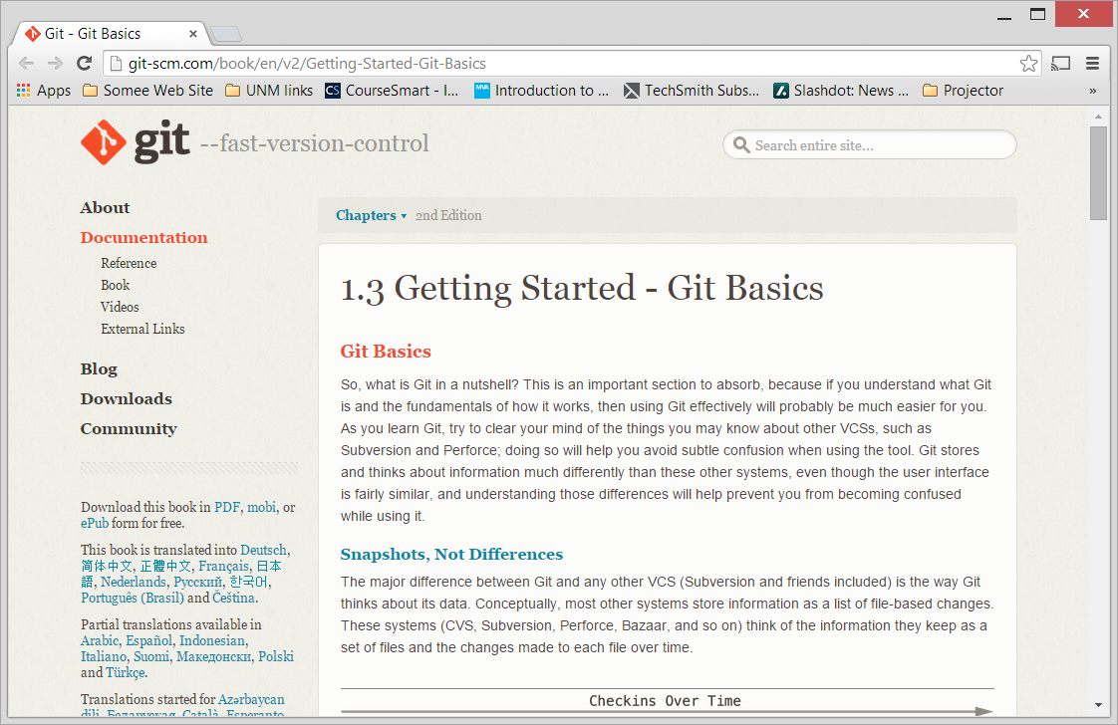
Learn GIT
http://git-scm.com/book/en/v2/Getting-Started-Git-Basics

Slide 22
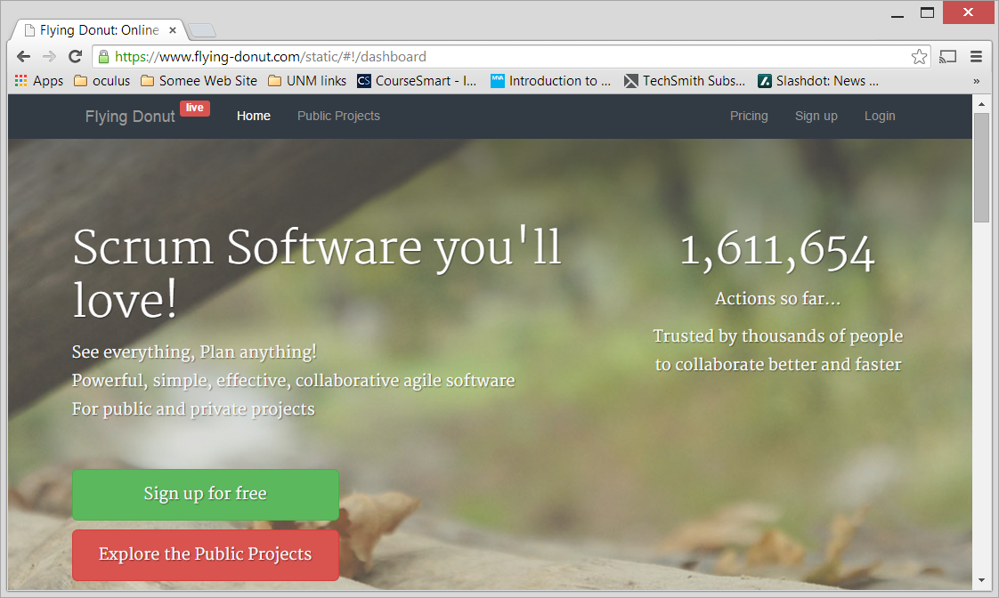
Flying Donut Scrum Software
https://www.flying-donut.com/

Slide 23
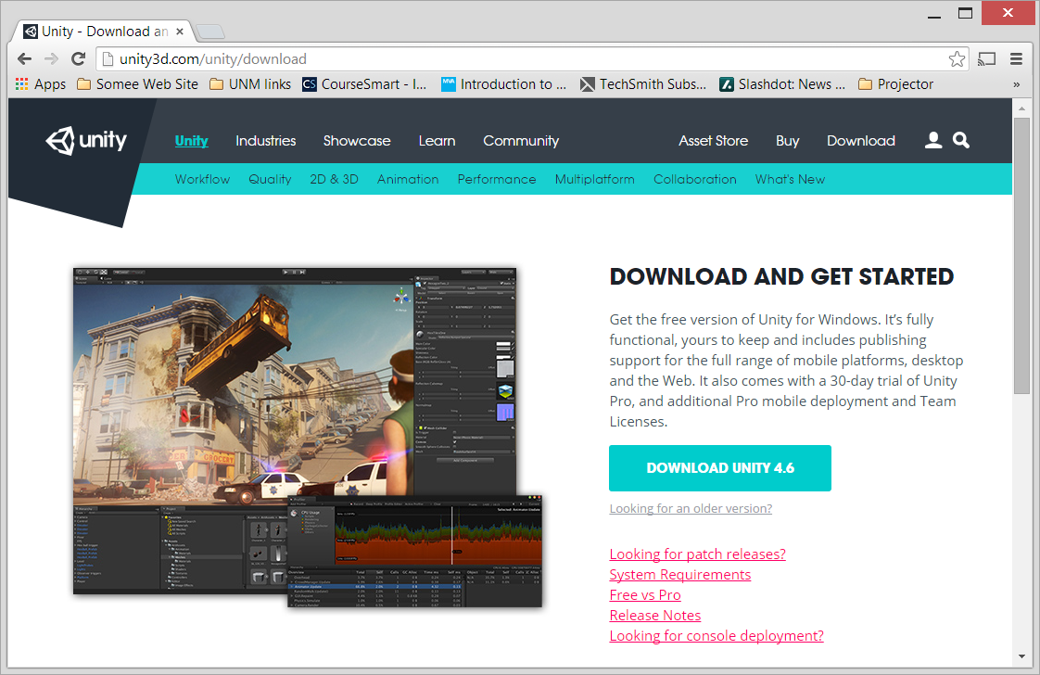
Unity
http://unity3d.com/unity/download

Slide 24
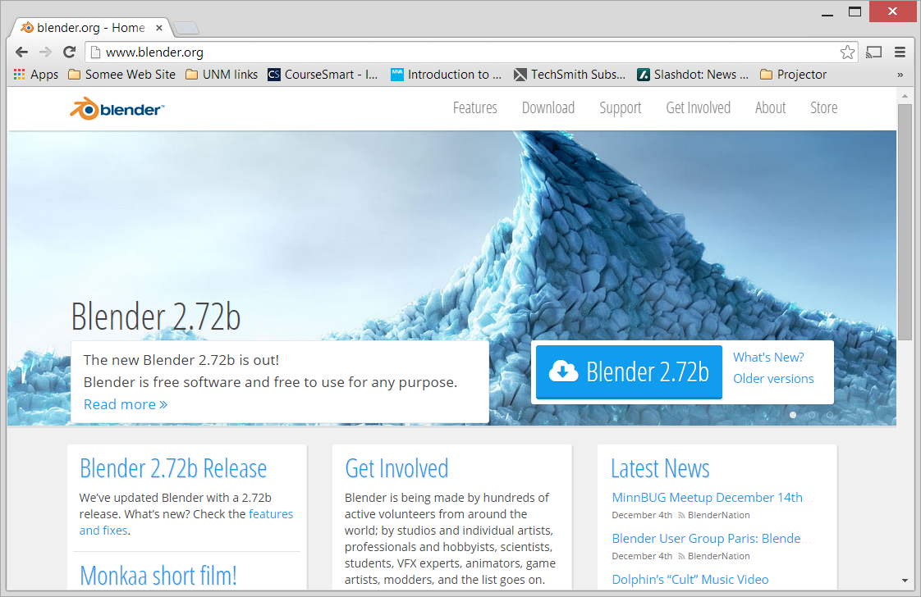
Blender 3D Modeling Software
http://www.blender.org/

Slide 25
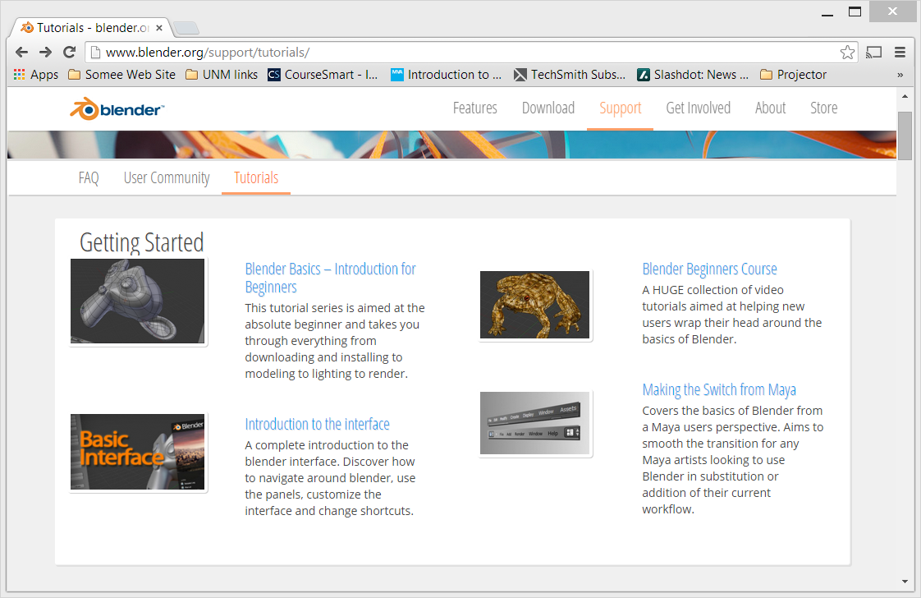
Learning Blender
http://www.blender.org/support/tutorials/

Slide 26
Next Meeting

Slide 27
Next Meeting
When is best time to Meet?
Goals for next meeting:
  Draft CSO documents
  Get candidates for four officer positions (interim?)
  Plan attendance at next game jam

Slide 28
Summary
Concept/Vision
Process/Procedure
Requirements for a Chartered Student Organization
First Game Jam
Technologies to Learn
Next Meeting

