Slide 1
Agenda
Need student for Programming Club Committee
Game Jam 23-25 Jan 2015
ACM Competition
Learn Git
Occulus, Neurosky etc.

Slide 2
Global Game Jam 2015
Dates 23-25 Jan 2015
Correct web site
Meet in E102 or E104 on 23 Jan 2015 at 5:00 PM to get the theme.
Tentative:
  23 Jan 2015 5:00 PM to 9:00 PM
  24 Jan 2015 9:00 AM to 9:00 PM
  25 Jan 2015 9:00 AM to 3:00 PM (projects have to be turned in by 3:00PM on last day)

Slide 3
GIT Chapter 1:
Getting Started
This presentation was prepared by Robert J. Garner, and is based on Pro Git by Scott Chacon and Ben Straub available at http://git-scm.com/book/en/
This work is licensed under the Creative Commons AttributionNonCommercial-ShareAlike
3.0 Unported License. To view a copy of this license,
visit http://creativecommons.org/licenses/by-nc-sa/3.0/ or send a letter
to Creative Commons, 171 Second Street, Suite 300, San Francisco, California,
94105, USA.
https://www.youtube.com/watch?v=ZDR433b0HJY

Slide 4
Summary
This chapter will be about getting started with Git.
Background on version control tools
Installing Git
Set up

Slide 5
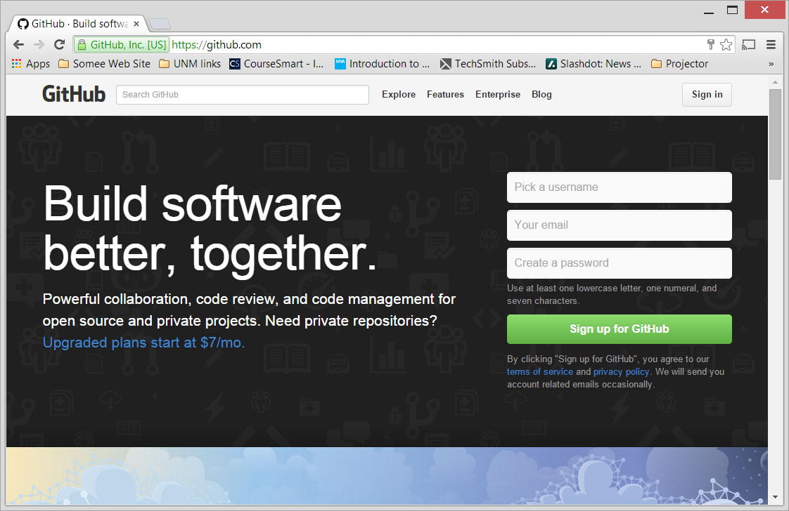
GIT and GITHUB
https://github.com/

Slide 6
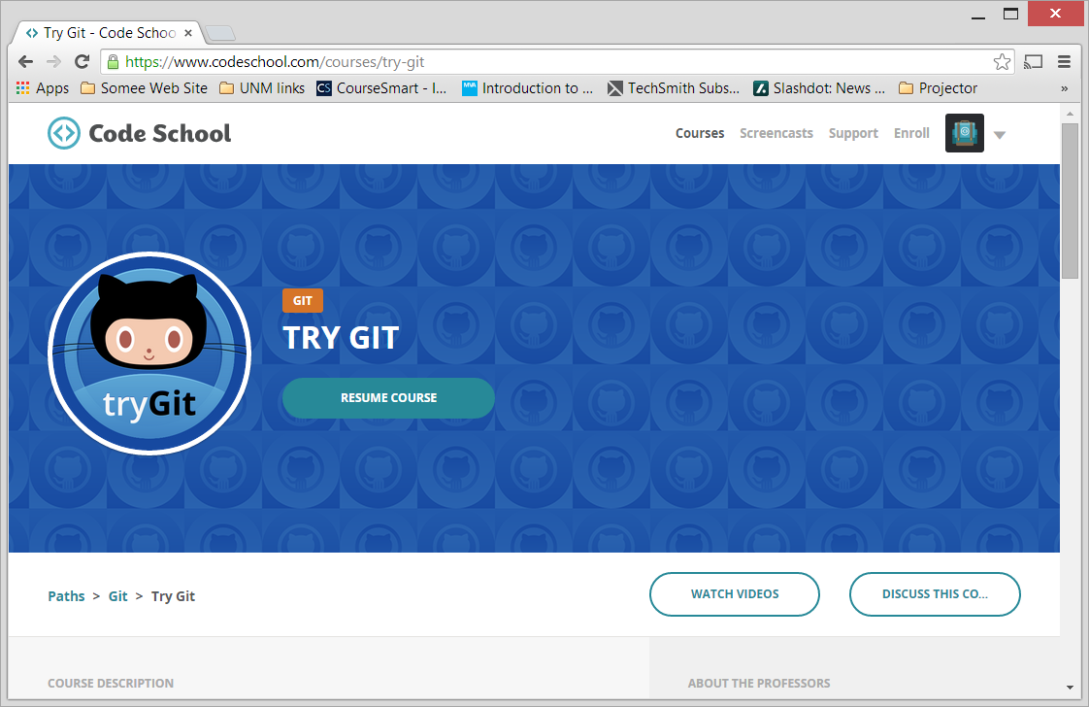
Learn GIT
https://www.codeschool.com/courses/try-git

Slide 7
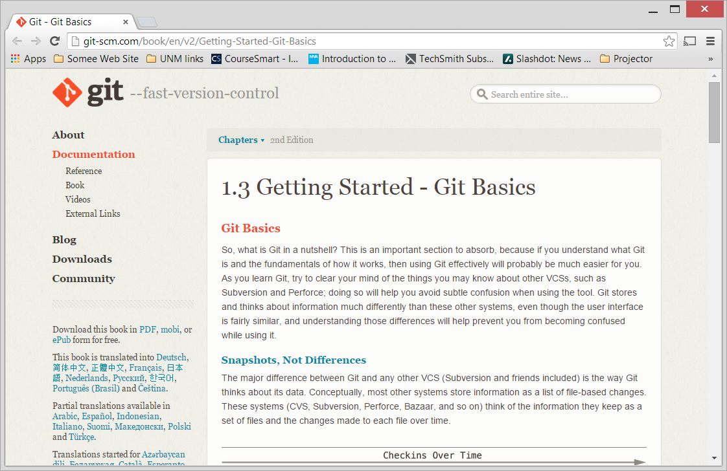
Learn GIT
http://git-scm.com/book/en/v2/Getting-Started-Git-Basics

Slide 8
About Version Control
1.1 Getting Started

Slide 9
About Version Control
Allows you to revert files back to a previous state
Revert the entire project back to a previous state
Compare changes over time
See who last modified something that might be causing a problem
Who introduced an issue and when, and more

Slide 10
Types of version control
Local Version Control Systems
Centralized Version Control Systems
Distributed Version Control Systems

Slide 11
Local Version Control Systems
Many people’s version-control method of choice is to copy files into another directory
  Simple, but it is also incredibly error prone.
  Easy to forget which directory you’re in and accidentally write to the wrong file or copy over files you don’t mean to.
To deal with this issue, programmers long ago developed local VCSs that had a simple database that kept all the changes to files under revision control.

Slide 12
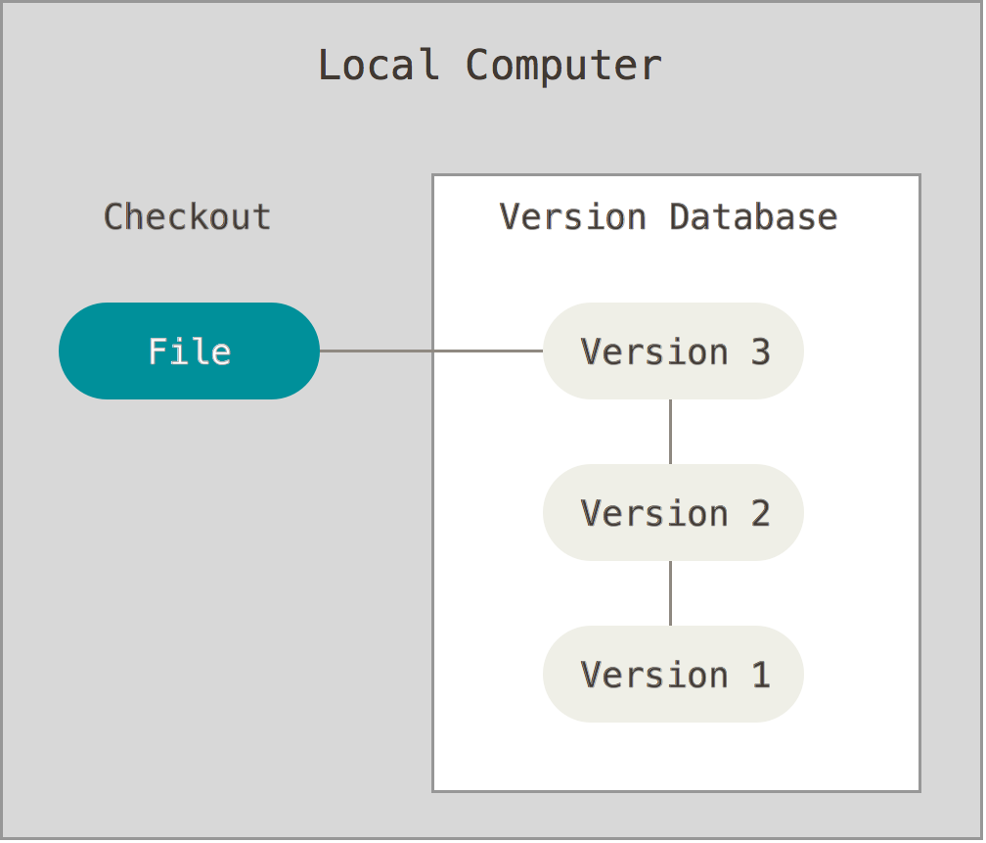
Local Version Control Systems

Slide 13
Centralized Version Control Systems
The next major issue that people encounter is that they need to collaborate with developers on other systems.
To deal with this problem, Centralized Version Control Systems (CVCSs) were developed.
These systems, such as CVS, Subversion, and Perforce, have a single server that contains all the versioned files, and a number of clients that check out files from that central place.
For many years, this has been the standard for version control.

Slide 14
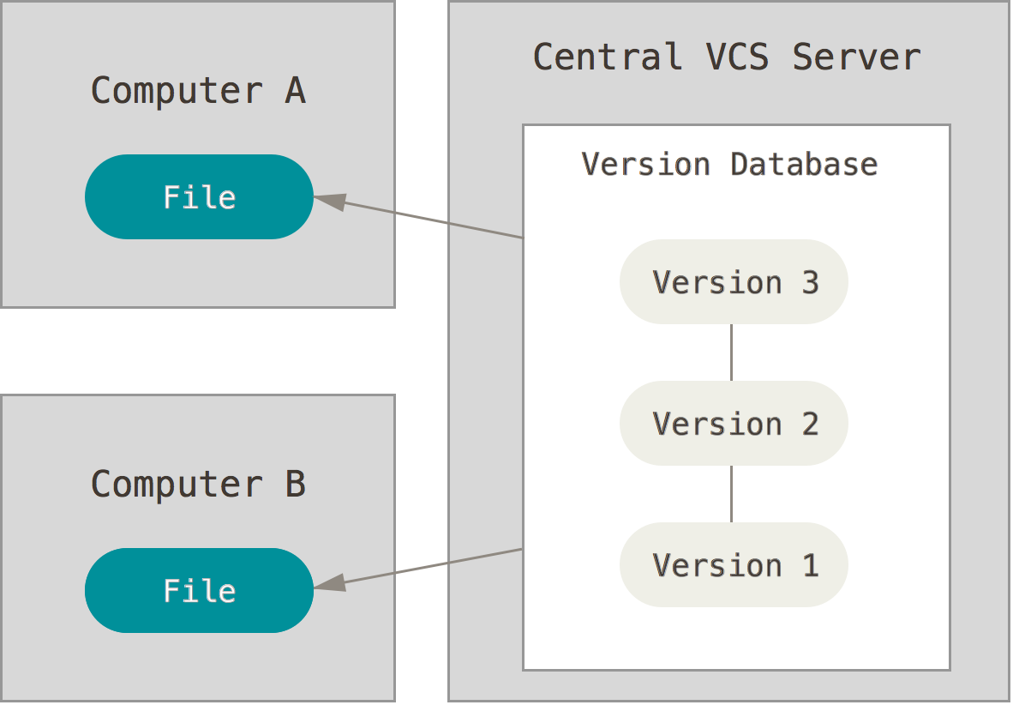
Centralized Version Control Systems

Slide 15
Centralized Version Control Systems
Advantages
Disadvantages
Everyone knows to a certain degree what everyone else on the project is doing.
Administrators have fine-grained control over who can do what
Easier to administer a CVCS than it is to deal with local databases on every client.
Single point of failure
If that server goes down for an hour, then during that hour nobody can collaborate at all or save versioned changes to anything they’re working on.
If the hard disk the central database is on becomes corrupted, and proper backups haven’t been kept, you lose absolutely.
Local VCS systems suffer from this same problem – whenever you have the entire history of the project in a single place, you risk losing everything.

Slide 16
Distributed Version Control Systems
In a DVCS (such as Git, Mercurial, Bazaar or Darcs), clients don’t just check out the latest snapshot of the files: they fully mirror the repository.
Thus if any server dies, and these systems were collaborating via it, any of the client repositories can be copied back up to the server to restore it.
Every checkout is really a full backup of all the data.

Slide 17
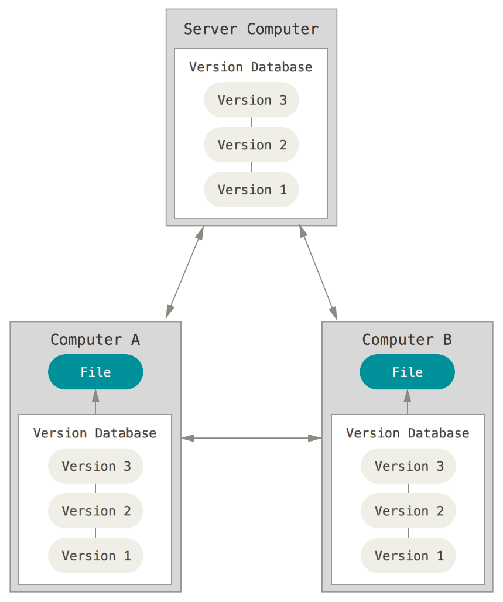
Distributed Version Control Systems

Slide 18
Distributed Version Control Systems
Many of these systems deal pretty well with having several remote repositories they can work with.
Can collaborate with different groups of people in different ways simultaneously within the same project.
Allows you to set up several types of workflows that aren’t possible in centralized systems, such as hierarchical models.

Slide 19
A Short History of Git
1.2 Getting Started

Slide 20
A Short History of Git
The Linux kernel is an open source software project of fairly large scope.
For most of the lifetime of the Linux kernel maintenance (1991–2002), changes to the software were passed around as patches and archived files.
In 2002, the Linux kernel project began using a proprietary DVCS called BitKeeper.

Slide 21
A Short History of Git
In 2005, the relationship between the community that developed the Linux kernel and the commercial company that developed BitKeeper broke down, and the tool’s free-of-charge status was revoked.
This prompted the Linux development community (and in particular Linus Torvalds, the creator of Linux) to develop their own tool based on some of the lessons they learned while using BitKeeper.

Slide 22
Goals
Speed
Simple design
Strong support for non-linear development (thousands of parallel branches)
Fully distributed
Able to handle large projects like the Linux kernel efficiently (speed and data size)

Slide 23
Git Qualities
Fast
Efficient with large projects
Branching system for non-linear development

Slide 24
Git Basics
1.3 Getting Started

Slide 25
Snapshots, Not Differences
The major difference between Git and any other VCS (Subversion and friends included) is the way Git thinks about its data.
Conceptually, most other systems store information as a. list of file-based changes
These systems (CVS, Subversion, Perforce, Bazaar, and so on) think of the information they keep as a set of files and the changes made to each file over time.

Slide 26
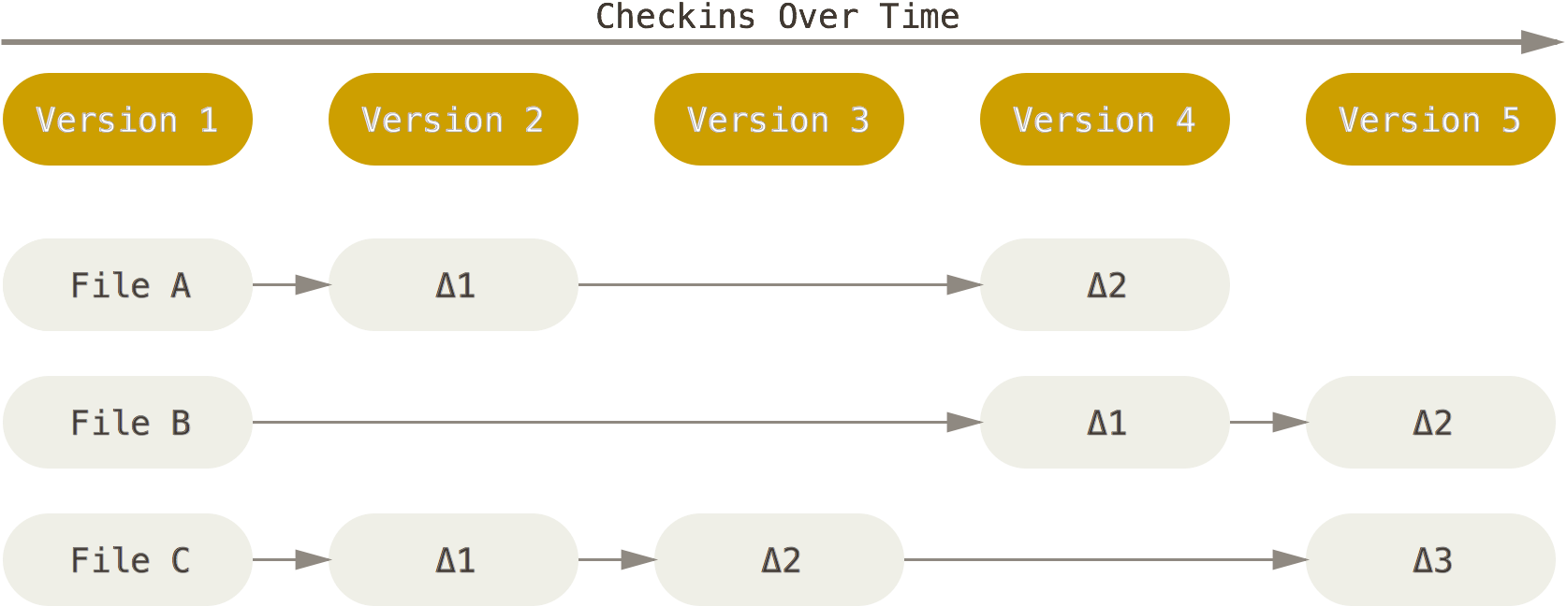
File-Based Changes Approach

Slide 27
GIT Approach
Git doesn’t think of or store its data this way. Instead, Git thinks of its data more like a set of snapshots of a miniature filesystem. Every time you commit, or save the state of your project in Git, it basically takes a picture of what all your files look like at that moment and stores a reference to that snapshot. To be efficient, if files have not changed, Git doesn’t store the file again, just a link to the previous identical file it has already stored. Git thinks about its data more like a stream of snapshots.

Slide 28
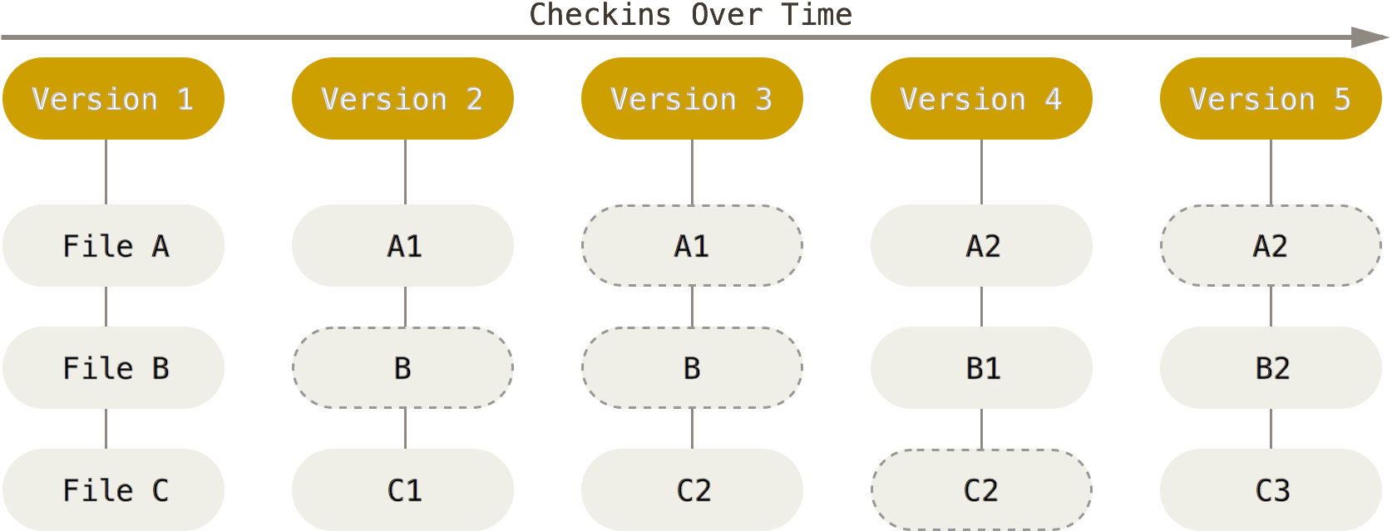
GIT Approach

Slide 29
Nearly Every Operation Is Local
Most operations in Git only need local files and resources to operate
No information is needed from another computer on your network.
Because you have the entire history of the project right there on your local disk, most operations seem almost instantaneous.

Slide 30
Offline Capability
Little you can’t do if you’re offline or off VPN.
If you get on an airplane or a train and want to do a little work, you can commit happily until you get to a network connection to upload.
If you go home and can’t get your VPN client working properly, you can still work.
In many other systems, doing so is either impossible or painful.

Slide 31
Git Has Integrity
Everything in Git is check-summed before it is stored and is then referred to by that checksum.
Impossible to change the contents of any file or directory without Git knowing about it.
Functionality is built into Git at the lowest levels and is integral to its philosophy.
Can’t lose information in transit or get file corruption without Git being able to detect it.

Slide 32
Git Has Integrity
The mechanism that Git uses for this checksumming is called a SHA-1 hash.
This is a 40-character string composed of hexadecimal characters (0–9 and a–f) and calculated based on the contents of a file or directory structure in Git.
A SHA-1 hash looks something like this:
24b9da6552252987aa493b52f8696cd6d3b00373
You will see these hash values all over the place in Git because it uses them so much. In fact, Git stores everything in its database not by file name but by the hash value of its contents.

Slide 33
Git Generally Only Adds Data
When you do actions in Git, nearly all of them only add data to the Git database.
It is hard to get the system to do anything that is not undoable or to make it erase data in any way.
You can lose or mess up changes you haven’t committed yet; but after you commit a snapshot into Git, it is very difficult to lose, especially if you regularly push your database to another repository.

Slide 34
The Three States
Git has three main states that your files can reside in:
Committed: data is safely stored in your local database.
Modified: you have changed the file but have not committed it to your database yet.
Staged: you have marked a modified file in its current version to go into your next commit snapshot.

Slide 35
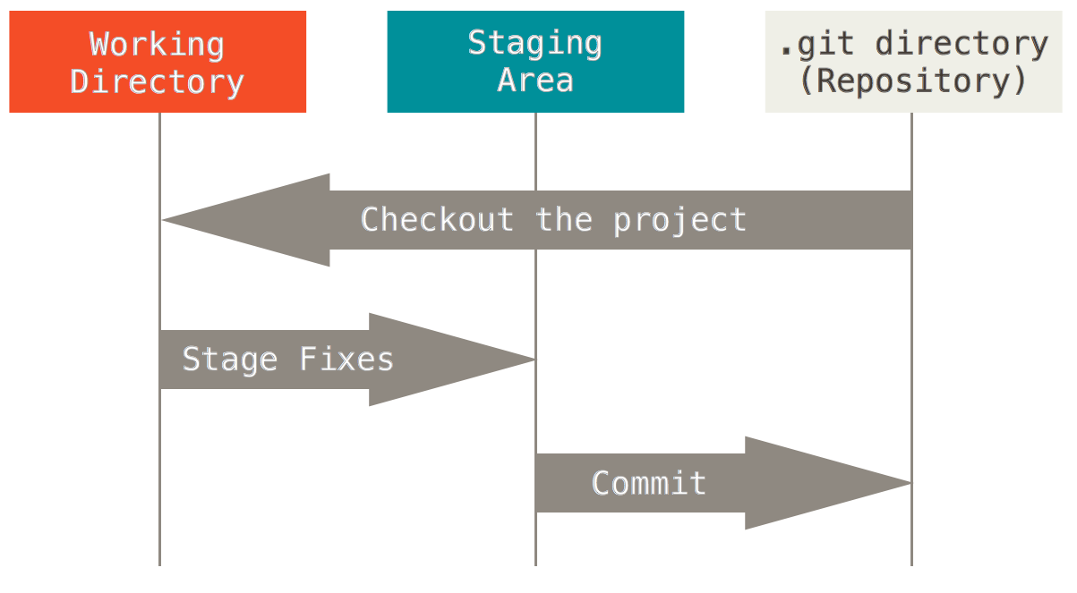
Main Sections of a Git Project
Single checkout of one version of the project
metadata and object database for your project
What is copied when you clone a repository from another computer

Slide 36
Staging area
Staging area is a file, generally contained in your Git directory, that stores information about what will go into your next commit
It’s sometimes referred to as the “index”

Slide 37
The Basic Git Workflow
Modify files in your working directory.
Stage the files, adding snapshots of them to your staging area.
Do a commit, which takes the files as they are in the staging area and stores that snapshot permanently to your Git directory.

Slide 38
Stages of a File
If it was changed since it was checked out but has not been staged, it is modified.
If it’s modified and has been added to the staging area, it is staged.
If a particular version of a file is in the Git directory, it’s considered committed.

Slide 39
The Command Line
1.4 Getting Started

Slide 40
The Command Line
There are a lot of different ways to use Git
  original command line tools
  graphical user interfaces
For this book, we will be using Git on the command line.
  only place you can run all Git commands
  most of the GUIs only implement some subset of Git functionality for simplicity
  If you know how to run the command line version, you can probably also figure out how to run the GUI version, while the opposite is not necessarily true.
  Also, while your choice of graphical client is a matter of personal taste, all users will have the command-line tools installed and available.
Terminal in Mac or Command Prompt or Powershell in Windows.

Slide 41
Installing Git
1.5 Getting Started

Slide 42
Installing Git
Before you start using Git, you have to make it available on your computer.
Even if it’s already installed, it’s probably a good idea to update to the latest version.
You can either install it as a package or via another installer, or download the source code and compile it yourself.

Slide 43
Installing on Linux
If you want to install Git on Linux via a binary installer, you can generally do so through the basic package-management tool that comes with your distribution.
If you’re on Fedora for example, you can use yum:
  $ yum install git
If you’re on a Debian-based distribution like Ubuntu, try apt-get:
  $ apt-get install git
For more options, there are instructions for installing on several different Unix flavors on the Git website, at http://git-scm.com/download/linux

Slide 44
Installing on Mac
There are several ways to install Git on a Mac.
The easiest is probably to install the Xcode Command Line Tools.
  On Mavericks (10.9) or above you can do this simply by trying to run git from the Terminal the very first time.
  If you don’t have it installed already, it will prompt you to install it.
If you want a more up to date version, you can also install it via a binary installer.
  An OSX Git installer is maintained and available for download at the Git website, at http://git-scm.com/download/mac.
You can also install it as part of the GitHub for Mac install.
  Their GUI Git tool has an option to install command line tools as well. You can download that tool from the GitHub for Mac website, athttp://mac.github.com.

Slide 45
Installing on Windows
Git on Windows
GitHub for Windows (If possible load this version)

Slide 46
Git on Windows
Official build is available for download on the Git website.
Go to http://git-scm.com/download/win and the download will start automatically.
Note that this is a project called Git for Windows (also called msysGit), which is separate from Git itself; for more information on it, go to http://msysgit.github.io/.

Slide 47
GitHub for Windows
The installer includes a command line version of Git as well as the GUI.
It also works well with Powershell, and sets up solid credential caching and sane CRLF settings.
We’ll learn more about those things a little later, but suffice it to say they’re things you want.
You can download this from the GitHub for Windows website, athttp://windows.github.com.

Slide 48
Installing from Source
Some people may instead find it useful to install Git from source, because you’ll get the most recent version.
The binary installers tend to be a bit behind, though as Git has matured in recent years, this has made less of a difference.
See http://git-scm.com/book/en/v2/Getting-Started-Installing-Git#Installing-from-Source

Slide 49
First-Time Git Setup
1.6 Getting Started

Slide 50
First-Time Git Setup
Now that you have Git on your system, you’ll want to do a few things to customize your Git environment.
You should have to do these things only once on any given computer; they’ll stick around between upgrades.
You can also change them at any time by running through the commands again.

Slide 51
Git Config
Lets you get and set configuration variables that control all aspects of how Git looks and operates.

Slide 52
Git Config On Lynux
Variables can be stored in three different places:
  /etc/gitconfig file: Contains values for every user on the system and all their repositories. If you pass the option --system to git config, it reads and writes from this file specifically.
  ~/.gitconfig or ~/.config/git/config file: Specific to your user. You can make Git read and write to this file specifically by passing the --global option.
  config file in the Git directory (that is, .git/config) of whatever repository you’re currently using: Specific to that single repository.
Each level overrides values in the previous level, so values in .git/config trump those in /etc/gitconfig.

Slide 53
Git Config On Windows
On Windows systems, Git looks for the .gitconfig file in the $HOME directory (C:\Users\$USER for most people).
It also still looks for /etc/gitconfig, although it’s relative to the MSys root, which is wherever you decide to install Git on your Windows system when you run the installer.

Slide 54
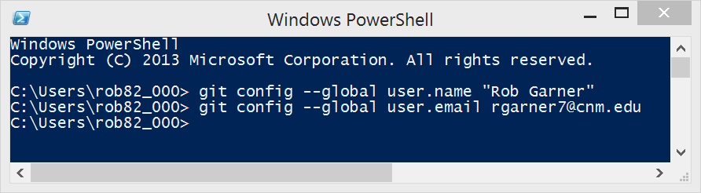
Your Identity
The first thing you should do when you install Git is to set your user name and e-mail address.
This is important because every Git commit uses this information, and it’s immutably baked into the commits you start creating:

Slide 55
--global option
You need to do this only once if you pass the --global option
Git will always use that information for anything you do on that system.
If you want to override this with a different name or e-mail address for specific projects, you can run the command without the --global option when you’re in that project.
Many of the GUI tools will help you do this when you first run them.

Slide 56
Your Editor
You can configure the default text editor that will be used when Git needs you to type in a message.
If not configured, Git uses your system’s default editor.
If you want to use a different text editor, such as Emacs, you can do the following:
$ git config --global core.editor emacs

Slide 57
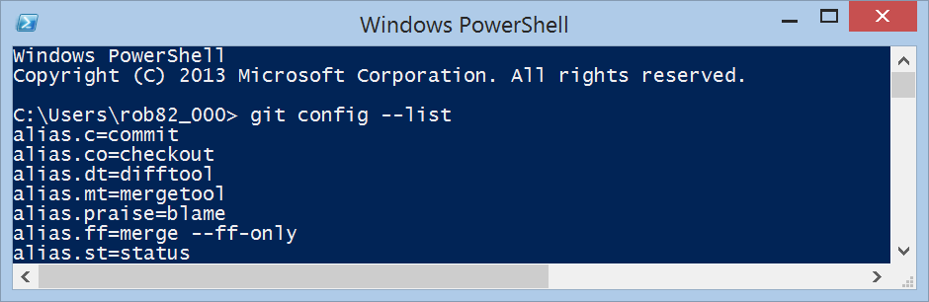
Checking Your Settings
If you want to check your settings, you can use the git config --list command to list all the settings Git can find at that point:
You may see keys more than once, because Git reads the same key from different files (/etc/gitconfig and ~/.gitconfig, for example). In this case, Git uses the last value for each unique key it sees.

Slide 58
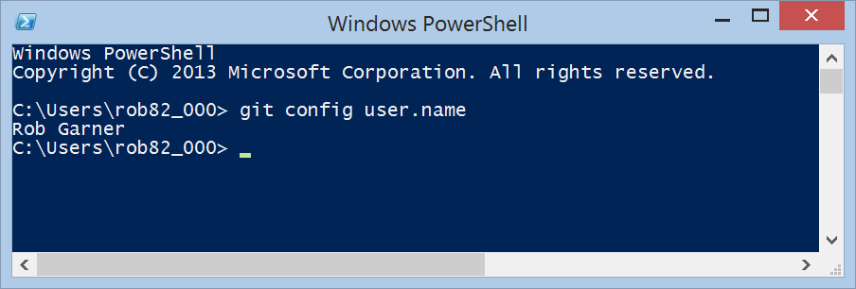
Checking Your Settings
You can also check what Git thinks a specific key’s value is by typing git config <key>:

Slide 59
Getting Help
If you ever need help while using Git, there are three ways to get the manual page (manpage) help for any of the Git commands:
$ git help <verb>
$ git <verb> --help
$ man git-<verb>

Slide 60
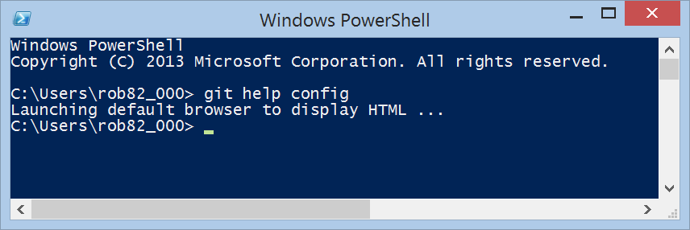
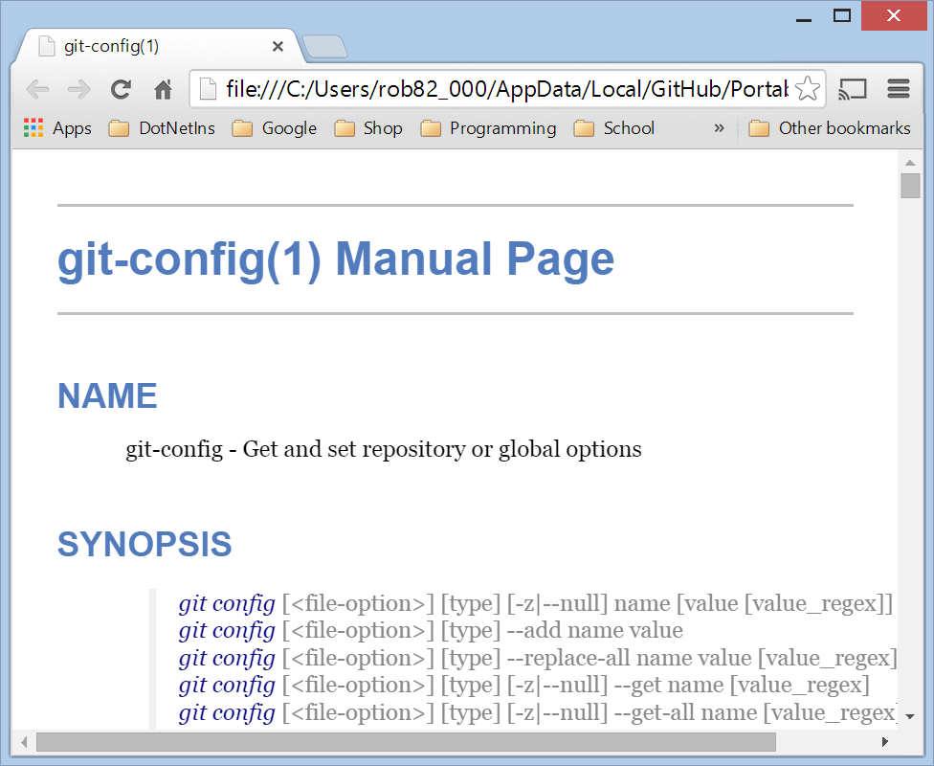
Getting Help
For example, you can get the manpage help for the config command by running git help config:

Slide 61
Summary
You should have a basic understanding of what Git is.
How it’s different from the centralized version control systems.
You should also now have a working version of Git on your system that’s set up with your personal identity.
Next: learn some Git basics.

